Slide 1

For Embodied AI
Physical Data
Producing
Cloud Architecture
STEM, Blockchain,
Quantum
concrete, visual.
Integrated, Experiential.
mindSTEMgame
Hüseyin Vatansever

Slide 2
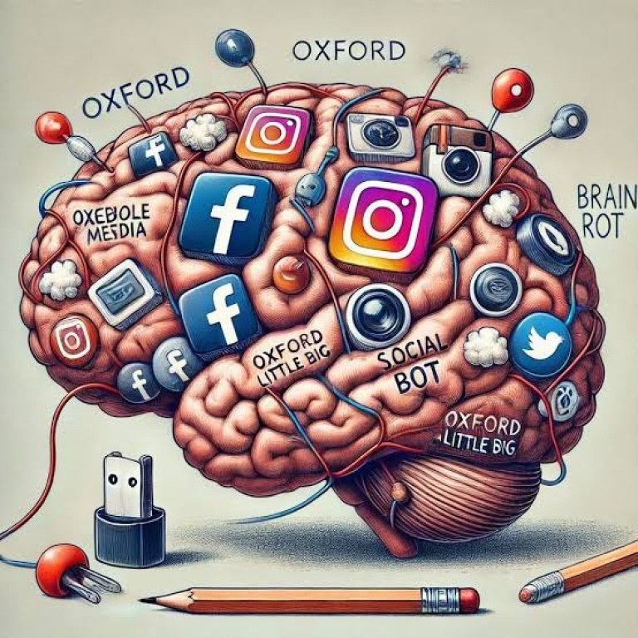
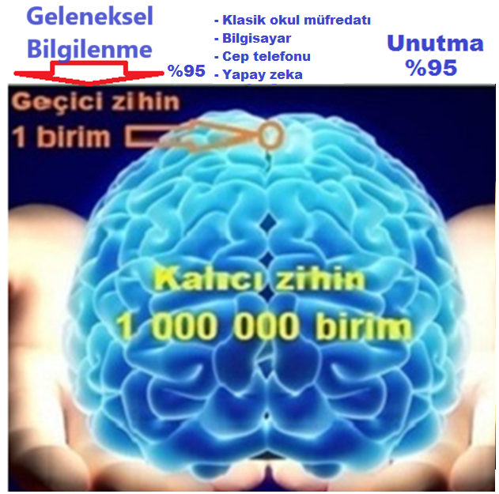

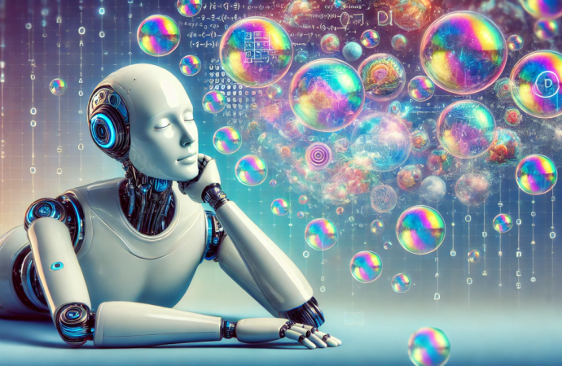
Problem
3- 'Brain rot' is becoming
widespread.
EU Parliament (2019)
Oxford Dictionary (2024)
1-Industrial age enlightenment
Theoretical Knowledge 70%
Communication 20%
Experience 10%
Mental gain
Below 10%
2-Screen addiction
4-Al hallucination

Slide 3
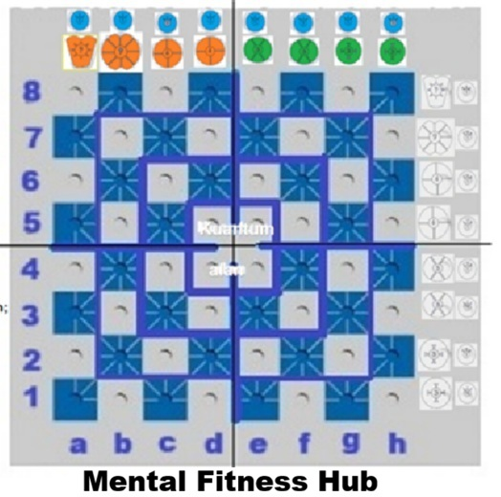
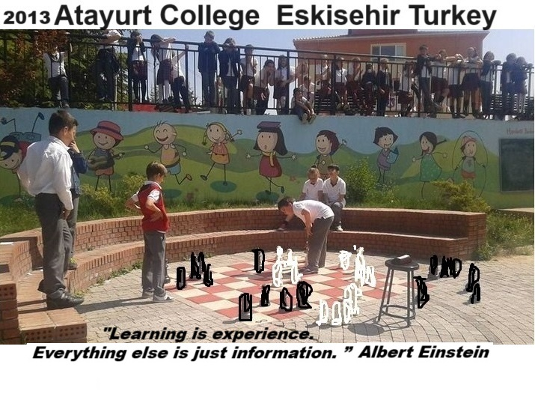
Solution
mindSTEMgame Platform
1. Digital Game Set
Science-Technology-Engineering-Math (STEM)
Blockchain, Quantum, Time are experienced integrally.
2. Physical Play Set
Mental Gain
Digital Physical
10% 90%
"Physical data for 'Embodied AI', a natural laboratory."
Cognitive development from simple to complex.
6 different types of game pieces, 5 difficulty levels.

Slide 4
Solution
mindSTEMgame Platform
“The only source of knowledge is experience.”
Albert Einstein
Our Mind
Operating System.
Experience 70%
Communication 20%
Theory 10%
Integrated Experiential Learning Cycle
Gamification
Socializing, Communication

Slide 5
Technical Superiority and Intellectual Property
- The depth of chess,
- The educational value of STEM kits,
- STEM, quantum blockchain.
Concrete-Visual
- AI coaching.
"Embodied AI" data formation
Turkish Patent and Trademark Office Design
Registration Certificate
(No: 2023 009750).
Bernstein.io; Blockchain for intellectual property
Decentralized Start
"A dynamic arrangement that rewards reasoning, not memory."

Slide 6
Potential Customers
AI with
Game application
coaching
Children 60+ Hours
Teens 10+ Hours
Adults 10+ Hours
Competition coaching ? hours

Slide 7

Business & Revenue Model (2-Year Projection)
Target Audience:
Global K-12 students, youth, adults, and schools
Feature | Estimated Unit Price | Target Customer | Total
AI rental, Paid tournament, In-game purchase | 100$ | ❌ 3 000 000 | 300 000 000$
Physical Play Set -Standard (1m² ertical) -Garden (12m2 horizontal) | 100$ 300$ | 1 000 000 10 000 | 100 000 000$
Genel Toplam |  |  | 400 000 000$
Year 1: 1 Million Customers (Product tests, market fit, initial distribution).
Year 2: 2 Million New Customers (Aggressive growth and global expansion).
Expenses (%80): 320 000 000$ Net profit (%20): 80 000 000$

Slide 8
Roadmap and Future
Does our technology scale faster with Gemini?
"High-speed reasoning"
"Global availability via Google Cloud"
2024-2026:
The "Gemini" Factor: "How will our technology scale faster with Gemini?"
2027-2029:
0.5% share from the global market 0.5 billion dollars in revenue.
Mission:
Building a qualified workforce for a sustainable world.

Slide 9
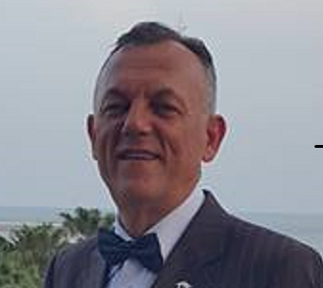
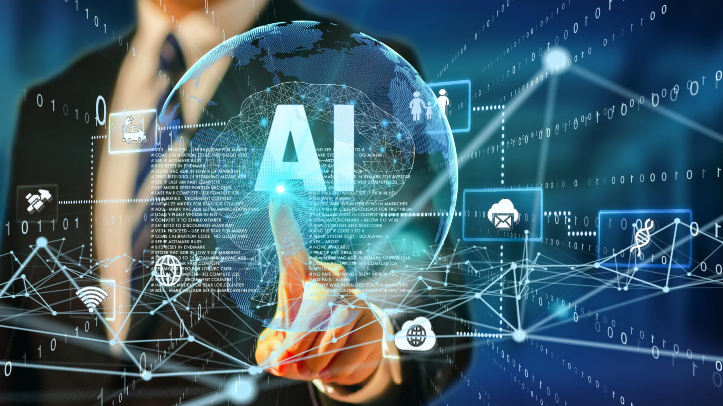
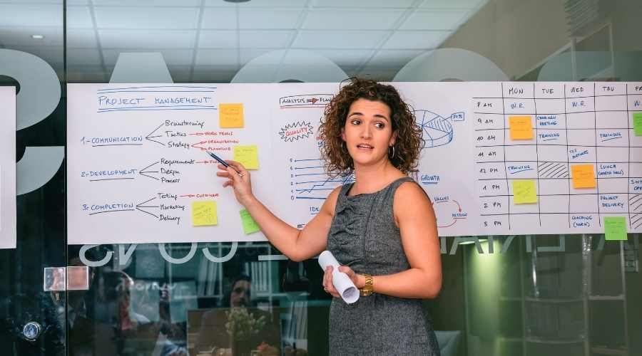
Team and Investment Demand Product and service ready.
Agent Army
Project responsible/1 year
Cloud Architecture/1 year
Founder
Hüseyin Vatansever
- 40 years of experience,
- Pedagogical training
- Licensed Bridge and Chess athlete background.
Investment Request:
- $500,000 for a 10% equity stake.
Use of Funds:
- Google Cloud infrastructure & Cloud architecture.
-AI Agent development and global marketing.

Slide 10
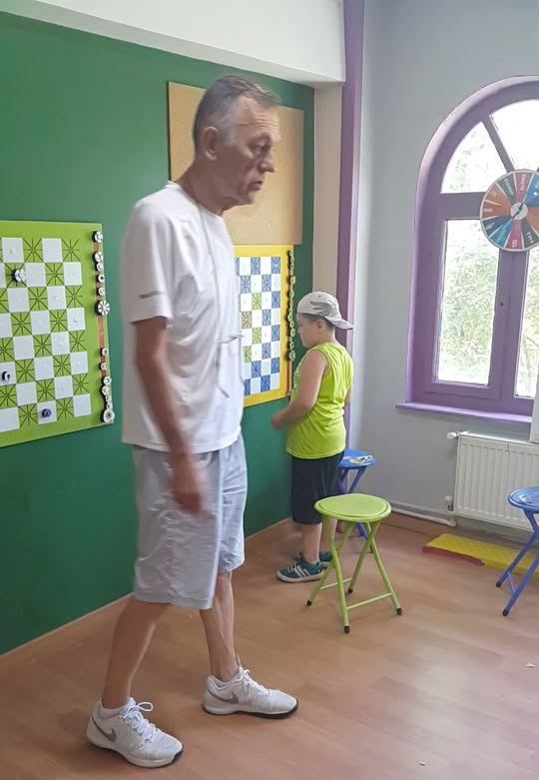
Thank you
"Building the minds of the future together."
huseyin.vatansever26@gmail.com
linkedin.com/in/huseyinvatansever26
https://youtu.be/urTcgLWIhtY

