Slide 1

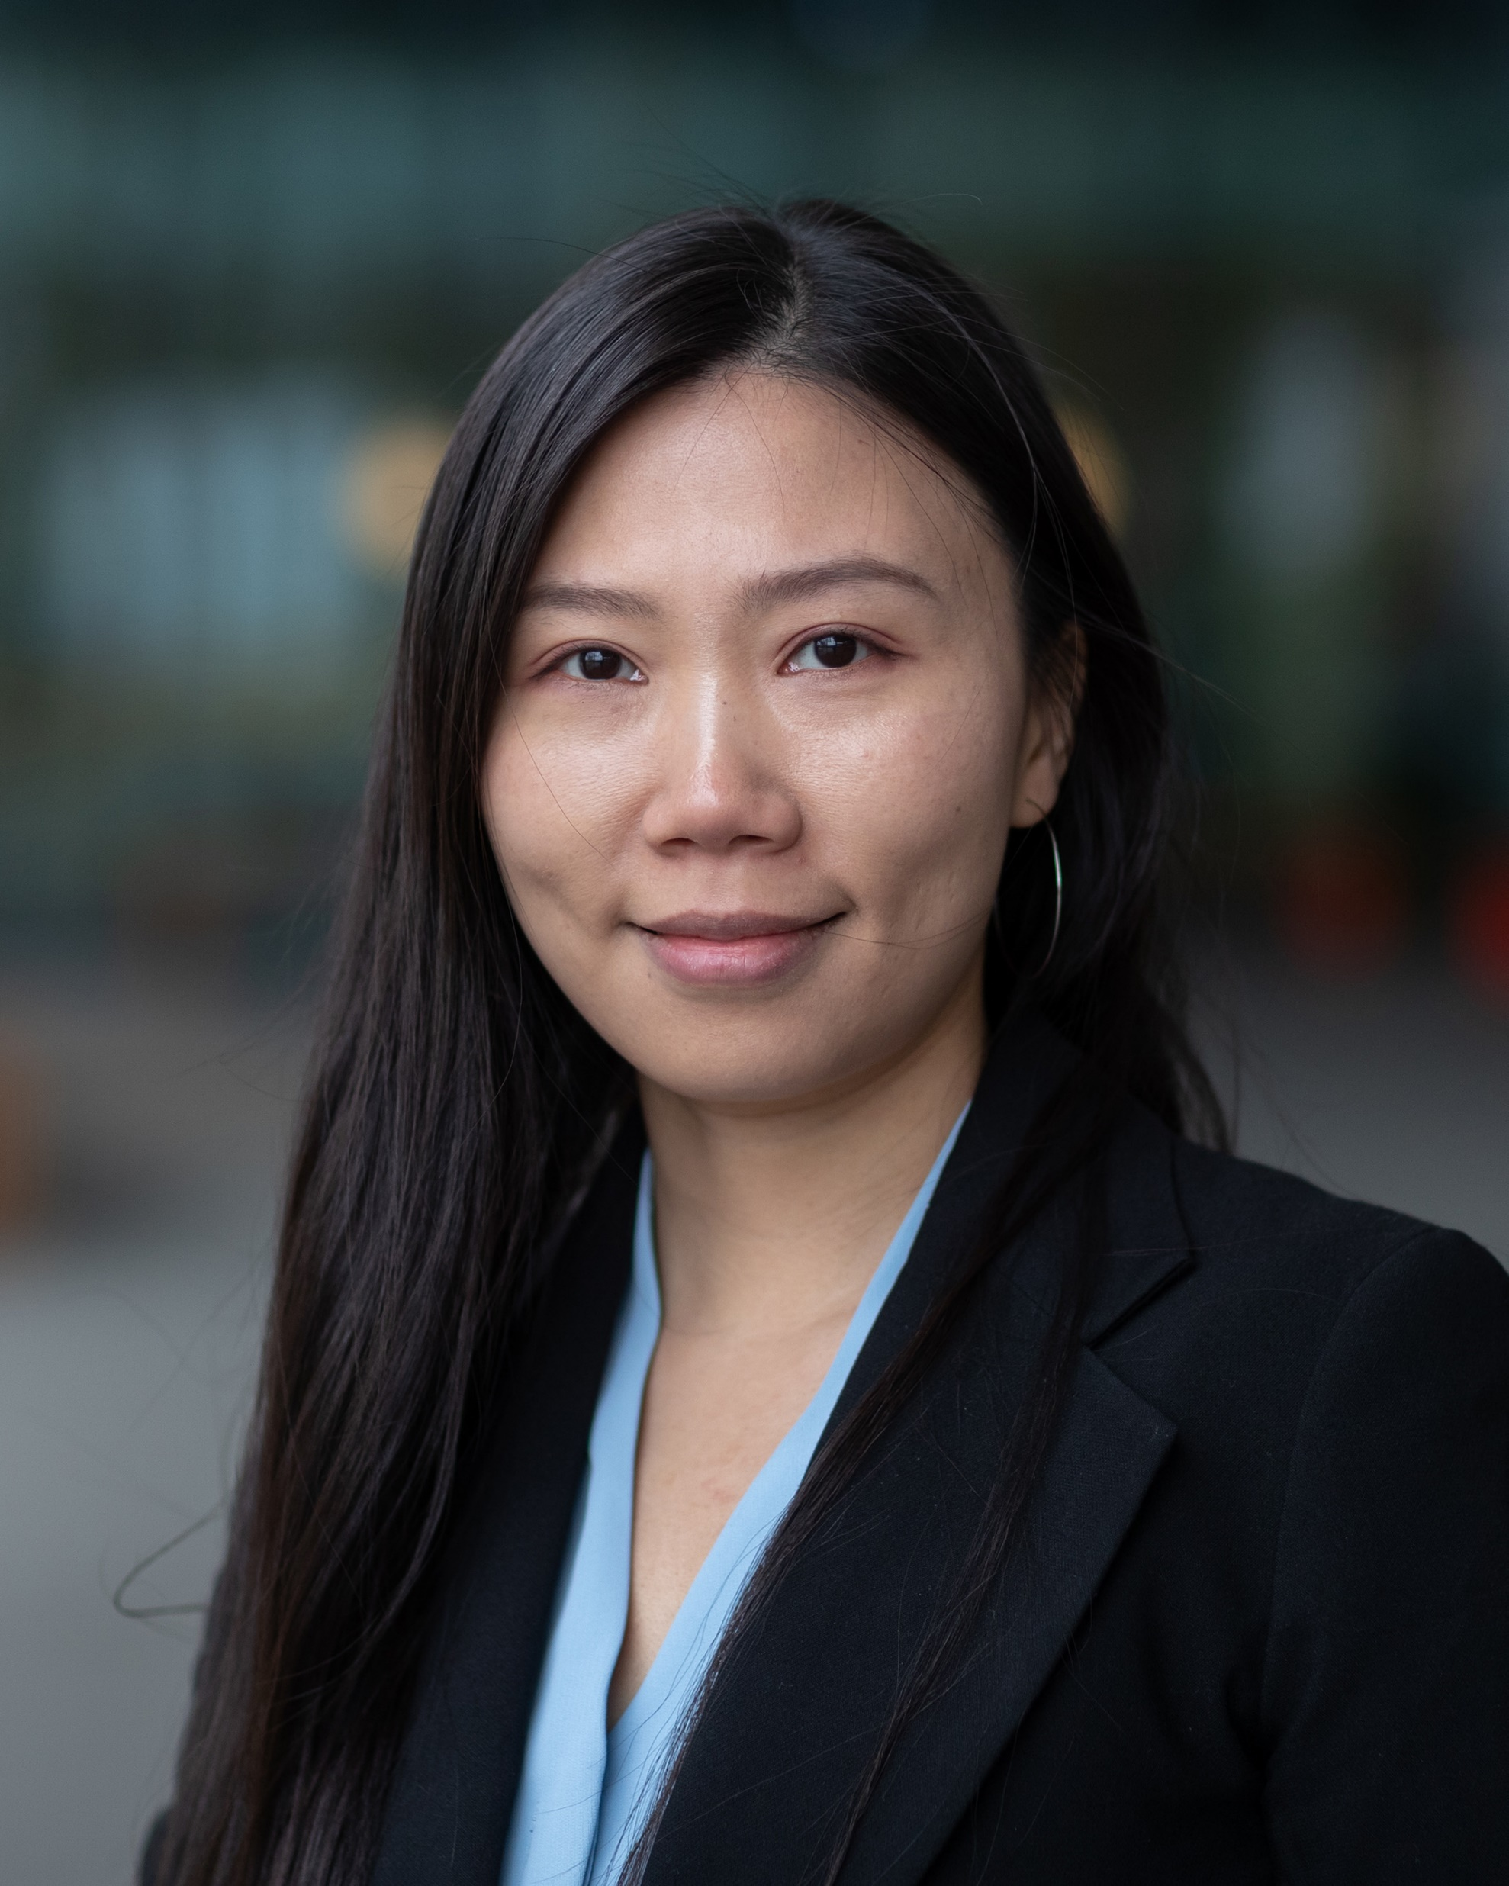
Expertise: Signal processing & modelling
- human sensory data
Name: | Linghan Zhang
Position: | Assistant Professor of Human-Technology Interaction (HTI); researcher of Expertise Centre of Dementia & Technology (ECDT); researcher of Eindhoven AI Systems Institute (EAISI), research fellow of ethics of socially disruptive technologies (ESDiT)
Highest Education: | Ph.D. in Computer Science
Technical Skills: | Signal Processing and Modeling (image, video, acoustic, speech, and other types of sensory data), Mobile/Wearable/Ubiquitous Sensing and Computing, Machine Learning/Deep Learning/AI
Main Research Areas: | Assistive Technology, Affective Computing, Human-Computer Interaction, Learning Analytics, Human-centered Computing
My Interests and Strength: | Trained in computer science and experienced in human factors studies, I am interested and capable of supporting transdisciplinary research that designs, builds, and deploys novel, as well as useful and usable technologies.
Please contact me at: l.zhang1@tue.nl

