Slide 1
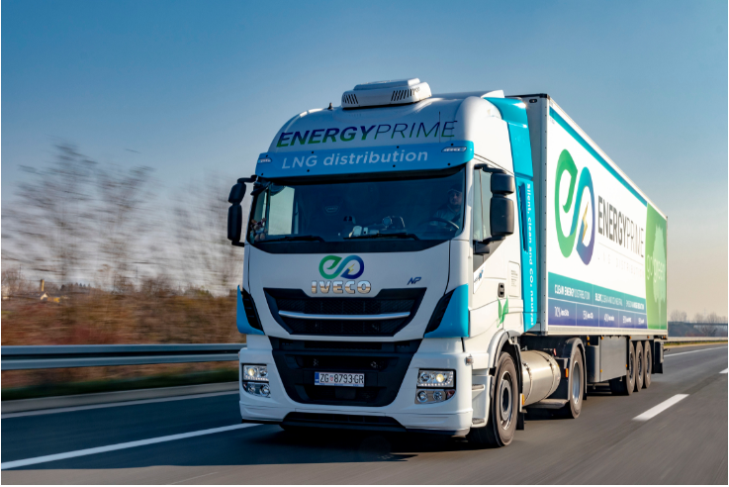
Small-scale LNG: Commercial models, market players and pricing
PRESENTATION FOR ENTERPRISE EUROPE NETWORK - UKRAINE
Presentation by Amani Al-Saidi
26 February 2026

Slide 2
FTI Consulting’s Energy Team combines economic expertise in regulation, modelling, contracts and financing
FTI Consulting Energy Practice
A
Expertise in understanding Economic Regulation
Experience in designing regulatory frameworks in 35+ countries
Experience in challenging regulatory decisions
B
Expertise in Modelling commodity markets and economic behaviours
A
Proprietary models of European electricity, gas, CO2 markets, hydrogen, LNG Shipping markets - Proprietary model forecasting LNG vessels charter has supported transactions on 60+ vessels.
FTI has advised 10+ LNG regasification and liquefaction terminals on their commercial and operational strategies
Experience of modelling for auction design, arbitrage value, transfer pricing, etc.
Regulation
Economic & Financial Expertise
D
B
C
Expertise in Commodity and Infrastructure Contracts
Financing
Modelling
Combined experience of negotiating USD >100 bn of commercial contracts for energy and infrastructure
Recognition as LNG industry expert, through 15+ appointments as independent expert in LNG industry disputes
Drafted Hydrogen Purchase Agreements (commercial aspects)
C
Contracts
D
Expertise in financing of infrastructure
FTI Consulting experts have advised on 50+ infrastructure asset financing strategies
Over USD 32+ billion in Project Finance facilities for the oil & gas sector concluded
FTI Consulting is currently involved in three major project finance assignments worth 70bn + USD

Slide 3






ssLNG covers end-use markets supplied through a logistics chain using small transport vectors, with infrastructure capacity below 1 mtpa
Overview of ssLNG & its associated logistics chain
Small-scale LNG definition
Overview of ssLNG logistics chain
  ssLNG refers to the end-use of natural gas in its liquid form and is characterized by a specific logistics chain that relies on truck/rail transport to supply regasification units
  It covers the value chain from the exit of the large-scale / bulk terminal to the final consumption of LNG
  In terms of volumes, ssLNG includes plants with capacities lower than 1 mtpa (million tonnes per annum)
  The ssLNG market represents a collection of niche demand segments that serve either stationary energy end-user (industry & residential) as a substitute to pipeline gas or heavy fuel / diesel, or mobile energy end-user (marine or road transport), via two products:
  LNG
  CNG from LNG (C-LNG)
LNG import terminal
(large scale >1 mtpa)
SMALL-SCALE LNG
Truck/rail transport
Maritime / river transport
Optional secondary storage
Truck/rail transport
Bunkering
Ship-to-Ship
Satellite plants for industry & Power Generation
Micro-grids
Fuelling stations
Truck-to-Ship
LNG-fuelled ship reservoirs
Small-scale LNG logistics chain
Truck transport allows the supply of satellite regasification plants and fuelling stations
Maritime transport (bunkering) is used for delivery to LNG-fuelled vessels
INDUSTRY & RESIDENTIAL
TRANSPORT

Slide 4






Small-scale LNG serves distinct end-use segments, each with different demand profiles, pricing sensitivities, and contractual structures
Main end-use segments for small-scale LNG
INDUSTRY & RESIDENTIAL
TRANSPORT
Satellite plants for industry & power generation
Micro-grids
Fuelling stations
LNG-fuelled ship reservoirs
Replaces diesel, HFO, LPG in off-grid sites
On-site storage + regasification
Typically 1-5 year supply contracts
Stable base-load consumption
Distributed generation / resilience-driven
Often project-based deployments
Can be temporary or long-term
Logistics-intensive (refill cycles critical)
Heavy-duty truck fleets
LNG & L-CNG configurations
Highly sensitive to diesel-LNG spread
Volume depends on fleet penetration
Port-based bunkering via truck
Ferry & short-sea focus
Infrastructure-led demand
Volume concentrated in specific corridors

Slide 5
ssLNG competitiveness emerges where favourable fuel spreads align with logistics efficiency and sufficient scale
What drives ssLNG competitiveness?
Fuel price differential
Logistics & distance
  LNG typically replaces diesel or fuel oil
  A sufficient price gap is required
  Carbon pricing can improve relative competitiveness
  Distance to reload terminal drives transport cost
  Truck utilisation significantly affects unit cost
  Demand clustering improves economics
1
2
ssLNG competit-iveness
3
Scale & utilisation
  Larger and more stable volumes reduce unit cost
  Minimum offtake commitments are common
  Infrastructure model affects embedded cost

Slide 6
Ukraine is no longer a corridor but a constrained end-market where ssLNG could provide flexibility and decentralised resilience
Why small-scale LNG in relevant for Ukraine
1
Structural shift in flows
Historic transit via Ukraine: ~117 bcm/year peak
Europe replaced Russian volumes with LNG
Ukraine lost both transit revenue and supply security buffer
3
Infrastructure reality inside Ukraine
War damage to transmission & compressor stations
Decentralised heating systems
Industrial nodes outside stable high-pressure grid
High seasonal demand peaks
Security of supply prioritisation
2
EU LNG is not guaranteed Ukrainian supply
LNG regasified in Poland, Greece, Germany can reach Ukraine
But flows are:
  Limited in volume
  Indirect (mulit-border routing)
  Dependent on pipeline availability
  Exposed to congestion and security risk
4
ssLNG value proposition
Structural constraint | ssLNG response
Pipeline congestion | Truck-based bypass
Grid damage | Modular regas units
Winter peak demand | Targeted local supply
Security risk | Decentralised resilience

Slide 7



Small-scale LNG contracts are typically tailored, shorter-term, and involve close operational coordination between supplier and buyer
Commercial and contract structures in ssLNG
Primary commercial logic
Structural implications
Contract duration and structure
1-5 year agreements
Bespoke SPAs (no standard template)
Minimum annual volume commitments
Pricing mechanism
Typically hub-indexed (e.g., TTF or regional hub), but may also be oil-indexed (e.g., Brent)
Delivered price basis (approximately 15-23 EUR/MWh on top of the gas wholesale price)
Periodic price review clauses
Infrastructure & delivery models
Supply-only (customer owns tank and vaporizer)
Tank leasing model
Turnkey supply + regas solution
Risk allocation
Supplier risk: logistics & delivery risk
Buyer risk: volume & take commitment
Commodity risk: typically passed through

Slide 8




Delivered small-scale LNG prices are built by layering logistics and commercial costs on top of a hub-indexed gas price
Overview of pricing for ssLNG
LNG price (e.g., hub-indexed)
LNG unloading & storage
Truck loading
Truck transport
Commercialization
Delivered price
Commodity volatility
Distance-
sensitive
Margin + risk premium

Slide 9
Molecule access in Ukraine exists, but ssLNG viability depends on corridor distance and utilisation
Ukraine’s position in the European LNG network
LNG import terminal (operational)
Ukraine’s access to European LNG corridors
LNG terminal (project)
Small-scale LNG services (operational)
Ukraine has no LNG import terminal, but could access LNG via nearby regas terminal with truck loading / reloading services
Indicative corridor anchors: Świnoujście (PL), Klaipėda (LT), Krk (HR), Revithoussa (GR)
Delivered competitiveness is corridor-driven: distance and asset utilisation determine whether hub-priced LNG remains competitive after logistics
In mature European markets, ssLNG trucking is typically most competitive within a few hundred kilometres of reload-capable terminals (max. 400km); longer corridors require stronger volumes and higher utilisation
Small-scale LNG services (project)
Klaipéda
Świnoujście
Gdańsk
Milford Haven
Isle of Grain
Gate
Zeebrugge
Dunkirk
Montoir
Mugardos
El Musel (Mothballed)
Panigaglia
Porto Levante
Bilbao
Fos Cavaou
OLT Offshore
Fos Tonkin
Barcelona
Alexandroupolis
Sines
Sagunto
Huelva
Cartagena
Revithoussa

Slide 10



























Four types of players are active in the retail of LNG and gaseous fuels, with different geographical footprints and business models
Overview of main market players in Europe and their dominant strategies
Characteristics of each category’s business model
EUROPEAN
Strategy of pan-European specialised leadership
Specialists / pure players:
  Specialisation, usually with integrated logistics capabilities
  Active in all market segments or focus on niche markets (ex: bunkering; LNG fuelling stations)
Integrated gas players (majors):
  Integration with midstream and or downstream gas activities (clients portfolio and expertise in natural gas retail)
  Brand recognition
LPG retailers which have diversified:
  Expertise in gas retail to industrial clients
  Clients portfolio
Petroleum fuel retailers which have diversified:
  Expertise in fuel retail
  Brand recognition
  Geographical footprint (existing network of stations)
REGIONAL /
MULTI-COUNTRIES
Strategy of expansion on existing adjacent fuels footprint
Strategy of specific target market(s) penetration
NATIONAL
SPECIALISTS /
PURE PLAYERS
NATURAL GAS RETAILERS
PETROLEUM FUEL RETAILERS WHICH DIVERSIFIED
LPG RETAILERS WHICH DIVERSIFIED
Segments
Transport
Sources: FTI Consulting, based on market research. Non-exhaustive
Note: SHV energy is a holding that owns and operates several brands (Calor, Primagas, Primagaz, PrimaLNG, Liquigas); PitPoint has been acquired by Total in 2017; Liqvis is a subsidiary of Uniper
Both market segments
Industry & Residential

Slide 11

Successful ssLNG projects are not opportunistic, they align supply access, logistics efficiency and bankable demand within viable corridors
How structural realities translate into project requirements
1
2
3
Logistics first
Scale before expansion
Risk premium in early markets
Market reality
Deployment develops along viable corridors
Delivered cost is highly distance-sensitive
Implication in practice
Requires corridor infrastructure – storage, vaporization and reload access
Access to reload-capable terminals
Economically viable trucking distance
Optimised fleet utilisation
Market reality
Early projects require stable anchor volumes
Isolated sites are structurally more expensive
Implication in practice
Demand aggregation is critical to create anchor volumes
Minimum annual offtake commitments
Creditworthy counterparties
Demand clustering where possible
Market reality
Early-stage markets include higher uncertainty
Infrastructure CAPEX often embedded in price
Implication in practice
Early projects prioritise bankability over pricing optimisation
Clear and transparent indexation
Longer tenors where needed
Regulatory and permitting clarity

Slide 12
Emmanuel Grand
Senior Managing Director, FTI Consulting
emmanuel.grand@fticonsulting.com | +33 6 88 40 86 23
Amani Al-Saidi
Senior Consultant, FTI Consulting
amani.al-saidi@fticonsulting.com | +33 6 98 35 69 40

