Slide 1


Irrigate it, Feed it, and remotely Care about it

Slide 2


142
Thousand
Hectares
Agricultural
Land

Slide 3






v
Problems Faced by Farmers
Irrigation & Fertigation
Waste
Fuel
Fertilizers
Pesticides
Water
Labor
Damaged Output

Slide 4

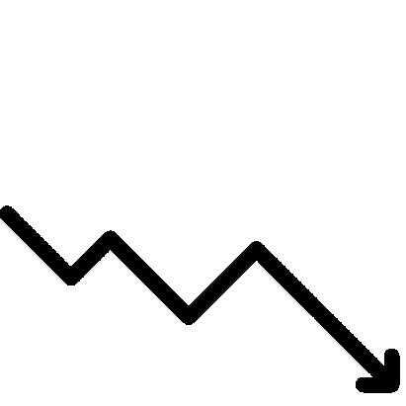
Ibrahim’s Extra Costs
(Wasted)
Water & Fuel
$700
Pesticides
$750
Labor
$4,000
Fertilizers
$750
Damaged Output
$9,000
$ 15,200
Extra Costs
Per season

Slide 5

v
Smartly Enabled -Soil
Smart Irrigation
Smart Fertigation
Continuous Monitoring and control
(facilitating by Mobile app)

Slide 6
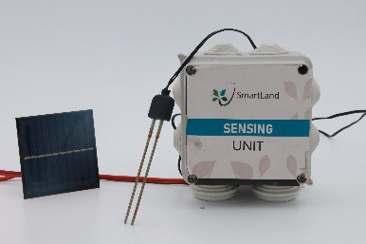
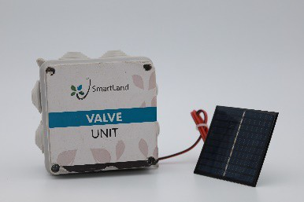
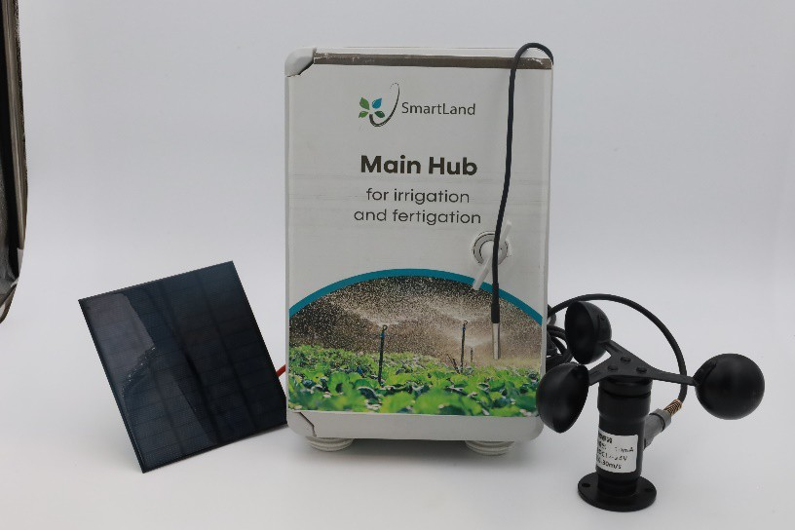
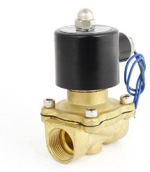



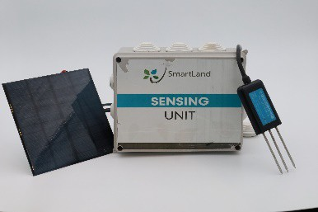
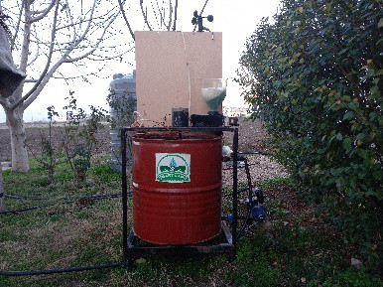
Innovative Solution
Moisture Sensing Unit
Valve Unit
Collecting Data
Giving Order
Irrigate water or Inject Fertilizer
NPK sensing Unit
Collecting Data
Fertigation Machine

Slide 7



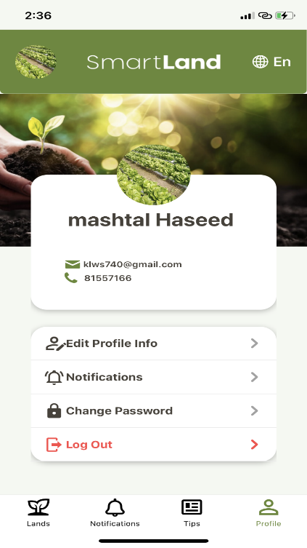
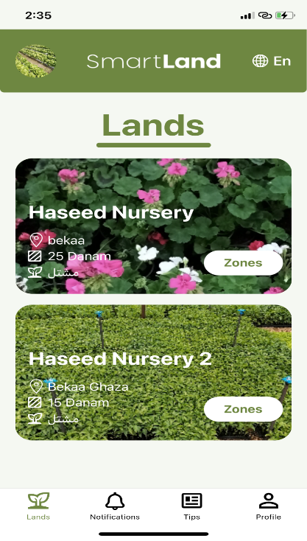
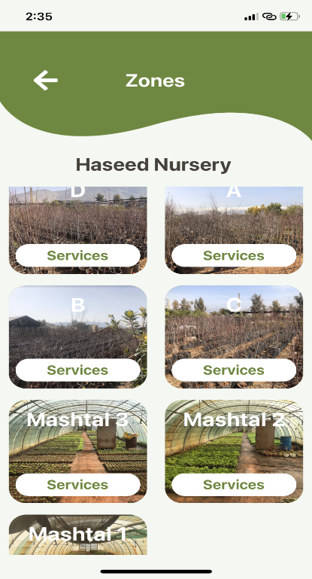
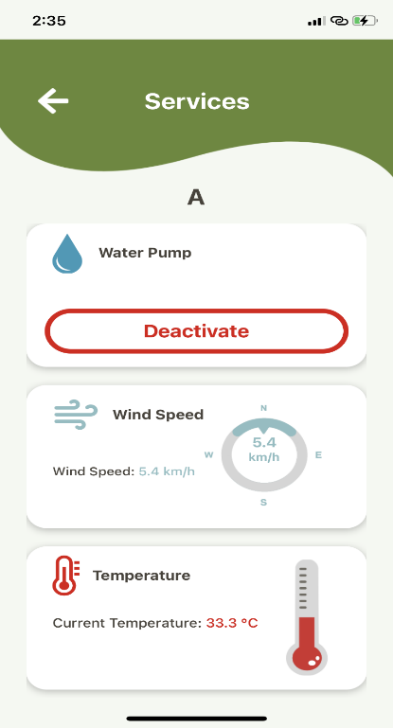



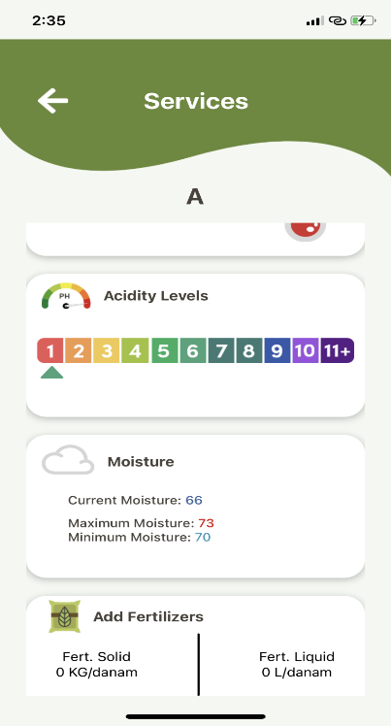
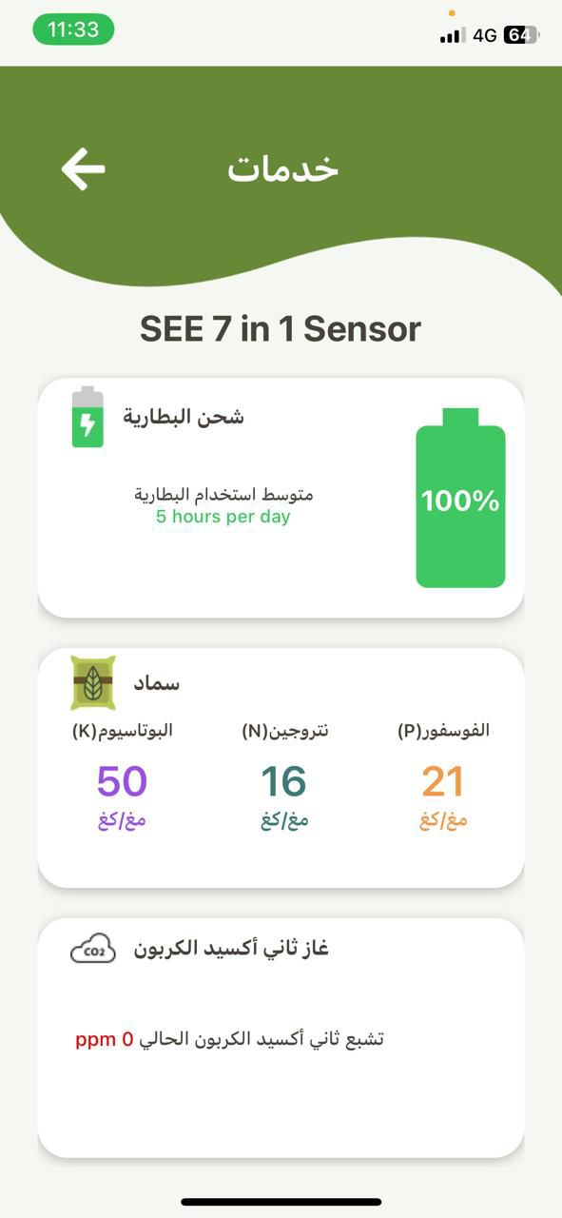
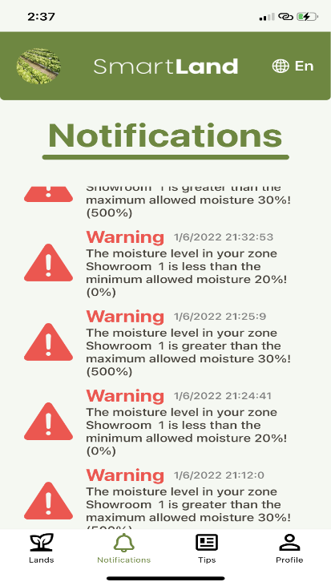
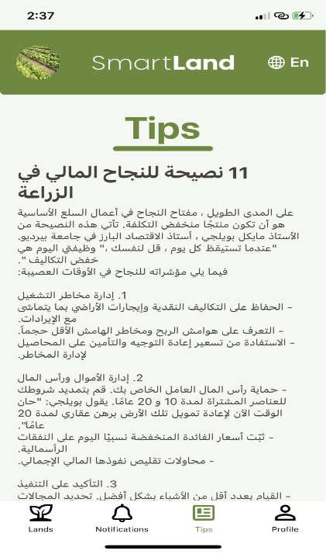

smartland
Solution
Mobile app
Control Irrigation system
Control Fertigation System.
Real Time Monitoring (Soil Moisture, N, P, K, PH, EC, Light, Soil Temp, Air Temp, Wind Speed….).
Receive Notifications.
Receive warnings.
Tips about agriculture.
Feeds (Where they can share their moments with other farmers.

Slide 8





Ibrahim’s Gains
Water Saving 35%.
Fertilizers Saving 47%.
Energy Saving 43%.
Increase Productivity by 18%
$ 13,776
Savings of
Per season

Slide 9




Competitors
Traditional Companies
Scheduled
Traditional Companies
Auto Control
Customization level
Fertigation Accuracy
Customer Support
Mobile App Affordable
SmartLand IOT solutions

Slide 10

smartland
Revenue Model
v
Setup Fees
Subscriptions Between 50-200 $/month
Consultancy Services

Slide 11



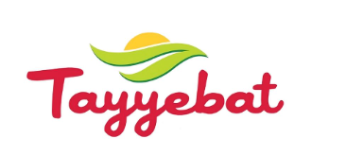



















Achievements
Clients
Collaborations
Partnerships & Investors
Grants & Awards
175K USD

Slide 12
Roadmap
2021
2023
2026
1st Client done
Started collecting data
Covering all Lebanese regions
Build more partnerships (AgPharm).
Start developing AI system
2022
2024 & 2025
2027
Hired 2 staff.
25 clients.
Start installing in MENA region.
Developing new fertigation machine
Partnered with Debbane Agri
Lunch the AI system
Secure series A investment for scaling

Slide 13

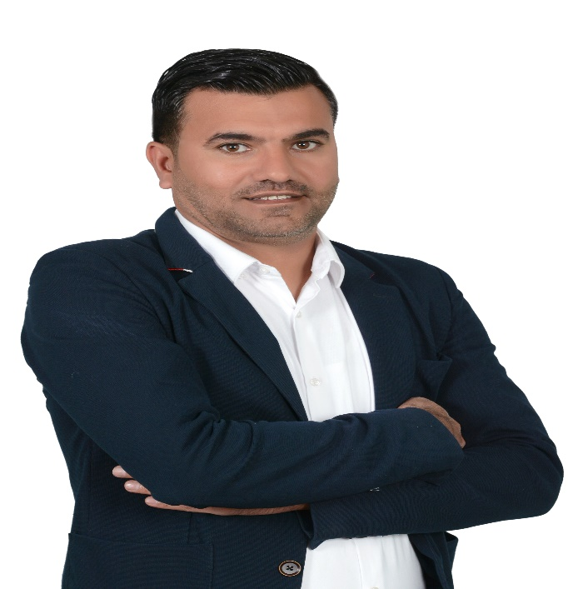
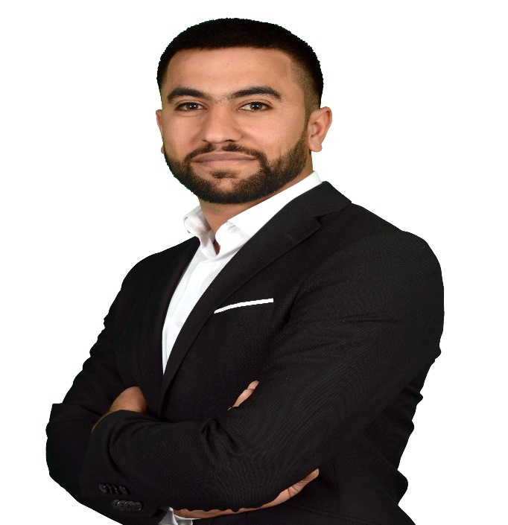
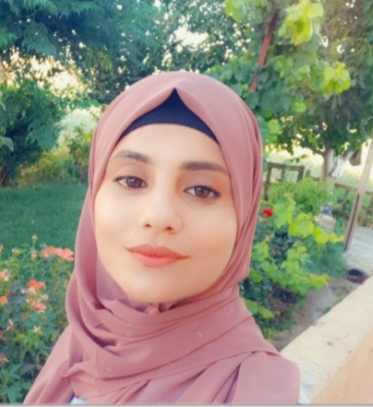
Managerial Team
Ahmad Alabbass
CFO
Khaled Alabbass
CEO & CTO
Reem Alabbass
CMO
Business Development
& Financial Specialist
Agricultural
& Electrical Engineer
Public Relations
& Marketing Specialist

Slide 14





ASK
Fund 35KUSD
Strategic Partnerships
Clients
Technology Experts

Slide 15

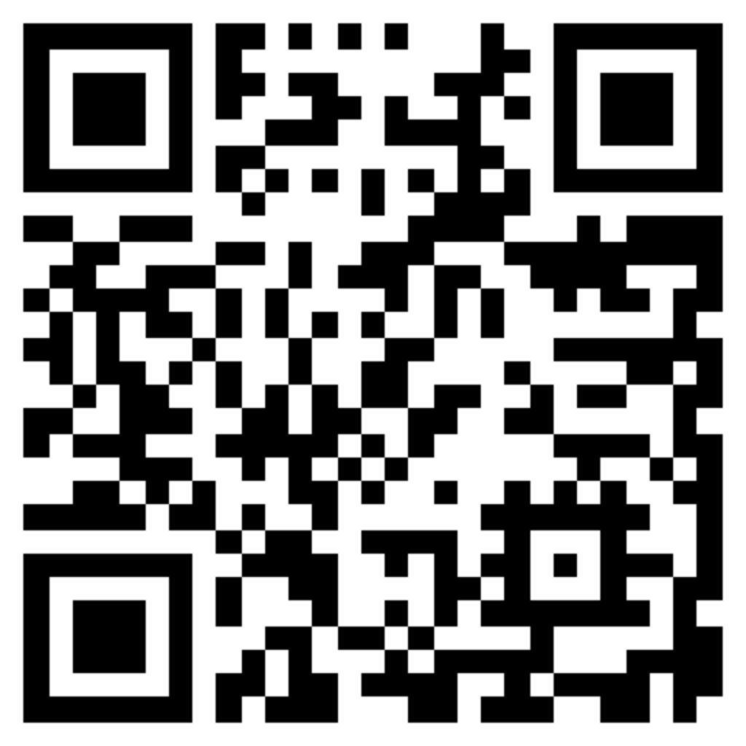
ﺎﻬﻴﻓ ﻢﺘﻫا ﺪﻌﺑ ﻦﻋرويها, وغذيها, و
Irrigate it, feed it, and remotely care about it.
THANK YOU

