Slide 1
ESTIA-TECH

Slide 2
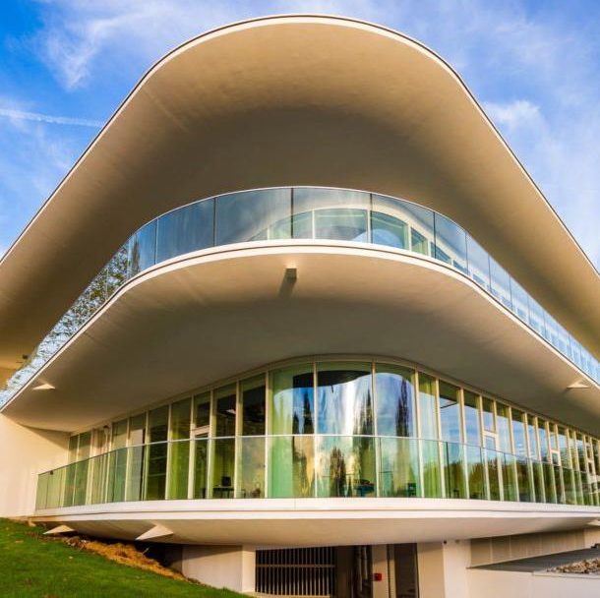
Institute Profile
Founded in 1996, the ESTIA INSTITUTE OF TECHNOLOGY is a general engineering French school training trilingual versatile engineers, to undertake positions such as product engineer, supply chain planner/manager, quality manager, production manager, and project manager.
The ESTIA campus is an ecosystem which includes:
Engineering courses & masters degrees
Research teams in technology
Technical platforms
A company incubator

Slide 3








Research Axes
CHAIRES
ROBOTICS
Creativity, Ecodesign and Circularity
STUDY  DESIGN  IMPLEMENTATION
Management Sciences
Computer Sciences
Mecanics
Automation
Electrical engineering
Renewable Energy Integration
SMARTGRID
SUSTAINABLE AND EMPOWERING INTERFACES FOR
ENGINEERING
FACTORY OF THE FUTUR
Tangible, Gestural and AR Interactions
IoT
Technological and Human Systems
ART & SCIENCES
Manufacturing Processes and Modeling
TEXTILE
LABCOM TMACH
BALI
Disruptions
Textile Technology (2017)
FLEXTECH
Complex Autonomous Systems (2019)
DREAM
Robotic Additive Manufacturing (2020)
PROVE
Green aeronautics propulsion (2023)
N°5
Circularity for Desirable Future
(2024)
for
6
Applications
Fields

Slide 4
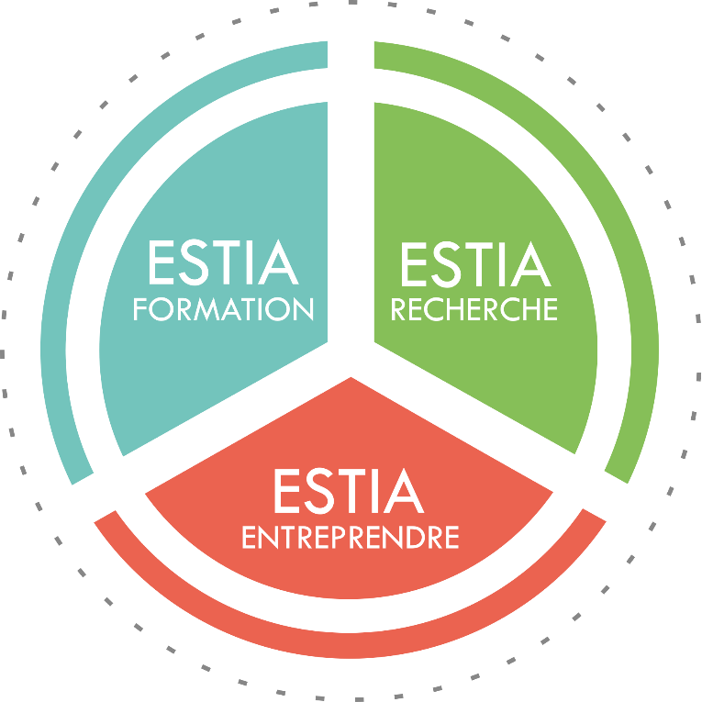

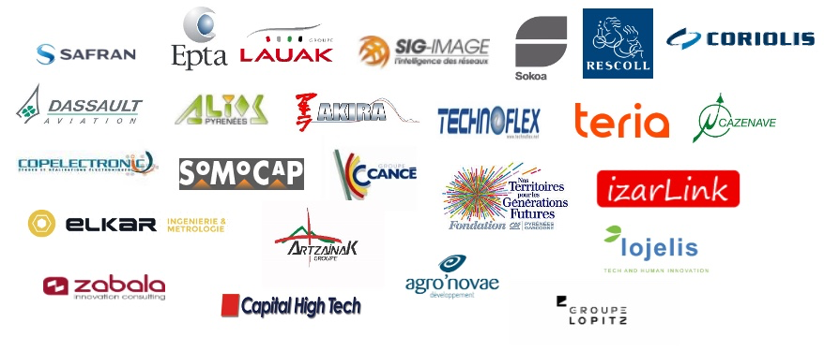

In the heart of the Campus
ENGYNEERING SCHOOL
BACHELOR of TECHNOLOGY
INTEGRATED PREPARATORY CLASS
MASTERS
~100 STUDENTS / YEAR
Staff as of September 1, 2024
ISO 9001, depuis 2010
& HCERES 2015 et 2021
RNSR n° 201420655V
90 People
31 EC of which 8 HDR - 6 Prof.
17 Associates (and Guests)
22 PhD Cand. et 1 Post-Doc
7 IE, 6 IR, 6 RA
ASSOCIATION AGREEMENT
DOCTORAL SCHOOLS
- Mathematics and Computer Science (39)
- Physical and Engineering Sciences (209)
- Business, Economics and Society (42)
In 5 Regional Research Networks
Dept. of Engineering and Digital Sciences
FONDATION
Partnership research
TERRITORY DYNAMICS INNOVATION
3 START-UP ACCELERATOR INCUBATORS
7 TECHNOLOGICAL PLATFORMS
1/4 industrial research training agreements
5 Industrial Chairs
Figures updated 14 December 2024
Mise à jour le 15/11/2022

Slide 5
What is ESTIA-TECH?
ESTIA-TECH promotes the links between ESTIA and companies looking for technological solutions, skills and training to develop innovative projects.
ESTIA-TECH helps ESTIA researchers and platforms to prepare winning proposals for funding projects calls and collaborative research offers with companies.
ESTIA-TECH represents ESTIA in clusters and other initiatives.
https://www.estia.fr/estiatech

Slide 6
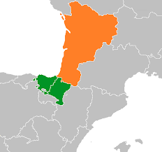
ESTIA-TECH – Strategic areas
Industry5.0
eHealth
Energy
Agri-food.

Slide 7
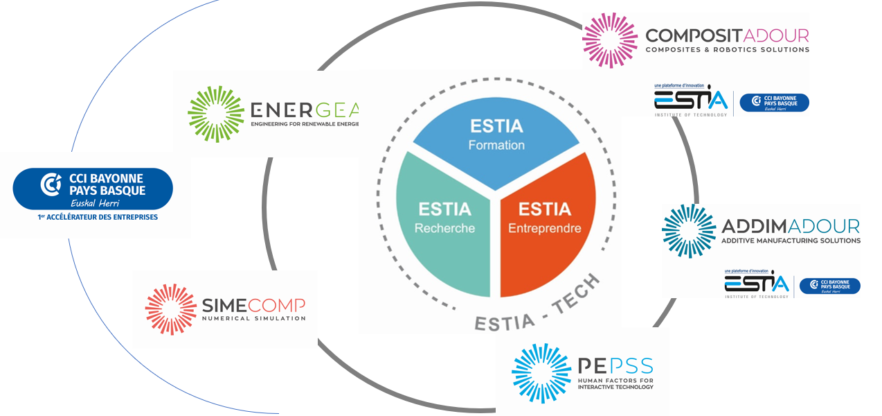



ESTIA TECH et l’écosystème Estia

Slide 8
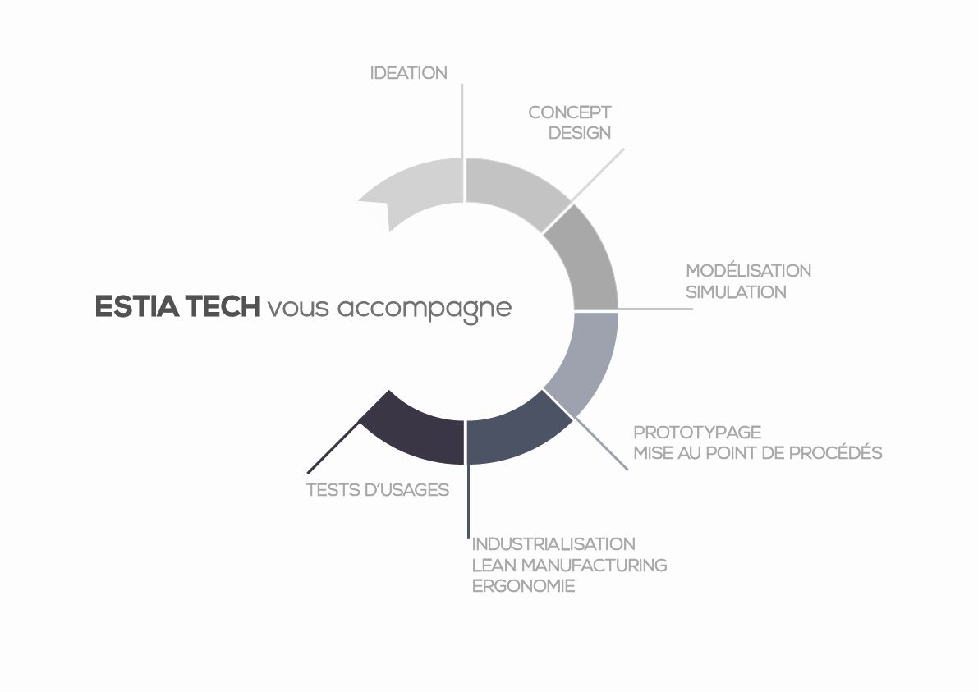
Where we can help you?

Slide 9







7 technology platforms
Support for research activity
Support for teaching
Support for companies
Recyclability of textile and leather articles
Digital Innovation, Artificial Intelligence & Big-Data
spinoff de la chaire BALI en partenariat avec le CETI
2006
2010
2017
2021
2023
en partenariat avec AKIRA
Engineering for renewable energies
Human factors for interactives technology
Composites & Robotics solutions
Additive manufacturing solution
Innovative Aircraft Propultion

Slide 10
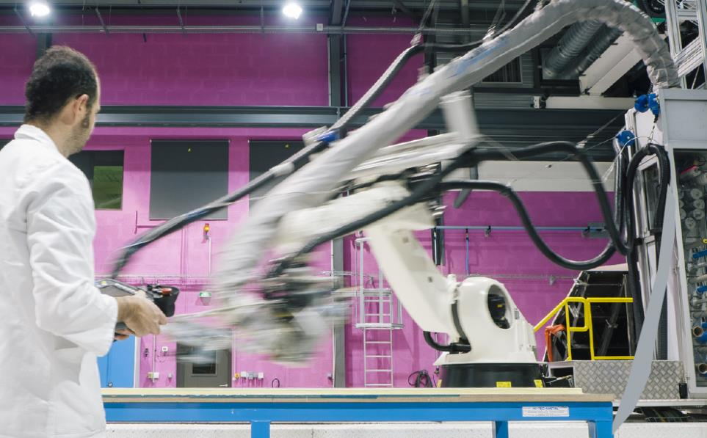
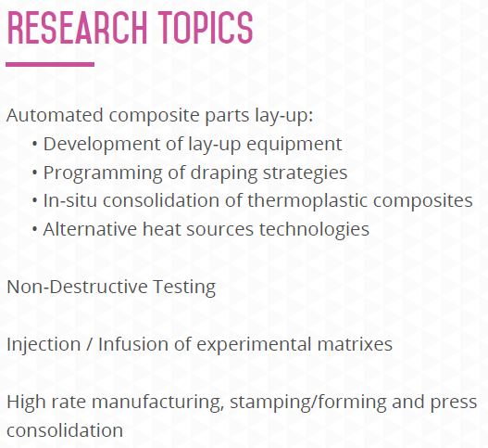
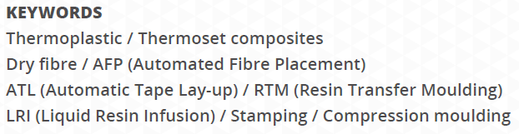
Composites

Slide 11
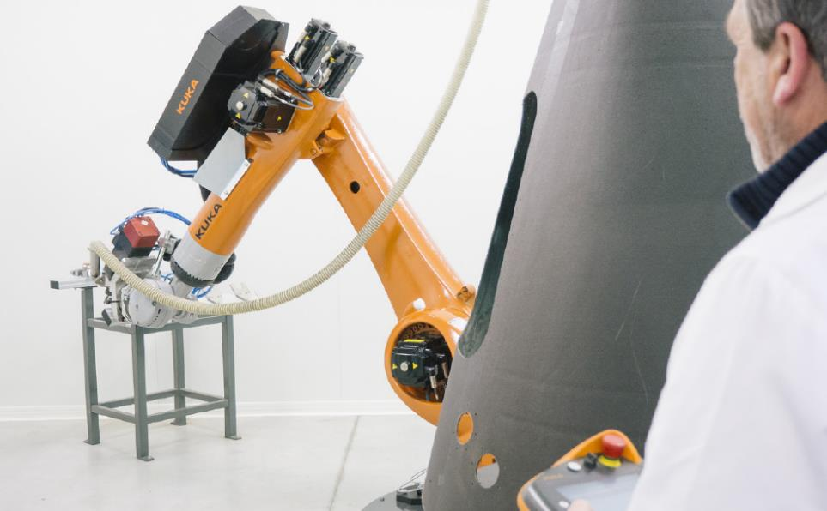
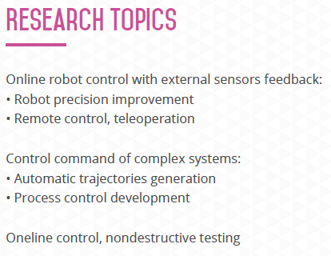
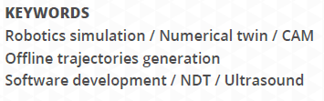
Robotics

Slide 12
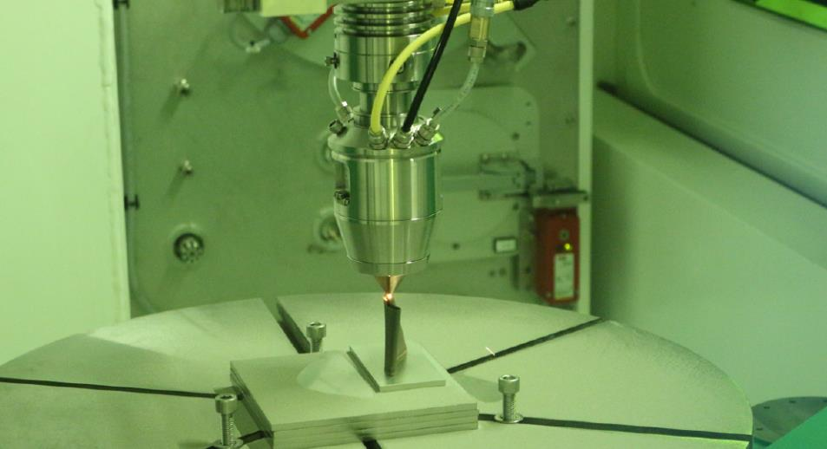
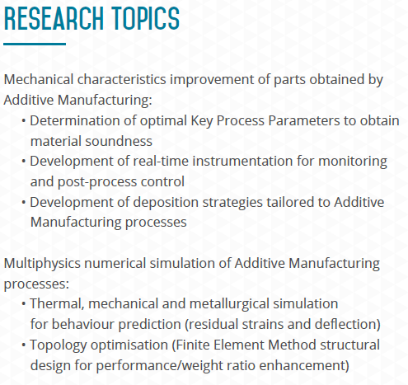
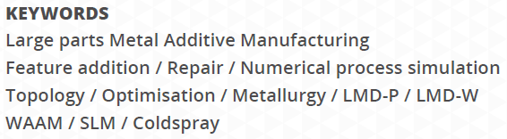
Additive Manufacturing

Slide 13

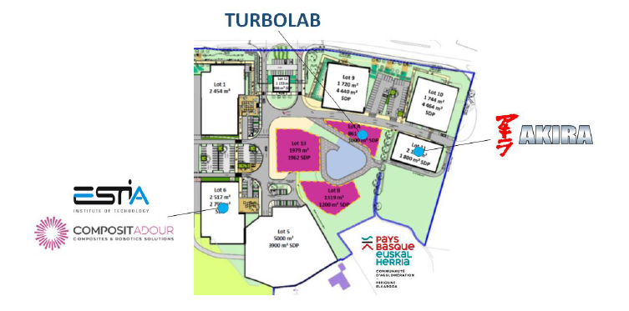
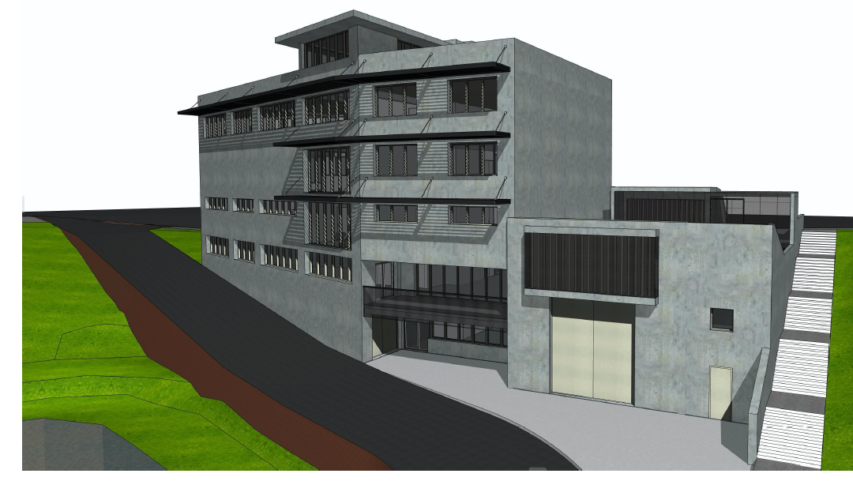

Whats Next : TURBOLAB
  TURBOLAB is a new plateform dedicated to innovative propulsion systems : Electric, Hybrid or Alternative Fuels (SAF and H2)
  Associating AKIRA expertise in innovative propulsion systems and ESTIA Compositadour Addimadour in Material and Processes

Slide 14

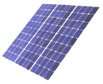


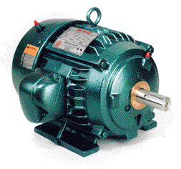


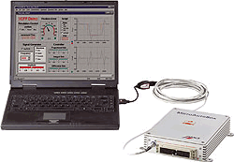





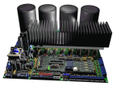
ESTIA Platforms
Electrical and Automatic Engineering for Renewable Energies
Automatic
Power Energy
Control
Energy storage
Smart grid
Electrical machines
Simulation
Electrical power quality
Control
Micro grids / Isolated grids
Emulators / Test benches

Slide 15
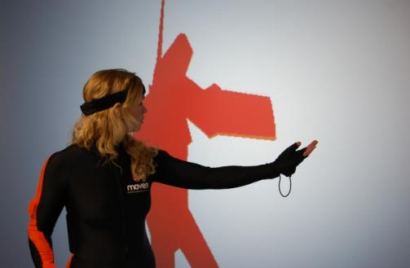
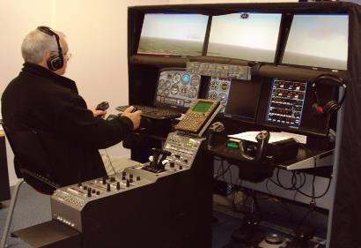


ESTIA Platforms
User centred design
Human Computer Interaction / Integration
Behavioral and Morphological Modeling
Platform for Prototyping, Evaluation and Usability Testing
Prototyping innovative systems
Facilitate the interaction between people and between a human and a system
  Model human behavior: use, appropriation and emotion

Slide 16

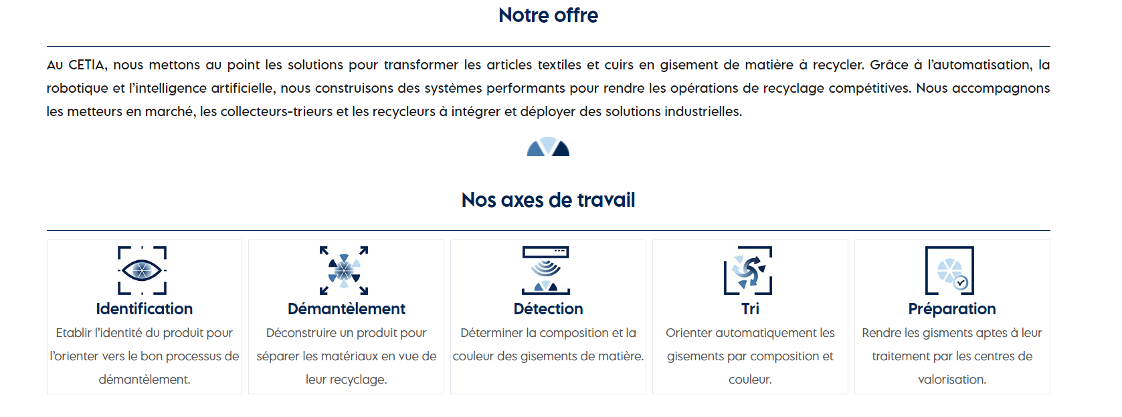
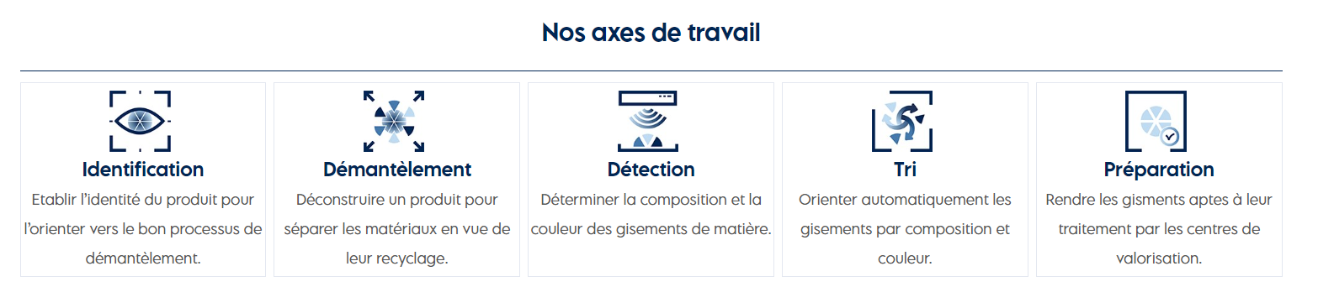

SOLUTIONS Automatisées et intelligentes
pour optimiser le recyclage des articles textiles et cuir
DECATHLON
GROUPE ERAM
ZALANDO
REVALOREM
Nos lignes
Nos clients

Slide 17
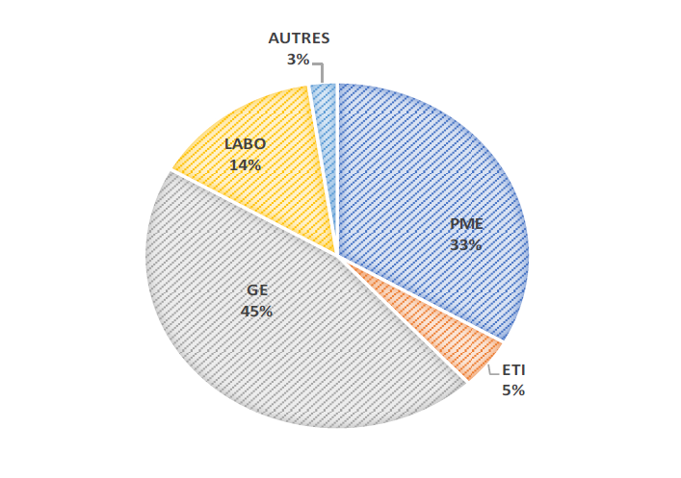
Partnership research commitments
ESTIA contracts with around fifty companies per year, mainly in the aeronautics and aerospace, energy and oil & gas sectors
For 2019 : Global Turnover : 2.600.000€
For 2020 : Global Turnover : 2.400.000€
For 2019 : EU and National funding : 3.900.000€
For 2020 : EU and National funding : 3.500.000€
Notes:
OLIVIER

Slide 18
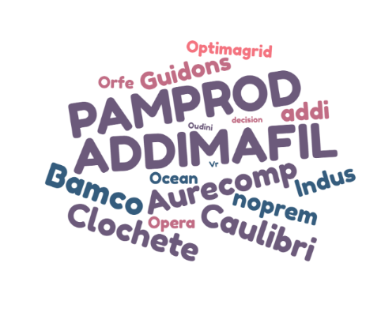

Ongoing collaborative projects https://www.estia.fr/recherche/projets-estiatech
20 EU projects
15 national projects
3 chairs
https://www.estia.fr/formations/les-chaires
Notes:
OLIVIER

Slide 19



Collaborative Networks
Notes:
OLIVIER

Slide 20
Ongoing collaborative projects
https://socialres.eu/
https://www.orhi-poctefa.eu/en/home/
http://www.greenplay-project.eu/?lang=fr
https://www.durableproject.eu/
https://www.hindcon3d.com/
https://rezbuildproject.eu/
https://hospitalsudoe40.eu/
https://www.ekate.eu/
https://fashiontechalliance.eu/en/
https://scirt.eu/
https://softdream-project.eu/
https://www.addispace.eu/fr/home-3
https://www.additool.eu/
https://www.hypercog.eu/
https://aptimeproject.eu/
https://chainproject.eu/fr/accueil/
https://gamelabsnet.eu/?lang=fr
Notes:
OLIVIER

Slide 21
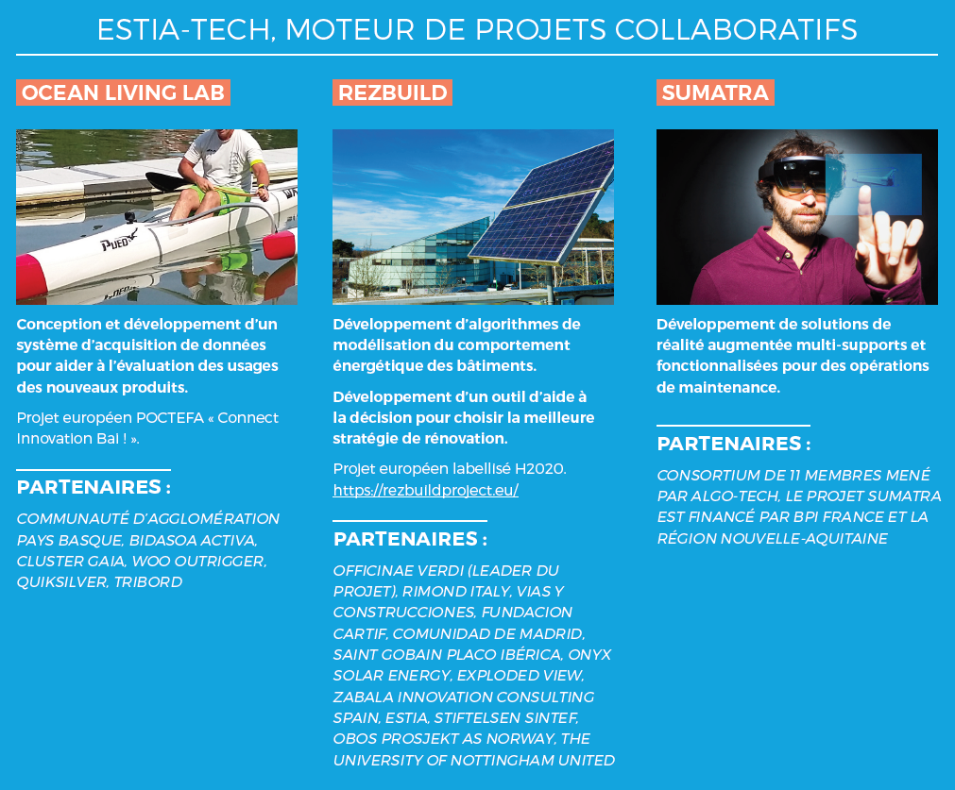
ESTIA-TECH Some projects

Slide 22
Thank you

