Slide 1





Industry Contact Points
2025
Co-financedby the project of Minister of Science Republic of Poland „Industry Contact Points for the Horizon Europe Research and Innovation Framework Program”

Slide 2














Coordinator

Slide 3




Place of ICP in the Beneficiary Support Ecosystem
Localization in Regions
– close to the Applicant,
Knowledge of the Region
Expertise Across the Entire Scope of Horizon Europe
Knowledge of the Industry and Industry Environment
Cooperation with the European Commission
Participation in European Partnerships
Formal and Administrative Consultations, Cross-cutting Issues
Substantive and Industry Consultations
Searching for Potential Participants in Horizon Europe
Information Actions and Training about Horizon Europe

Slide 4




Support in the areas of:
Smart services
Data science
Artificial intelligence
Digital networking
Internet of Things (IoT)
Smart logistics and cities
Digital agriculture
Digital education
Digital administration
Digital technologies (across all sectors)
Virtual reality VR
Supported European Partnerships:

Slide 5







What sets us apart?
Specificity of ICP – multiple projects within a single undertaking
Interdisciplinarity
Diversity of competencies
Expert knowledge – access to the know-how of the entire ŁRN
Practical knowledge of design-related issues
Industry knowledge
Collaboration with the European R&D ecosystem

Slide 6
How do we work with ICP clients?
Individualized approach
Identification of the client's level of 'advancement'
Tailored interdisciplinary support

Slide 7
Levels of project maturity
Innovation at the regional scale
Support pathway implemented by ICP:
Informing about Horizon EuropePromoting
Horizon Europe and Partnerships
Highlighting the benefits of participating in Horizon Europe projects
Consultations regarding the possibilities of obtaining funding from Horizon Europe
Matchmaking and networking
Industry consultations
Networking and brokerage activities
Searching for international partners
Promoting project ideas (e.g., pitching, contact/client database)
Identifying relevant competitions based on needs
Analyzing competition topics in terms of the potential of entities
Building partnerships
Substantive support in refining the project scope (expert consultations)
Innovation at the national scale
Innovation at the supranational scale
Horizon Europe
R&D project

Slide 8
Success stories
Over 3,088 Polish entities gained knowledge and raised awareness about the Horizon Europe Program and European Partnerships through industry-specific training, webinars, and thematic conferences organized by ICP.
Approximately 955 B2B meetings were held during international events, matchmaking, and brokerage activities involving Polish entities.
770 individual industry consultations regarding Horizon Europe competitions were conducted.
305 Polish entities were connected with foreign partners to build project consortia for Horizon Europe.
A significant increase in the number of Polish beneficiaries and the value of projects in Horizon Europe compared to Horizon 2020 (676 Polish entities in 1,270 projects = 664.7 million EUR).

Slide 9



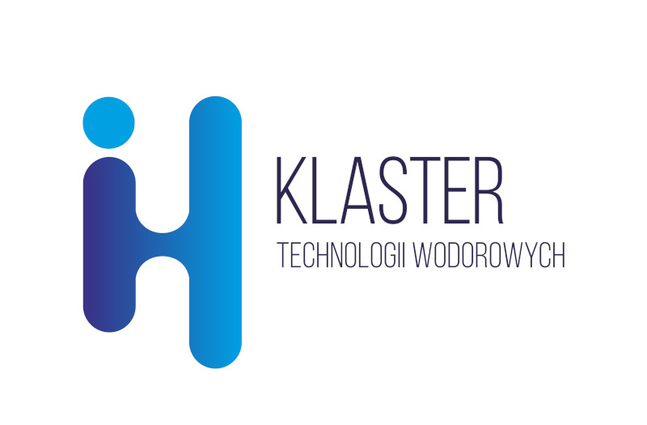



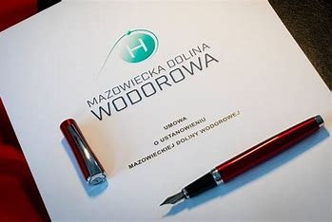

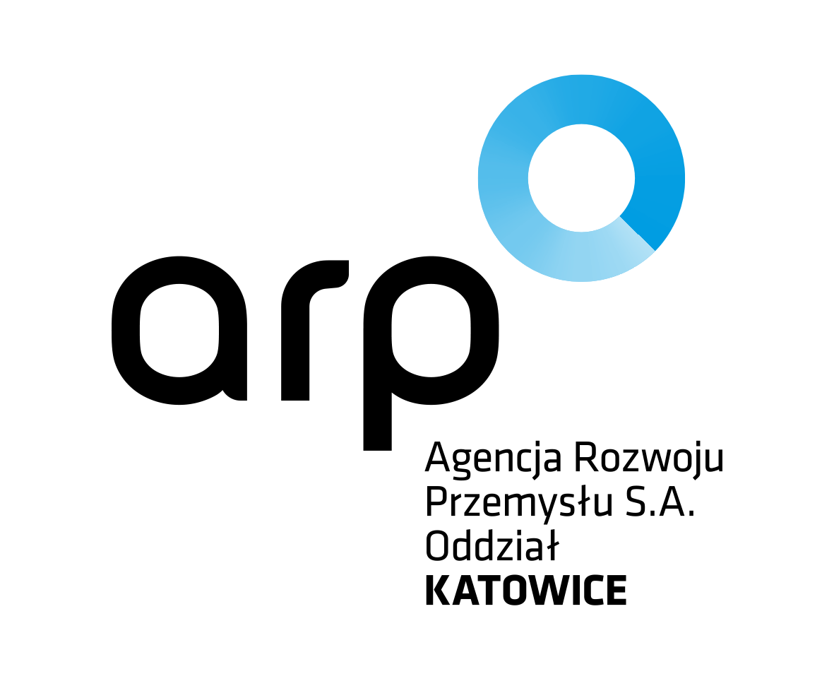



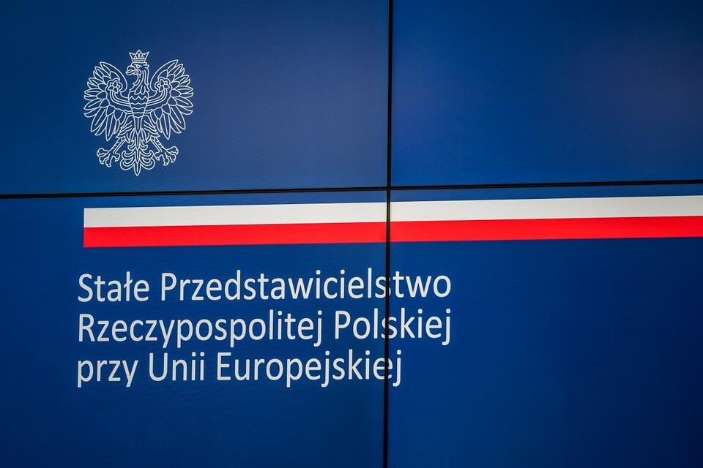



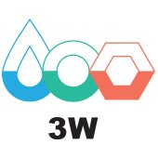
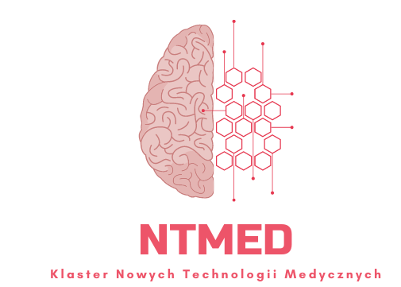








We cooperate with the national innovation ecosystem

Slide 10






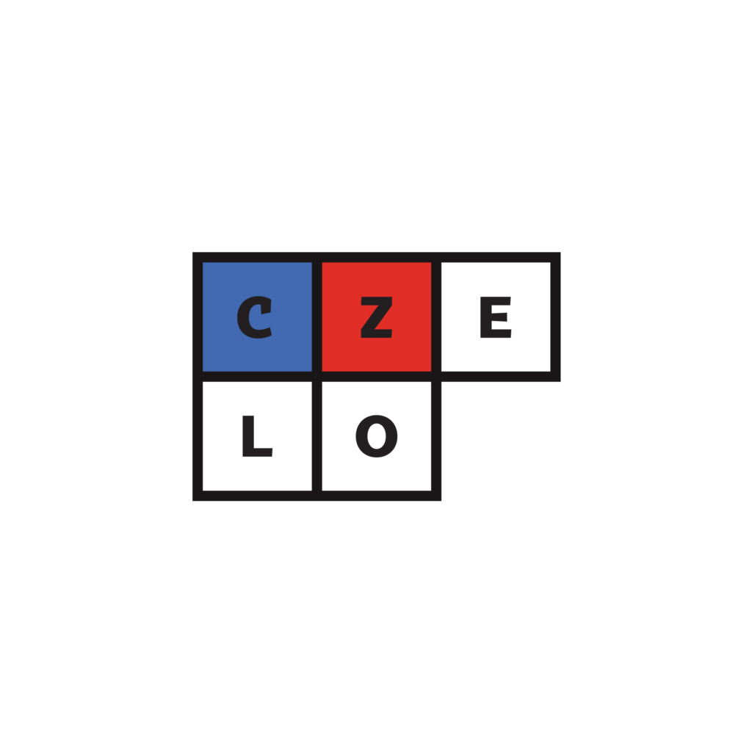



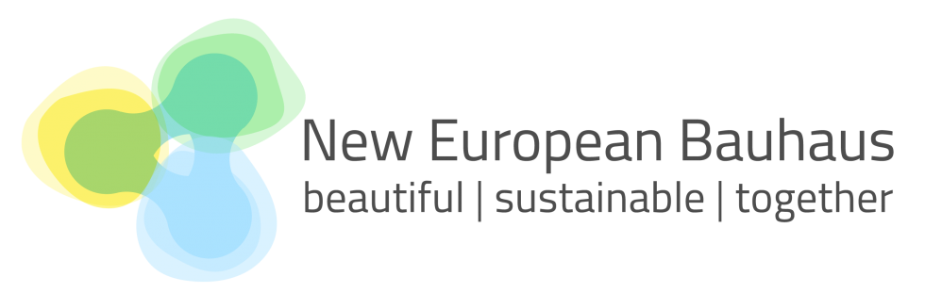








We are part of a global network of connections

Slide 11


Contact us
Co-financedby the project of Minister of Science Republic of Poland „Industry Contact Points for the Horizon Europe Research and Innovation Framework Program”

