Slide 1
Slovenian open science infrastructure
Milan Ojsteršek,
University of Maribor, Faculty of Electrical Engineering and Computer Science
milan.ojstersek@um.si
tel.: +386 2 220 74 51, +386 40 696 538

Slide 2





Structure diagram of the Slovenian openscience infrastructure
Openscience monitor
SLING
Big research data archive
National portal (http://www.openscience.si)
      search engine and digital objects aggregator,
      recommender system,
      similar content detection,
      digital objects deduplication.
DMP assistant
PID service
Common services
Portal of Slovenian Scientific Journals and Monographs
RUL
DKUM
RUP
RUNG
DIRROS
REVIS
Other digital archives
Digital preservation of research results
Genomic data archive
CLARIN.SI
DKMORS
Journals and monographs
Provider of backbone network based on broadband fibre-optic links, server infrastructure and data archive:
Provider of supercomputing infrastructure and big data archive:
Notes:
The Slovenian open-access infrastructure consists of Slovenian universities’ repositories (a repository of the University of Ljubljana, a Digital library of the University of Maribor, a Repository of the University of Primorska, and a Repository of the University of Nova Gorica), a Repository for research organizations (DIRROS), the Repository for standalone faculties which are not part of universities (REVIS) and a national portal that aggregates content from the repositories and other Slovenian archives (Digital library of Slovenia (dLib.si), VideoLectures.NET, Digital library of Ministry of Defence (DKMORS), Social Science data archive (SSDA), CLARIN.si and repositories of Slovenian open access publishers of journals and monographs). The national portal provides a common search engine, a recommender system of similar publications, and text-matching software. It is also used for deduplication of publications, normalization of authors of publications, and distribution of content and metadata to other repositories if authors are from different institutions. The repositories are connected to the national bibliographic system COBISS.SI and the national current research information system SICRIS. Aggregated data from repositories enable funders to check the actual openness of scientific publications, research data, and other research results. Metadata from repositories are harvested from OpenAire, Google Scholar Google dataset search, Core, from the European portal for doctoral theses DART-Europe, and other directories, aggregators, and search engines. The Slovenian open-access infrastructure has a national service for assigning persistent identifiers to digital objects and a big data archive for the storage of big data sets from repositories. The digital objects from the national infrastructure are used in the Slovenian national supercomputing network SLING, the national COVID-19 data portal, and the European COVID-19 data portal. The Academic and Research Network of Slovenia (ARNES) enable us to use backbone network based on broadband fiber-optic links. They also host DIRROS and REVIS repositories on their server infrastructure. We also use their disk storage to store backups. The Institute of Information Sciences from Maribor provides us with the use of the VEGA supercomputer and a big data archive from which users can process data on the Slovenian National Supercomputing Network (SLING) and other supercomputers in Europe. The infrastructure enables Slovenia to implement the policy of open access to the results of nationally funded research, as expected of the EU Member States participating in the ERA.
Web links:
National portal: http://www.openscience.si/
Description of Slovenian open-access infrastructure:
University of Ljubljana Repository: https://repozitorij.uni-lj.si/info/index.php/eng/
University of Maribor Digital Library: https://dk.um.si/info/index.php/eng/
Repository of the University of Primorska: http://repozitorij.upr.si/info/index.php/eng/
Repository of the University of Nova Gorica: http://repozitorij.ung.si/info/index.php/eng/
Repository of independent higher and higher education organizations: http://revis.openscience.si/info/index.php/eng/
Repository of Slovenian research organizations that are not part of Slovenian universities: http://dirros.openscience.si/info/index.php/eng/
Social science data archive: https://www.adp.fdv.uni-lj.si
CLARIN.si: https://www.clarin.si/repository/xmlui/
Digital library of Ministry of Defence: https://dk.mors.si/info/index.php/sl/
Digital library of Slovenia: https://www.dlib.si/
Videolectures.net: https://videolectures.net/
Journals from Slovenian Academy of Science: https://ojs.sazu.si/
Journals from the University of Maribor: https://journals.um.si/index.php/
Slovenian openscience monitor: https://monitor.openscience.si/
Portal of Slovenian Scientific Journals and Monographs: https://revije.openscience.si/about
Research Data Management Plan Assistant Tool: https://nrrp.openscience.si/

Slide 3
Achievements
A national approach to building of open science infrastructure and FAIR digital objects.
National PID service.
National big data archive.
Slovenian openscience monitor.
Digital preservation archive
Portal of Slovenian scientific journals and monographs.
Templates for amendments to the policies about a mandatory copy of research publications, research data, final theses and other research results ( software, workflows, lab notebooks, online courses…) is developped for all partner institutions.
Development of adapted processes for filling publications, research data sets and other research results from students and employments on all partner institutions.
Open Aire compatibility is established to facilitate in registration, discovery, access and re-use of research publications and research data, in particular in the context of funded projects across European countries.
Integration with COBISS, SICRIS, higher education information system, university information systems and university autethication systems.
Plagiarism detection software is developed and included into processes for filling publications from students and employments.
Recommendation system of similar works within repositories and between repositories and other is implemented.

Slide 4
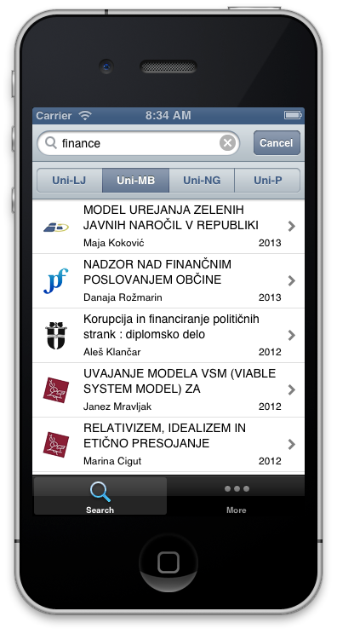





Structure diagram of repository infrastructure
HPC
EUDAT
Open access analytics
Institutional web servers
Social networks
Digital preservation of digital objects
ARNES AAI or institutional authentication system
Repository
OpenAIRE,
B2Find
DART-Europe,
Google,
Google datasearch,
OpenDOAR
re3data
….
Institutional information system
Common services
PID service
Open Science Slovenia
Notes:
The repository is based on the software solution used by the Digital Library of the University of Maribor and developed by the Laboratory for Heterogeneous Computing Systems of the University of Maribor. It has been significantly updated and upgraded with new functionalities due to the establishment of different processes of publication submission by students and university staff.
For the needs of the processes of submission, preservation and cataloguing of digital objects, each institutional repository of the universities of Maribor, Ljubljana, Primorska and Nova Gorica is connected to the university authentication system, the university higher education information system and the COBISS.SI system. The REVIS repository also has a number of institutions that have their academic information system linked to the repository software.
Each digital object is given a national persistent identifier (PID) so that, once it has been cataloged, the repository software calls a national service that returns the persistent identifiers. We use EUDAT's B2Handle service to assign persistent identifiers.
The repositories store the big data sets in a big data archive. We use EUDAT's B2Safe service to archive them. We use EUDAT's B2Stage service for transferring data between the supercomputers and the big data archives.
To speed up the metadata deposit of digital objects already assigned a persistent DOI in repositories, we use the API services offered by Crossref and Datacite. The repository software calls the service by sending the DOI persistent identifier as input to the service and retrieves back the metadata stored by Crossref and Datacite about that digital object.
For the purpose of aggregation of metadata by OpenAire, we have established an OAI-PMH service that returns metadata according to the instructions provided by OpenAire. Other aggregators (Core, Dart Europe, Base...) also aggregate metadata through this service. For Google Scholar and Google Dataset search, we have embedded metadata for individual digital objects in the repository’s website according to the Highwire press format and the Schema.org specification.
At the University of Ljubljana, digital objects are stored in the University's document system after being deposited in their repository. The national portal, ARNES archive, and IZUM big data archive are used to archive digital objects and their metadata from the repositories.
The repositories send metadata and electronic versions of digital objects to the national portal as soon as they have been cataloged in the national bibliographic system COBISS.SI. From the national portal, the University of Ljubljana repository retrieves metadata and electronic versions of publications from ePrints.FRI, PeFprints and ADP. The repository also retrieves additional metadata about researchers and research organizations from the national portal, which it extracts from SICRIS.
The repositories send to dCOBISS the data needed for open access analytics. The metadata they send is linked to the projects that funded the research and to the APC payments charged by the publishers.
The national portal carries out the recommendation of digital objects. When a metadata of the digital object is clicked on in the repository, a list of similar documents is sent from the national portal to the institutional repository. The recommendation consists of the titles of documents within the repository and the titles of documents in other university repositories, dLib.si, the Social Science Data Archive CLARIN.si, journal and monograph publishers' repositories, VideoLectures.NET and DKMORS.
The repositories provide both curator-oriented and user-oriented functionalities. The curator part is used by the librarians, the data stewards, and the system administrators and is designed differently for each institution. The student office employees carry out the checking and locking of students' final theses. Librarians review student and staff publications, catalog them in COBISS, and transfer their metadata from COBISS.SI to the repository. In the curator part, the librarian can import the publication metadata from the local COBISS.SI database and add an electronic version of the digital object to it. In this way, digital objects that are already cataloged in COBISS.SI, for which electronic versions exist and for which the University has the appropriate copyrights, can also be stored in the repository.
The user part of the institutional repository is divided into a part for the interested public and a part for registered users (students and university staff). After registration, students and university staff can submit their works to the repository and browse their content (metadata and similar content found by the text-matching software). The part accessible to the interested public is bilingual (Slovene and English user interface) and is accessible online and on mobile platforms (Android and IOS). The web version is friendly for users with disabilities and contains the main features of web applications that comply with the WAI specification. The web interface allows usage by people with reduced mobility and people with slightly reduced vision (e.g. the elderly and visually impaired).
The software allows easy and advanced search and browsing. A member institution can integrate the content from the repository on its website by calling the JavaScript API to access simple or advanced search and browsing of the institutional repository. The same API is also used by mobile applications. University members and staff can also export metadata about their publications in RSS, JSON, and RDF formats.
The repository displays various statistics that can be used to identify for each institution or individual unit within an institution the total number of its digital objects in the repository and how many have been stored in the last period, as well as the number of metadata accesses and downloads of the digital object. For the faculties of each university, the statistics of interest are those that report the number of views and downloads of the faculty's materials for the previous years on an annual basis. The statistics on thesis mentors can be used to find out with which tutors they cooperate and which theses have been produced by students under their supervision. Another interesting statistic is based on the keywords of the mentor's publications, it indirectly shows which research areas the mentor is involved in and how the mentor's research area has changed over time.
At the University of Ljubljana, digital objects are also stored in the University's document system after being uploaded to their repository. The national portal and the infrastructure set up at ARNES and IZUM are used to archive digital objects and their metadata.
The repositories send metadata and electronic versions of digital objects to the national portal as soon as they have been cataloged in COBISS.SI. From the national portal, the University of Ljubljana repository retrieves metadata and electronic versions of publications from ePrints.FRI, PeFprints and ADP. The repository also retrieves additional data on researchers and research organizations from the national portal, which it extracts from SICRIS.
The repositories send to dCOBISS the data needed for open access analytics. The data they send is linked to the projects that funded the research and to the APC payments charged by the publishers.

Slide 5
Structure diagram of research big data archive and PID service infrastructure
….
Repository 1
Repository 2
Repository N
External sources
B2Find
Openscience.si
Services
B2Handle on ARNES
EOSC + EUROHPC
HPC Vega and Maister archive
B2stage
B2Safe
HPC
ARNES digital preservation archive
B2Handle copy on IZUM

Slide 6
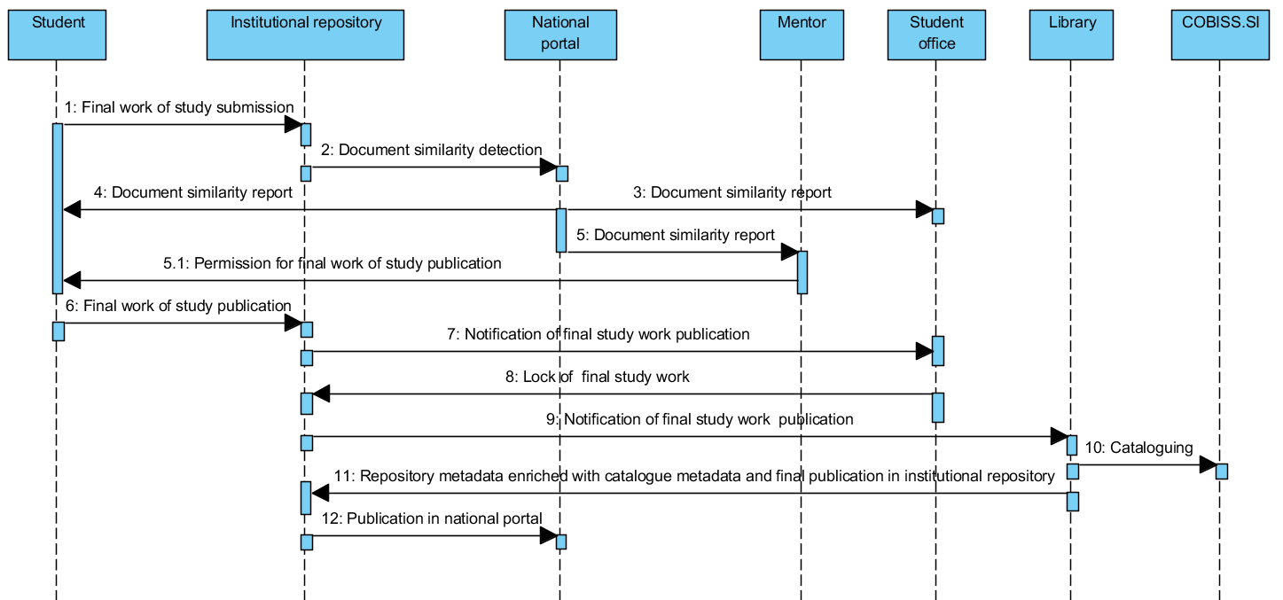
A sequence diagram of final study work submission and publication at the universities of Maribor and of Nova Gorica
Notes:
The process, which was established at universities, allows authors to submit their work into the institutional repository. After which, the submission is reviewed and catalogued into COBISS.SI by a librarian. Based on the experiences accumulated since 2008, it was found that a manual review of metadata is mandatory as in many cases the submissions are incomplete or contain spelling errors. In addition, only librarians can normalise those authors using the CONOR.SI authority file. After the publication metadata have been successfully catalogued within the COBISS.SI, they can be transferred to the institutional repository via SRU/SRW services.
The working group, which consisted of librarians, legal experts and IT professionals from all four Slovenian universities, suggested the submission processes of the final study works. Slovenia lacks a common university academic information system (UAIS), therefore each university provided its own variation of this process. Students at the universities of Maribor and of Nova Gorica submit their final study works into university repository, which is filled with some metadata from university academic information system. A sequence diagram of the final study work publications of the universities of Maribor and of Nova Gorica is presented in slide. The submissions at the universities of Ljubljana and Primorska take place at university academic information system, the sequence of operations is otherwise the same as described for the universities of Maribor and of Nova Gorica.

Slide 7
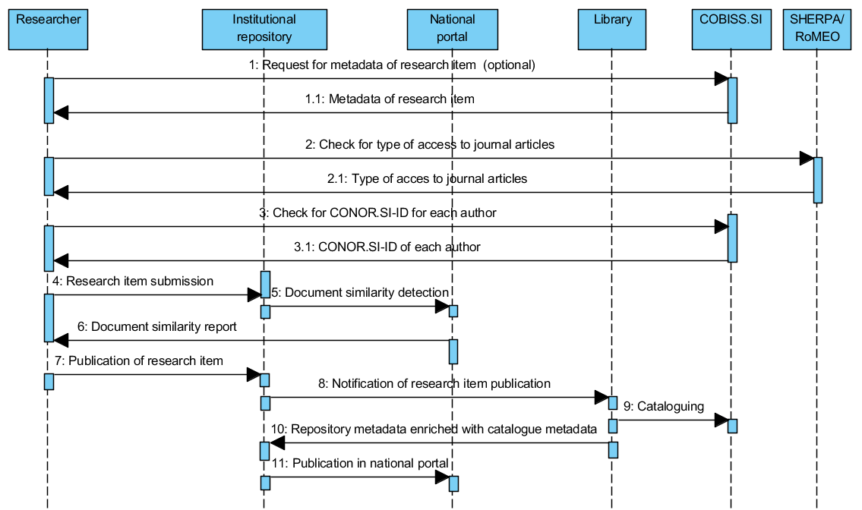
A sequence diagram of research item submission and publication
Notes:
All four institutions have established the same process for submission of research publications, which is presented the sequence diagram in the slide. Researchers can submit articles, monographic chapters, monographs, conference papers, e-lectures, publications about patents, research data, and other types of publications. The types of publications are adapted according to the COBISS.SI typology (http://home.izum.si/COBISS/bibliografije/Tipologija_eng.pdf), which is used by the Slovenian Research Agency for researchers’ bibliographies evaluation. Once researchers are logged into the institutional repository, they can submit new content as a whole, or they can use metadata from the catalogued record in COBISS.SI (optional request and reply on the beginning of the process). In the latter case, the institutional repository takes care of the metadata transfer from COBISS.SI using the SRU/SRW protocol. In this case, researchers only need to provide the electronic version of their publications. A link to the SHERPA/RoMEO portal is also enabled to the publication authors, so they can check what type of access they can use depending on the publisher's copyright transfer agreement. During the insertions of names and surnames, suggestions from the CONOR.SI authoritative file are provided. These suggestions include the year of birth, if available in CONOR.SI, and researcher identifier from SICRIS, which simplifies the determination of the correct author. This can greatly simplify the librarian’s work of cataloguing the publication in COBISS.SI. Authors can also determine the copyright holder and the type of access to the full-text publication. They can choose between immediate publication, closed access or delayed publication with embargo (these metadata are part of OpenAIRE compliance).

Slide 8
Establishing processes to support the handling of research data in the national open access infrastructure
Pre-publication activities.
Publication in the repository or data archive.
Digital preservation.

Slide 9
Phase before publication of research data and required documentation
Phase before publication of research data:
  Planning and finding data sources.
  Preparation of a research data managament plan, applications for the ethics commission and proposals for informed consent, proposals for declarations by data providers.
  Obtaining relevant statements and opinions.
  Data collection and creation.
  Data Processing and analysis.
  Preparation of files in appropriate formats.
  Preparation of documentation.
Before a researcher applies for the publication of a research dataset in the national open access infrastructure, he must have:
  a data managament plan (if requested by the funder or the organization in which he is employed),
  metadata about the research dataset,
  documentation that is necessary for understanding and using the data,
  data files in appropriate formats,
  ethical approval if the research study involves humans, animals or environmental data,
  statements of data providers and signed informed consents of research participants,
  defined licenses for the use of research data,
  the software, containers, workflows that was used to generate or process the data, if he created it himself,
  research notes and other research results, if any.

Slide 10
Publication phase of research data
The researcher inserts the research data set and other research results into the repository or data archive himself or his librarian inserts them .
The librarian checks the adequacy of the metadata and whether the appropriate documentation is available.
The librarian informs the appropriate authority within the institution, which is in charge of checking the appropriateness of data publication and other research results, that the data set and other research results have been uploaded. They are accessible in closed access and are only available via a link that requires a password provided by the librarian.
The appropriate body within the institution, which is in charge of checking the adequacy of the data publication, checks the adequacy of the content of the data set and other research results. If the content is appropriate, inform the librarian that the data set and other research results can be published.
The librarian, after a positive response from the body within the institution, which is in charge of checking the appropriateness of data publication, publishes the data set and other research results in the repository and performs cataloging in COBISS.
Central specialised information centre of the scientific field, established by Slovenian research and inovation agency checks the adequacy of the typology, metadata and documentation of the research data set and other research results.

Slide 11
Digital preservation phase
Data can be stored in different formats and in several versions. For digital preservation of research data, we must ensure the independence of the data from the technology. We will establish processes for digital preservation according to the OAIS reference model ( ISO 14721 ) using metadata according to the PREMIS meta data standard.

Slide 12

European Genomics Data Infrastructure (GDI)
Onboarding: 6
Addressing national challenges for deployment
Deployment: 3
National node operational and addressing challenges for EU level connections
Operational: 15
Fully deployed national node interconnected to EU services, able to provide access to data across borders following 1+MG Governance
Notes:
Croatia, Cyprus, Hungary, Ireland, Malta, Romania
Bulgaria, Latvia, Lithuania
Belgium, Czech Republic, Denmark, Estonia, Finland, France, Germany, Italy, Luxembourg, Portugal, Slovenia, Spain, Sweden, The Netherlands, Norway

Slide 13
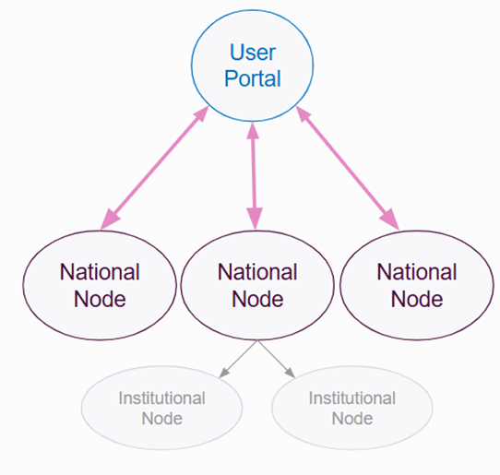
GDI Infrastructure
Centralised Discovery and Access Management
User Portal (DCAT - AP)
Passport and AAI
REMS
European level interconnectivity
Beacon Network (Beacon v2.2 data model and API)
Passport and AAI
REMS
National node level
Secure storage, secure computing and analysis, federated execution, federated learning. Common framework of standards and APIs.
Manage your own data and metadata.
Institutional level
Secure storage, execution of institutional processes, secure computing and analysis,

Slide 14
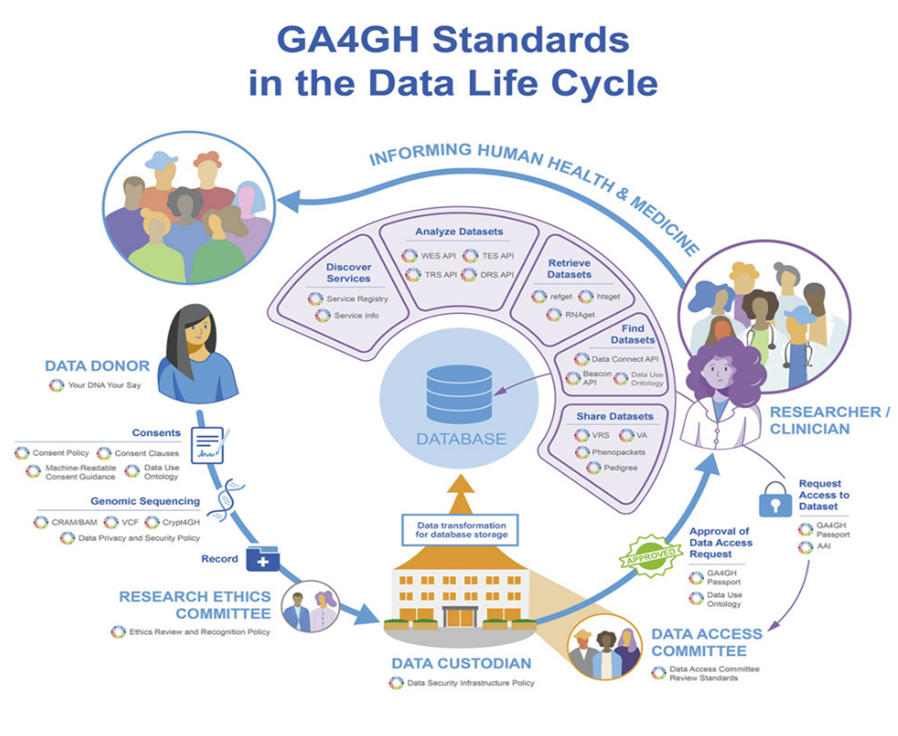
The Global Alliance for Genomics and Health (GA4GH) unites an international community dedicated to advancing human health through genomic data. They build technical standards, and policy frameworks, and tools that will expand responsible, voluntary, and secure use of genomic and other related health data.
GA4GH: International policies and standards for data sharing across genomic research and healthcare
Rehm, Heidi L. et al.
Cell Genomics, Volume 1, Issue 2, 100029, 2021, DOI: 10.1016/j.xgen.2021.100029

Slide 15
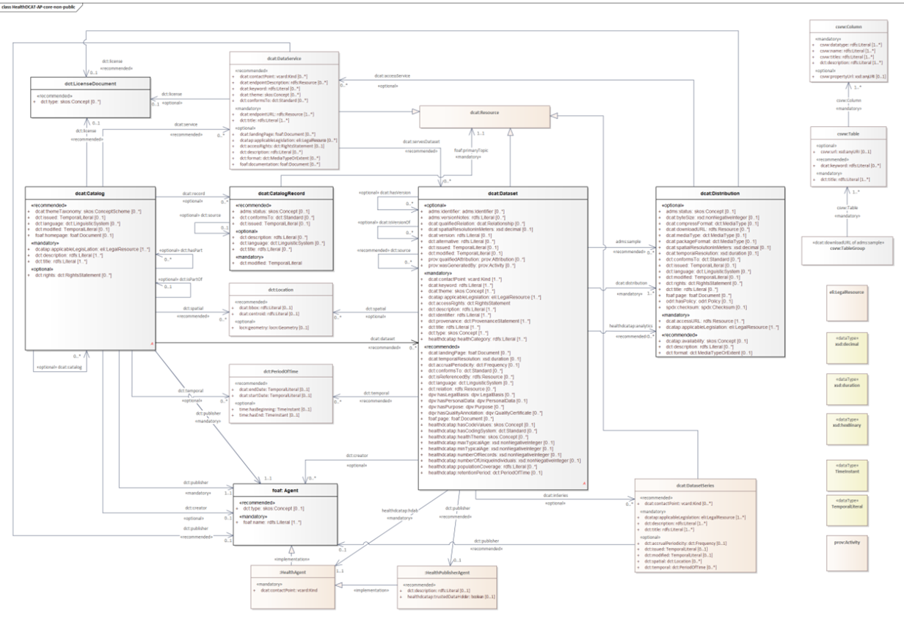
HEALTHDCAT-AP
Notes:
The HealthDCAT Application Profile (HealthDCAT-AP) is a domain-specific metadata model designed to support the implementation of the secondary use framework under the European Health Data Space (EHDS).
HealthDCAT-AP introduces new properties that enable semantically consistent dataset descriptions, structured for automated exchange and federation across catalogues. This ensures that metadata can be processed and integrated into local, regional, national and EU-level catalogues, including the one operated by the central platform of the HealthData@EU infrastructure.
A distinctive feature of HealthDCAT-AP is its explicit classification of dataset access rights into three categories: non-public, restricted, and public. Each category is defined with specific technical requirements.
In addition, new controlled vocabularies have been developed to harmonise property values, thereby ensuring comparability and interoperability of dataset descriptions across Member States.

Slide 16
1+MG data models, standards and ontologies
Minimal metadata model v1.0 (sample, subject&diagnosis, treatment, environmental exposure&biomarkers, sequence, metadata submission).
Report on semantic interoperability scenarios
Documented best practices in sharing and linking phenotypic and genetic data v2.0
Phenotypic and clinical metadata framework 3v0
Data Use Ontology
Phenopackets
DCAT
DCAT-AP
1+MG Minimal dataset for cancer
ODRL
CroissantML
MLDCAT AP

Slide 17
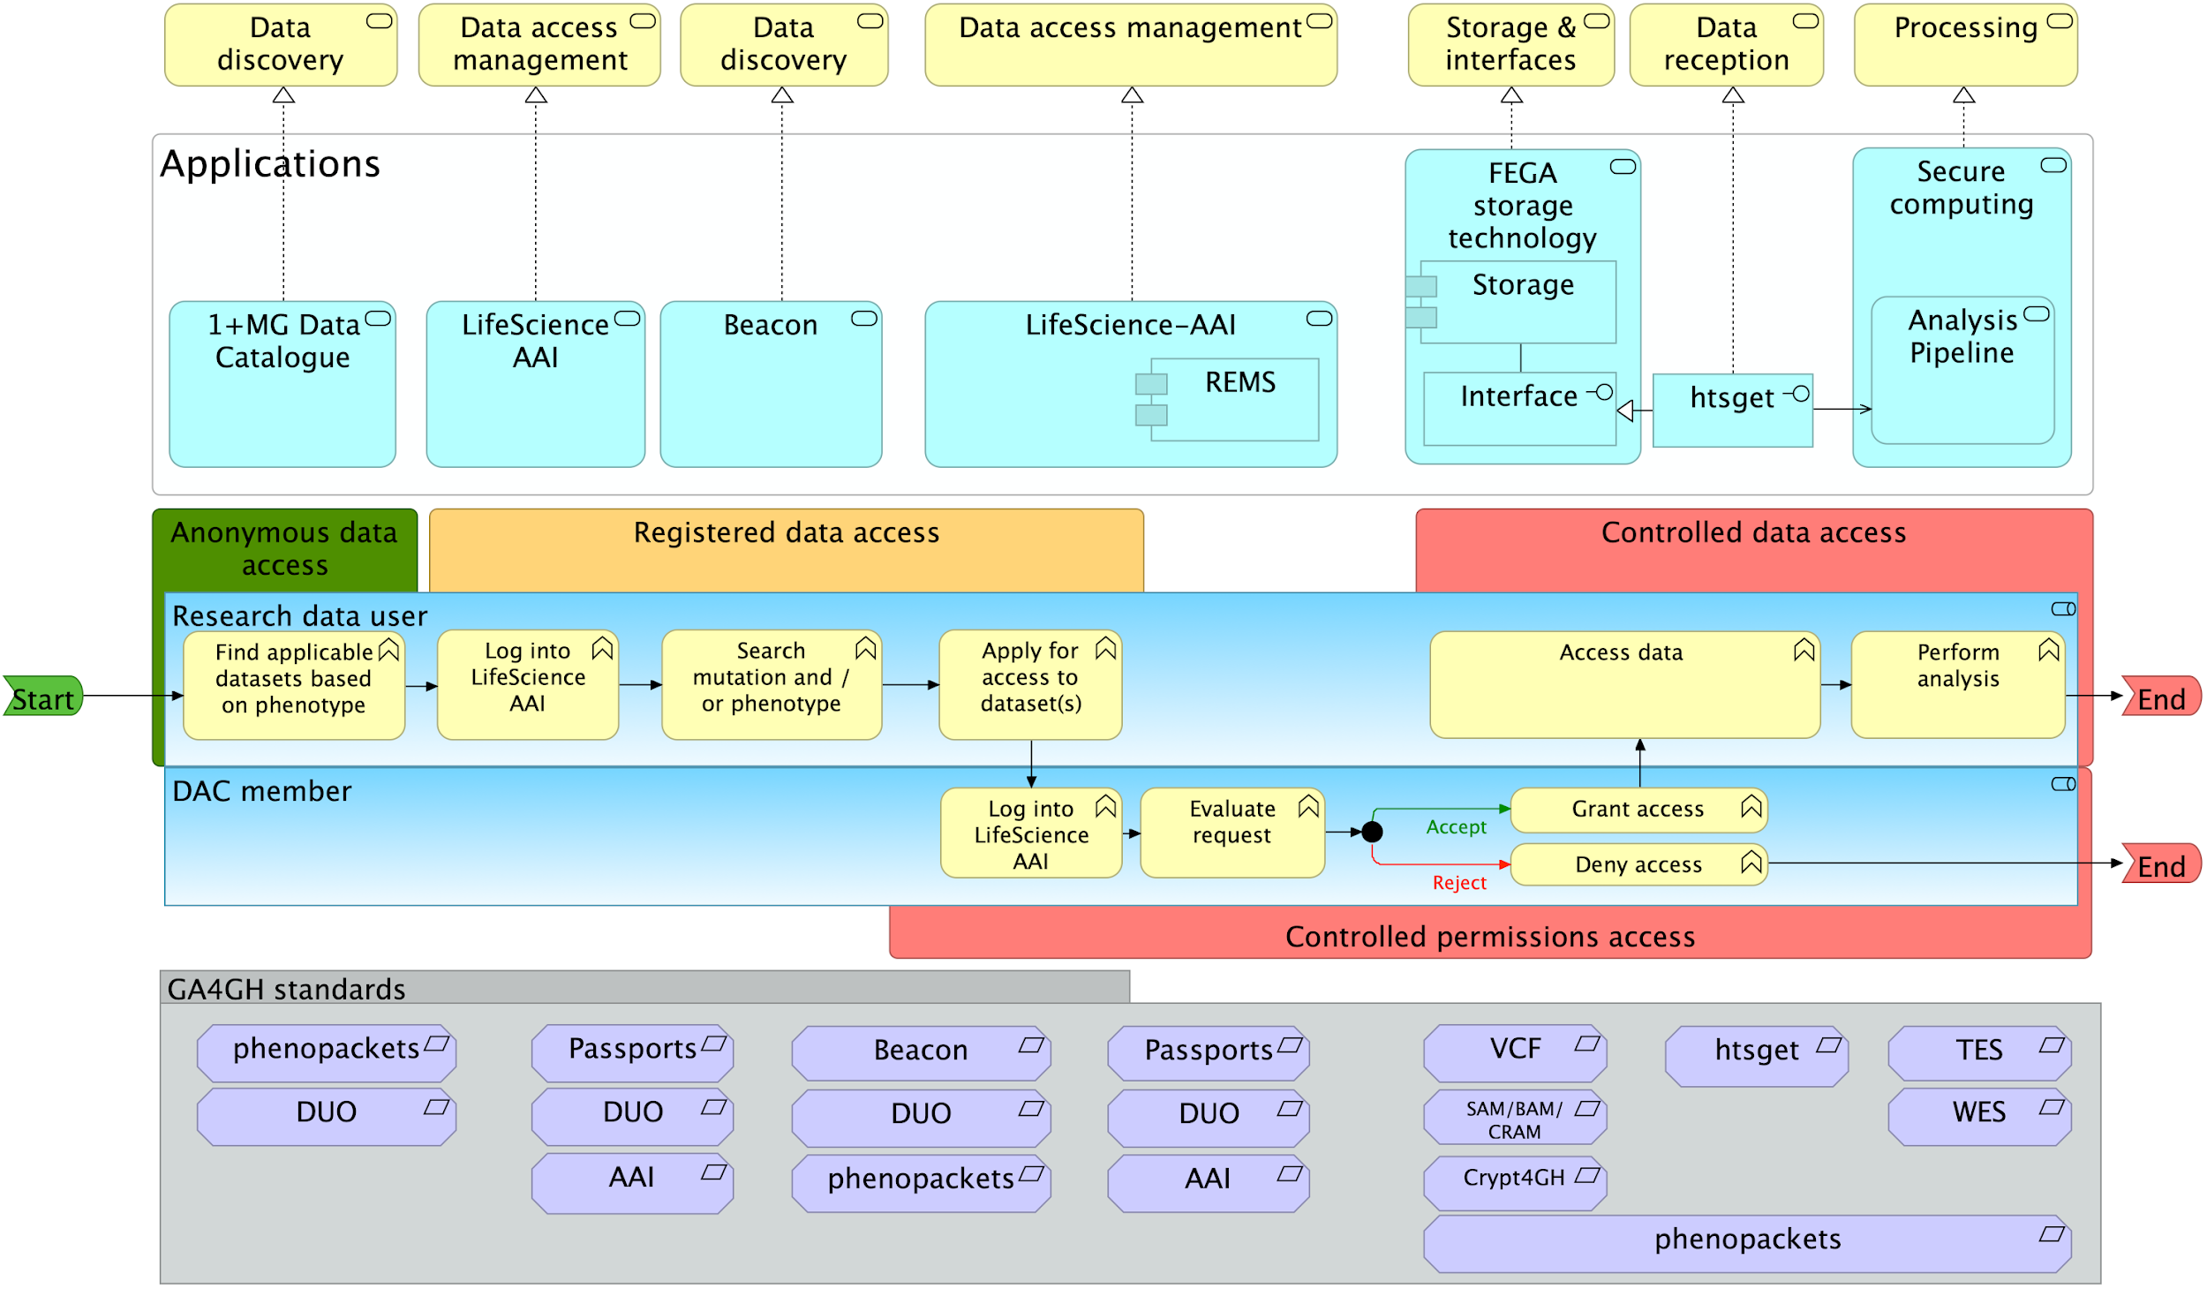
GDI Workflow

Slide 18
Slovenian GDI architecture diagram
Slovenian GDI node
European GDI infrastructure
Institutional GDI node 1
Institutional GDI node 2
….
Institutional GDI node N
Genomic data archive
Slovenian national supercomputing network (SLING)
Slovenian openscience infrastructure
Slovenian health dataspace and services

