Slide 1
Session 3: Equity distribution and how to plan your captable
Jaume Argerich

Slide 2


Value and stock
Equity distribution and how to plan your captable
Start-ups
Value is in the future, illiquid and tied to ownership (equity)
Temptation to use equity as monopoly money.
Equity implies control and is expensive in the long term.
Need to restrict its use to acquire critical resources or skills.
What are the critical resources or skills in your startup?

Slide 3
Everybody wants equity!
Equity distribution and how to plan your captable
Investors
Intermediaries
Employees
EQUITY
Advisors
Suppliers
Debt providers
There is overdemand so we must establish some rules

Slide 4
Prioritizing resources and skills
Equity distribution and how to plan your captable
Which critical resources/skills do we need?
1
  List the resources/skills
  What do I need to achieve my final goal?
  Money, yes, but what else?
2
  Rank the resources/skills depending on how critical they are
  How important is that for the startup success?
  Are there alternatives? Can we do without?
  How scarce is that resource/ skill?
3
  Determine whether that resource/skill is eligible for equity distribution
  Is that a resource/skill I will need during a long time?
  What is the standard practice on the market?
  What is the market price of that resource/skill?
10-15’ work to develop your list of critical resources/skills

Slide 5
Groups for the activities
Equity distribution and how to plan your captable
1 | Barbelo
2 | Behavix
3 | Bionova
4 | BizToys Ltd
5 | Earthfarms Collective
6 | FutureFastFood
7 | Gojenie
8 | Kelpeat
9 | Lyophilised Organic Donkey Milk
10 | Nexodify
11 | NutrisAvIng Advisor
12 | RegenFarm
13 | The Green Float
14 | TropicStream
15 | Vevibal
16 | Yield Hunter

Slide 6
Tools for equity distribution
Equity distribution and how to plan your captable
SHARES
  Normal equity
  Dual share classes
OPTIONS ON SHARES
  Stock options
  Anti-dilution and other clauses in SHA
SINTHETIC EQUITY
  Phantom shares
  Other bonuses linked to equity valuation

Slide 7
Everybody wants equity!
Equity distribution and how to plan your captable
Investors
Intermediaries
Employees
EQUITY
Advisors
Suppliers
Debt providers
There is overdemand so we must establish some rules

Slide 8
Stock-based compensation
Equity distribution and how to plan your captable
What are the objectives of stock-based compensation?
1
  Align objectives and incentives between employees and company
2
  Minimize cash outflows in launch and growth phase
3
  Encourage employees to stay with the company

Slide 9
Definitions
Equity distribution and how to plan your captable
Some definitions
Stock options, a derivative contract that allows someone to buy shares in the future at a certain price (strike) and upon fulfilment of certain conditions
Phantom shares, economic rights that mimic the economic behavior of actual shares, under several limitations and upon fulfilment of certain conditions
Vesting, is when granted stock options or phantom shares are earned. That is conditional on certain events. Usually the passage of time, in some cases can be the achievement of milestones
Cliff, initial period after granting during which rights are not vested. Typically, one year
Strike price, the price at which stock options can be redeemed (converted into shares).

Slide 10
Stock options
Equity distribution and how to plan your captable
Employee X is eligible for 1500 stock options for $10 each
Vesting period is 3 years with 1 year cliff
Month 0: company includes employee X in the program
Months 13-36: every month 41.7 stock options are vested
Months 12-120: employee X can exercise the stock options as they are vested. To exercise, the employee must pay $15.000 and will receive the shares than can sell afterwards
Month 12: 1 year cliff.
500 options are vested on 1st anniversary
Month 36: all stock options vested
Month 120: limit to exercise option
If the company shares are worth $20 in year 8, how much will the employee make?
Exercise stock options 10*1500 = (15.000)
Sell shares 20*1500 = 30.000, net 15.000

Slide 11
Issues with Stock options
Equity distribution and how to plan your captable
Stock options are a mechanism that works well for companies with a reasonable IPO expectation. This is not the case for most startups
From a company point of view, stock options may lead to a complex cap table
  Deterrence for new investors
  Shareholder agreements
  …
 | Publicly traded | Private
Liquidity | Options are liquid, they can be exercised, converted into shares and sold | Options can be exercised and converted but selling may prove difficult
Pricing | Stock quote provides instant pricing | No instant pricing. Reference of previous round or comparables Illiquidity discount
Investment | Any broker will allow the employee to exercise the shares and get the difference without advancing the strike price | Employee needs to pay the strike price upfront and sell shares later

Slide 12
Phantom shares
Equity distribution and how to plan your captable
They behave like shares (economic rights) but cannot be converted into shares (no political rights)
  Phantom shares are not an option, employees possess them or don’t
The company grants phantom shares to employees
  Granting is similar to stock options (vesting period, cliff,...)
  Can be ‘appreciation only’ or ‘full value’
Phantom shares can be cashed in certain conditions
  Liquidity event: sale of the company, capital increases,
  Valuation: subject to a minimum threshold sometimes.
Compared to stock options...
Liquid
They are activated at liquidity event
Fair valuation
Liquidity event provides a market valuation
No upfront
Do not require employees to advance cash
Cap table
Do not change the existing cap table

Slide 13
Principles for stock-based compensation
Equity distribution and how to plan your captable
Do not mix with compensation. It is not a variable or a bonus, it’s an upside in case something outstanding happens.
Restricted to people with a direct influence on performance.
Avoid treating it as Monopoly money. It has to be paid eventually.
Beware of political rights, make sure there is a good shareholders agreement to avoid temptations to block.
Take into account tax environment (capital gains whenever possible instead of general income tax).
Define rules and plan. Be fair.
10-15’ work to fit list of critical resources/skills with stock-based compensation tools (or not)

Slide 14
Groups for the activities
Equity distribution and how to plan your captable
1 | Barbelo
2 | Behavix
3 | Bionova
4 | BizToys Ltd
5 | Earthfarms Collective
6 | FutureFastFood
7 | Gojenie
8 | Kelpeat
9 | Lyophilised Organic Donkey Milk
10 | Nexodify
11 | NutrisAvIng Advisor
12 | RegenFarm
13 | The Green Float
14 | TropicStream
15 | Vevibal
16 | Yield Hunter

Slide 15
Everybody wants equity!
Equity distribution and how to plan your captable
Investors
Intermediaries
Employees
EQUITY
Advisors
Suppliers
Debt providers
There is overdemand so we must establish some rules

Slide 16
Minimize capital raised
Equity distribution and how to plan your captable
Example: venture needs $10 million to complete development
Hare approach
Venture value
(in $bn)
Raises $0.2m in seed round
Raises a further $4.0m in preclinical
Finally gets $5.0m in phase I-II
Complements this with $0.8m in public funds
TOTAL $10m
1,5
Tortoise approach
Raises $0.2m in seed round
Obtains $0.4m in grants for research
Raises $1.0m in preclinical
Complements round with a further $1.0m in soft loans and $0.6m grants
Raises $2.0m in phase I, partners with research institution to cut testing costs by $1.0m and obtains $2.0m in government support
Raises $2.6m in FDA phase.
TOTAL $10m
0
t
Development stage
Research
2-3 years
Preclinical
1-3 years
Clinical Trials
6-7 years
FDA, mfg, mktg
0.5-2 years

Slide 17
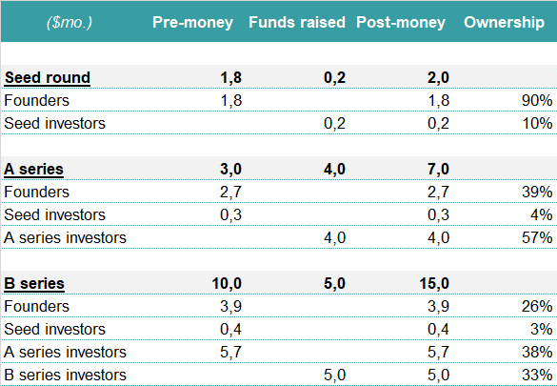
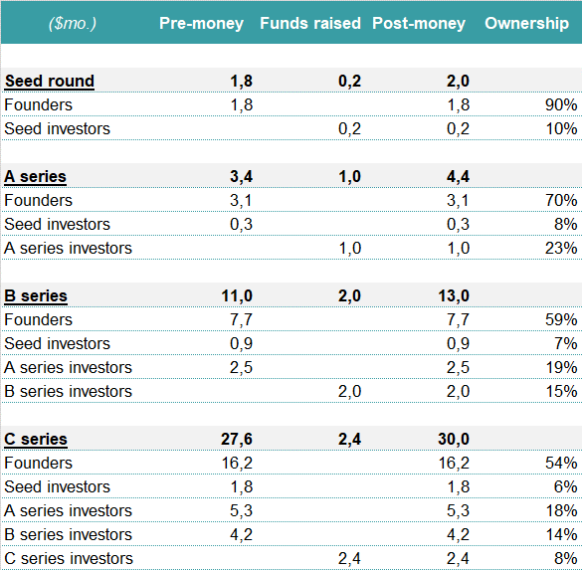
Minimize capital raised
Equity distribution and how to plan your captable
Hare approach
Tortoise approach
Equity funding is expensive if you consider opportunity cost
Raise as little and as late as possible and complement equity $ with other “soft sources” (1-1 at least)
Use alliances, cost cutting, WC deals to bring cost as low as possible. Keep structure at minimum.
Avoid post financing round spending hangovers

Slide 18
Some guidance
Equity distribution and how to plan your captable
Investors
Maximize valuation, minimize dilution
Intermediaries
Employees
Very restricted. Refer to suppliers
Only C-level, never more than 5% of cap table.
Clear rules
EQUITY
Advisors
Venture debt when capital increase route is blocked
Suppliers
Never
Try to keep to normal payments or royalties if needed. Keep an eye on prices and conversion
Debt providers
What would be your rules?

Slide 19
Q&A
Equity distribution and how to plan your captable

