Slide 1
MORAVIO
Delivering Complex Software Systems

Slide 2
About Moravio
2011 - Established in Prague, Czechia
International team, Prague, Barcelona, Ostrava
Software Development, Advanced Solutions
50+
14+
200+
Experts in the team
Years on the market
Projects delivered

Slide 3
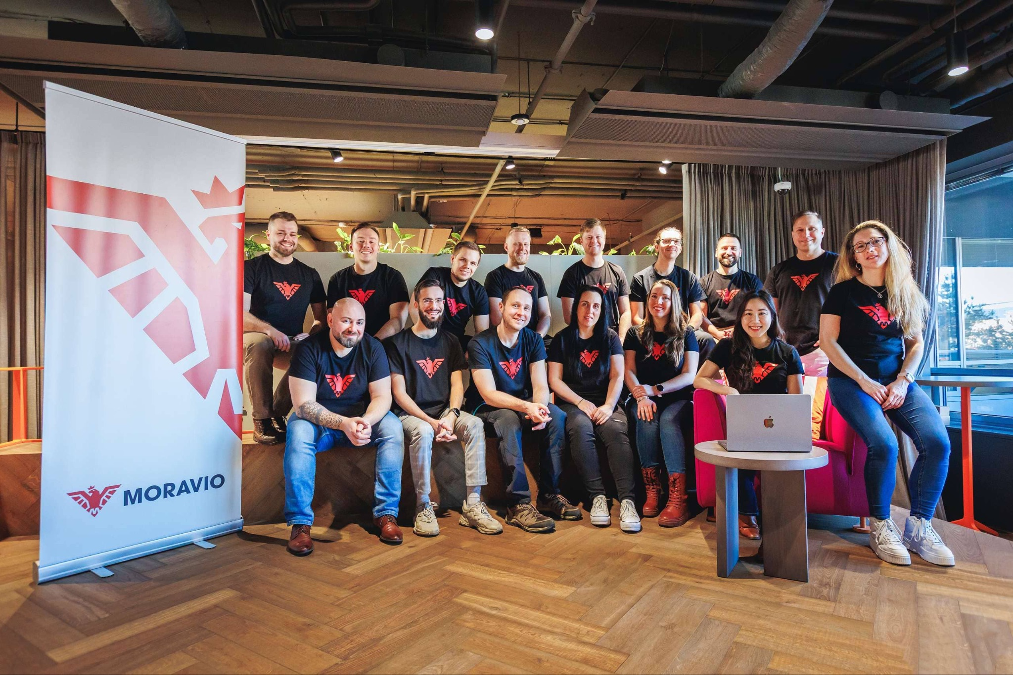
What We Do
Delivering complex software systems for businesses.
Transforming ideas into innovative software solutions.
Empowering companies with agility and efficiency.
Providing flexible co-development partnerships

Slide 4
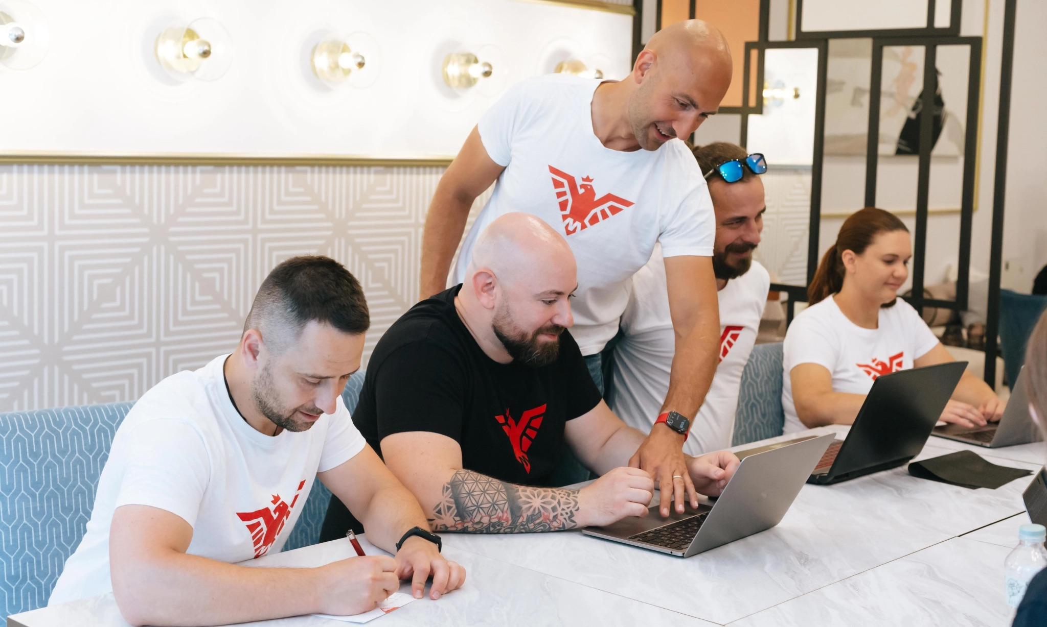
Positioning
Competing with Large Software Companies:
We deliver more effective solutions, enhanced communication, and cost efficiency, achieving equal or better results.
Enterprise Companies:
We bring innovation and agility, functioning as an extension of your team focused on deliverables.
Mid-Size Companies:
Co-development partnership offering experience, scalability, and flexible scaling without long-term commitments.
Scale-Ups: Helping startups that have grown rapidly and accumulated tech debt. We rebuild platforms to be scalable and ready for future growth.

Slide 5

Key Markets
USA - Fortune #190 company JLL, Nokia, Vote Smart
UK - NonStop Consulting, TTG, Stard.io
Prague - 2x 1B+ revenue companies (Datart, Notino)

Slide 6
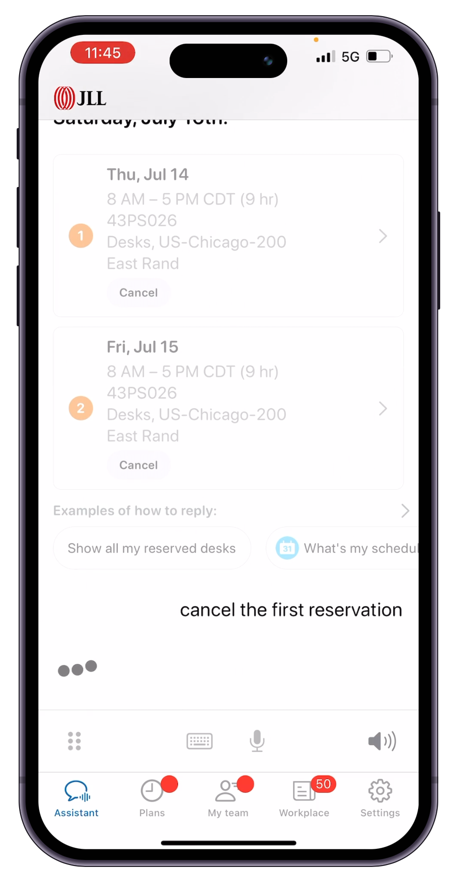

JET by JLL (2019)
San Francisco, USA
JLL - Fortune 500 (#190), 103 000 employees
We've developed a new kind of AI in cooperation with Google Engineers
JLL operates in Commercial Real Estate, leasing and servicing offices
JLL clients (HP, P&G, Nike, McDonalds) have access to their own AI personal work assistant.
Our team of 10 co-developed AI driven application
Integration with 10 different 3rd party systems
Check out the video (sound on) ->
More info: https://www.moravio.com/portfolio/jll-jet-intelligent-assistant

Slide 7

Nokia (Bell Labs)
100 years old company Bell Labs
  Invented the laser, transistor, unix, C++
  11 nobel prizes
They invented new encryption algorithm for audio and video streaming
They found Moravio as the best partner to implement applications like Zoom, MS Teams or Google Meet, but for Nokia, to use the new encryption technology
We've understood theoretical background of the new cutting edge technology and implemented a real application using that technology
More info: https://www.moravio.com/portfolio/jll-jet-intelligent-assistant

Slide 8

Stard.io
Birmingham, UK
We’ve built a Zoom-like live streaming platform for trainers
Trainers design their lectures in a special editor - adding music, cues for segments etc.
Clients pay, join the session, see each other
More info: https://www.moravio.com/portfolio/stardio-live-fitness-platform

Slide 9
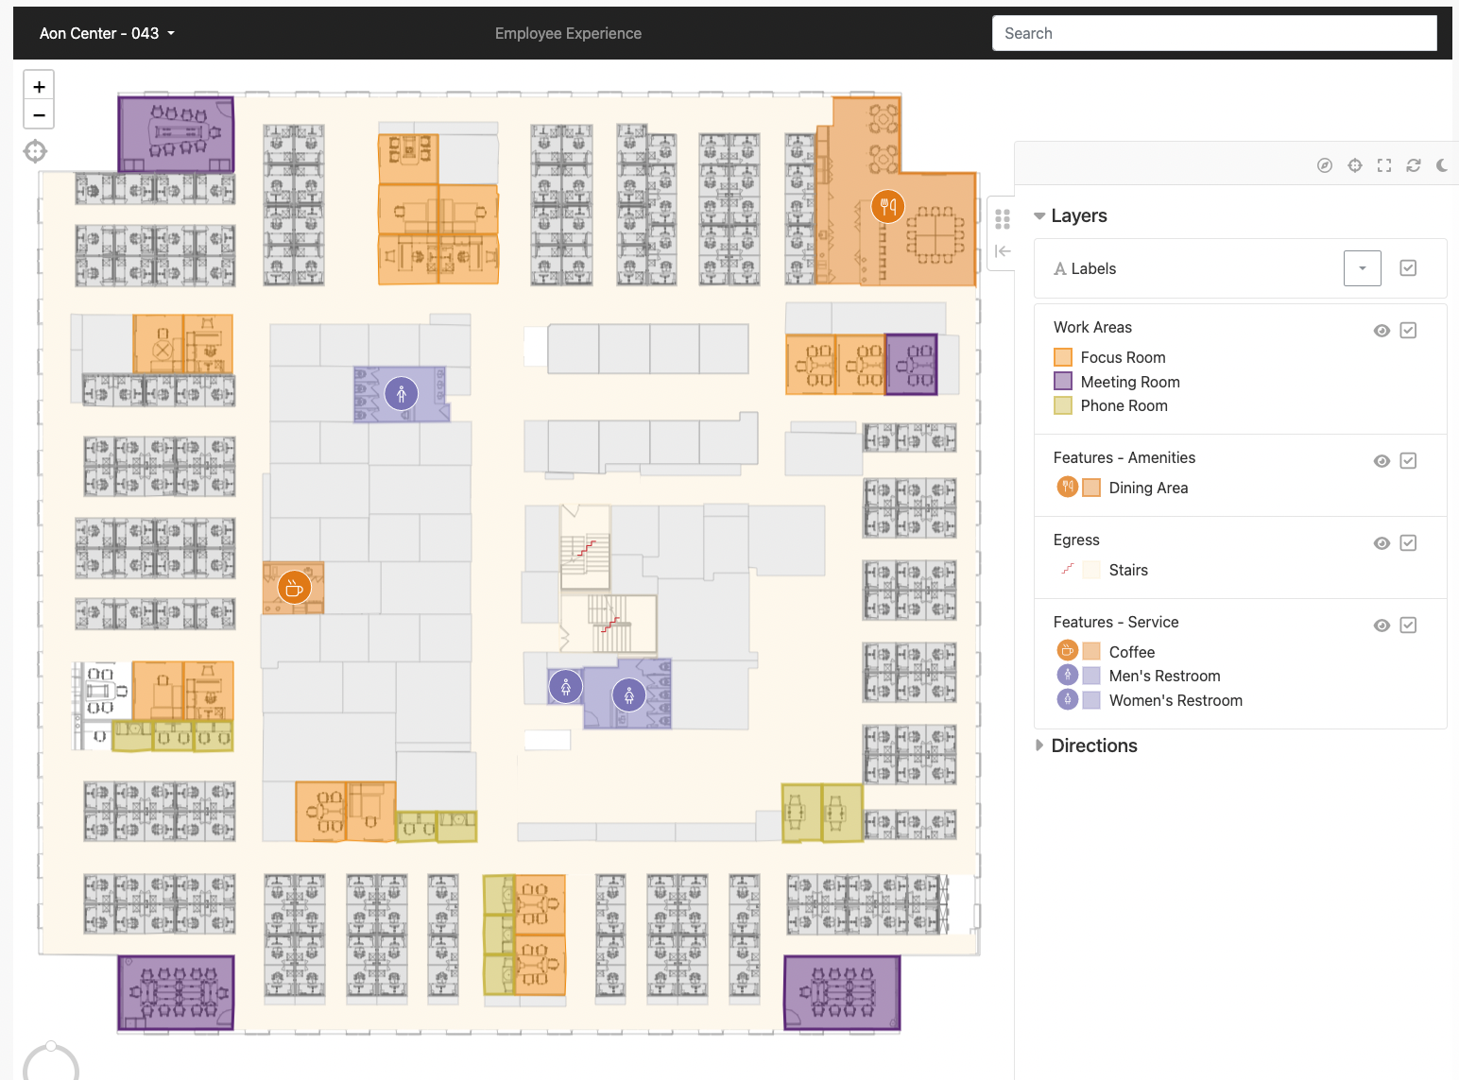

OSIS
San Francisco, USA
Another cooperation with JLL
Comprehensive solution for managing buildings
and assets using CAD, GIS and IWMS
Floorplan imports, asset management
Room and desk reservation
Integration with other systems
More info: https://www.moravio.com/portfolio/jll-workspace-management

Slide 10

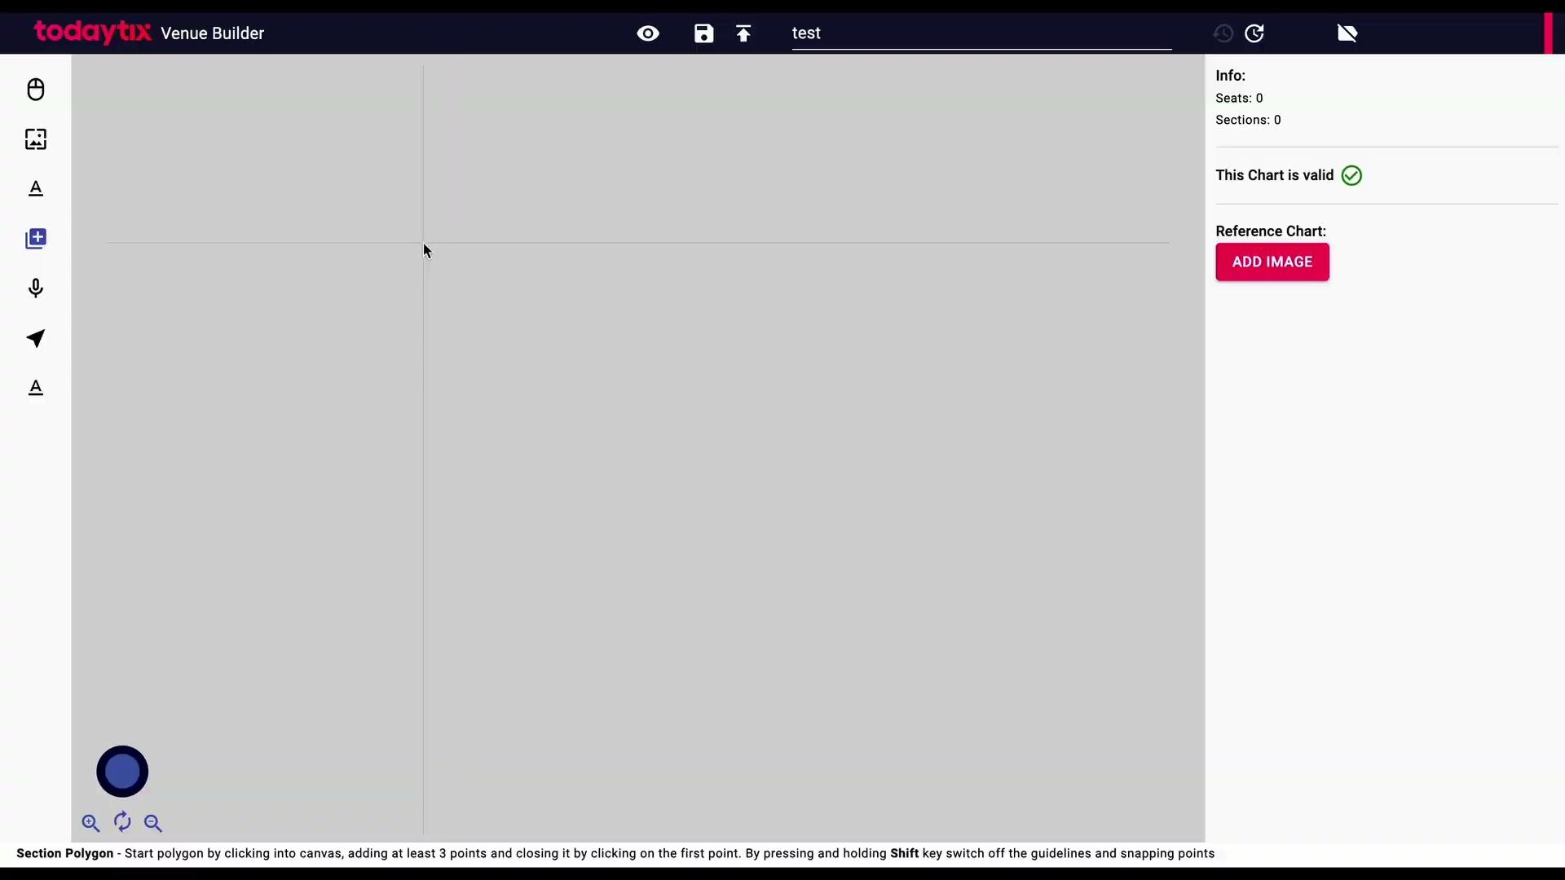
Theater Seating Editor
New York, USA + London, UK
Tool for creating interactive maps for venues & events
Possibility to draw various geometric shapes including polygons
Everything is based on SVG vector canvas, so no matter what device you use, it will always look good
Easy to use for different teams and different complexity
Integration with 3rd party services for payments and invoices
More info: https://www.moravio.com/portfolio/vector-based-map-editor-to-create-beautiful-maps

Slide 11

NonStop Consulting
London, UK
Team of 23 devs/pms/designers/AI research
Completely new bespoke internal CRM covering full agenda of a big recruiting company
Many different automations to save time
Digitization of several key recruitment tasks
AI assistant integration to further save and streamline recruiters time to focus on what matters most
Integration of many 3rd party services like Broadbean etc.
More info: https://www.moravio.com/portfolio/custom-ai-powered-crm-web-application

Slide 12
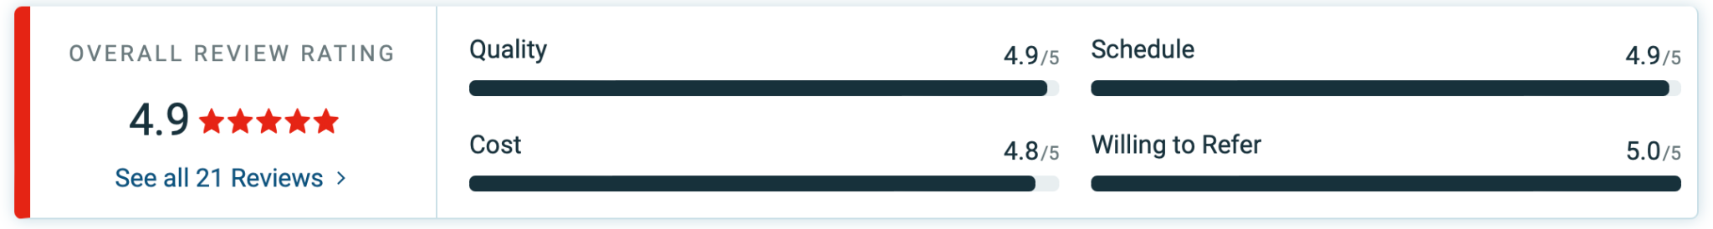
Moravio in reviews
Clutch.co is the biggest international catalog of service providers in our industry
We currently have 4.9 / 5 review score
21 extensive reviews https://clutch.co/profile/moravio#reviews

Slide 13
Services
SW Development Outsourcing + Co-development
Design, build and maintain custom software solutions
Custom AI solutions, CRMs, ERPs, information systems, integrations, AI automations, data processing & analysis, dashboards, web apps, mobile apps, cloud applications, automations, due diligence, consultations
Product management
We design the right solution for a given problem with the client together.
Type of cooperation
Time & Material ( Large projects)
Fixed Price ( Smaller projects ), or large project split into fixed milestones
Subscription ( Maintenance, SLA, 24/7 support)

Slide 14
Why Choose Moravio?
Quality
Proven expertise in solving complex challenges.
Trusted by mid-sized to Fortune 500 companies.
13 years of market experience.
Scale
Flexible growth: start small, scale up or down bi-weekly.
Adaptable to your needs, ensuring optimal resource allocation.
We bring the whole team architecture and processes
Agility
Dynamic scope adjustments and team resizing.
Rapid response to changing project requirements.
Time to market, seasoned team available in matter of weeks

Slide 15
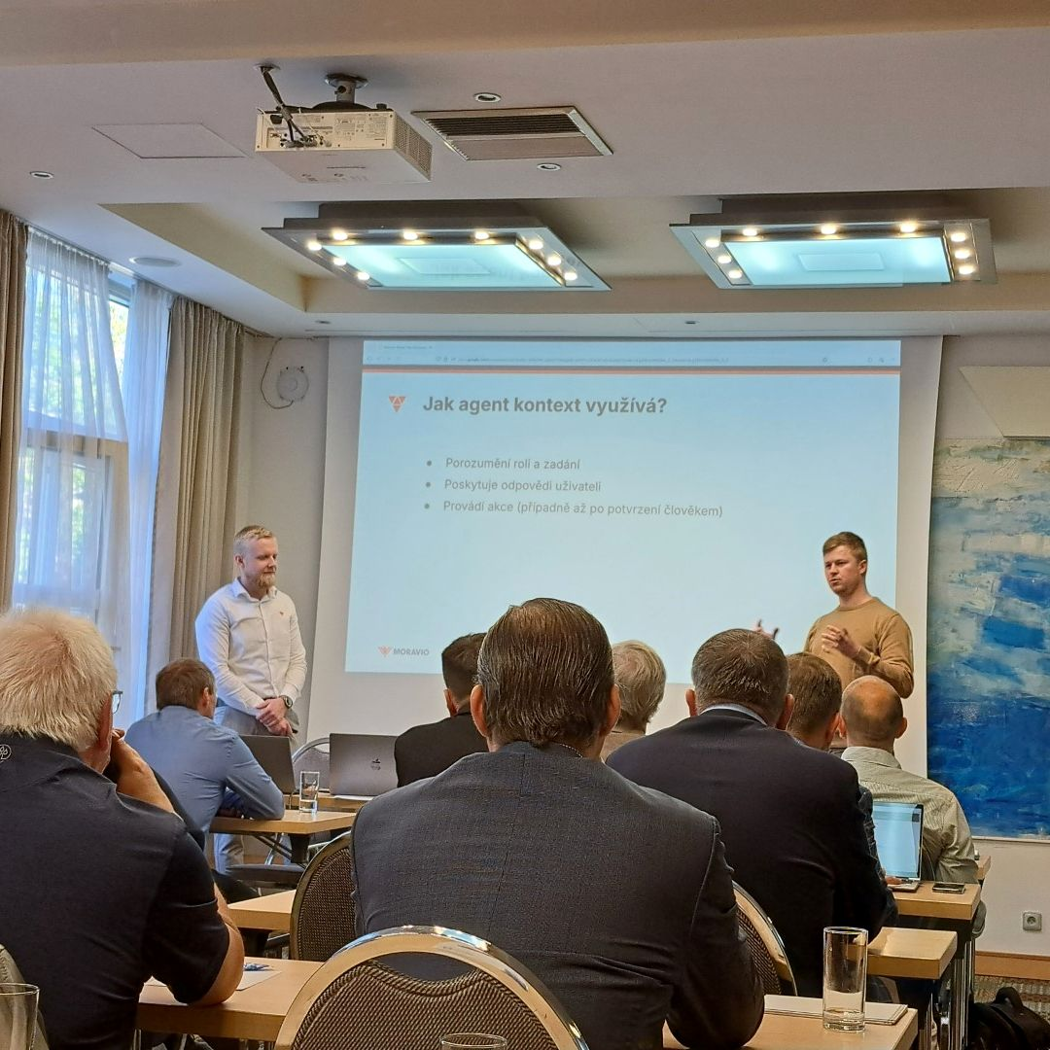
Recent AI projects
Supply Chain Automation SW (NDA)
TOP 2 out of 5 Ecommerce players in Czechia
  Datart - $1B+ monthly turnover, internal systems with AI fraud detection
  Notino - $1B+ AI shopping assistant
IS Produkce - Face recognition in film industry
TOP 3 Sporting bets player in Czechia (NDA) - AI assistant for user registration process

Slide 16
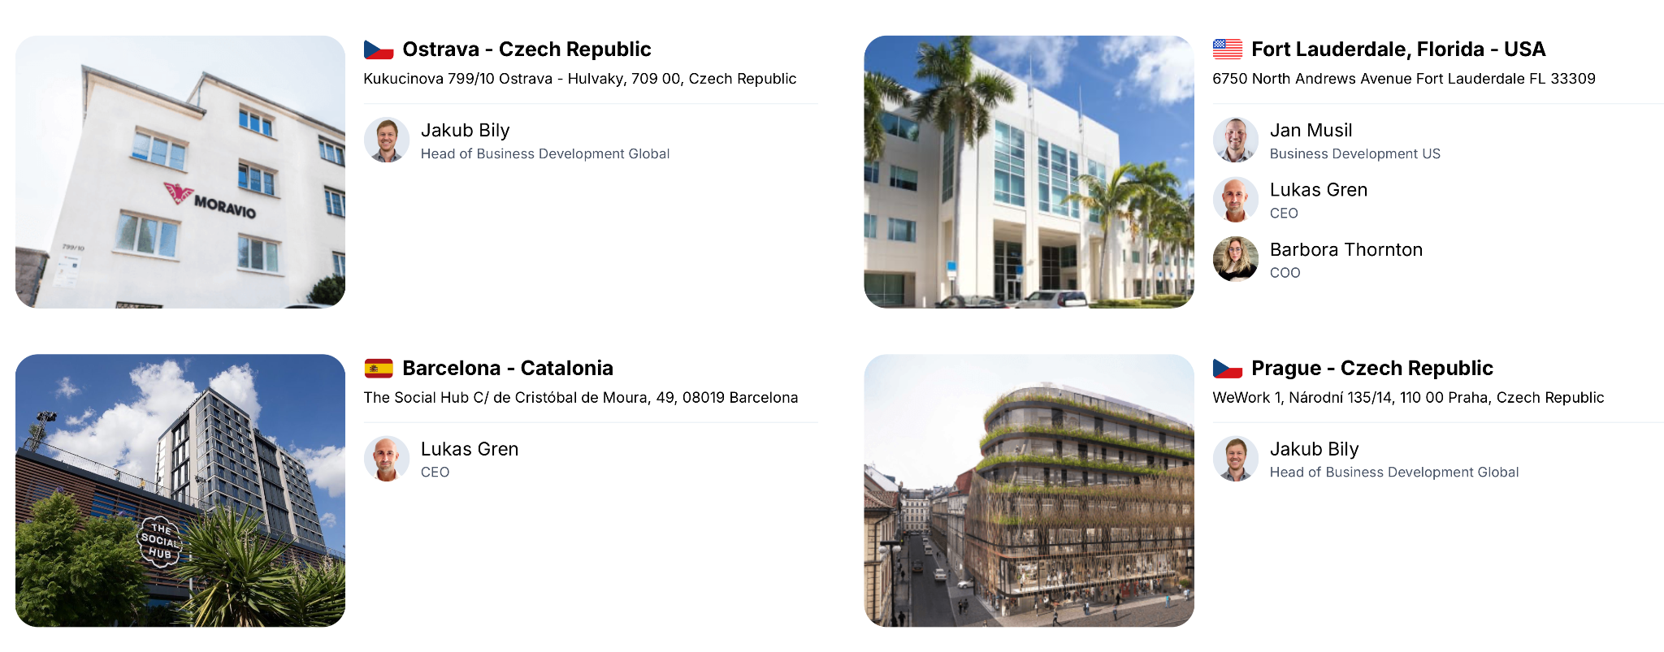
Where to Find Us

Slide 17
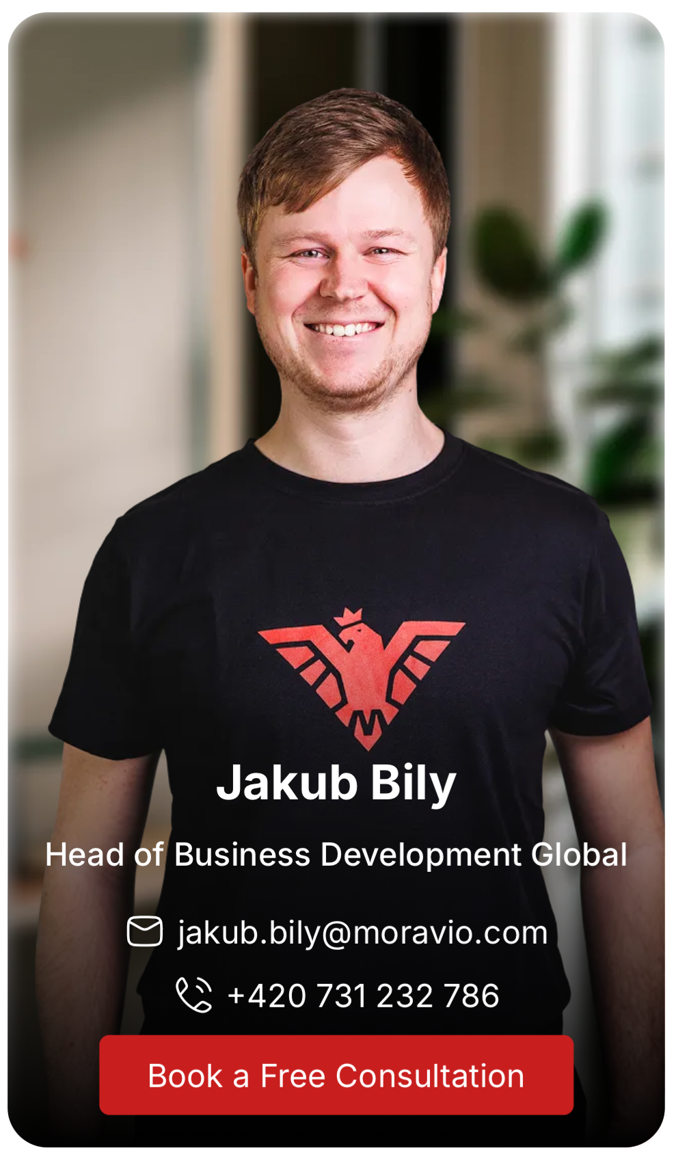


Contacts

Slide 18

Thank You
We appreciate your time and interest in Moravio. Together, we can transform complex challenges into seamless solutions.
moravio.com

