Slide 1







Kythrion IC – Animation for TX/RX Reduction
Shrinking complexity. Powering the next leap in space infrastructure.
Confidential and Proprietary information © Circuits Integrated

Slide 2
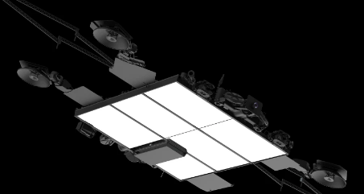
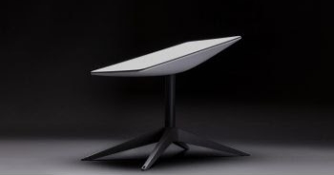

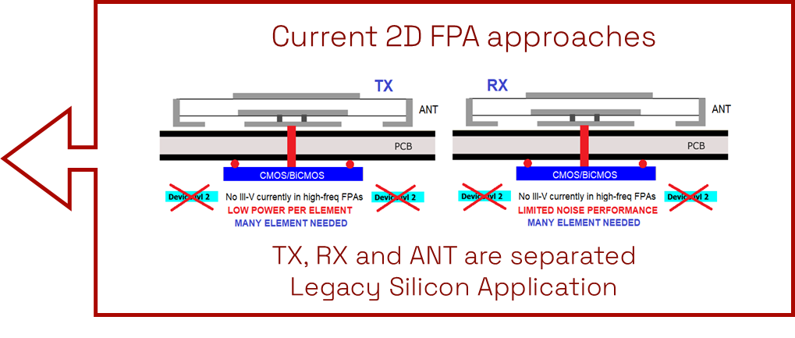





CURRENT STATE OF THE ART
Why Current FPAs Aren’t Enough
Starlink
Starlink
Legacy 2D design
Silicon technologies on PCB
PAIN POINTS
FPA Space Deployed
FPA Terrestrial Deployed
Heavy Panels
(Up to 30KG)
Hundreds of components
Large Form Factor
Expensive
Complex PCB required

Slide 3
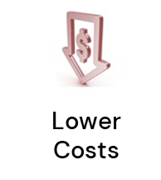
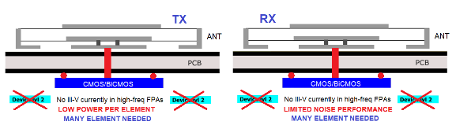
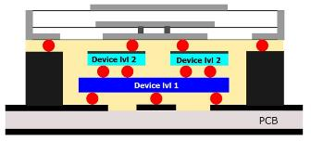



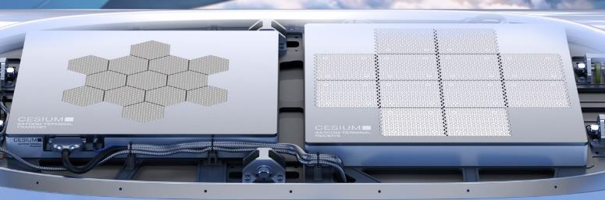
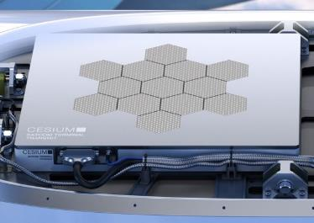
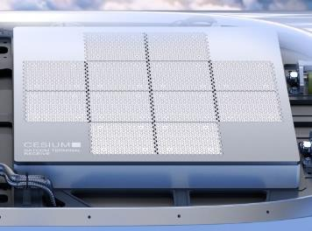

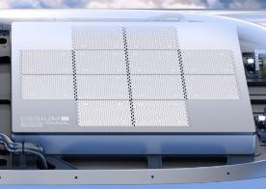
KYTHRIONTM: ACHIEVING MORE WITH LESS
Current FPA approaches
Kythrion™
TX, RX and ANT are separated
Legacy Silicon Application
Combines TX/RX/ANT
Innovates Silicon and III-V
  Kythrion™ antenna chip (5x pat. pend) provides 60% full SWaP-C

