Slide 1
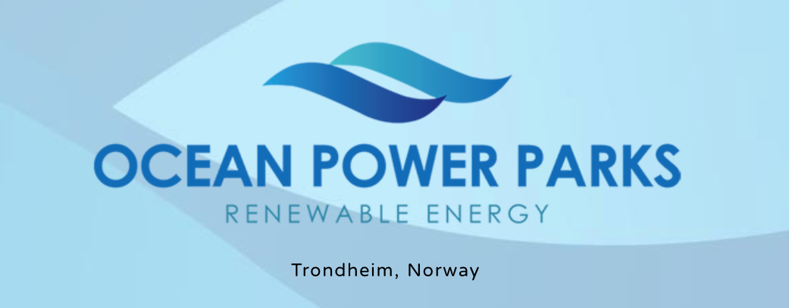

Slide 2
Ocean power parks ( OPP )
OPP (Ocean Production Parks) are multipurpose marine constructions designed for the large-scale, low-cost production of renewable energy and sustainable fish farming in the ocean. These parks aim to combat global warming and its severe consequences.
- The increasing global population, coupled with the loss of arable land due to droughts, floods, and land erosion caused by climate change, demands innovative, sustainable solutions for renewable energy production and food security.
- Currently, almost all food production and farming occur on land, leaving the vast, untapped resources of the ocean underutilized. Sustainable solutions in the ocean offer significant potential for future food production.
The primary goal of OPP is to develop parks that produce and sell renewable energy while cultivating marine life through natural food chain processes in large-scale ocean facilities.
- In the initial phase, we seek funding to build a small prototype and conduct laboratory testing to proof of the concept, while also focusing on assembling a strong team and organizational structure.

Slide 3
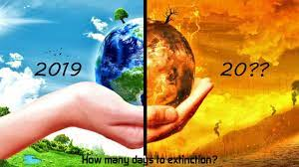
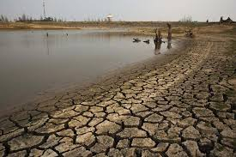
GLOBAL WARMING
LACK OF FOOD IN THE FUTURE

Slide 4
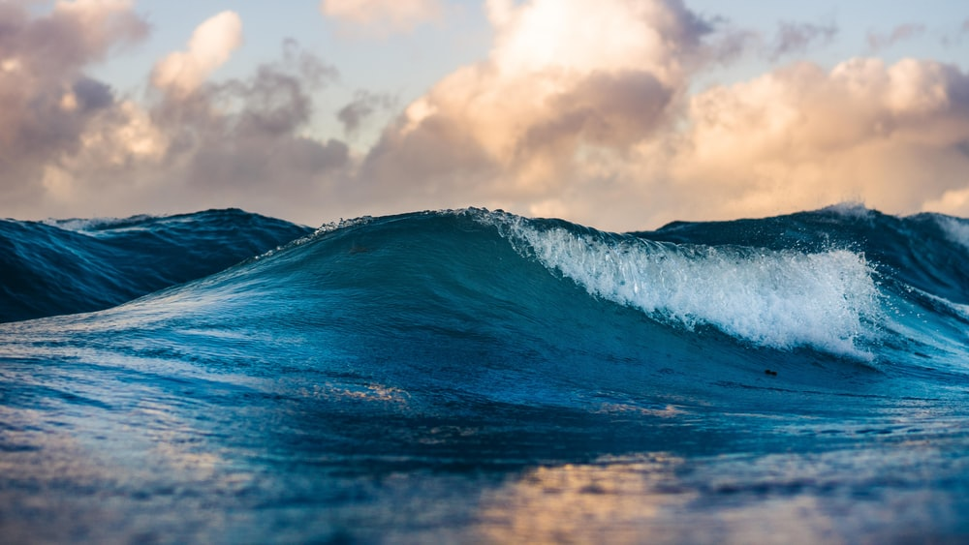
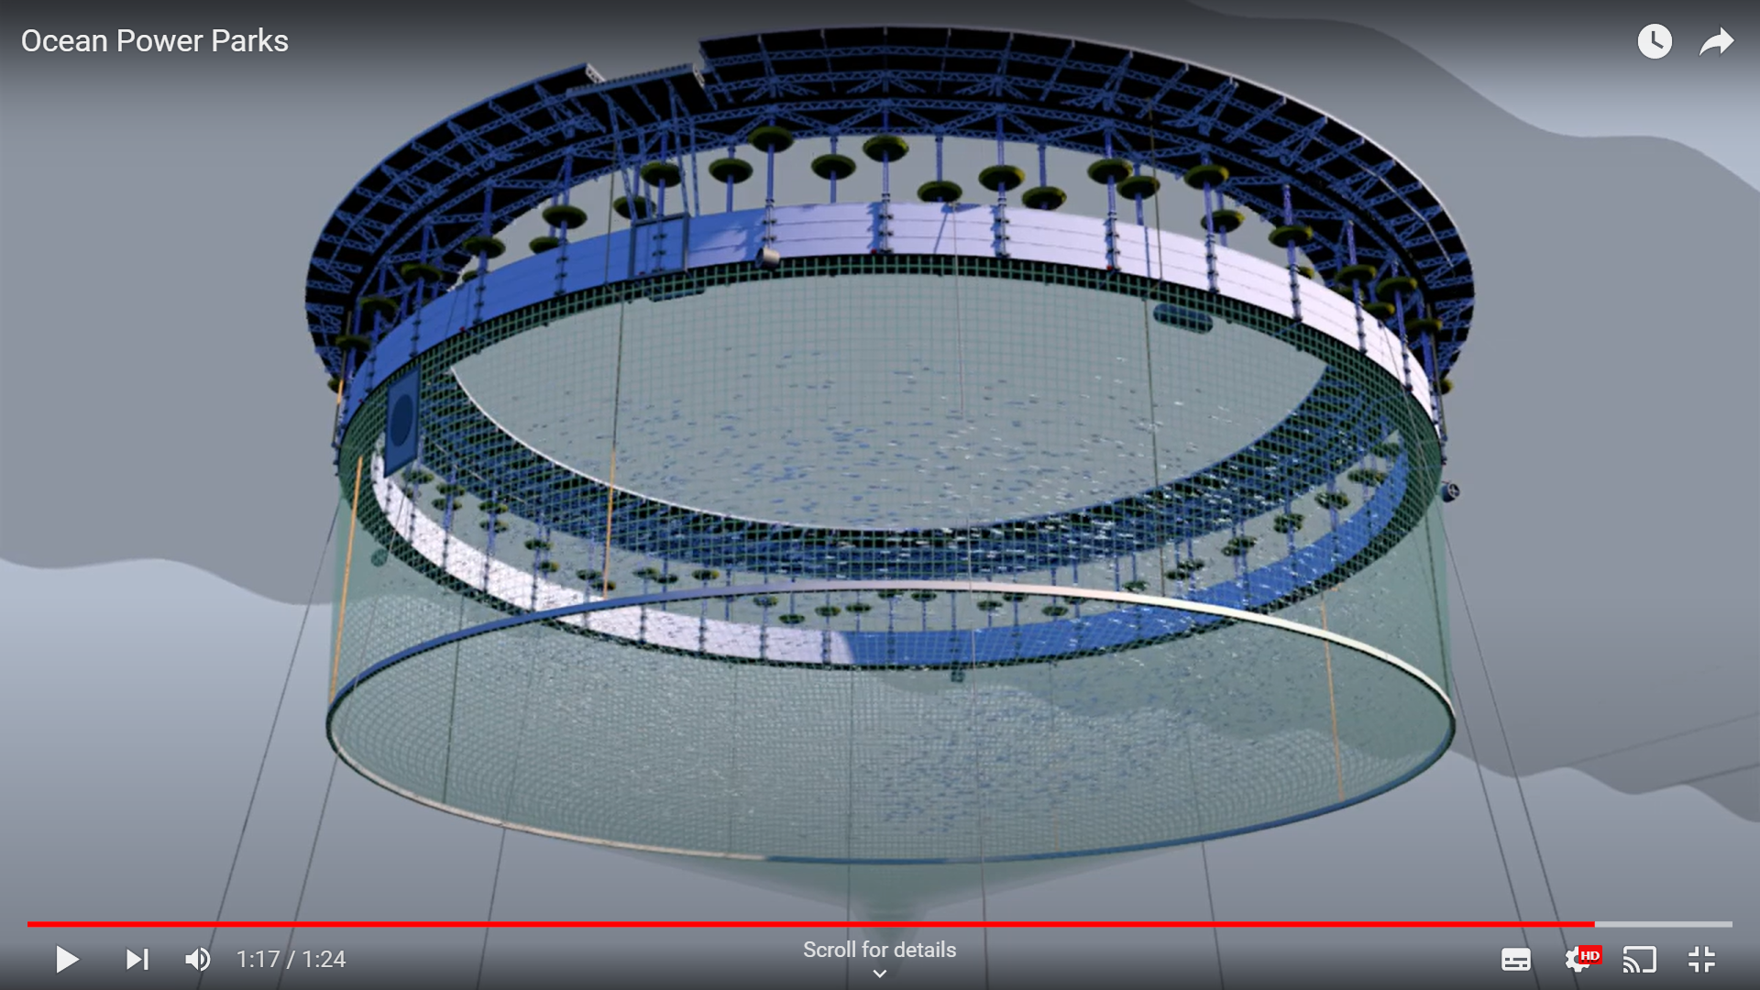
SOLUTION
RENEWABLE ENERGY PRODUCTION
SUSTAINABLE FISH FARMING
OPP has a wide range of positive environmental effects, including reducing air pollution, mitigating global warming, improving air quality for public health, and decreasing climate-related mortality.
The economic impact, both in the short and long term, will be substantial. The large-scale production of these parks will create numerous job opportunities, provide access to low-cost renewable energy, and generate significant returns for involved investors.

Slide 5
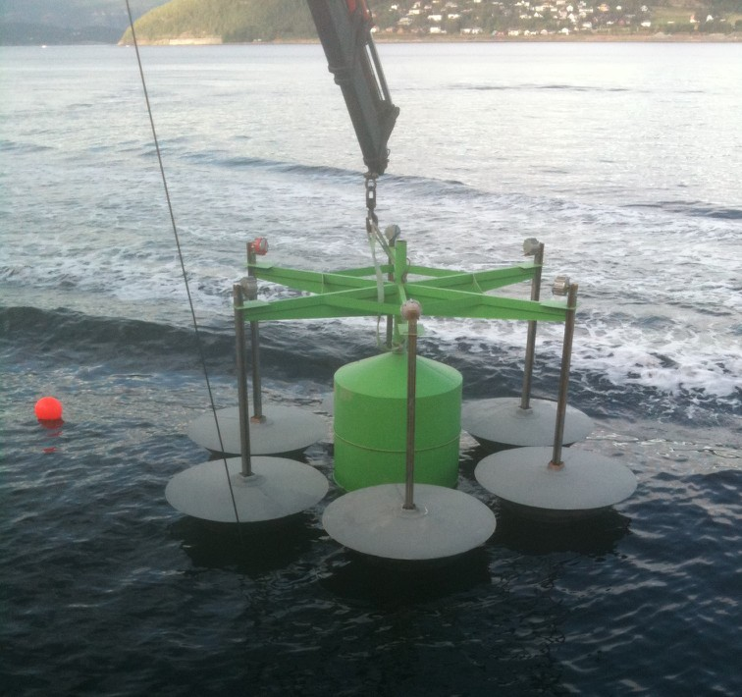
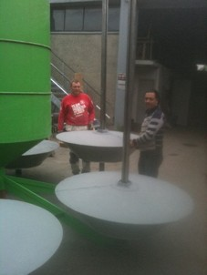
The Second prototype was built in 2011

Slide 6
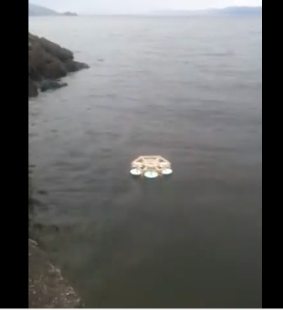
The Third prototype was built in 2012

Slide 7
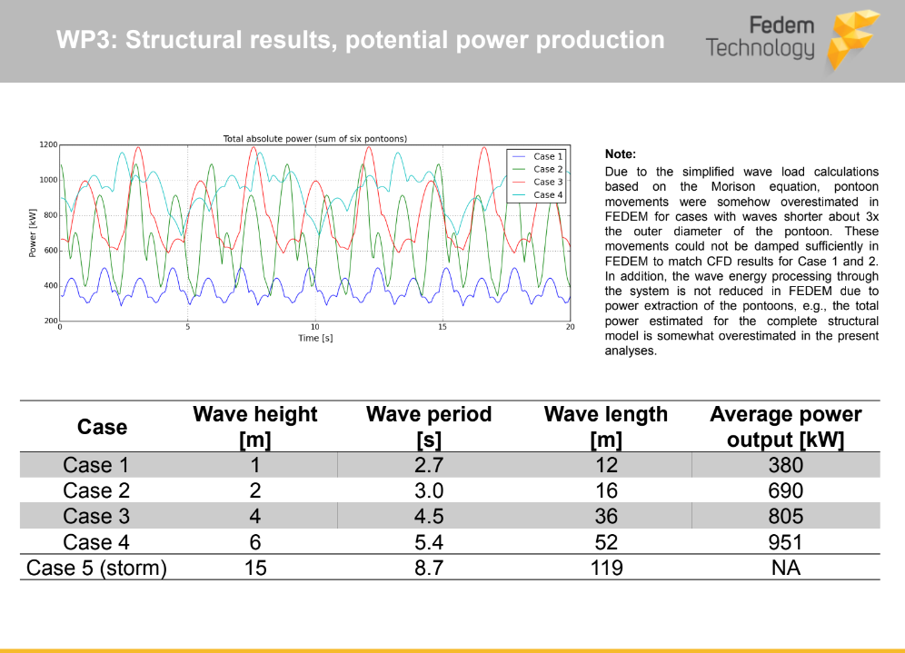
Third party analysis for a prototype with 6 pontoons.

Slide 8
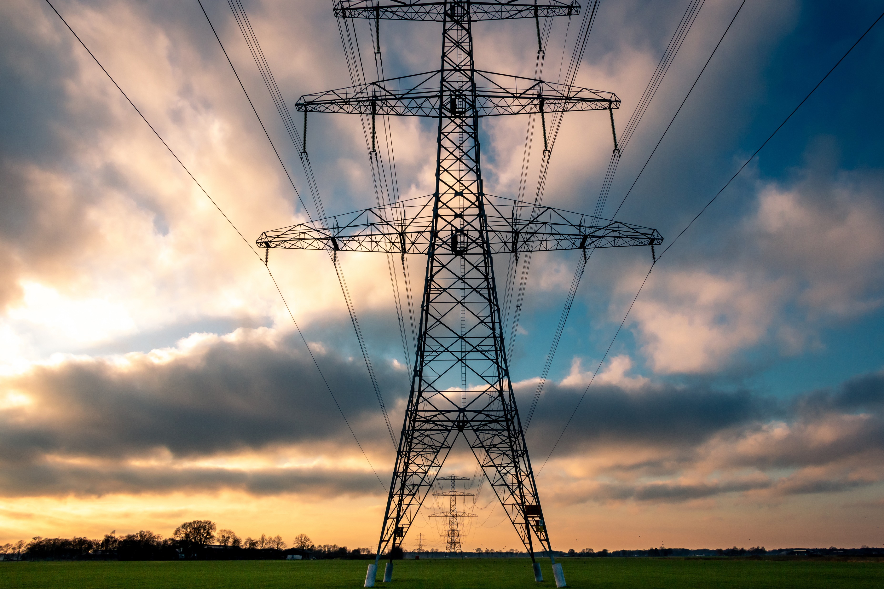
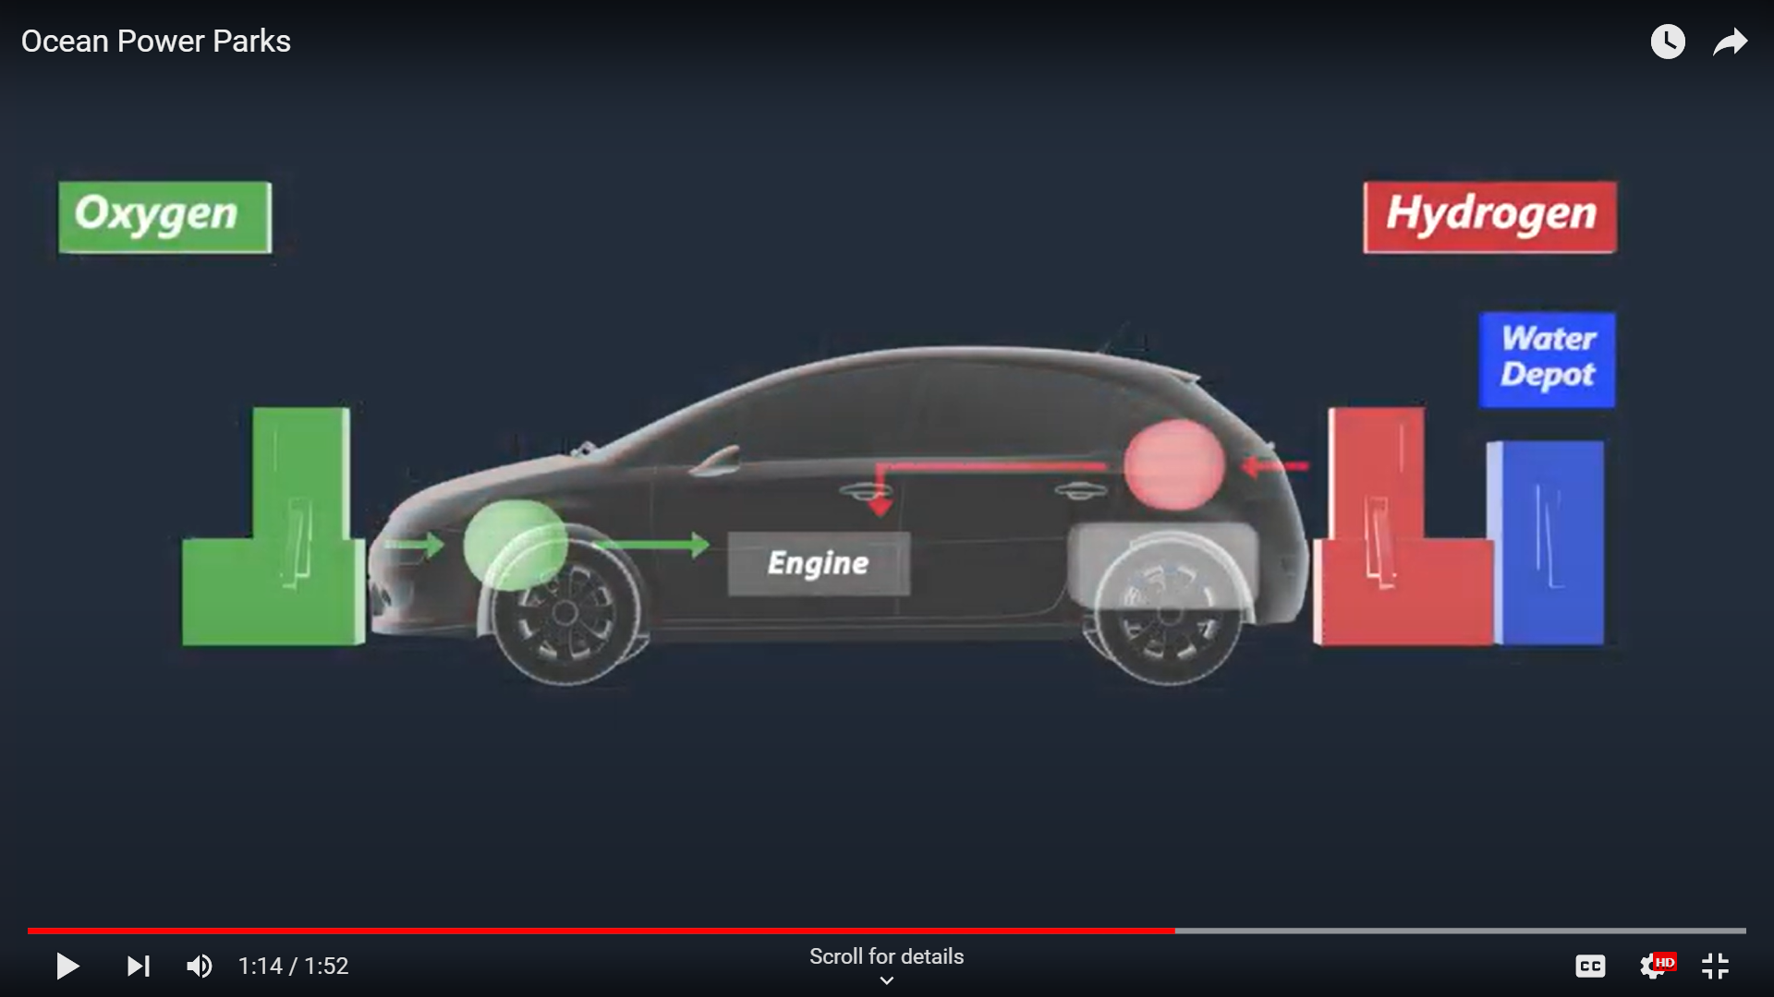
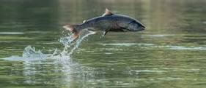
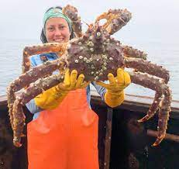


Products
1- Renewable Electricity
2- Hydrogen, Oxygen.
3- Fish farming.
4- Marine products

Slide 9
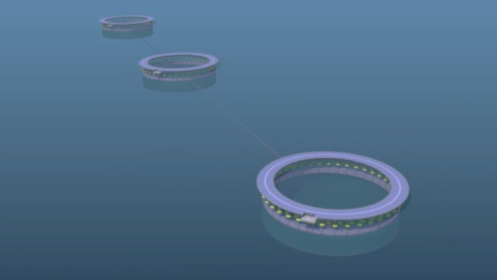
Competitive advantages
A multipurpose marine construction:
1- Production of hydrogen and oxygen using waste energy.
2- Large-scale, low-cost marine life production using natural food chain methods in the Ocean.
3- Integration of renewable energy and food production
4- Access to unlimited resources and space with efficient logistics
5- Reliable food production unaffected by drought, flooding, or wildfires

Slide 10
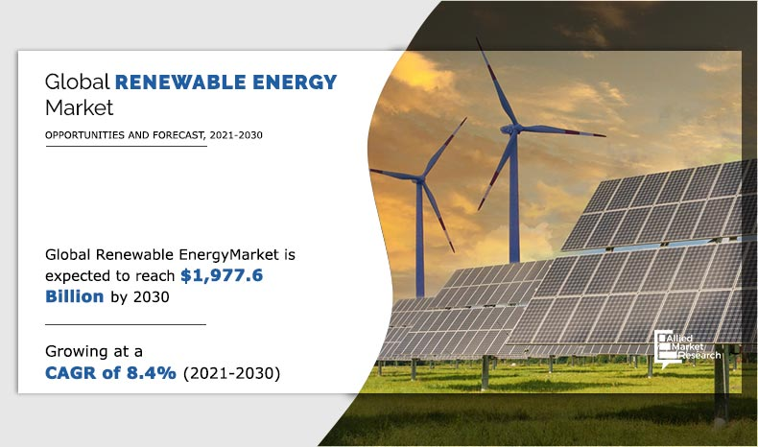
MARKET SIZE

Slide 11
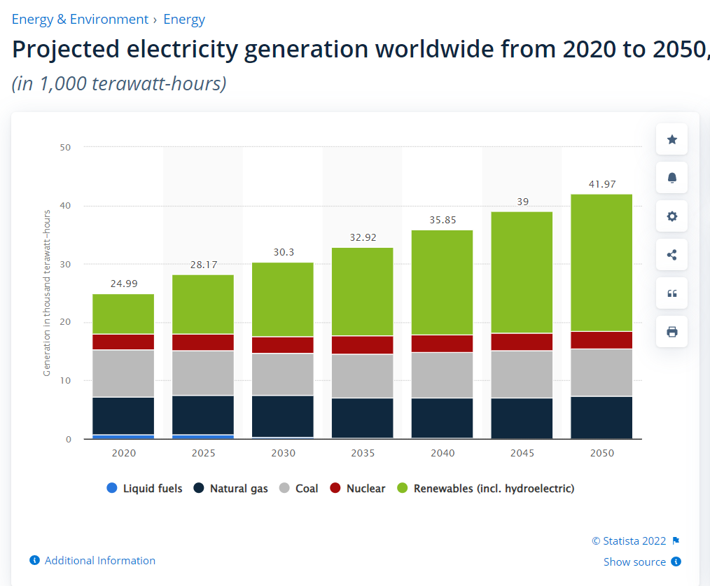

Slide 12
Cost Revenue Payback Time
Cost-Revenue Payback Time
Calculated cost
€120,000,000
Yearly revenue from electricity
€9,460,800
Yearly profit from fish
€13,083,000
Total income after tax (15%)
€19,941,680
Payback time
6.29 Years

Slide 13
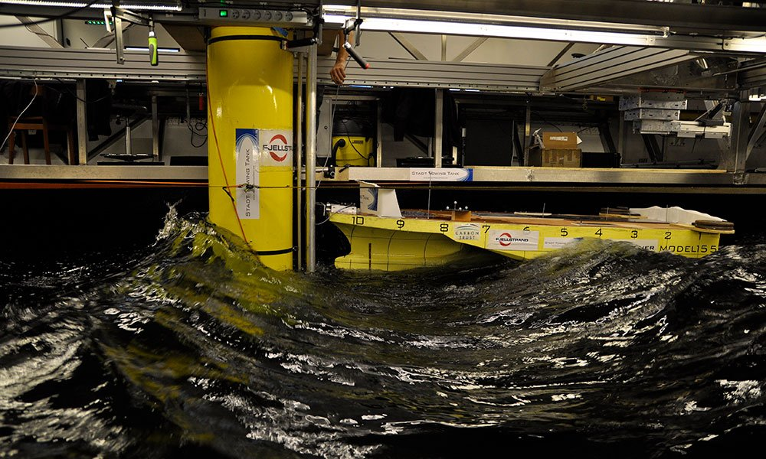
Financial needs in the first stage.
Måløy test senter

Slide 14



Roadmap
08
Expansion with More Units
07
2029
IPO
06
2028
30 Units
05
Investments €4.5 billion.
Income €80 Million.
04
Sept 26 – Apr 27
R&D,
Testing
03
2027
02
Deployment and testing and production of renewable energy
Building
3 units
Income €20 million.
Investments €500 million
Nov 2024- Mars 2025
Establish a strong team and prepare for fundraising to build the actual size prototype
April 25- Sept 26
Sept- Nov 2024
First stage
proof of concept
Lab test
Building of the actual
size prototype
01
Q1
Q2
Q3
Q4
Q1
Q2
Q3
Q4
Q1
Q2
Q3
Q4
Q1
Q2
Q3
Q4
Q1
Q2
Q3
Q4
Q1
Q2
Q3
Q4
Q1
Q2
Q3
Q4
2024
2025
2026
2027
2028
2029
2030

Slide 15
Revenue and cost / Year

Slide 16
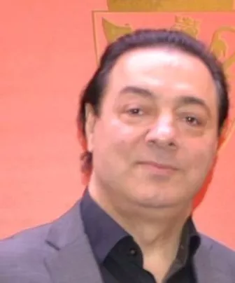
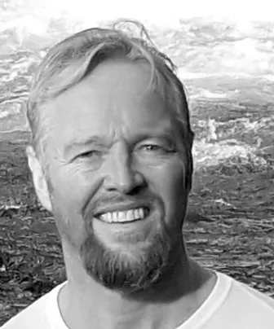



Team
Nader Hassavari
CEO / Founder
Construction Engineer
Harald Tronstad
PhD in Marine Technology & Fishery Expert
Mary N. Hasavari
CMO
BA Marketing
Dr. Shirin Hasavari
Assistant Professor, Department of Information Science and Systems
Morgan State University
Quoc-Anh Tran
Senior Reseacher (Marie Skłodowska-Curie Individual Fellow)

Slide 17

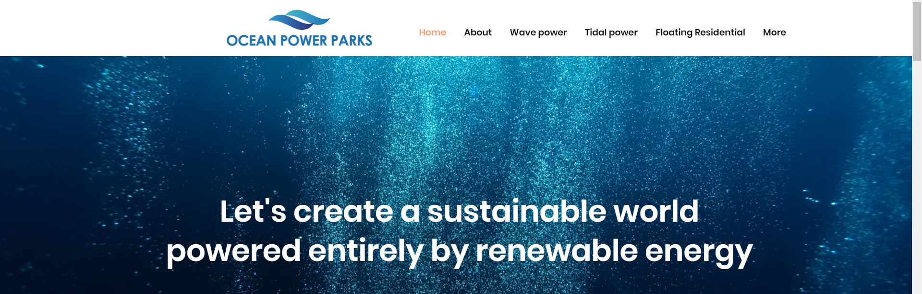
Thank you !

