Slide 1



UNIVERSITY & ERASMUS OFFICE
OVERVIEW

Slide 2

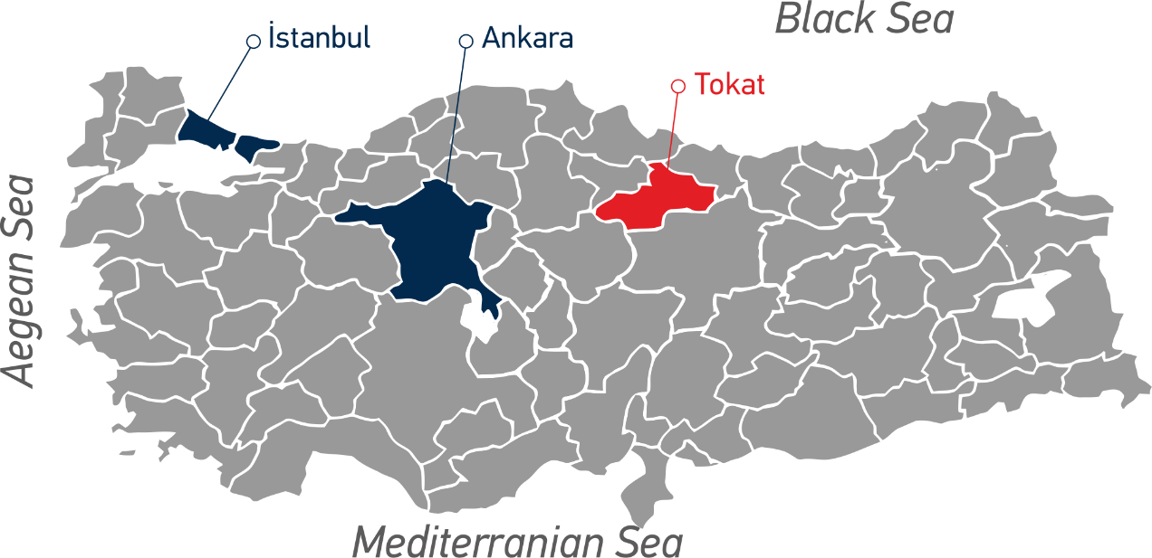

ABOUT TOKAT
A historic Anatolian city with over a thousand years of cultural heritage
Home to remarkable Seljuk and Ottoman monuments and historical landmarks
A vibrant social life with concerts, theaters, cinemas, and Canal Tokat
Affordable and student-friendly cost of living
Surrounded by beautiful natural landscapes with forests, rivers, and lakes
Ideal for outdoor activities such as hiking, cycling, and photography
Famous for its rich Anatolian cuisine and local hospitality
Located in the Black Sea Region
2

Slide 3
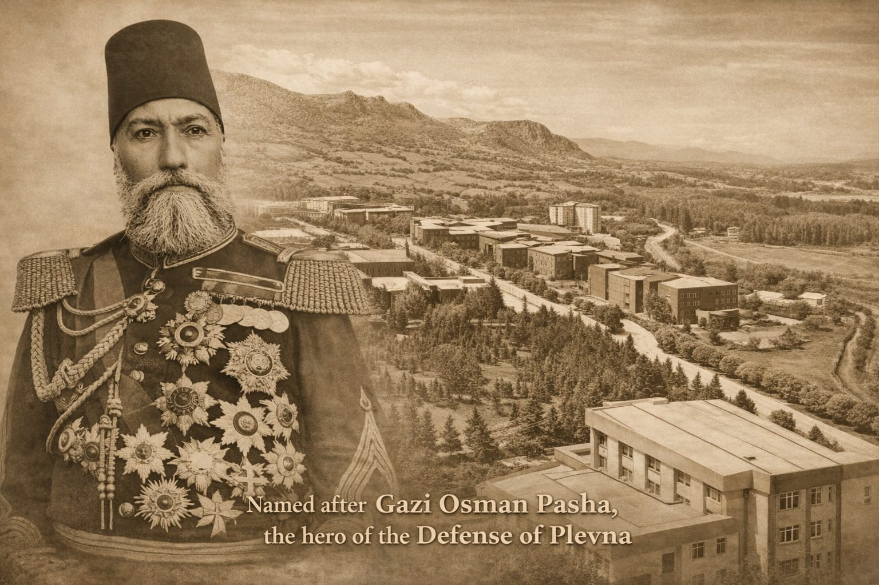
LEGACY BEHIND OUR NAME
Gazi Osman Pasha (1833–1900) was a distinguished Ottoman military commander born in Tokat.
He became internationally recognized for his leadership during the Defense of Plevna (1877) in the Russo-Turkish War. His strategic resistance against Russian forces made him one of the most respected commanders of his time.
For his bravery and leadership, he was awarded the honorary title “Gazi,” meaning victorious warrior. Our University proudly carries his name in honour of this historical legacy and the values it represents: leadership, resilience, and dedication.
3

Slide 4
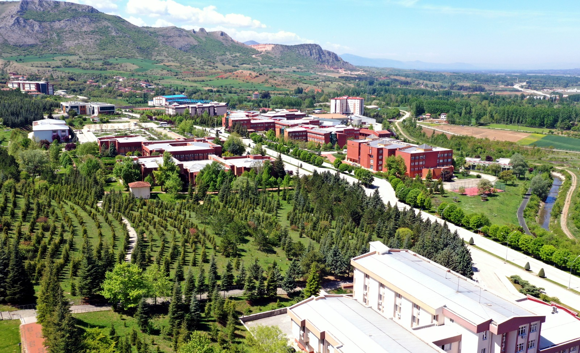
OUR CAMPUS
2 campuses in the city center and 8 campuses in surrounding districts
Taşlıçiftlik Campus serves as the academic and administrative center of the institution
Modern and green campus environment
Faculties, research centers, and laboratories
Sport complexes and recreational areas
Social and cultural facilities for students
Easy access to the city center
The campus provides a dynamic academic atmosphere supporting education, research,
and student life
4

Slide 5
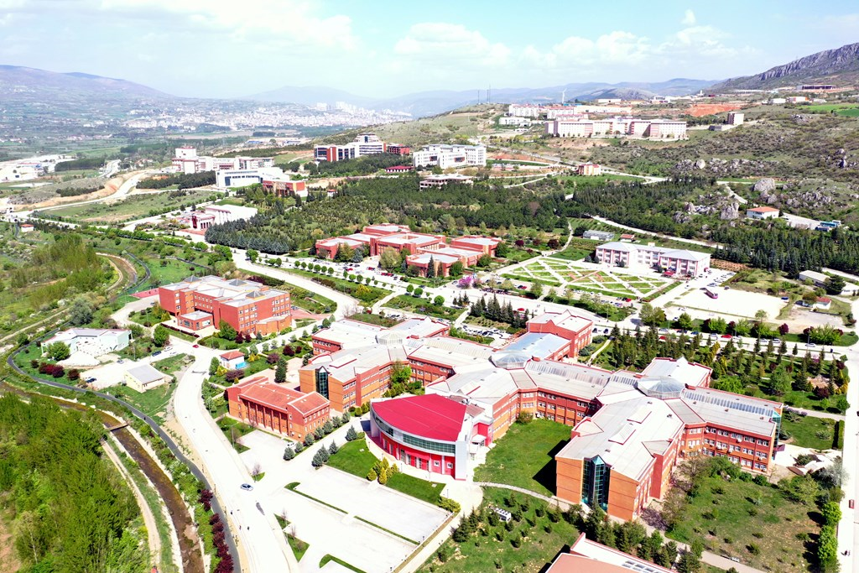
TOGU IN NUMBERS
Academic Structure
Faculties: 19
State Conservatory: 1
Applied Schools: 2
Vocational Schools: 13
Establishment: 1992
Students
Undergraduate: 17,919
Associate: 11,777
Graduate: 3,796
International: 2,917
Graduate Programs
Master’s Programs: 89
Doctoral Programs: 45
Academic and Administrative Staff
Academic: 1,610
Administrative: 2,265
Research and Institutional Units
Research Centers: 19
Research Units: 3
Coordinatorships: 38
5

Slide 6
ACADEMIC STRUCTURE
Faculties | Vocational Schools | Applied Schools
Faculty of Agriculture | Almus Vocational School | School of Foreign Languages
Faculty of Science and Letters | Artova Vocational School | Zile Dinçerler School of Tourism & Hotel Manag.
Faculty of Medicine | Erbaa Vocational School
Faculty of Sport Sciences | Erbaa Vocational School of Health Services | State Conservatory
Faculty of Education | Niksar Vocational School
Faculty of Economics and Administrative Sciences | Organized Industrial Zone Vocational School
Faculty of Dentistry | Pazar Vocational School
Faculty of Pharmacy | Reşadiye Vocational School
Faculty of Fine Arts | Tokat Vocational School
Faculty of Law | Tokat Vocational School of Health Services
Faculty of Islamic Sciences | Turhal Vocational School
Faculty of Engineering and Architecture | Turhal Vocational School of Health Services
Faculty of Health Sciences | Zile Vocational School
Faculty of Health Sciences (Erbaa)
Faculty of Social Sciences and Humanities (Erbaa)
Faculty of Applied Sciences (Niksar)
Faculty of Applied Sciences (Turhal)
6

Slide 7
RESEARCH & INNOVATION INFRASTRUCTURE
Research Centers | Research Units
Disaster and Emergency Management Research Center | Scientific Research Projects Office (BAP)
Atatürk’s Principles and History of the Turkish Revolution Research Center | Technology Transfer Office (TTO)
Scientific and Technological Research Center | Tokat Technopark
Agricultural Research Center
Health Research Center
Continuing Education Research Center
Palliative Care Research Center
Guidance and Psychological Counseling Research Center
Dentistry Research Center
Special Education Research Center
Obesity and Diabetes Research Center
Career Research Center
Women and Family Studies Research Center
Early Childhood Education Research Center
Islamic Studies Research Center
Natural Dyes Research Center
Occidentalism Research Center
Tokat Studies Research Center
Tokat Manuscripts and Traditional Handicrafts Research Center
7

Slide 8
QUALITY & INSTITUTIONAL ACHIEVEMENTS
Our university, recognized for its pioneering role in energy storage, proudly stands as a Sports- and Nutrition-Friendly Campus, certified with the Zero Waste Certificate for its strong commitment to sustainability.
TOGÜ has achieved Institutional Accreditation and holds the Quality Management System certification, reflecting our dedication to continuous improvement, excellence in education, and the highest international standards.
Tokat Gaziosmanpaşa University places strong emphasis on quality assurance and institutional development.
8

Slide 9
RANKINGS
Awards
Higher Education Council of Türkiye - Local Develepment Award (2017)
Global Rankings
THE World University Rankings – 1501+
QS World University Rankings – 601+
Sustainability & Regional Rankings
UI GreenMetric – 182
Times Higher Education Asia University Rankings – 601+
U.S. News Best Global Universities – 2004
CWUR - 1572
9

Slide 10
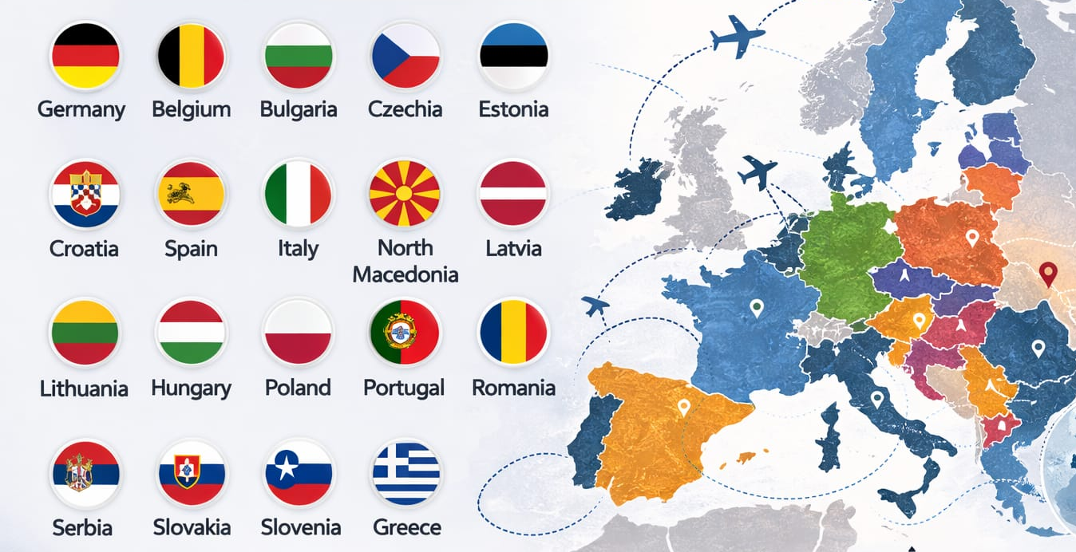
KA131 INTER-INSTITUTIONAL AGREEMENTS
19 Countries
87 Universities
10

Slide 11
KA171 INTER-INSTITUTIONAL AGREEMENTS
14 Countries
7 Regions
40 Universities
11

Slide 12
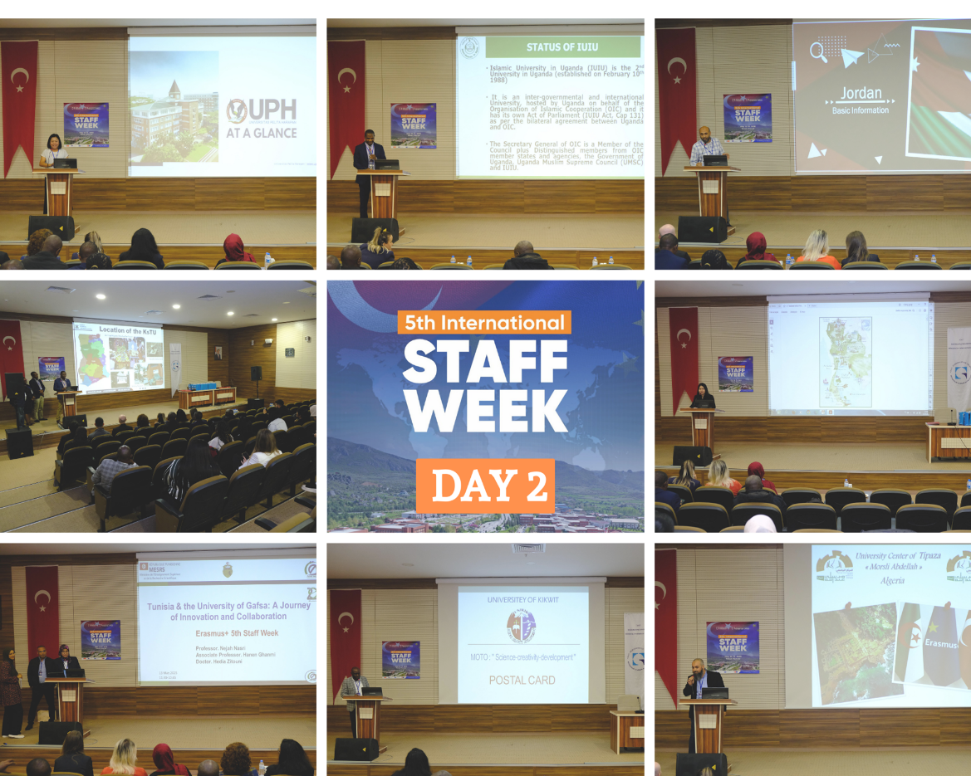
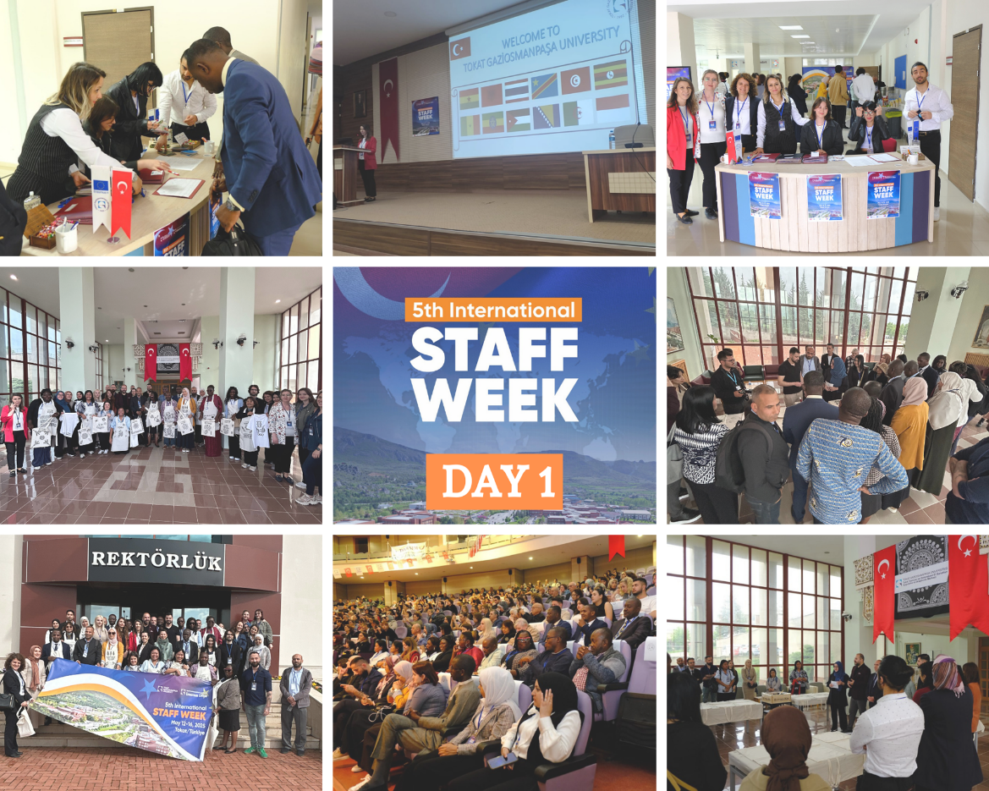
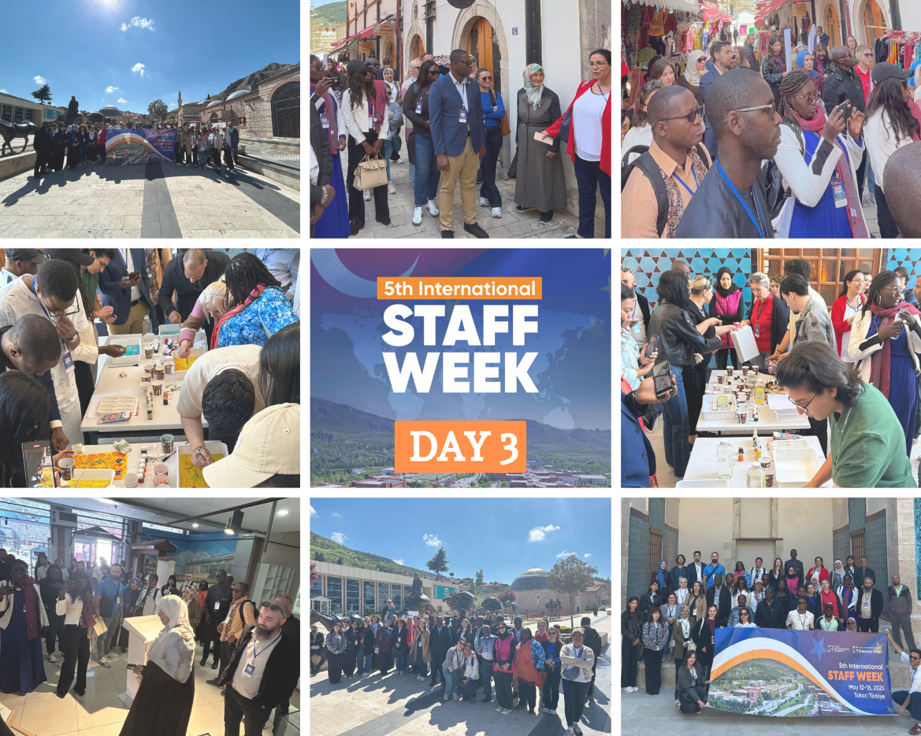
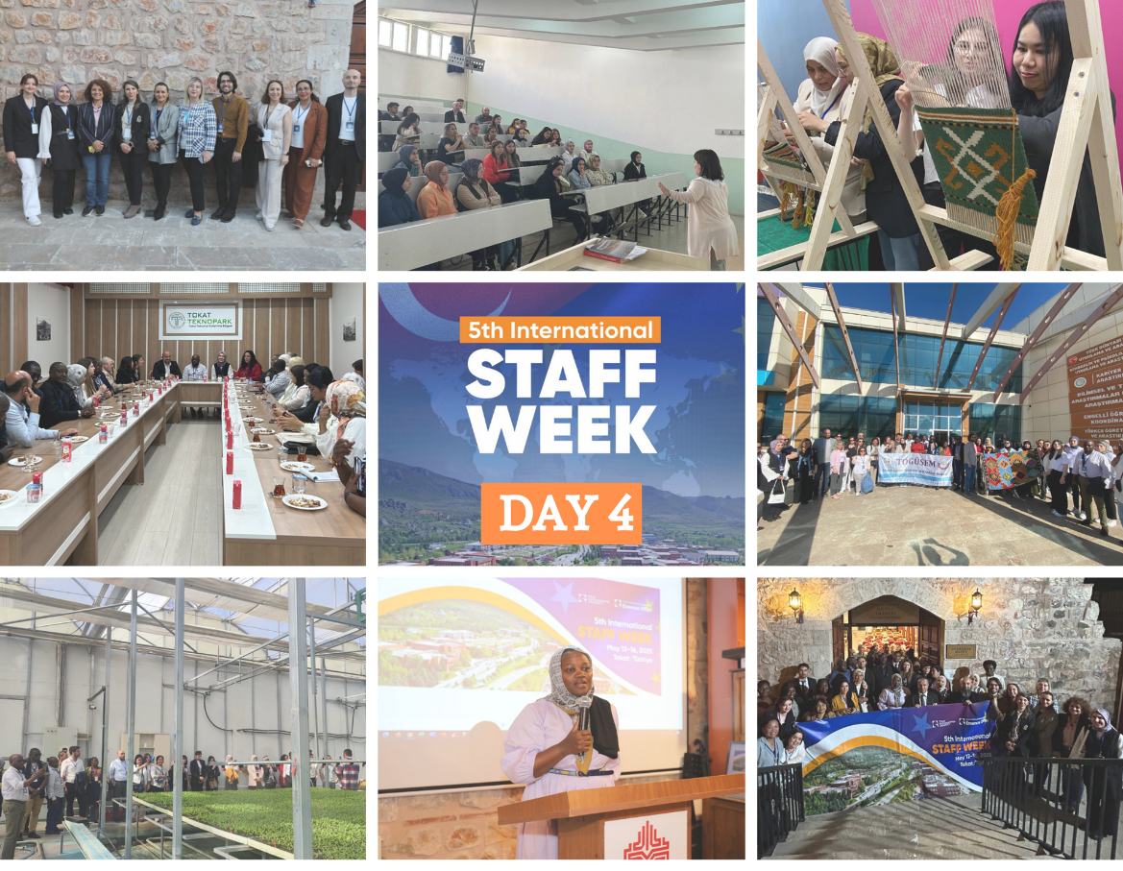
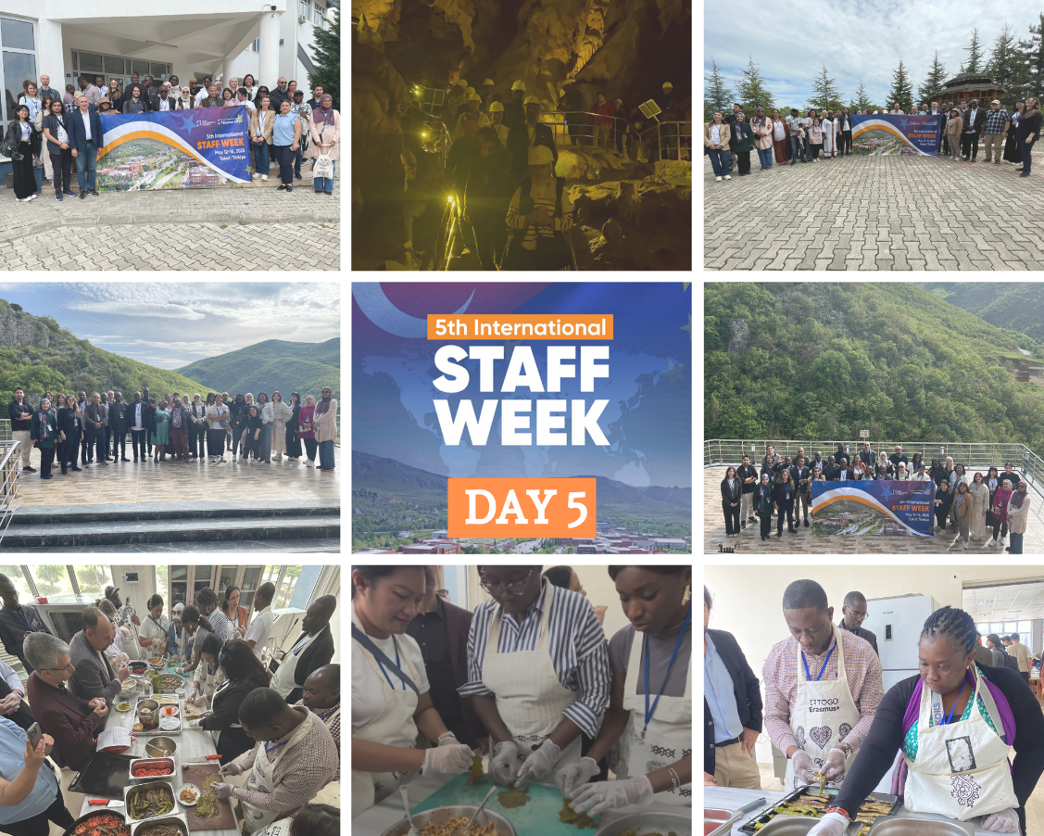
12

Slide 13
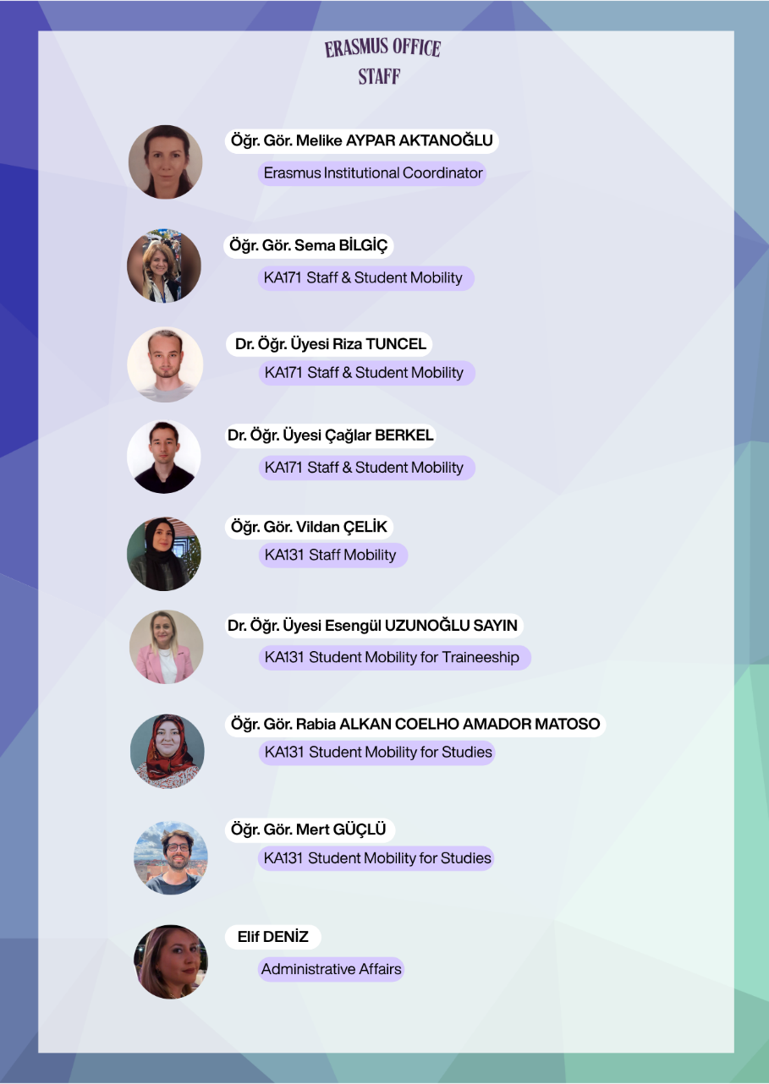

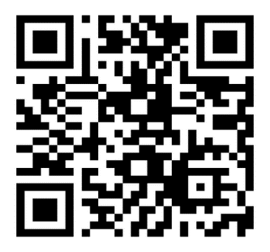
CONTACT
erasmusyonetim@gop.edu.tr
+90 (356) 252 16 16
www.erasmus.gop.edu.tr
toguerasmus
13

Slide 14
THANK YOU
14

