Slide 1

ZAN MITREV CLINIC
A Center of Excellence in Healthcare

Slide 2

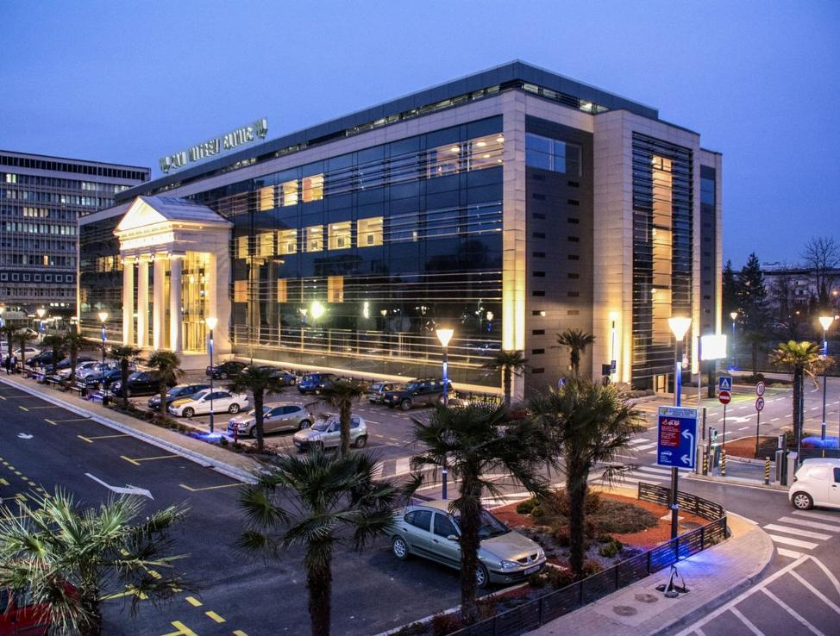
Zan Mitrev Clinic:
A Center of Excellence in Healthcare
Pioneering Advanced Medical Care in the Balkans

Slide 3

Location

Slide 4

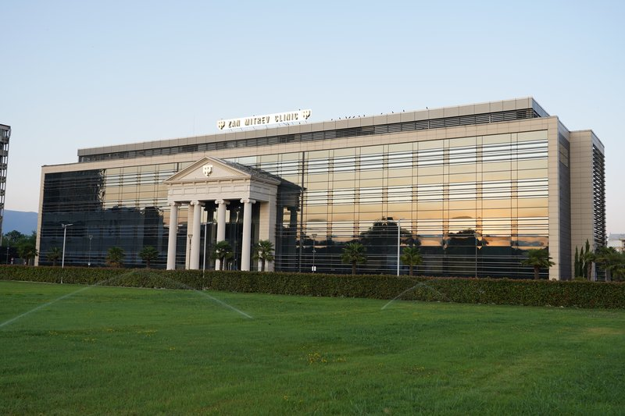
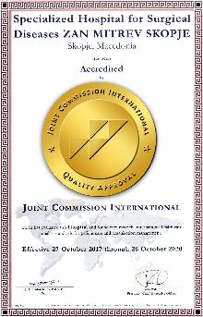
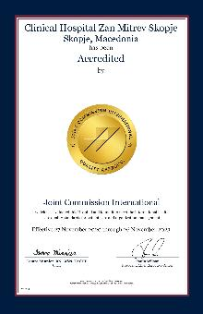
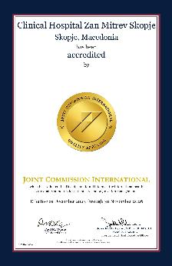
Committed to Excellence in Healthcare
  Established in 2000, Zan Mitrev Clinic has set the benchmark for modern healthcare in the region.
  Accredited to JCI American standards, consistently innovating and expanding.
  A leading institution in specialized medical care and diagnostics.

Slide 5


Our Mission & Vision
Mission: Delivering patient-centered, innovative, and top-quality healthcare.
Vision: Being the first choice for patients and a leader in regional healthcare excellence.

Slide 6
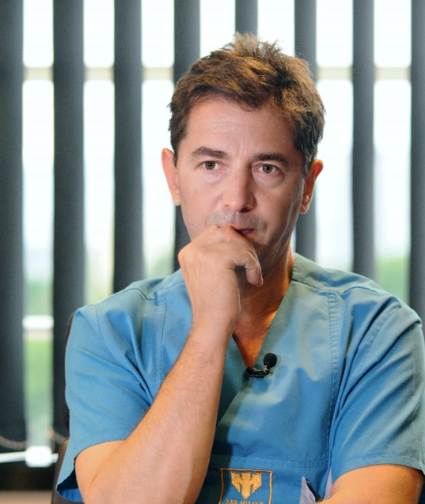
Guided by Our Core Values
Trust | Dedication | Expertise |
Innovation | Integrity
“Our patients are at the heart of everything we do. Through trust, dedication, and expertise, we provide exceptional diagnostics, treatment, and care—extending our support beyond their time at the clinic. With innovation and integrity, we build lasting partnerships, continuously improving to meet every health challenge with excellence”. - Zan Mitrev-Founder

Slide 7
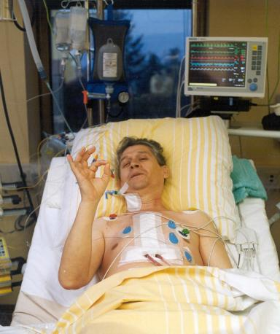
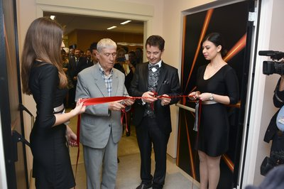
25 Years of Medical Excellence
Key Milestones:
  2000: First bypass surgery in Macedonia
  2002: First open-heart surgery on an awake patient
  2008: Opening of a world-class diagnostic center
  2016: Expansion to a new state-of-the-art facility
  2017, 2020, 2023: JCI International accreditations
  2020: Over 25,000 surgeries performed
  2025: Celebrated 25 Anniversary

Slide 8
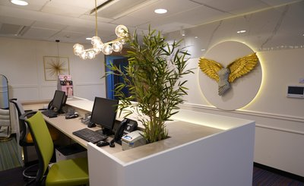
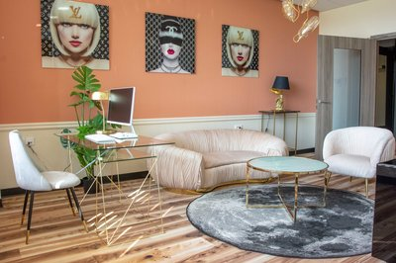
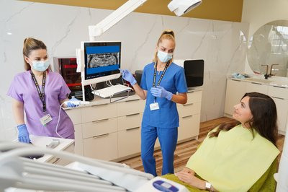
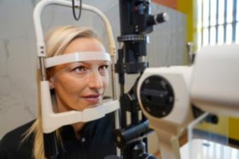
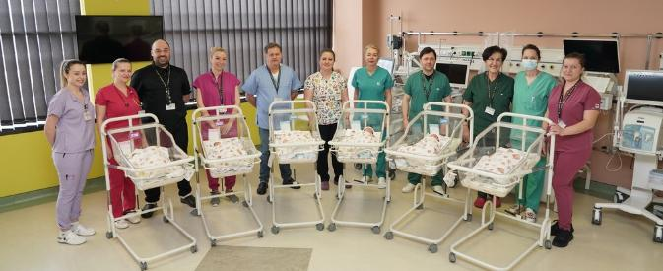
Comprehensive & Specialized Healthcare
Centers:
  Mother & Baby Center
  Dentistry Center
  Ophthalmology Center
  STROKE Center
  Emergency Center (24/7)
  Pain Relief Center
  Aesthetic Dermatology Center
  Women's Health Center

Slide 9
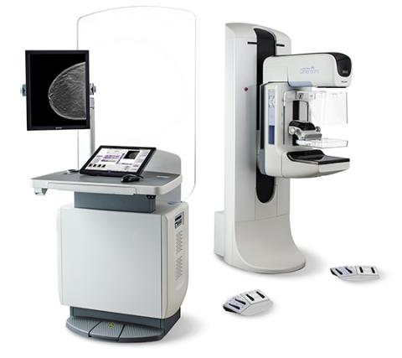
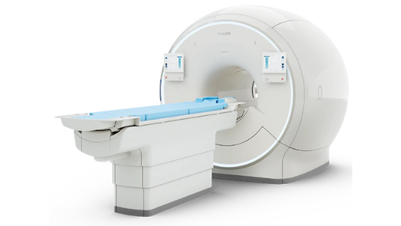

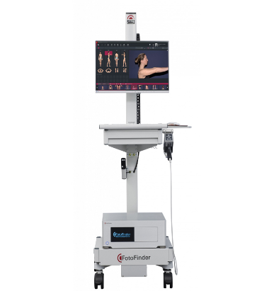
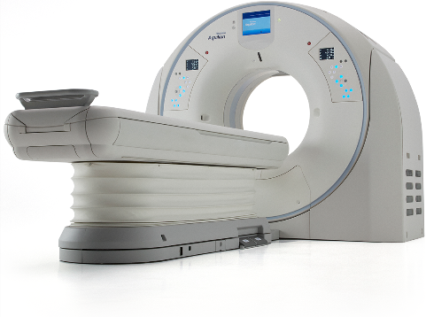
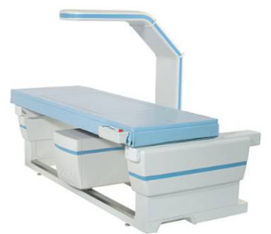
Precision & Innovation in Diagnosis
  Equipped with the latest medical imaging and diagnostic tools
  Fast & accurate results for optimal treatment plans
  Three diagnostic centers: Skopje, Strumica, Bitola
25 modern diagnostics machines

Slide 10
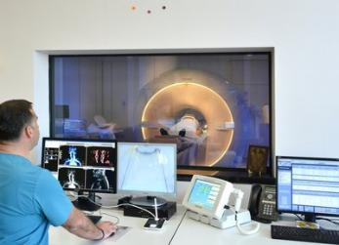
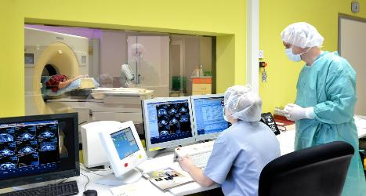
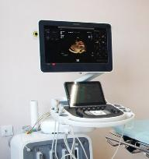
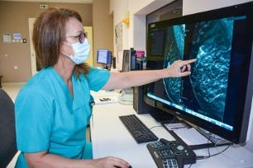
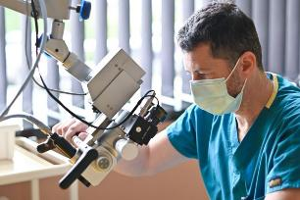
Diagnostics
Cardiology
Internal Medicine
Angiographic Services and Interventions
Radiology (MR, CT, X-ray, Dexascan, 2D and 3D mammography)
Anesthesiology Examinations
Surgical Examinations and Outpatient Interventions
Orthopedics
Urology
Gynecology
Nephrology
Abdominal examinations
Neurology
ORL
Dermatology
Neuro-psychiatric examinations
Psychological treatments
Pediatrics
Nutritional examinations
Ozone therapy
Physiotherapy treatments

Slide 11
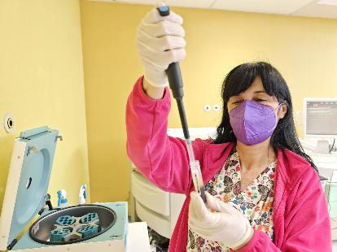
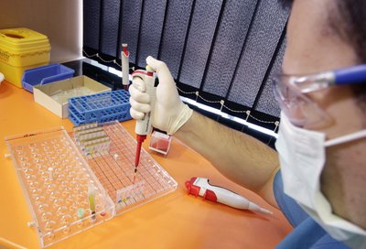
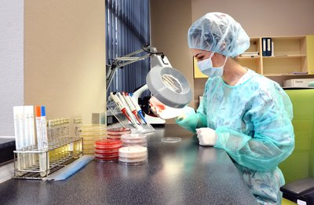
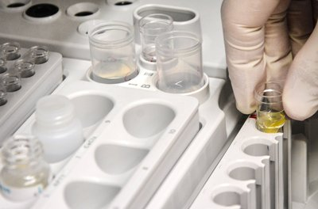
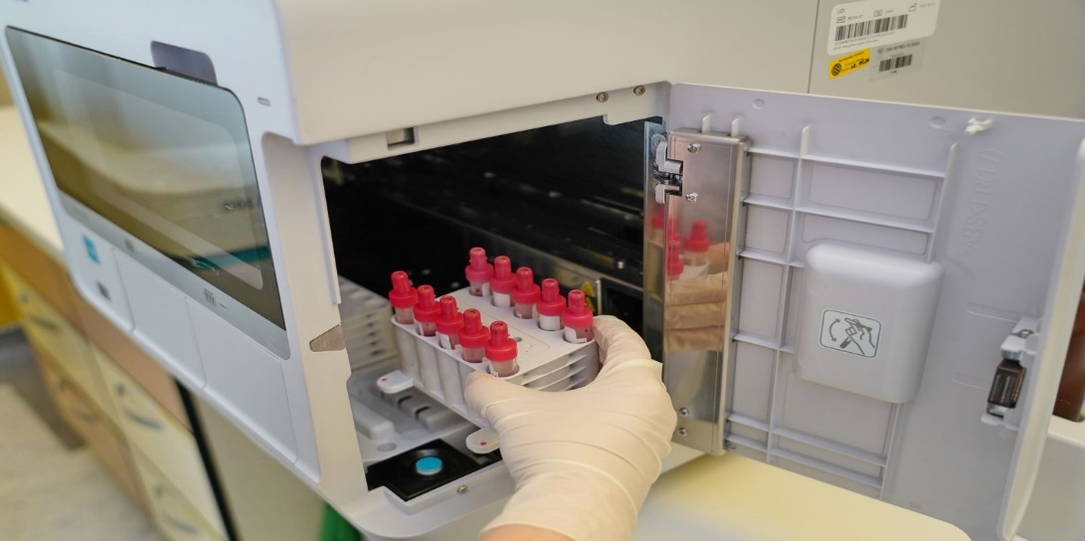
Laboratories
Biochemistry
Microbiology
Genetics
Transfusion

Slide 12
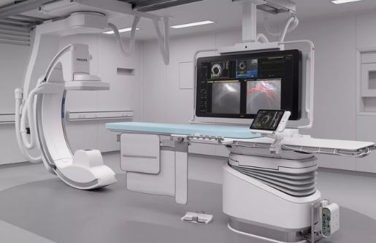
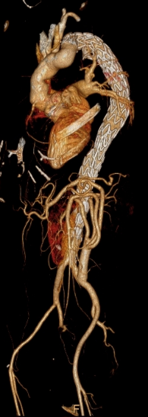
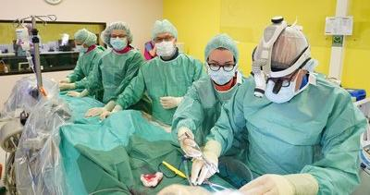
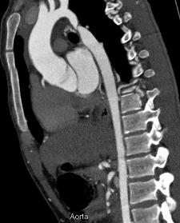
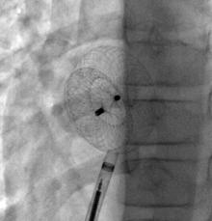
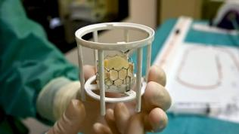
Interventional Procedures
  Balloon valvuloplasty
  Transcatheter aortic valve implantation (TAVI)
  Thoracic endovascular aortic repair (TEVAR)
  Endovascular treatment of abdominal aortic aneurysms (EVAR)
  Pacemakers
  Implantable Cardioverter Defibrillators (ICDs)
  Correction of atrial/ventricular septal defect
  Aortic coarctation
  Correction of pulmonary stenosis
  Treatment of existing ductus arteriosus
  Correction of transposition of the large blood vessels
  Correction of congenital heart defect
  Double right ventricle (DORV)
  Therapy of Fallot

Slide 13
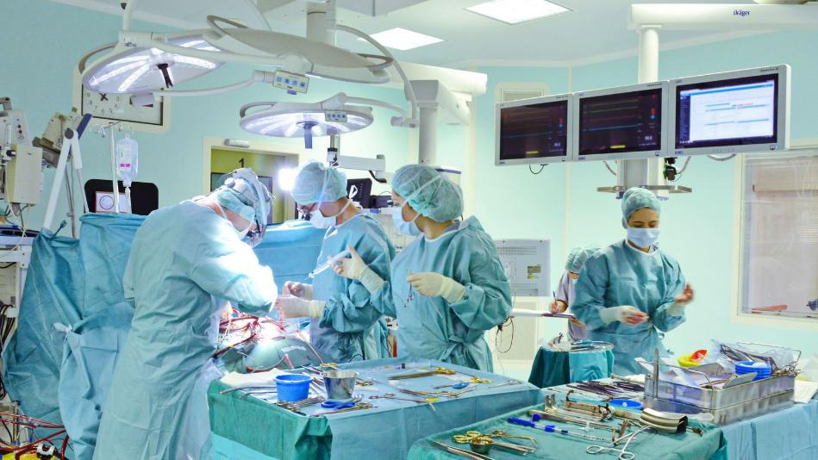
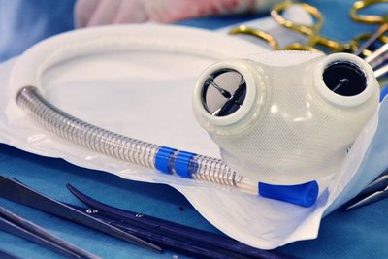
World-Class Surgical Procedures
  Five modular operating theatres with advanced technology
  Over 45,000 surgeries performed
  Multidisciplinary surgical teams ensuring patient safety

Slide 14
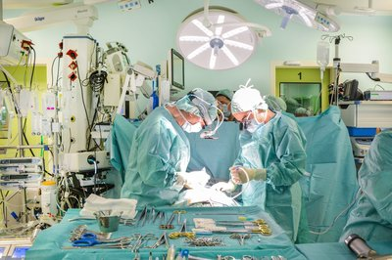
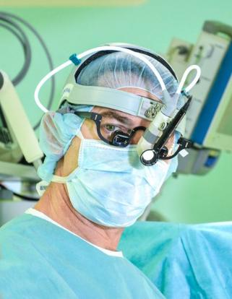
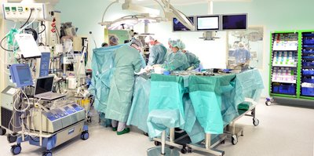
Expert Care Across Multiple Disciplines
Specialties:
  Cardiovascular & Cardiac Surgery
  Vascular, Thoracic, and Abdominal Surgery
  Urology, Gynecology, Orthopedics, Neurosurgery
  Plastic, Aesthetic & Maxillofacial Surgery
  Interventional Procedures

Slide 15
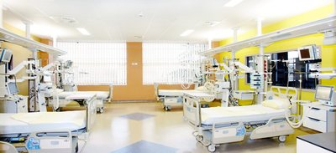

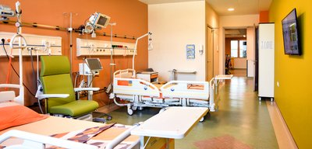
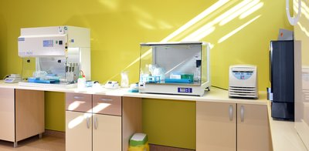


A Hospital Built for Excellence
  Modern facility with controlled environments
  Cutting-edge medical technology
  Infection control & patient safety protocols
  128-bed capacity including luxury suites
5
modular operating theatres
128
hospital beds
74
hospital beds on intensive care

Slide 16
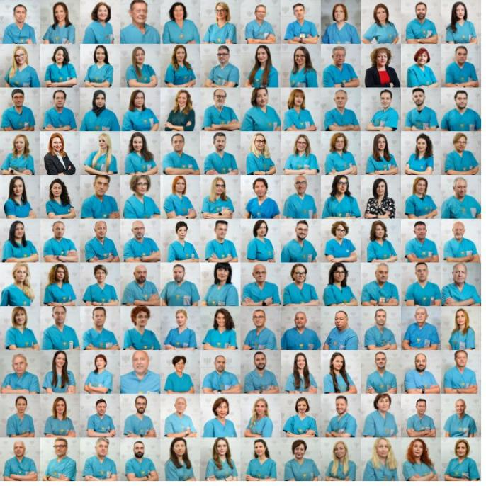

Our Team of Experts
  360+ professionals, including 145 physicians & 94 nurses
  Continuous training & development
  University Hospital - Affiliated with "Goce Delchev" University Providing clinical education and training to future and current healthcare professionals

Slide 17
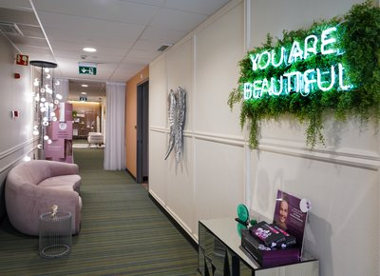
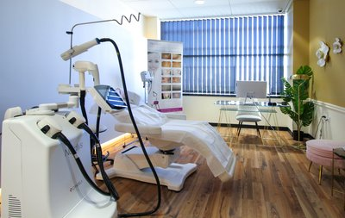
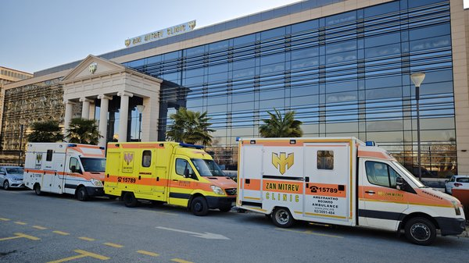
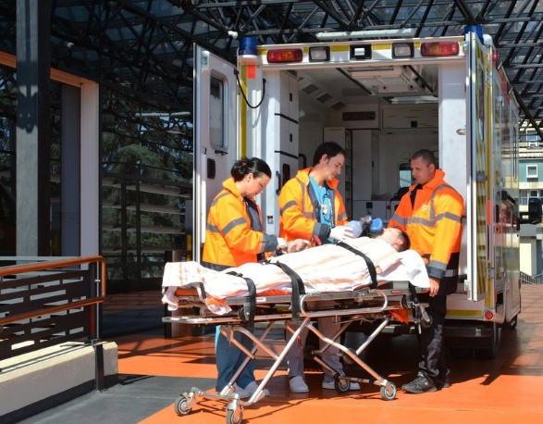
Your Health, Our Priority
  Personalized treatment plans
  Post-treatment follow-ups
  Holistic care for patients & families
  Medical transport

Slide 18

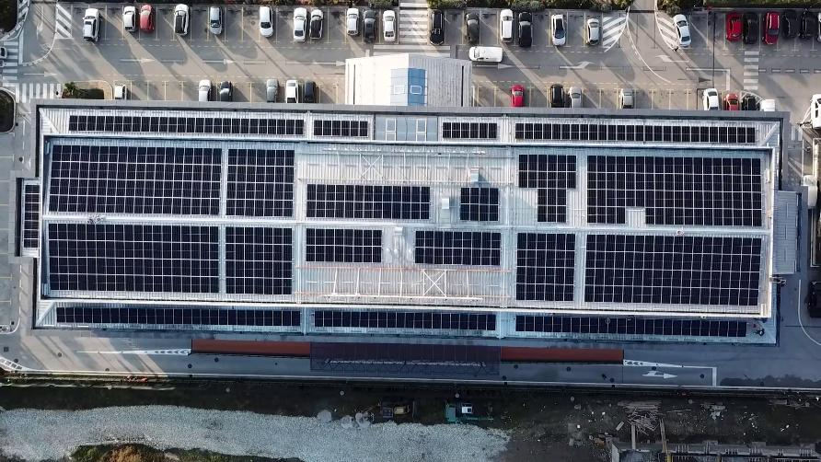
Sustainability in Healthcare
  17,000 sq. meters of energy-efficient infrastructure
  Reduced carbon emissions & green spaces for healing
9 000m2
surface
17 000m2
usable space

Slide 19

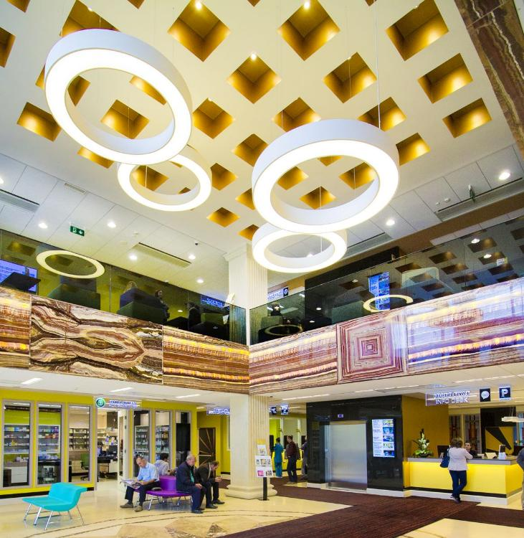
Making a Difference
  400K+ patients treated
  1 million+ hospital visits
  45K surgeries
  Leading private healthcare provider in the region

Slide 20
Partner with Us
for Excellence in Healthcare
  Thank you for your time!
  Contact:
  www.zmc.mk
  Phone: +389 2 3091 484
  E – mail: info@zmc.mk

