Slide 1
National Institute of Health and Care Research (NIHR)
NIHR Support to the Life Science Industry
NOV 2024

Slide 2


Develop your innovation within the most integrated research system in
the world
Notes:
Primary Slide:
The National Health Service (NHS) is a publicly funded Healthcare System that delivers healthcare to a population of over 67 million people.
Each person in the UK has individual NHS number, similar to a social security number that includes all EHR information from ‘ cradle to grave’.
The NHS comprises of health care services across the system, including primary, secondary, emergency, community and social care through a integrated network of 1148 hospitals, 6495 GP practices, 11500 pharmacies.
The NHS celebrated it’s 75th birthday in June 2023 and is one of the most integrated care systems in the world

Slide 3

Scotland
700 life sciences organizations employing over 41,000 people.
Contributes £3.1bn gross value added to the Scottish economy
UK: Key Regional Facts
Midlands UK
Largest UK MedTech cluster, contributing 31.6bn to the local economy
1,200 life sciences companies and 33,000 highly paid jobs
Northern Ireland
250+ life sciences companies
Exporting to over 140 countries
Supporting 19,500 jobs
25% of the region’s economic output.
Northern England
Over 1,300 organisations employing
more than 52,730 people.
220 patents, creating 250 spin-offs
Wales
Strengths in diagnostics, wound healing, regenerative medicine, and cell therapy.
Southern England
Over 3,600 life sciences businesses,
60% of industry turn over, (£56.9bn).

Slide 4




Therapeutic Areas mentioned in UK White Papers
2023
2022
2021
2019
DHSC Areas of Research Interest
Life sciences: industrial strategy Update
Vaccine Taskforce
Life Science Vision
Medical Technology Strategy
Build Back Better: our plan for growth
Dementia Mission
NHS Long Term Plan
Women’s Health Strategy for England
Best Research for Best Health: The Next Chapter
NHS Core20PLUS5
NICE Strategy
Cancer (5)
Mental Health (6)
Cardiovascular (4)
Respiratory (4)
Diabetes (2)
Stroke (1)
Ageing (2)
Dementia (2)
Obesity (2)
Maternity (2)
Addiction (1)
AMR ()

Slide 5


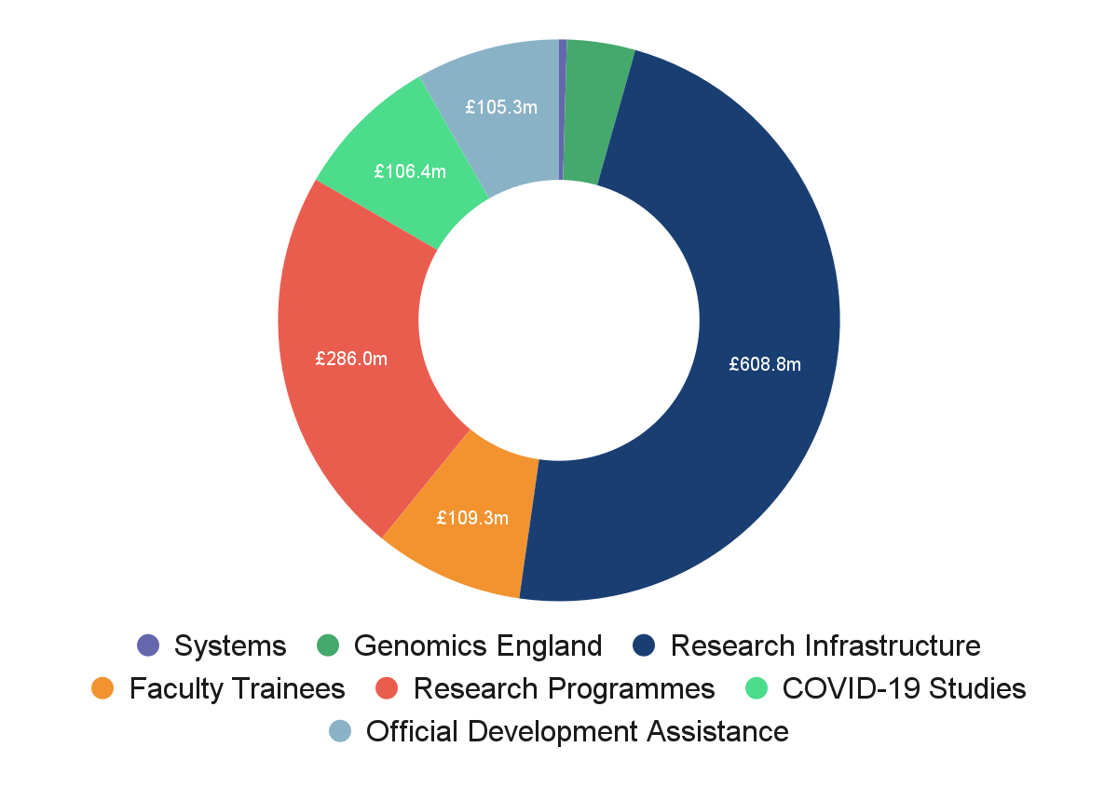
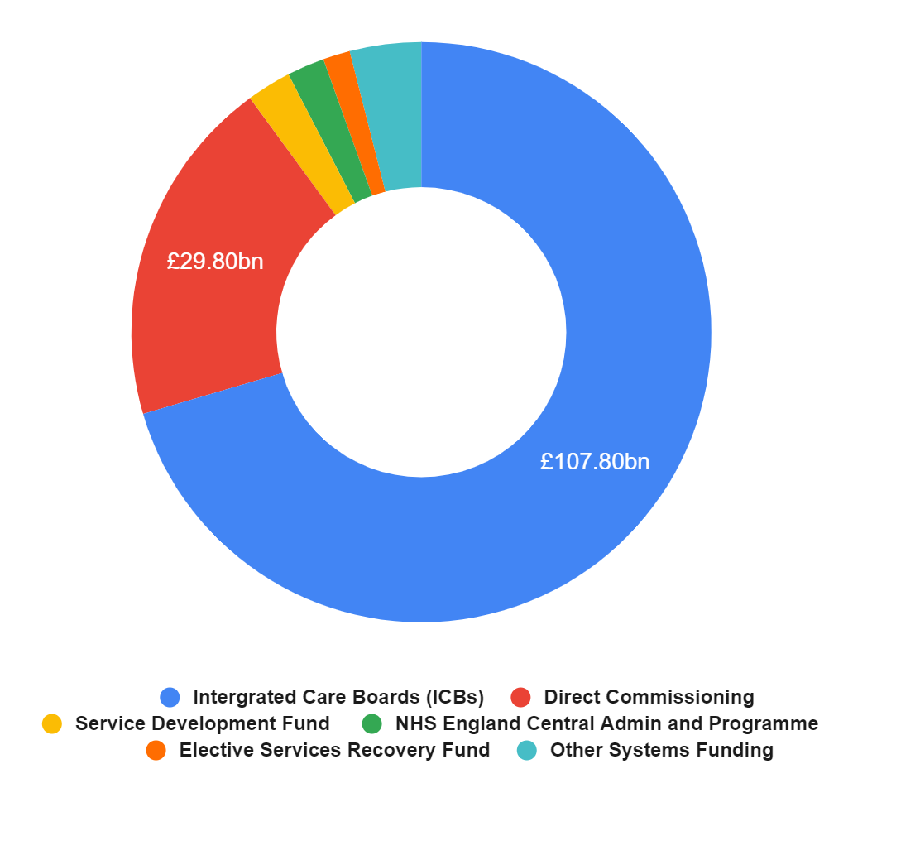
NIHR is the largest funder of health and social care research in Europe
The NIHR is the research arm of the NHS
£153 billion
£1.22 billion
NHS England Total Funding (2022/2023)
NIHR Total Funding (2021/2022)*

Slide 6
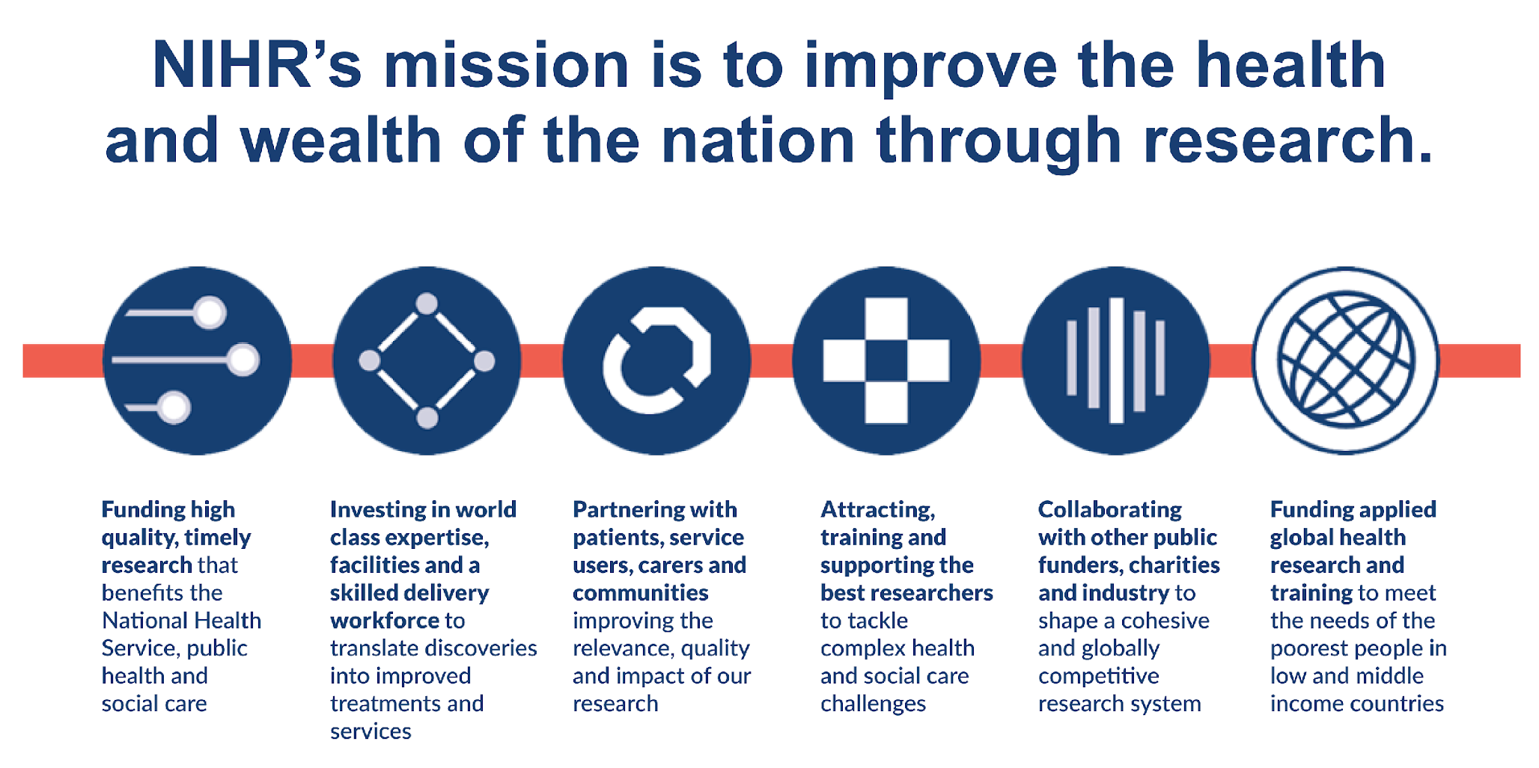
We aim to improve the health and wealth of the nation

Slide 7
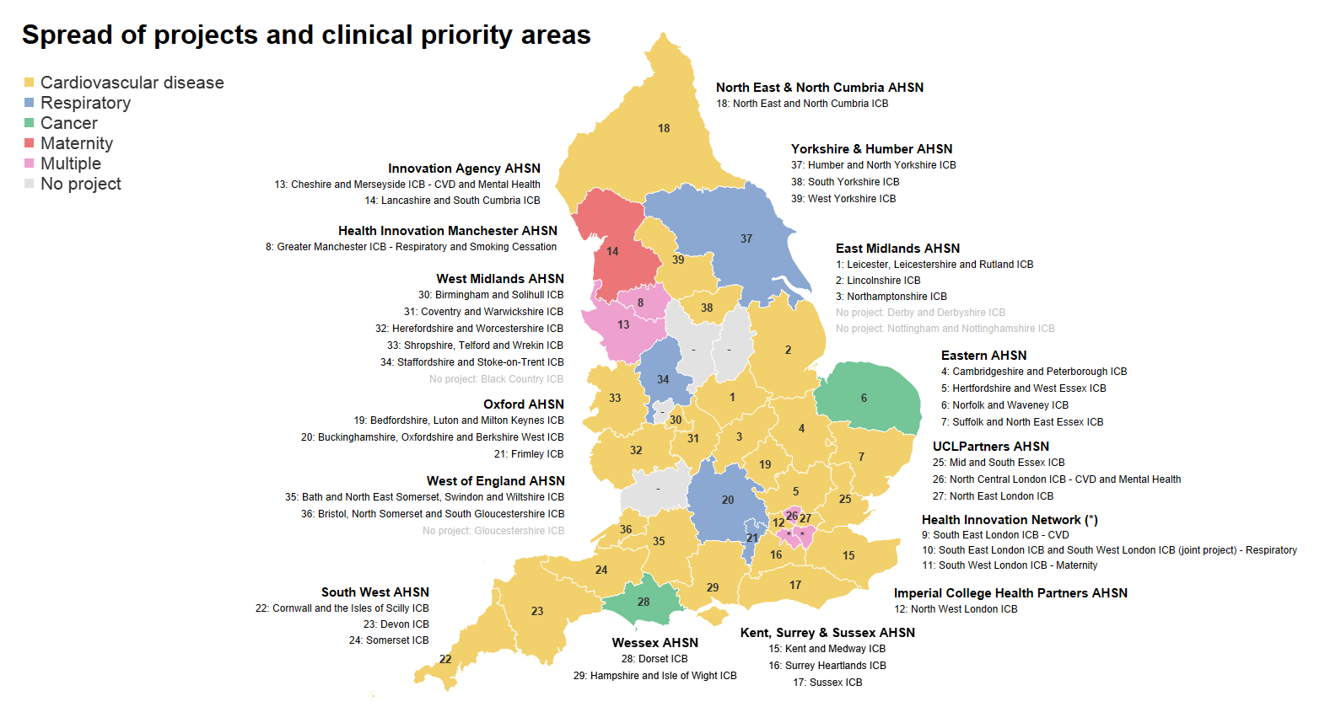

Research spread across NHS ICBs and clinical priority areas addressing local health inequalities

Slide 8





An average day in the NHS
Nearly
45,000
More than 250,000 people will attend
an outpatient appointment
people will attend a major A&E department, and about 20%
of A&E patients will be
admitted into hospital
Around
750
patients
will go into
critical care
More than
1 million
people will attend
a GP appointment
More than
30,000
people will
call 999
Notes:
Primary slide:
Presents the opportunity for support improving the delivery of services support and care to patients
NHS is persistently scrutinised by long waiting lists and referrals, it is one of the highest priorities for the NHS to reduce the waiting time and providing high standards of care to patients through the adoption of new innovations and improvements.
The NHS is publically funded so performance information of the system is within the public domain and NHS priorities and other organisations that review and audit the system have made this information freely available for the Life Science industry to access this information.
Individual Trusts publish and produces annual reports
NHS priorities and Strategy white papers
CQC - independent audit publishes information around the operational performances of NHS services

Slide 9

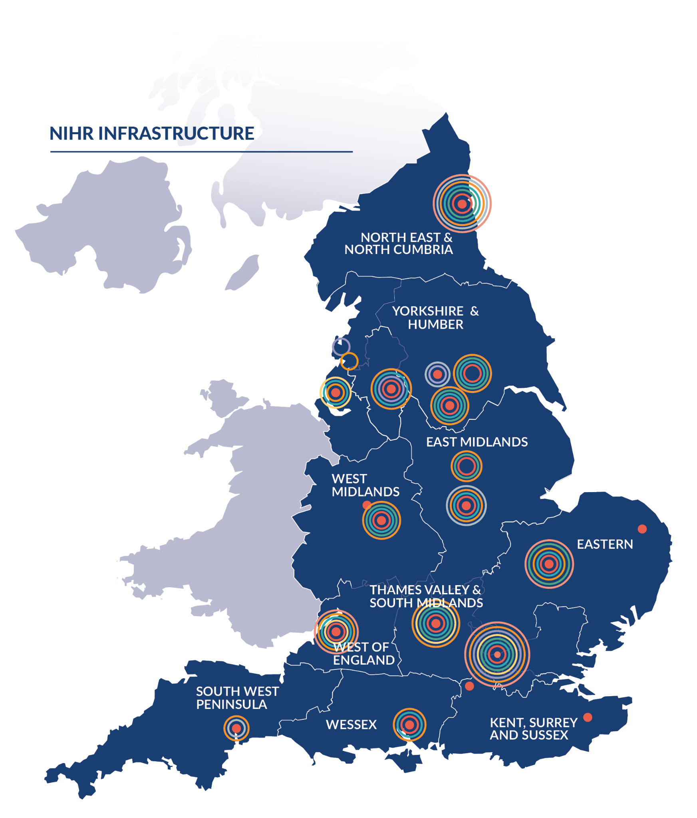
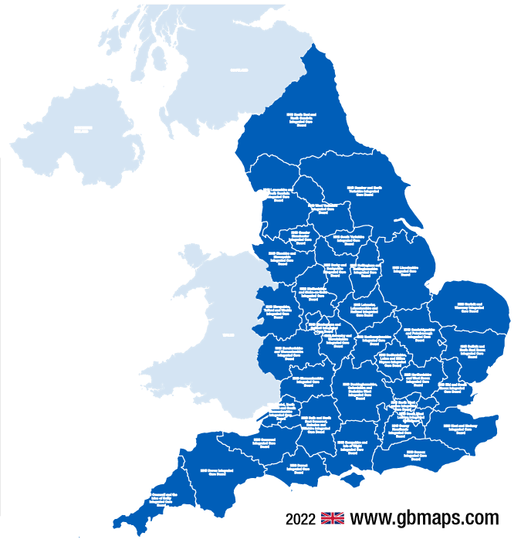
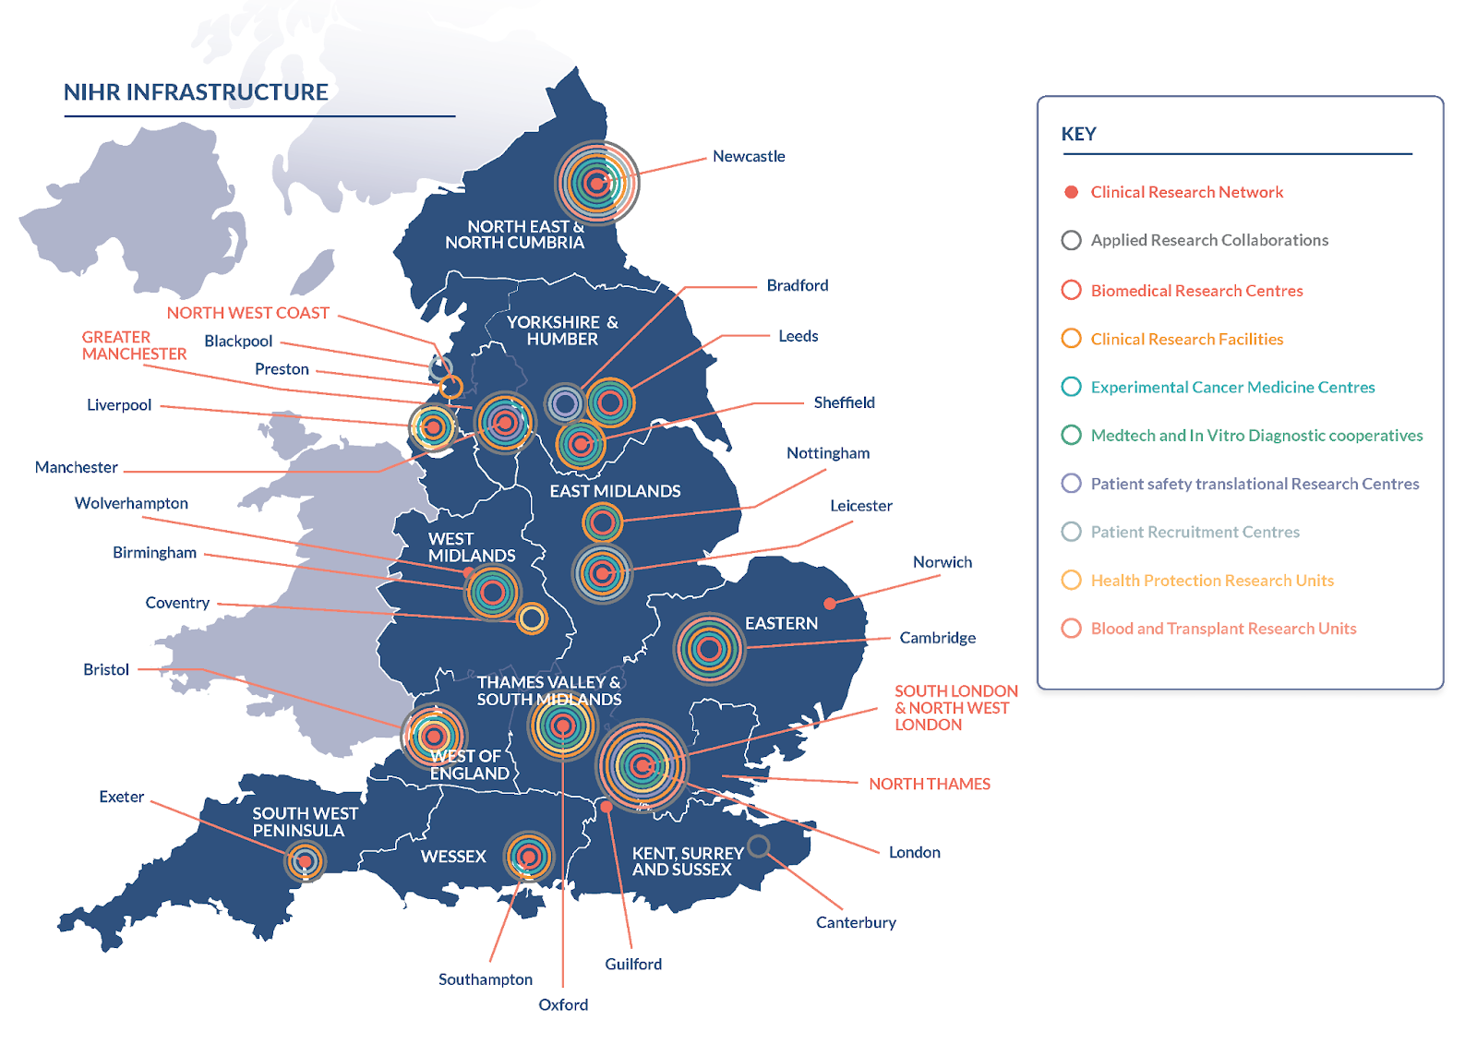
Research Infrastructure
£608.8M
The NHS provides a national test bed for the NIHR to deliver clinical research
42 NHS Integrated Care Boards (ICBs)
10 Research Networks embedded across the NHS

Slide 10
Health Technology Pathway Navigation Tool for Innovations in England
NHS
AAC
Health Technologies, Data & AI R&D Resources
Artificial Intelligence (AI) and Digital Regulations Service
UK Government Strategy Papers
Digital Technology Assessment Criteria (DTAC)
NHS Innovation Service
NHS Transformation Directorate
NHS
AAC
MHRA
HRA
NICE
CQC
Accelerators
Incubators Resources
DataSavesLives
A plan for digital health and social care
A guide to good practice for digital and data-driven health technologies
NHS Long Term Plan
NHS Transformation Directorate API Developer Hub
Regulatory Approval
2022
2022
Digital Health.London Online Resources
Evaluating Digital Health Products
Innovators Guide to Navigating the barriers to health
Clinical Risk Management: its Application in the Manufacturing of Health IT Systems
How to involve patients in digital tech innovation
Digital Transformation
UKCA Marking
NHS Transformation Directorate
How we support medical technology, device and diagnostic companies
HINS
2021
Evidence standards framework (ESF) for digital health technologies
The Regulations on Medical Devices 2017/25
NIHR
Health Technology Assessment (HTA)
2019
The Innovative Devices Access Pathway (IDAP)
AHSN Accelerator Programme
NIHR Observatory: ScanMedicine
NICE
NICE
MHRA
NHS England
Digital Health.London
NHS AI Lab
SHTG
MHRA
NICE
HTW
InnovateUKEdge
UKRI
NHS
AI Skunkworks Case Studies

Slide 11
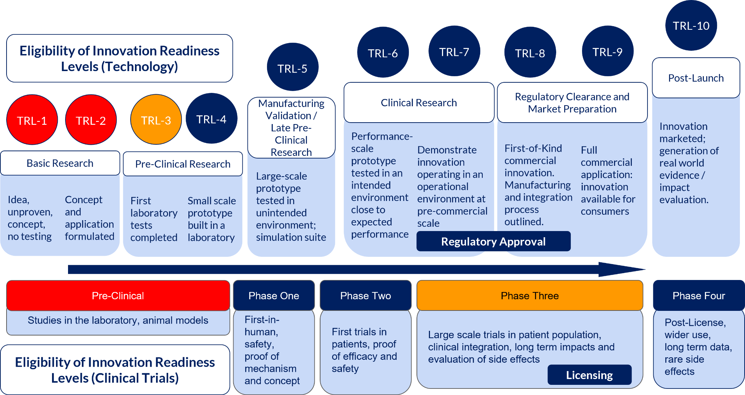
Notes:
In the UK, TRLs are used across the system to describe the phase of development of a product.
The NIHR interacts and support innovations from TRL3 upwards, many funding awards will state in the guidance as to what stage of development of a product is eligible.

Slide 12
Product development pipeline
Research
Development
Adoption
Fundamental Research
Proof of Concept
Building evidence
Clinical evaluation
Real-world Evaluation
Commissioning
Support for experimental to late stage multi-centred trials from phase I/II/III&IV
Market Access
Prototype Development
Local and National Commissioning
Therapeutics
Clinical Design/ Application
Efficacy of Mechanism/ Patient Safety
Evaluate Cost Effectiveness
Preclinical Testing
Care Pathway Analysis/Impact Assessment
Evidence to support scale and spread
Qualify Analytical and Clinical Validity
Procurement Routes
Manufacturing Process
Quality
HealthTech
PPIE/NetZero Impact/ Health Inequalities
Post market surveillance
Value proposition
Evaluate Clinical Utility /
Human Factors
Support of Innovation at Technology Readiness Level 3 to 9
Organisations directly supporting R&D pipeline*
Notify MHRA
Regulatory Approval for Trials
Health Technology Assessment/UKCA marking
NICE Evidence Framework for RWE
NHS AI Lab & NHSE (AAC & HINs)
ICBs/PCNs
UKRI MRC/Innovate UK
NICE
MHRA
HRA
CQC

Slide 13
Product development pipeline
Research
Development
Adoption
Fundamental Research
Proof of Concept
Building evidence
Clinical evaluation
Real-world Evaluation
Commissioning
Clinical Design/ Application
Efficacy of Mechanism/ Patient Safety
Evaluate Cost Effectiveness
Care Pathway Analysis/Impact Assessment
Qualify Analytical and Clinical Validity
Evidence to support scale and spread
HealthTech/Biotech
Therapeutics
Evaluate Clinical Utility /
Human Factors
PPIE/NetZero Impact/ Health Inequalities
Innovation Readiness Levels (Technology)
Value proposition
TRL-6
TRL-7
TRL-8
TRL-9
TRL-5
TRL-10
TRL-2
TRL-3
TRL-4
Manufacturing Validation / Late Pre-Clinical Research
Clinical Research
Regulatory Clearance and Market Preparation
Post-Launch
TRL-1
Performance-scale prototype tested in an intended environment close to expected performance
Pre-Clinical Research
Demonstrate innovation operating in an operational environment at pre-commercial scale
First-of-Kind commercial innovation. Manufacturing and integration process outlined
Full commercial application: innovation available for consumers
Innovation marketed; generation of real world evidence / impact evaluation
Basic Research
Large-scale prototype tested in unintended environment; simulation suite
First laboratory tests completed
Small scale prototype built in a laboratory
Idea, unproven, concept, no testing
Concept and application formulated
Regulatory Approval
Support of Innovation at Technology Readiness Level 3 to 9
NIHR Remit

Slide 14
Innovation development pipeline
Research
Development
Adoption
Fundamental Research
Proof of Concept
Building evidence
Clinical evaluation
Real-world Evaluation
Commissioning
Support for experimental to late stage multi-centred trials from phase I/II/III&IV
Experimental Medicine
Phase 1
Phase 2
Phase 3
Phase 4
Therapeutics
Safety
Efficacy
Health Economics
Therapeutic Readiness Levels (Clinical Trials)
Pre-Clinical
Phase One
Phase Two
Phase Three
Phase Four
Studies in the laboratory, animal models
First-in-human, safety,
proof of mechanism and concept
First trials in patients, proof of efficacy and safety
Large scale trials in patient population, clinical integration, long term impacts and evaluation of side effects
Post-market authorisation, wider use, long term data, rare side effects
Licensing
NIHR Remit

Slide 15
Product development pipeline
Research
Development
Adoption
Fundamental Research
Proof of Concept
Building evidence
Clinical evaluation
Real-world Evaluation
Commissioning
Support for experimental to late stage multi-centred trials from phase I/II/III&IV
NIHR Support
Efficacy of Mechanism/ Patient Safety
Clinical Design/ Application
Experimental Medicine
Phase 1
Phase 2
Phase 3
Phase 4
Safety
Efficacy
Evidence to support scale and spread
MedTech / Digi Therapeutics
Health Economics
Support of Innovation at Technology Readiness Level 3 to 9
Value proposition
Care Pathway Impact Assessment
Qualify Analytical and Clinical Validity
Evaluate Cost Effectiveness
Evaluate Clinical Utility /
Human Factors
PPIE/NetZero Impact/ Health Inequalities

Slide 16
Product development pipeline
Research
Development
Adoption
Fundamental Research
Proof of Concept
Building evidence
Clinical evaluation
Real-world Evaluation
Commissioning
Support for experimental to late stage multi-centred trials from phase I/II/III&IV
Therapeutics
Clinical Design/ Application
Efficacy of Mechanism/ Patient Safety
Evaluate Cost Effectiveness
Care Pathway Analysis/Impact Assessment
Evidence to support scale and spread
Qualify Analytical and Clinical Validity
HealthTech
PPIE/NetZero Impact/ Health Inequalities
Value proposition
Evaluate Clinical Utility /
Human Factors
Support of Innovation at Technology Readiness Level 3 to 9
HRA
CQC

Slide 17
Product development pipeline
Research
Development
Adoption
Fundamental Research
Proof of Concept
Building evidence
Clinical evaluation
Real-world Evaluation
Commissioning
Design a clinical trial?
Adapt existing protocols to fit the UK/NHS setting?
Conduct evaluation of my product in a real-world setting
Therapeutics
Which patient care
pathway is suitable for my product?
Find a PI and research team to run a clinical trial?
Generate costing saving effectiveness against the current standard used in the NHS
What are the NHS priorities?
Generate evidence to access the safety and efficacy
Assess the impact of my product on patients with comorbidities evaluate the precision
Develop a value proposition
HealthTech
My product is designed for a nurse - can I connect with nurses to conduct feasibility/user testing
My product has several applications - which one should be the focus?
How I can prove my product can be scaled?
HRA
CQC

Slide 18

Key Opinion Leaders
methodologists
Clinical Trial Unit Managers and operational workforce
Principal Investigator/Chief Investigator
Speech Therapists
Academics
Paramedics
Health Economists
Nutritionists
Statisticians
Radiographers
Specialist Nurses
Physiotherapists
General Practitioners
Psychiatrists/Psychologists
Health Protection Practitioners
Pharmacists
Surgeons
Care workers
Dentist

Slide 19



Slide 21
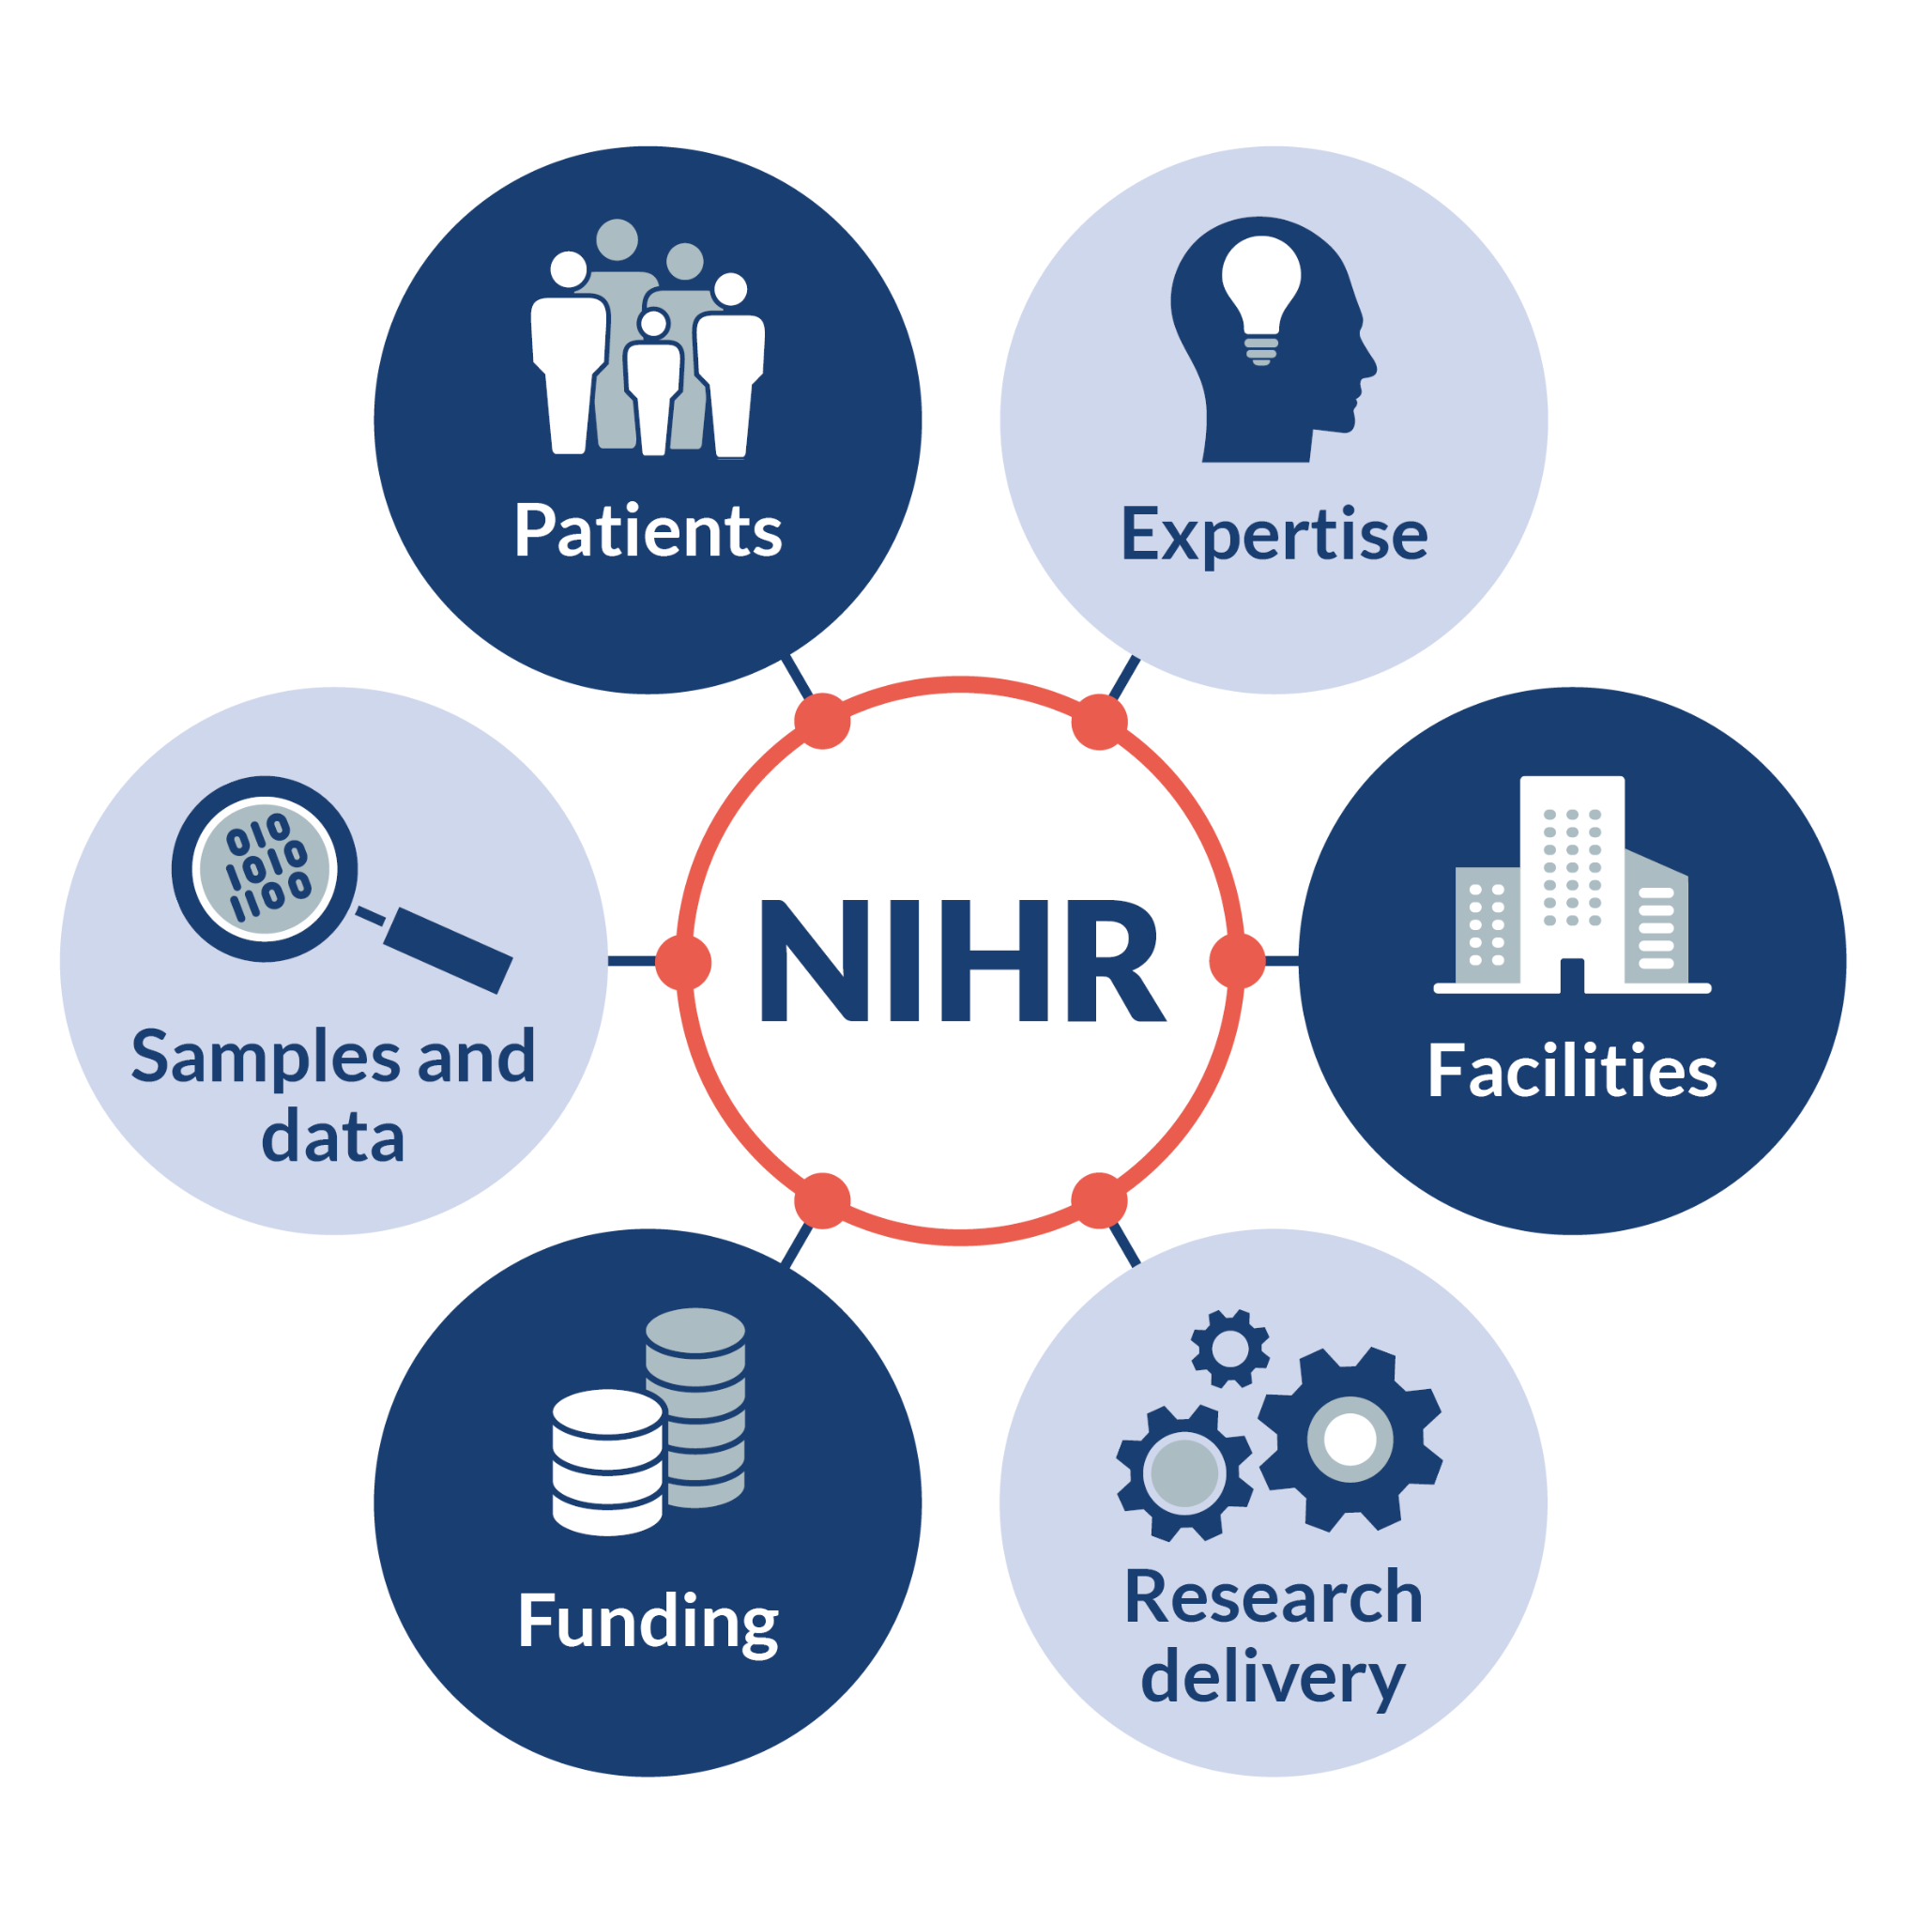
We can support all stages of your clinical development

Slide 22


Slide 23

Gain unique access world class research infrastructure of world leading experts across the whole innovation pathway
Notes:
GUIDANCE
Slide summarises range of NIHR research infrastructure
There is a huge range of options available - represented by this busy slide - which is why we encourage you to come and talk to us so we can tailor your package of support.
The dots and coloured circles represent different types of research facilities and collaborations of expertise.
Some locations have multiple different facilities - which is signified by the different coloured circles - and many of these are highly specialised facilities, for example, sleep clinics or Experimental Cancer Medicine Centres.
For instance PET scans can be provided at some centres,
Birmingham able to host a simulation suite with 4K HD cameras for remote trials
The dark blue regions that sit behind the dots illustrate how we cover the whole of England through our 15 regional networks.
Our research workforce of over 14,000 staff is embedded within the NHS in these 15 regions,
Their role is to help to ‘perform’ your research research in the chosen health or care setting.

Slide 24







There are currently
6 TRCs to tackle areas of urgent clinical need:
1
2
3
4
5
6
Respiratory TRC
NIHR-Versus Arthritis UK Musculoskeletal
TRC
Dementia TRC
NIHR-British Heart Foundation
Cardiovascular
Partnership
Mental
Health TRC
Oncology TRC
Notes:
N.B. These reflect the current membership, strategies and workstreams, which will further evolve to take on the contributions from any new participants.

Slide 25









brain and spinal cord injuries
respiratory disease
community healthcare and mental health
The new NIHR HealthTech Research Centres focus on
trauma and emergency care
rehabilitation and assistive technologies
diagnostics
NIHR HRCs Launching 2024
young adults and children
dementia and brain health
cardiovascular disease

Slide 26
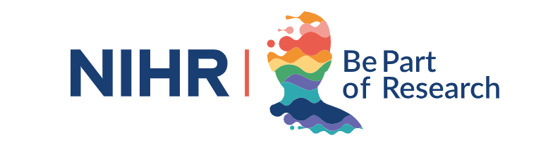


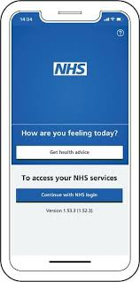




Unparalleled access to patients across the NHS, social care and local communities
Connect with patients who can help to improve the design and delivery of clinical research
Research targeting based on prevalence data
Reaching underserved communities & rare diseases
Digital engagement tools
Pre-consent research registries
Making research more inclusive
Notes:
GUIDANCE
The purpose of this slide is to position patients throughout all NIHR services and outline how we can help companies to access patients and research participants.
SPEAKER NOTES / KEY MESSAGE
Core to the NIHR’s mission is the needs of patients and the public - ‘patients are at the heart of what we do’ this includes ensuring patient and public
In terms of supporting you, we can facilitate access to patients for both recruitment/research participation and also for engagement activities.
NHS
An obvious and key area of focus is our National Health Service - NHS - which treats 1.4 million patients every 24 hours
Our research infrastructure is embedded within the NHS, consequently we have unparalleled access to well defined patient populations, including patient cohorts of rare diseases.
Over 1 million participants took part in research across the UK 2022/23
Over 33,000 of those took part in commercial research
Over the last five years we have helped to recruit over 6.3 million participants into all research and almost 190,000 into commercially-sponsored research
The NIHR brand is trusted by patients and the public in the UK and we are viewed by many as the research arm of the NHS
Using our our national network structure, combined with the ability to access NHS data, we can help you to rapidly find, recruit and follow up research participants.
Beyond the hospital clinic - Social care and community care
However can also support research activity beyond the hospital clinic
In the UK many chronic, long term conditions are managed in primary care or in the community
Think general practice, social care, community pharmacy, care homes, hospices, ambulance services, prisons, schools, opticians.
We can help you to plan and place your research in these settings.
Patient and public engagement
We have had a strong focus on patient engagement and involvement for over a decade
We have designed a bespoke service specifically to help you, the life sciences industry, engage directly with patients to help shape your research and conduct/achieve patient centric clinical trials and meet your regulatory and Research Ethics Committees (RECs) requirements.
Worth mentioning PECD service for CRN support for patient engagement across disease areas and Be part of research: easy access for patients and public involvement with research

Slide 27

Our end-to-end process allows you to deliver high quality research at any scale
Plan
Perform
Place

Slide 28
Deliver high quality research at any scale, facilitated by access to >3500 investigators with a deep understanding of local care pathways and patient needs
Plan
Place
Perform
Patient engagement
Site data & intelligence
Monitor site performance
NHS clinical experts
Contract & costing
Recruitment activity
Study feasibility
NCVR
Protocol review
DCTs
NHS DigiTrials
Notes:
SPEAKER NOTES / KEY MESSAGES
We can help you to plan, place and perform your research throughout England.
This could be in an NIHR funded facility, or in the wider NHS - primary, secondary or tertiary care. We can also support research in social care settings and the wider community.
Our Clinical Research Network covers the whole of England through 15 regional networks.
Our research workforce of over 14,000 staff is embedded within the NHS within these 15 regions.
Their role is to help to ‘perform’ your research research in the chosen health or care setting.
In year 2020/21 the combined number of CI/PIs leading commercial clinical trials across all 15 regions exceeded 3500
A national network with local knowledge patient and user populations and a deep understanding of care pathways and patient needs.
We offer an end to end research process through including:
Access to clinical experts and patients to advise on the design and deliverability of your proposed research
Access to a range of data, intelligence and our costing tool to help you to plan and place your study more strategically to optimise its chances of success
Once your sites are open our research workforce will support recruitment
We will monitor study-wide performance at a national level and can identify if/where additional support may be required.
Your support package will vary depending on your where you are in your research journey, your product or innovation, what type of company you are - we encourage you to come and talk to us so we can tailor your package of support.
Decentralised trials: https://www.nihr.ac.uk/partners-and-industry/industry/uk-research-delivery-spotlights/decentralised-clinical-trials.htm#:~:text=Decentralised%20trial%20delivery%20holds%20many,for%20travel%20to%20clinical%20sites.

Slide 29





The richest omics, primary, secondary and public research data in the world
Uniting UK health datasets
Collection, processing and storage logistics
Whole genome sequencing diagnostics
>100k consented patients

Slide 30

Competitive grants funding multi-disciplinary health and social research in clinical and non-clinical settings
EME
HSDR
i4i
PDG
PRP
ESP
HTA
PGfAR
PHR
RfPB

Slide 31
Basic research
Translational development
Clinical evaluation
Implementation
Adoption & diffusion
Charities
Engineering and Physical Sciences Research Council
Biotechnology and Biological Sciences Research Council
MRC Biomedical Catalyst
Medical Research Council
Wellcome Trust
Development Pathway Funding Scheme
Innovate UK Biomedical Catalyst
Innovate UK
MRC DPFS
Feasibility Studies
Primer Award
NIHR i4i Product Development Award
NIHR Challenge Award
NIHR i4i Connect/FAST Award
UK Life Sciences Funding Landscape
NIHR/MRC EME
NIHR HTA
WT/MRC Joint Global Health Trials
Angel Investors
Venture Capital

Slide 32
Elements to include
Things to consider
What makes a good NIHR funding application?
UK Lead Applicant
✔
Value for money
✔
Proof-of-concept
✔
Clinical need
Project plan
Patient benefit
Team
Patient & public involvement
NHS adoption strategy
Health Inequalities/Net Zero
IP & commercial strategy
NHS Trust/HEI partner
Expertise Partnering Service
Notes:
Secondary Slide

Slide 33
Grant application resources and support
NIHR Resources
Funding Programmes Guidance documents
External Partners
NIHRtv pre-launch webinars
InovateUkEdge
HINs
SEHTA
Consultancy Services
NIHR Research Support Service
Expertise Partnering Service
Notes:
Secondary Slide

Slide 34









Life Sciences Industry Information Service
Access health datasets and
biobanks
Work with clinical and academic experts
Generate the evidence required to support market access
Access world class health datasets and biobanks
Develop your innovation in purpose built research facilities
Connect with the wider UK research ecosystem
Find funding that is right for your innovation
Build
bespoke collaborations

Slide 35




Please get in touch if ever in doubt:
Central entry point for the Life Science Industry to start accessing support through the NIHR
industry@nihr.ac.uk
www.nihr.ac.uk/industry
Support companies at any stage of product development, location, study type, study size, therapy or research area
Tailored support to the individual needs of a company

Slide 36
brain and spinal cord injuries
respiratory disease
community healthcare and mental health
The new NIHR HealthTech Research Centres focus on
trauma and emergency care
rehabilitation and assistive technologies
diagnostics
NIHR HRCs Launching 2024
young adults and children
dementia and brain health
cardiovascular disease

