Slide 1


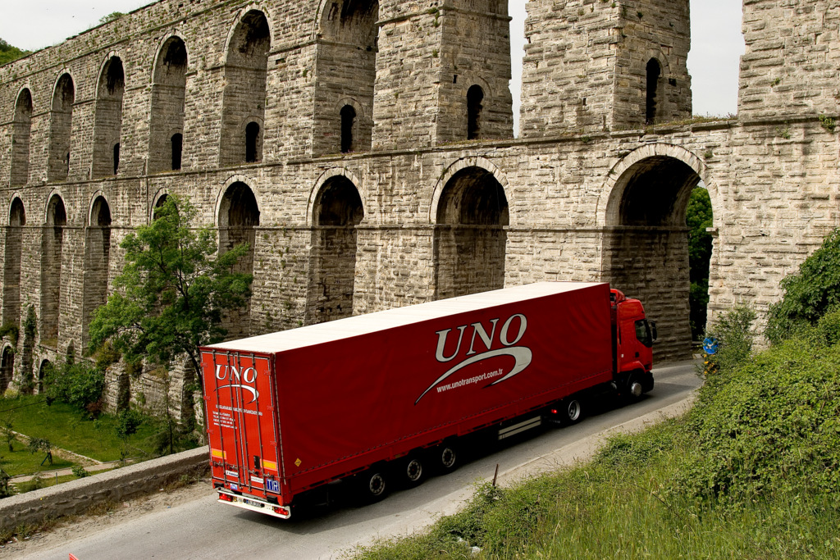
Company Profile

Slide 2
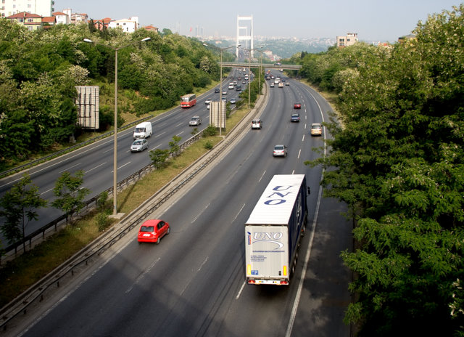
Company Profile
Since 1996 for 20 years already UNO Transport provides logistic services as exporter and importer in Turkey. Our company has gained a well deserved reputation for its reliable services in road shipment of goods by our own fleet within Turkey, Russian Federation, Ukraine, Republic of Belarus and other CIS countries and since 2003 within Turkey and European countries as well.

Slide 3

Company Profile
UNO Transport has opened an agency “UGD Logistics”, LTD. in Russian Federation in 2003 which is an active member of the Association of International Road Carriers (ASAMP).
This helped us to gain a foothold in logistic market of Russia.
“UGD Logistics”, LTD. is located in the city of Belgorod which is one of the main routes of all trucks going from Turkey to CIS countries.

Slide 4
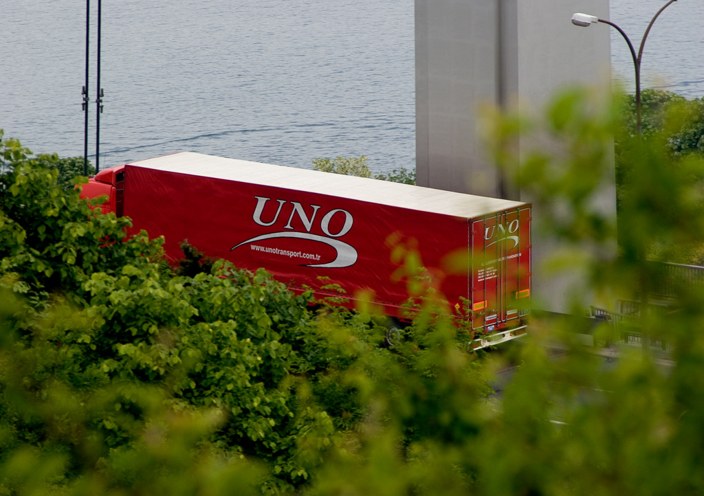
Company Profile
Our main shipment routes are:
Russian Federation
Ukraine
Kazakhstan
Belarus
Poland
France
Slovakia
Slovenia
Great Britain
Latvia
Estonia
Romania

Slide 5
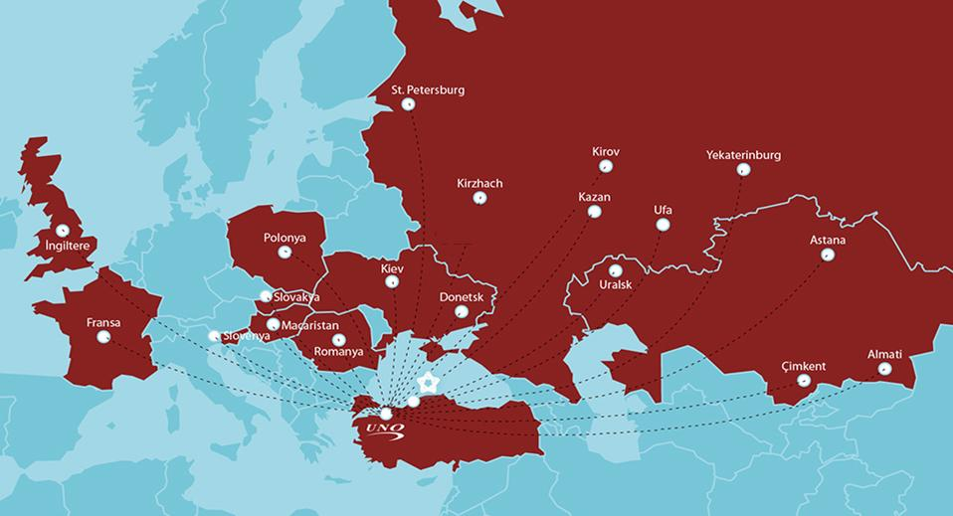
Company Profile

Slide 6
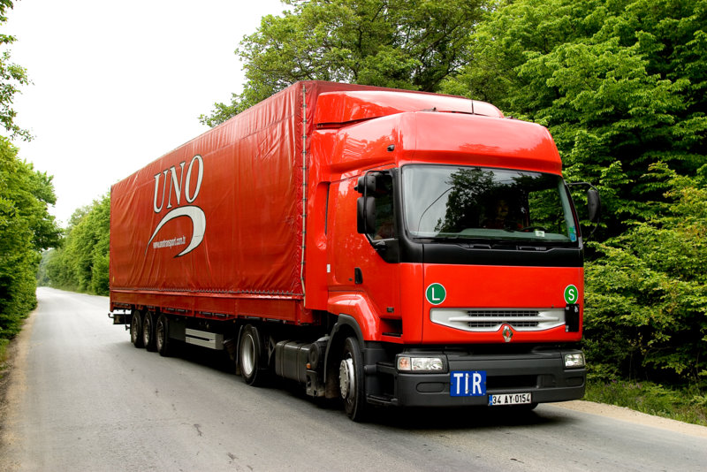
Company Profile
Our fleet consists of 100 vehicles (mega maxima, tent). All vehicles are equipped with a GPRS system that allows our clients to track their positions on-line.
Also as UNO Transport works on a contract basis with proven carriers, professionals of our company will pick up and form a model of shipment according to customers’ needs.

Slide 7
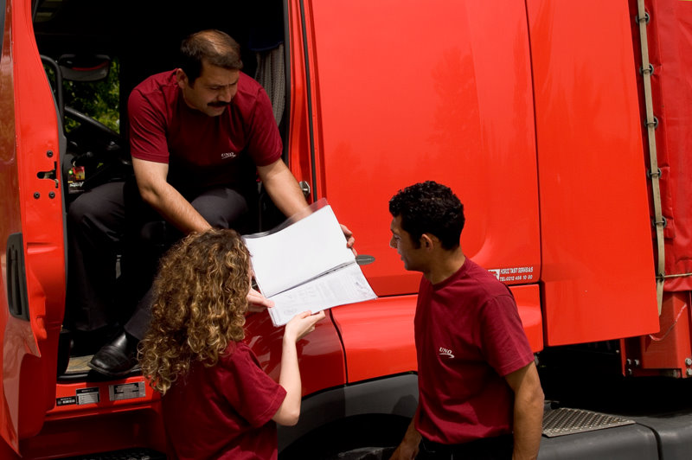
Company Profile
An ideal way for customers who needs to deliver their consignments fast and reliably is a groupage (LTL Transportation) which allows to deliver smaller parcels inside of a bigger shipment. For “UNO Transport” as modern customer oriented company groupage (LTL Transportation) services became one of the main stream in everyday work.
Convenience. Possible to combine different goods.
Cost effectiveness. Our groupage shipment allows to minimize delivery costs. Tariffs costed are based on your own individual requirements.
Rapidity. Don’t wait, you can schedule delivery for a specific date and time.

Slide 8
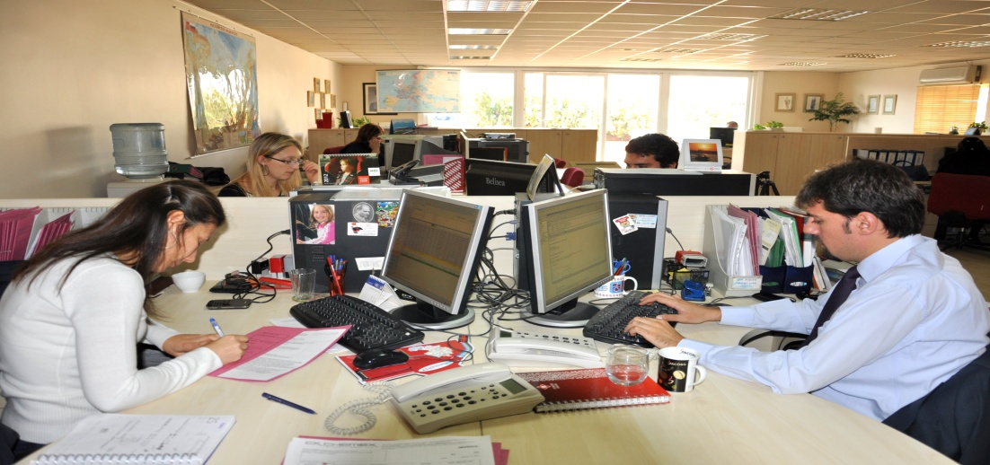
Company Profile
Our main goal is constantly improving the quality of service, to keep pace with modern technologies and requirements of the logistic market and customers. Our target is to achieve a high level of customer satisfaction by providing professional, high-quality and reliable services.
Thanks to the excellent coherency of our team and the use of time-management principles, we deliver the goods to their destinations on time, to minimize the costs associated with time.

Slide 9
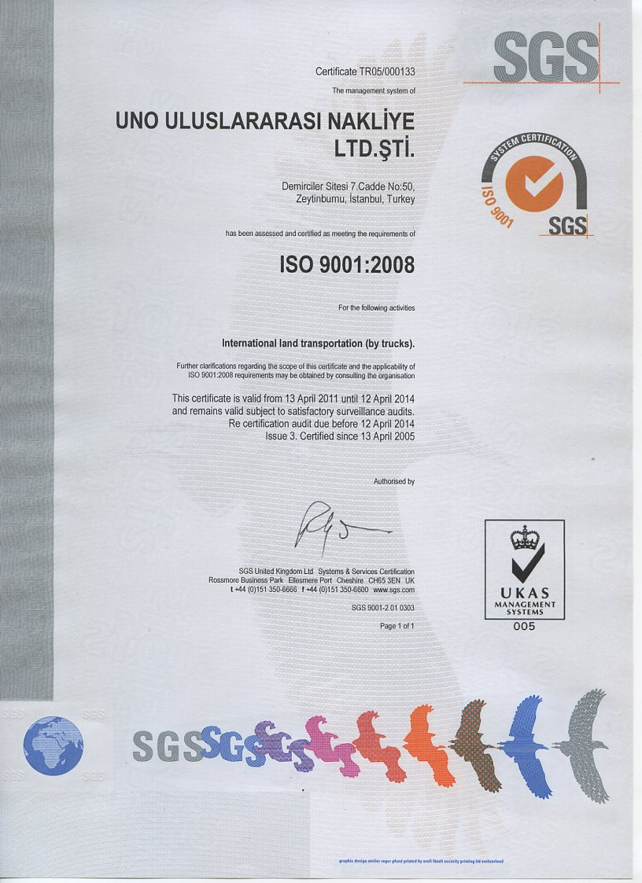
Company Profile
Strict implementation of Quality Management System standarts excludes any loss of time and money as a result of mistakes of the staff.

Slide 10
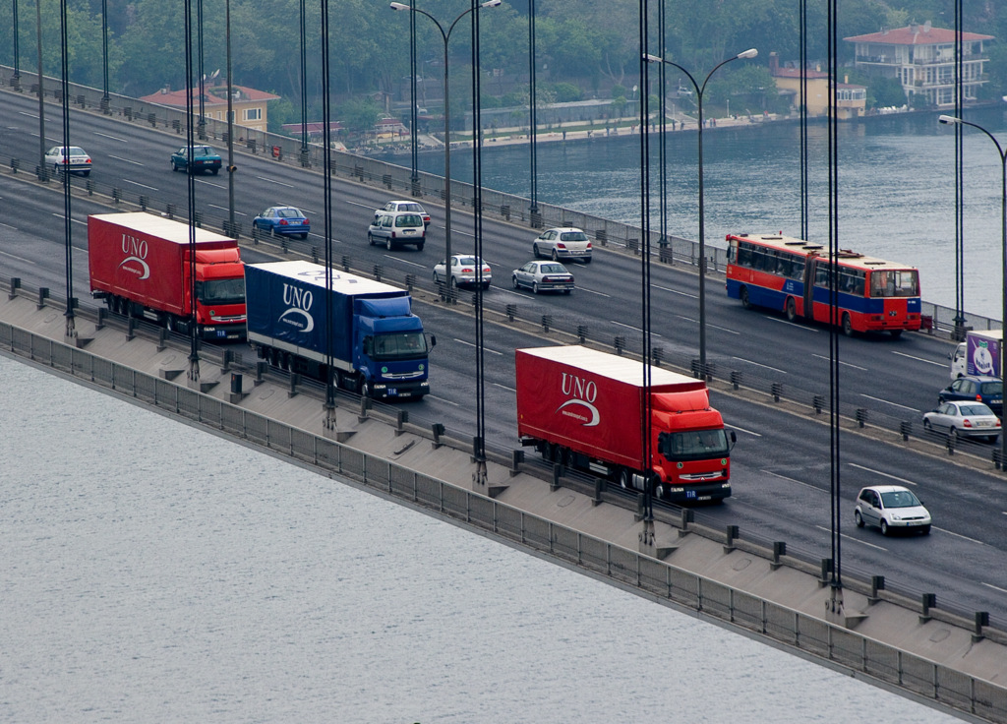
Company Profile
Why UNO Transport
Quality, reliability, transparency of processes
Professionalism
A wide network of international partners
Own car park
The use of modern technologies and technical solutions
Quality Management System ISO 9001
Selection of the best shipment models according to customers' requirements
Flexible pricing policy

Slide 11






Профиль Компании
Roberta Cantoni / Italy - Roberta.Cantoni@pirelli.com
Ayşegül Şenalp / Turkey - Aysegul.Senalp@pirelli.com
Gökçegül Yıldız / Turkey - gokcegul.yildiz@pirelli.com
Thomas Füller / Germany - fcm-team@goodyear.com
Seçkin Ozan / Turkey - seckin_ozan@goodyear.com
Mücahit Akgül / Turkey- mucahit.akgul@bshg.com
Asuman Arat / Turkey - asumana@koczer.com
Erol Ersoy / Turkey – eersoy@teklas.com.tr
Altan Özyiğit / Turkey – aozyiğit@sisecam.com
Aydın Ar / Turkey – aar@sisecam.com
UNO Transport Co. Demirciler Sitesi 7/50 Zeytinburnu İstanbul Türkiye +902126649702/444 0 866 (UNO) www.unotransport.com.tr

Slide 12






Профиль Компании
Irina Gaydukova / Russia – tdreferent@kurskvolokno.ru
Mikhaylin Boris Borisovich / Russia – MikhailinBoB@sibur.ru
Bahadır Emir / Turkey – bemir@coskunoz.com.tr
Hande Doğdurucu Sevindik / Turkey - hande.dogdurucu@lcwaikiki.com.tr
Ebru Kaptan / Turkey – ebru.kaptan@lcwaikiki.com.tr
Erdoğan Bayraktar / Turkey – e.bayraktar@enpay.com
Esra Sakaoğlu / Turkey – esra.sakaooglu@dalgakiran.com
UNO Transport Co. Demirciler Sitesi 7/50 Zeytinburnu İstanbul Türkiye +902126649702/444 0 866 (UNO) www.unotransport.com.tr

Slide 13
For any questions don’t hesitate to contact:
Mehmet Cem Dönmez
UNO Uluslararasi Nakliye Ltd. Sti.
Demirciler Sitesi 7.Cadde no:50.
Zeytinburnu/ İstanbul
Tel: +.90.212.664.97.02(Pbx)
Fax: +.90.212.582.44.98
Cell: +905305216505
cem@unotransport.com.tr
www.unotransport.com.tr

Slide 14
We carry your trust and safety!

