Slide 1

NUH YAPI ÜRÜNLERİ A.Ş.

Slide 2

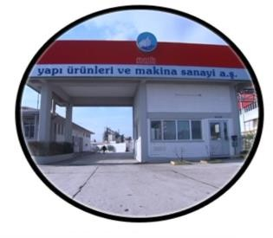
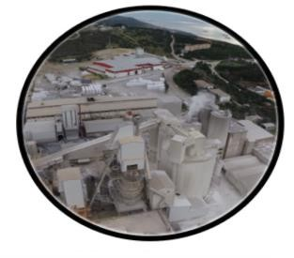

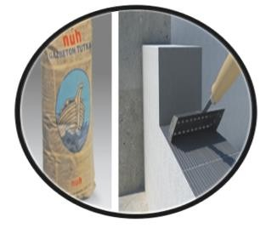
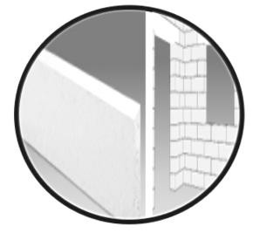
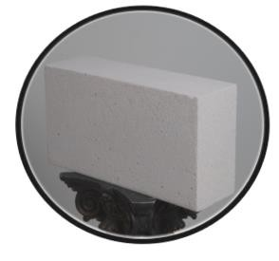
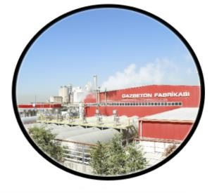
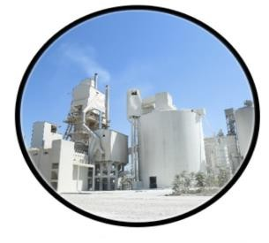
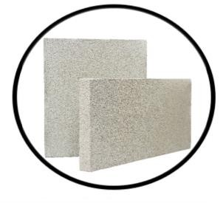
Company Description
1984
1995
1996
1998
1999
Lime plant has commenced its operation with a capacity of 160.000 t/year
Nuh Yapı Ürünleri ve Mak.
San. A.Ş. was established
AAC Plant has commenced to production with 110.000 m3/year capacity
Lime Plant, Machine Plant and AAC Plant were gathered under the Nuh Yapı roof
AAC Thin-bed Mortar production has commenced
2000
2005
2008
2011
2013
AAC Jamb and Lintel production has commenced
The first lightweight AAC (ecoblock) production has made as 350 kg/m³ in Turkey
Increased the capacity of AAC Plant with a new AAC Plant as
408.420 m³/year capacity
By increasing the capacity of Lime Plant has continued the production with a new Lime Plant as 208.000 t/year capacity
Thermal Insulation Plate (Termoküp) production has commenced

Slide 3

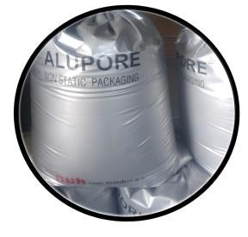
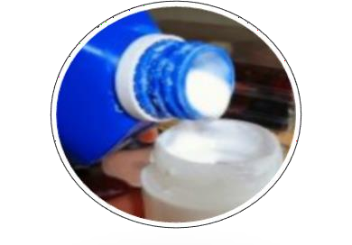
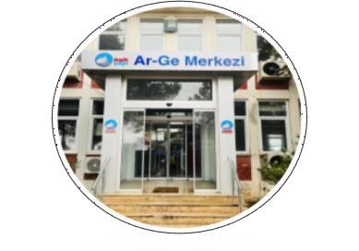
Company Description
2014
2016
2018
2023
2023
Title change was made as Nuh Yapı Ürünleri A.Ş.
Aluminum paste production was commenced as the first and only in Turkey to produce AAC
Magnesium milk hydroxide was commenced as the first and only in Turkey
Research and Development Center was commenced

Slide 4
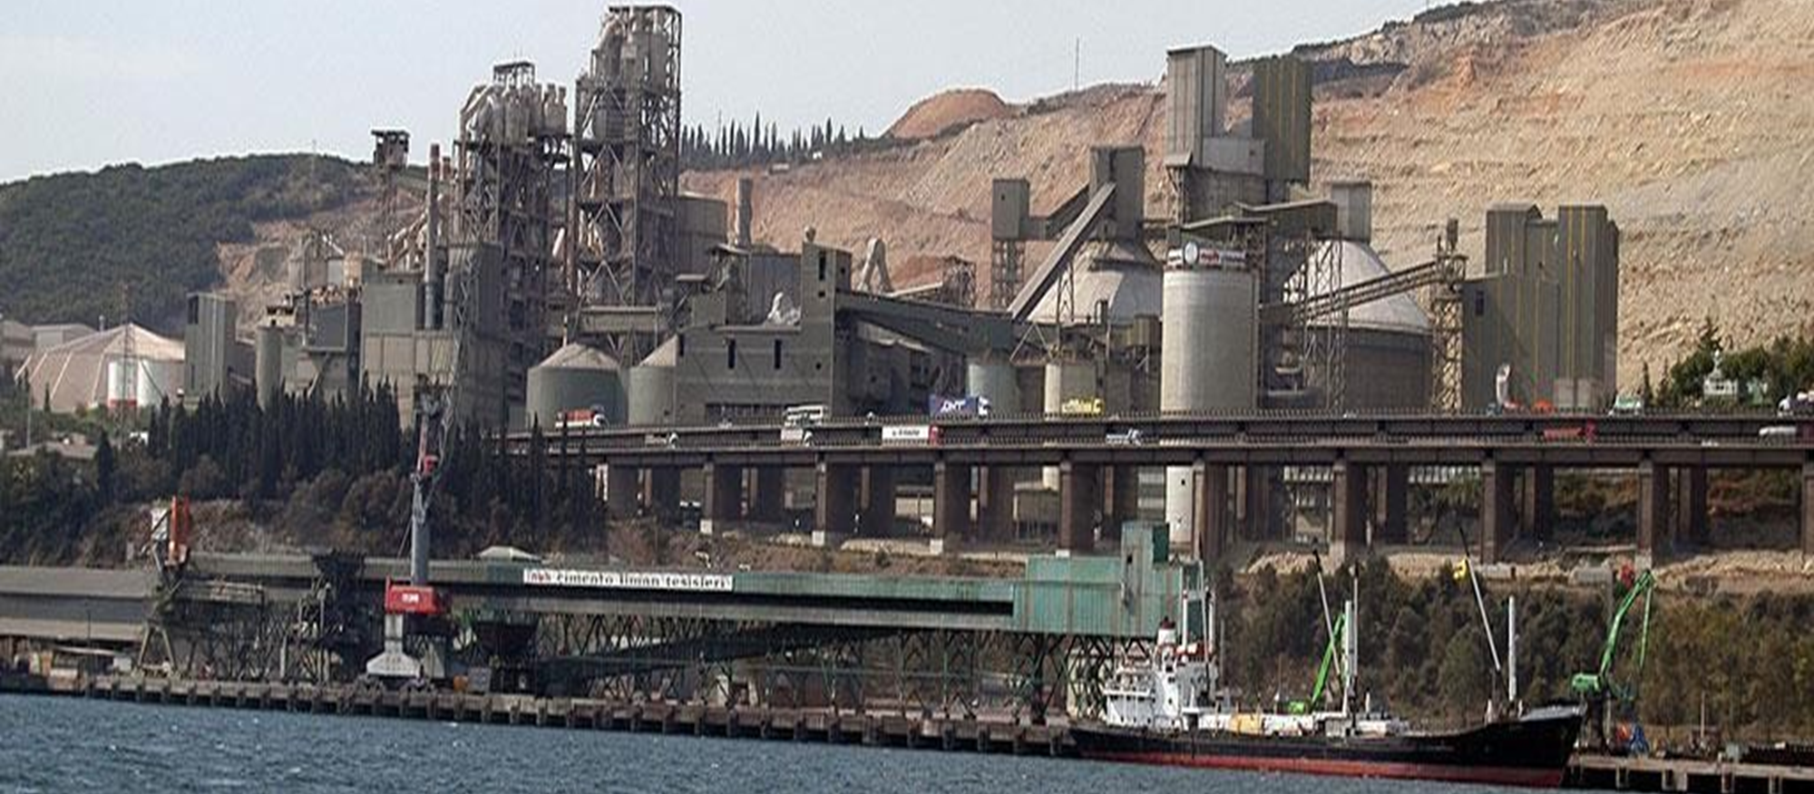
Company Expertise
(Expertise and Specializations)
BEING PART OF A FINANCIALLY STRONG GROUP
ADVANCED
R&D CAPABILITY
INTEGRATED PRODUCTION FACILITIES
CUSTOMER ORIENTED PRODUCTION
OWNING A PORT FACILITY

Slide 5
Project topics you plan to participate in
  Development of gypsum based, lime, and autoclaved aerated concrete products,
  New product studies specific to the construction sector,
  Green transformation and reduction of carbon emission studies,
  Artificial intelligence projects,
  Innovative R&D projects,
  Development of autoclaved aerated concrete, lime, and gypsum production process.

