Slide 1

SIMATECH INTEGRATED SOLUTIONS
Technological Smart Solutions

Slide 2
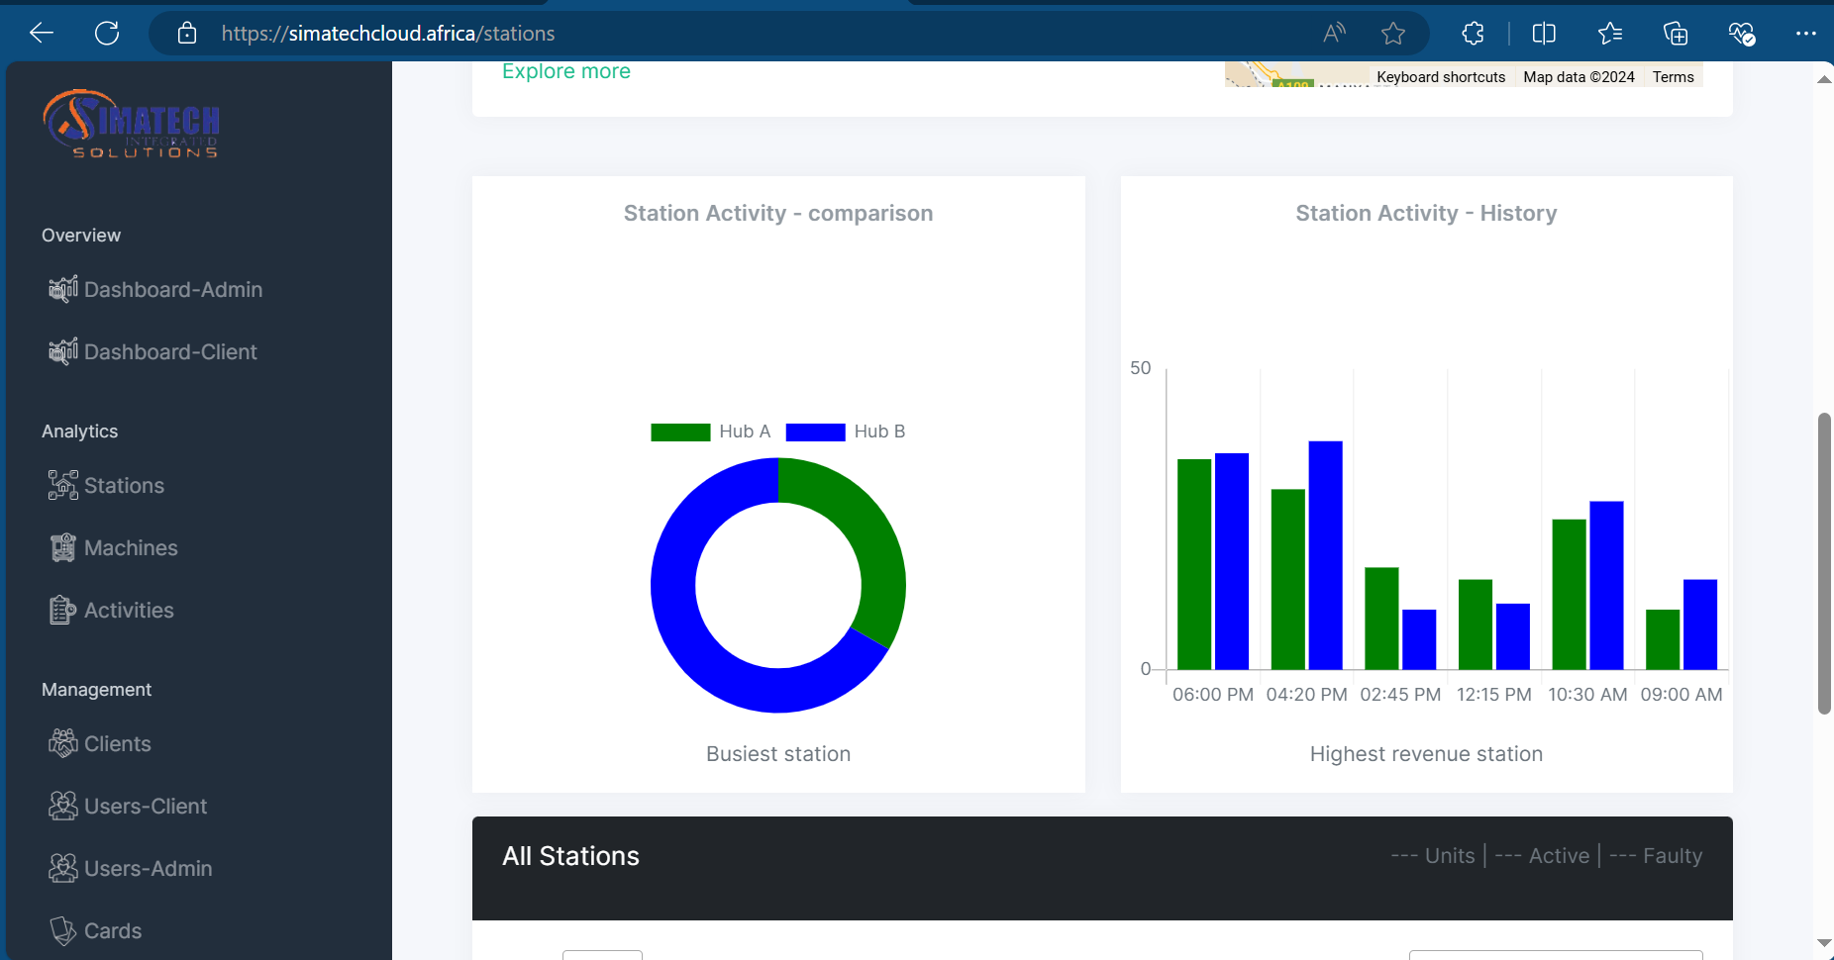
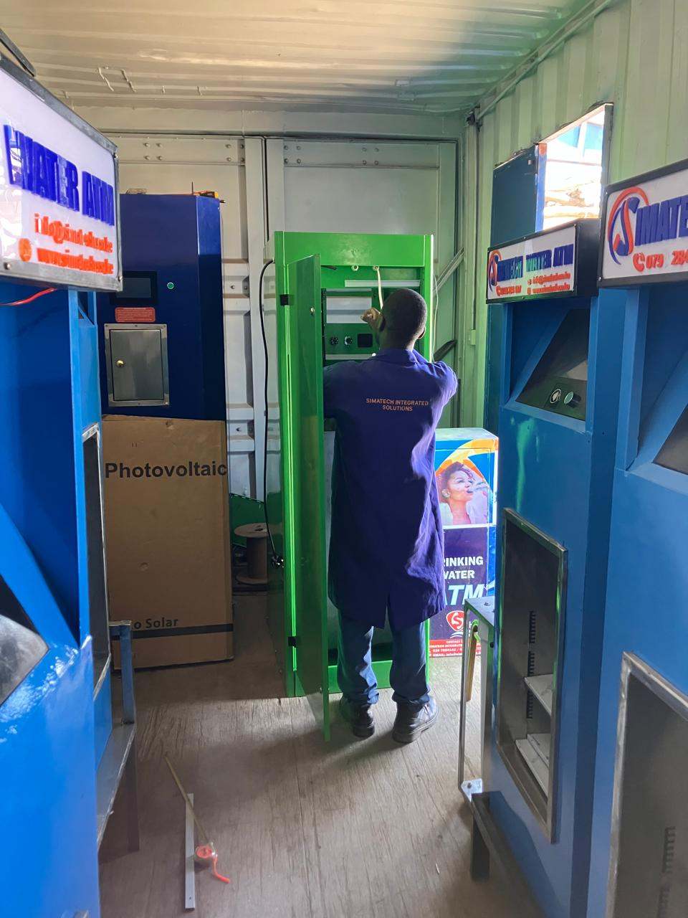
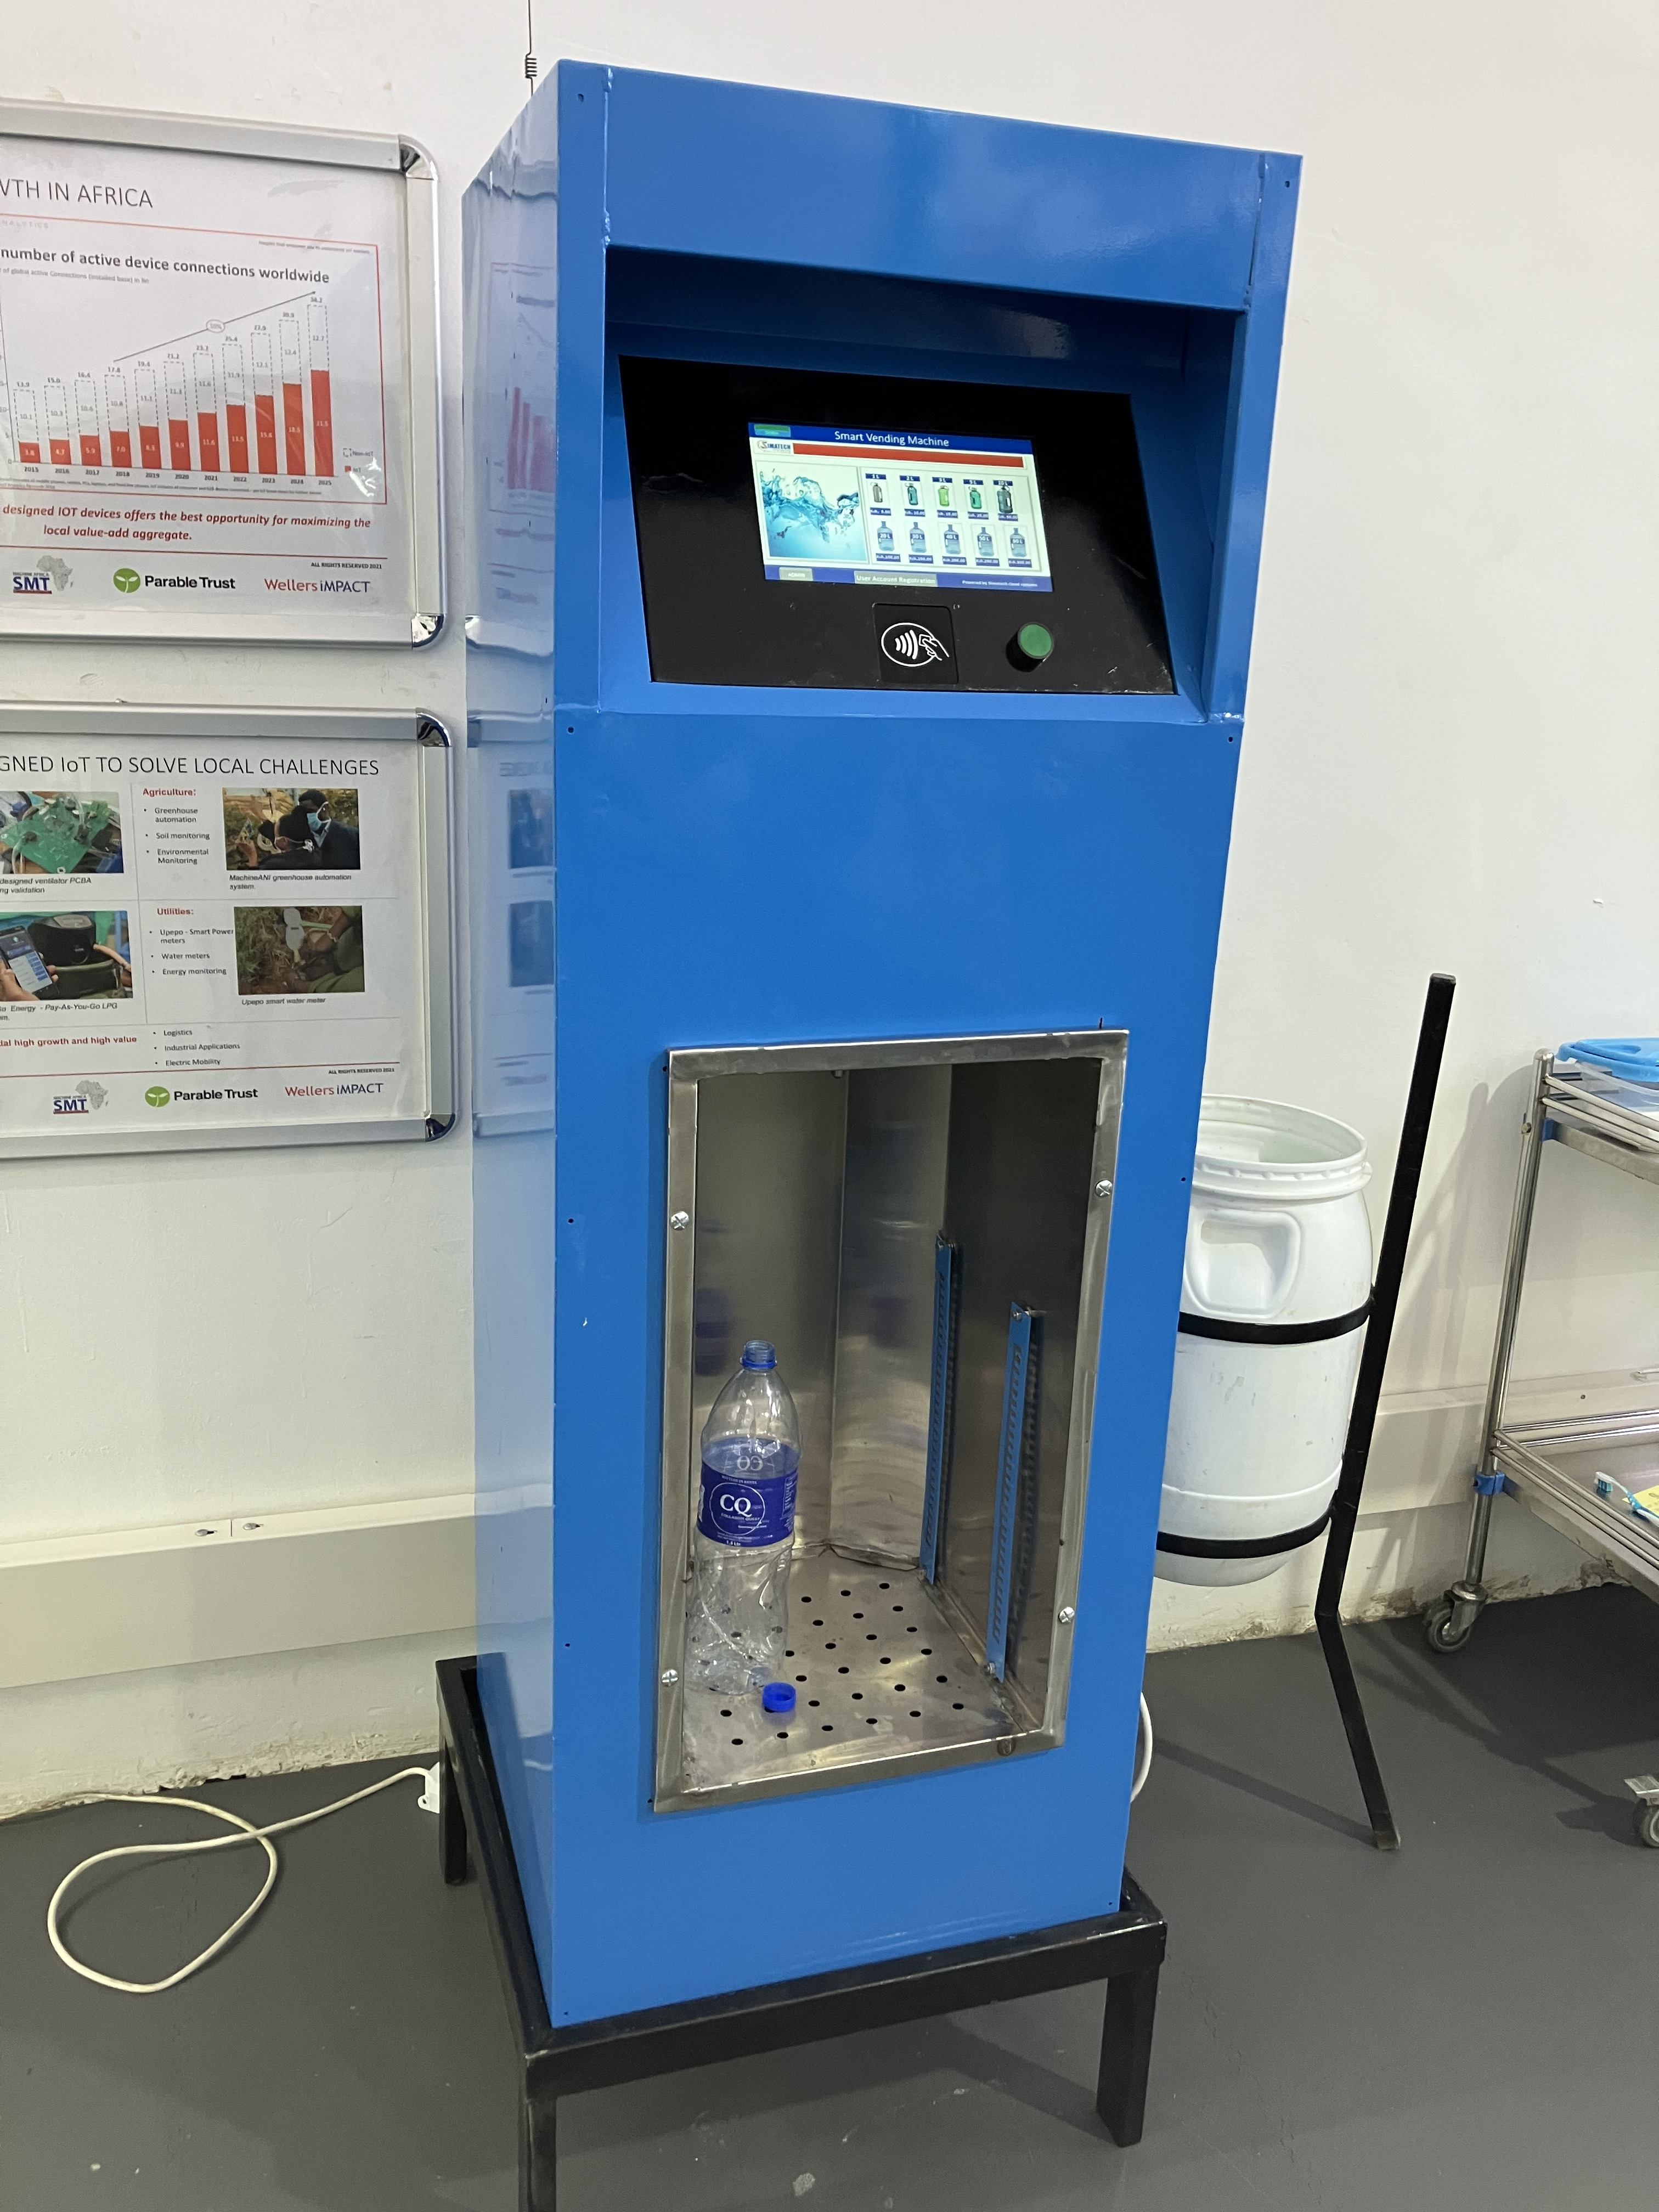
Company Overview
Simatech Integrated Solutions is a Kenyan tech company designing, building, and manufacturing smart automated vending machines with an IoT dashboard providing real time data for remote business management and enhanced customer experience.

Slide 3
Problem Statement
Solution
Operational Efficiency
IoT dashboard for real time data collection allowing remote business management and informed decisions.
Non-Revenue water
Automated alerts, machines are equipped with sensors that detect leaks or unusual water flows.
Payment Barriers
A pool of payment options. M-Pesa integration, NFC wallets and token systems.
Lack of Convenience
Accessibility is now available; with the self-service capability this allows 24/7 services.
Plastic Waste Management
Promoting circular economy allows reduction of plastic waste and leads to healthy climate practice.

Slide 4




Products & Service Key Features
Remote Management Dashboard.
Allows business to access, manage, and track their vending network & data through management dashboards.
Enhanced Payment Options
Integration with mobile payments, NFC wallets, and Tokens.
Environmental Sustainability Focus
Promoting refilling and recycling to reduce single-use plastics by promoting circular economy practices.
Smart Water ATMs
Improved efficiency by using cutting edge industry 4.0 technology such as AI, IoT, FinTech.

Slide 5
Market Opportunity
TAM 2.3 billion USD/year
These valuations provide a comprehensive overview of the potential and realistically achievable segments of the pure drinking water market in Kenya for the year 2023.​
Total Addressable Market, 45.3 billion liters/year.
Serviceable Addressable Market 22.65billion liters/year.
Serviceable Obtainable Market 4.53billion liters/year.
Data Sources; KNBS, WHO, WASREB
SAM 1.2 billion USD/year
SOM 226.5 million USD/year

Slide 6

Business Model
Direct Sales – One time or multiple installments of hardware with integrated software for businesses and organizations.
Upgrade & Retrofitting – Fostering digital transformation by Enhancing existing machines in the market to integrate new technology.
Monthly Subscription – sh2500 per unit, from businesses using our technology to manage their water vending & distribution network.
After Sale Services – Comprehensive and Maintenance Support.
Partnerships – Partnerships on revenue share models.

Slide 7




Go-To-Market Strategy
Marketing through Multi-channels(Digital Marketing, CRM)
Adapt a Pay-Go Model to incentivize our potential customers
Target Market profiling
Partnerships with key Industry Players

Slide 8
Competitive Landscape
Component | Competitor 1 | Competitor 2 | Competitor 3 | Competitive Advantage
1Water purification & dispensing with cloud management. | Grundfos | Maji Milele |  | Enhanced Payment Options, & remote management.
2 Sale of vending machines with basic features. | Olmec | Saset | Tasmart | Advanced cutting edge technology.
3 Offers convenience and not climate conscious. | Bottling companies |  |  | Propagate Circular economy practices (refilling, recycling, reuse)
4 Inconsistent life cycle support from imported vending machines. | China-made | India-made |  | Offer Complete life cycle and reliable after sale support.
5 Compatibility for local market conditions. | China- made & overseas |  |  | Operational efficiency & tailored vending machines for local market.

Slide 9
Ask Amount
Use of funds description | Amount
Manufacturing: Local Production Set-up | $110,000
2. Job Creation: Employment for Local Youth. | $35,000
3. Marketing: Brand Awareness and Partnerships. | $25,000
4. R&D Technology and Product enhancement. | $30,000
TOTAL | CV
Capital Injection
$200,000
$
$200,000

Slide 10
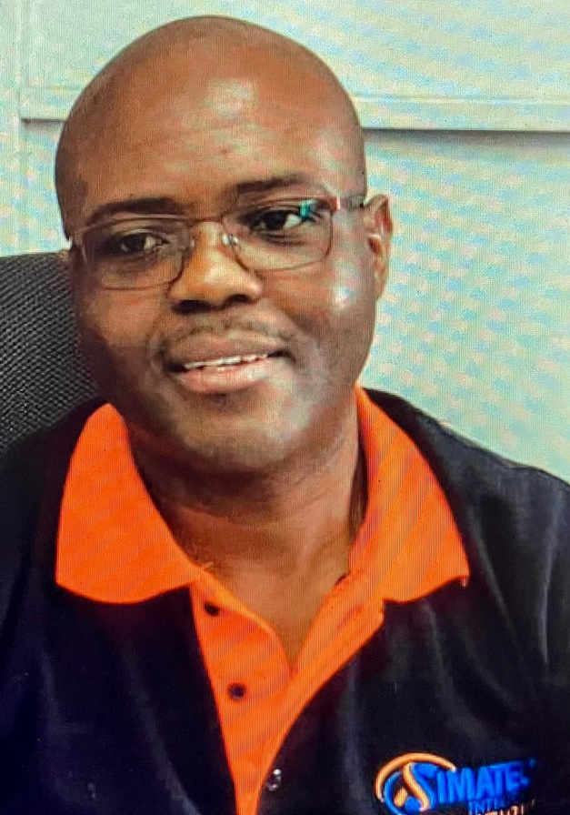
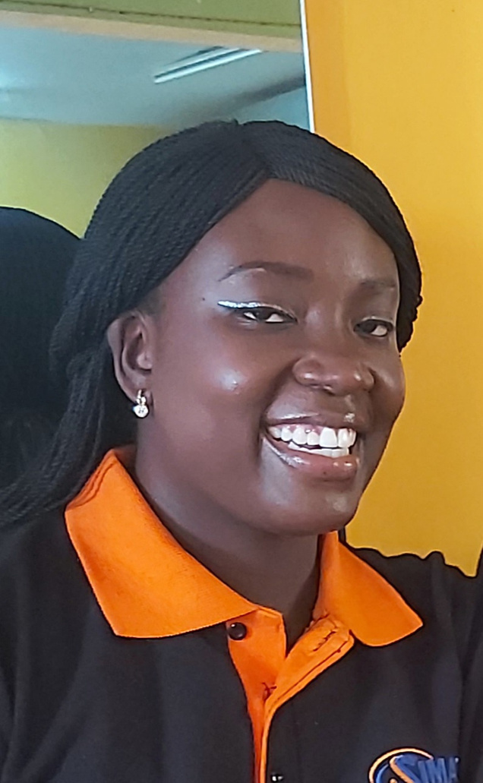
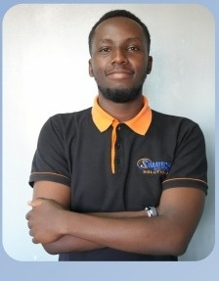
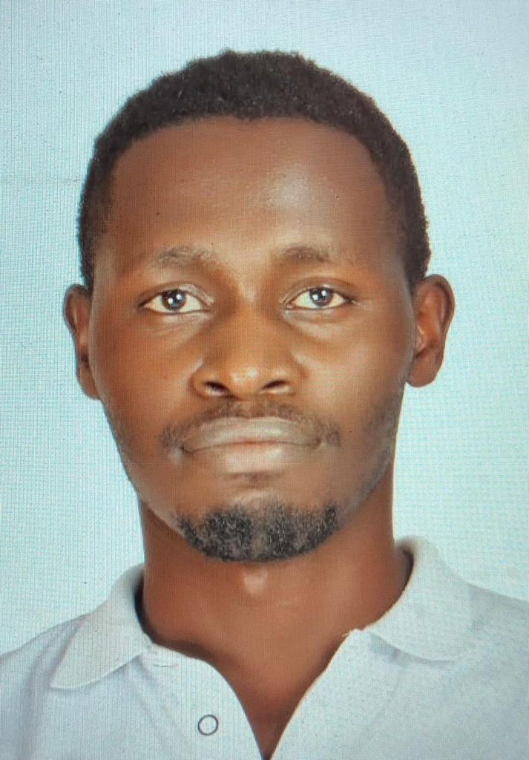
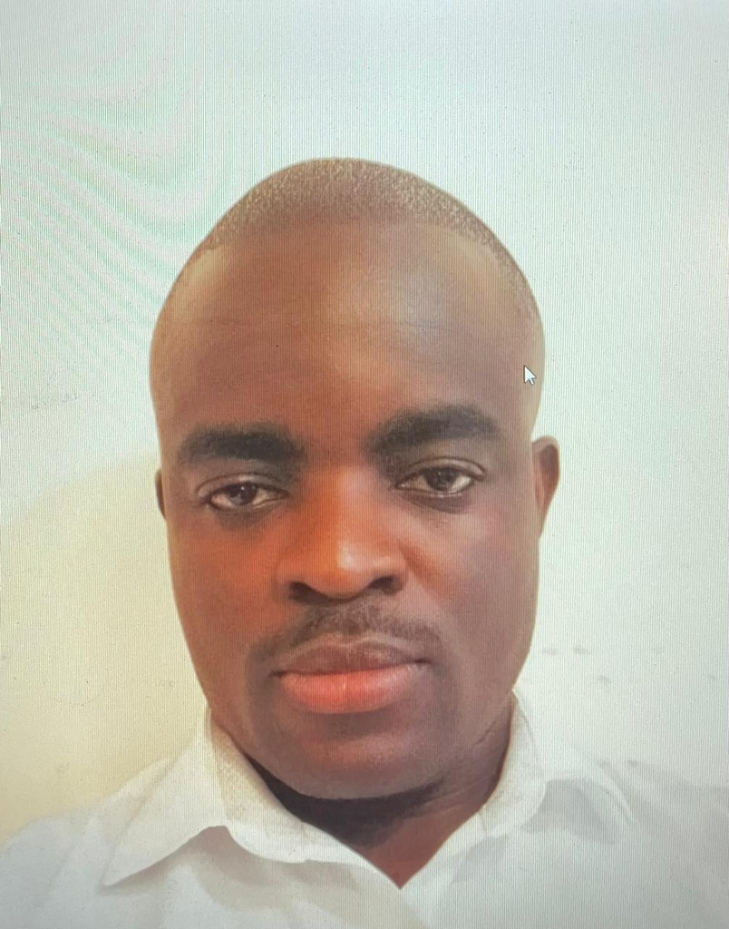
Our Team
Paul Kinambuga
CEO, Project Lead
Nataline Olang
Director, Business Operations
Isaac Mwangaza
Sales & Marketing
Emmanuel Mariara
NPD, IoT Solutions Architect
Aineah Omuyonga
NPD, Embedded Systems Engineer

Slide 11
THANK YOU
Simatech Integrated Solutions
+254 798 2841987
@simatechintegratedsolutions on all social media platforms

