Slide 1
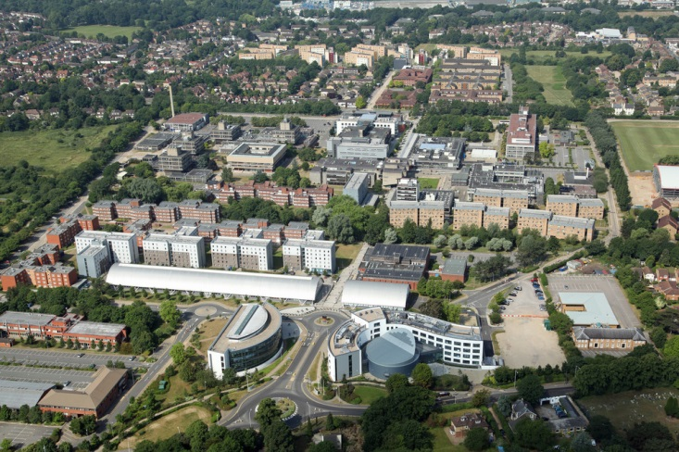
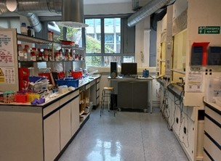
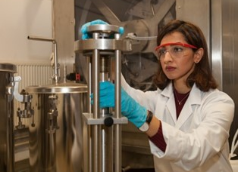
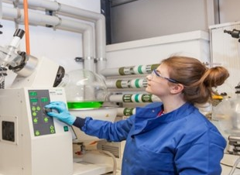
Brunel University of London
Project idea/ Field of expertise – Cost effective long-duration stationary storage
Organisation name – Brunel University of London
Addressed topic - HORIZON-CL5-2025-01-Two-stage-D2-02- Expected project outcomes:
Developing long storage duration using multivalent chemistries (targeting Al and Zn based batteries)
Reduced cost, safety and sustainable battery chemistry
Minimum/ no critical raw materials usage depending on the battery chemistry
Skills and expertise
New battery chemistry
In situ spectroscopy techniques
Electrode and electrolyte synthesis
Process modelling and technoeconomic analysis
3D printing
BUL Project and collaboration opportunities of New battery chemistry
Developed Zn and Al batteries with ionic liquids and biodegradable electrolytes (TRL 3)
Synthesized biodegradable electrolytes
Collaborating with SMEs to scale-up the facilities
What we can offer
Synthesis of new electrolytes
Synthesis of nanomaterials
Battery testing and in situ spectroscopic analysis techniques
Process design and intensification for technoeconomic assessment at scale
Development of experimentally-informed detailed process designs
Publications
Brahma et al, J. Power Sources, 2025, 641, 236843
Lahiri et al, ACS Appl Energy Mater., 2023, 6, 11874
Contact details
Dr Abhishek Lahiri, abhishek.lahiri@brunel.ac.uk
Dr Svetlana Ignatova, svetlana.ignatova@brunel.ac.uk
Dr Peter Hewitson, peter.hewitson@brunel.ac.uk
Dr Salman Masoudi Soltanisalman.masoudisoltani@brunel.ac.uk

