Slide 1


Fully digitalize IVF laboratories to securely and efficiently speed up procedures

Slide 2
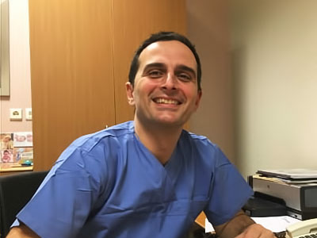

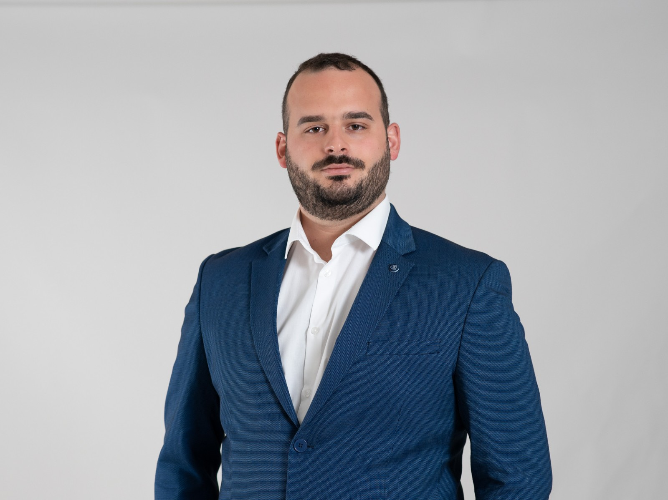

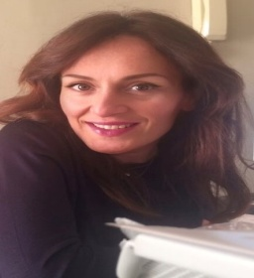

Our team
Triantafillos Triantafillou, MSc
George Tsomidis, PhD
Konstantinos Mavrogiannis, MSc
Michalis Perakis, MSc
Co-Founder
Sen. Clinical Embryologist
Director of IASO Institute of Life
Co-Founder
Managing Partner
Sen. Full Stack Engineer
Sen. Backend Engineer
Maria Paterianaki, MSc Athina Koutsi, MSc
Sen. IVF Consultant – Coordinator Sen. Clinical Embryologist

Slide 3
Problems
High risk of mistake
  €2Κ per error
  Legal prosecution
Cyber-security breach
  €4M (IBM, 2022)
  Downgrade Reputation
  Business interruption
Wasted per annum €40Κ / IVF unit on:
  Paperwork
  Communications

Slide 4
How do we help IVF labs & Gynecologists ?
Mobile App
Data management system
On-the-job developed SaaS by embryologists for embryologists (>70 market experts)

Slide 5
Value creation
Secure patients’ data
Save 2 - 3 working hours daily
Reduce risk of mistake
Enhance patients’ experience
Reduce payroll costs
Provide a user-friendly software

Slide 6
Competition
TMS (GR)
MedITEX (DEU)
Babysentry (US)
FertilityEHR (US)
ART compass (US)
Fertility Pro (US)
Pocket.ivf (app)
Artemis IVF (AUS)
IVF-Lab Solutions (UK)
IVF Hospital software (UK)
EmbryoTools (ESP)
NextGen Healthcare (US)
eIVF (US)
CompuGroup Medical (TUR)
FertiSmart (TUR)
BinFlux (TWN)

Slide 7



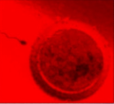


Operating in Greece and Cyprus
Genesis Fertility Center

Slide 8
Global market
Global market of $28B (2025)
Annual growth of 7%
>15K IVF labs worldwide (identical procedures, growing at 2% per annum)
30% of couples facing infertility, trending upwards (50% in 2050, W.H.O.)
Approximately 2K instances per 1M of population
Increasing number of small-size IVF labs, globally

Slide 9
Go to market
Enter the US, sub-Saharian Africa & LATAM market
Direct Sales
  Contact IVF labs of all sizes (official lists)
  Contact Gynecologists (official lists)

Slide 10





Why us?
A cheaper, On-the-job developed SaaS
15 years of fully operational experience
UX : Easy-to-use / efficient
A.I. / Medical BigData (goldmine!)
We believe in our product/service

Slide 11
Business Model aiming at 2% (in 5y time) of the global market -> projecting 8M revenue
Annual subscription:
  Basic plan [€4K / €9K / €16K]
  Premium plan (extra features and services)

Slide 12




Asking for
1M
wages
infrastructure
networking and marketing

Slide 13







Thank you for your attention

Slide 14
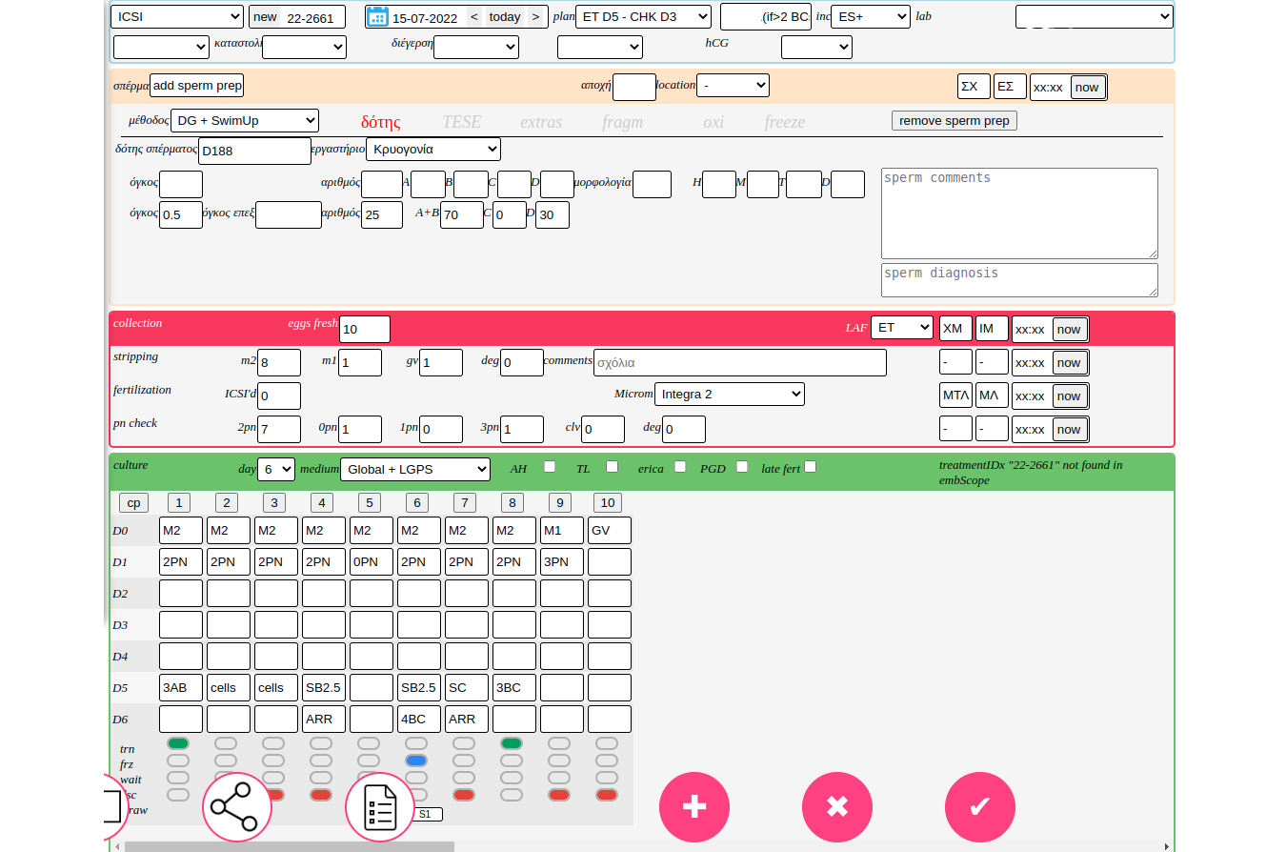
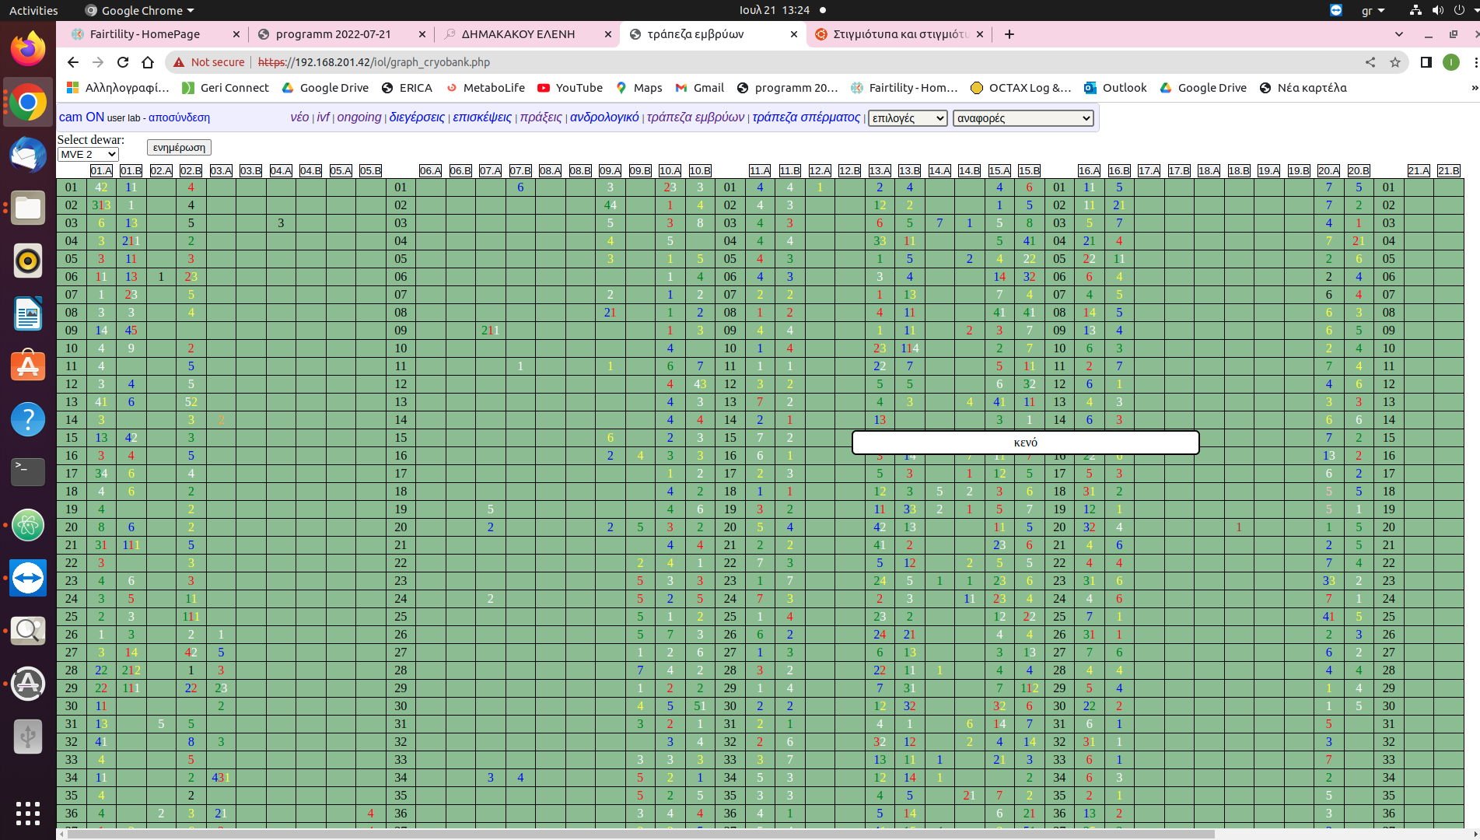
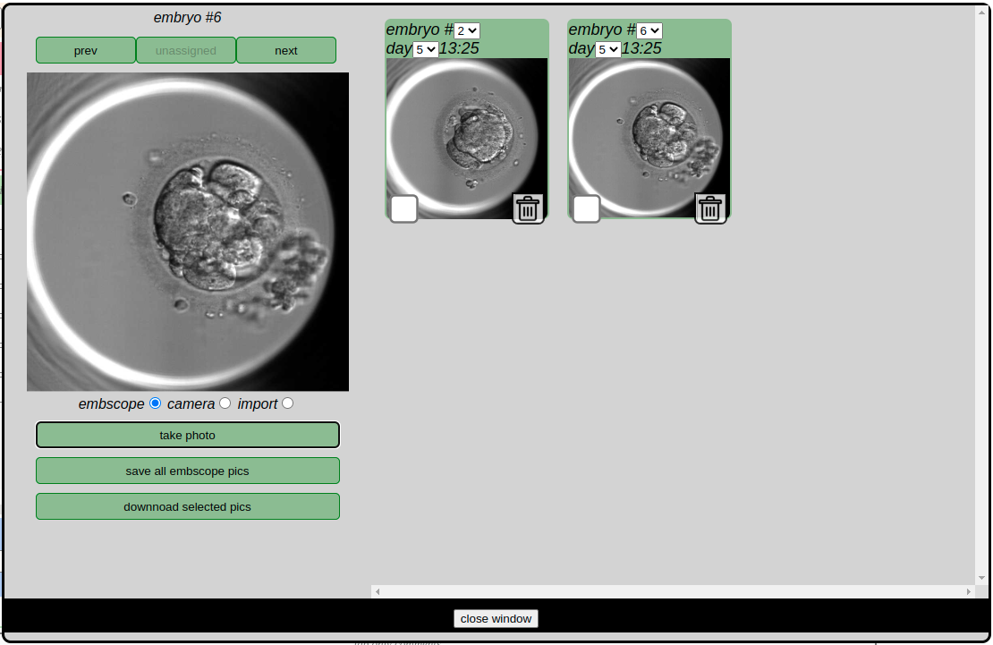
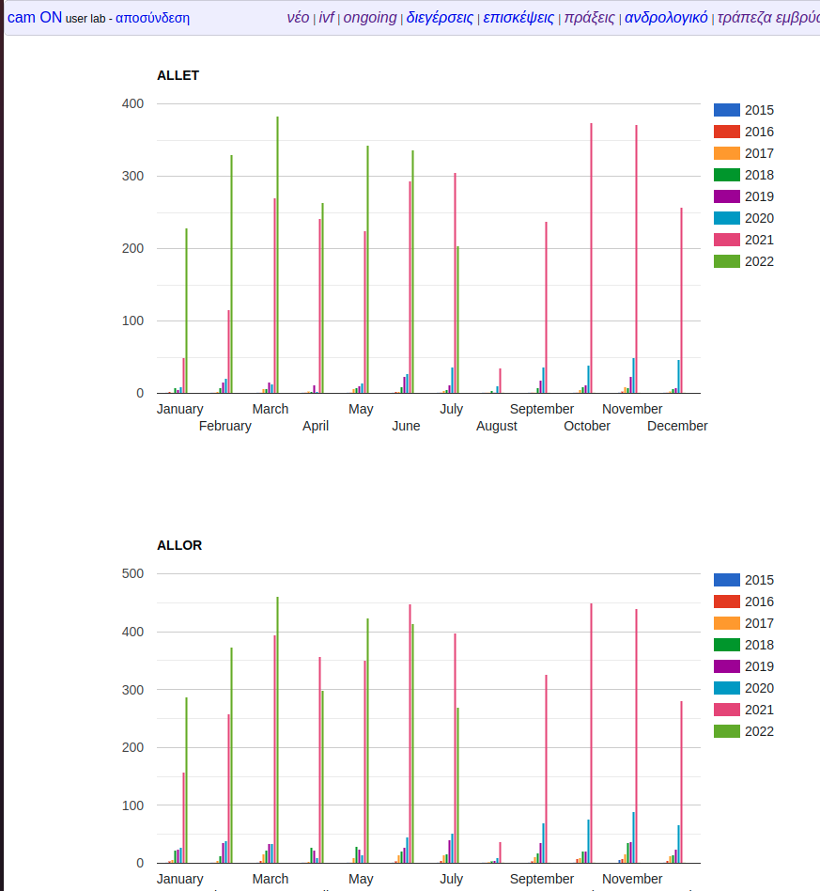
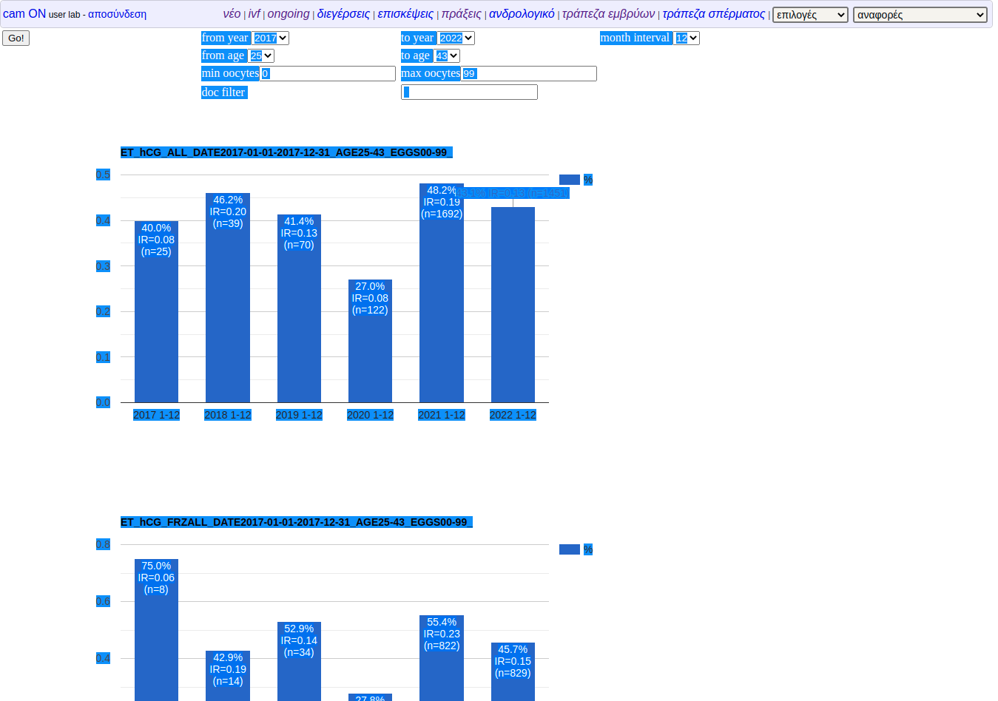
Up and running
Patient’s Form Cryopreservation Embryos Photo Management

