Slide 1




ARDGRUP INFORMATICS TECNOLOGIES INC.
www.ardinformatics.com

Slide 2






COMPANY INFORMATION
Founded in 2011, ARD Informatics is a leading technology company headquartered in Ankara, Turkey. The company operates globally with offices in the United States, United Kingdom, United Arab Emirates, Bahrain, and Uzbekistan. ARD Informatics has been publicly traded on Borsa Istanbul (ARDYZ) since February 2020 and quickly gained entry into the prestigious BIST 100 list due to high investor confidence.
ARD Informatics is committed to supporting digital transformation processes by converting global technology trends into software solutions that meet the specific needs of organizations and companies.

Slide 3


COMPANY HISTORY
2011
ARD Informatics founded
OUR OFFICES
2015
ARD Defence
ARD Health
2016
ARD Energy
ARD Construction
ARD Consultancy
England
United States of America
Türkiye
Uzbekistan
2018
Bahrain
ARD Informatics
Londra, Dubai
United Arab Emirates
2019
ARD Informatics
San Francisco, Bahreyn
2022
ARD Informatics R&D Center

Slide 4

R&D Projects
ARD GROUP INFORMATICS is a key actor for technological innovation through its R&D initiatives. ARD proudly collaborates with distinguished global technology partners and actively participates in reputable international consortia, including ITEA and EUREKA AI. Its projects are dedicated to leveraging cutting-edge technologies to address and solve real-world challenges. In the ITEA Cluster, ARD is highly committed to driving progress in key areas such as Smart Health, Smart Cities and Smart Industry. Through these pioneering R&D initiatives, ARD is not only enhancing its technological capabilities, but also consolidating its leading position in the dynamic arena of digital transformation.

Slide 5
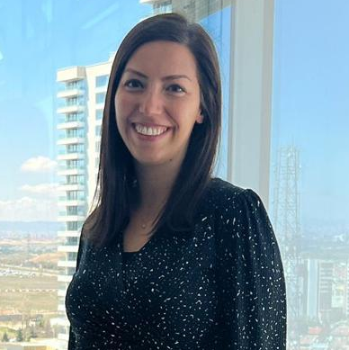
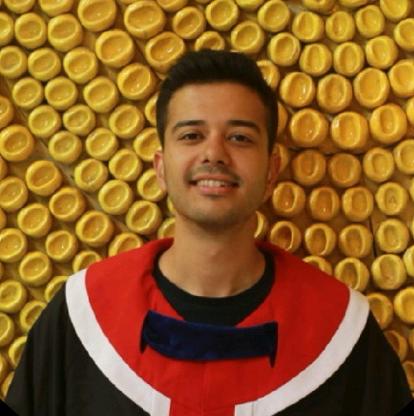
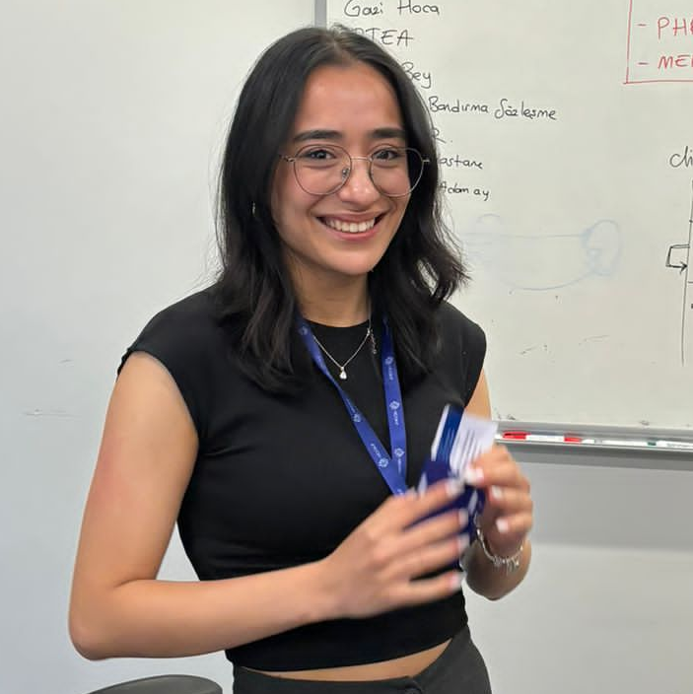
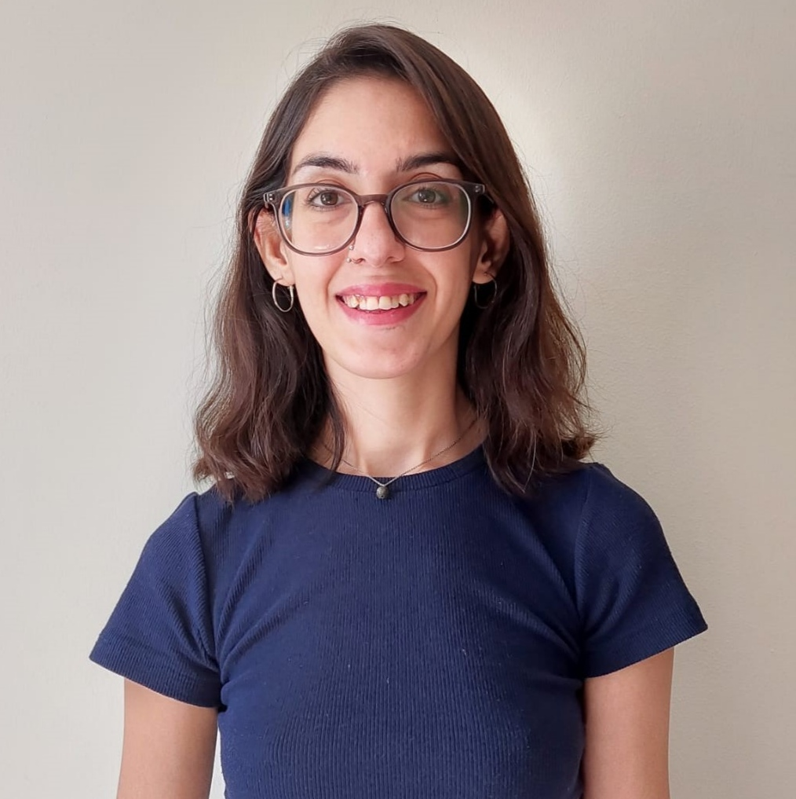
OUR
TEAM
Gülçin Ozanırk
Sr. Project Specialist
Ege Seçgin
Project Specialist
İrem Turanlı
Jr. Software Engineer
Sultan Kırkan
Jr. Project Specialist

Slide 6

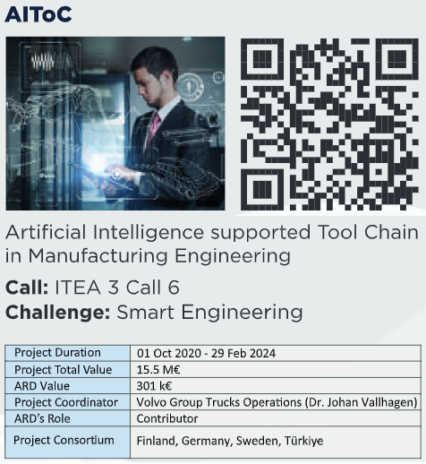

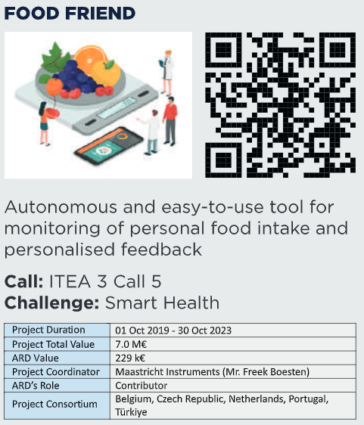

COMPLETED
PROJECTS

Slide 7
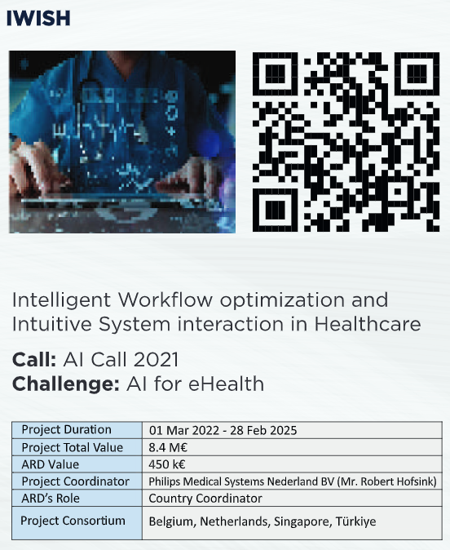
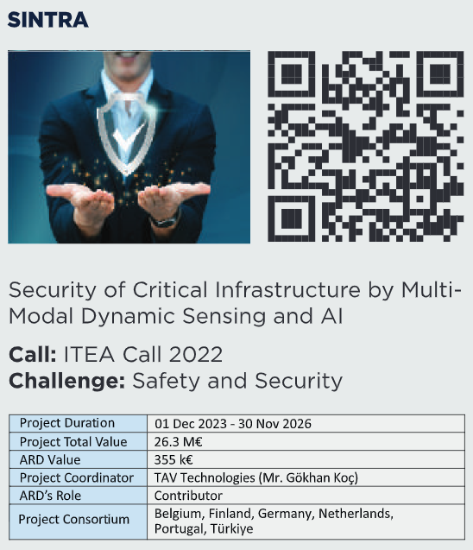
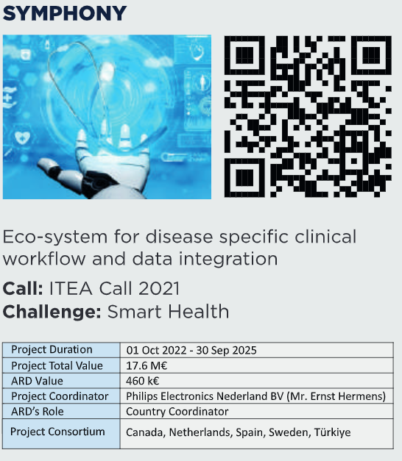
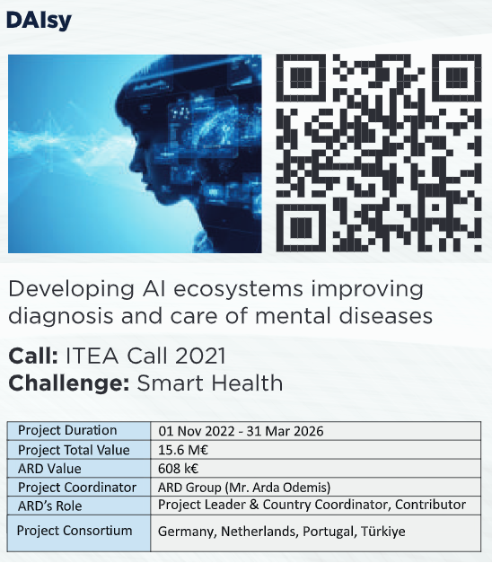
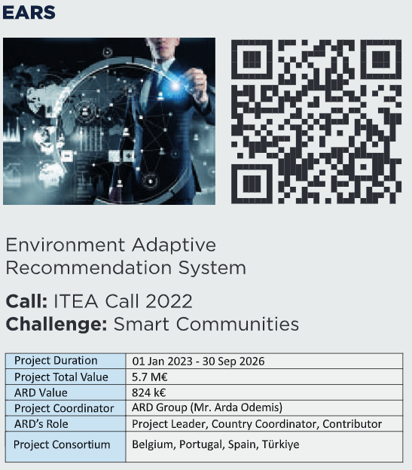
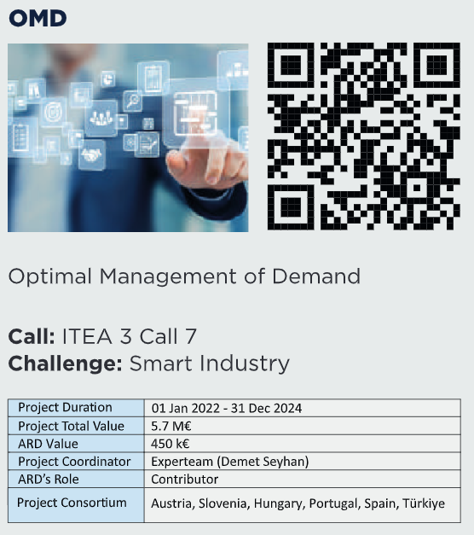
ONGOING
PROJECTS

Slide 8
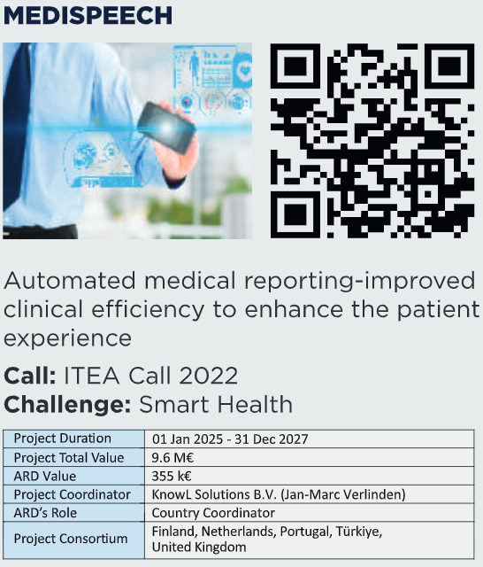

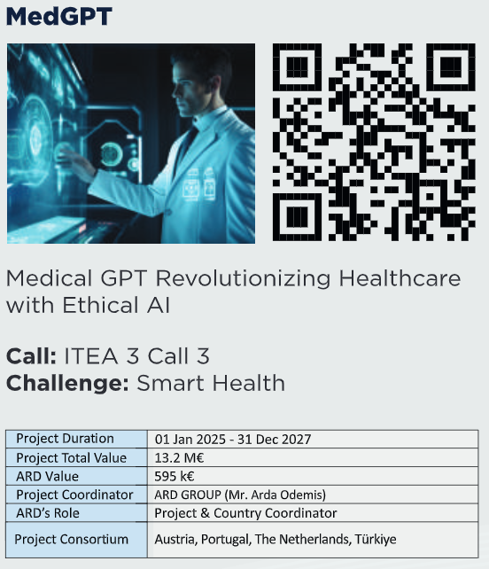
PENDING
PROJECTS
1

Slide 9

Thank you!
HEADQUARTERS
Koç Towers, Söğütözü Mah. Söğütözü Cad. No:2,
A Block, Floor 20-21, Office Number: 60
Çankaya/Ankara
Phone: +(90) 312 299 25 95
Fax: +(90) 312 299 25 96
info@ardbilisim.com.tr

