Slide 1
InvestEU Sustainability Guarantee

Slide 2

EIF’s investment approach
Crowding in private investment to maximise the reach & impact of public resources whilst ensuring sustainability and climate focus
Risk sharing instruments
Products & target areas
Intermediaries
Reach & impact
The EIF’s proven risk sharing instruments to mobilise private resources
A range of products & target areas to address different policy areas
Rigorous due diligence and impact assessment in the area of ESG
A 13x leverage of public resources to improve access to finance for SMEs, small mid-caps & mid-caps, infrastructure projects & individuals
(Counter)
Guarantees
Innovation &
Digitalisation
Sustainability
€150bn
for smaller companies, projects and individuals
Banks
Competitiveness & Growth
Culture & Creative Sectors
Non-banks
€11.8bn
InvestEU Fund deployed by the EIF
Skills & Education
Social Impact & Inclusive Finance
Equity
investments
Enabling sectors
Climate & environmental solutions
VC Funds
PE Funds
Digital & CCS
Capital
markets union
Debt Funds
Climate & infrastructure
Climate & Infra Funds
Social impact
Social Impact Funds

Slide 3





Sustainability Guarantee InvestEU deployment status
As of end September 2025
140 guarantee agreements signed
133 financial intermediaries involved
c. €9bn is the total financing enabled amount, including both capped and uncapped guarantees
27countries covered, including multi-country transactions.
Notes:
Data taken from the 6th PRD
SMEW SIW
EUR 5,863m enabled financing (signed). EUR 2,780m enabled financing (signed)
Capped: EUR 2,589m Capped: EUR 754m
Uncapped: EUR 3,274m Uncapped: EUR 2,026m
Climate Change Mitigation: EUR 1,751m
Capped the signed amount (cap amount) is EUR 149m Capped including Romania via Multi-country applications is EUR 60m
Uncapped the signed amount (guarantee amount) is EUR 2,292m Uncapped including Slovakia and Romania via Multi-country applications is EUR 1,428m
Total signed: EUR 2,441m Total signed: EUR 1,489m

Slide 4



EIF’s first pan-EU guarantee product designed to contribute to green and sustainable enterprises and investments
InvestEU resources deployed by FIs
leveraging a total EU Guarantee capacity of €5.6bn to share risks with our partners
Final Recipients
contribute to the green and sustainable transformation of the European economy
Eligibility criteria
spans both sustainable enterprises as well as green investments
Sustainable Enterprise incl.
Prize/grant/funding previously received
Eco-label products
Cleantech IP
Green Business model/revenues
Green Investments incl.
Energy efficiency in buildings, industry, agriculture
Renewables
Climate resilience
Low/zero emission transport
Circular economy,
Banks
SMEs & Small Mid-Caps
NPBIs**
Housing associations
The EIF provides a (counter-) guarantee*
Private Individuals
Alternative lenders
Should the Final Recipient fail to repay the loan amount to the Financial Intermediary, the EIF covers up to 70-80% of losses, in line with contractual arrangements.
*The Sustainability Guarantee Product is offered by EIF in the form of either a Capped (Counter-) Guarantee or an Uncapped (Counter-) Guarantee.
** National promotional banks and institutions

Slide 5




Approach to eligibility for Green Investments
Sustainability proofing requirements based on InvestEU Technical guidance
GREEN Investments
Climate Change Mitigation
Climate Change Adaptation
POSITIVE CRITERIA BASED ON TAXONOMY PRINCIPLES AND BEYOND
ESG Questionnaire for Financial Intermediaries
Transition to a circular economy
Pollution prevention and control
Excluded and restricted sectors (including Paris alignment)
Protection of biodiversity
Sustainable Agriculture

Slide 6
Who are in practice the recipients of the Sustainability Guarantee?
64%
36%
45%
14%
37%
Sustainable Investments
Sustainable enterprises
32%
Energy efficiency in buildings and industry
Prize/grant funding
Renewable energies
Sustainable enterprises with 90% green revenues
12%
14%
11%
Zero and low emissions mobility
14%
13%
Other sustainable businesses
8%
Circular economy, waste management & recycling
Eco-labels
Certified businesses
Other sustainable investments*
* Includes other investments for climate change mitigation and adaptation, investments related to environmental impact, investments in biodiversity, investments in agricultural and forestry activities and investments in accessibility.

Slide 7

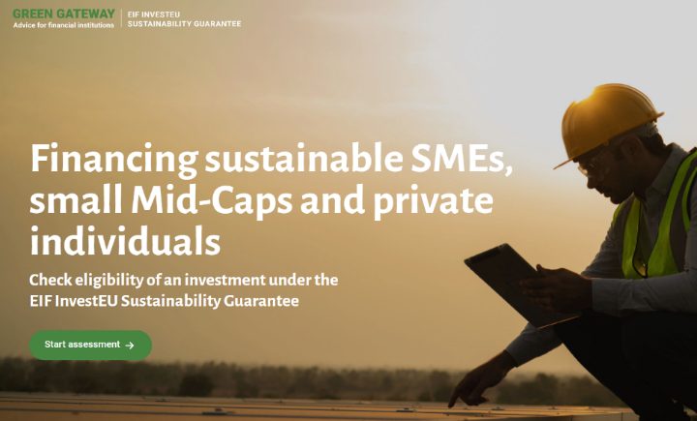






Capacity building for deployment
Group Green Checker
      Assessment of eligibility criteria
      Assessment of climate impact estimations
      Transposition and guidance on the eligibility criteria
Web-tool to assist EIF FIs, in the assessment and reporting of investment projects
Green Gateway Helpdesk
E-learning
Online platform tool to support the FIs on eligibility and impact reporting requirements.
Key features:
  A contact form to submit questions
  Comprehensive FAQ library
  Detailed Knowledge Base with guidance material.
Dedicated interactive courses on green and sustainable financing

Slide 8






For additional information:
InvestEU and EIF:
https://www.eif.org/InvestEU/index.htm
EIF InvestEU Portfolio Guarantees digital brochure
https://engage.eif.org/investeu/guarantees
Sustainability Guarantee: https://www.eif.org/InvestEU/guarantee_products/index-sustainability.htm
Group Green Checker:
https://greenchecker.eib-group.org/
Diana Patrascu
Head of Sustainable Finance Unit
d.patrascu@eif.org
To find out more please visit us at: www.eif.org
European
Investment Fund
37B avenue J.F. Kennedy
L-2968 Luxembourg
Phone: +352 24851

