Slide 1
CETP Pitching & Matchmaking Event for validation cooperation and new project initiatives
(collaboration between CETP/TRI5 and ERA-Net JPP SES)
Pitch template for
ISOTHERMAL COMPRESSOR WITH LIQUID PISTON

Slide 2
Pitch for the ISOTHEMRALIZER project 1/5
Isothermal Compressor with Liquid Piston
Name of the project and acronym
ISOTHERMALIZER
Consortium partners
Coordinating organisation: SESAM TECHNOLOGY SRL BERCENI
Main contact person: TÖRÖK ARPAD – Lead researcher
List of consortium partners: OANA LAZA – Founder, CEO
          SMARANDA IGNAT – Start Up advisor, Proptech ROMANIA

Slide 3
Pitch for the ISOTHEMRALIZER project 2/5
Challenge
Reduced energetic efficiency of compressors used today
Gas compression leads to gas heating in the process, especially for high speed compression
In targeted applications, the ideal process is the isothermal one (where gas keeps constant temperature)
A very low speed would reduce energy loss, but lead to low power density.
The best performances were obtained with "near-isothermal" compressors, but their performances are accepted in a small number of applications
The low compressor efficiency has a negative impact on the process efficiency.
The wide application of compressors (cooling/ heating devices, engines, energy storage, industrial machines, etc) increase the relevancy of this challenge
In other words, the challenge can be rephrased as:
Increasing speed and power density of compressors while keeping process isothermal.

Slide 4
Pitch for the ISOTHEMRALIZER project 3/5
Solutions this far
The key solutions to solving the main challenge are:
Intelligent, real time adjustment of the heat to be recovered at every position of the piston
Increasing the heat transfer surface between the gas and its surrounding environment to offer possibility of rapid cooling
Controlled removal of the heat given off by the gas to its surrounding environment
For these solutions, our project proposes:
- equipping the system with actuation devices for all mobile elements and with an intelligent processor which, based on a closed-loop regulation system and on the information collected with the help of some transducers mounted in the enclosure, send commands to the actuation devices in order to keep the gas temperature constant
- the introduction of a deformable "thermal sponge" in the enclosure, with a very large heat transfer surface, constant during the process
- the inclusion of the device enclosure in a closed circuit traversed by a heat transfer fluid, which "washes" the surface of the thermal sponge and transports the heat to a heat exchanger

Slide 5
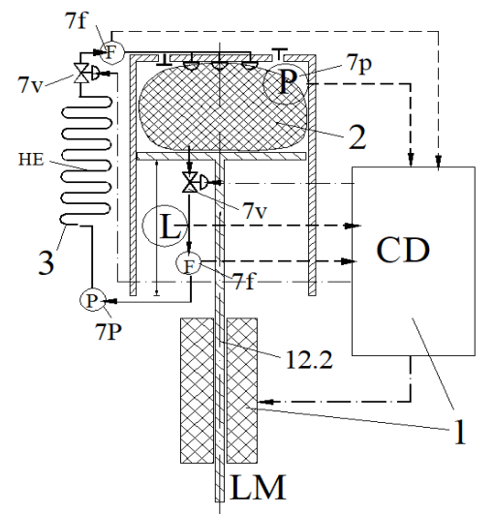
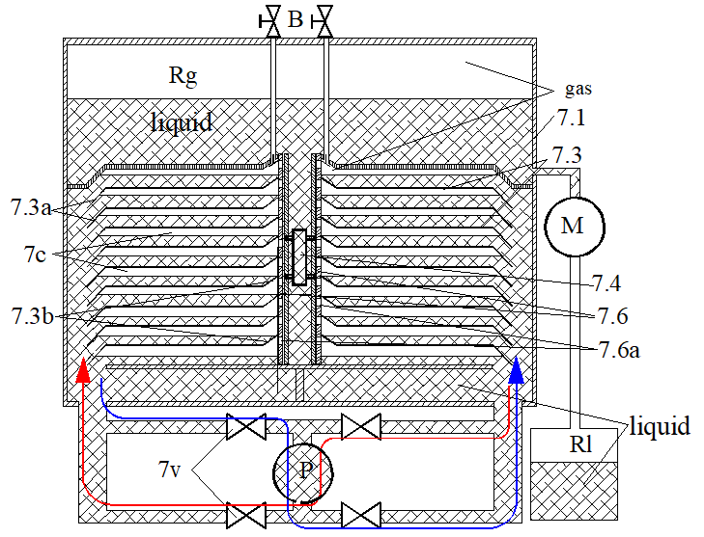
Pitch for the ISOTHEMRALIZER project 3.1/5
Solutions this far - illustration
basic scheme
liquid piston compressor for hydrogen
Rg= gas tank under constant pressure
Rl= ionic liquid tank
P= variable flow hydraulic pump
M= hydraulic motor
1: CD = processor
LM = linear motor
- 2: thermal sponge
- 3: the cooling system
Notes:
The left drawing shows the key components described in the previous slide: a compressor, with a thermal sponge, a linear motor that can have the speed regulated by the processor based on the info collected by the sensors: pressure, volume, temperature. All is aided by a heat exchanger that recovers the temperature from the compressor.
The second picture is an exemplification of such a device in a liquid piston. Picture shows 2 interconnected pistons that work in sync, with a pump that can push water from left to right. The design ensures pressured gas is close to a cooling surface area.

Slide 6
Pitch for the ISOTHEMRALIZER project 4/5
Our next step activities
Building and testing a demonstration prototype of a liquid piston, double acting, 6 atm output pressure, with an internal volume of 3-5 L. Key activities require collaboration with:
  A laboratory of hydraulic processes, to:
    build the compressor casing and complete the system with a hydraulic pump with a flow rate of 300 l/min, with a hydraulic motor with a flow rate of 50 l/min, with a servo valve for flow regulation, with 4 on/off solenoid valves
    carry out tests with the progressive modification of the main parameters, of the working gas and the heat transfer liquid
  2. An electrical automation laboratory for the installation of two flow transducers, two piezoelectric pressure transducers, two temperature transducers, for the realization of the flow regulator, the solenoid valve handling system and the compressed gas exhaust system
In case of positive results, we would proceed to the realization and testing of a compressor for hydrogen, with a pressure of 700 atm, with same partners

Slide 7
Pitch for the ISOTHEMRALIZER project 5/5
Our next step: VALIDATION
Given the multiple potential applications of ISOTHERMALIZER that could lead to eliminating fossil fuels, eliminating greenhouse gas emissions and thermal environmental pollution, below would be potential areas for commercial validation:
Testing within transport and storage facilities for all types of gas - compression of gases at high pressures, in one stage, without heat exchangers
Testing within CAES and TES industrial and residential storage facilities - thermal energy storage facilities, with progressive change of the storage temperature - thermal engines with external combustion, with small temperature differences between the two sources
Testing within high COP compressed gas heat pumps with Carnot/Ericson/Stirling cycle - compressed gas heat pumps, with variable COP, modified with actuators - heat pumps with isothermal vapor compression, with Ericsson cycle – industrial and residential Smart Multipurpose Carnot batteries, with high power density,
Testing within thermal engines with internal combustion and isothermal precompression, for changing the exhaust gas parameters of pressure and temperature - thermal engines with internal combustion of hydrogen, without Nox exhaust.

Slide 8
Thank you & contact information
Thank you for your interest
For more information contact:
Main contact person: TÖRÖK ARPAD, SESAM TECHNOLOGY
SRL BERCENI, ROMANIA
e-mail : arpi.torok@sesamtechnology.eu / oana.laza@sesamtechnology.eu
tel. +40722405041

