Slide 1



Slide 2
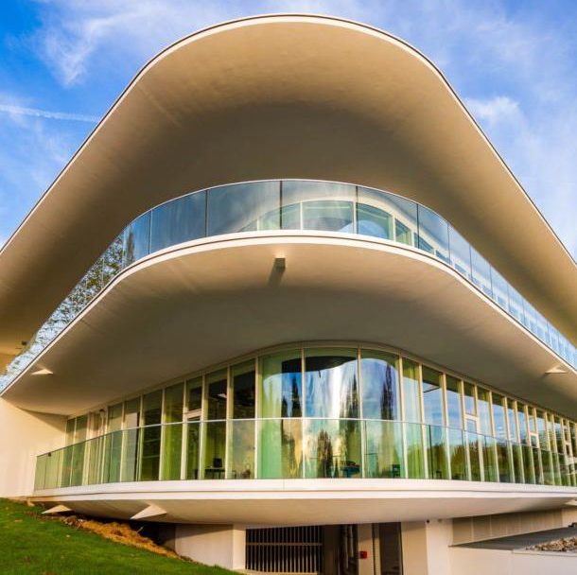
Institute Profile
- Founded in 1996, the ESTIA INSTITUTE OF TECHNOLOGY is a general engineering French school training trilingual versatile engineers, to undertake positions such as product engineer, supply chain planner/manager, quality manager, production manager, and project manager.
- The ESTIA campus is an ecosystem which includes:
Engineering courses & masters degrees
Research teams in technology
Technical platforms
A company incubator

Slide 3






Lab Experience and Key Projects
CHAIRS
ROBOTICS
Creativity, ecodesign & Circularity
STUDY  DESIGN  IMPLEMENTATION
Management sciences
Computer science
Mecanics
Automation
Electrical Engineering
Renewable energy integration
SMARTGRID
SUSTANAIBLE AND EMPOWERING INTERFACES FOR ENGINEERING
INDUSTRY 4.0
Tangible, Gestural and AR Interactions
IoT
Technological and human systems
ART & SCIENCES
Manufacturing processes and modeling
TEXTILE
Circularity for textiles
BALI
Complex
systems
FLEXTECH
Additive
manufacturing
DREAM
5
divided into
for
for
CNU Competencies
5
Capacitive
interfaces
6
Research topics
Study, design, implement
Application fields
06, 27, 60, 61 et 63

Slide 4
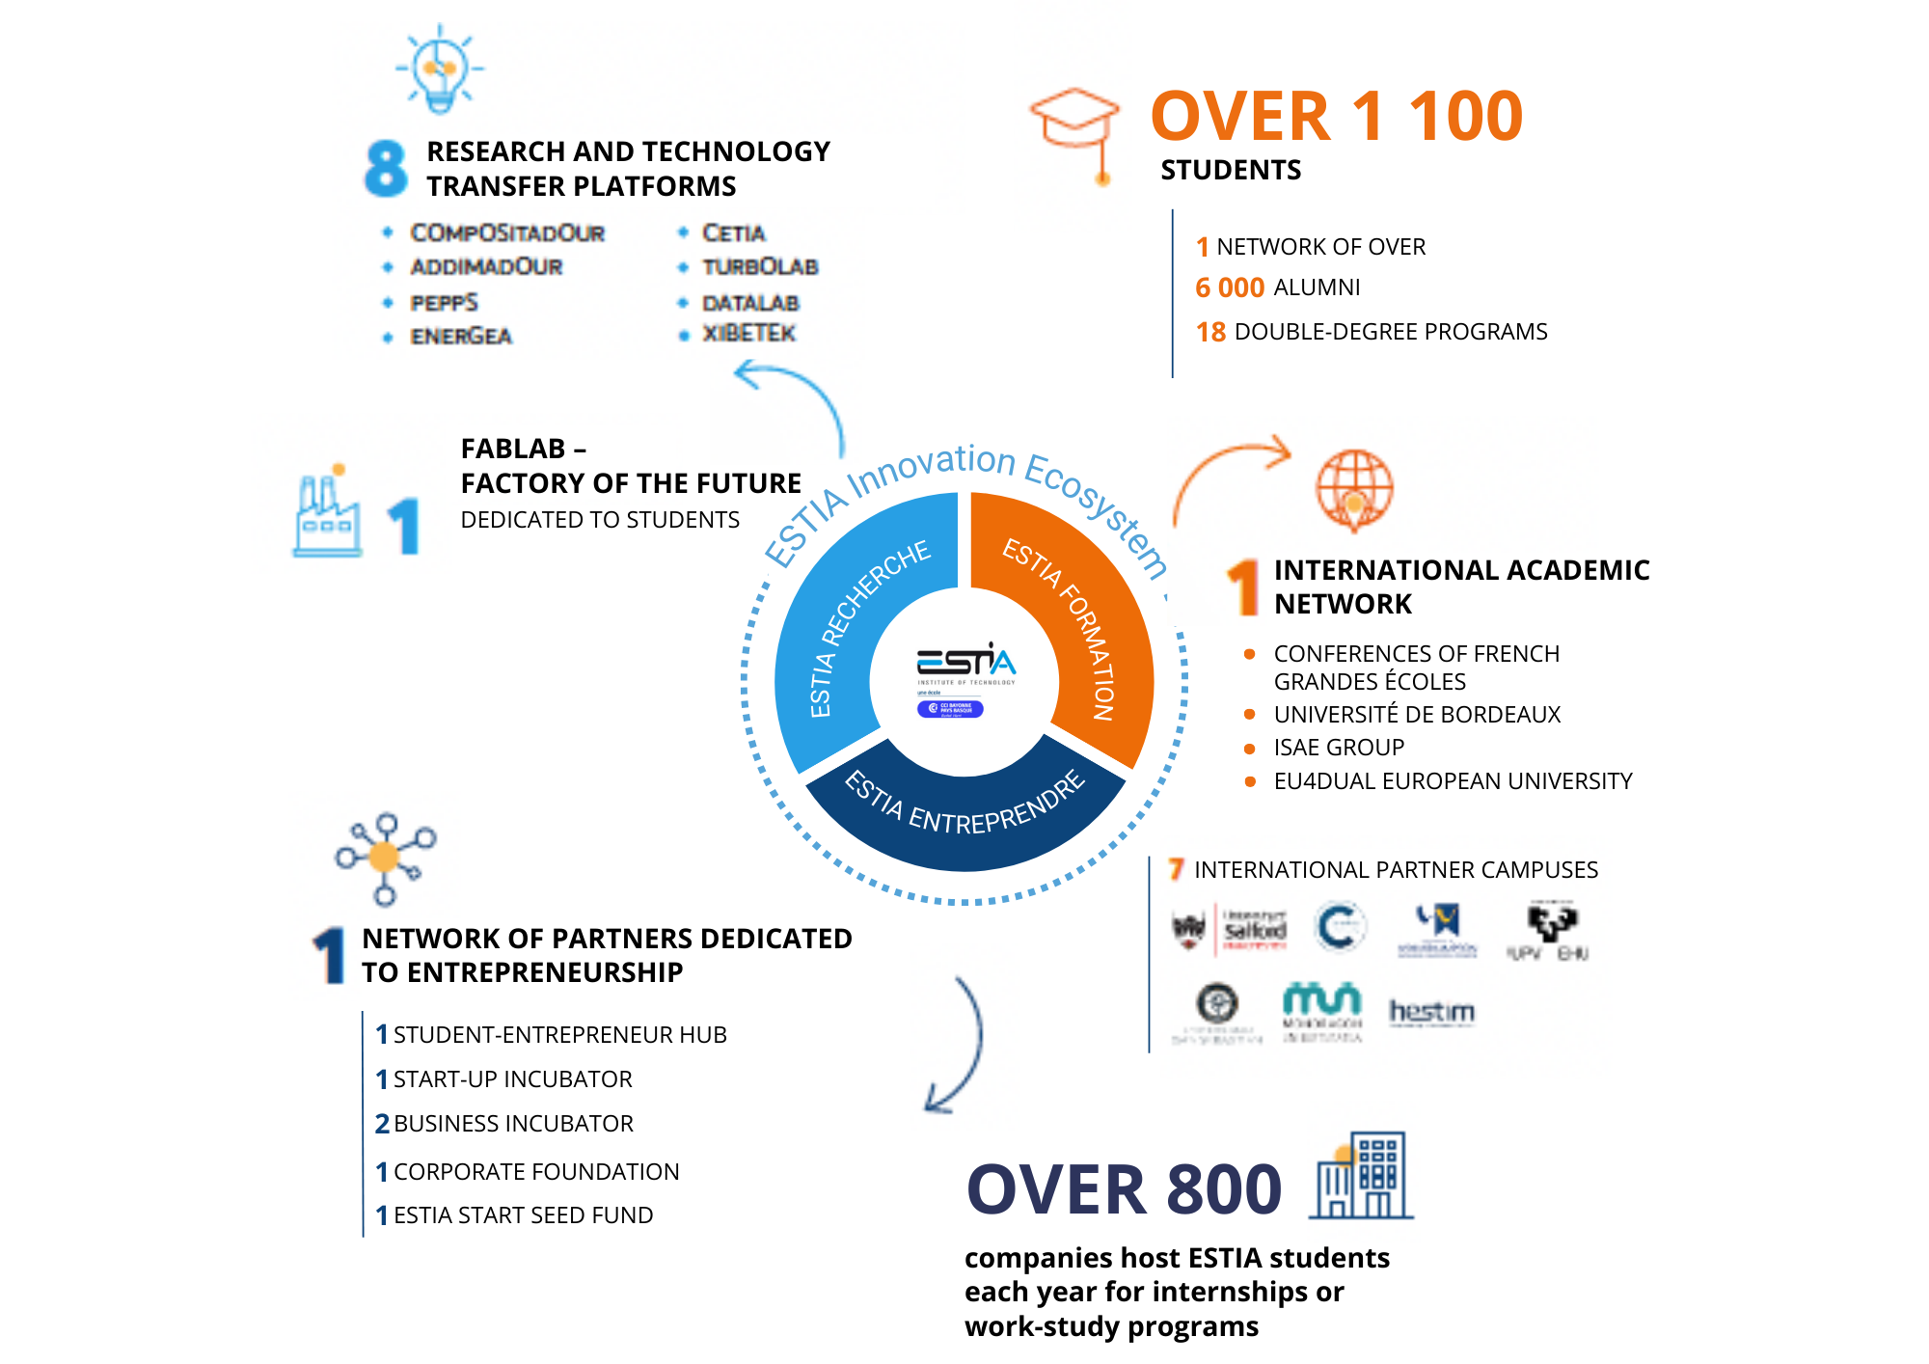
In the heart of the Campus

Slide 5

The European Dual Studies University
Lighthouse Strategy https://eu4dual.education/
1. Business & Management for Green Transition
  Sustainable tourism and green logistics
  Local government leadership
  Circular economy and sustainable design in fashion and textiles
2. Engineering for Sustainable and Digital Industry
  Human-machine interaction
  Artificial intelligence applications
  Additive manufacturing and 3D printing
  Industrial circularity and resource efficiency
3. Health and Welfare Transition
  Nutrition, diabetes, and food systems
  Mental health and cognitive aging with VR
  Inclusive health for vulnerable populations
  Working conditions, motor skills, and health in the workplace
4. Interdisciplinarity in Social Sciences: A European Way of Life
  Workforce development and education
  Future skills and emerging technologies
  Social and ethical dimensions of digital transformation

Slide 6
What is ESTIA-TECH?
ESTIA-TECH promotes the links between ESTIA and companies looking for technological solutions, skills and training to develop innovative projects.
ESTIA-TECH helps ESTIA researchers and platforms to prepare winning proposals for funding projects calls and collaborative research offers with companies.
ESTIA-TECH represents ESTIA in clusters and other initiatives.
https://www.estia.fr/estiatech

Slide 7
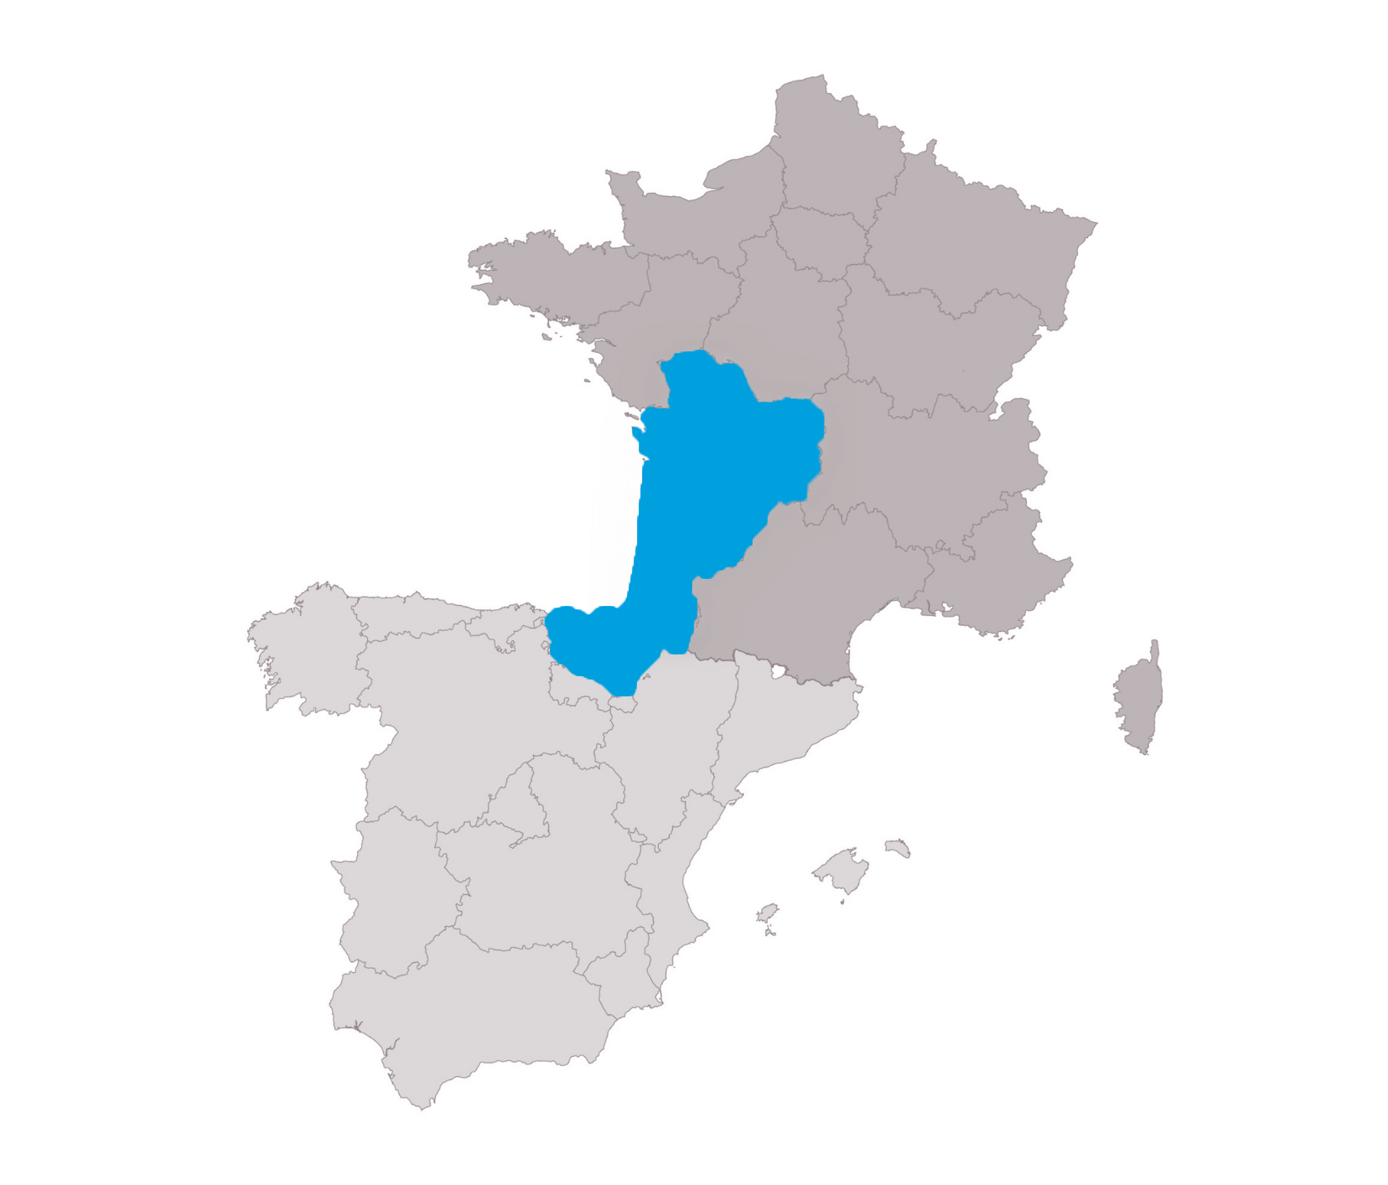
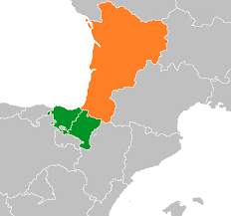
ESTIA-TECH – Strategic areas
Industry5.0
eHealth
Energy
Agri-tech

Slide 8



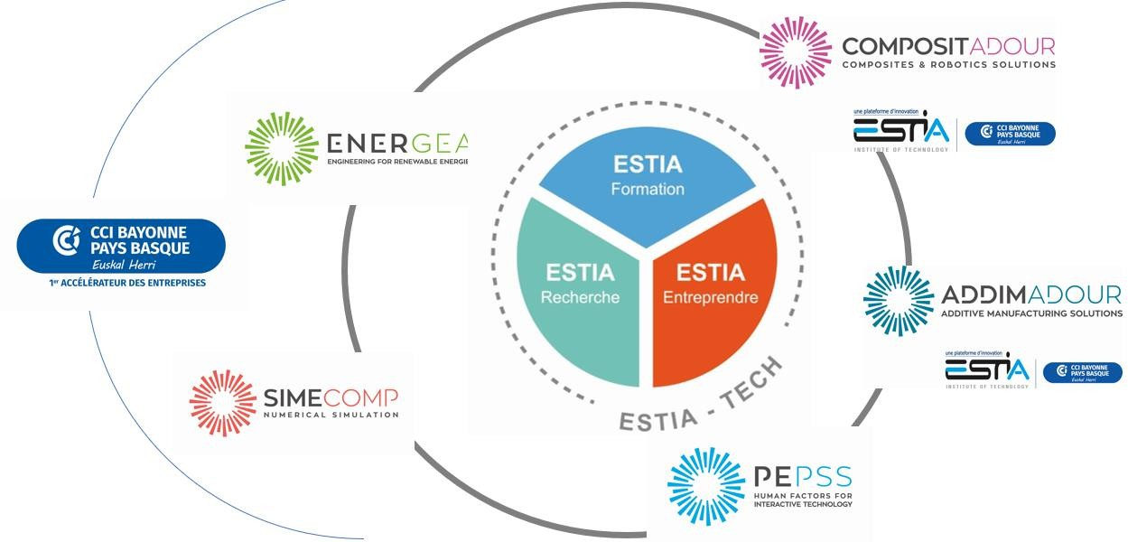







ESTIA ecosystem
CETIA: high-performance systems to make textile recycling operations competitive
ENERGEA: Power and control electronics for hybrid energy storage systems, energy management & optimization, micro-grids.
COMPOSITADOUR: advanced processes, including composites and robotics
TURBOLAB: innovative, low-carbon, high-performance aeronautical propulsion systems
ADDIMADOUR: metal additive
manufacturing
DATALAB: R&D projects & training. Applied AI: agriculture, industry, satellite imagery
PEPSS: Prototyping and evaluation. Expertise in ergonomics, human-machine interaction, and human factors analysis.

Slide 9
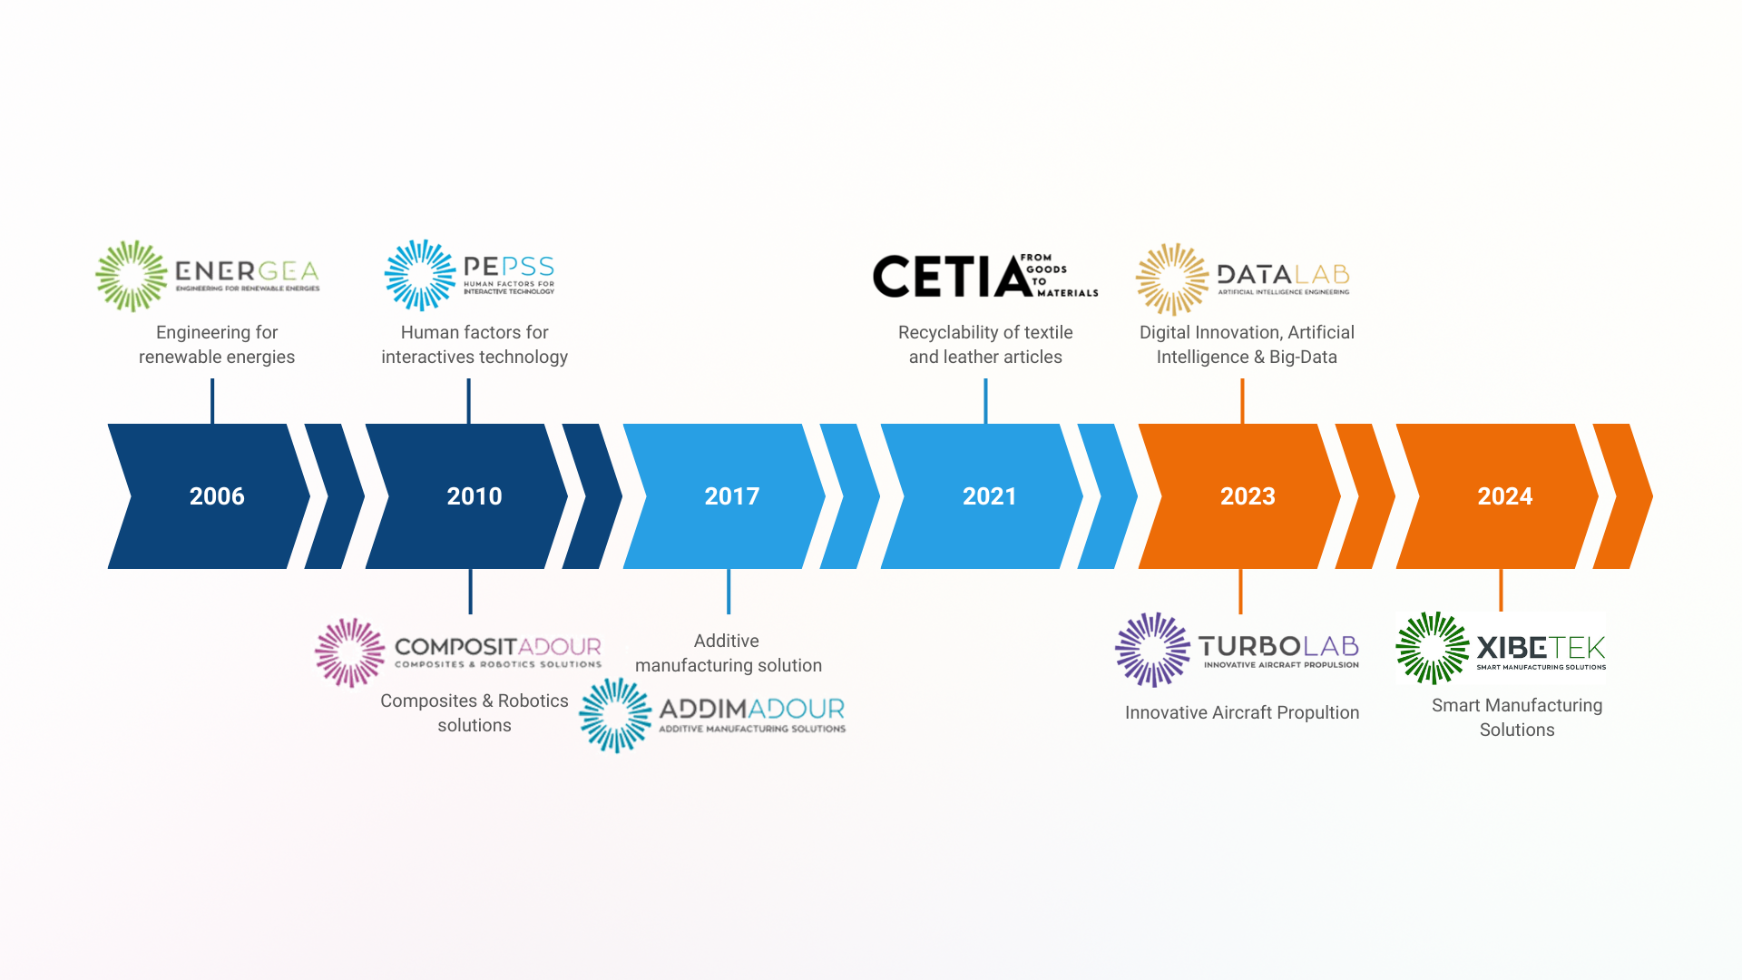
8 technology platforms
Support for research activity
Support for teaching
Support for companies

Slide 10

=
Technical Plateform : COMPOSITADOUR (COMPOSITES ROBOTICS ADDITIVE MANUFACTURING) is a true
platform for experimenting with the Factory of the Future’s digital and robotic technologies. Compositadour provides high-tech equipment and mobilises its network of skills, from laboratories, SME’s and major industrial groups to develop innovative projects. To help businesses appropriate these new technologies, Compositadour carries out the following missions:
R&D : In partnership with industry, Compositadour initiates and carries out R&D programmes for new parts and manufacturing processes with outstanding researc teams.
Training : In association with vocational training players, Compositadour provides courses for operators, technicians and engineers in composites, automating and robotising processes, and additive metal manufacturing.
Technology transfer : The platform’s teams helps industry (SME, ETI, large groups) to integrate new solutions developed.

Slide 11

Technical Plateform : ADDIMADOUR (ADDITIVE MANUFACTURING SOLUTIONS) is dedicated to metal additive manufacturing technology transfer, the Addimadour platform provides the Technocité Technology Park with innovative and efficient facilities for industrial projects.
Mechanical characteristics improvement of parts obtained by additive manufacturing :
Determination of optimal Key Process Parameters to obtainmaterial soundness.
Development of real-time instrumentation for monitoring and post-process control.
Development of deposition strategies tailored to Additive.
Manufacturing processes Multiphysics numerical simulation of additive manufacturing processes
Thermal, mechanical and metallurgical simulationfor behaviour prediction (residual strains and deflection).
Topology optimisation (Finite Element Method structuraldesign for performance/weight ratio enhancement.

Slide 12

Technical Plateform : ENERGEA (COMPOSITES ROBOTICS ADDITIVE MANUFACTURING) is s a
research platform in power and control electronics for the integration of renewable energy sources and storage (hybrid energy storage systems), for energy management and its optimization, through the quality management of power supply and network stability, but also demand management.
Automatic
Power Energy
Control
Energy Storage
Smart Grid

Slide 13

Technical Plateform : PEPSS (HUMAN FACTORS FOR INTERACTIVE TECHNOLOGY) was created in 2010 by resarchers from ESTIA (N. Couture & S. Minel) and University Paris Descartes (R. Mollard & M. Wolff).
Human Centered Design
Prototyping innovative systems
Behavioral and Morphological Modeling
Facilitate the interaction between people and between a human and a system
Model human behavior: use, appropriation and emotion

Slide 14

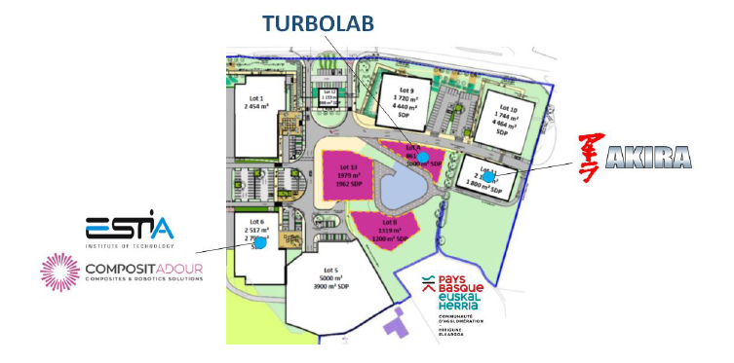
  TURBOLAB is a plateform dedicated to innovative propulsion systems : Electric, Hybrid or Alternative Fuels (SAF and H2)
  Associating AKIRA expertise in innovative propulsion systems and ESTIA Compositadour Addimadour in Material and Processes

Slide 15

Technical Platform : DATALAB
DATALAB is ESTIA’s innovation platform focusing on Artificial Intelligence (AI) and Big Data applications. It supports industries in integrating these technologies into their processes, fostering digital transformation across sectors such as agriculture, healthcare, and manufacturing.
R&D & Innovation: Conducting applied AI research and development projects.
Technology Transfer: Assisting companies in adopting AI and Big Data solutions.
Training: Offering specialized training programs in AI and Big Data for professionals and students.

Slide 16

Technical Platform: Xibetek
Xibetek is a training and experimentation platform dedicated to the local industry. It provides access to advanced technologies, prototyping tools, and expertise to help companies and students develop innovative projects and strengthen industrial skills.
Training & Skills Development: Courses and workshops for students and professionals.
Prototyping & Experimentation: Access to machinery and equipment for testing new industrial solutions.
Industrial Support: Assisting local companies in adopting and integrating new technologies.

Slide 17

Technical Platform: CETIA (Centre for Textile Innovation and Automation)
CETIA develops innovative solutions to transform textile and leather waste into recyclable materials. By combining automation, robotics, and AI, the platform supports brands, recyclers, and collectors in designing, testing, and implementing sustainable recycling processes.
Innovation & Prototyping: Developing proofs of concept and pilot systems.
Industrial Demonstration: Testing solutions at pre-production scale.
Technology Transfer: Supporting companies in adopting new recycling technologies.

Slide 18
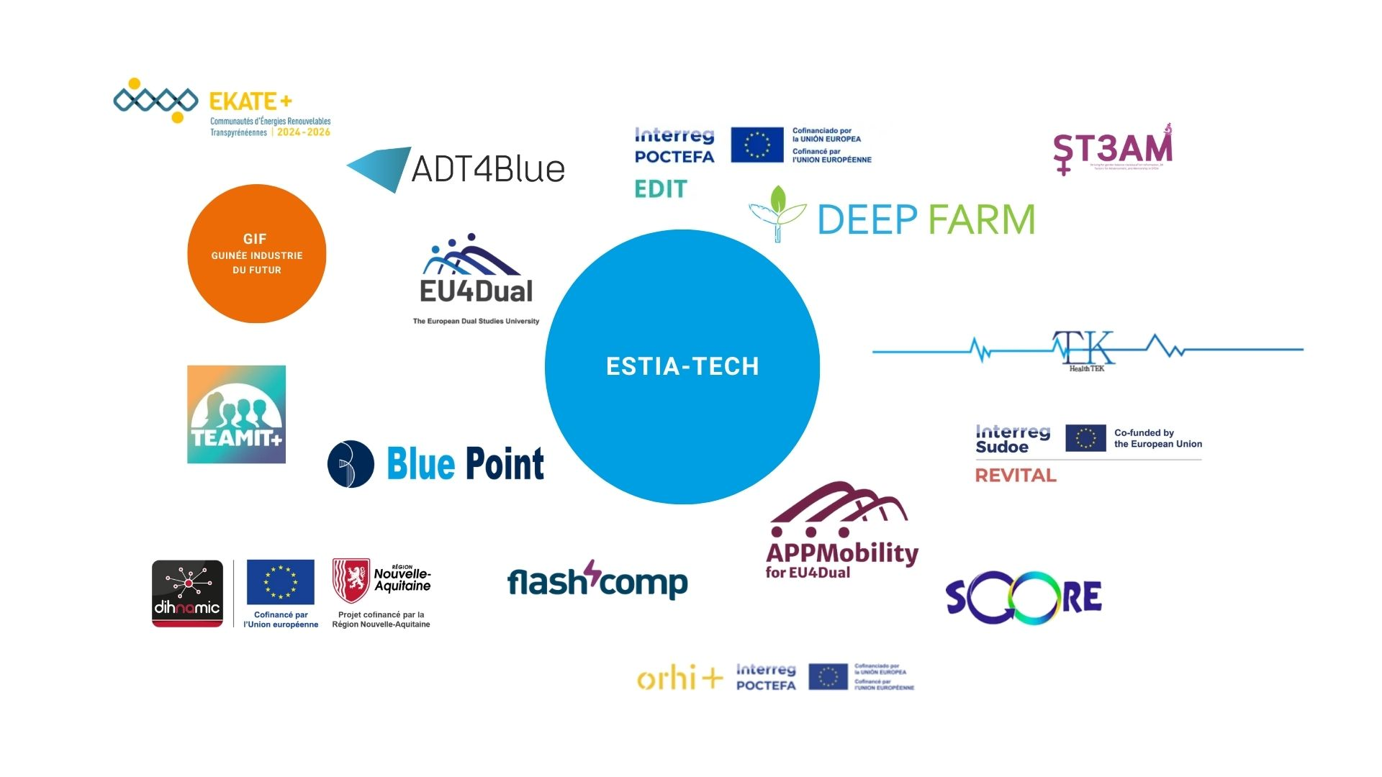
On-going projects https://www.estia.fr/recherche/projets-estiatech

Slide 19



Collaborative Networks

Slide 20


Arambarri Jon Ingénieur chargé d'affaires ESTIA-Tech 90 allée Fauste D’Elhuyar Technopole Izarbel 64210 BIDART ✆ : 00 33 7 61 12 33 41 @ : j.arambarri@estia.fr ➲ : www.estia.fr

