Slide 1
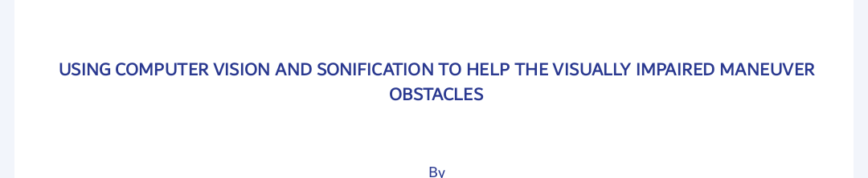

Slide 2
INTRODUCTION
We are innovating a solution that:
will help the visually impaired to navigate or move both indoor and outdoor.
Will help the visually impaired to find or locate different items around the surrounding.

Slide 3
PROBLEM AT HAND
In our communities we have individuals who are either totally or partially visually impaired. These people have a serious challenge of going on with their daily lives as sight is a vital necessity in most of the activities we do.
They greatly rely on other individuals for help who might not be available at their time of utmost need and the available smart technologies that would help them for example smart whitecane,guide dogs ,orcam MyEye , Orion are expensive that their unable to afford them .

Slide 4
How expensive are smart technologies[1]
Technology | Cost
1)Orcam MyEye | 296,000 UGX paid in 24 installments per month.
2)Smart white cane(We walk smartcane and App) | 2,396,000 UGX with the application or 2,000,000 UGX without the application
3)Guide Dogs | 192,000,000 including training costs and operation costs for 5 years
4)Orion | Still in prototype

Slide 5
REFERENCES
References:
https://youtu.be/HFQsbdDv6v4
https://youtu.be/NZuKcXA9tlk
https://puppyintraining.com/how-much-does-a-guide-dog-cost/#:~:text=Total%20cost%20for%20a%20guide%20dog%20%3D%20%2459%2C600,that%20aid%20individuals%20with%20disabilities

Slide 6
Limitations of these smart technologies
Orcam MyEye can help you read the text but can not aid in giving you directions .
However much the smart white cane are widely recognized , portable, have speakers inside and foldable , after detecting obstacles how to maneuver after that is somehow challenging .
The smart white cane especially the “Be My Walk” has the campus direction but it is being affected by noise interference that disorganizes the direction-campus of the Visually Impaired.
Misunderstanding of the detected objects .
Changing levels of the land
Late or Delayed updates on online tools for example google maps .

Slide 7
SOLUTION IDENTIFIED
We are coming up with a smart solution that is cheaper, learnable, portable and wearable compared to the existing smart technologies that we identified earlier by helping the blind;
To detect obstacles in the environment .
To know what's around them without having to move around.
To advise them on what directions to take without having to leave their their paths i.e left , right ,straight.

Slide 8
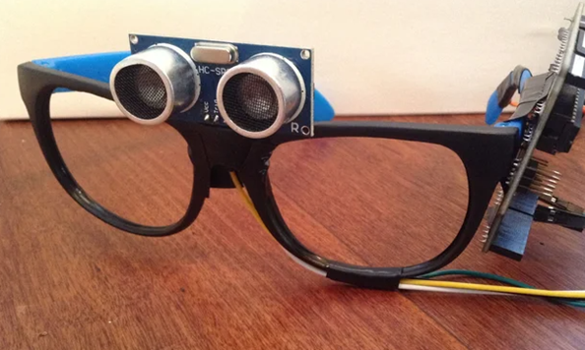
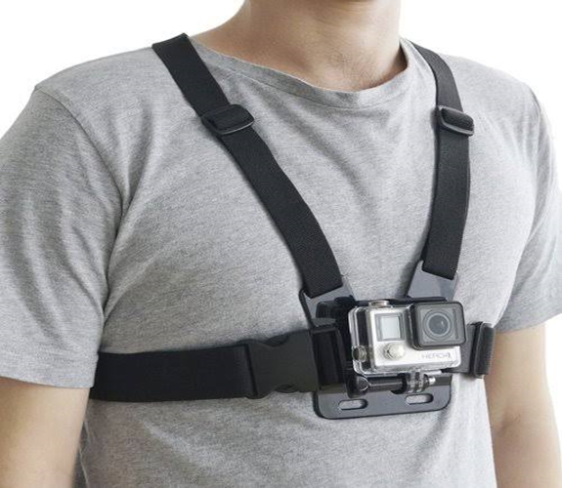
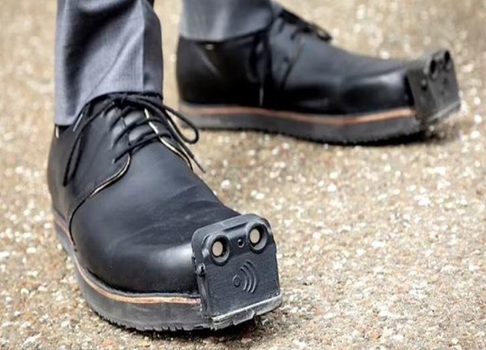
HOW OUR SOLUTION WILL LOOK

Slide 9
1. To design a system that will detect objects using real-time video streams and echoes through its sensors and then provide a description of the obstacles detected to the user .
2. To design an assistive tool with a wide field of view in order to effectively aid movement of the visually impaired.
3. To provide an assistive visually impaired tool at the lowest cost possible.
OBJECTIVES OF THE PROJECT

Slide 10
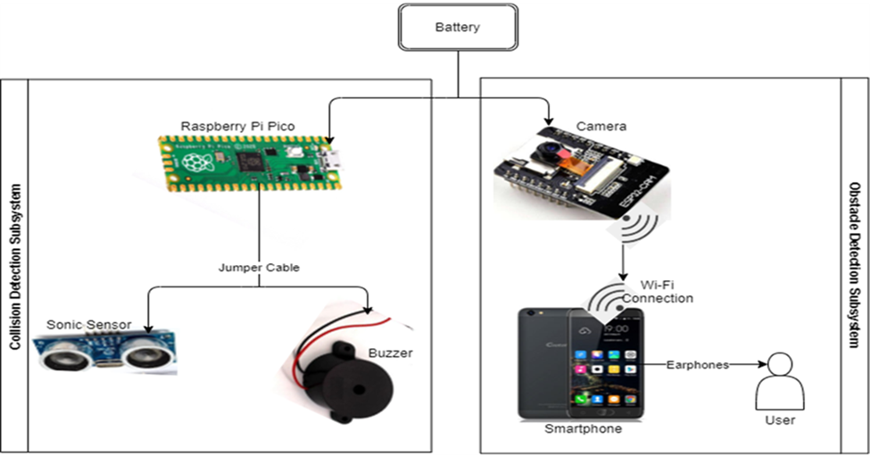
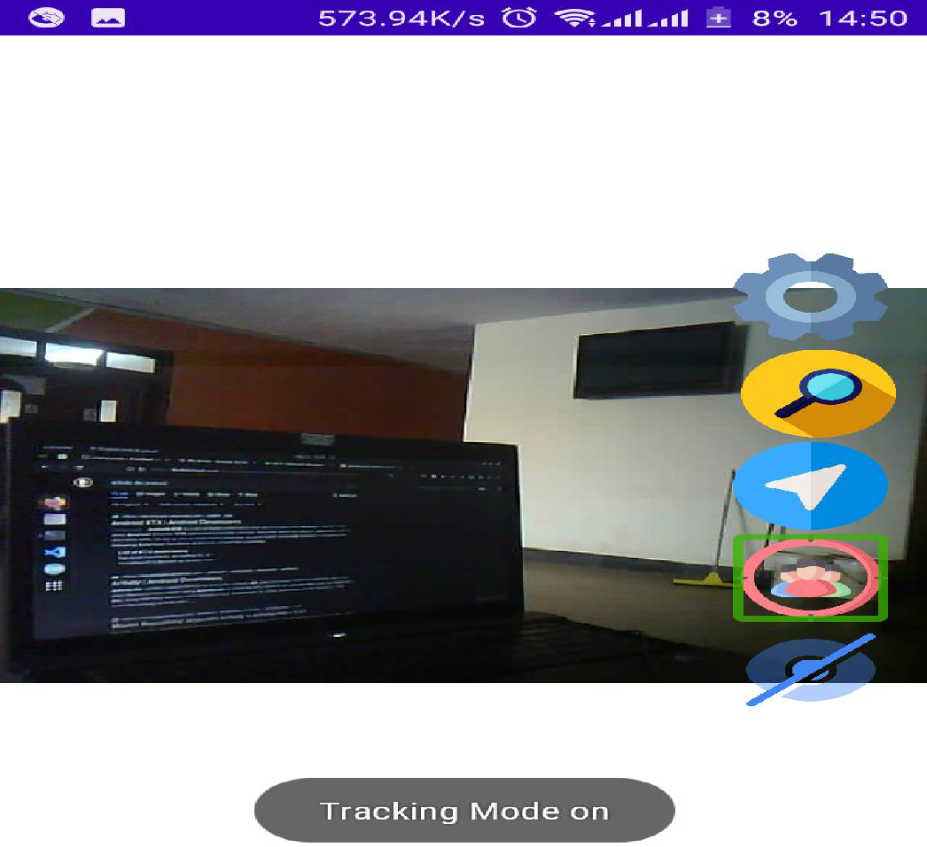
Cont’d…

Slide 11
OPPORTUNITY AND MARKET SIZE
Global health estimated 217 million people with visual impairment and 36 million suffering from blindness[2].
Therefore according to this population ,our solution is likely to have ready market and users for it anywhere because the number of the visually impaired keep on increasing due to uncertainties for example accidents , diseases of the eyes that make one to lose sight.
Reference
[1] S. Real and A. Araujo, “Navigation Systems for the Blind and Visually Impaired: Past Work, Challenges, and Open Problems,” Sensors (Basel)., vol. 19, no. 15, Aug. 2019, doi: 10.3390/S19153404.

Slide 12
ESTIMATES OF COSTS AND QUANTITY
ITEM | PRODUCTION COST | SELLING COST
Foot device | 102,000 | 169,100
Chest device | 60,000 | 99,500
Head device | 49,000 | 81,000
HOW MUCH ARE YOU SAVING ON EACH DEVICE ?? :
Foot device (2,000,000-169100) = 1,830,000
Chest device (2,000,000-99500)=1,900,500
Head device (2,000,000–81000)=1,919,000
HOW MANY CAN WE PRODUCE AND IN WHAT PERIOD OF TIME
One hour we can we produce 4 gadgets that is a whole set
Eight hours we can produce 32 gadgets .

Slide 13
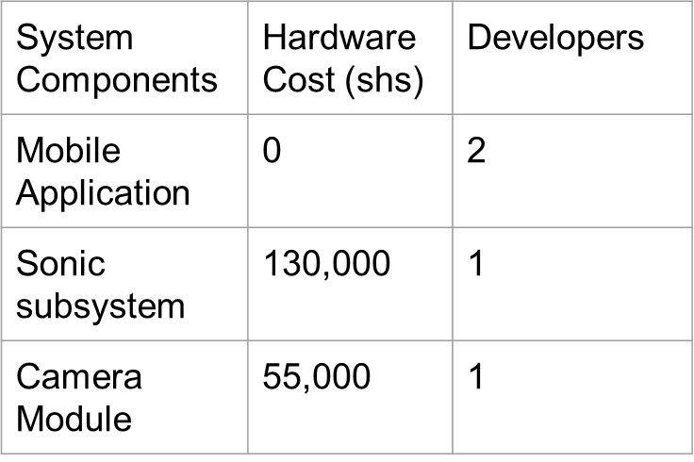
Cost Metrics
Unit cost per hour per developer
= shs.48,000
Total CVAS Hardware cost : shs.211,000 Therefore, CVAS System’s cost is a potential competitive cost compared to an average of 2.4Million pricing for existing blind smart tools as per the field study research.

Slide 14

Persona
 | Bio Mary is aged 22 years, single, visually impaired, a student and a resident at Africa Hall-Makerere University. She stays with a colleague in the same room who normally misplaces Mary’s items. Mary finds it hard to know the items around her. She also finds it hard to move to the lecture room when she wants to attend lectures. | Goals -To locate the misplaced item of interest with ease. -To move without ramming into obstacles.
Demographics
Name | Mary
Age | 22
Status | single
Occupation | student
Tier | Visually Impaired

Slide 15
PROJECTED GROWTH OF PRODUCT
CVAS’s usage of smartphones, wearables with built-in cameras and support of computer vision and sonification state-of-the-art, will further be boosted by;
Smaller convenient wearable chips for use by the visually impaired
Multi-linguistic audio output
Position awareness
Eliminate use of smart phones to enable the devices be self sufficient .

Slide 16
Low Fidelity Prototype

Slide 17
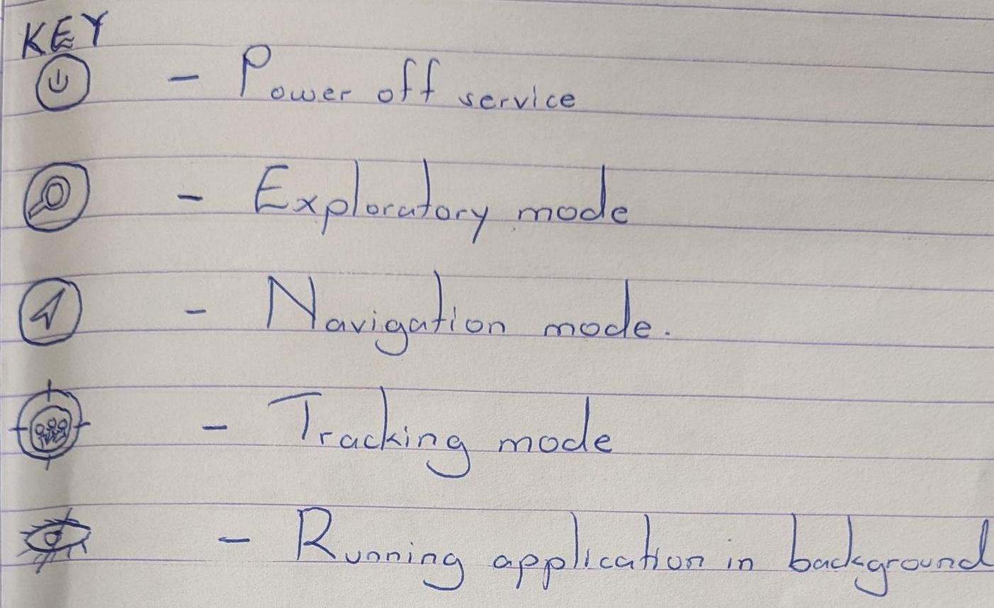

Slide 18
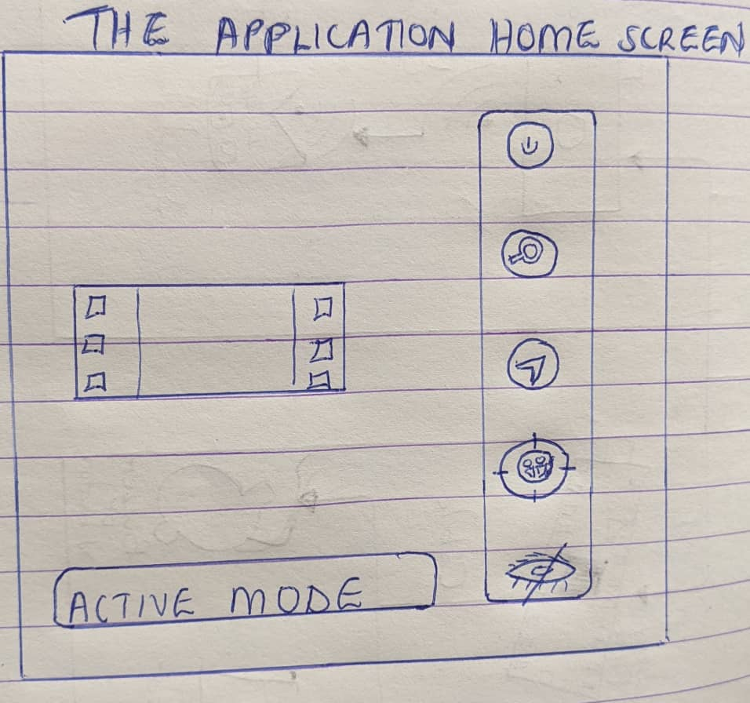

Slide 19
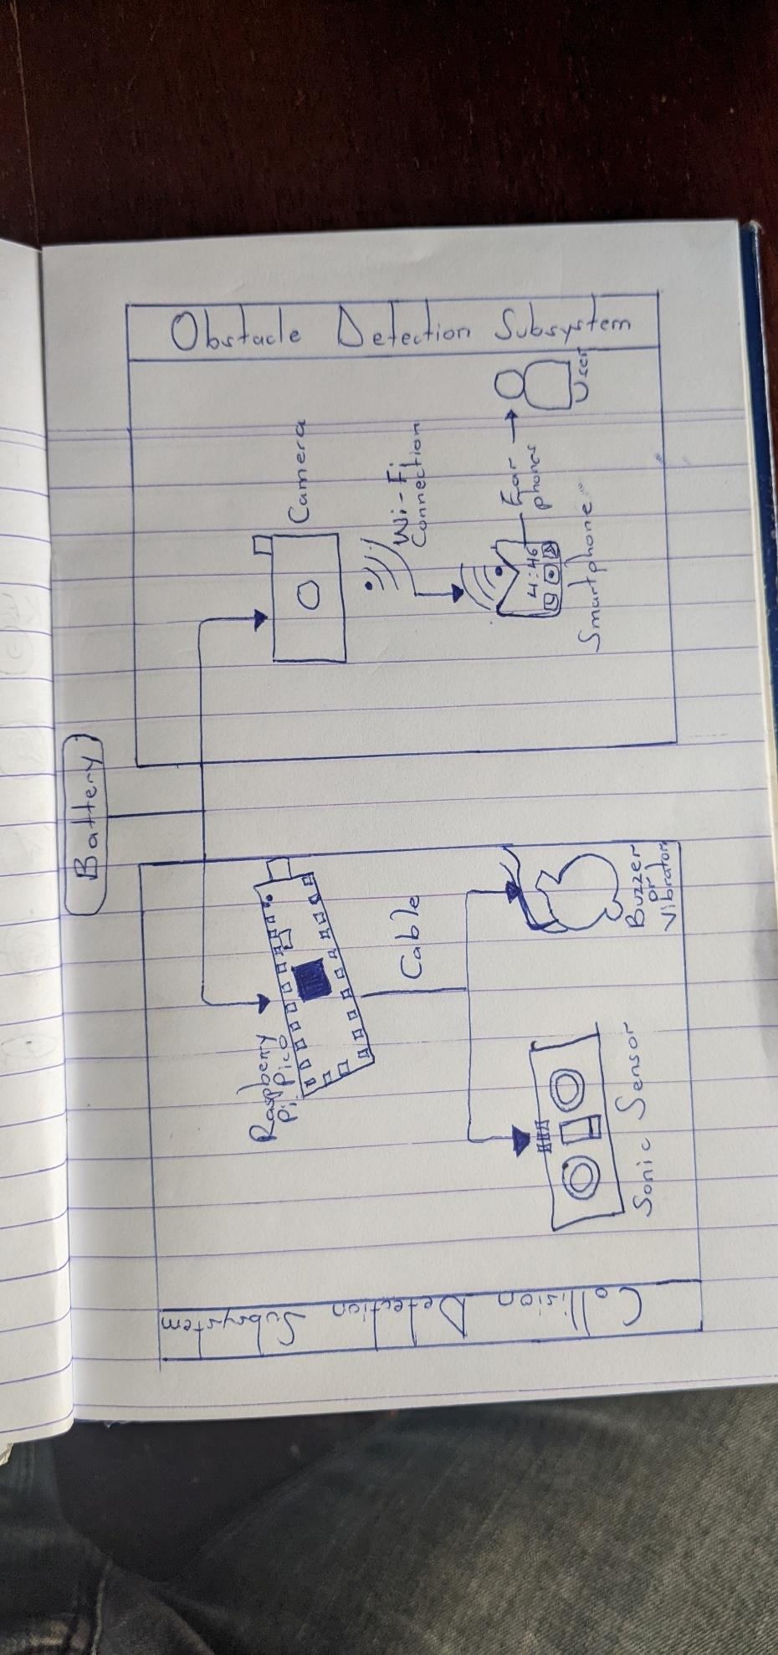

Slide 20
References
[1] S. Real and A. Araujo, “Navigation Systems for the Blind and Visually Impaired: Past Work, Challenges, and Open Problems,” Sensors (Basel)., vol. 19, no. 15, Aug. 2019, doi: 10.3390/S19153404.
[2] https://data.oecd.org/popregion/urban-population-by-city-size.htm

