Slide 1

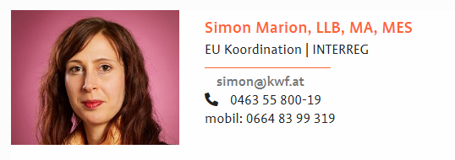
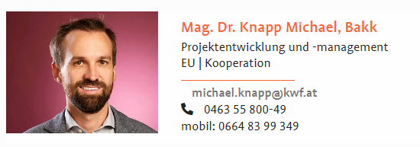








➔ Your Organisation
Kärntner Wirtschaftsförderungsfonds
Carinthian Economic Promotion Fund
KWF is the organisation in charge of economic development in Carinthia – non partisan and independent
Offices in Klagenfurt am Wörthersee | Director: Mag. Sandra Venus | Number of employees: 40
Cornerstone: KWF Strategie 2030
Strategic foci:
  Competitiveness and sustainability
  Research & development
  New enterprises
  Economic development
-> particular attention paid to small and medium enterprises (SMEs) and cooperations
-> management of national and EU-funds
Yearly budget: approx. EUR 26 Mio regional funds plus approx. 10 Mio EU-Funds
Fields of action:
- ICT | EBS | Digitalisation
- well-established manufacturing | traditional SMEs
- tourims

Slide 2
➔ Your specific competence
Regional coordination for Interreg A SI-AT and IT-AT programs - KWF & Amt der Kärntner Landesregierung
-> Priority 1 in IT-AT Program for Research and Innovation, entrepreneurship as focus
-> Example of project 2021-2027: MOZART, Carinthian project partner: Build! Gründerzentrum
KWF products in the field of entrepreneurship & start-ups, examples:
  vor.GRÜNDEN (Pre-incubationphase ->
    Focus on new knowledge-based and technology-oriented enterprises
    Enterpreneuship eco-system enhancement: guidance and trainings through Universities, technical colleges, non-university research institutes
  „Starthilfe“ (Start-up phase ->
    Focus on competitive, technology oriented and innovative enterprises
    loan for the creation of enterprises and its first activities, max. 400.000 EUR
    covers R&D, product development and launch of the production, market entry and expension
  Equity financing (growth phase ->
    Financing of demanding, promising and risky projects of SMEs with a budget above 300.000 EUR
    Covers i.e. acquisition of equipment, market expension, construction of extension of research facilities
    Management through Carinthia Venture Fonds (CVF)

