Slide 1

SMART
POWER
MODUL
(project INPOMOD)
SPM
SESAM
TECHNOLOGY
SRL BERCENI
The most efficient tool for distributed zero-carbon energy systems

Slide 2
Universality : can capture, convert, store, distribute mechanical/electrical and thermal energy from/to any sources, from the smallest to the largest
Efficiency : all processes are exergetically optimized
Flexibility : can be realized in various variants, for a variable number of sources and users
Perfect adaptability to any type of application served, with components adapted to the temperature, power and mobility range of the application
Profitability : low manufacturing, operability, maintenance costs, doubled by high productivity
Advantages:

Slide 3
Modularity: parts of the installation can be added, replaced, or removed at any time
Energy security: can incorporate any energy production unit and any consumer from the electrical network, increasing its flexibility and safety. The coupling of all these modules leads to the most secure and efficient distributed network
Maneuverability: is equipped with an intelligent processor that exergetically optimizes both each process and the entire module, modifying the system configuration, the optimal operating time interval for each configuration, based on the measurement of the main parameters, of orders received from the dispatch, weather forecasts and energy price predictions, collected from the Internet
Advantages:

Slide 4
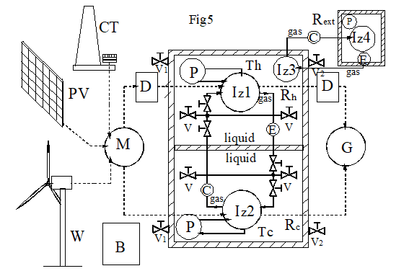
The core of SPM Structure
LEGEND:
Rh = hot tank
Rc = cold tank
Rext = heat exchanger
Iz = isothermalizer
P= pump
C= adiabatic compressor
E= adiabatic expander
M= electric motor
P= synchronous electric
generator
D= clutch
V= valve
B= electric battery

Slide 5
The core of SPM : an efficient Carnot Battery
1. In the capture stage : - W, PV, CT supplies electricity
- Iz1-C-Iz2-E is heat pump
-Rh heats up, Rc cools down
2. In the distribution stage : - G pumps energy into the grid
- Iz1-C-Iz2-E is heat engine
- Rc heats up, Rh cools down
3. At any time : - Iz3-C-Iz4-E is heat engine or heat pump
- Rh pumps or supplies thermal energy
OBS. - Through irreversible processes, part of the mechanical energy is converted into heat and accumulates in Rh
- Instantaneous power, energy efficiency for the heat engine, COP for the heat pump, all are are controlled by the processor

Slide 6
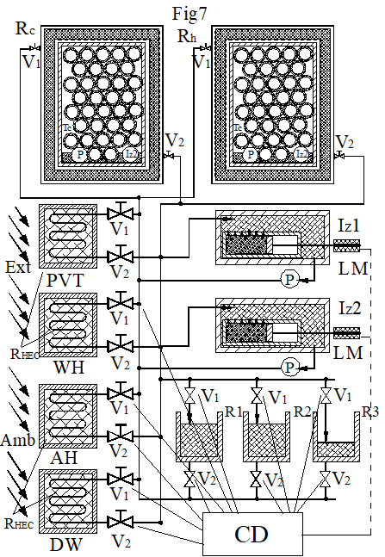
SPM-I (individual)
- CD configures 2 circuits Iz-RHEC,c,h
- This is a heat pump that transfers heat between the 2 RHEC, or a heat engine between the two sources
LEGEND:
Rh = hot tank
Rc = cold tank
R1,2,3=transfer tank
Iz = isothermalizer
P= pump
LM= liniar motor
CD=processor
V= valve
RHEC=heat exchanger

Slide 7
Other operating modes of a residential SPM-I
pump: - Ramb→Rh, Rhot water ; Tamb↘, Thw,Th ↗: ambient cooling,
hot water heating
- Rc, Rground→Ramb ; Tamb ↗, Tc ↘ : ambient heating
engine:- Rc, Rground← Rext, Ramb; Tc ↗,Tamb↘ : ambient cooling
- Rh →Ramb ; Tamb ↗, Th ↘ : ambient heating
in winter: - Rground → Rext : engine
- Rground → Ramb : pump
in summer: - Rground ← Rext : engine
- Rground ← Ramb : engine
- during the day: - Rground ← Rext : engine ; - Rc ← Rext : engine
- during the night: - Rground → Rext : engine ; - Rc → Rext : pump

Slide 8
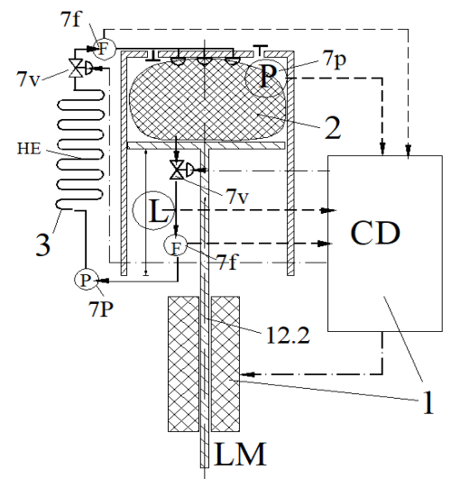
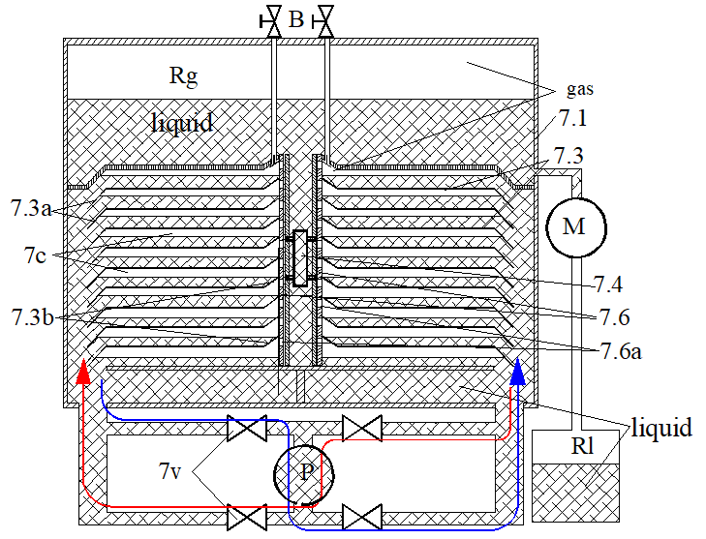
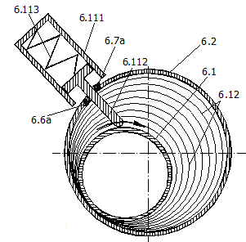
THE ISOTHERMALIZER
1. CD: calculates and imposes the isothermal speed
2: thermal sponge. Ensures high thermal transfer speed and high power density
3: cooling system with heat transfer fluid. Ensures heat transfer to the tank
SOLID PISTON LIQUID PISTON ROTARY PISTON

Slide 9
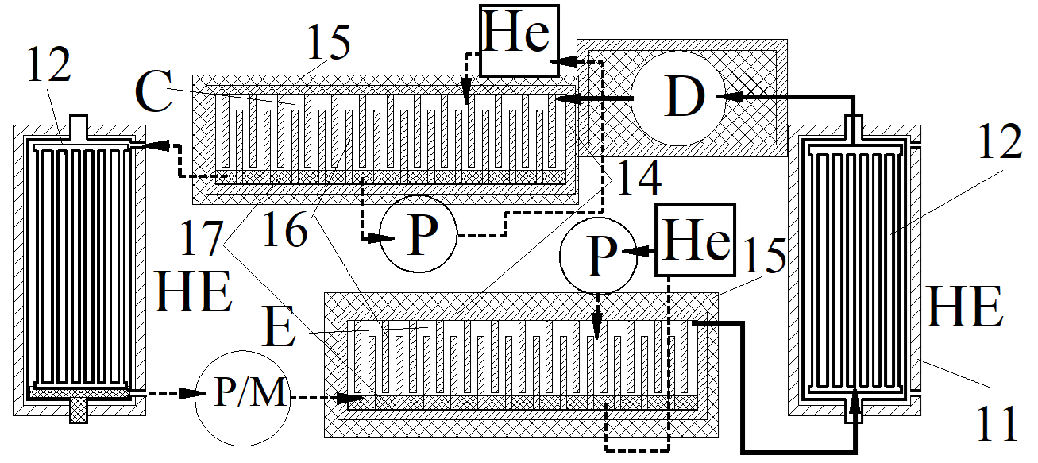
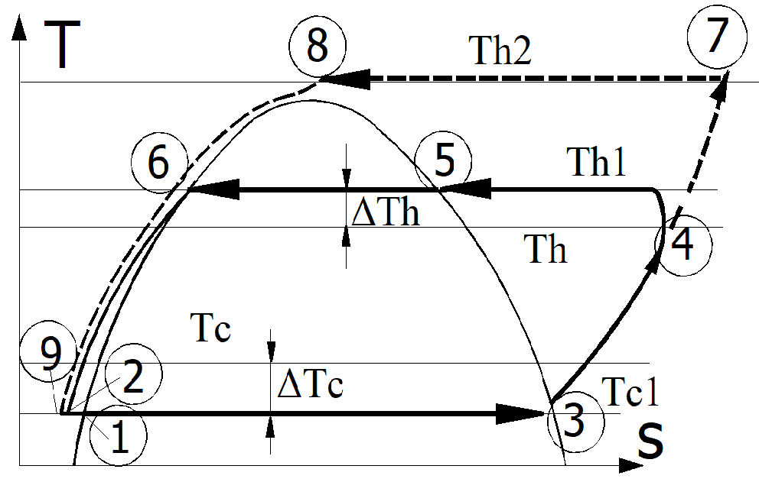
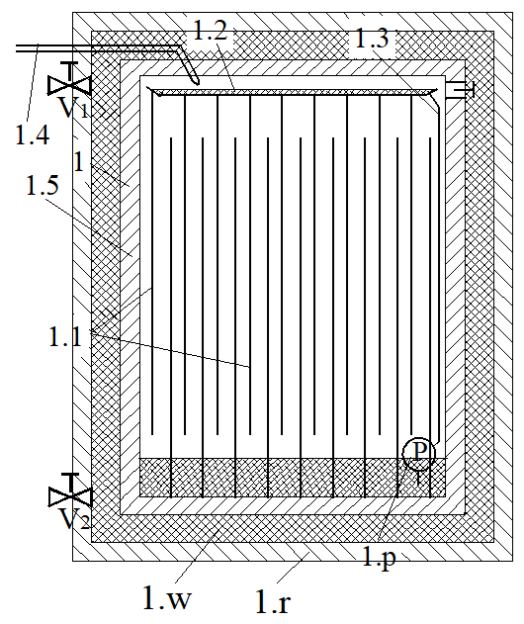
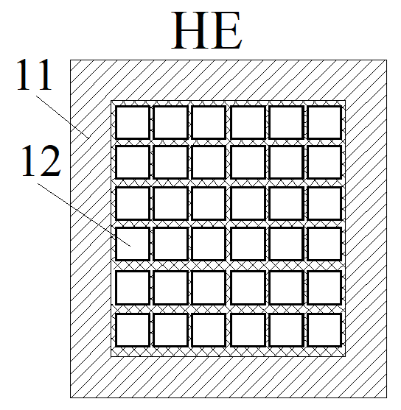
PHASE CHANGE HEAT PUMP
Block diagram T-s diagram
condenser
heat excheanger

Slide 10
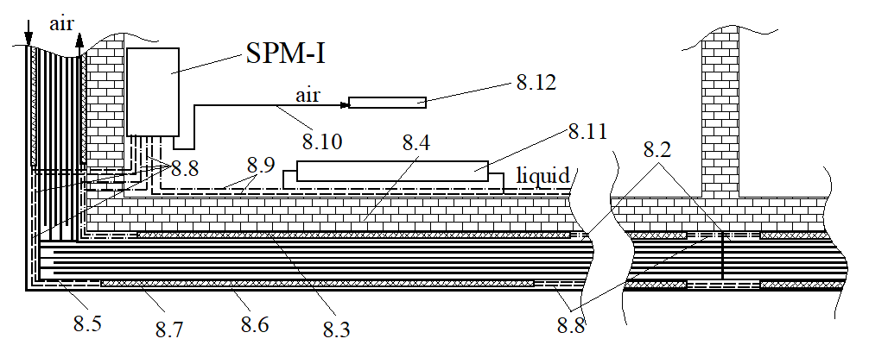
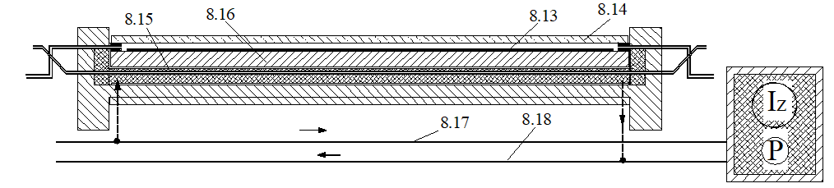
Other components of SPM-I
LEGEND:
8.3=Cold RHEC
8.7=Warm RHEC
8.4=Wall
8.5=Active thermal insulation
8.12=Radiator
8.15=heat transfer liquid
HVAC system
Hibrid PVT

Slide 11
Thank you
SESAM
TECHNOLOGY
SRL BERCENI
Comuna BERCENI
județul ILFOV
ROMANIA
Arpi Torok
arpi.torok@sesamtechnology.eu

