Slide 1

CO.LI.E.R PLATFORM
(COLLECTION, DELIVERY, OPERATION, RECYCLING)
COLIER is a Valorisation, Marketing and Distribution Platform,
COLIER, .... Join the two ends

Slide 2
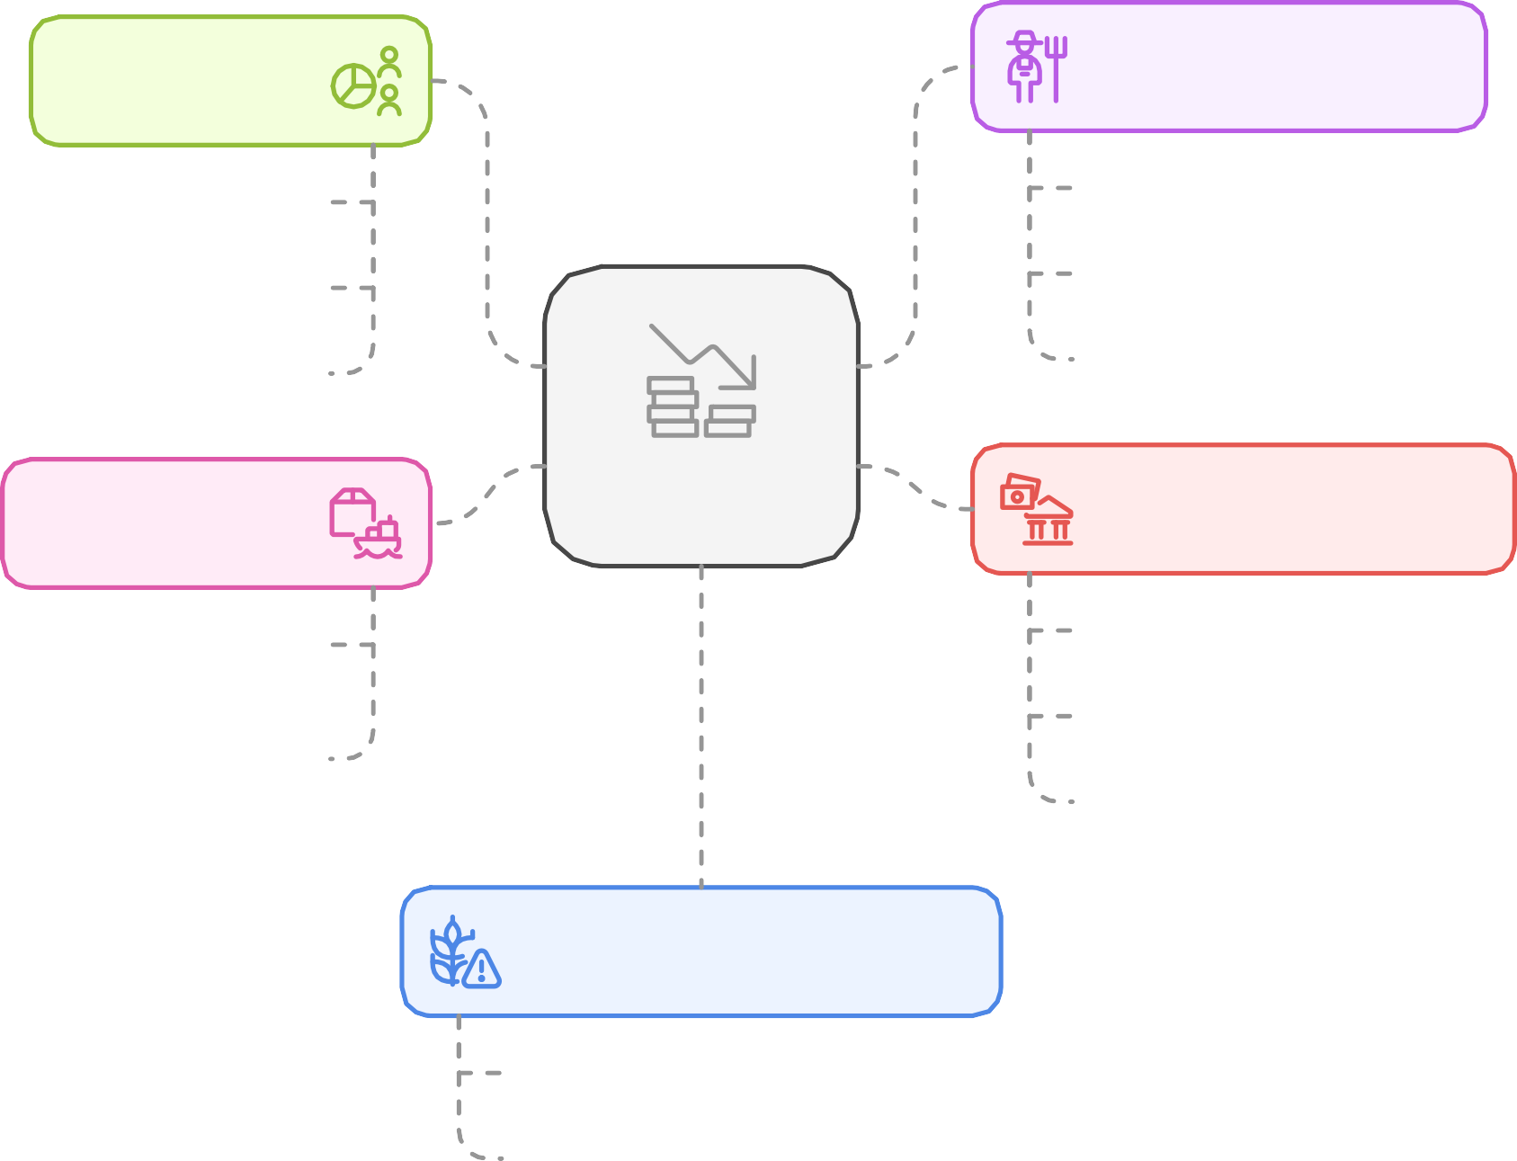
Economic and Agricultural Overview of the Zone
Potential
Main activities
140,000 ha
22 rivers and streams
Young, active population
Agriculture Livestock Fishing
Podor
Institutions
Senegal
Challenges
Government
Farmers' organisations
Furnishings
Financing
Transformation
Issues
post-harvest losses
marketing

Slide 3














The IAEA's objectives through Atoms4Food and their alignment with COLIER
Improving food safety
Soil and water management
Combating pests and diseases
Improving Production
Improving Nutrition
COLIER aims to ensure a fair distribution of income and food products, by reducing losses and improving access to markets.
COLIER provides diversified, healthy and nutritious food to rural and urban populations, while ensuring product traceability.
COLIER promotes the use of modern techniques in agriculture and livestock farming, including the use of biogas and digestate as fertiliser.
COLIER provides for medical monitoring of livestock and modern farm management, which can be enhanced by Atoms4Food's nuclear techniques.
COLIER works with farmers and breeders to modernise practices, reduce post-harvest losses and increase both animal and plant production.

Slide 4

Potential benefits of collaboration between Atoms4Food, ALDEP and COLIER
Inclusion
involve and benefit all stakeholders, particularly marginalised communities.
Durability
Promoting sustainable agricultural practices to preserve
natural resources.
Financial resources
Mobilise financial support to implement collaborative initiatives.
Food safety
Ensuring a stable and adequate food supply for local communities.
Technical resources
Providing technical expertise and technologies to improve local capabilities.
Collaboration between Atoms4Food, ALDEP and COLIER

Slide 5

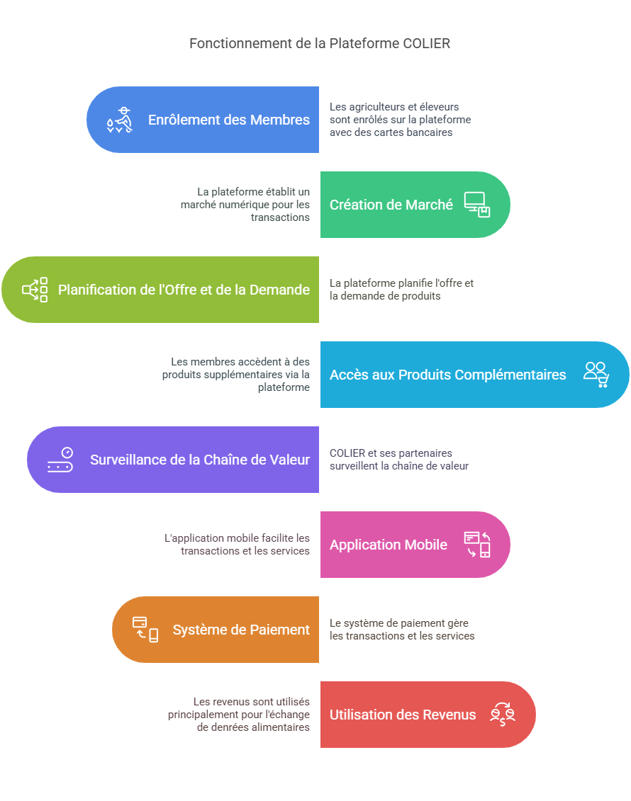
WHAT IS COLIER?
The COLIER Platform is based on the traditional African economic system of TROC (or commodity exchange) using New Information and Communication Technologies (NICT).

Slide 6





COLIER'S PRODUCTS AND SERVICES FOR PRODUCERS
Beneficiaries
Doctors Workers Consumers
Intervention zones
14 vulnerable regions
Activities
Production, processing Marketing
Partnership (6P)
Educational, Technical, Financial

Slide 7
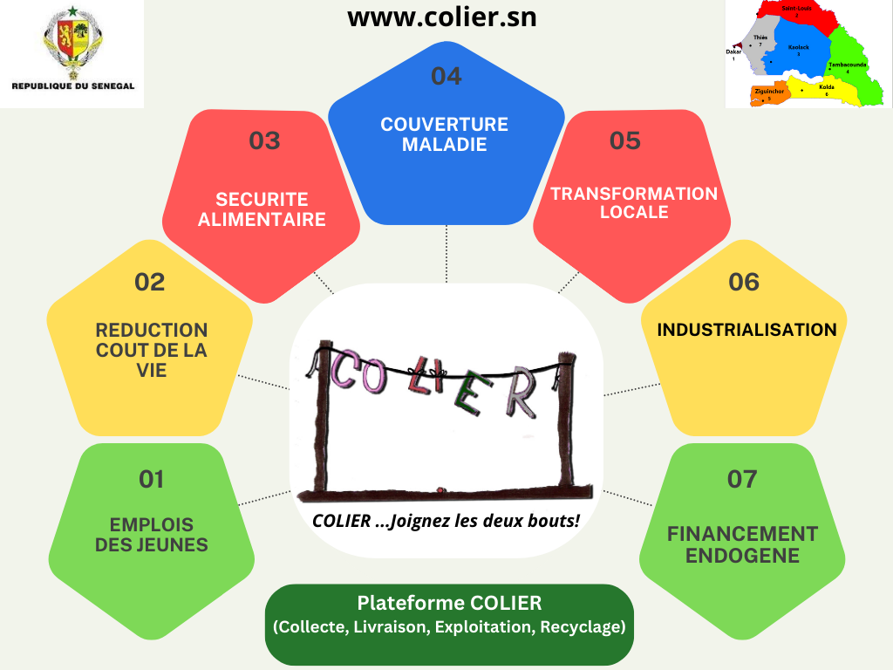

Slide 8
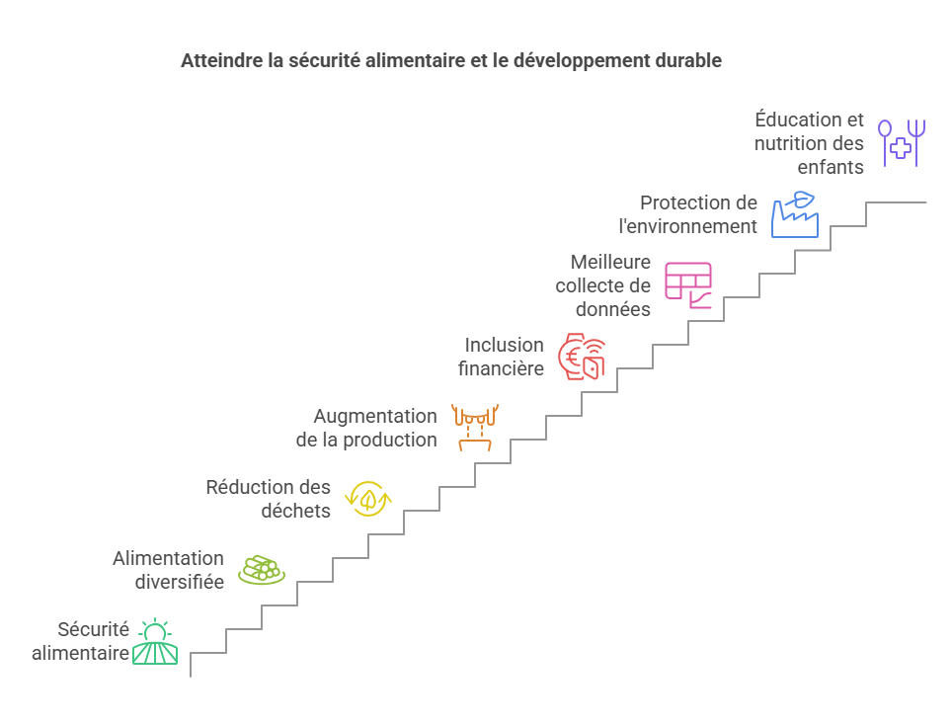
SOLUTIONS PROVIDED BY THE COLIER PLATFORM

Slide 9
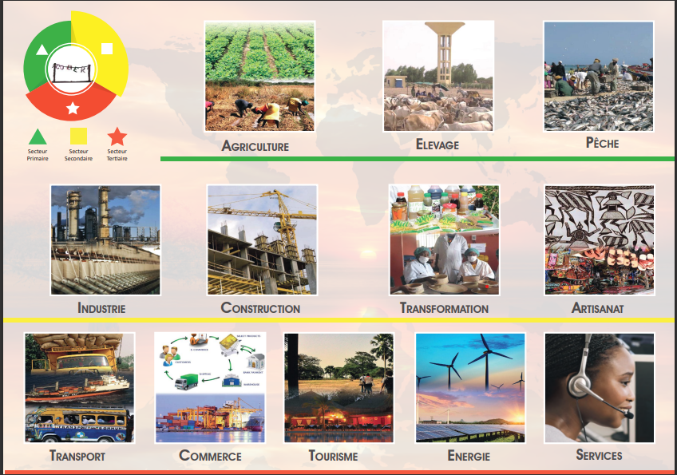
The 12 areas of activity of the COLIER Platform

Slide 10


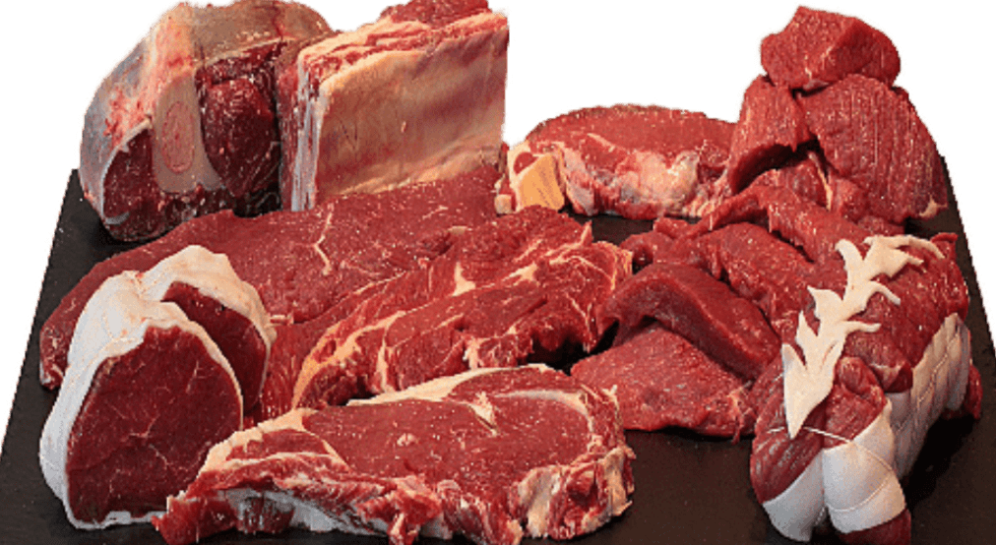
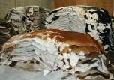

PRODUCTS SUPPLIED BY BREEDERS ON THE PLATFORM
Milk: milk produced by member family farms will be collected from farmers.
Meat: slaughter quotas will be set according to animal reproduction.
Hides and skins: hides and skins from quota slaughterings will be included in the credits of member breeders.
Cow dung: By stabling the animals, the dung collected will replace wood cutting for cooking by using biogas. The digestate will be used in agriculture as fertiliser.
MILK
MEAT
LEATHER AND SKIN
GOAT BOX

Slide 11

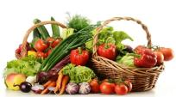
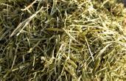

PRODUCTS RECEIVED BY THE PLATFORM'S BREEDERS
Cereal flour (millet, maize, sorghum, cowpea) produced by farmers.
Fodder for livestock from other members' farms.
Pressed or processed fruit and vegetables and juices.
Handcrafted products (shoes, bags, accessories) from the artisans who received the hides and skins
CEREALS
FRUIT AND VEGETABLES
FURNISHING
SHOES

Slide 12






DIGITAL PLATFORM, BANK CARD, MOBILE APPLICATION
BANK MEMBERSHIP CARD
HALMAMY
MOBILE APPLICATION

Slide 13
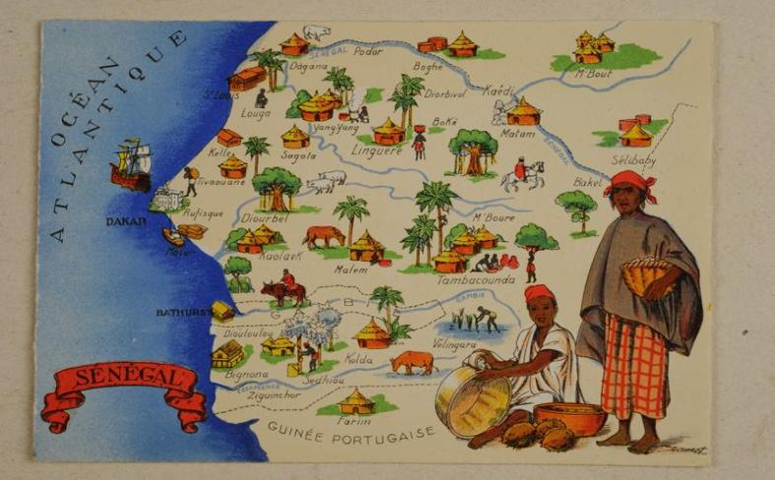
THANK YOU FOR YOUR KIND ATTENTION

