Slide 1


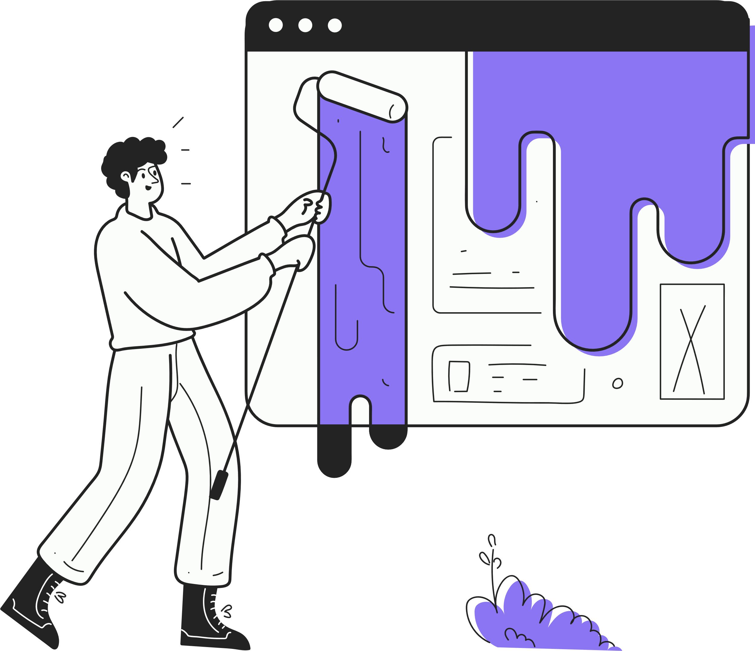


Team Up 2024
June 25, 2024
Session 4 - Prototyping

Slide 2


Introduction to today's session (5 min.)
Today’s Agenda
Prototyping canvas (15 min.)
Working 1:1 in break-out rooms (60 min.)
Summary & Next Steps (10 min.)

Slide 3




Why and when to prototype?
Determine whether or not the idea for your product will work the way you intended, before they’re out in the world and in the hands of customers
Does it solve the problem exactly as planned?
Is it customer-friendly, intuitive and effortless?
Test product functionality, appearance and performance.

Slide 4
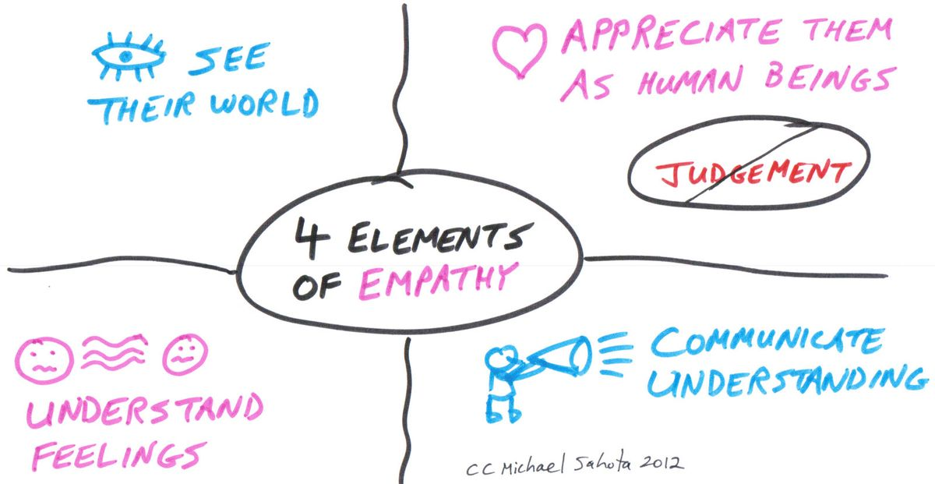
Prototyping
Understand
Understanding ends in Insight
IDEATE
Generation of Ideas
Deliver
Creation and experimentation
Figuring out the Problem
Empathy
Define
Ideate
Prototype
Test
What?
Why?
How?
SWOT analysis
PEST analysis
scoring matrices
to compare and rank your ideas
Refining the product based on customer feedback

Slide 5
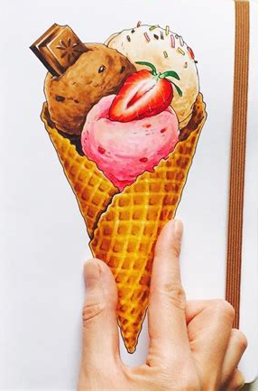


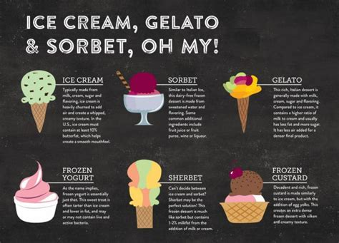
Different prototyping techniques
Storyboarding
mock-ups
3D modeling
description of your product that summarizes its features

Slide 6


Prototype canvas
Problem / Opportunity
Solution / Concept?
Stakeholders
Communications Strategy for prototype?‘
EXPLAIN
FEEDBACK
NEGOTIATE
PERSUADE
Assumptions & Questions:
About the clients and their needs
About technical feasibility & functionality
About the cost & business
Reseources to build:
What you have? What is needed?
Time; Money & People?
Prototype
Build the simplest prototype possible (least cost,& materials) to test critical assumptions & answer critical questions
Prototyping approach
  Parallel prototyping Sequential prototyping
  Experience prototyping Scaling
  Role playing Remove unessential features
  Requirements relaxation Re-purpose existing product
  Paper prototyping Other: …………………………
Testing Plan
What are you testing?
What metrics are needed? / Qualitative / Quantitative assesment
Time, Place, Materials & People required to test
Critical Assumptions & Questions
What is the most critical to the success of this project?
Succes when?
Scaling impact
Insights gained from testing:
What did you learn? Did you fully answer the questions?
KPI‘s

Slide 7
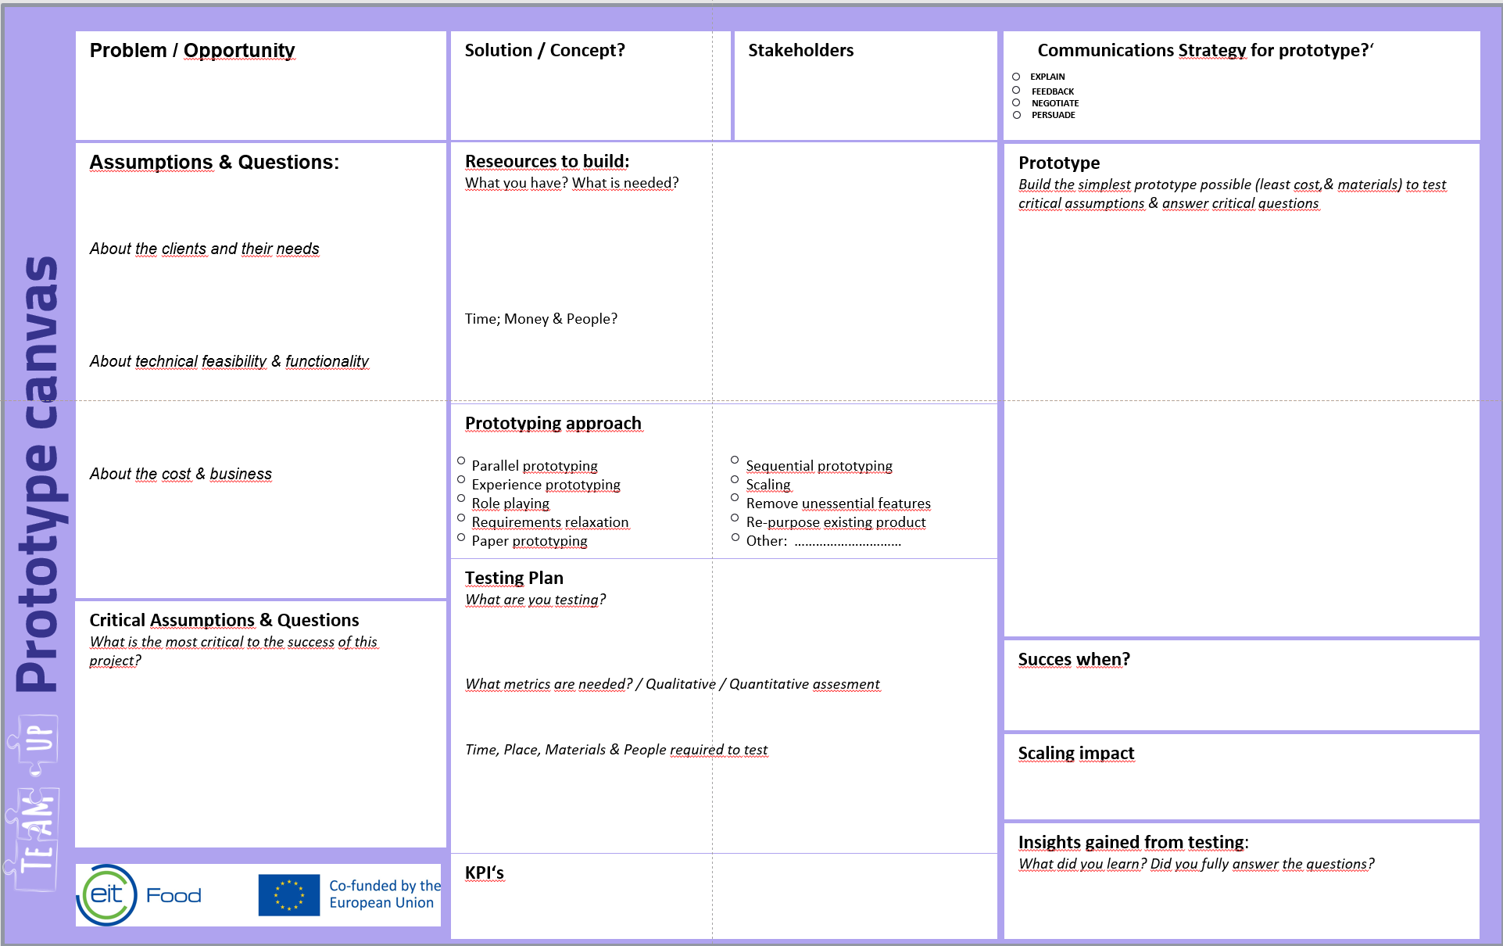
1:1 work
please go to breakout room to work in teams
come back to the main session at 17:20 CET

Slide 8
Prototyping Canvas -
short feedback
What did you learn?
Did you fully answer the questions?
Biggest challenge?
More on Design Thinking & Tools
https://en.dt-toolbook.com/tools

Slide 9



Save the Dates
Session 4: Speed dating Prototyping
Session 5: Speed dating Business Model
Friday: hang-out
25th June
16:00 - 17:30 CET
27th June
16:00 - 17:30 CET
21th June
16:00 - 17:00 CET
Tech show Biz
Biz show Tech
Q&A and more!
Week 1
Week 2
Week 3
Week 4
Week 5

Slide 10

Week 1 Let’s get started | Week 2 Speed dating | Week 3 Get to know your potential matches | Week 4 Working together: Case studies | Week 5 Preparing your proposal
Session #1 Matchmaking Kick-off 17th June 16:00 - 17:30 CET | Session #4 Speed dating Prototyping 25th June 16:00 - 17:30 CET | Session #6 Get to know three co-founders 2nd July 16:00 - 17:30 CET | Session #8 Working together co-founders 9th July 16:00 - 17:30 CET | Session #10 Preparing proposal with co-founder 16th July 16:00 - 17:30 CET
Session #2 Tech pitch 19th June 16:00 - 17:30 CET | Session #5 Speed dating Business Model 27th June 16:00 - 17:30 CET | Session #7 Get to know three co-founders 4th July 16:00 - 17:30 CET | Session #9 Working together co-founders 11th July 16:00 - 17:30 CET | Session #11 Preparing proposal with co-founder 18th July 16:00 - 17:30 CET
Session #3 Biz Pitch 21st June 16:00 - 17:30 CET | Friday hang-out 28th June 16:00 - 17:00 CET | Friday hang-out 5th June 16:00 - 17:00 CET | Friday hang-out 12th July 16:00 - 17:00 CET | Last call 19th July 16:00 - 17:30 CET

Slide 11
Next Steps
Manage your agenda for next week
to find a match
Biz - work on the business models canvas with your #Tech partners

Slide 12

Contact Us!
Do you have any questions?
teamup@eitfood.eu

