Slide 1
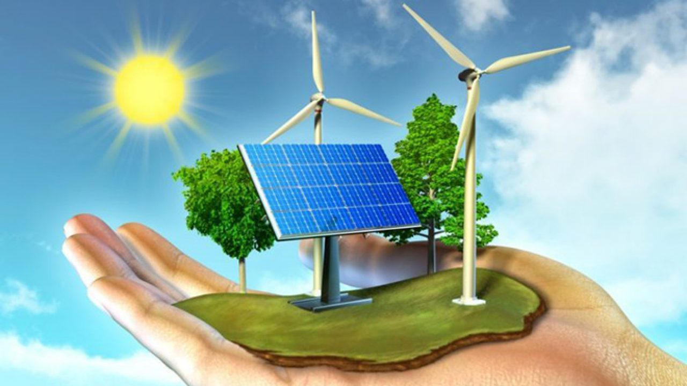
SESAM TECHNOLOGY presents
Multipurpose
marine
platform

Slide 2
1. Marine power
The seas and oceans of the Earth constitute an inexhaustible source of clean energy, capable of meeting all the energy needs, present and future, of all mankind and solving the thorny problems generated by the use of fossil fuels.
The current technologies absorb only a few drops from this reservoir with:
off-shore wind turbines in areas with significant winds
floating platforms for photovoltaic panels
wave power converters in open coastal areas with significant waves
tidal turbines placed in coastal and estuarine areas
ocean current turbines in areas of strong marine currents;
ocean thermal energy converters in deep tropical waters
In general, these are installations specific to a single type of energy, which require high costs and sophisticated technical processes for their implementation.

Slide 3
2. What does a multipurpose platform do?
Although marine energy is huge, it is dispersed over very large areas, with only some locations
favored. For this reason, the optimal configuration of a marine capture system is a modular,
flexible one. Depending on the geography of the respective location, the platform can include a
variable number of modules of different types, to constitute a unitary system. Our multipurpose
modular marine platform (MMP) puts together several types of capture systems:
wave energy capture modules with oscillating columns, folding blade turbines, or point absorber buoys, (also used as compressed air reservoirs, or as gravity capture elements)
wind energy capture modules (horizontal axis turbines mounted on independent pilars, or on the existing support/floating structure, horizontal axis turbines, or folding blade turbines)
solar energy capture modules (PV, thermal, or hybrid)
ocean current turbines energy capture modules
water thermal energy capture modules
In addition to some capture systems that are part of the state of the art, the MMP contains
some innovative systems, much more suitable for a modular system. In order to achieve a high-
performance unitary system, the elements for energy capture jointly use:

Slide 4
3. Energy storage systems
the supporting infrastructure, composed of hollow cylindrical pillars, also used as reservoirs
the floating infrastructure, composed of tanks filled with gas, sized so as to ensure the buoyancy of the entire system, provided with safe anchoring or displacement systems
energy storage systems (with electric batteries, ICAES/TES systems, Carnot batteries)
systems of conversion, optimal adaptation of output parameters and supply of stored energy.
An MMP platform contains a large number of capture modules of different types, which provide physical quantities with different amplitudes and frequency spectra, therefore cumulative storage systems become a necessity. Can be used:
Electric batteries limited to temporary and partial storages, due to their heavy weight
ICAES and TES systems, with an isothermalizer and a gas tank under constant pressure
Carnot batteries, with two isothermalizers, one hot and one cold tank, with active thermal
insulation, for high power systems
The main component of compressed gas storage systems is the isothermalizer, described in patent pending application, PCT/RO2022/000007, a particularly powerful instrument, capable of isothermally compress/expands gases and vapors, working at high pressures and temperatures, as well as in cryogenic mode, constantly controlling the exergetic efficiency of the processes taking place in the device.

Slide 5
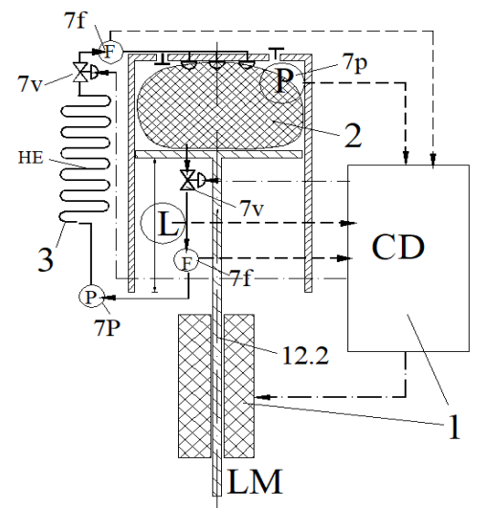
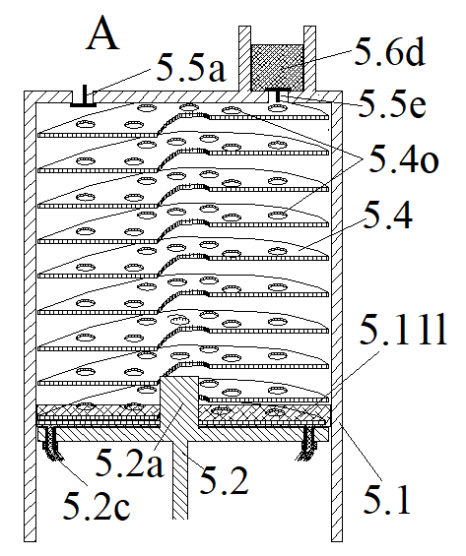
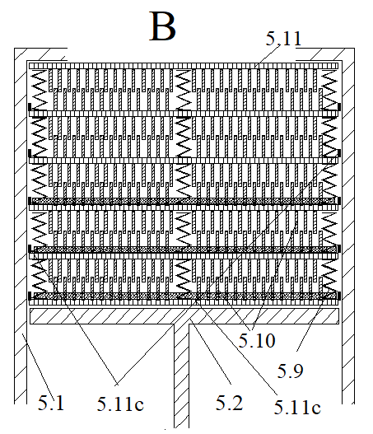
4. The isothermalizer, the main component of the system
- CD = processor: isothermal speed calculation and adjustment system. It ensures maximum efficiency - LM = linear motor
- 2: thermal sponge. Ensures high heat transfer speed and high power density
- 3: the cooling system. Ensures the transfer of heat to the tank
thermal sponge configurations

Slide 6
5. Smart heat engines and heat pumps
In the energy storage systems we propose, for a maximum utilization of the
available exergy, we have considered several rules:
to be avoided direct contact between gases with different temperatures and/or pressures
to be avoided electrical heating of system components
all heat transfer processes between two media should be done with minimal entropy generation
all heat transfer processes between the system and the external environment should be isothermal, with minimum ∆T
the mechanical devices should be located, inside the system, so that the exergy transformed into thermal energy can be accumulated and finally, extracted
The system processor will permanently adapt the power of the capture and supply modules, by changing the speed of the pistons and/or the working pressure of the gas in the isothermalizer

Slide 7
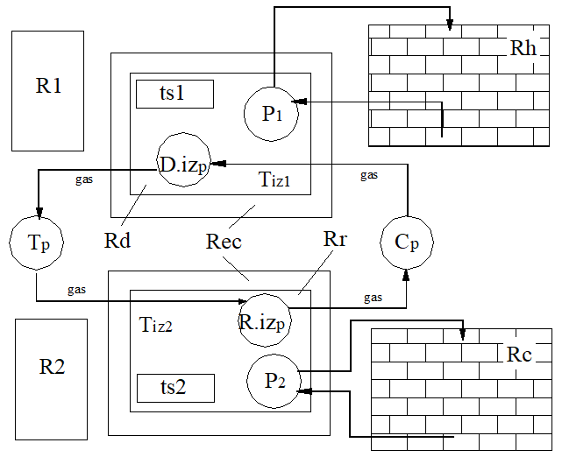
6. Smart Thermal Energy System as Carnot battery
liquid
Rh: hot reservoir
Rc: cold reservoir
Diz: densifier
Riz: rarefier
ts: thermal sponge
P: pump
Rd: the densifier tank
Rr: the rarefier tank
Tp:adiabatic expander
Cp: adiabatic
compressor
liquid
liquid
liquid

Slide 8
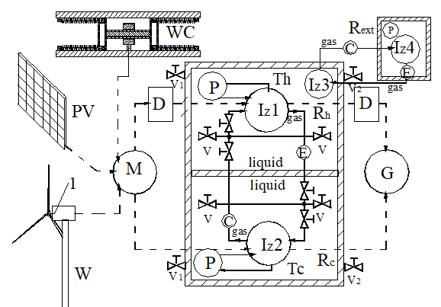
6a. Marine platform as Carnot battery
WC: wind capture modul
PV: photovoltaic panel
W:wind turbine
M: motor
G: generator
D: on/off clutch
Rh: hot tank
Rc: cold tank
Rext: excess heat exhaust system
P: pump
Iz: isothermalizer
A large part of the exergy losses accumulates in the hot reservoir in the form of useful heat

Slide 9
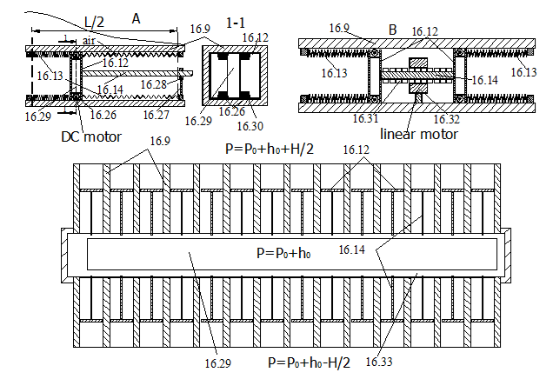
7. Wave energy capture modules
The active element is the piston 16.14 whose displacement determines the generation of electricity. On one side of the pistons there is air at the pressure
in the tank 16.33, and on the other, water, whose pressure differs from this, with the pressure corresponding to the water column at the end of the capture tube (with +, or with -). For the front modules, the initial position of the pistons is fixed by changing the volume of air in the tank, and for the side ones, by changing the angle of incidence.

Slide 10
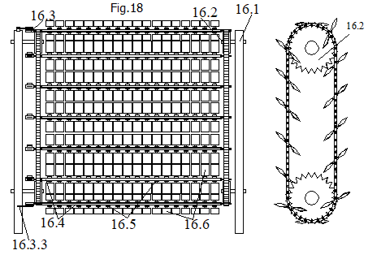
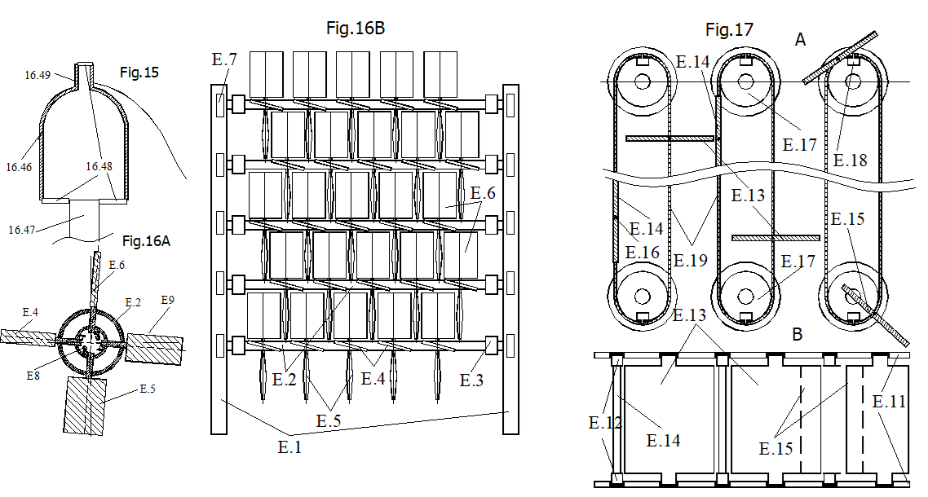
8. Wind energy capture modules
Fig.15: buoy with filling/emptying system
Fig.16A: wind turbine with folding blades
Fig.16B: wind turbines system, pe axe comune, paralele
Fig.17A: wind turbine systems, whith horizontal
bycicle chains and vertical sails; plan view
Fig.17B: idem, front view
Fig.18A: wind turbine systems, whith vertical bycicle chains and tilted sails; frontal view
Fig.18B: idem, side view

Slide 11
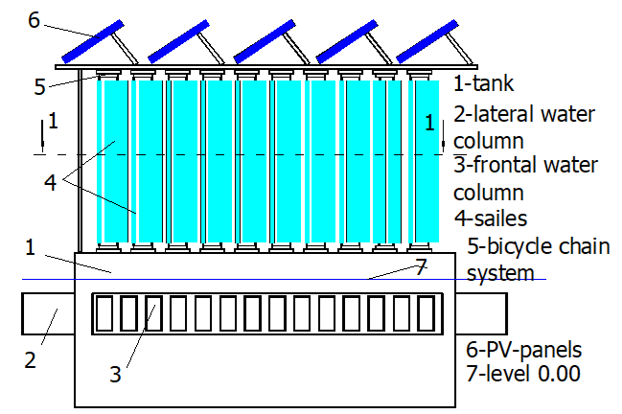
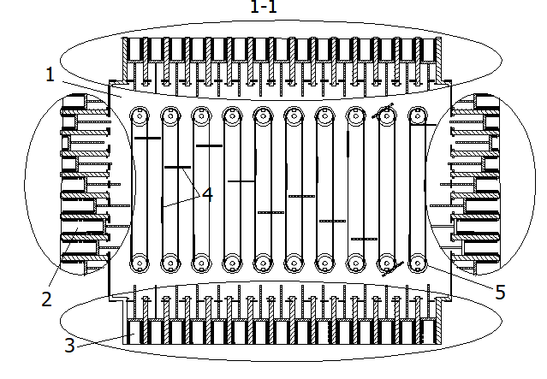
9. Multipurpose platform
Frontal view
View in horizontal section

Slide 12
10. Who is waiting for the platform?
Power producers who will have at their disposal a highly efficient and safe installation, with beneficial effects on the distribution network, with low costs, using common materials
Energy consumers in coastal regions, who will receive cheap and "clean" energy in abundance
Coastal residents, port and tourist facilities, which will be protected against the destructive effects of waves and winds
The inhabitants of planet Earth, who will be protected from the destructive effects of thermal and chemical pollution

Slide 13
Implementation perspectives
The system being modular, it can be made for a wide range of powers, so as to successfully satisfy the needs of a wide range of users. By replacing marine capture systems, they are also particularly effective for on-shore systems. However, in the initial phase, our efforts will be directed towards attracting large energy producers and relevant government institutions, so that the effect of the invention is fast and convincing. This time frame will be used to study the market response to such an offer and act accordingly

Slide 14
SESAM TECHNOLOGY SRL Berceni
STARTUP COMPANY, FOUNDED IN 2023
CO-FOUNDED BY:
OANA LAZA – CEO AND BUSINESS MANAGER
oana.laza@sesamtechnology.eu
ARPAD TOROK – INVENTOR and patent holder
arpi.torok@sesamtechnology.eu
Bibliography: - https://hal.science/hal-04398998
- PCT/RO2022/000007
- PCT/RO2023/050009

