Slide 1







HYPERION ADVANCED TECHNOLOGY INC.
Look to the future with more confidence and health with Hyperion…
Cancer Screening and Preliminary Diagnosis Device
Taner KARATEKE/Founder

Slide 2

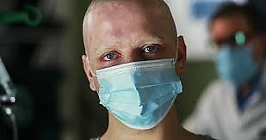
Did you know that one in four people closest to you, including you, has a 100% risk of developing cancer?

Slide 3
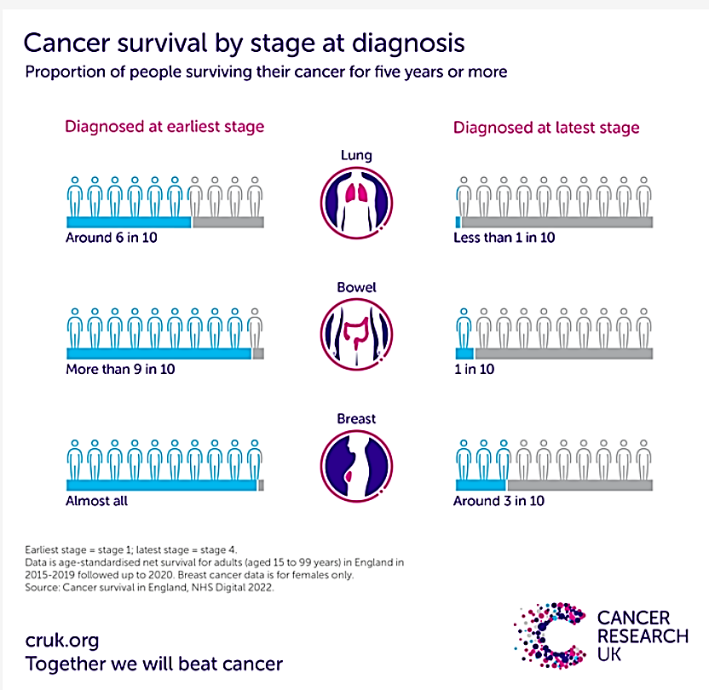
Cancer diagnosed at an early stage has a higher chance of being successfully treated.
Early diagnosis of cancer saves lives.
The earlier the diagnosis, the longer the life expectancy

Slide 4
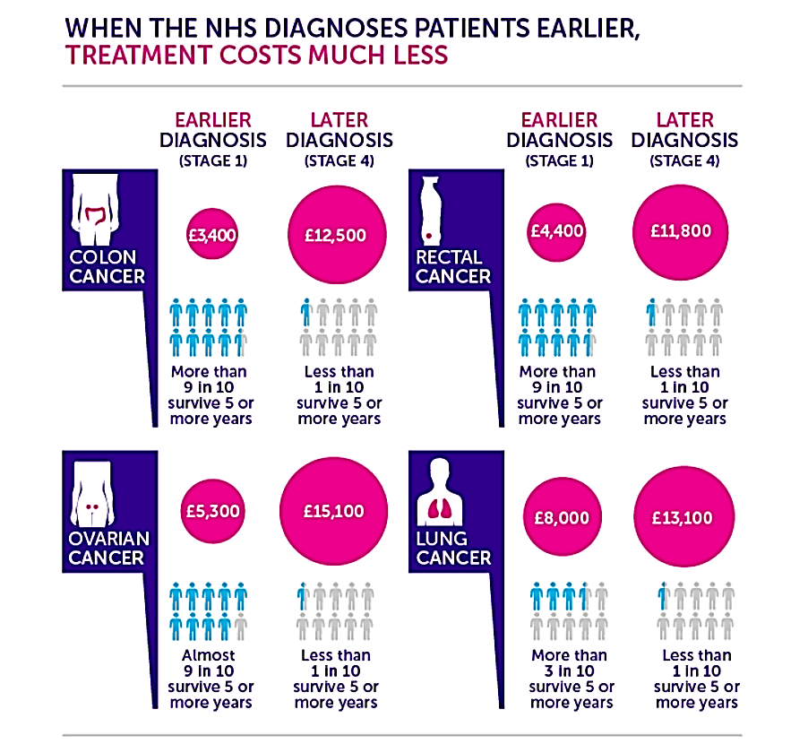
With early diagnosis;
The patient's survival potential increases.
Costs for treatment and diagnosis decrease.
Elimination of symptoms that reduce the quality of life and shorten life expectancy during and after treatment.

Slide 5
About us…
It was founded in 2022 with the aim of developing a completely original and innovative preliminary diagnosis device against cancer, supported by TÜBİTAK 1512.
1 national and 1 international patent applications were made for the project. It is planned to make 2 national and international patent applications.
In the long term, it was aimed to develop R&D projects in the fields of health, bioinformatics, defense, space and aviation, quantum technologies, nanotechnology, robotics, agriculture and energy.
In 2022, the same project was eligible to receive support within the scope of the KOSGEB Advanced Entrepreneurship Program.
Expanded the team from 3 to 5 people.

Slide 6
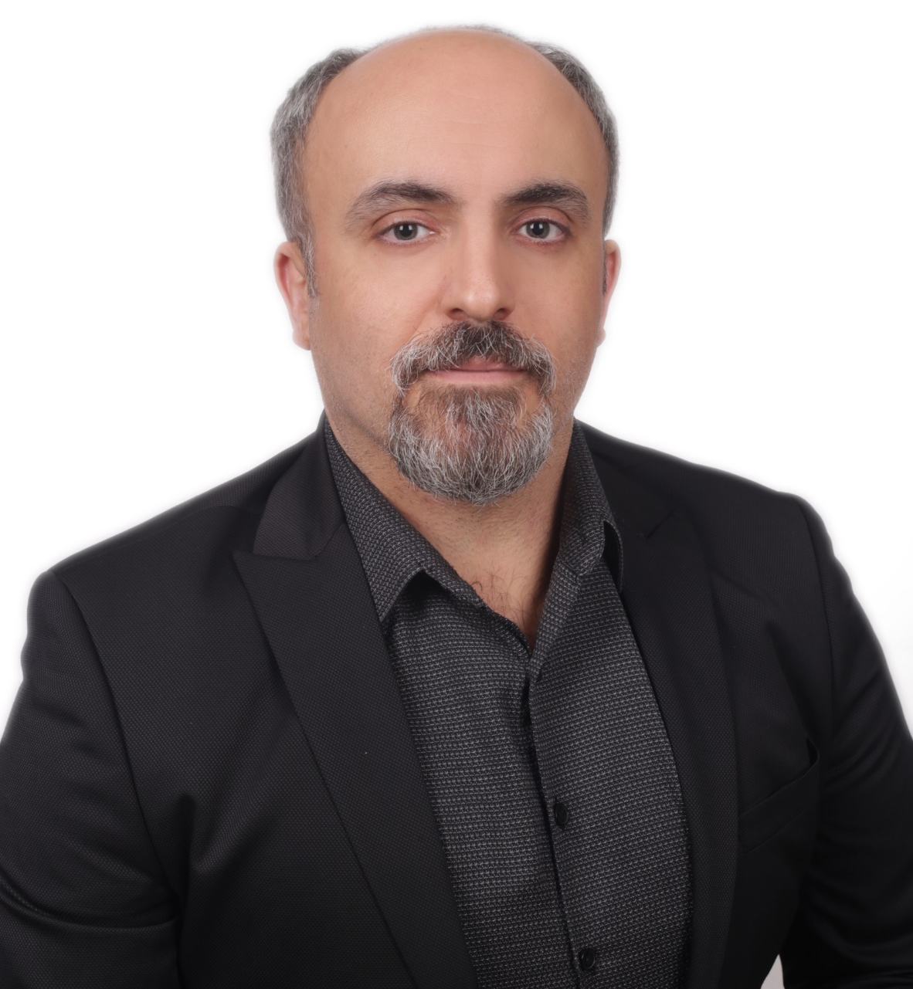
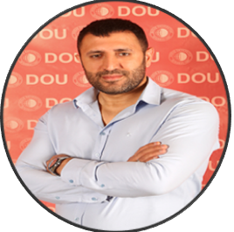
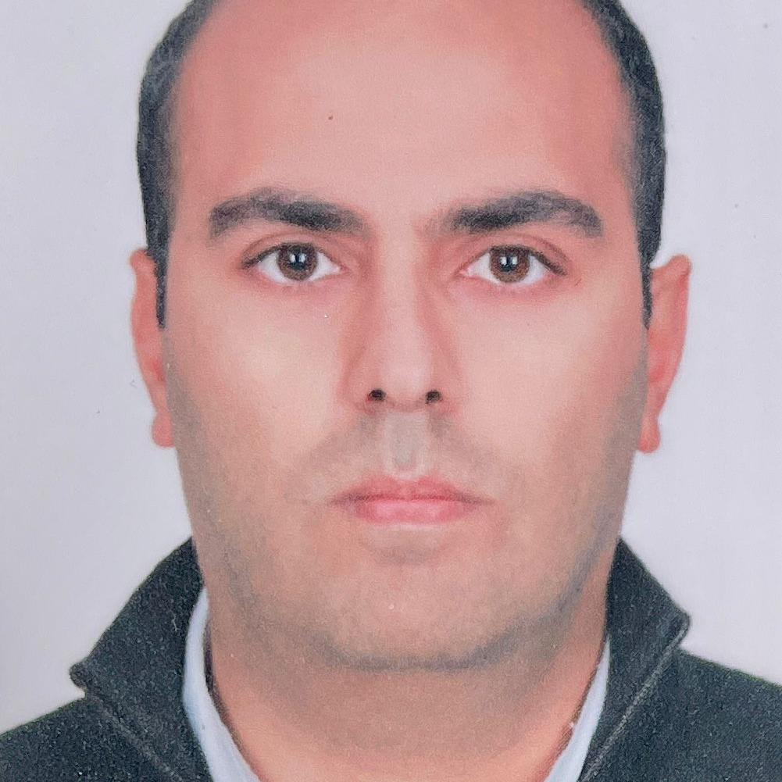
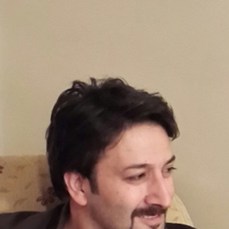




Our Team
Taner KARATEKE/Lecturer
Title: Founder/CEO Modelling and Simulation Engineer
Bachelor’s Degree:Physics
Master of Degree: Physics/Optical Engineering/Computer Engineering
Phd: Physics
Ertuğrul KIRAÇ/Assistant Professor
Title: Software/Hardware Engineer
Bachelor’s Degree: Physics (English)
Master of Degree: Physics
1.Phd: Defense Technologies 2.Phd: Computer Engineering (Contiuneing)
Abdullah YURTOĞLU
Title: Mechanical Design and Fluid Mechanics Engineer
Bachelor's Degree: Mechanical Engineering

Slide 7
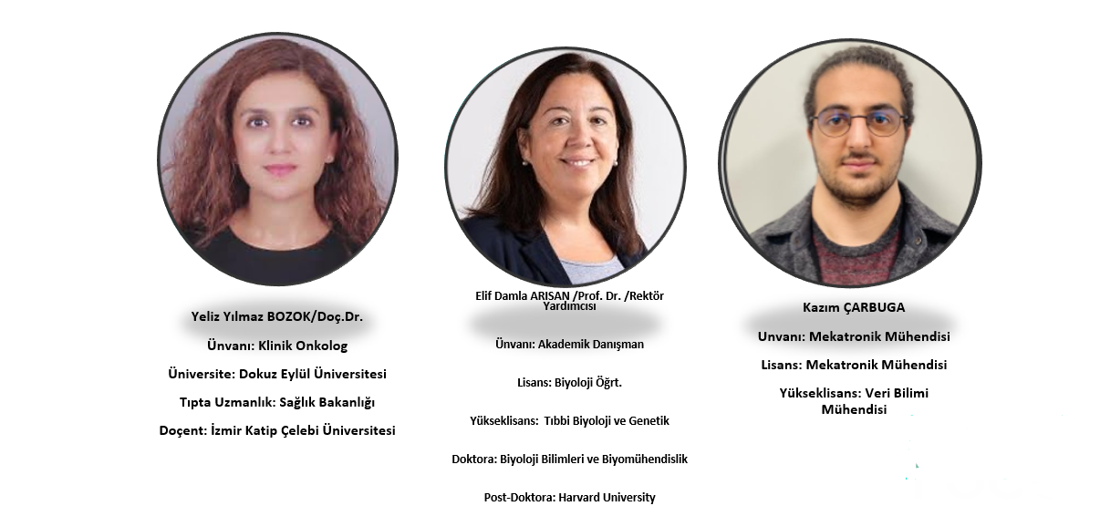
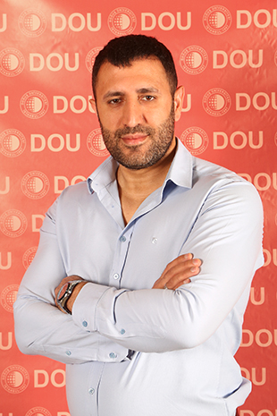
Our Team
Elif Damla ARISAN/ Prof. Dr./Vice Rector
Title: Academic Consultant/Cancer Biology Expert
Graduate: Biology Teacher
Master of Degree: Medical Biology and Genetics
Phd: Biological Sciences and Bioengineering
Post-Doc: Harvard University
Yeliz Yılmaz BOZOK/Assoc. Prof.
Title: Clinical Oncolog
University: Medicine
Medical Specialization: Ministry of Health
Assoc. Prof. Dr.: İzmir Katip Çelebi University

Slide 8


Insights That Reveal Project Ideas
1
2
3
4
Trying to treat cancer with conventional methods only after it reaches a certain mass size
High costs in disease diagnosis and treatment
The patient's life expectancy and quality decrease at the end of the diagnosis and treatment processes.

Slide 9
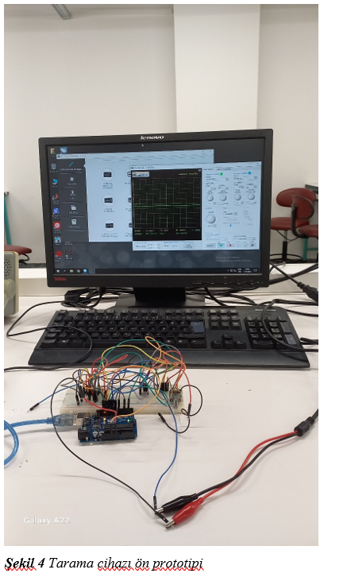
Our Solution Proposal
1.Our Value Proposition
2. Our Value Proposition
Our Solution to the Scanning Problem
Our Solution for Preliminary Diagnosis
Providing biomechanical data of cancerous and healthy cells
Determining the probability of a healthy intestinal cell turning into a cancerous cell

Slide 10
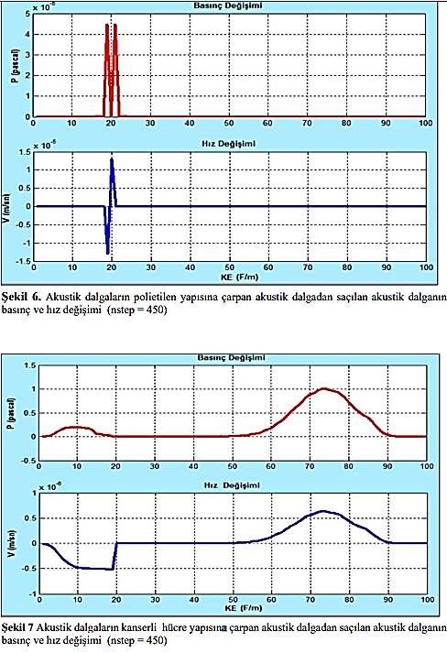
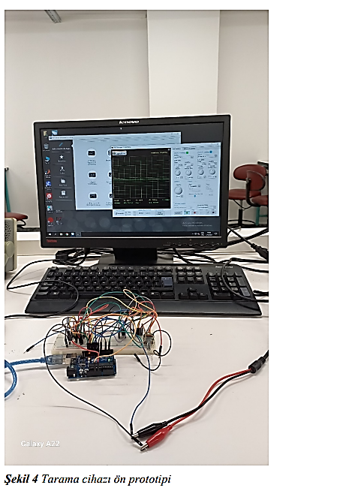
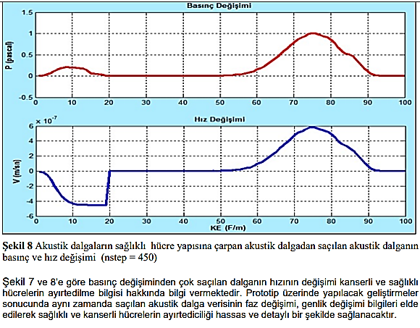




HOW DO WE DO IT?
4
1
Acoustic waves sent to and scattered from the cellular structure
Creating a large data bank
PRE-DIAGNOSIS with Machine Learning/Deep Learning method
Detection and Processing of Scattered Acoustic Wave
ADIM 4
2
3

Slide 11
Current Status & Intermediate Processes & Future Status
It started with the support we received within the scope of TÜBİTAK 1512 and KOSGEB Advanced Entrepreneurship program.
Creation of a large data bank within the scope of hospital collaborations
Transforming a healthy cell into a cancerous cell with the appropriate machine learning method
Performing validation and verification processes using a large data bank
The final product for the screening problem was developed within the scope of TUBITAK 1507.
3.Step
Cancer Screening and Preliminary Diagnosis Device
2.Step
Development of a preliminary prototype for the scanning problem of the device
1.Step

Slide 12



Our Road Map
-Obtaining a prototype of the final product
-Conducting large data bank studies for testing, verification and validation purposes
-Conducting studies on potential long-term projects
-Completion of the preliminary prototype for the scanning problem
-Application to TUBITAK 1507 program
2019
Q2
2024
Q2
-Completing the prototype of the scanning section, which represents the intermediate output/product of the project.
-Conducting testing and validation of the prototype.
-Obtaining a national patent covering the method and hardware structure while the project is in the idea process
2025 Q4
2025 Q1

Slide 13
Competitors
Strengths
Weaknesses
Preliminary diagnosis at or before phase zero can be made.
Targeting cancer treatment with simple drug therapy.
Reducing diagnostic and treatment costs.
Extending life expectancy.
Access to international cancer cell data
Organization and financial resources necessary to conduct scientific studies on the product on a large scale
SWOT
Analysis
Opportunities
Threats
Steady growth of the diagnostic market.
It enables the development of potentially effective drug therapy and advanced imaging devices in the field of cancer.
Potential for intermediate product production other than the main product as a result of the development of the project.
Difficulty in carrying out R&D studies of the project due to financial inadequacy.
Inability to employ the necessary human resources due to financial inadequacy.

Slide 14



Revenue Model
Direct Product Sales + certain amount of profit for each measurement
Monthly or annual rental for a certain period of time + commission at a certain rate for each measurement
Revenue Model
B2B: Hospitals, Clinics, Medical Centers
B2G: Social Security Institution, Private Health Insurance
B2B: Hospitals, Clinics, Medical Centers
B2G: Social Security Institution, Private Health Insurance

Slide 15

Marketing Plan
The estimated product cost is 1,800,000.
The estimated turnover for the 1st and 4th years is only valid for device sales and does not include commission amounts for each measurement for the device to be developed, as stated in the income model.
Real and accurate turnover information is included in the financial analysis section.
 | 1.Year | 2. Year | 3. Year | 4. Year
Estimated Number of Customers | 5 | 10 | 15 | 20
Estimated Product Quantity | 5 | 12 | 16 | 22
Estimated Average Product Price ($) | 200.000 | 200.000 | 250.000 | 270.000
Estimated Turnover($) | 725.000 | 1.500.000 | 2.960.000 | 4.730.000

Slide 16






info@hyperionadvancedtech.com
https://www.hyperionadvancedtech.com/
+534 380 06 20

