Slide 1
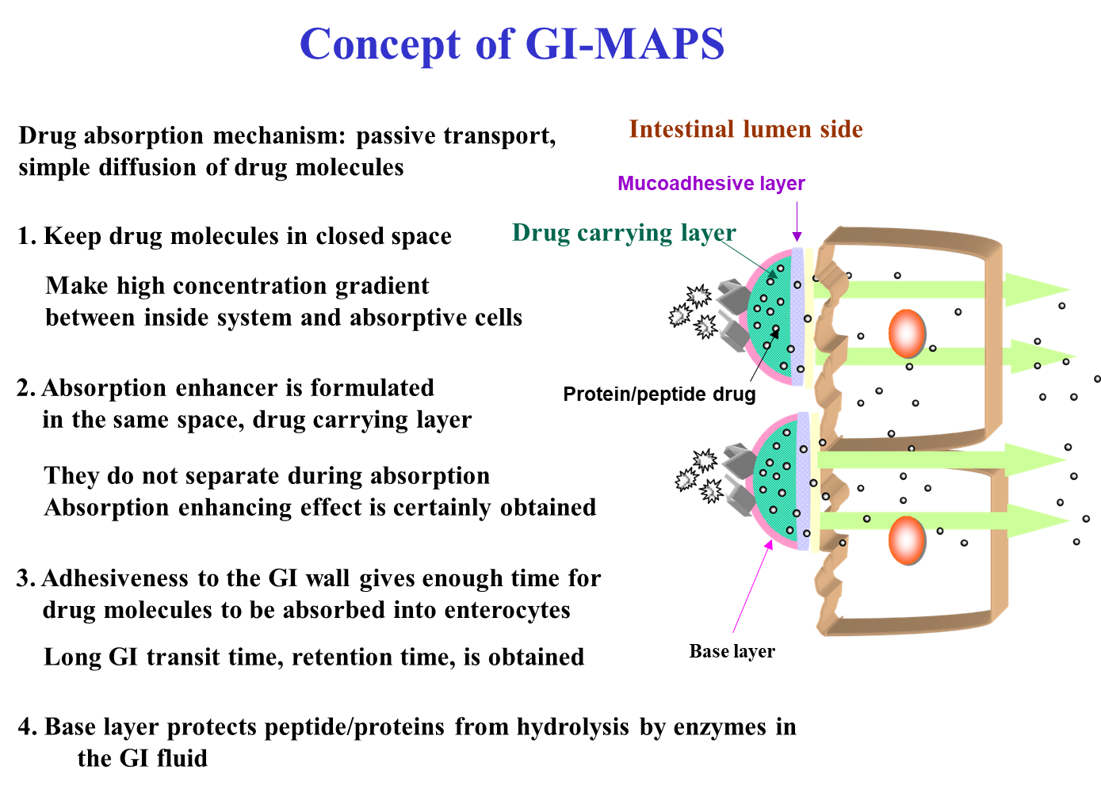
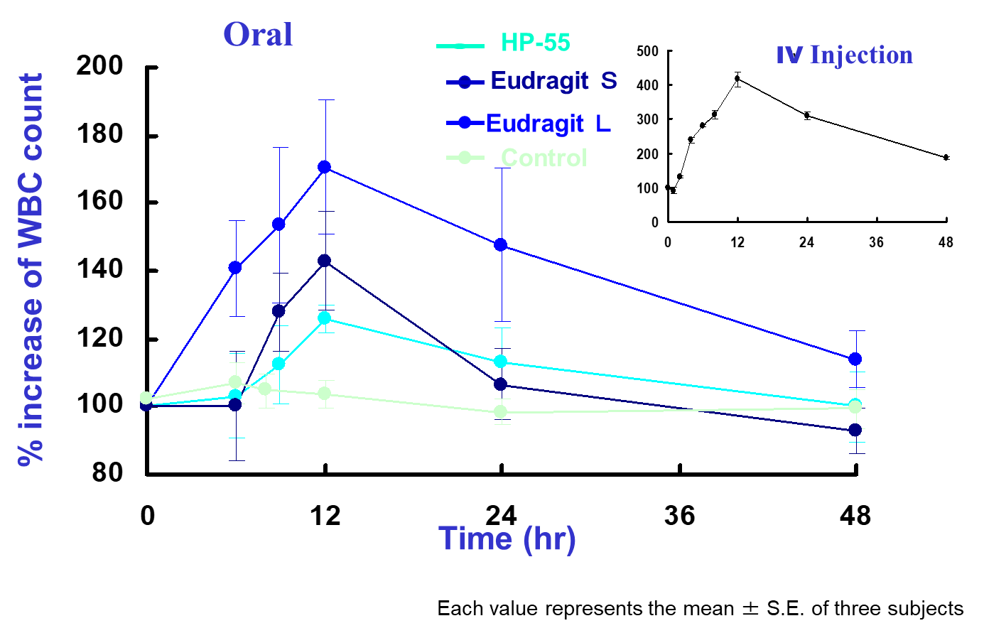
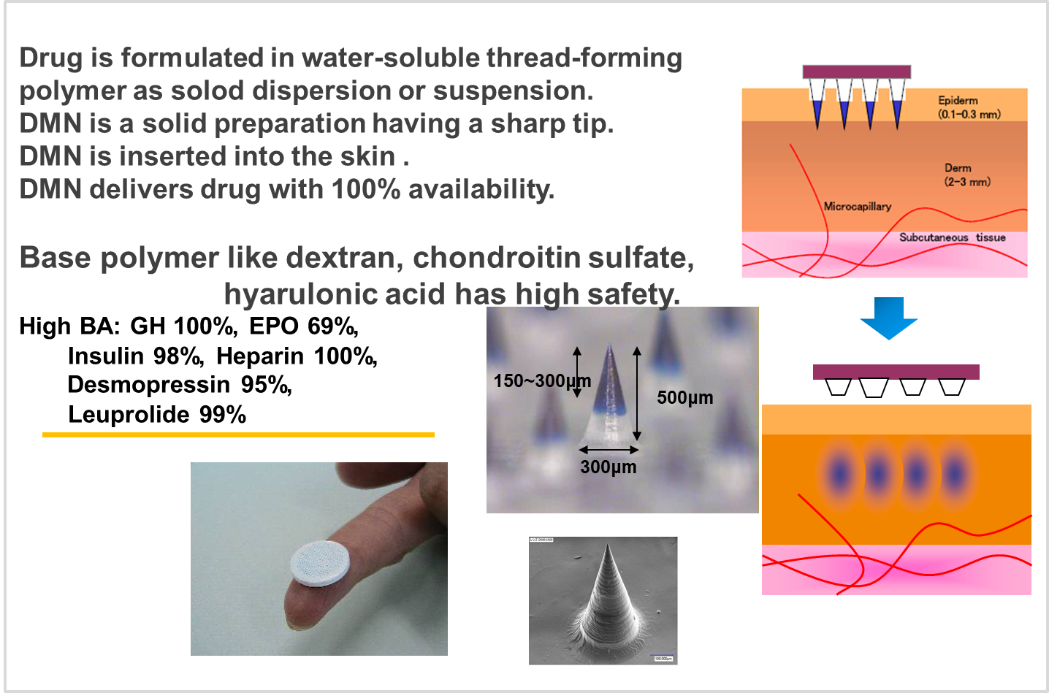
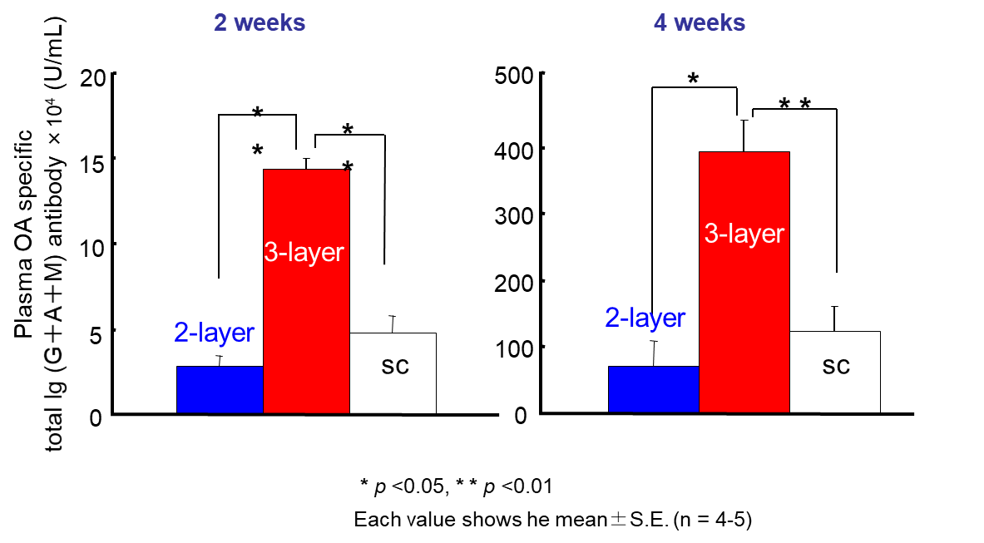
BioSerenTach Inc.
Address : Shimizu-cho 389, Nakagyo-ku, Kyoto, Japan 〒604-0874
Tel & Fax : +81-75-746-2160
E-mail :info@bioserentach.co.jp
Key Words：DDS, Oral, Transdermal, High Bioavailability
Company Activity Description：
To solve low bioavailability (BA) problem of macromolecules, we provide two DDSs. Gastrointestinal Mucoadhesive Patch System (GI-MAPS), and Dissolving Micropiles (DMs). GI-MAPS gives better solution, 5-10% BA, and DMs gives best solution, almost 100% BA is obtained. As both DDSs are made of pharmaceutical additives, both DDSs have high safety. We are looking for client companies to produce under GMP and to develop new oral and transdermal DDS preparations.
Products & Service：
Products & Service Name | Stage | Outline | Type of Partnership Considered
bFGF DM | clinical | Anti-aging effect in 300 patients | License
GI-MAPS | Pre-clinical | Feasibility study in big pharm | Technical cooperation
GMP production partner |  | Contract manufacturing | License
(Fig. 1) Concept of GI-MAPS
(Fig. 2) PD study of GCSF GI-MAPS
DM is a high patient compliance needle-free patch and has high potency for pandemic infectious diseases, COVID-19
・Convenient / Easy to apply・Potential for in-home / expanded use
・Avoid ‘cold chain’ / Room-temperature stable patch
(Fig. 3) Concept of DMs
(Table 1) Skin vaccination by DMs

