Slide 1



UNITE Project Proposal
Remote Health Parameter Monitoring and Data
Analysis
Mihaela Vida - Lecturer
Liliana Filip - Project Manager
November 2025

Slide 2
Romanian Consortium Parties to be involved in the Project
Consortium Leader: Polytechnic University from Timişoara –
Large company: ETA2U – ITC Company, responsible for the monitoring system
User: Timiş County Emergency Hospital “ Pius Brȋnzeu” for monitoring the health status of pregnant women before and after child birth. Obviously, the use cases can be extended to other type of patients as well.

Slide 3
Project preliminary information
Innovation challenges: Digital Innovations Advancing More Personalized and Human-Centric Remote Care
P4 medicine engagement: developing effective digital health solutions relying on new technologies and close collaboration with healthcare organizations and patients.
New innovative technologies (IoT, smart sensors, machine learning (ML) and AI) tackle a human-centric and personalized medicine approach.

Slide 4
Project Presentation
Scope: A Monitoring System able to support Medical Practioners, Hospital/ Clinic Specialists with real time data, alert thresholds, and next to generate predictions on the health status, patient specific care needs including medication updates.
Advanced Applications & Tools: ML/AI, IoT, Smart Sensors integrated in an Arm Band LoRaWAN® Device for the Health Monitoring.
Health parameters to be monitored: Body Temperature, SP02 (periferal oxygen saturation), Heart Rate and Respiration Rate.

Slide 5
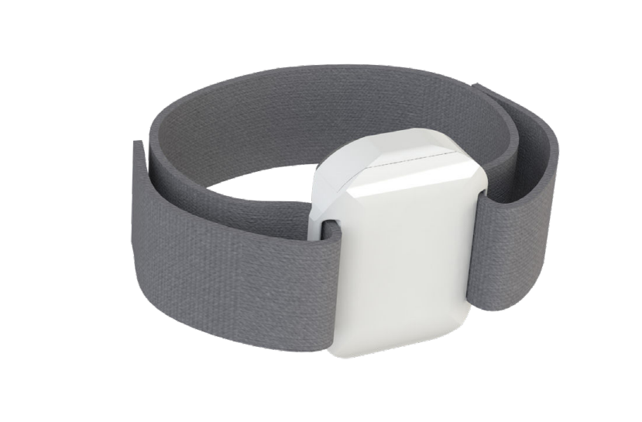
Why an Arm Band LoRaWAN® Device for the Health Monitoring?
Compliant with the safety standard IEC 60950-1 (CE).
Data are protected with the state-of-the-art security properties.
Device was tested to ensure the right data reception: FCC 15.247, FCC 15.209.

Slide 6
Consortium needs
A Hospital/Care Unit agreeing with the monitoring system concerning the previous mentioned parameters for a specific number of patients.
A SME able to overview the LoRaWAN® network and the monitoring system in the specific user area during the Project life.
Investement costs in the LoRaWAN® network can be with the Hospital or SME, up to the local arrangements.
ETA2U will provide all the necessary information on the hardware & software requirements for that purpose.

Slide 7
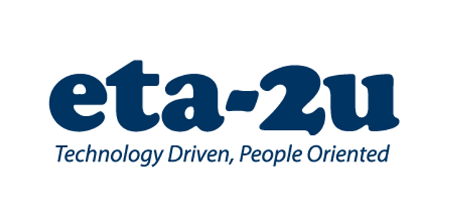
Thank you!
UNITE Project Proposal
Remote Health Parameter Monitoring and data analysis
Mihaela Vida - Lecturer
Liliana Filip - Project Manager
November 2025

