Slide 1

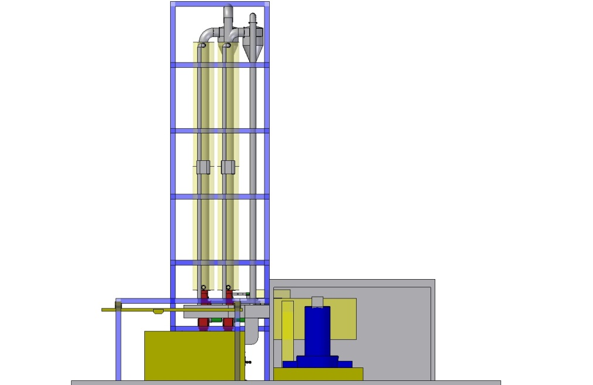
Value circle
Consumers
End-of-Life Plastics
New Plastics
Shredded mixed plastics
Syngas
LTC-Gasifier

