Slide 1
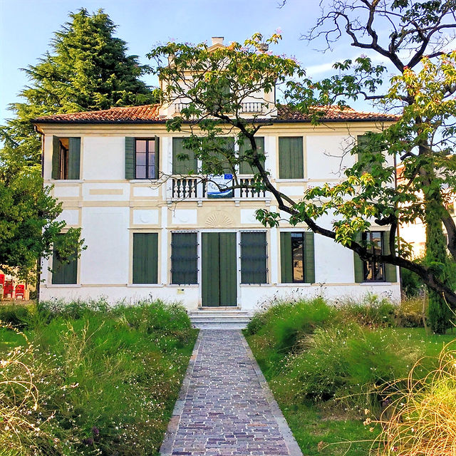


Innovation and Development Department
Oscar Zanutto
faber@israa.it
Treviso - Italy

Slide 2

WHAT IS ISRAA?
ISRAA is an Italian public senior care provider based in Treviso with knowledge and experience in assisting seniors to remain independent, by promoting positive feelings in an age-friendly environment.
ISRAA is specialised in:
providing support to people with Alzheimer and dementia
research and actions on Age-Friendly environments, assistive technologies and the therapeutic function of art.

Slide 3
4
nursing homes
2
day-care centres
+700 employees
350
12
850
carers
GPs
residents
70
21
Care managers
nurses
32
flats for autonomous seniors
17
Physical rehabilitation trainers
1000
15
psychologists
seniors in home care

Slide 4
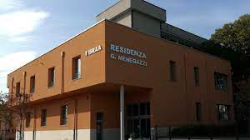
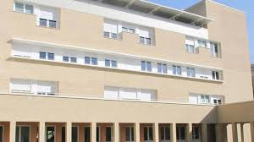
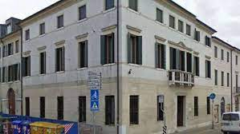
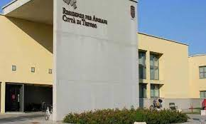
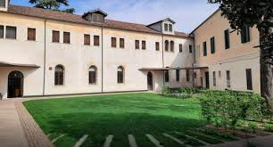
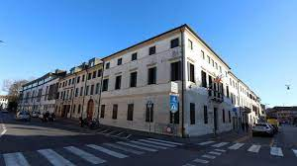
Giuseppe Menegazzi nursing home
Rosa Zalivani nursing home
ISRAA headquarter
Residenza per Anziani città di Treviso nursing home
BMSC Cohousing
Casa Salce nursing home

Slide 5
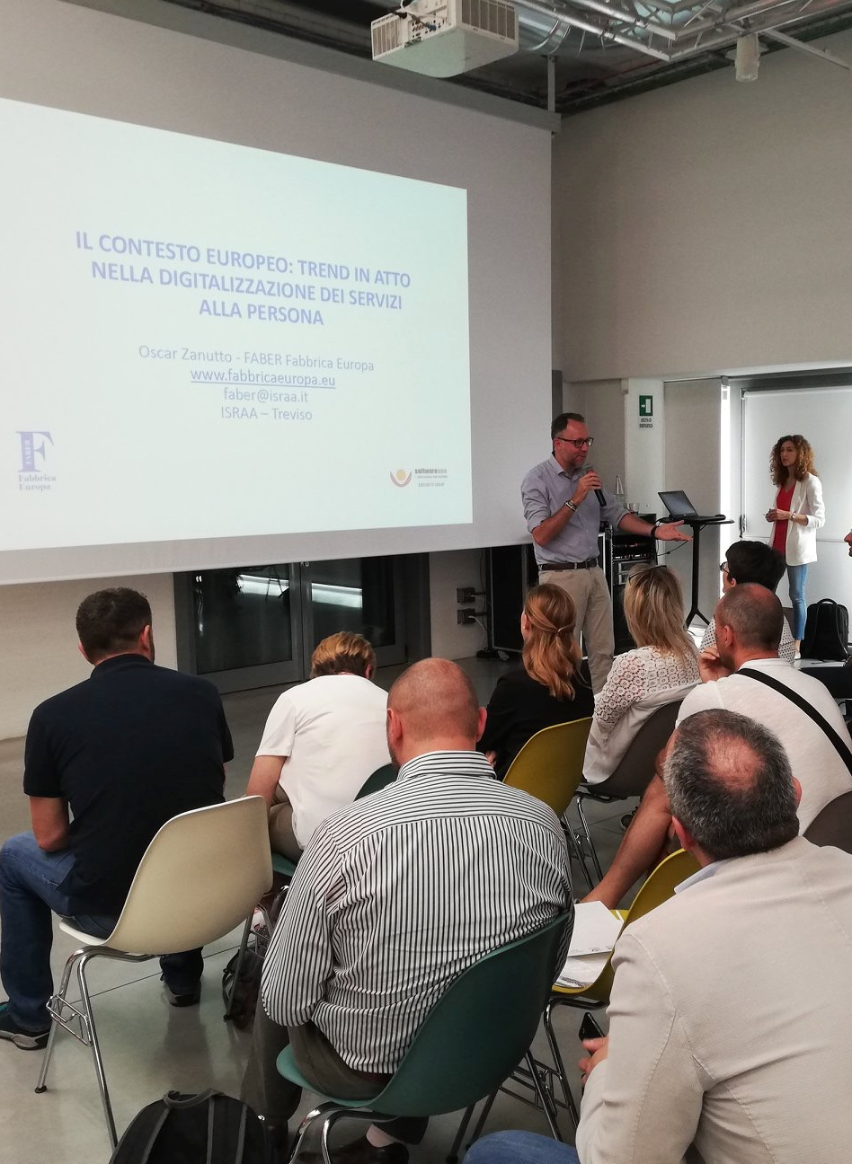
What we do
Our projects are intended to:
promote the digitalisation of health and social services;
support new forms of inclusion;
Support social innovation;
Support active ageing and health

Slide 6




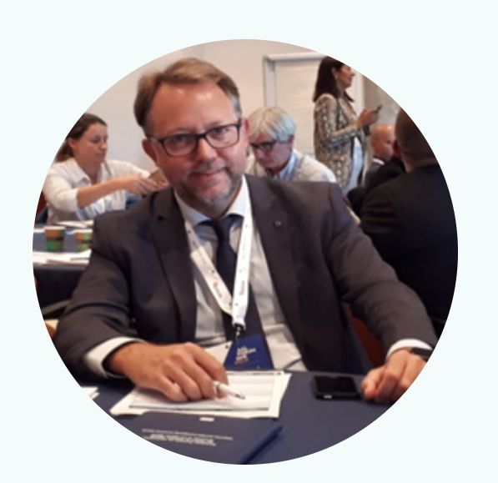



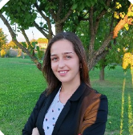
OUR TEAM
SARA CERON
GIORGIA COLDEBELLA
ADELE DE STEFANI
OSCAR ZANUTTO FABER Coordinator
FRANCESCA MASIERO
MARTA MATTARUCCO
SILVIA PALMA
DAVIDE TUIS

Slide 7







OUR PROJECTS
25 ACTIVE PROJECTS

Slide 8

SIRENE
CSA Horizon Europe
(2022-2024)
The main aim of the SIRENE proposal is to support the growth of social innovation ecosystems delivering eco-friendly and sustainable community-based services for SHAFE (Smart Healthy Age-Friendly Environments) implementation in Europe, by providing a workable framework for investment and the broad adoption of high-quality smart living solutions, combining the housing sector and ICT infrastructure.
PARTNERS:
1 SHINE2EUROPE lda (PT) coordinator
2 Afedemy, academy on age-friendly environments in europe bv (NL)
3 Echalliance company limited by guarantee (IRELAND)
4 F6s network ireland limited (IE)
5 Istituto per servizi di ricovero e assistenza agli anziani (IT)
6 Fundacion tecnalia research & innovation (ES)

Slide 9

DEDALUS
IA Horizon Europe
(2023-2025)
DEDALUS will design, develop and demonstrate SSH-driven multi-value energy carrier-agnostic micro (home/apartment)-to macro(building & district-scale) participatory Demand Response (DR) ecosystem, aimed to: (a) facilitate and scale up residential energy consumers massive participation to DR; (b) adapt to a variety of different mono-carrier (electricity, heat) or multi-carrier synergetic scenarios (electricity vs heat and natural gas) at building/district scale, while strengthening social interactions within respective communities
PARTNERS:
1 ENGINEERING - INGEGNERIA INFORMATICA SPA Italy Coordinator
2 ETHNICON METSOVION POLYTECHNION Greece Partner
3 FUNDACION CARTIF Spain Partner
4 UNIVERSITA POLITECNICA DELLE MARCHE Italy Partner
5 ARCELIK A.S. TR Partner
6 COMSENSUS, KOMUNIKACIJE IN SENZORIKA, DOO SI Partner
7 OURPOWER ENERGIEGENOSSENSCHAFT SCE MIT BESCHRAAT Partner
8 Green-Point 62 GmbH AT Partner
9 BLUEPRINT ENERGY SOLUTIONS GMBH AT Partner
10 FAELLESBO Denmark Partner
11 NEOGRID TECHNOLOGIES APS DK Partner
12 EUROPEAN GREEN CITIES APS Denmark Partner
13 IRON THERMOILEKTRIKI ANONYMI ETAIREIA Greece Partner
14 DOMX IDIOTIKI KEFALAIOUCHIKI ETAIREIA EL Partner
15 ISTITUTO PER SERVIZI DI RICOVERO E ASSISTENZA AGLI ANIT Partner
16 DYNAME SRL Italy Partner
17 CENTRE INTERNACIONAL DE METODES NUMERICS EN ENGSpain Partner
18 Productora Elèctrica Urgellenca S.A. ES Partner
19 ROMUR RENOVALBES SL ES Partner
20 CENTRICA BUSINESS SOLUTIONS BELGIUM Belgium Partner
21 UNIVERSITATEA TEHNICA CLUJ-NAPOCA Romania Partner
22 SMART INNOVATION NORWAY AS NO Partner
23 FONDAZIONE ICONS Italy Partner

Slide 10

IDEAHL
CSA Horizon Europe
(2021-2023)
IDEAHL purpose is the empowerment of EU citizens in using digital tools to take a more active role in the management of their own health.
PARTNERS:
1 CONSEJERIA DE SALUD Y SERVICIOS SANITARIOS - Principado de Asturias ES
2 SERVICIO DE SALUD DEL PRINCIPADO DE ASTURIAS ES
3 FUNDACION PARA EL FOMENTO EN ASTURIAS DE LA INVESTIGACION
CIENTIFICA APLICADA Y TECNOLOGIA ES
4 CONSULTA EUROPA PROJECTS AND INNOVATION SL Spain
5 ISTITUTO PER SERVIZI DI RICOVERO E ASSISTENZA AGLI ANZIANI IT
6 ROYAL MELBOURNE INSTITUTE OF TECHNOLOGY SPAIN SL ES
7 E-SENIORS: INITIATION DES SENIORS AUX NTIC ASSOCIATION FR
8 EUROPEAN INSTITUTE OF WOMEN'S HEALTH COMPANY LIMITED BY GUARANTEE IE
9 INCE INIZIATIVA CENTRO EUROPEA - SEGRETARIATO ESECUTIVO IT
10 BEHOERDE FUER ARBEIT, GESUNDHEIT, SOZIALES, FAMILIE UND
INTEGRATION HAMBURG DE
11 PROFESSIONSHOJSKOLEN UNIVERSITY COLLEGE NORDJYLLAND DK
12 Malardalen University SE
13 SEINAJOEN AMMATTIKORKEAKOULU OY FI
14 ADI & SALU SERSOC SL ES
15 ALL DIGITAL AISBL BE
16 CARITAS DIOCESANA DE COIMBRA PT

Slide 11

DYNAMO
PCP Horizon Europe
(2023 – 2025)
DYNAMO will result in a lean and powerful solution enabling quick, data-driven and platform-independent planning of care pathways for situations where health system functions are threatened. This solution will allow EU health care systems to build resilience and respond to public health threats better than they can today
PARTNERS:
1 EMPIRICA GESELLSCHAFT FUR KOMMUNIKATIONS UND TE Germany Coordinator
2 KLINIKUM DER UNIVERSITAET ZU KOELN Germany Partner
3 TICBIOMED TECNOLOGIAS DE LA INFORMACION PARA LA Spain Partner
4 PERIFEREIA ATTIKIS Greece Partner
5 IRMANDADE DA SANTA CASA DA MISERICORDIA DA AMA Portugal Partner
6 ISTITUTO PER SERVIZI DI RICOVERO E ASSISTENZA AGLI ANZIANI Italy Partner
7 HYWEL DDA LOCAL HEALTH BOARD United Kingdom Partner

Slide 12

VALUECARE
Horizon 2020
(2019 – 2024)
VALUECARE will deliver efficient outcome-based integrated (health and social) care to older people facing cognitive impairment, frailty and multiple chronic health conditions in order to improve their quality of life (and of their families) as well as the sustainability of the health and social care systems in Europe.
PARTNERS:
1 ERASMUS UNIVERSITAIR MEDISCH CENTRUM ROTTERDAM (NL)
2 FONDAZIONE BRUNO KESSLER (IT)
3 VODAFONE INNOVUS ANONIMI ETAIREIA SYSTIMATON EPIKOININIAS AYTOMATISMONKAI EFARMAGIS
PLIROFORIKIS (EL)
4 VIDAVO S.A. (EL)
5 CARITAS DIOCESANA DE COIMBRA (PT)
6 AZIENDA UNITA LOCALE SOCIO SANITARIA N 2 MARCA TREVIGIANA (IT)
7 ISTITUTO PER SERVIZI DI RICOVERO E ASSISTENZA AGLI ANZIANI (IT)
8 SVEUCILISTE U RIJECI, MEDICINSKI FAKULTET (HR)
9 UNIVERSITAT DE VALENCIA (ES)
10 IATRIKO ATHINON EMPORIKI ANONYMOS ETAIREIA (EL)
11 FUNDACION DE LA COMUNITAT VALENCIANA PARA LA PROMOCION ESTRATEGICA (EL)
DESARROLLO Y LA INNOVACION URBANA (ES)
12 UNIVERSITY COLLEGE DUBLIN, NATIONAL UNIVERSITY OF IRELAND, DUBLIN (IE)
13 ECHALLIANCE COMPANY LIMITED BY GUARANTEE (IE)
14 SYMMACHIA GIA TIN OLOKLIROMENI FRONTIDA (EL)
15 AGE PLATFORM EUROPE (BE)
16 STICHTING INTERNATIONAL FOUNDATIONFOR INTEGRATED CARE (NL)
17 SENIOR EUROPA SOCIEDAD LIMITADA (ES)

Slide 13

PROCAREFUL
Int Central Europe
(2022 – 2025)
PROCAREFUL project will develop an innovative hybrid model for better and more sustainable home care service devoted to older people and other adults at risk and in need of support. The model will include ways to improve or at least help older people to sustain their mental and physical level of wellness and autonomy, taking advantage of digitalization. The project will overcome the challenge of the existing urban and rural gap in home care accessibility and timely delivery by upscaling the existing health and social care services and by moving them from a reactive towards proactive approach
PARTNERS:
1 INSTITUTE FOR OLDER CARE AND SHELTERED HOMES LP Italia (IT)
2 Anton Trstenjak Institute of Gerontology and Intergenerational Relations PP Slovenija (SI)
3 Polish Foundation of the Opportunities Industrialization Centers “OIC Poland” PP Polska (PL)
4 IFKA Public Benefit Nonprofit Ltd. PP Magyarország (HU)
5 Central European Initiative – Executive Secretariat PP Italia (IT)
6 Association Mi PP Hrvatska (HR)
7 Welfare organization for Baden-Württemberg PP Deutschland (DE)
8 Municipality of Log - Dragomer PP Slovenija (SI)

Slide 14

DIGICARE4CE
Int Central Europe
(2022 – 2025)
DigiCare4CE will help increase the level of digitisation in long-term care facilities for older people. Since the potential of digitisation in this sector is often untapped, Digi4Care wants to take action here. In promoting digital solutions, the project intends to relieve the burden on nursing staff and to improve the quality of care
PARTNERS:
1 Deggendorf Institute of Technology LP Deutschland (DE)
2 Active Geriatric Health Care Centers of the City of Graz PP Österreich (AT)
3 Active INSTITUTE FOR OLDER CARE AND SHELTERED HOMES PP Italia (IT)
4 Active Association of Social Services Providers Czech Republic PP Česko (CZ)
5 Active Technical University of Kosice PP Slovensko (SK)
6 Active Anton Trstenjak Institute of Gerontology and Intergenerational Relations PP Slovenija (SI)
7 Active Czech Institute of Informatics, Robotics and Cybernetics of the Czech Technical University in Prague PP Česko (CZ)
8 Active Health Agency of Lower Austria PP Österreich (AT)
9 Active European Grouping of Territorial Cooperation Via Carpatia PP Slovensko (SK)
10 Active Rzeszow Regional Development Agency (PL)

Slide 15

ITOSA
(2022 – 2025)
The objectives of the project are to collect innovative methods of working with seniors, which empower seniors to introduce social change in their local communities. The project also aims at raising the competences of trainers / educators in the 6 participating countries: Poland, Bulgaria, Serbia, Italy, Cyprus and Slovenia and inspiring seniors to get involved in new initiatives and also to develop co-operation between senior organisations / communities across Europe.
PARTNERS:
1 ISTITUTO PER SERVIZI DI RICOVERO E ASSISTENZA AGLI ANZIANI Italy
2 Institut Antonan Trstenjaka za gerontologijo in Medgeneracijsko sozitje Slovenia
3 A & A Emphasys Interactive Solutions Ltd Cyprus
4 INTER ART FOUNDATION Bulgaria София (столица) (Sofia)
5 CENTAR ZA DRUSTVENO EKONOMSKI RAZVOJ UDRUZENJE Serbia
6 Fundacja Rozwoju przez Całe Życie Poland

Slide 16

AFECO
(2022 – 2025)
The core idea of the AFECO proposal is to empower older adults to apply affordable age-friendly and eco-friendly solutions
in their own living environments to foster their participation in society, quality of life and prolonged independent living.
PARTNERS:
1 AFEDEMY, ACADEMY ON AGE-FRIENDLY ENVIRONMENTS IN EUROPE BV Netherlands Zuid-Holland Gouda
2 Corporation for Succor and Care of Elderly and Disabled-FRODIZO (Greece)
3 ISTITUTO PER SERVIZI DI RICOVERO E ASSISTENZA AGLI ANZIANI Italy Veneto
4 ISIS Institut für Soziale Infrastruktur gemeinnützige GmbH (Germany)
5 SHINE 2EUROPE, LDA Portugal Centro (PT)
6 STICHTING HOGER BEROEPSONDER WIJS HAAGLANDEN (Netherlands)
7 UNIWERSYTET PRZYRODNICZY WE WROCLAWIU (Poland)

Slide 17
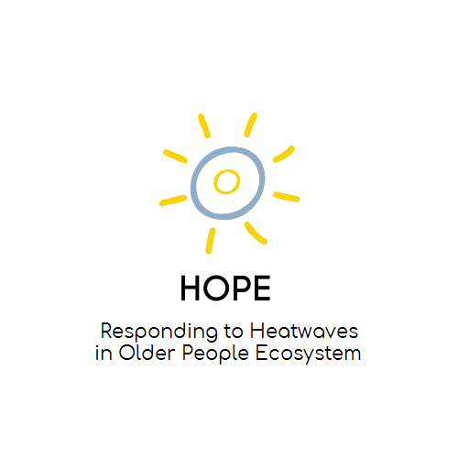
HOPE
(2022 – 2025)
The project HOPE aims to put the severe health threats of heatwaves on the agenda of the older adult service and healthcare sectors and to have an inclusive approach for the whole ecosystem.
PARTNERS:
1 GEMEENTE ROTTERDAM (Netherlands)
2 Istituto per servizi di ricovero e assistenza agli anziani (Italy)
3 Irmandade da santa casa da misericordia da amadora ipss (Portugal)
4 Stichting hogeschool rotterdam (Netherlands)
5 Social cooperative enterprise of cyclades (Greece)
6 Elisan reseau europeen pour l inclusion et l action sociale locale association (France)

Slide 18

PA4AGE
(2021– 2024)
The project’s general objective is the promotion of physical activity, as one of the most important components in the notion of active ageing, aiming to change older people’s mindset, by encouraging their participation to physical activity at any form and intensity, and under any physical condition, for improving their quality of life in physical, mental and social terms. The project’s specific objective is the education and training of adults from various professional profiles, having relation to promotion of active ageing or social and health care of older people, to act as promoters of physical activity to older people population.
PARTNERS:
1 WESTFAELISCHE WILHELMS-UNIVERSITAET MUENSTER (Germany)
2 Corporation for Succor and Care of Elderly and Disabled-FRODIZO (Greece)
3 ISTITUTO PER SERVIZI DI RICOVERO E ASSISTENZA AGLI ANZIANI (Italy)
4 PIKEI New Technologies (Greece)
5 European Group for Research into Elderly and Physical Activity (Germany)

Slide 19
VENETO IN ROSA DPE
The objective is to develop a psycho-social support intervention addressed to women who act as caregivers of elderly persons in the Veneto Region through psychological empowerment interventions useful to cope with the stress and challenges posed by the pandemic context.
The direct target are 350 women who are the final beneficiaries of the initiative. (50 women for each Veneto province). While the indirect target Elderly people, family members, organisations.
Patronage: Veneto Order of Psychologists

Slide 20


CONTACTS
www.israa.it
faber@israa.it
Via Noalese 40, Treviso
FABER – Fabbrica Europa

