Slide 1




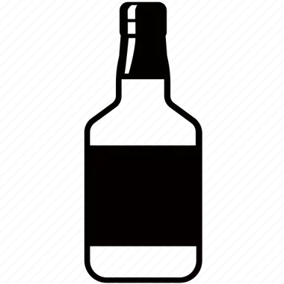










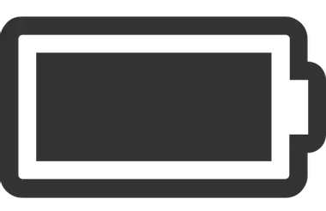





THE ONLY INVISIBLE NON-INVASIVE SOLUTION THAT LINKS PHYSICAL ITEMS TO THEIR
DIGITAL PRODUCT PASSPORTS (DPP)
DPP
Sep. 2026
Lausanne – Switzerland
Notes:
1

Slide 2




Markets | 2030 Industry Forecasts (CHF)
Luxury
Watches
+70B
Gems &
Jewelry
+200B
+50B
Luxury
Handbags
Luxury industry
Wines &
Spirits
+800B
+700B
Perfumes &
Cosmetics
Medical
Glass
Vials
+ 20B
+900B
+900B
+300B
Electrical
Vehicle
Batteries
Other industries
Semi-conductors
Aerospace
& Defense
QBP SA | 2026 ©
2
PROPRIETARY & CONFIDENTIAL
Notes:
TAM => 1.5~2 bn /year
SAM => 0.5~1 bn/year
Number of Swiss watch units sold in 2024: 15.3 million units (-9.4% vs 2023)
Swiss watch exports declined by 2.8% to CHF 24.8 billion, and unit sales dropped by 9.4% to 15.3 million units. Quartz watches accounted for 10 million units, while mechanical watches accounted for 5.4 million units.
SAM (Serviceable Addressable Market): 5.4 units x CHF 40 (estimated revenue per unit)= 216 Mn CHF
CHF 40: equivalent to 0.1% of the retail value of most of the high-end watch brands (Richar Mille: 275’000 Jacob&Co: 85’000 Journe: 79’000; AP: 48’500 Lange: 48’000; Patek: 40’000 Vacheron: 39’000; Moser: 37’000)
2

Slide 3


Identified Need | Feedback from Pilot Customers & Prospects
INDUSTRY CHALLENGE
HOW TO BEST LEVERAGE THE BLOCKCHAIN CERTIFICATION TECHNOLOGY ?
BY ESTABLISHING A TAMPER-PROOF LINK BETWEEN
THE PHYSICAL PRODUCT AND ITS DIGITAL PASSPORT
INDUSTRY BENEFITS
AUTHENTICATE, TRACK & TRACE
SECOND-HAND MARKETS (CPO)
AFTER-SALES SERVICES
REGULATIONS & COMPLIANCE
CRM, ETHIC & REPUTATION
QBP SA | 2026 ©
3
PROPRIETARY & CONFIDENTIAL
Notes:
3

Slide 4










Ecosystem | Digital Product Passport (DPP) Stakeholders
APPLICABLE INDUSTRIES
Physical Retail
Luxury Watches
Online Retail
Customers
@
Gems & Jewelry
Luxury Handbags
Manufacture
Repair & Maintenance
Spirits
& Wines
DPP
Perfumes
& Cosmetics
PHYSICAL PRODUCT
EV Batteries
Components
Resale
Medical
Glass Vials
Semiconductor Chips
Raw Materials
Recycle
Aerospace
& Defense
QBP SA | 2026 ©
4
PROPRIETARY & CONFIDENTIAL
Notes:
4

Slide 5


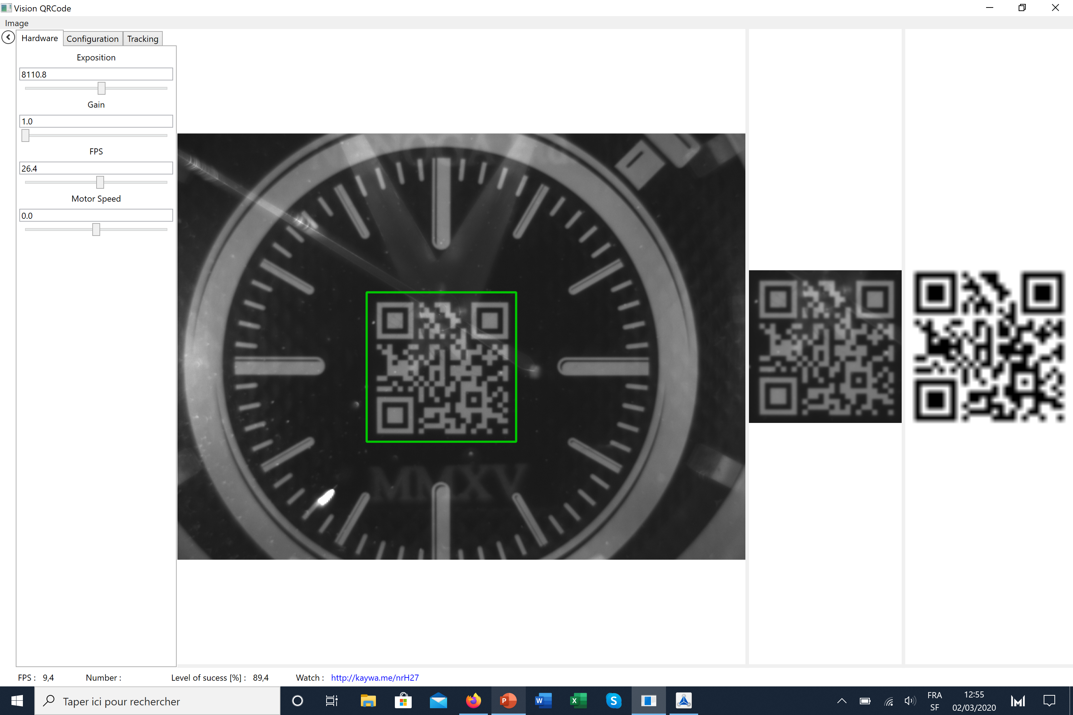
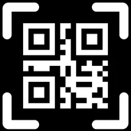







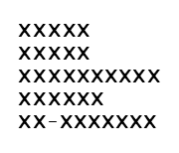



Architecture | Accessing the Digital Product Passport (DPP) via Proprietary App.
B2B
PHYSICAL KEY
Tattooed products with Invisible encrypted 2D-code
Visible 2D-code via Smart Reader
100%
INVISIBLE
NON
INVASIVE
VERY HIGH LONGEVITY
BLOCKCHAIN AGNOSTIC
CERTUS
DIGITAL SAFE
Users access control
DPP – Digital Product Passport
Secure B2B digital architecture to mitigate potential cyber breaches
QBP SA | 2026 ©
5
PROPRIETARY & CONFIDENTIAL
Notes:
5

Slide 6

IP Portfolio | Patents Granted in 25 Key Markets
We Cover the vast majority of Globally Targeted Markets
QBP SA | 2026 ©
6
PROPRIETARY & CONFIDENTIAL
Notes:
6

Slide 7
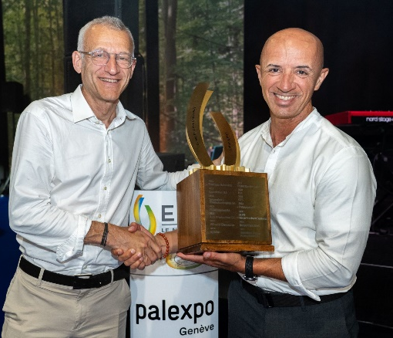
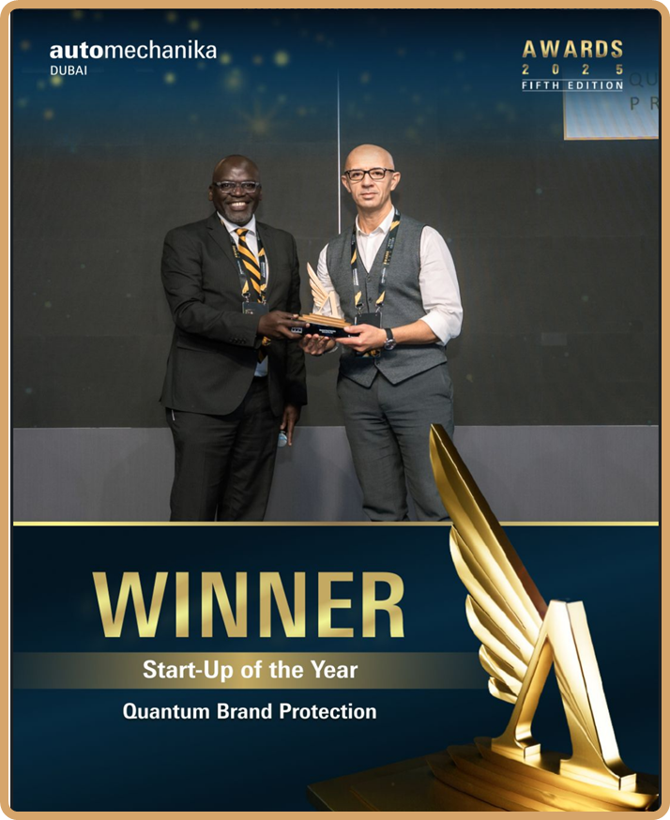

PROTECT AUTHENTICITY, ENABLE TRACEABILITY, ELEVATE YOUR BRAND
DPP
Geneva, June 2025
Dubai, Nov. 2025
QBP SA | 2026 ©
PROPRIETARY & CONFIDENTIAL
Notes:
7

