Slide 1

Sustainable Future through Innovative Biodiversity Restoration (SFIBR)
www.regreen.ua

Slide 2
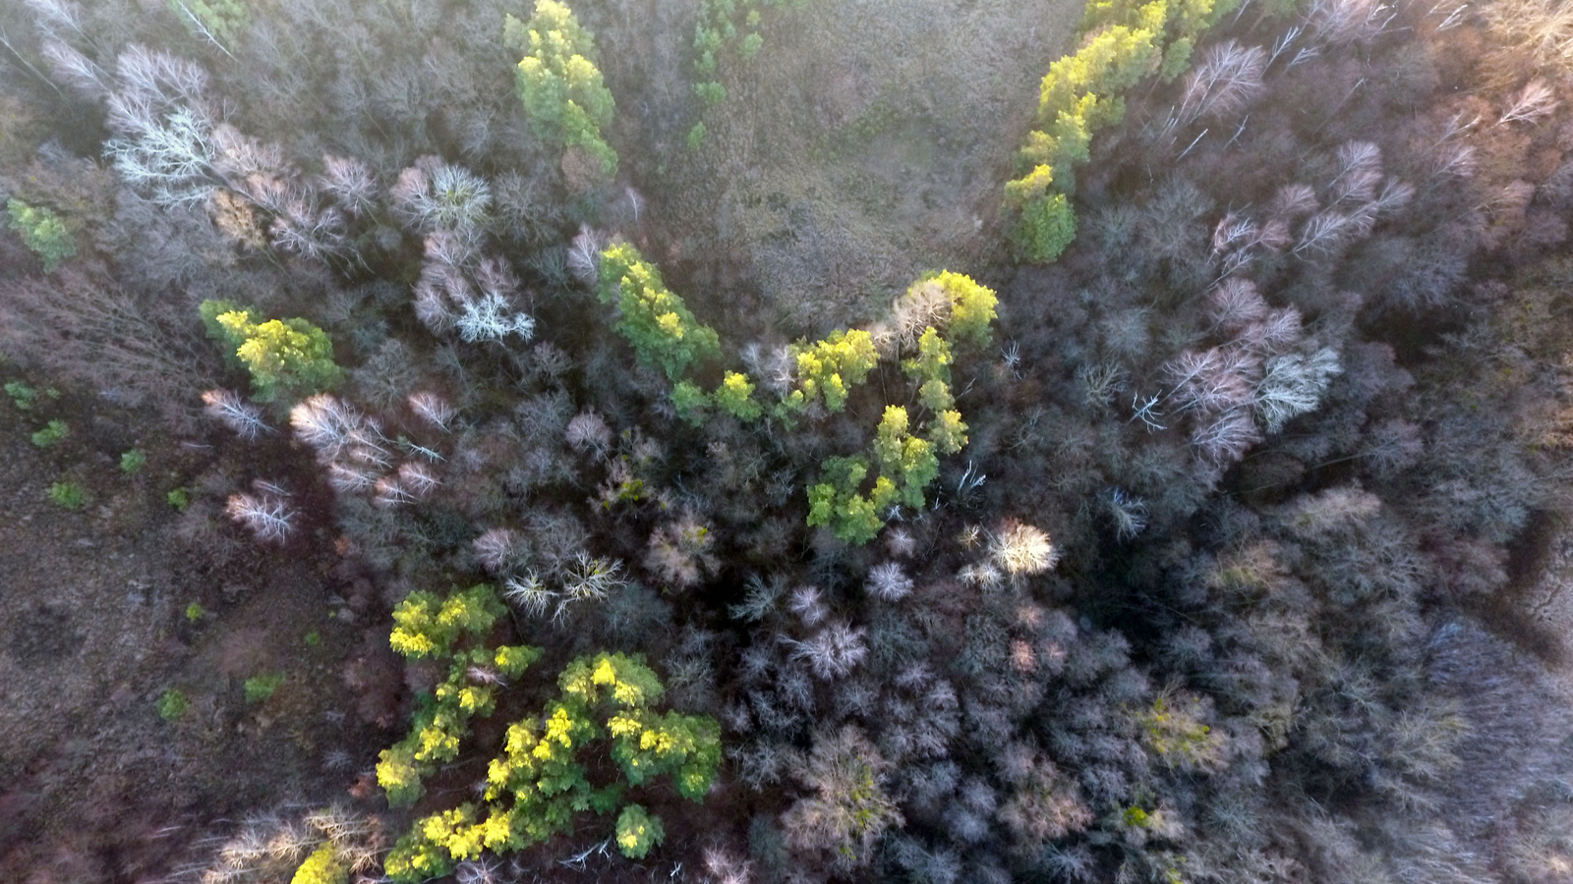
Introduction to SFIBR
This is a leading project in the field of biodiversity restoration and sustainable development. Our mission is to create innovative and sustainable solutions for environmental conservation while promoting social inclusion and economic development of local communities. By leveraging cutting-edge technologies and eco-friendly methods, we aim to restore natural areas affected by military actions and ensure equal opportunities for all participants.

Slide 3
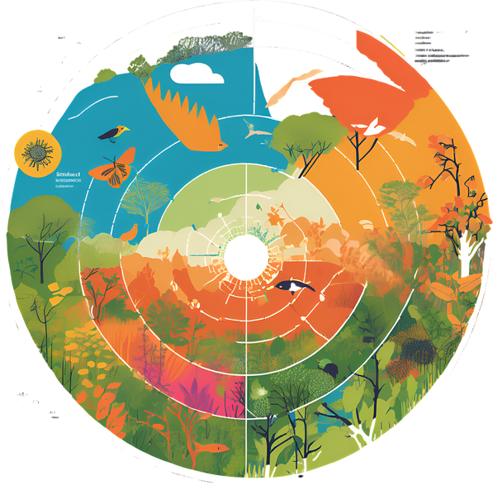
Our Mission
and Vision
Biodiversity Restoration: Enhance natural habitats through the use of local plant species and innovative restoration technique.
Environmental Responsibility: Implement eco-friendly practices such as composting organic waste and using resource-saving technologies.
01.
Our mission is to restore biodiversity, conserve natural resources, and create inclusive environments for all. We envision a future where green spaces flourish, local communities thrive, and innovative technologies drive sustainability. Our project are designed to promote environmental responsibility, economic growth, and social cohesion, ensuring a better world for future generations
02.
Economic Development: Support local economies by creating jobs and encouraging sustainable business practices
Economic Development: Support local economies by creating jobs and encouraging sustainable business practices.
Transparency and Participation: Engage with local communities and stakeholders in decision-making processes to build trust and ensure the success of our initiatives.
03.

Slide 4
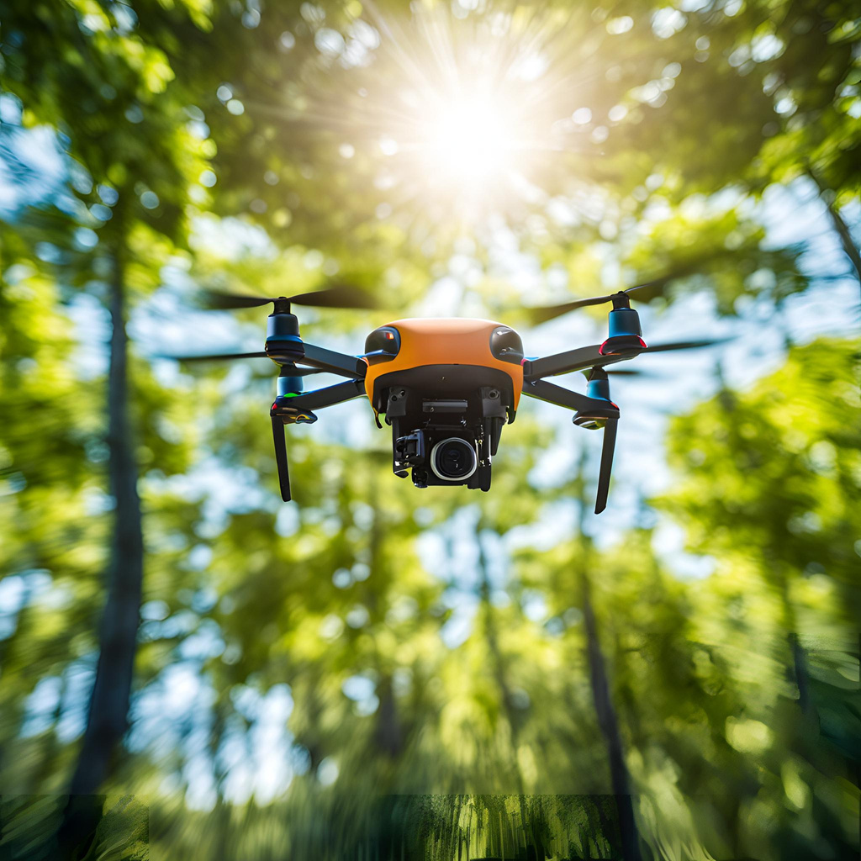
Innovative Solutions and Technologies
Implements advanced technologies for biodiversity restoration and the creation of sustainable communities. Our innovative solutions help efficiently use resources, reduce environmental impact, and enhance the effectiveness of our projects.
  Drones and Robotic Systems: Utilizing drones and robots for monitoring and managing green zones, allowing us to collect precise data and respond quickly to changes.
  Artificial Intelligence and Big Data: Analyzing large volumes of data using AI to develop optimal restoration and biodiversity management strategies.

Slide 5
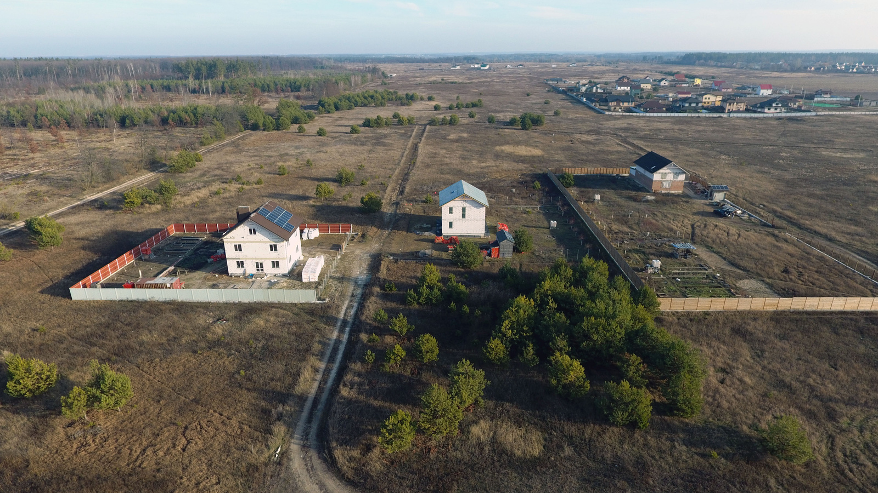
Social Impact and Community Engagement
We dedicated to making a positive social impact by engaging and empowering local communities. Our projects are designed to create inclusive environments where everyone, regardless of background or ability, can contribute and benefit. We believe that by fostering strong community bonds and providing equal opportunities, we can achieve both environmental sustainability and social well-being.
  Community Workshops: Photos of educational workshops and training sessions with diverse participants, highlighting community engagement.
  Inclusive Work Environment: Images of people with disabilities or from vulnerable groups working together on project sites, showcasing inclusivity and collaboration.
  Support Initiatives: Images of support programs for vulnerable groups, such as distribution of resources or specialized assistance.

Slide 6
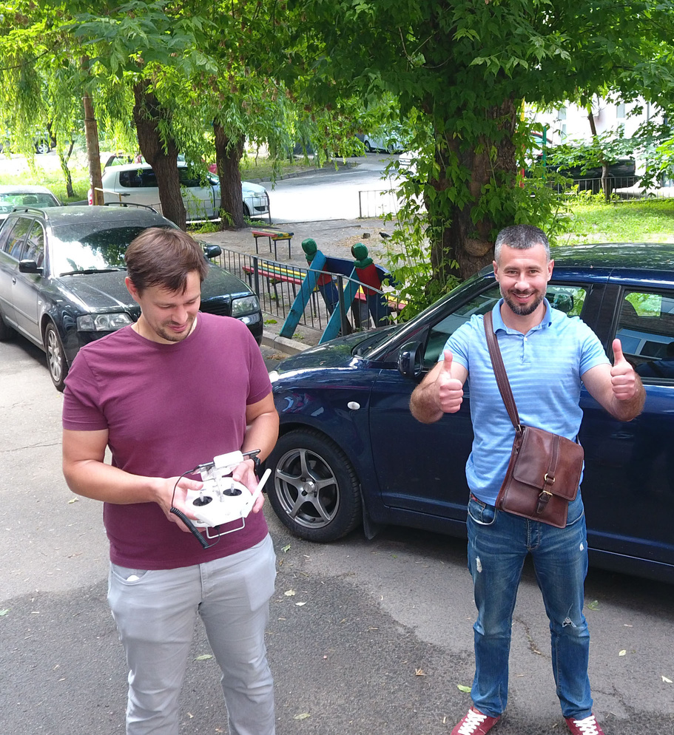
Responsible Governance for a Sustainable Future
We strive to ensure maximum transparency and accountability in all our actions and initiatives. We believe that openness in decision-making and regular reporting to our stakeholders contribute to achieving our goals and strengthening community trust.
  Open Data: Providing access to information about our projects, including financial data, research results, and monitoring.
  Ethical Standards: Adhering to high ethical standards in all aspects of our activities, including project management and interactions with partners.

Slide 7
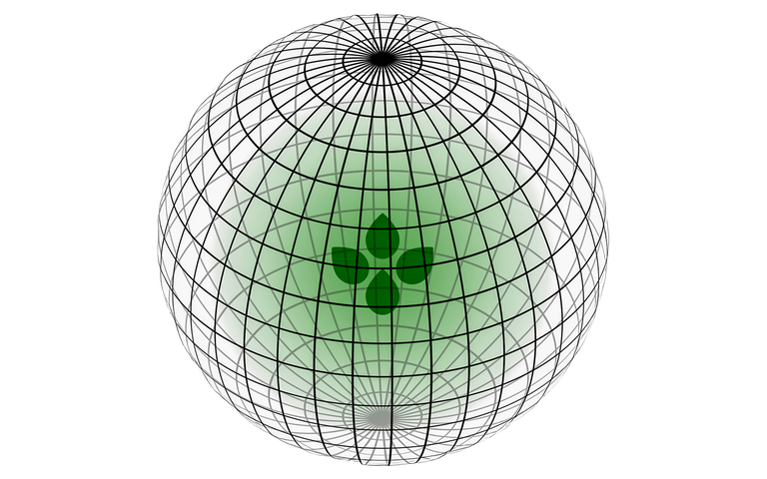








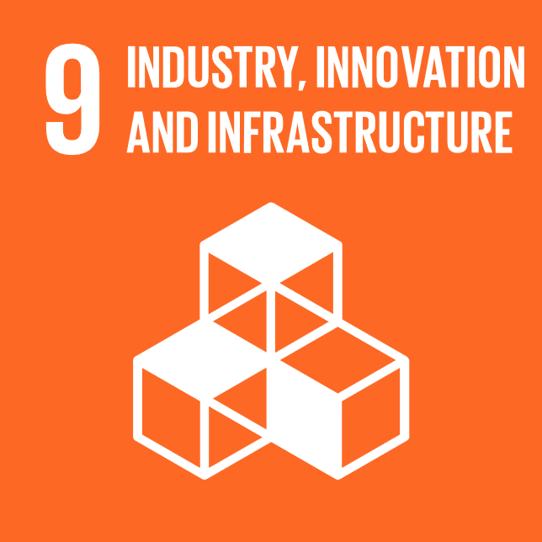









Join Us in Creating a Sustainable Future
We invite you to join our mission of environmental conservation and sustainable development.
Every action counts, and with your support, we can create a lasting positive impact. Together, we can restore natural habitats, empower communities and foster a greener future for the generations to come.
Contact Information:
Address: 10 Kashtanova St., Kyiv, Ukraine
Phone: +380 93 501 2581
Email: info@regreen.ua
Website: www.reGreen.ua
Social Media:
Linkedin: reGreen
Facebook: reGreen_UA
YouTube: reGreen_UA

