Slide 1

Subscribe to DeepL Pro to edit this document.
Visit www.DeepL.com/pro for more information.

Slide 2








PREDIC: Preventing hospitalisations using AI
Confidential document | January 2026
PAGE

Slide 3



Chronic heart failure,
a public health issue
150,000 hospitalisations/year in France (€680 million)
Doctor:
Hospital:
Complex decision
Significant time spent per patient
Rare expertise
Long stays (more than 8 days)
Overcrowding in emergency departments
Patient:
17% rehospitalisation rate at 3 months
Loss of opportunity
Notes:
Focus on the issue (5P medicine): objectives for the three stakeholders, discussing the characteristics of PREDIC (doctor – hospital – patient) in relation to milestones

Slide 4




PREDIC: a digital medical device for personalising the treatment pathway for heart failure
Risk score and personalisation of the post-hospitalisation pathway
Impact
Patient data: clinical, biological, care pathway
High risk:
Enhanced pathway
Patient:
Avoid rehospitalisations
Improve quality of life
Improve access to care
Low risk:
Simplified care pathway
Doctor:
Save time
Reliable and transparent decision-making
Evidence-based recommendations
Digital medical devices for hospital use
Users: doctors treating patients with chronic heart failure
Secondary prevention and population-based approach
Hospital: Direct ROI
Reduced length of stay
Relieve pressure on emergency departments
Accelerate digital transition
On-premise

Slide 5
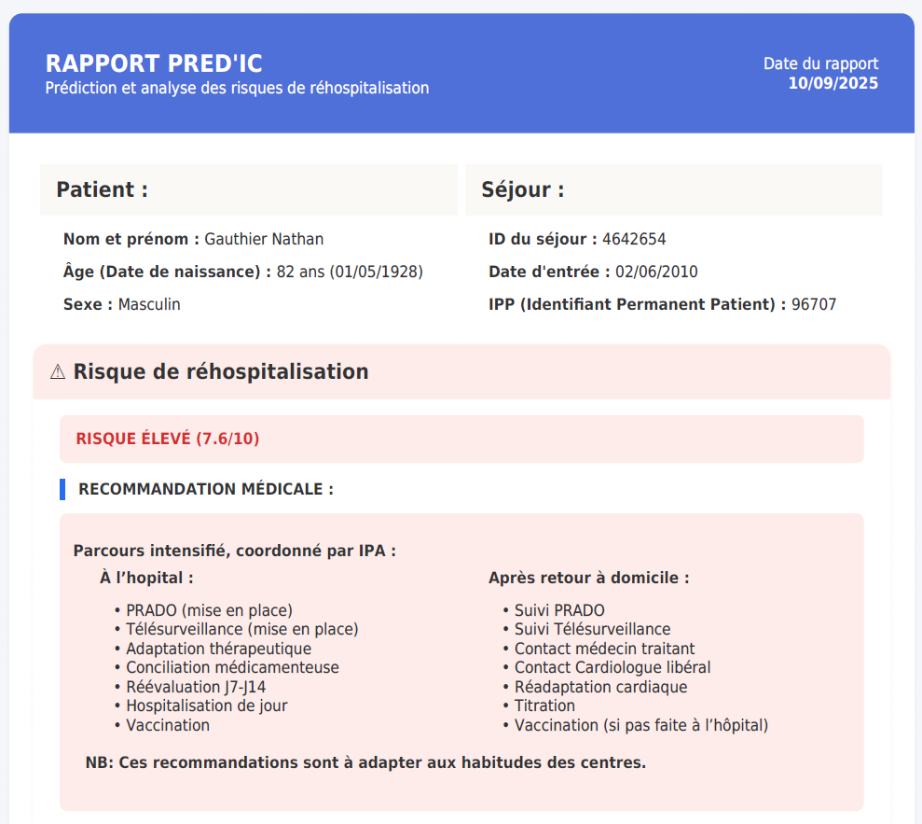
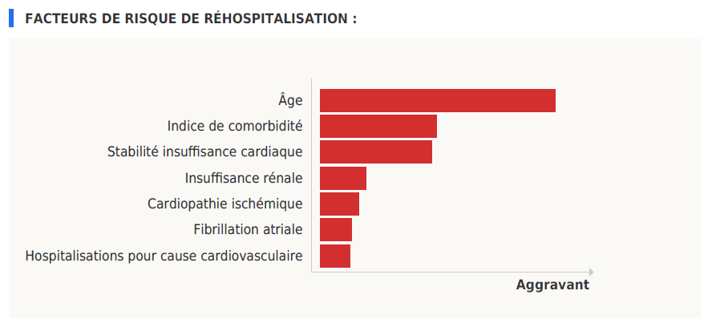

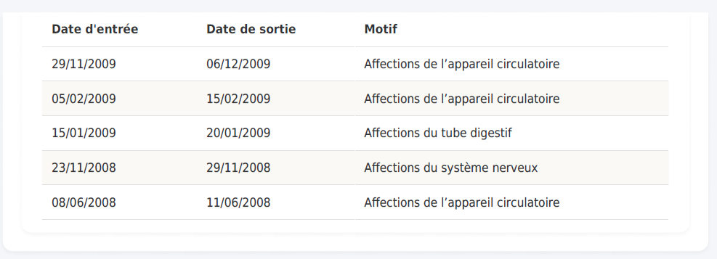
Display of individual risk of rehospitalisation within 90 days for heart failure
Display of individual risk factors contributing to the risk of rehospitalisation

Slide 6


PREDIC: Proven reliability in over 2,300 patients
1,352 patients
VPN: 93%
1,027 patients
VPN: 92%
Twice the specificity of standard clinical judgement

Slide 7
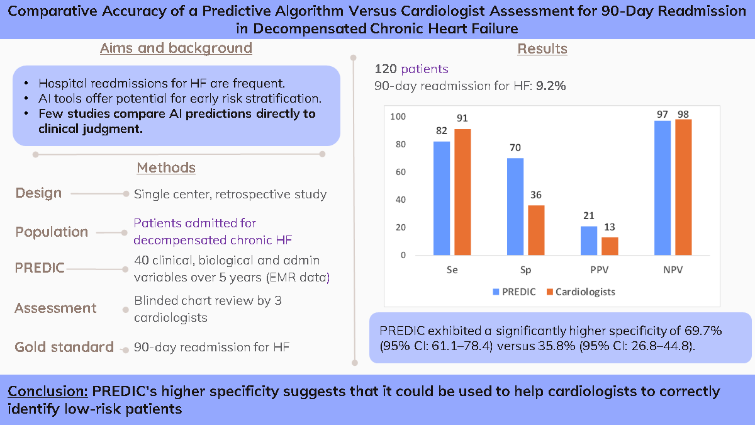
Clinical validation: PREDIC outperforms cardiologists in specificity

Slide 8




Market validation: 4 key partnerships currently being rolled out
Certifications
Traction Terrain (Pre-sales)
4- Toulouse Digital Health: cybersecurity, UX/UI
- Chalon sur Saône Hospital: regional vision
- HNFC: clinical validation
- Troyes Hospital: medical and economic impact
Class IIb CE marking: currently being audited for approval (Q2 2026) + QMS already deployed
AI Act ethical certification
Clausier and PIA validated with TSN
AAP Impact of DMNs (Montpellier University Hospital)
Marked interest from the French Society of Cardiology

Slide 9

ROI modelling for Champagne Sud Hospitals in 2023
ROI calculation for Champagne Sud Hospitals in 2023
- 307 patients, 10% readmission
214 low-risk patients: early discharge by 1 day 🡺 145 days freed up at constant revenue, including 14 in intensive care
93 high-risk patients: 20% reduction in the risk of rehospitalisation 🡺 6 hospitalisations avoided
Valuation based on average revenue observed at HCS and variable costs recorded.
Additional revenue linked to the reduction in length of stay | + €81,745
Savings linked to shorter length of stay | + €21,603
Lower revenue linked to the decrease in readmission rates | - €28,465
ROI of PREDIC | + €74,883
Notes:
Choice to work on chronic diseases because they represent the largest item of expenditure for health insurance in France and Europe. An issue that affects all stakeholders in the care pathway, including hospital doctors, hospitals and patients.

Slide 10








A hybrid business model
Updates (technical and regulatory)
Ongoing technical support
Minor upgrades included
Integration & Interoperability
Technical tests
User training
Maintenance & Upgrades
Commissioning
Initial cost: €80k
Annual cost: €32k
A very quick return on investment (positive ROI > licence cost)
Current listings:
Unlimited number of users and patients
Access to population indicators

Slide 11

PREDIC: Transforming Cardiology Practice
How PREDIC changes medical practice in concrete terms:
Objectification of the risk of rehospitalisation within 90 days
Decision support, without automation
Personalisation of the post-hospitalisation pathway
Reduction in avoidable readmissions
Why adopt it at the medical level?
Multicentre clinical validation.
Greater specificity than standard clinical judgement.
Certified medical device (CE IIb – currently being audited).
Secure hospital integration (on-premise, HIS interoperability).
Next step: Pilot deployment
Analysis of local data.
Clinical and technical configuration with teams.
Definition of expected clinical and organisational impacts.
PREDIC acts as a medical partner, working alongside your teams to improve the quality of care and patient safety.

Slide 12

Contacts:
Ulysse RODTS: urodts@kanopymed.com | +33 (0)6 29 32 53 46
Grégoire MERCIER: gmercier@kanopymed.com | +33 (0)6 28 35 67 17
PAGE ‹#›

