Slide 1

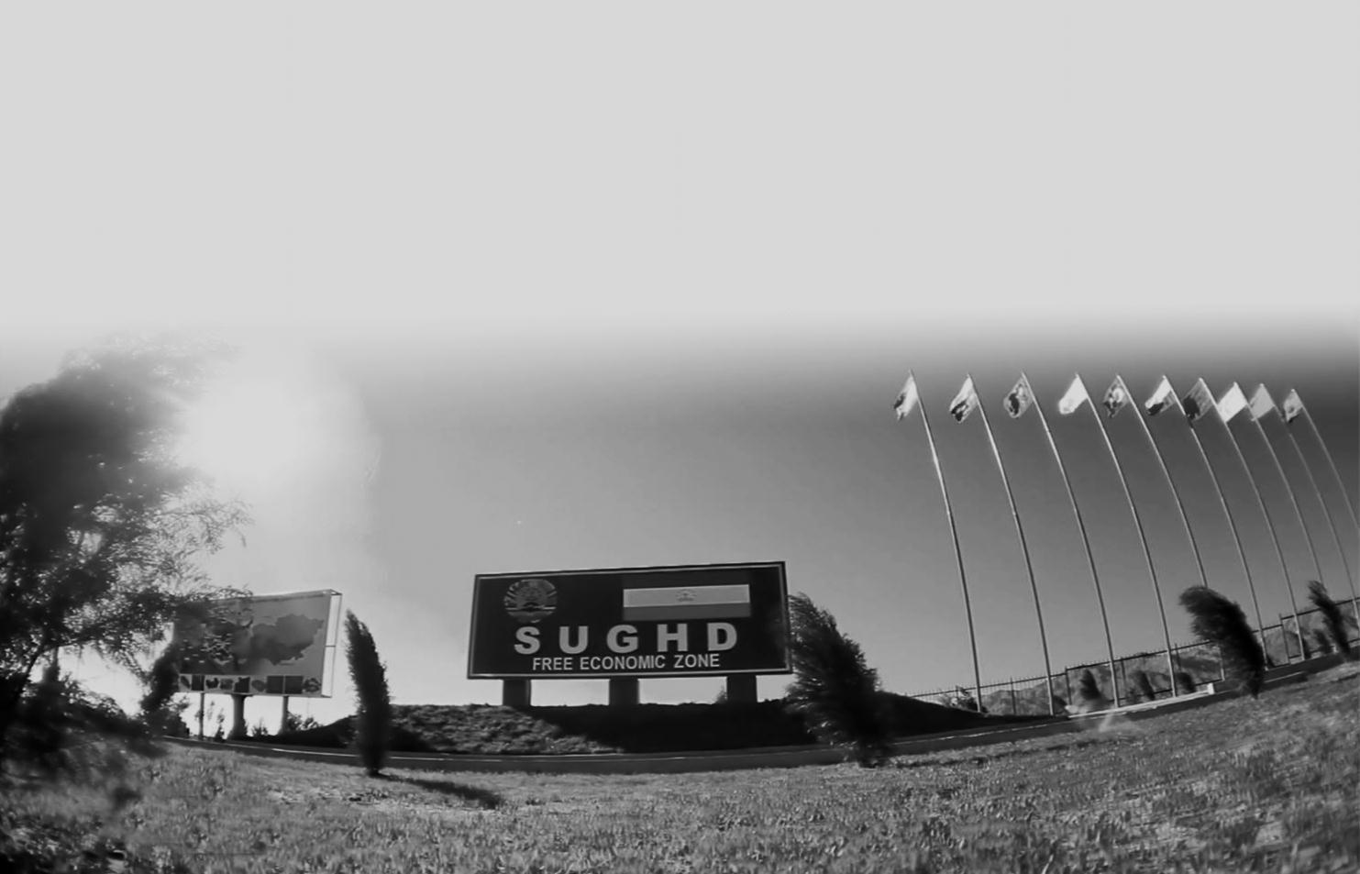
KHUJAND CITY
FREE ECONOMIC ZONE
SUGHD
W
E
L
C
O
M
E
PRODUCTION AND INNOVATIVE TYPE

Slide 2
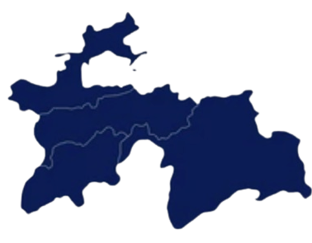






TAJIKISTAN FREE ECONOMIC ZONES
SUGHD FEZ
(2008)
320 ha
SUHGD FEZ
KULOB FEZ
(2019)
309 ha
SUGHD REGION
DANGARA FEZ
(2011)
521 ha
DRS
MOUNTAINOUS
BADAKHSHON
KHATLON REGION
PANJ
FEZ
(2008)
401 ha
ISHKOSHIM FEZ
(2011)
200 ha
PAGE 2
FEZSUGHD.TJ

Slide 3


TAJIKISTAN FREE ECONOMIC ZONES
THE MAIN GOALS OF CREATING
attract investment and new technologies;
creation of a modern infrastructure;
producing quality products;
development of foreign trade relations;
providing new job places and improving livelihoods of population, etc.
PAGE 3
FEZSUGHD.TJ

Slide 4



























SUGHD FEZ
TOTAL AREA
JOBS CREATED
START OF ACTIVITIES
NUMBER OF SUBJECTS
320 ha
1055
2009
51
TERM OF ACTIVITY
JOINT
VENTURES
50 years
EMPTY
LANDS
6
FINISHED BUILDINGS AND FACILITIES
205 ha
115 ha
PAGE 4
FEZSUGHD.TJ

Slide 5
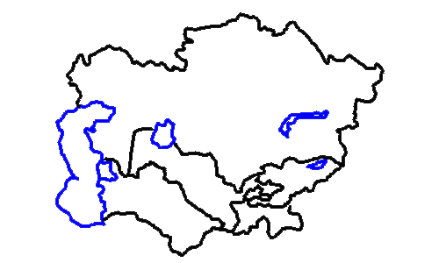



REGIONAL FAVORABLE LOCATION
DISTANCE TO:
KAZAKHSTAN
UZBEKISTAN - 71 km
KYRGYZSTAN - 30 km
KAZAKHSTAN - 182 km
UZBEKISTAN
KYRGYZSTAN
AFGHANISTAN - 486 km
TURKMENISTAN
KHUJAND
ASHT
AFGHANISTAN
KHUJAND
ISFARA
TERRITORY
25400 km²
ISTARAVSHAN
POPULATION
PANJAKENT
^{3,2} million
AYNI
PAGE 5
FEZSUGHD.TJ
VOLUME OF INDUSTRIAL
PRODUCTION 442 млн somoni (2024)

Slide 6



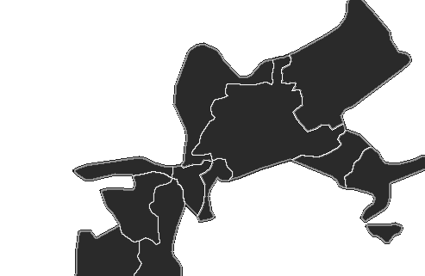






FAVORABLE DOMESTIC LOCATION - KHUJAND
FOUNDED
TERRITORY
514 bce
^{25400 км2}
FAMOUS DISCOVERER
POPULATION
A. Macedonian
¹⁹⁸ ⁷⁰⁰
INTERNATIONAL HIGHWAY
ASHT
DUSHANBE - CHANAK
KHUJAND
KANIBADAM
INTERNATIONAL AIRPORT
“KHUJAND”
ISFARA
RAILWAY STATIONS
ISTARAVSHAN
KHUJAND AND SPITAMEN
PAGE 6
FEZSUGHD.TJ
WITHIN A RADIUS OF 15 TO 20 km

Slide 7

REGULATORY LEGAL ACTS
Law of the Republic of Tajikistan on free economic zones
Regulation of Sughd free economic zone
Tax code of the Republic of Tajikistan
Chapter 49. Basis for taxation of activities of free economic zones
Customs code of the Republic of Tajikistan
Chapter 32. Free customs zone
PAGE 7
FEZSUGHD.TJ

Slide 8







TAX EXEMPTIONS
GENERAL REGIME
FEZ REGIME
INCOME TAX
INCOME TAX 12%
SOCIAL TAX
SOCIAL TAX 20%
VALUE ADDED TAX (VAT)
0%
COTTON AND PRIMARY ALUMINUM SALES TAX
NATURAL RESOURCES TAX
EXCISES
PROPERTY TAX
PAGE 8
FEZSUGHD.TJ

Slide 9


FREE CUSTOMS ZONE
IMPORT
FOREIGN
COUNTRIES
REPUBLIC OF
TAJIKISTAN
0%
0%
CUSTOMS
DUTY
VAT
CUSTOMS
DUTY
VAT
PAGE 9
FEZSUGHD.TJ

Slide 10
FREE CUSTOMS ZONE
EXPORT
FOREIGN
COUNTRIES
REPUBLIC OF
TAJIKISTAN
0%
0%
CUSTOMS
DUTY
VAT
CUSTOMS
DUTY
14 % VAT
PAGE 10
FEZSUGHD.TJ

Slide 11






OBTAINING THE STATUS OF A SUBJECT OF FEZ
5
Obtain a Certificate of a status of Subject of Sughd FEZ
4
Conclude an agreement with the Administration of Sughd FEZ
3
Promote the investment project in commission under the Administration of Sughd FEZ
2
Develop a business-plan or an investment project and prepare necessary documents
1
Register an enterprise in tax authority of Khujand city as a legal entity
PAGE 11
FEZSUGHD.TJ

Slide 12



REQUIREMENTS FOR A BUSINESS PLAN
VOLUME OF INVESTMENTS
LAUNCH TIME
EQUIPMENTS
CONSUMPTION OF IMPORTED EQUIPMENT SHOULD NOT BE MORE THAN
3 YEARS
PRODUCTION ACTIVITY
300 000 $
START OF ACTIVITY SHOULD NOT LONG MORE THAN
3 YEARS
EXPORT-IMPORT OPERATIONS
50 000 $
PROVISION OF
SERVICES
10 000 $
PAGE 12
FEZSUGHD.TJ

Slide 13



KEY PAYMENTS
LAND LEASE
UTILITY
BILLS
CERTIFICATE
1m² = 0,50$/year
1 ha = 5000 $/year
5000 $
a one-time payment for a period of 50 years
According to tariffs in general regime excluding
(-14%)
PAGE 13
FEZSUGHD.TJ

Slide 14


PRIORITY TYPES OF ACTIVITY
ALLOWED
BANNED
Sewing threads, knitwear
Machinery
Electro technical,
radio-electronic and household devices
Mineral fertilizers and bioadditives
for agriculture
Glass and basal fibers
Modern construction materials
Sanitation supplies
Electrical wires
Pharmaceuticals and medicines
Processing of fruits and vegetables
Subsoil use activities
Production of excisable goods
Manufacturing of securities
Production, processing, storage and
sale of narcotic drugs
Broadcasting of radio and TV programmes
Production of primary steel and non-ferrous metallurgy
Activities related to external labor migration
Creation of environmentally harmful productions
For detailed list - Chapter 3, Regulation of Sughd FEZ
Full list - Chapter 2, paragraph 11, Regulation
PAGE 14
FEZSUGHD.TJ

Slide 15
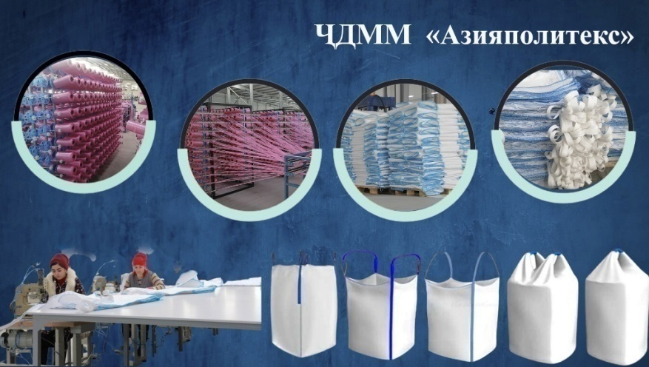
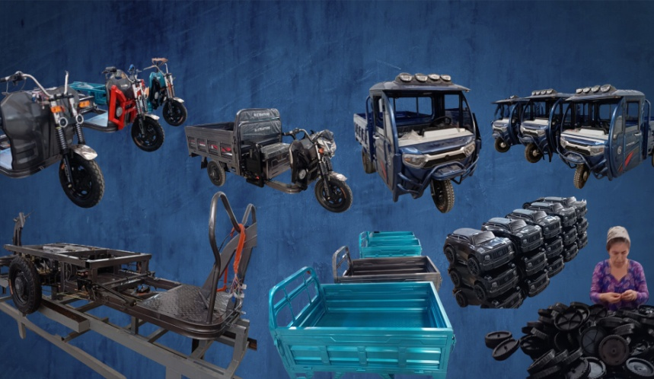
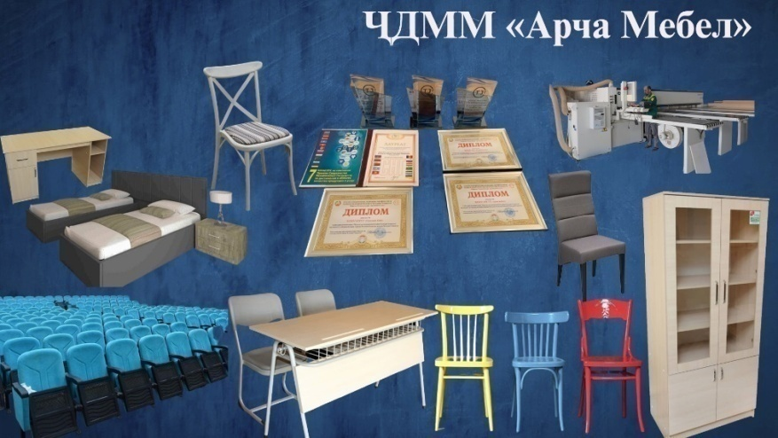
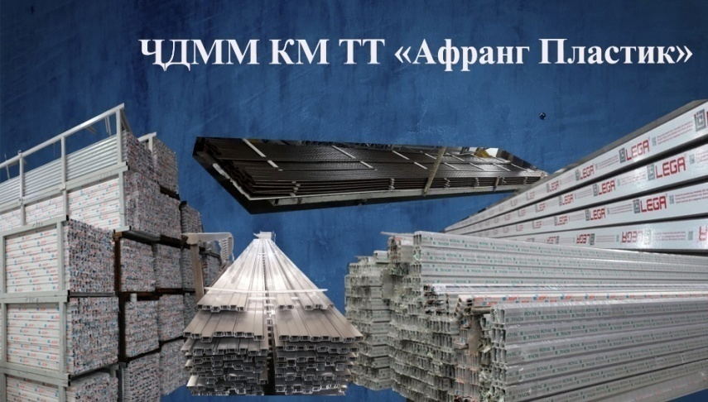
SUBJECTS OF SUGHD FEZ AND THEIR PRODUCTS
ASIAPOLITEKS LLC
ARIANA METAL PLAST LLC
JV ARCHA MEBEL LLC
AFRANG PLASTIC LLC
PAGE 15
FEZSUGHD.TJ

Slide 16
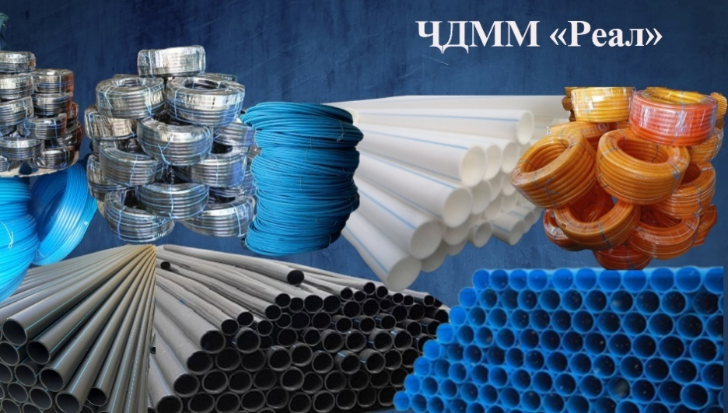
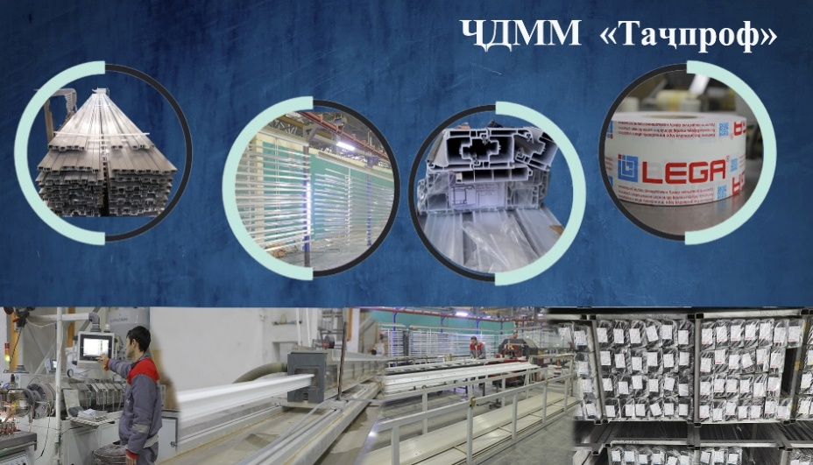
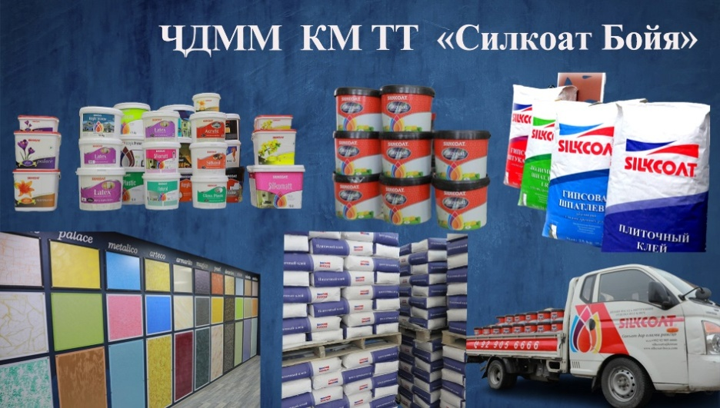
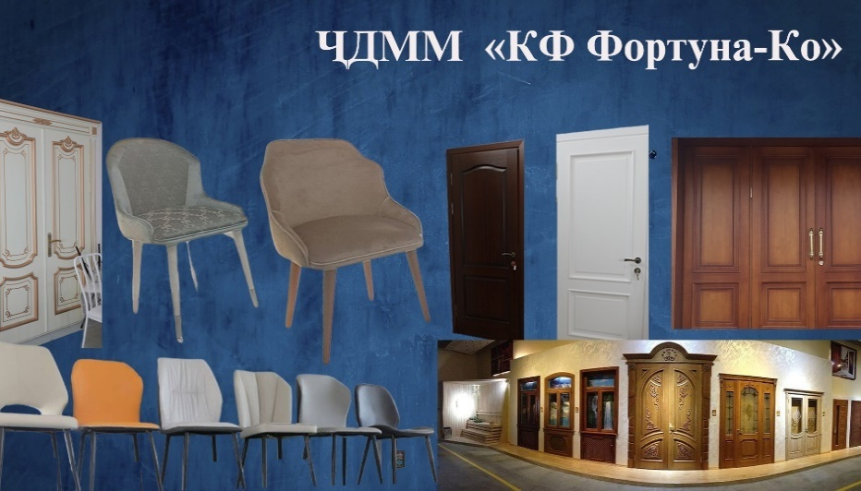
SUBJECTS OF SUGHD FEZ AND THEIR PRODUCTS
REAL LLC
JV TAJPROF LLC
JV SILKCOAT BOYA LLC
JV FORTUNA-CO LLC
PAGE 16
FEZSUGHD.TJ

Slide 17
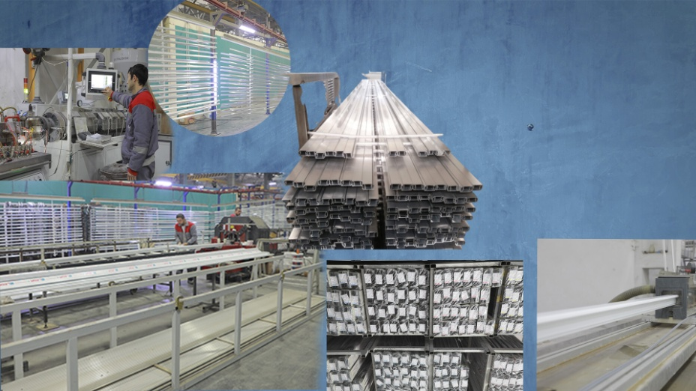
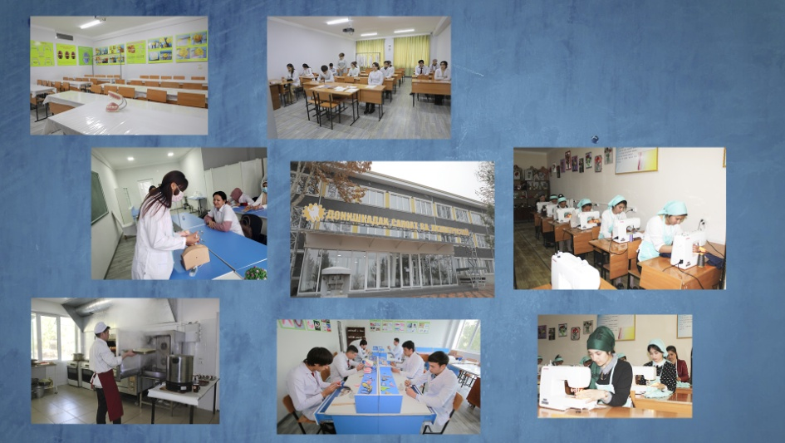
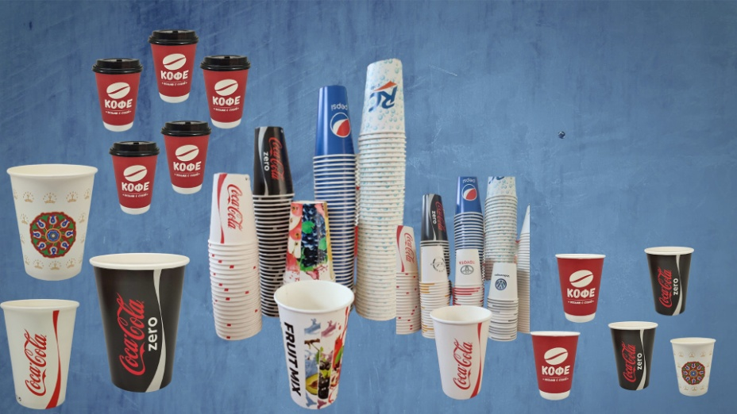
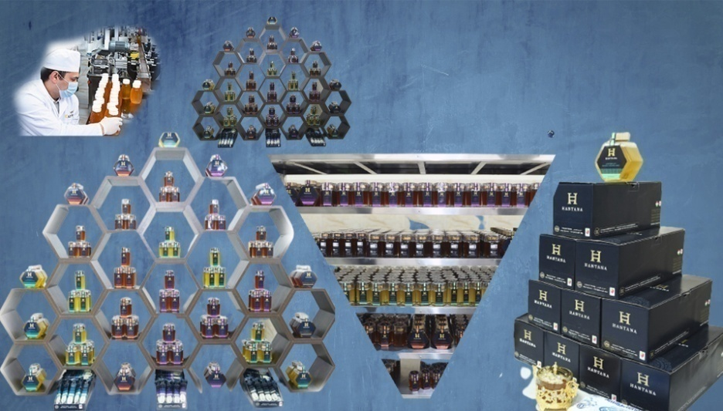
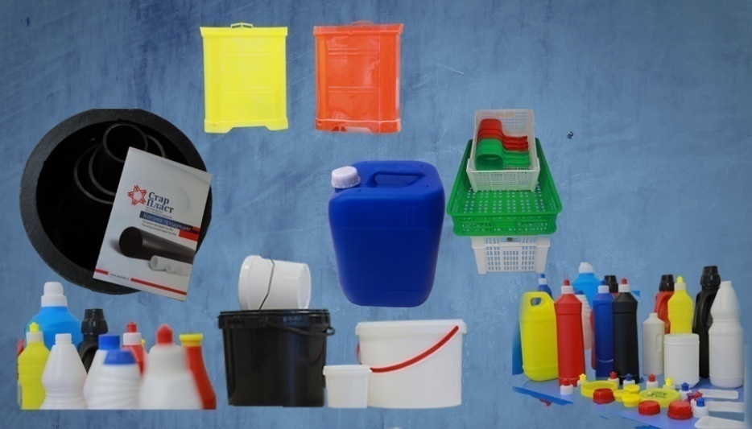
SUBJECTS OF SUGHD FEZ AND THEIR PRODUCTS
INSTITUTE OF INDUSTRY AND SERVICES
POKZARF
LLC
KHANTANA CANADA LLC
STAR PLAST
LLC
PAGE 17
FEZSUGHD.TJ

Slide 18
INVESTMENT GROWTH
INVESTMENT VOLUME OF SUGHD FEZ ENTITIES
(million TJS)
PAGE 18
FEZSUGHD.TJ

Slide 19
PRODUCTION DYNAMICS
PRODUCTION VOLUME OF SUGHD FEZ ENTITIES
(million TJS)
PAGE 19
FEZSUGHD.TJ

Slide 20





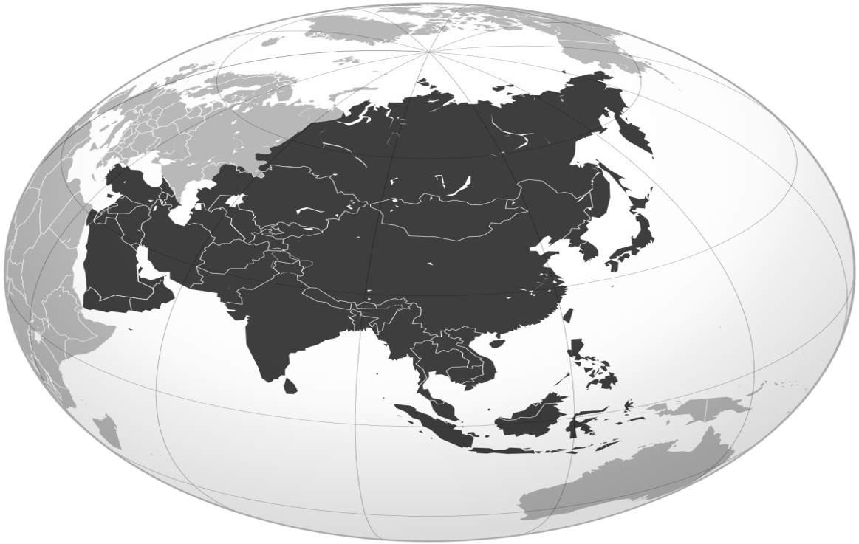
EXPORT GEOGRAPHY
RUSSIA
IRAQ
UNITED ARAB
EMIRATES
KYRGYZSTAN
TURKEY
UZBEKISTAN
GERMANY
TURKMENISTAN
KAZAKHSTAN
AFGHANISTAN
PAGE 20
FEZSUGHD.TJ

Slide 21





THANK YOU FOR YOUR ATTENTION!
WE ARE ALWAYS OPEN
FOR COOPERATION!
(+992 44) 630-11-90
630-11-81
Info.fezsughd@gmail.com inter@fezsughd.tj
facebook.com/fezsughd
@fezsughd
WWW.FEZSUGHD.TJ

