Slide 1

Vector Healthcare Ltd
Digital Health, AI & NHS Structural Adoption Consulting
Helping scale-ups, pharma, medtech and AI vendors ensure
their solutions are structurally ready for NHS adoption not
just technically functional.

Slide 2

Marco Aldovardi
Why Vector Has Frontline Authority
10+ Years NHS Critical Care Experience
UK Digital Clinical Safety Practitioner
Pharma & Medtech Innovation Advisory
High-pressure NHS environments. Real operational consequences.
Translating DCB0129/DCB0160 requirements to real-world NHS governance.
De-risking NHS scale through structural readiness.

Slide 3
Core Services
01
02
03
UK Adoption & Structural Readiness Sprint
UK Readiness
Diagnostic
Deployment & Alignment Support
2 weeks | Early-stage or exploratory UK entry
4–6 weeks | AI / SaMD / DTx vendors entering or scaling in the NHS
Activated when implementation friction emerges inside a Trust

Slide 4

SERVICE 1
UK Adoption & Structural Readiness Sprint
4 - 6 weeks | Identify where adoption will stall before it becomes expensive.
Clinical Safety
Governance
Workflow Fit
Named accountability & risk boundaries
Real NHS pressure-tested integration
Hazard clarity & DCB alignment
Go / No-Go Scale
Executive-level structural recommendation

Slide 5
Structural Readiness Prevents
6 - 12 Month Scale Delays
Procurement & Governance Rejection
Clinical Resistance Escalation
Expensive Redesign & Rework
Avoid structural friction that emerges after pilot success.
Reduce trust breakdown caused by unclear ownership or workflow burden.
Prevent last-minute compliance gaps during DTAC / DCB review.
Identify accountability, safety, and integration risks before full rollout.
A 6–12 month NHS delay can materially affect runway and commercial viability.
Structural readiness is scale risk mitigation.

Slide 6
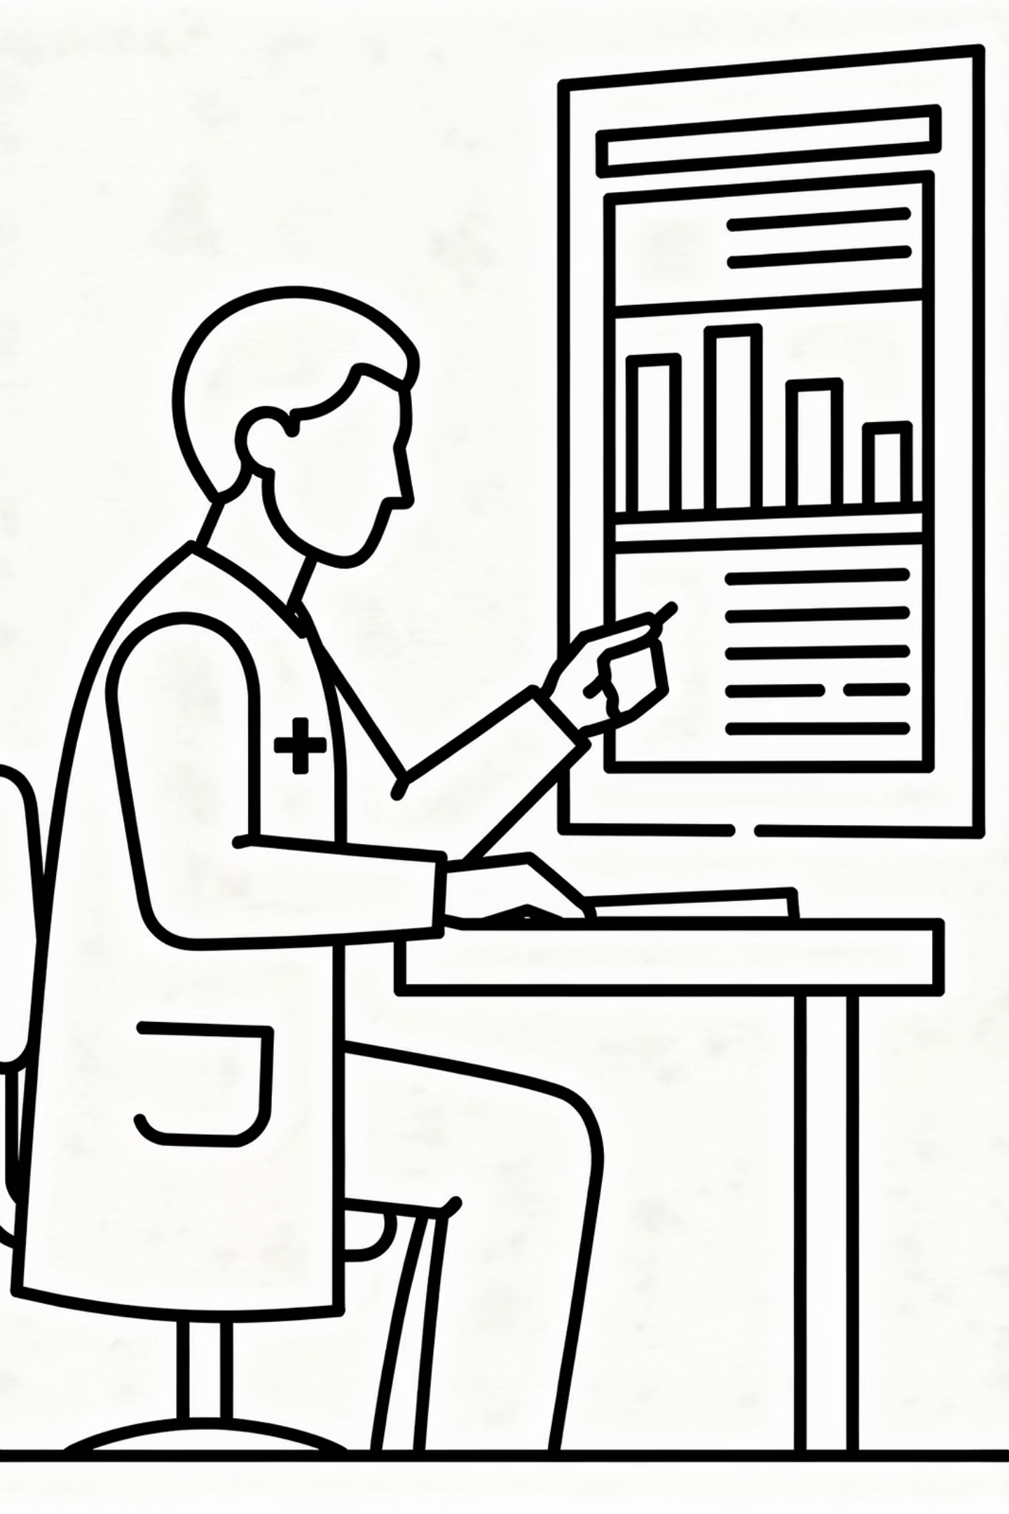

SERVICE 2
UK Readiness Diagnostic
2 weeks | Lightweight structural scan for early-stage or exploratory UK entry. Used to reduce commercial friction and assess whether deeper work is required.
Top structural adoption risks
Accountability heatmap
Early governance red flags
Clear next-step recommendation

Slide 7
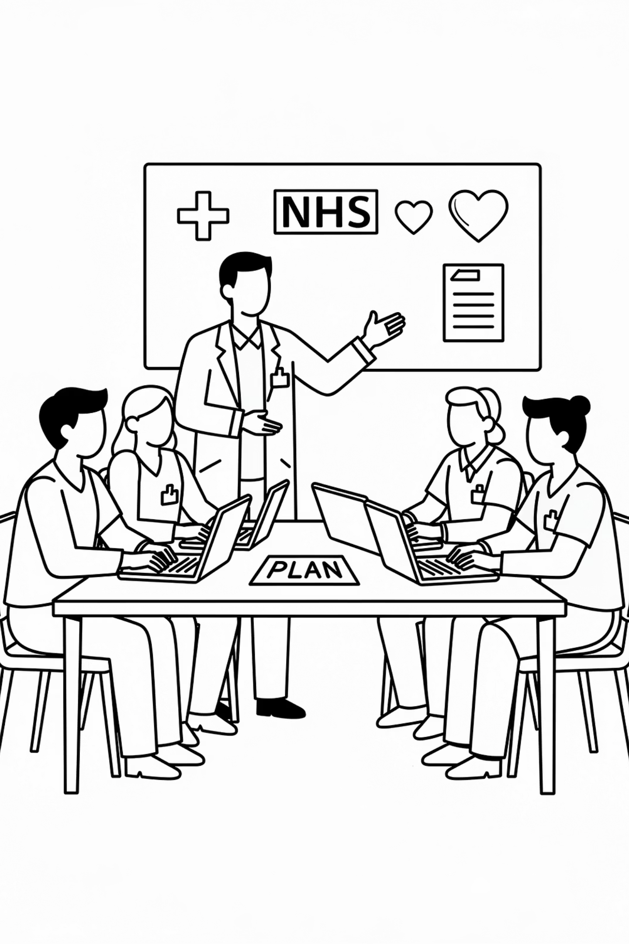



SERVICE 3
Deployment & Alignment Support
Activated when scale stalls not a standalone product.
Stakeholder Alignment
Sessions to resolve clinical resistance and ownership gaps
Workflow Refinement
Workshops grounded in frontline NHS reality
Governance Clarification
Risk boundary mapping and accountability clarity

Slide 8

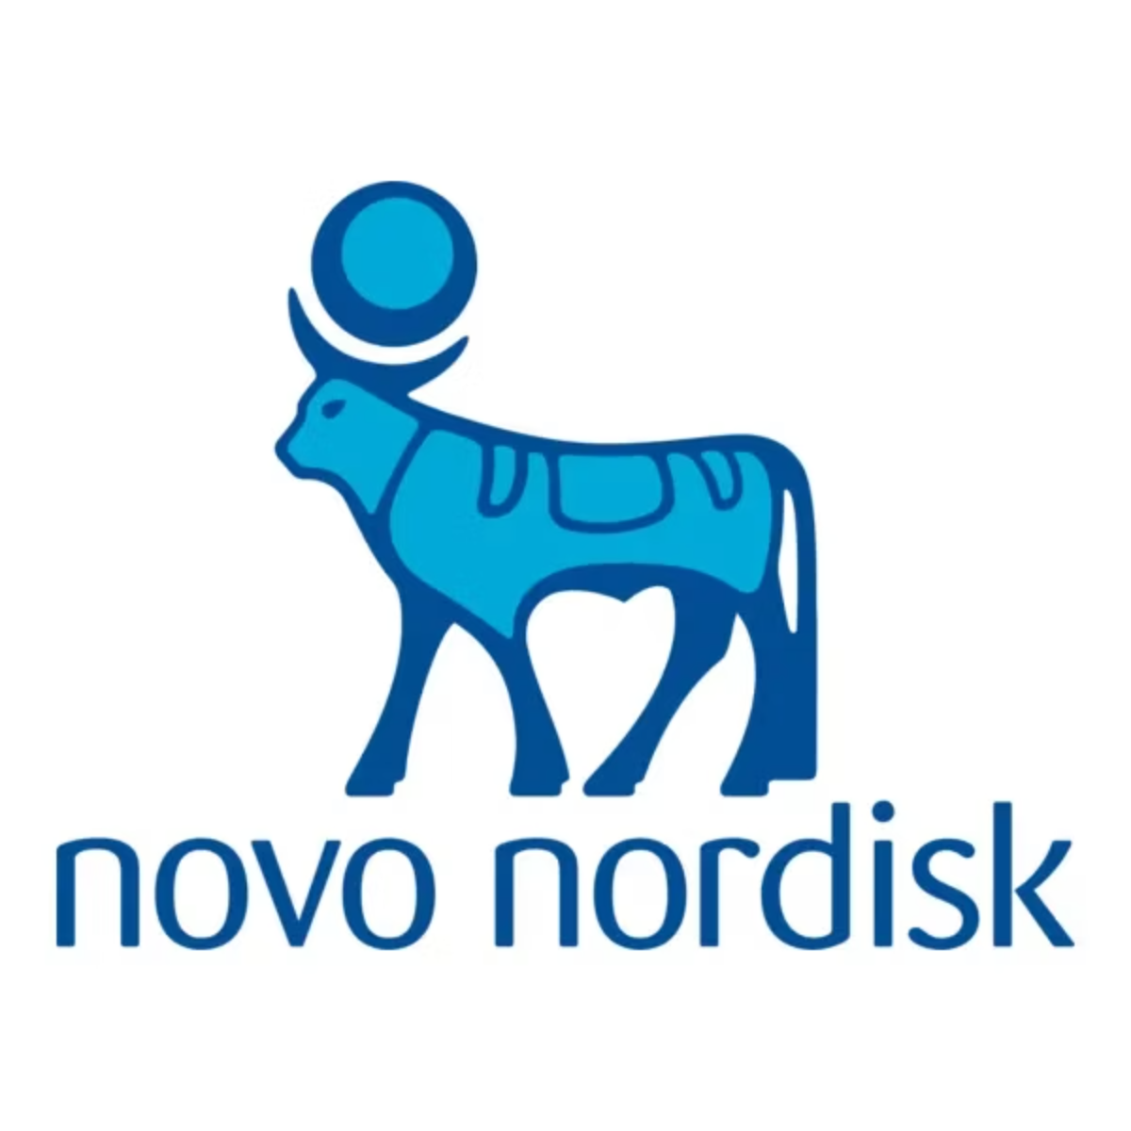
CASE STUDY 1
Novo Nordisk:
Digital Pilot Structuring
Exploring integration of anti-obesity therapy within a digital health ecosystem.
Intervention
Startup scouting with clinical validation lens; aligned corporate, clinical & product teams; defined OKRs and pilot reporting framework
Impact
Improved partnership qualification, reduced pilot misalignment risk, structured innovation process before scale

Slide 9
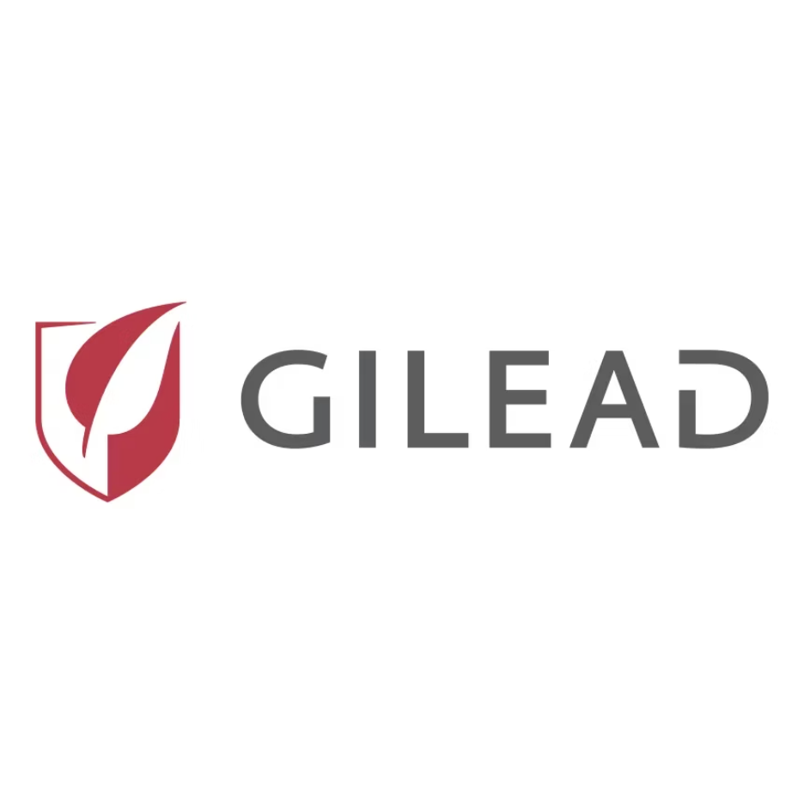

CASE STUDY 2
Gilead: NHS Co-Creation & Prototype Development
Exploring digital patient support models with NHS stakeholders.
Facilitated design thinking workshops & journey mapping
Translated insights into an operationally grounded prototype
Supported pilot initiation within NHS Trust
Impact: Strong cross-stakeholder alignment and early validation before wider rollout.

Slide 10


CASE STUDY 3
Bracco: Medtech Adoption & Clinical Fit
Medtech product development requiring validation against real radiology workflows.
Intervention
Stress-tested usability in high-pressure environments; interviewed senior clinicians; leveraged synthetic data insights to refine product positioning
Impact
Reduced workflow misfit risk, improved clinical usability, strengthened real-world adoption readiness
Demonstrates clinical stress-testing applied to physical medtech, not only digital tools.

Slide 11


CASE STUDY 4
Royal London Hospital: Workflow & Safety Redesign
Delays and safety risks in recovery-to-theatre patient transfer.
📉 Fewer Cancellations
Mapped multidisciplinary workflow
Introduced structured surgical transfer checklist
Embedded feedback loop and governance clarity
⚡ Theatre Efficiency
📋 CQC-Aligned Docs
✅ Clear Accountability

Slide 12
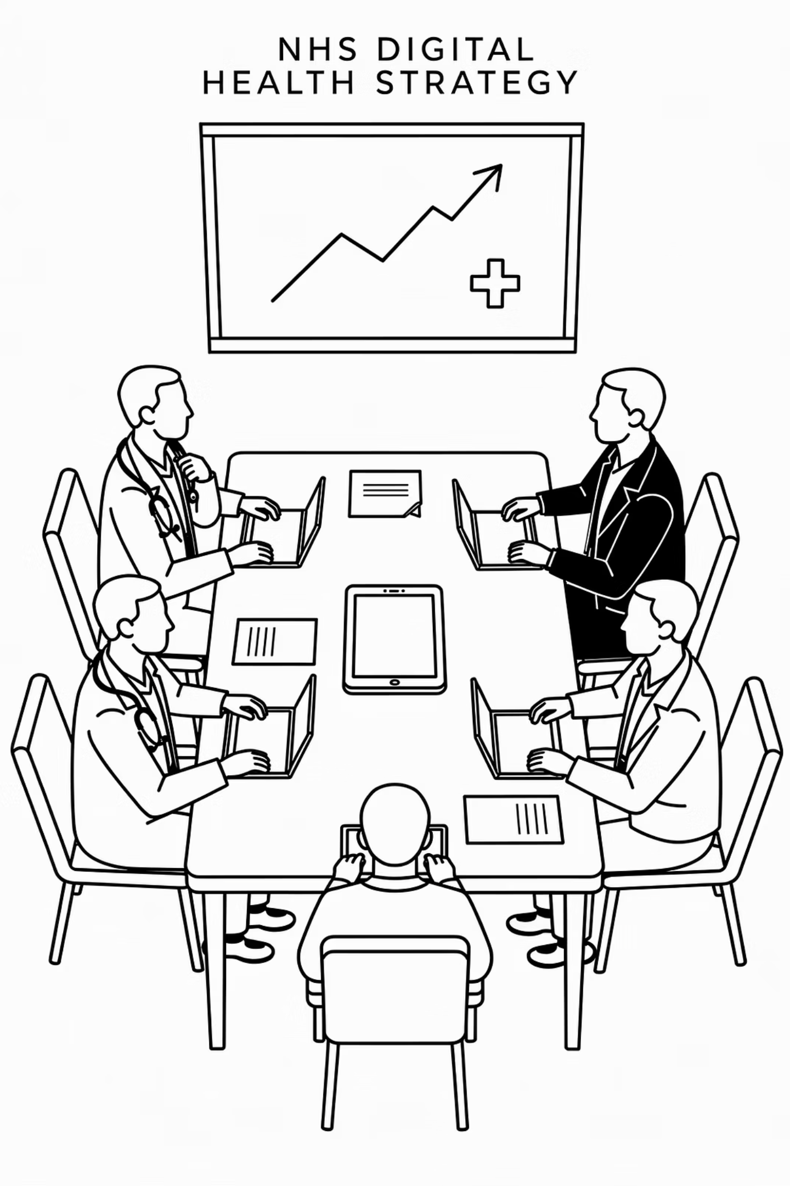
Where I Add Value
Product works in pilot but scale is uncertain
Governance and accountability are slowing deployment
Clinical trust is fragile or workflow risk is underestimated
Leadership needs a clear, defensible adoption decision

Slide 13








The Intersection I Operate In
Clinical Safety
NHS Workflow
DCB0129 / DCB0160 certified
Real-world frontline experience
Decision Framing
Adoption Strategy
Clear, defensible recommendations
Structural readiness for scale

Slide 14
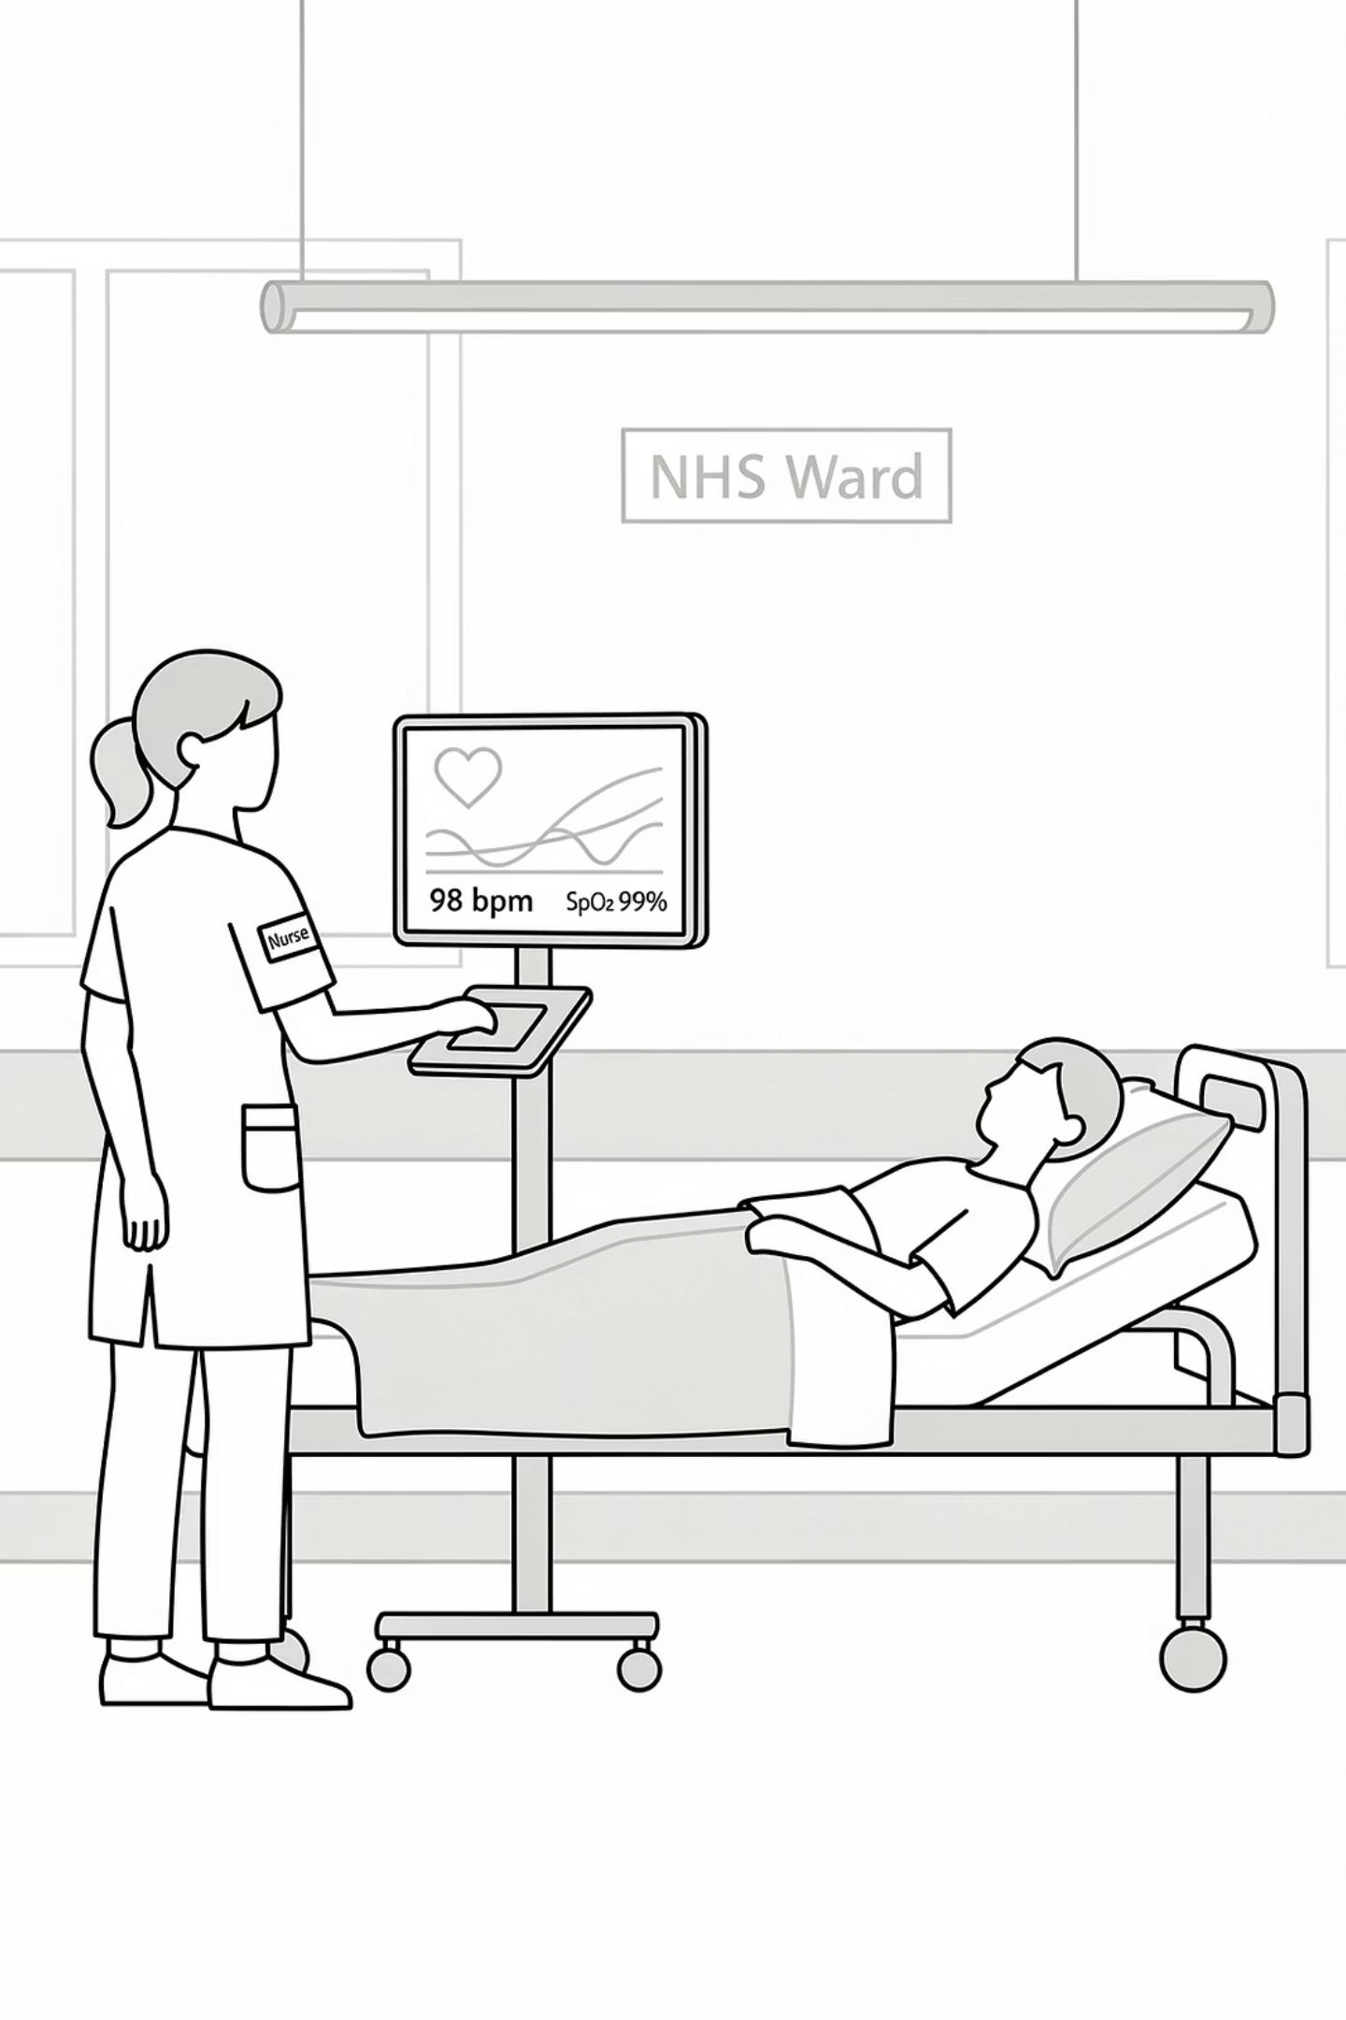
The Focus: Structural Readiness
Not whether a product works.
But whether it can live inside routine care.
Vector Healthcare ensures your solution is ready for the NHS; structurally, clinically, and operationally before adoption stalls.
marco.aldovardi@vector-healthcare.com
https://www.linkedin.com/in/marcoaldovardi/

