Slide 1

Post-quantum technologies
Reliable protection & Strong encryption

Slide 2

In a decade where security is a must, you need a solution that cover all your needs.
What is Crypthor?
What it does?
What is consists of?
Why you need it?

Slide 3
The problem about modern society is that everyone want to know everyone's secrets.
Unknown author

Slide 4
In today global digital world threats are everywhere:
Most information breaches come as a result of a come as a result of a intentional activity from someone that is familiar with company's IT infrastructure.
Information and data have the highest net value compared to human resources and financial assets.
New threats are generated every 5 minutes somewhere in the world.
Forecasting through AI and ML are the only useful tools when coping with global cyber threats.

Slide 5
Basic conclusions:
Today more than ever is a need for a robust, reliable solution that allows maximum coverage of the company IT infrastructure, data arrays and work end-points.
It is important to be provided a solution that is cost effective, flexible, humancentric, and most of all secured.
It is important to be provided a solution that is cost effective, flexible, humancentric, and most of all secured.

Slide 6
What is Crypthor:
Crypthor is a project that unites years of experience of our engineers and security analysts and provides modular based software solutions that cover the most sophisticated modern requirements and standards in the field of cyber security, information security, data protection and cyber defense.
Crypthor is a project that aims to provide to the audience a new type of post-quantum cryptography system that eliminates most of the common weaknesses that occur in basic and more complex cryptographic systems designed for securing small to large enterprises, structures, organizations and their data arrays and information flows.

Slide 7
What is Crypthor:
Crypthor was started back in early 2009 as part of the large R&D project Black Screen which focus was design and development of new type people centric software that corresponds with the needs of the modern business person, IT professional and the enterprise of the new century. Through the work on the Black Screen project the team behind Crypthor managed to develop a number of sophisticated software solutions that managed to prove themselves as an easy-to-use software tools for the everyday work.

Slide 8
History of the Crypthor project:
Beginning of the Black Screen Project, that will later become the cornerstone of Crypthor
Presentation of the core mathematical apparatus behind Crypthor
Initial phase of Crypthor development
First patent application filing .
Definition of the secure hybrid cloud concept that utilize a set of cryptographic primitives.
Gatelink launches the development of new enterprise oriented security modules.
2008
2009
2010
2011
2014
2015
2016
2017
2019
2020
2021
2022
For a first time G-92 presents to the audience secured customized web browsers
The New Generation Internet Tools concept is defined.
Presentation of the object-relational approach for data encryption
Patent recognition received for the object-relational encryption approach.
Gatelink is established and continues the Black Screen - NGIT project.
Crypthor is presented to the audience as a modular post-quantum security system.

Slide 9
What is behind Crypthor:
More than 20+ years of proven experience in the IT industry and deep knowledge of the main principles that lay down in the foundations of modern cyber world and its processes.
Deep knowledge that covers the areas of AI, ML, Math and their fundamentals. Moreover, we focus also on the deep understanding of the mathematical apparatus that stays behind the contemporary cyberthreats and cyberattacks.
State-of-the art cryptographic algorithms and mechanisms along with innovative security management approaches. Crypthor provides you with inimitable strong encryption system that reduces security risk with up to 75%.

Slide 10
Technology and principles:
We have managed to redesign the processes of key generation and key exchange along with the way communication is established and executed. Something more, we’ve developed our own cryptographic algorithms that allow us to provide the user with a solution that allow strong encryption and renders attempts at possible cryptanalysis and compromise pointless.
We are not focused on positioning Crypthor as another one cybersecurity solution that will establish secure channels and policies over the existing ones. We're focusing on the open public channels, because we assume that the existing infrastructure is already compromised, and there is a zero chance for prevention of insider attack.
We consider the prevention, since it is a normal practice, but we focus on how to make the attempts for attack pointless and to allow complete reduction of the information security risk. We consider Artificial Intelligence and Machine Learning in their whole and strive to extract the fundamental apparatus that after small redesign will allow us to provide modular robust system that is capable to work absolutely autonomously without the need for continuous administration and support.

Slide 11


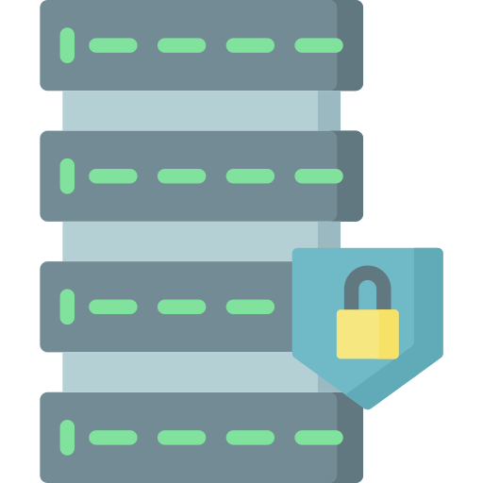





What Crypthor covers:
Secured cloud based infrastructure;
Secured file and information storage;
Database security through strong encryption;
Secure notarization and identity management;
Infrastructure and device security;
Secured communication through standard public channels;
Precise 3D localization and geo-positioning;

Slide 12








Compatibility:
And more…

Slide 13
Crypthor’s core principles:
Interact
Observe
Analyse
The result is: human-centric hybrid post-quantum cybersecurity solution.

Slide 14
The Crypthor autonomousity model:
OBSERVATION
Continuous monitoring of information resources and business processes.
ANALYSIS
In-depth analysis of your data arrays and information flows
INTERACTION
Work-processes and habits learning
ASSESMENT
ICategorization of the data arrays and infrastructure nodes
INTEGRITY
Complete integration with existing infrastructure and BPs
SECURITY
Contemporary forms of information and data protection through post-quantum approaches
DATA
Data and information protected by strong encryption mechanisms and custom algorithms

Slide 15
The trinity of Crypthor:
File Package Manager (FPM)
File integrity
Monitor
Legend:
SCE – Secured Cloud Explorer
DES – Database Encryption System
PDS – Protected Data Safes
PDC – Protected Data Cases
File Protect System
(FPS)
File Destruction Manager (FDM)
PDS & PDC
SCE
File
Shredders
And more….
DES
BSMail
File integrity
Monitor

Slide 16
File Protect System - FPS
Post-quantum approaches, Strong encryption, ease of use.

Slide 17
File Protect System – FPS:
FPS is an innovative software solution for protection of information arrays and personal data. This software application is a fully scalable cryptographic system.
File Protect System combines a set of specialized software functions, crypto-primitives and cryptographic algorithms and functions that allow achievement of high levels of information and data protection.
FPS is capable to transform almost every computer with a Windows operating system into a powerful cryptosystem that can be technically and functionally compared to existing government and national security systems.
Utilized crypto primitives and cryptographic algorithms are NIST – compliant and are covered by the NIST Cryptographic Module Validation Program – CMVP.

Slide 18
File Protect System – FPS:
FPS provides its users with the necessary set of tools needed for establishing a secure and reliable system for protected electronic exchange and storage of information and data.
File Protect System combines some well-known features, such as “password encryption” with modern approaches such as the encryption through use of digital objects. The combination between proven and contemporary methods and approaches provides the end user with the ability to create his own cryptosystem, through the ability to use a user-defined file for generation of cryptographic keys.
Distinguishing feature of FPS is the option to secure information and data both on a local computer and on external media (flash drive, portable HDD, etc.), as well as in the cloud, without the user having to worry about the security of his information and data.

Slide 19
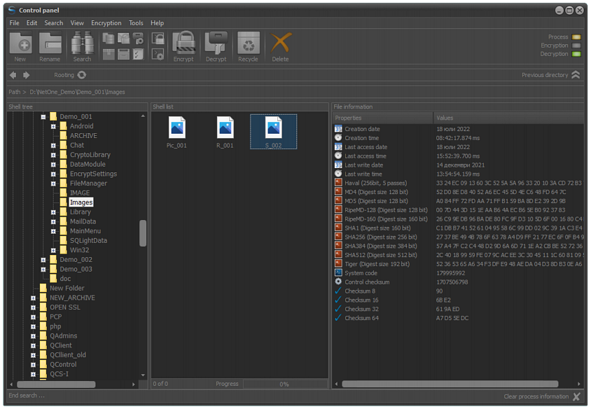
File Protect System - FPS:

Slide 20
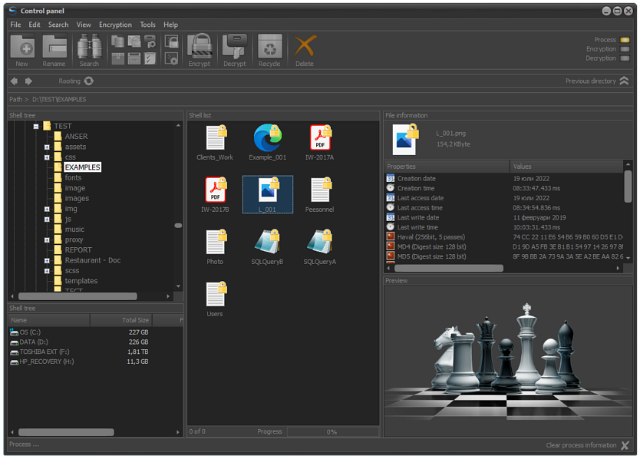
File Protect System - FPS:

Slide 21
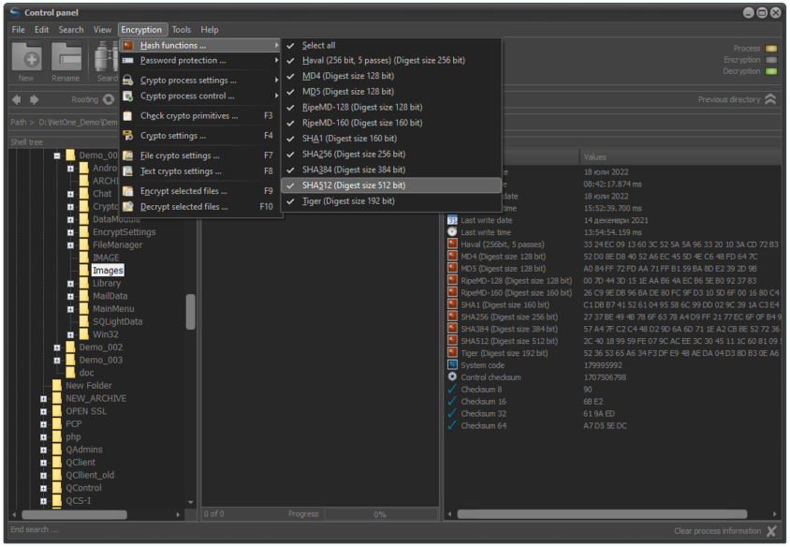
File Protect System - FPS:

Slide 22
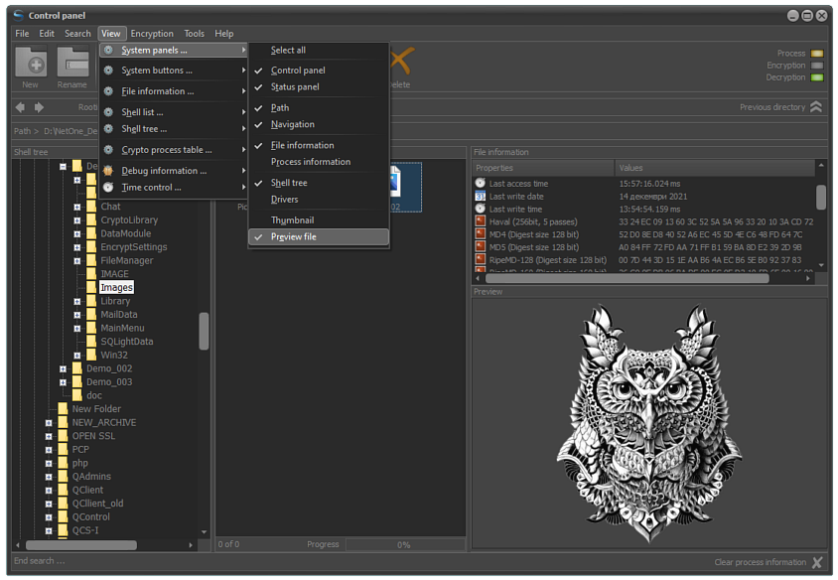
File Protect System - FPS:

Slide 23
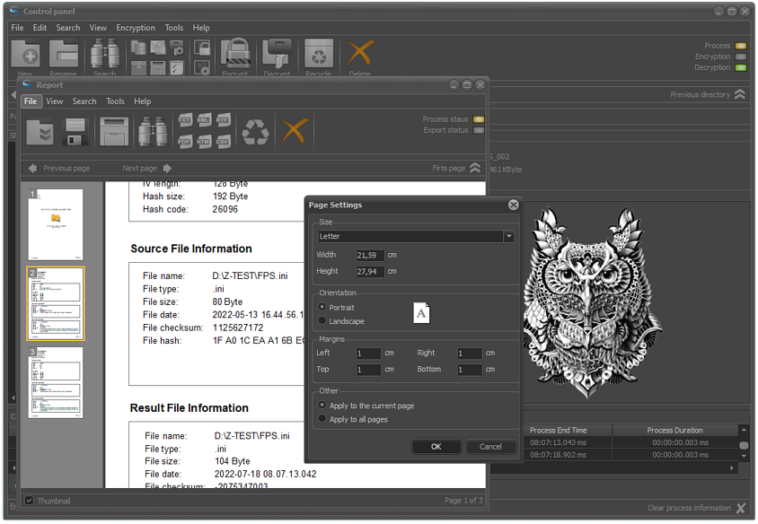
File Protect System - FPS:

Slide 24
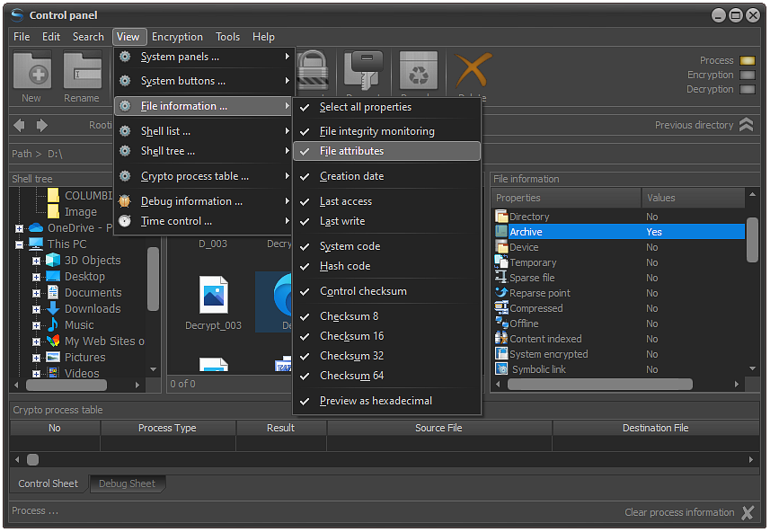
File Protect System - FPS:

Slide 25
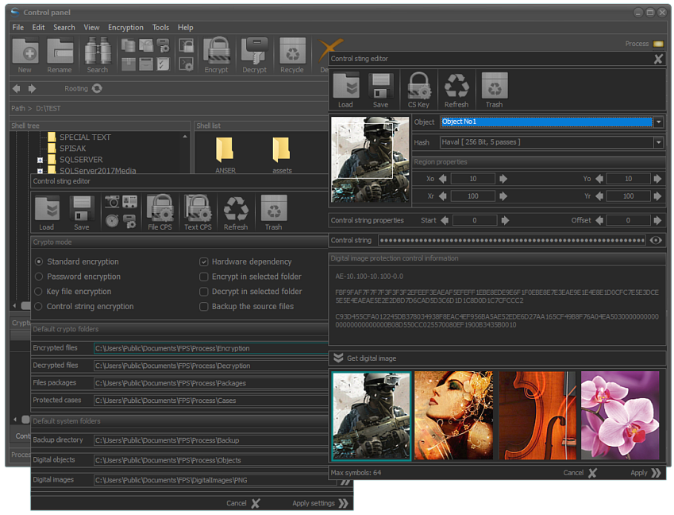
File Protect System - FPS:

Slide 26
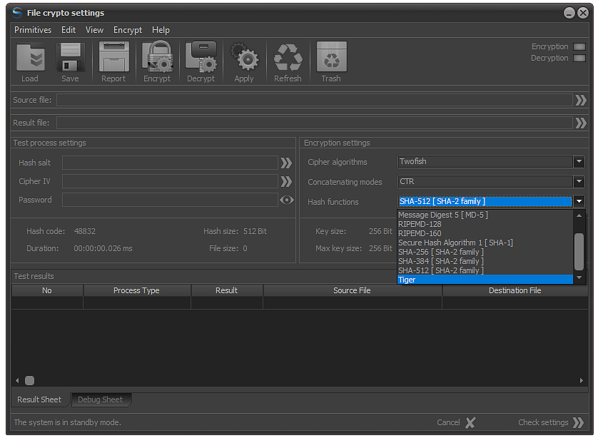
File Protect System - FPS:

Slide 27
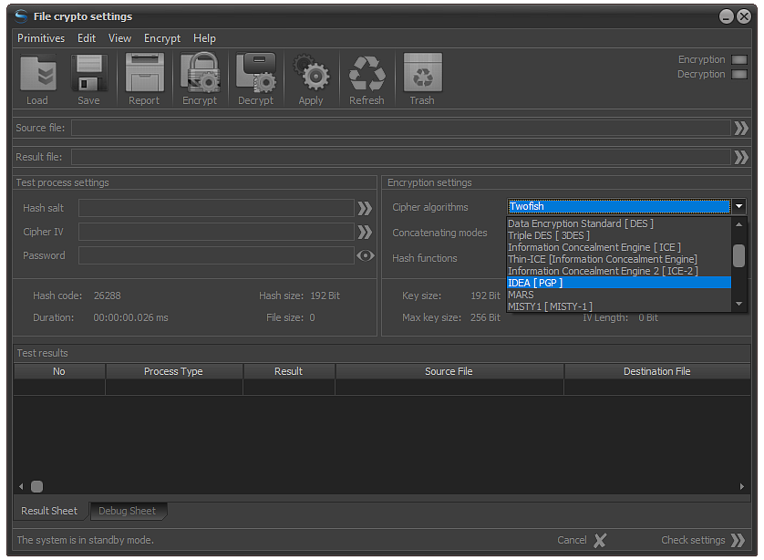
File Protect System - FPS:

Slide 28
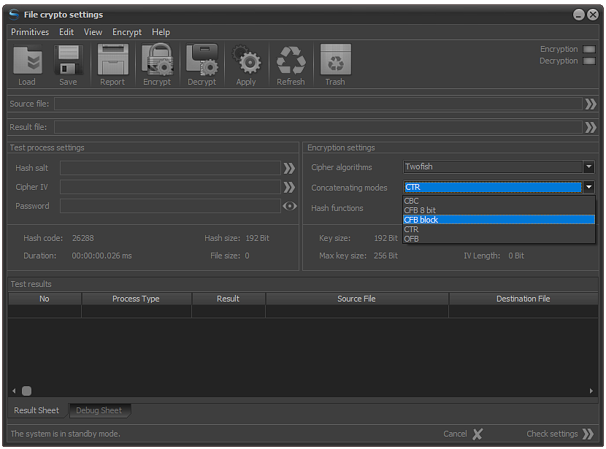
File Protect System - FPS:

Slide 29
File Destruction Manager - FDM
Post-quantum approaches, Zero risk, No reverse engineering possibility.

Slide 30
File Destruction Manager - FDM:
File Destruction Manager (FDM) is a software solution designed to assist the processes of data sanitization and wiping by utilizing post-quantum encryption and hybrid cryptographic methods for random configuration of basic crypto primitives.
FDM utilizes the data destruction technique. This technique uses a software approach for recording a set of random bytes for each free sector of the disk that is used to store sensitive to critical information.
The data deletion approach ensures that the possibility for recovering of deleted data by utilization of specialized software or hardware means and approaches is equal to zero. Data destruction is a very reliable form of device (drive) sanitization and wiping as it confirms that 100% of the data is replaced at the lowest possible level (byte level).

Slide 31
File Destruction Manager - FDM:
Pros and Cons of data destruction:
Pros:
No need for physical destruction;
No third party involving;
Ability for “device recycling” – the device can be sold out or used once again in company/organization infrastructure;
Eco-friendly;
Cons:
Time consuming process;
Needs administrative privileges;
Access restrictions during sanitization and wiping process;

Slide 32
File Destruction Manager - FDM:
FDM is characterized by another one feature - the data random encryption. Random data encryption is a hybrid cryptographic method that use a random configuration of basic crypto primitives. In this process a secret key is generated based on a random selected key derivation function (KDF) and it is destroyed, once the process is complete.
Why Random data encryption?
Random encryption is fast and very efficient method for hybrid sanitization of storage devices and because of this it is a great option for sanitization and wiping of “frequently used” devices such as flash drives, removable drives, portable HDDs, etc. or devices that contain sensitive to critical information.
So, are there any special requirements?
The encryption technology that FDM utilizes is hardware independent and works on most common operating systems.

Slide 33
File Destruction Manager - FDM:
How about the human error, how you protect me from this ?
File Destruction Manager can be characterized by the completely automated processes that exclude any ability for human intervention and this reduce to zero the possibility for human error.
I want to know more about this where can I find more information?
More about sanitization, its types, why it is important and so on, you can find in the “Good to know” section at crypthor.gatelink.bg where we have provided some useful information from which you could benefit. In case you are interested to learn more and to see a live demo, we encourage you to make yourself free to download and test the free or the standard version of FDM from Microsoft store. There is a 15 days free trial period. No credit card required. :)
Free version: https://apps.microsoft.com/store/detail/fdm-ii-fe/9PLZ069MZJKD
Standard version: https://apps.microsoft.com/store/detail/fdm-ii-se/9N9RRZ3TR3FB
Cool isn’t it ? 😉

Slide 34
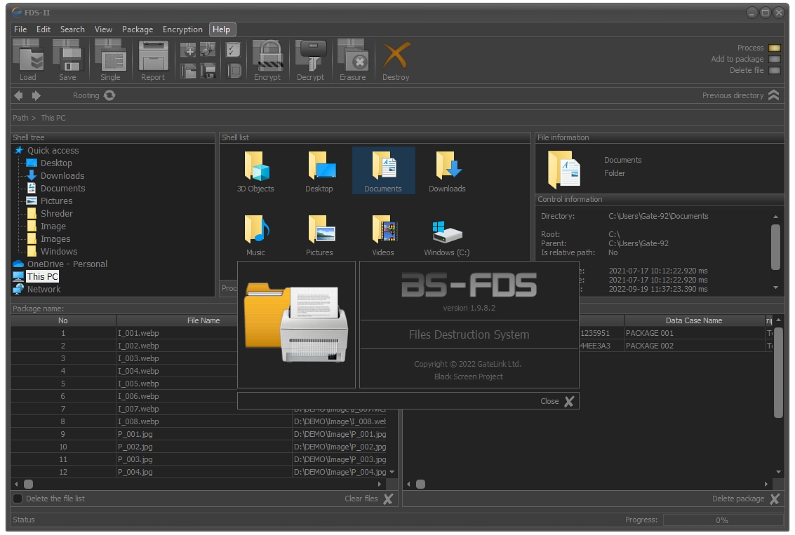
File Destruction Manager - FDM:

Slide 35
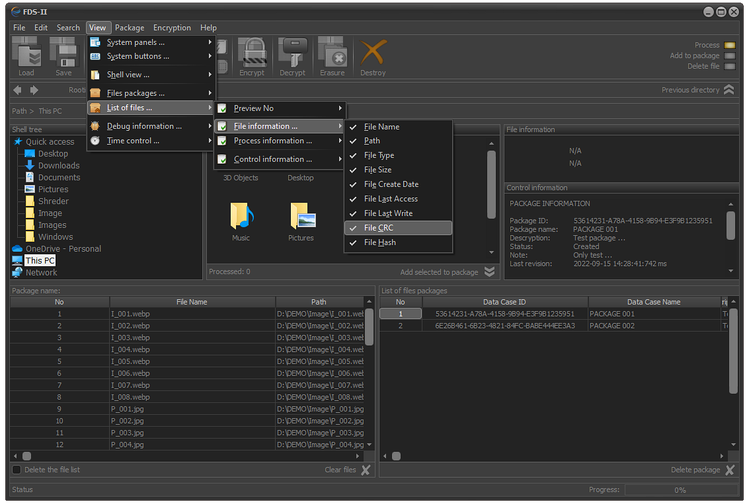
File Destruction Manager - FDM:

Slide 36
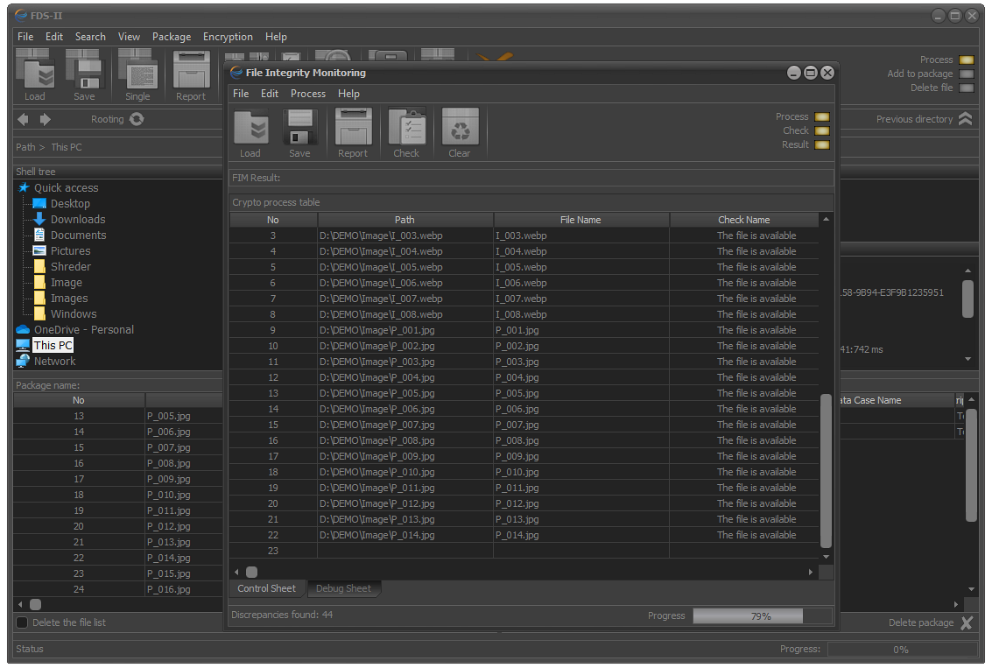
File Destruction Manager - FDM:

Slide 37
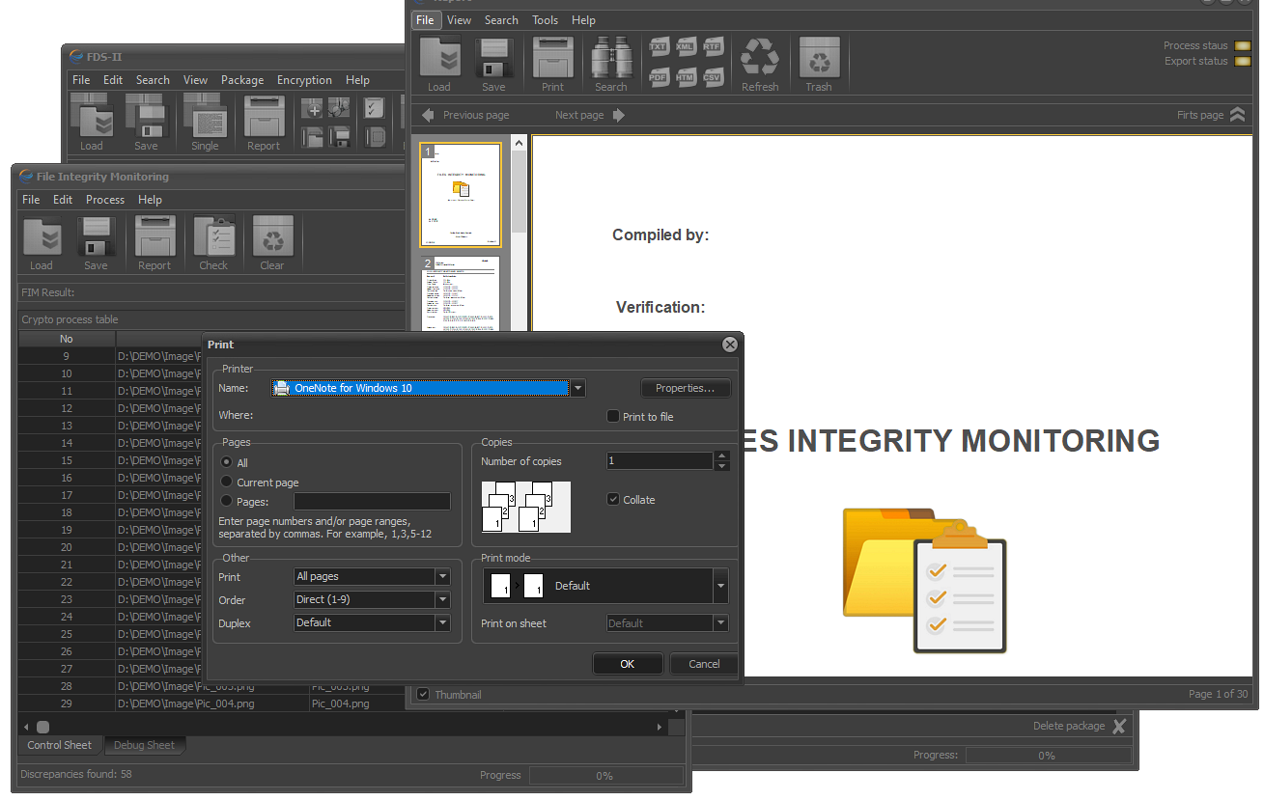
File Destruction Manager - FDM:

Slide 38
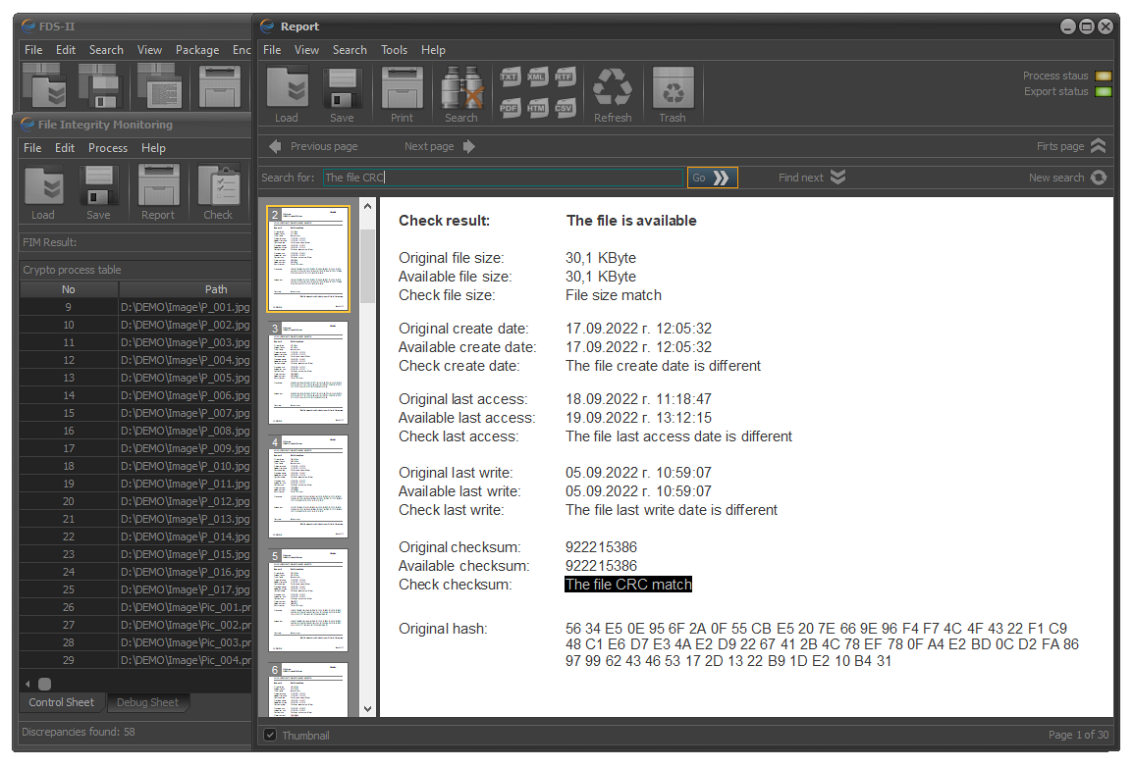
File Destruction Manager - FDM:

Slide 39
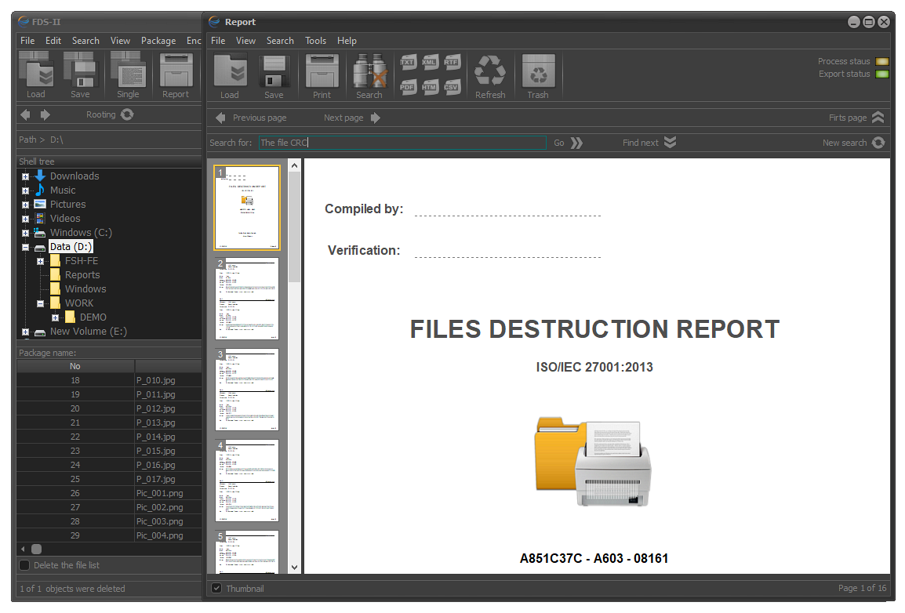
File Destruction Manager - FDM:

Slide 40
File Package Manager - FPM
Strong encryption, Secured data, No information risk.

Slide 41
File Package Manager - FPM:
File Package Manager is a specialized easy-to-use software application for encryption and protection of files and folders that are located and stored at local, network, server or external storage arrays and devices.
The application provides its users with the following functionality:
Encryption and Decryption of file packages;
File integrity check;
File modification control;
Continuous monitoring and check of current status of files and directories;
Mutual overlapping of files contained in a package;
Shredding and/or sanitization of files contained in a package;
Additional strong security and strong encryption features;

Slide 42
File Package Manager - FPM:
Operations through FPM over files and folders saved in a given package are executed only when these files and folders are physically accessible. If it occurs that these files and folders are not accessible (have been deleted, moved to a physically inaccessible network drive or other reason) then this event is recorded and a time stamp is made that signify the exact time of detection.
In case an encryption process has been executed on the files consisting the file package, all accessible files will be encrypted by utilizing the user-defined crypto primitives.
What is the file package and why it is so special?
File packages are spreadsheets that contain meta information about files and directories that are physically located on one or more physical devices.
File package manager (FPM) is a modular solution part of the Crypthor cybersecurity and data protection system and as such it can be used as a standalone solution or coupled with some of the other software modules that constitute Crypthor.

Slide 43
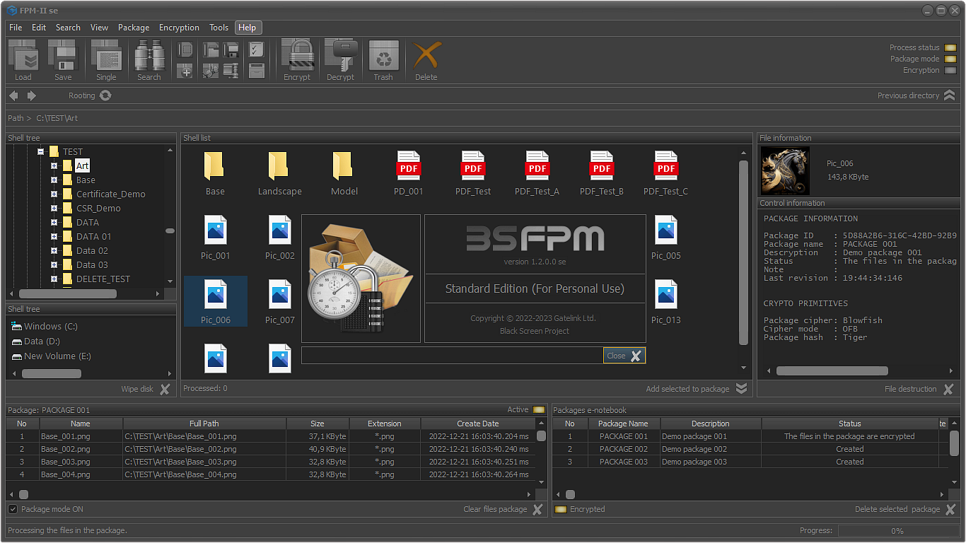
File Package Manager - FPM:

Slide 44
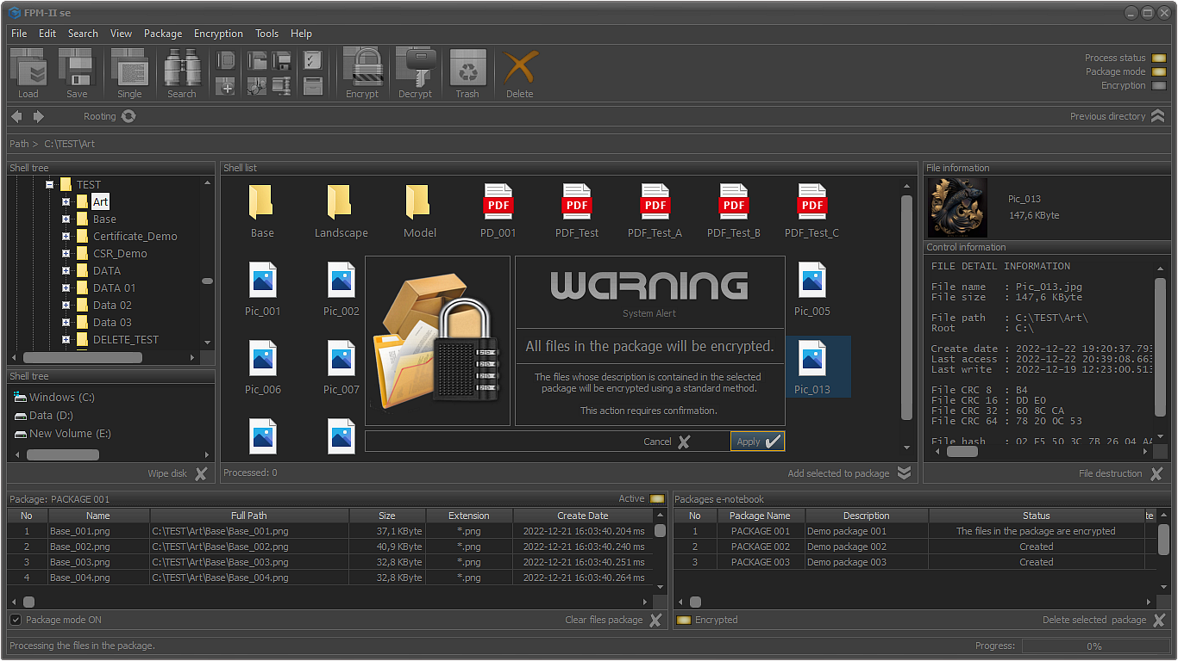
File Package Manager - FPM:

Slide 45
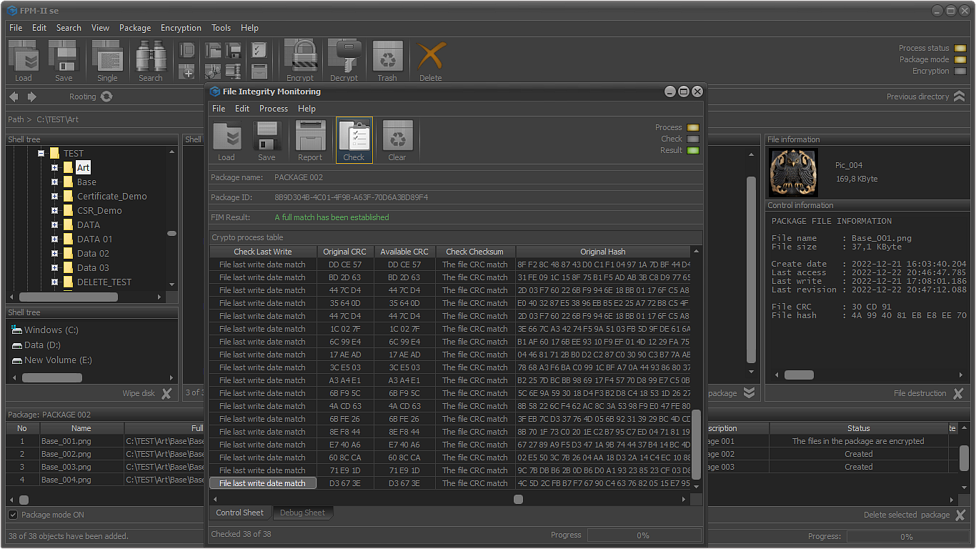
File Package Manager - FPM:

Slide 46
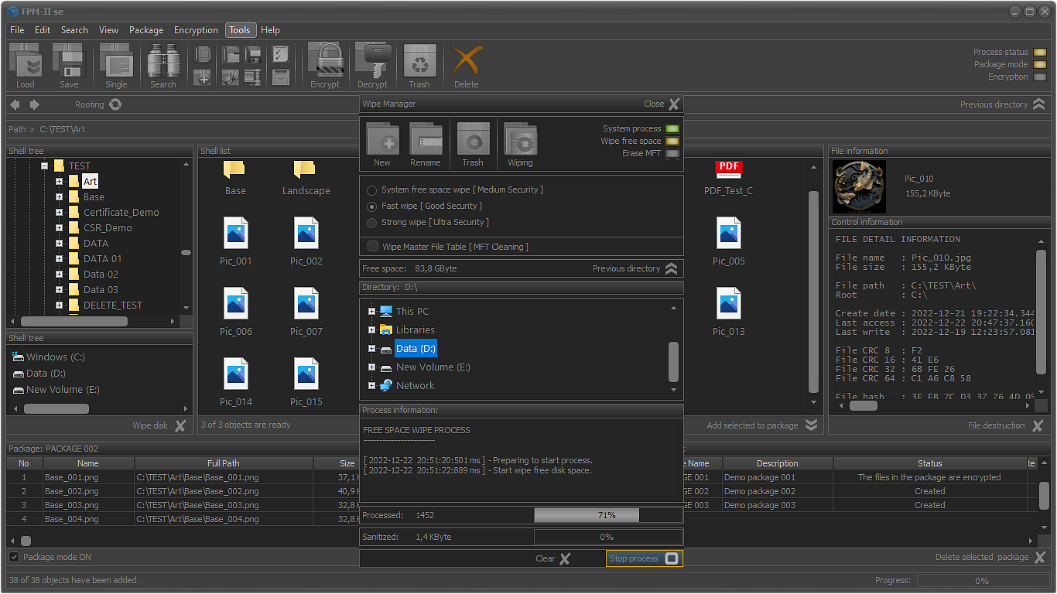
File Package Manager - FPM:

Slide 47
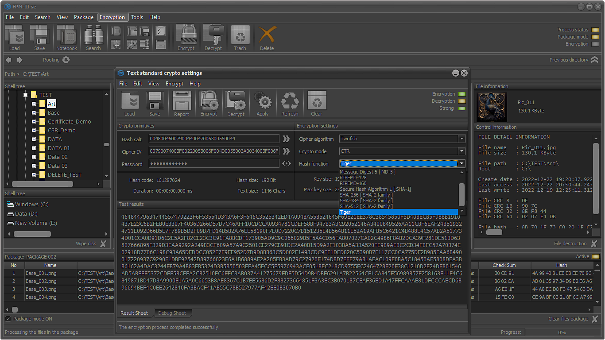
File Package Manager - FPM:

Slide 48
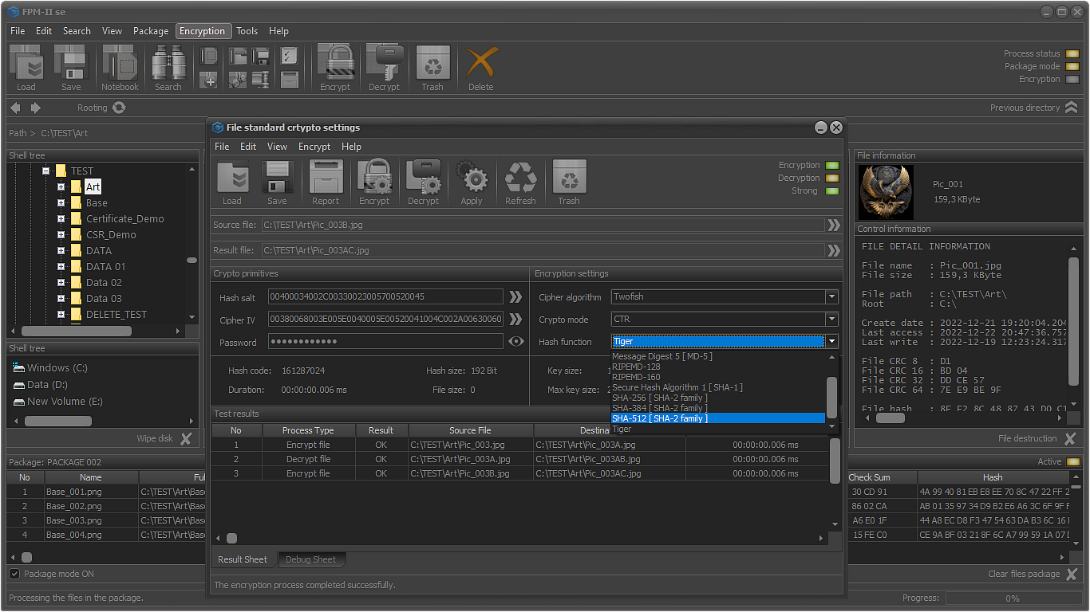
File Package Manager - FPM:

Slide 49
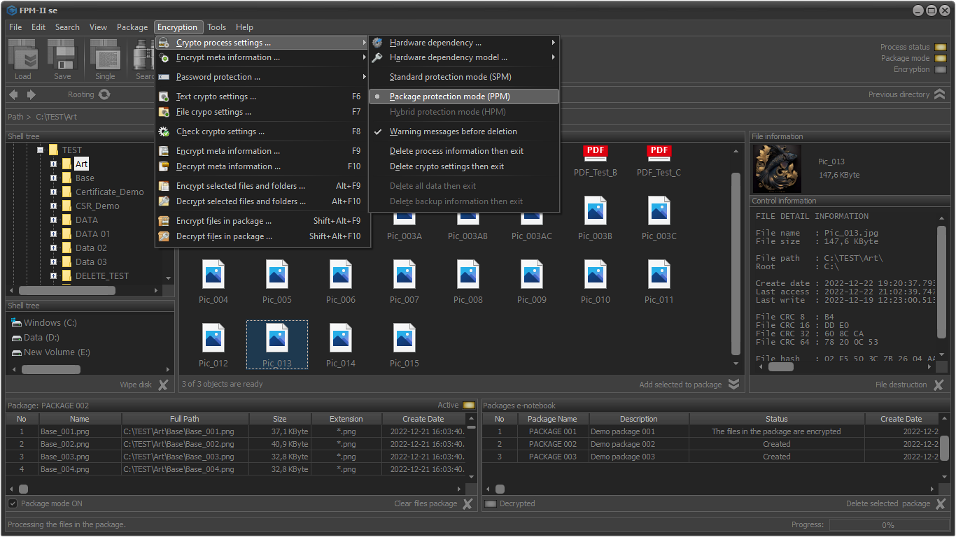
File Package Manager - FPM:

Slide 50
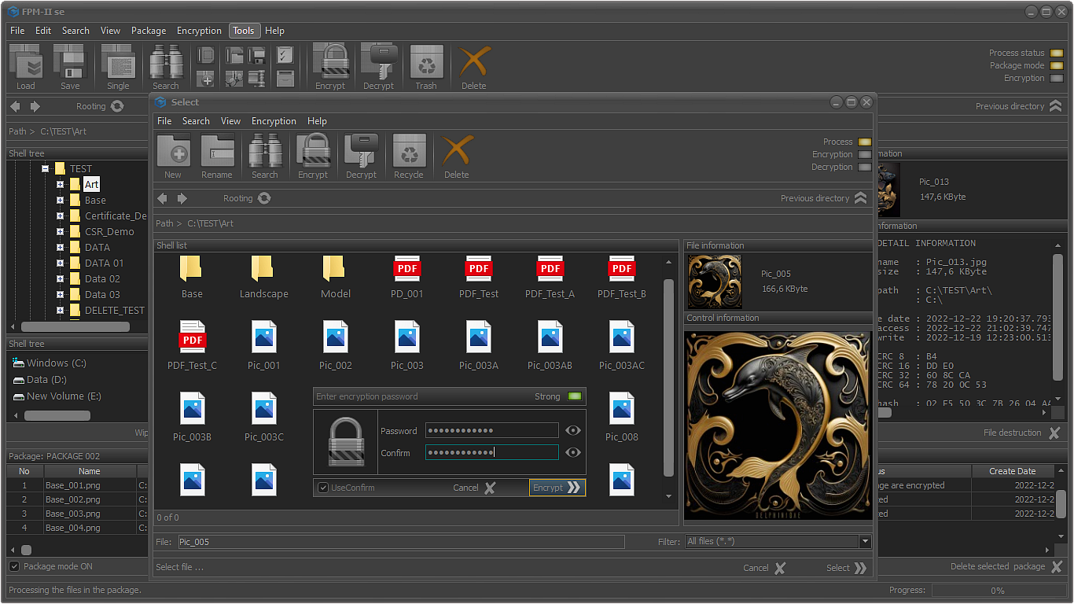
File Package Manager - FPM:

Slide 51
File Package Manager - FPM:
That is nice, but how and where I can see more about this module?
You can enjoy a 15 days free trial of FPM through downloading the free or the standard version from Microsoft store. There is no credit card requirement. ☺
In case you like it, leave us a 5-star rating. 😉
Free edition: https://apps.microsoft.com/store/detail/fpm-ii-fe/9NCR9K18F706
Standard edition: https://apps.microsoft.com/store/detail/fpm-ii-se/9NK90KVC5F12

Slide 52
Non-standalone and special modules
Modules that are part of a main Crypthor module or are provided in some occasions as on-premise ones.

Slide 53
Secured mail client – BS Mail:
BS Mail – the first strong security open channel communication email client:
BS Mail is a specialized non-standalone software module part of Crypthor often distributed as an integral part of File Protect System – FPS. (Note: In some specific cases like enterprise clients and largescale integration this module can be obtained as a standalone application). BS Mail is designed to allow its users to securely exchange messages and documents. This feature is allowed by the core of BS Mail that combines post quantum encryption approaches with standard open communication channels (complete utilization of the mass used email protocols) along with the ability for securing email accounts at public email providers and the connected mailboxes. BS Mail is a solution that allows its users to create secure correspondence lists and groups, while utilizing the standard email communication protocols like POP3, IMAP, SMTP. With BS Mail the possibility for interception or execution of a "man-in-the middle" attack is reduced to minimum.
BS Mail has internal sub-modules that allow the user to execute secure communication over TCP/IP and some other communication protocols. We call this function SEMessenger.

Slide 54
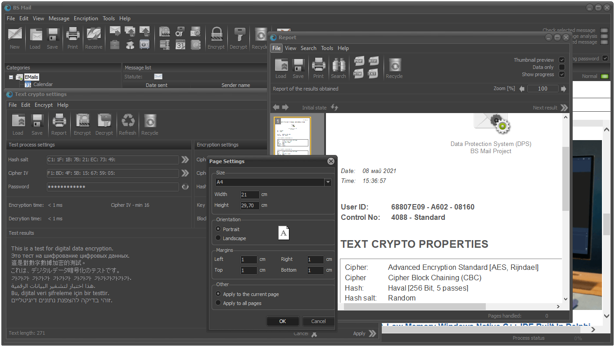
Secured mail client – BS Mail:

Slide 55
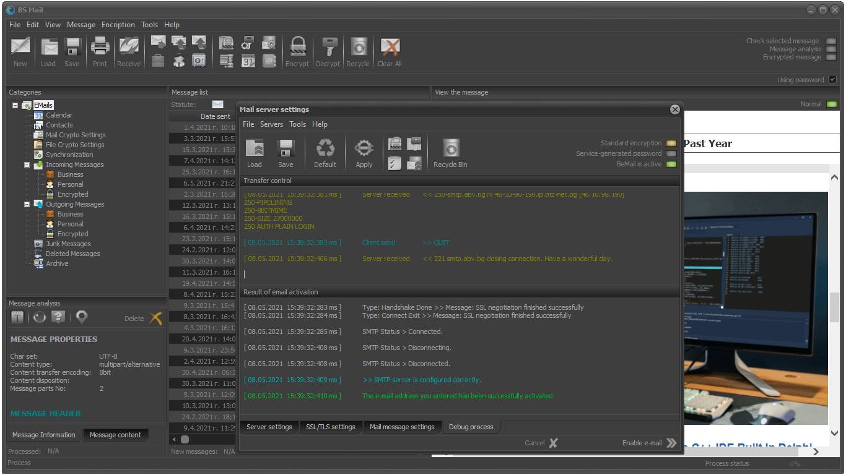
Secured mail client – BS Mail:

Slide 56
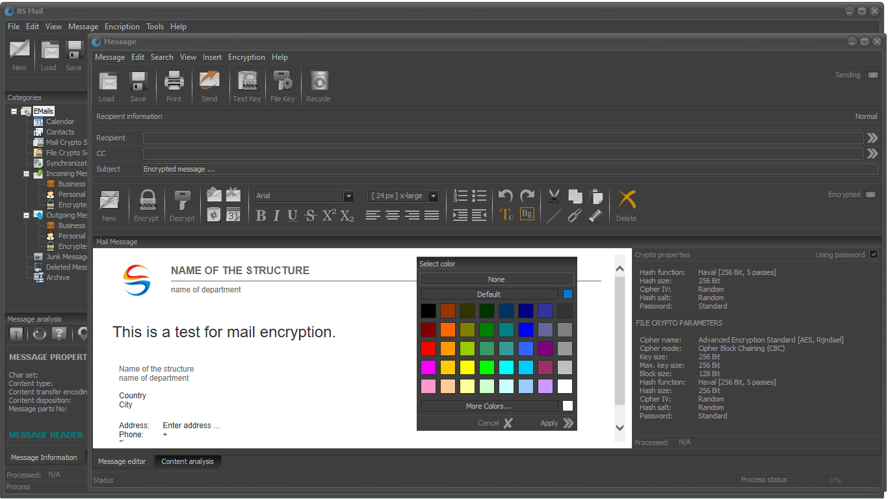
Secured mail client – BS Mail:

Slide 57
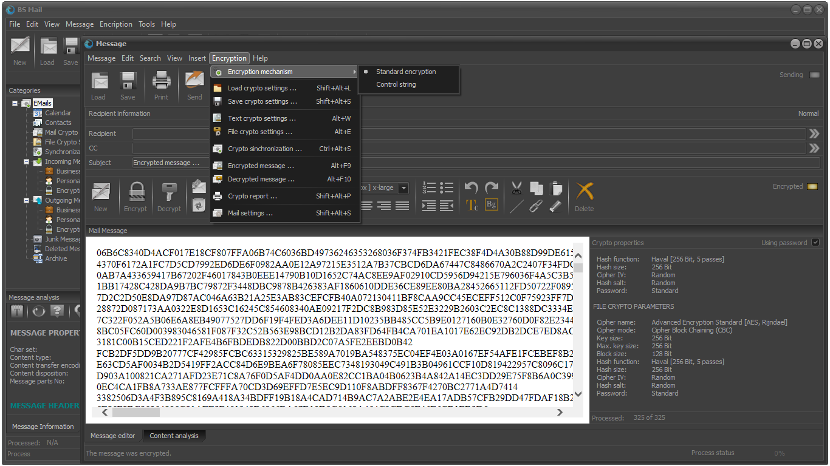
Secured mail client – BS Mail:

Slide 58
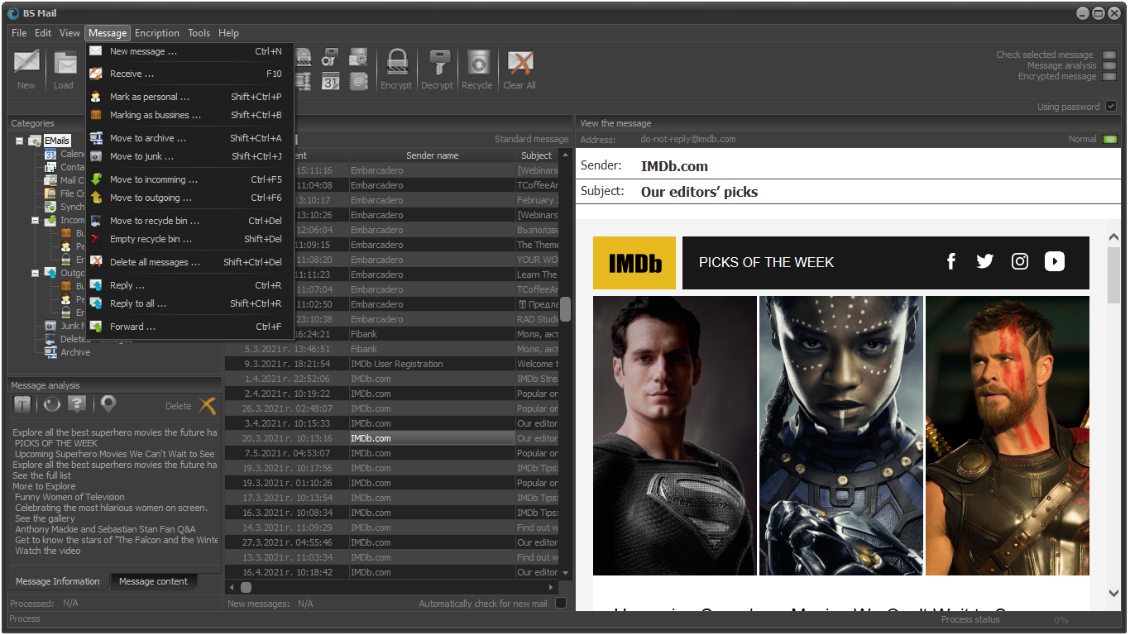
Secured mail client – BS Mail:

Slide 59
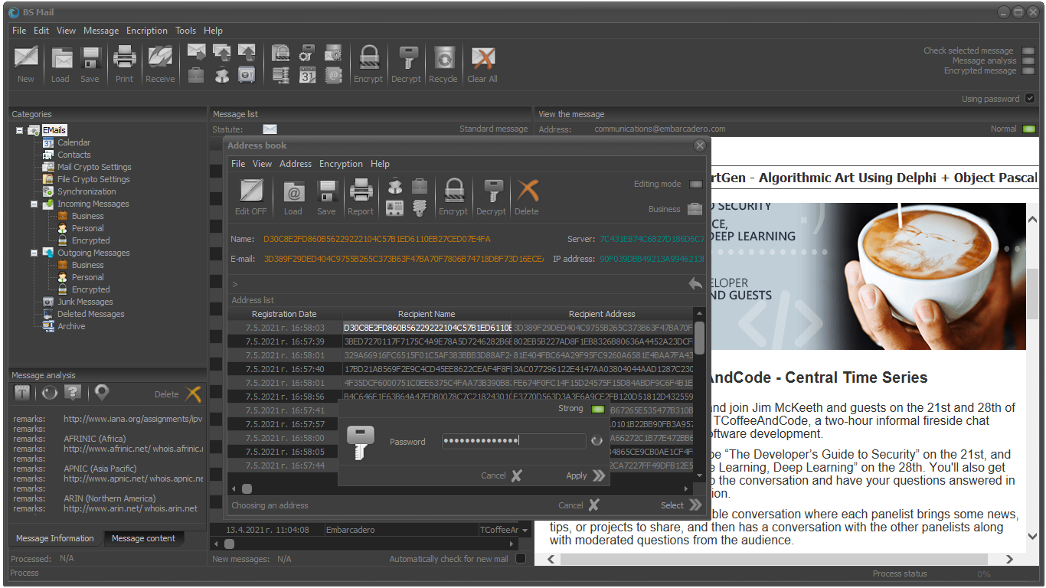
Secured mail client – BS Mail:

Slide 60
Protected data cases and safes – PDC & PDS:
Protected data cases (PDC) and Protected data safes (PDS) are integral part of the core functionality of File Protect System and the Cryptor system. These two modules look kind of similar at first glance but in reality, each of them combines a specific functionality for providing high degrees of security and protection for your sensitive information and data.
The protected data cases allow the user to create highly secured virtual cases that can be based on the user’s personal or work device, external drive etc. The data cases utilize the system provided encryption algorithms and hash functions and allow the end user to allocate specific encryption algorithm and hash function for a single data case or for a specific file in the data case. This option allows better management of the information risk on the end user side even in environments with high degrees of information risk.
The protected data safes are similar to the protected data case, but they are more oriented towards the working station or device of the user. The working principle is similar to the one of the data cases, but the data safes are specific by their ability to provide strong post-quantum encryption functionality to the end user.

Slide 61
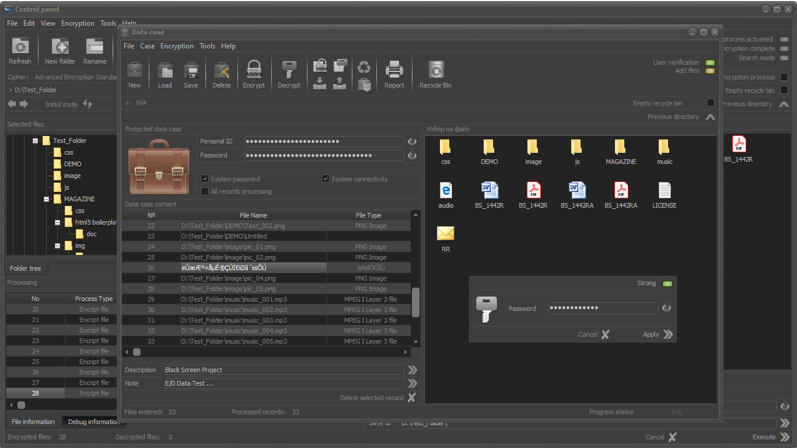
Protected data cases and safes – PDC & PDS:

Slide 62
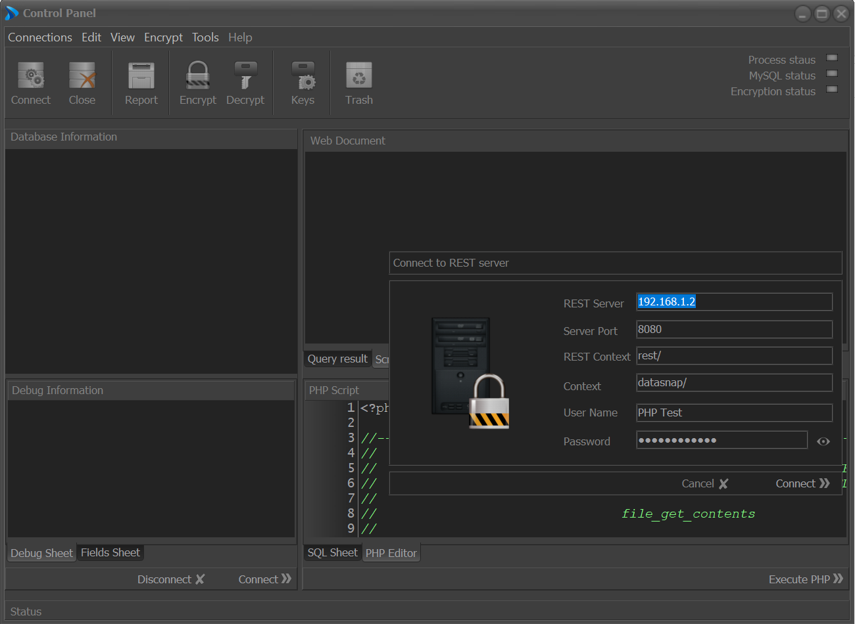
Database encryption system – DES
The database encryption system – DES is specialized non-standalone module for database protection that is provided only with the enterprise versions of Crypthor.
The DES allows through a REST server-based connection to be accessed all types of databases (relational and non-relational). This module is capable to work with almost every well-known database management system (MS SQL, MySQL, Mongo DB, Maria DB, Oracle, etc.)
This is only a sample image, for more information concerning this module, please ask for a presentation and live demo. Concerning the nature of this tool information about it is provided only after a written request.

Slide 63
Database encryption system – DES
The application of the REST technology allows smooth connection and execution of simple to complex queries in the protected databases. The system provides the user with the ability to provide “strong encryption” on a given database that will provide significant levels of security to the data stored in the database. The significant advantage of DES is the ability to execute simple to complex queries in the already encrypted database and to receive all the requested information without the need to decrypt and encrypt the whole database. The DES-module allows database administrators, Data analytics and BI specialists to work in a highly secured environment without the need for additional proxy servers, secured VPNs, etc. Significant advantage of DES is the ability for execution and processing of encrypted queries, that allow to be achieved 100% degrees of securitization of the data analytics, data extraction, data processing and data transfer processes and activities.

Slide 64
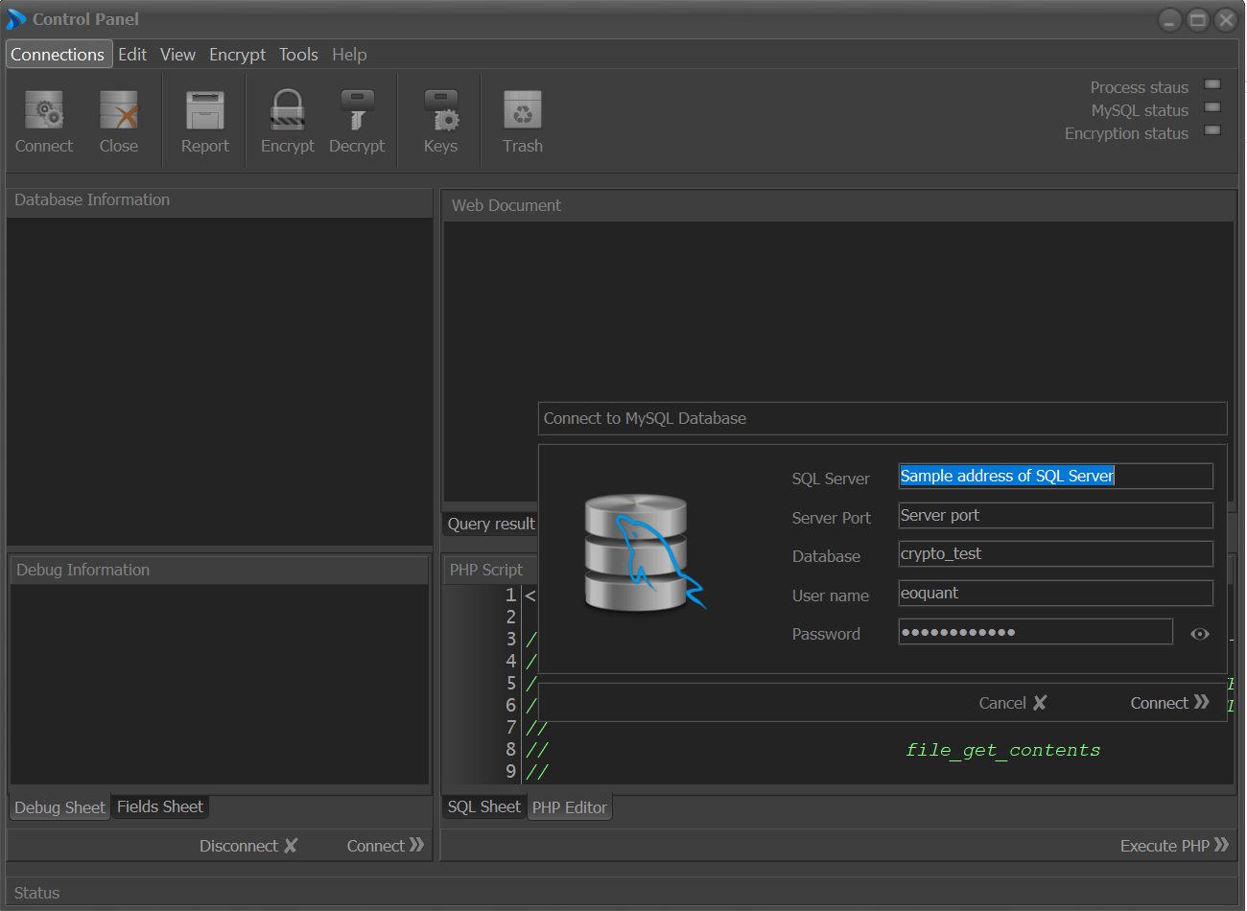
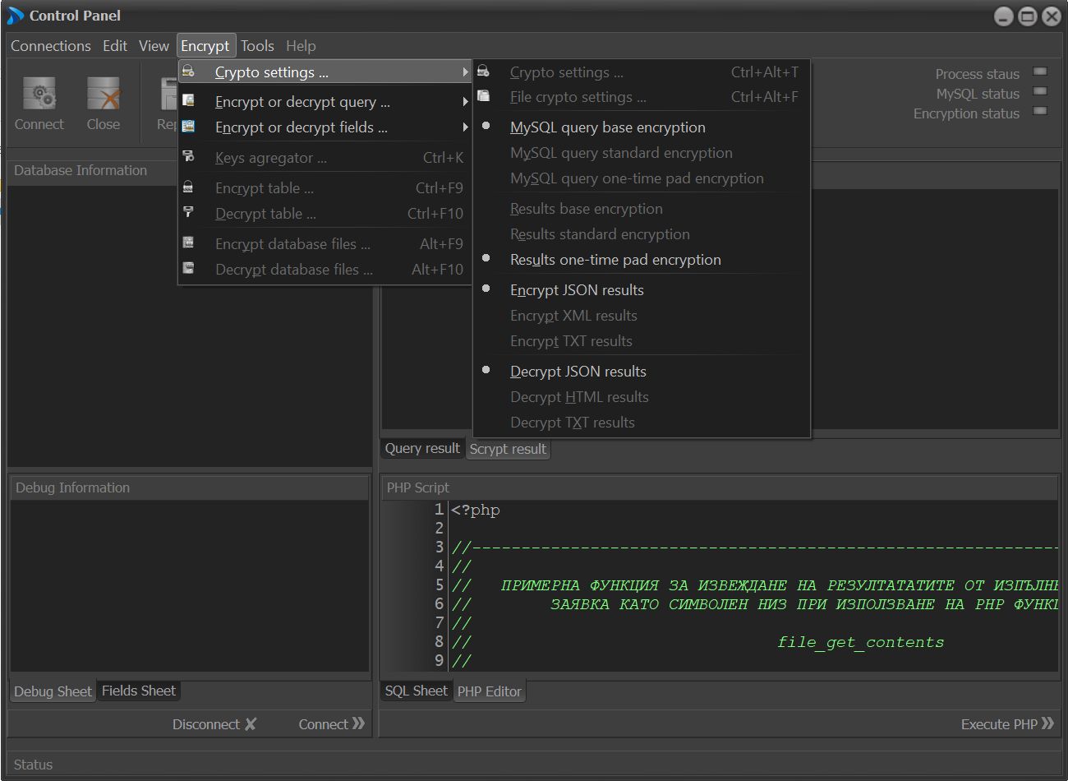
Database encryption system – DES
This is only a sample image, for more information concerning this module, please ask for a presentation and live demo. Concerning the nature of this tool information about it is provided only after a written request.

Slide 65
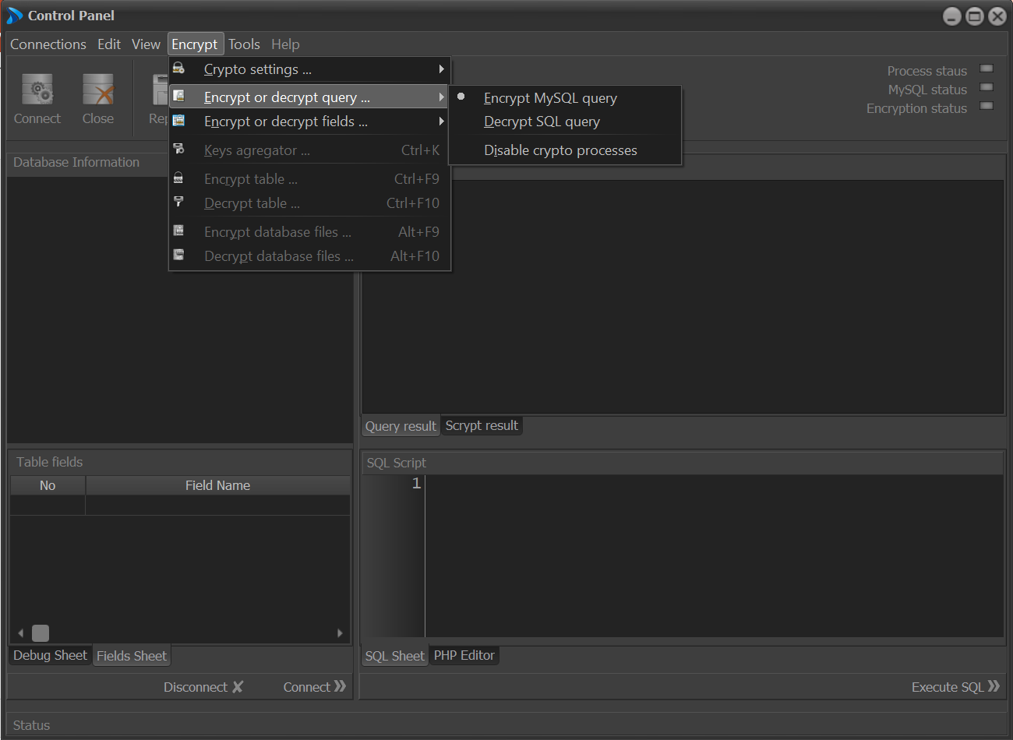
Database encryption system – DES
This is only a sample image, for more information concerning this module, please ask for a presentation and live demo. Concerning the nature of this tool information about it is provided only after a written request.

Slide 66
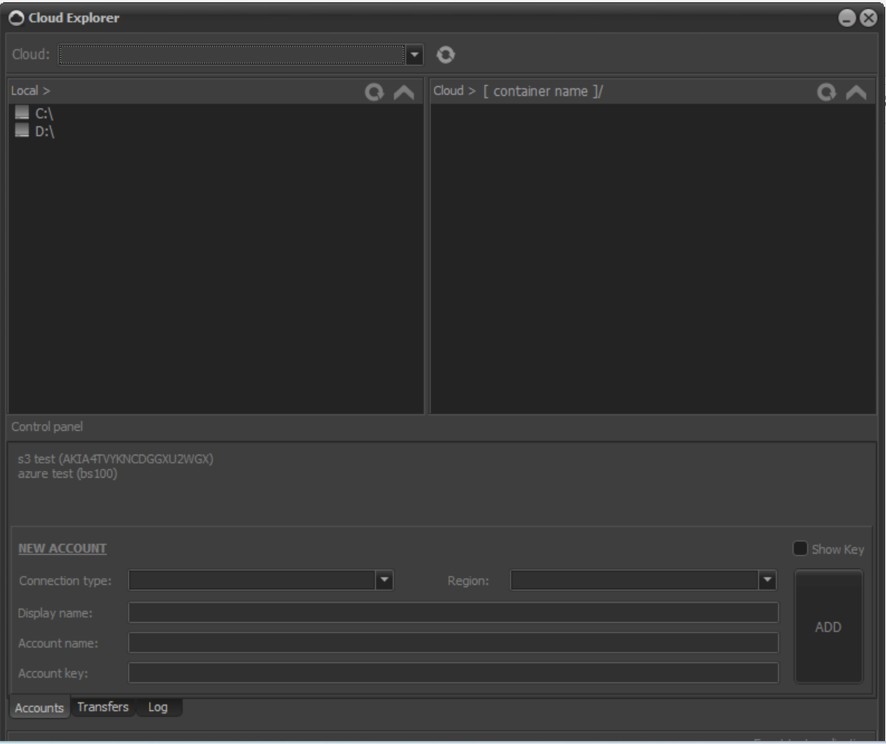
Secured cloud explorer – SCE
The secured cloud explorer (SCE) is a non-standalone software module part of the Crypthor cybersecurity and data protection system. This software module allows establishment of secured environment for continuous access to company's cloud resources. This module is designed to work with two of the most common cloud providing services - Microsoft Azure and Amazon Web Services. The SCE module allow to be established secured end-to-end connection with the company cloud infrastructure expelling the need for external bandwidth consuming tools like VPN's and security-threatening instruments like proxy servers.
The Secured Cloud Explorer – SCE module is mostly distributed as an integration module is mostly distributed as an integration module but it can be obtained as a on premise solution on a subscription or development license.
For more information or to see a live demo of SCE and how it works, please send us an enquiry through the contact form below or on the email provided. Thank you.
This is only a sample image, for more information concerning this module, please ask for a presentation and live demo. Concerning the nature of this tool information about it is provided only after a written request.

Slide 67
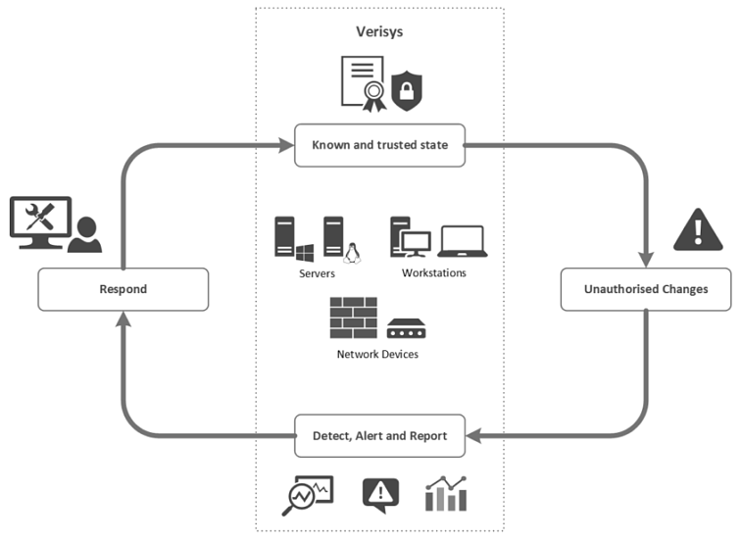
File Integrity Manager – FIM
File integrity monitor is a non-standalone software module that is commonly part of FDS or FPS software modules. FIM is designed to allow continuous monitoring over the information and data protected by Crypthor. File Integrity Monitor, utilizes techniques and approaches that allow immediate action against unsanctioned access to specific end-points, nodes and storages of your company/organization IT infrastructure.

Slide 68
Compliance
How we comply to international standards and regulations
Because we understand how important is to be precise and strict.

Slide 69

Compliance:
Applied ISO – Standards:
ISO-10116: Information Processing – Modes of Operation for an n-bit block cipher algorithm;
ISO 9797: Data cryptographic techniques – Data integrity mechanism using a cryptographic check function employing a block cipher algorithm;
ISO 10118-2: Information technology – Security Techniques – Hash-functions – Part 2: Hash-functions using an n-bit block cipher algorithm;
ISO 9798-2: Information technology – Security techniques – Entity authentication mechanisms – Part 2: Entity authentication using symmetric techniques;
ISO 11770-2: Information technology – Security Techniques – Key management – Part 2: Key management mechanisms using symmetric techniques;

Slide 70

File Integrity Manager – FIM
Applied USA – Standards:
Encryption: Data Encryption Standard (DES)-FIPS 46-3;
Encryption: DES Modes of Operation – FIPS 81;
Encryption: Advanced Encryption Standard (AES) – FIPS 197 (with keys sizes of 128 and 256 bits);
Hashing: Secure Hash Algorithm – FIPS 180-2 (using SHA-256 and SHA-384);
Guidelines on Electronic Mail Security – Special Publication 800-45 Version 2;

Slide 71
EOQUANT
The technology behind Crypthor.

Slide 72
EOQUANT
EOQUANT the name that describes a technology for hybrid-object-relational encryption for all forms of data exchange, storage and utilization.
The EOQUANT technology allows generation of common encryption keys for communication and for files and data units access and interfaces.
Everything is happening during the information exchange process.
Only open communication channels are utilized. No hidden channels, no information and data hiding.

Slide 73
EOQUANT
EOQUANT eliminates the need for secured channels for sharing common secret information;
The encryption keys are dynamically generated and synchronized at the end points. There is no key storage or exchange procedures. No key generation, No close-form access;
Cost-effective development of “Red Zone” security with limited equipment requirements;
Completely encapsulated crypto processes – EOQUANT treats the insider and outsider access uniformly;
EOQUANT allows the formation of decoy mechanisms such as imaginary keys, fake access credentials and passwords, information-system noise, etc. All of these force the attacking party to focus their resources on useless information pieces, that pertain nothing but noise.
EOQUANT allows deployment of data format independent cryptographic systems – both Analog and Digital data are protected.

Slide 74
EOQUANT
Encryption keys are dynamically generated and are renewed multiple time during communication session;
A single encryption key exists only for one single session. This feature eliminates the need for key generation, storage or pre-definition;
Session keys are synchronized on the basis of the exchange of both trivial and useful/secret information bundled in information containers.
End point users, interfaces or processes continuously generate secret keys at their end and exchange those in a timesharing process.
One pad algorithm
Object-relational encryption
Quantum effect of random events

Slide 75
EOQUANT
Key generation:
The availability of key generating “objects” to be chosen randomly is practically unlimited – eligible Information Carriers include text, video, images, web site elements, excerpts of TV reports or live performances, medical means, chemical compounds and any element with a clear information structure.
The random generation of keys can also be based on the utilization of physical generators of pulse noise, apparatus fluctuations of the devices / pink noise, or program generated white noise.
Encryption keys have a different length from that of the encrypted message. It is thus possible to use an LSK-type key with a length of over 2.5TB without it ever affecting the speed of the conversions performed.

Slide 76
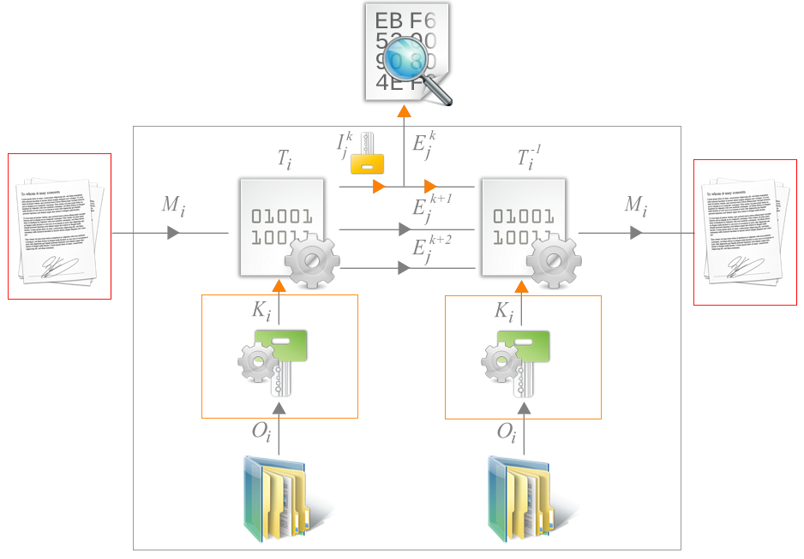
EOQUANT
Quantum effect description:
When utilizing this effect – the information is transmitted in small pieces with no granularity or length variability restrictions.
The secret keys are part of the transmitted “quants”.
The secret/critical information is transmitted together with “trivial” data pieces.
The yellow key is “imaginary” – boosts the dimensionality of the crypto analysis resilience and enables a broad spectrum of disinformation activities.

Slide 77
Crypthor around the globe
Our market pressence…

Slide 78
Crypthor’s market presence:
Legend:
- Existing market presence;
- Gatelink main office;

Slide 79
Crypthor integration roadmap
Initial infrastructure, business processes and workflows research.
Development and provision of initial software modules
System administrators and personnel certification and training
1
3
5
2
4
6
Development of system integration analysis that marks the weak endpoints and processes.
Development and provision of additional software modules and hardware (if requested)
System integration and launch of the Crypthor system

Slide 80
Interested to learn more about us?
Do not hesitate to reach us at: office@gatelink.bg
Follow us on LinkedIn: Gatelink Ltd. Bulgaria
See what new about us at: https://gatelink.bg
We are looking forward to work with you…!

