Slide 2



GREEN GATEWAY Rationale
Advisory programme, funded under the InvestEU Advisory Hub, to strengthen the role of financial intermediaries in financing the EU’s transition to a low-carbon and climate resilient economy.
Green Gateway Advisory is complementary to the EIB Group green and sustainable financing offer.
The programme includes a web portal with online tools and a bilateral advisory offer.

Slide 3


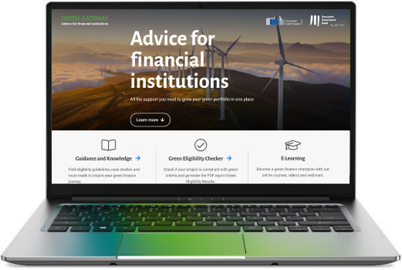



GREEN GATEWAY Advice for Financial Institutions
WEB-based operational tools
EIB Group Green Checker, an online tool to assess whether projects meet EIB Group green eligibility criteria and estimate their environmental impact.
Bilateral advisory assignments
Research, analysis, on-the-job support
Reports, manuals, templates, tools
Trainings
Webinars, trainings
On-boarding trainings
Thematic trainings
Green Gateway Helpdesk
greengateway.eib.org
Q&A platform
Toolbox of supporting material (manuals, templates, reports)
e-Learning programme
E-learning courses targeting front- and middle-officers of financial intermediaries implementing EIB Group green financing operations.

Slide 4

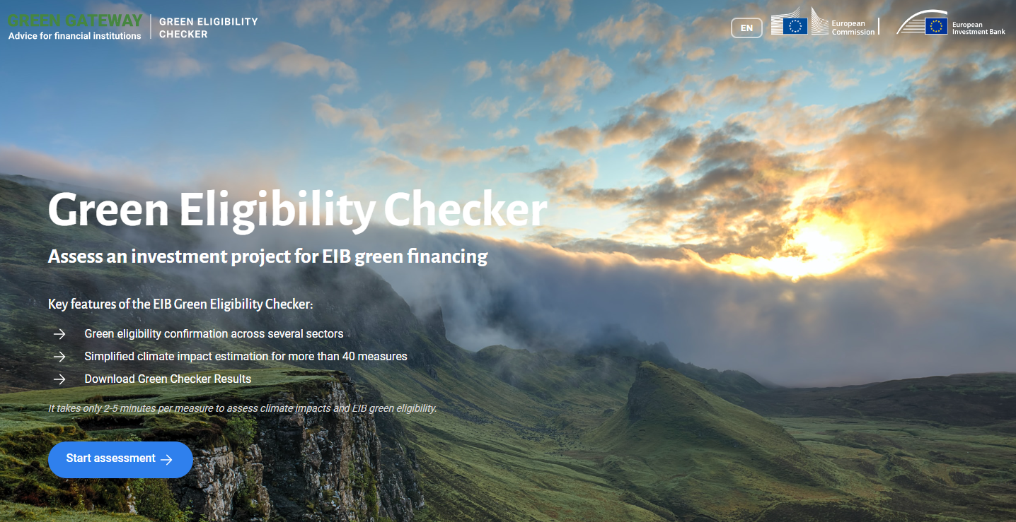
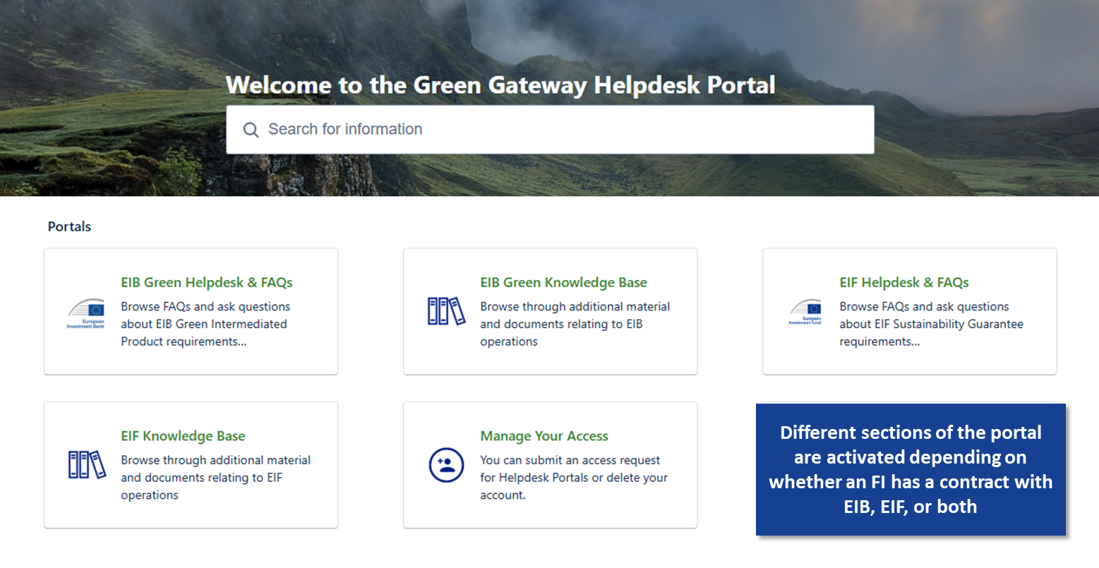
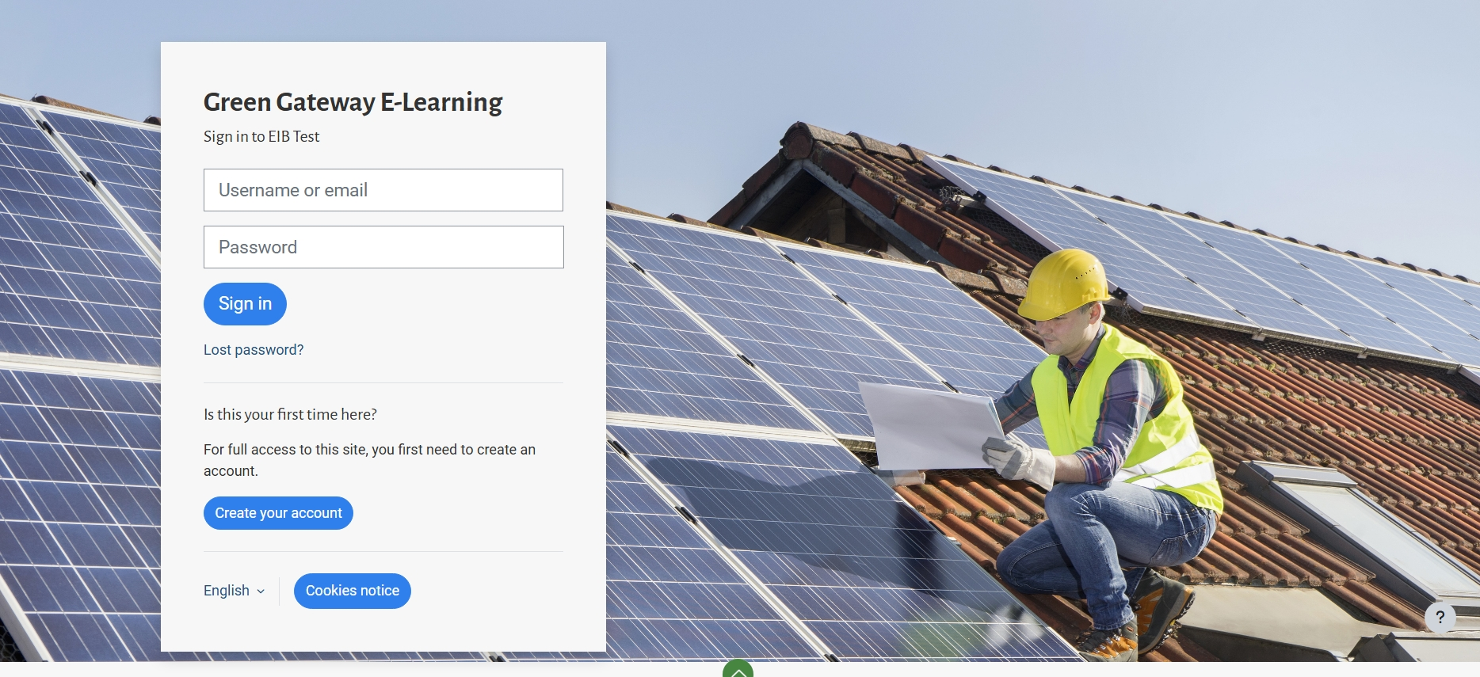
EIB Green Eligibility Checker
Online tool helping banking/leasing institutions assess green eligibility of projects, estimate their impact and produce PDF report with assessment results;
Upcoming work priorities: expand the tool’s coverage to new investment sectors and EU Taxonomy objectives, and improve the tool’s reporting functionalities.
Green Gateway Helpdesk
Online platform providing guidance to EIB Group financial intermediaries in relation to eligibility, documentation and reporting requirements.
Contact form for EIBG clients to submit operational questions on green eligibility and reporting topics to technical experts.
FAQ Library where the most common questions are recorded.
Knowledge base: trainings, webinars and guidance material.
E-Learning Platform
E-learning courses targeting front- and middle-officers of financial intermediaries implementing EIB Group green financing operations.
Key Topics:
Energy
Buildings
Transport
Manufacturing
Adaptation
Coming soon:
Agriculture
Green Entreprises

Slide 5
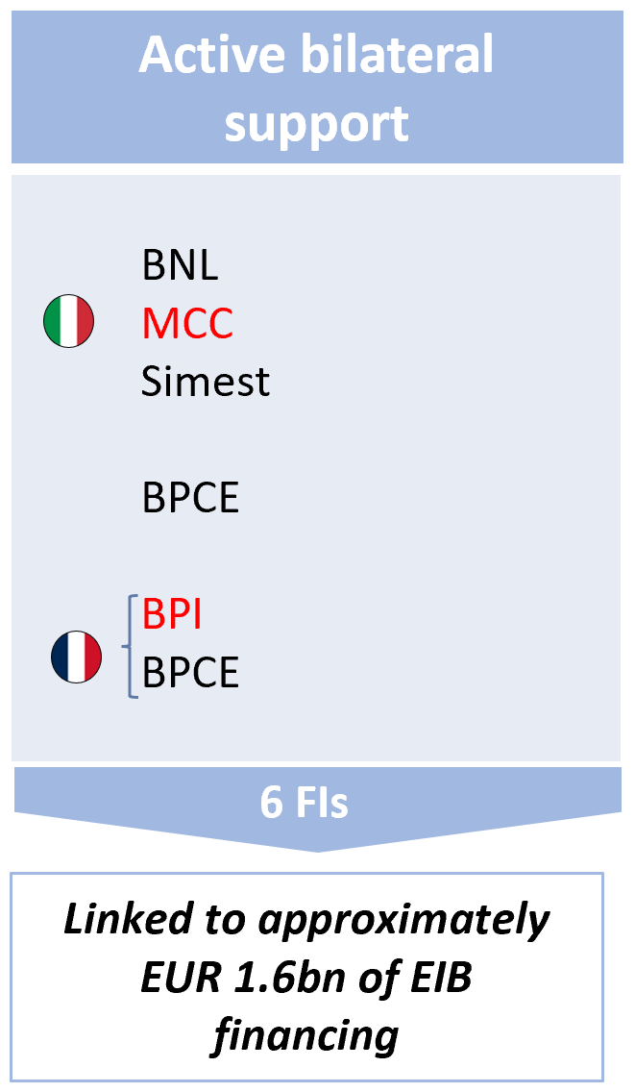
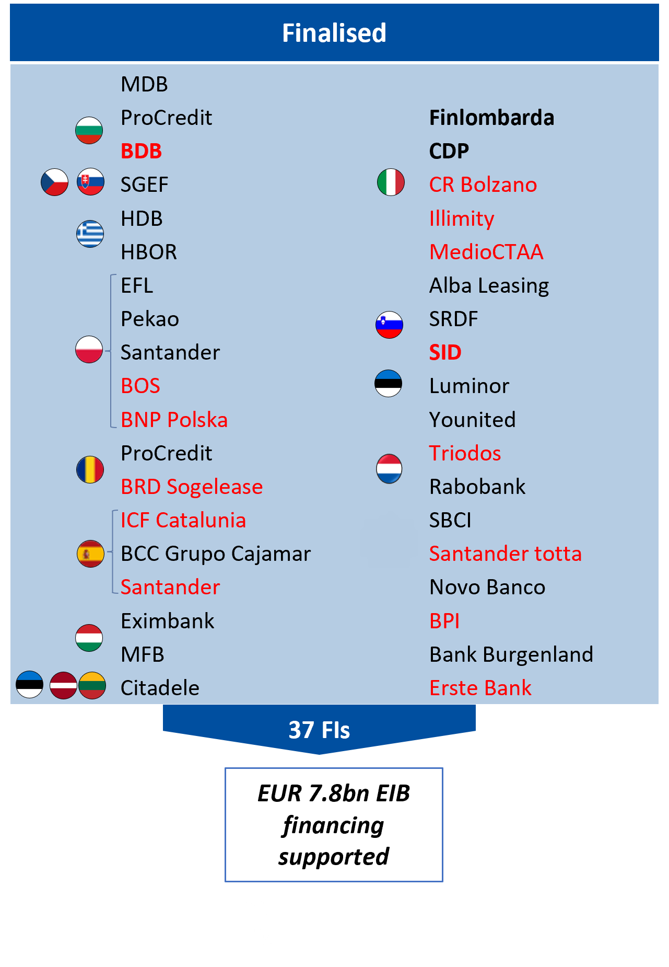
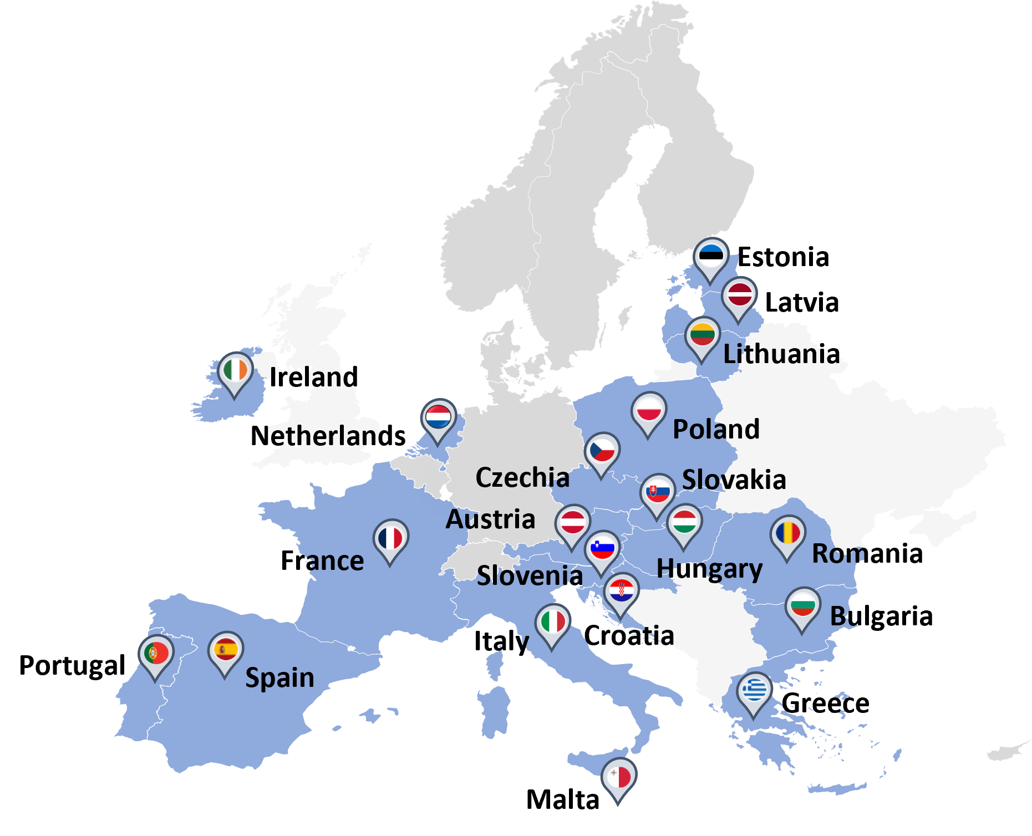
GREEN GATEWAY Bilateral Support – State of play
Support being provided:
  43 partner financial intermediary assignments completed or ongoing (incl. 13 NPBIs)
  Pipeline targeting more intermediaries in 6 different Member States.
  More than 50 reports, 200 manuals, and additional supporting material developed for partner FIs
  Over 300 training sessions provided to FI staff
  *Institutions in bold are National Promotional Institutions
  **Institutions in red are also signed/approved for IEU Sustainability Guarantee

Slide 6
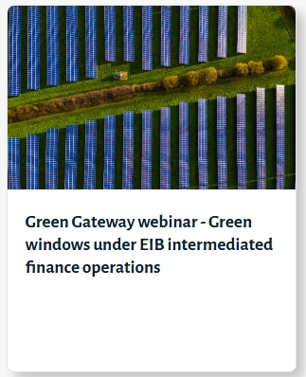
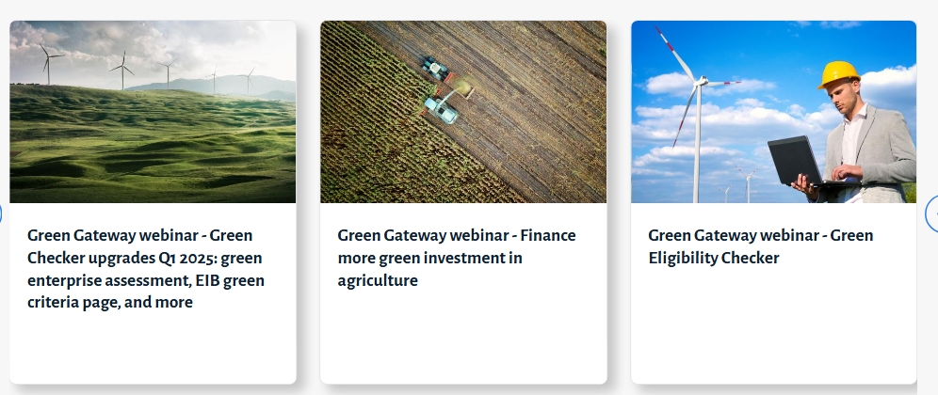
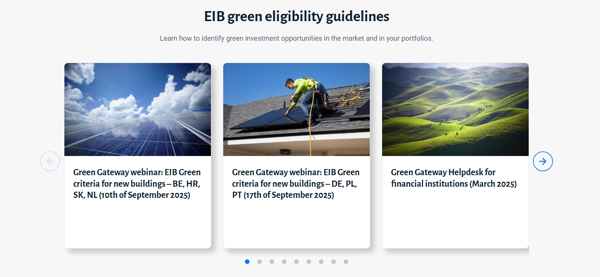
GREEN GATEWAY Webinars
Stay up to date!
greengatewaywebinar@eib.org
June 2024
Feb 2025
Mar 2025
Sep 2025
Power Purchase Agreements (PPAs)
Climate Adaptation
June 2024
Mar 2025
Sep 2025
Upcoming

