Slide 1


Slide 2
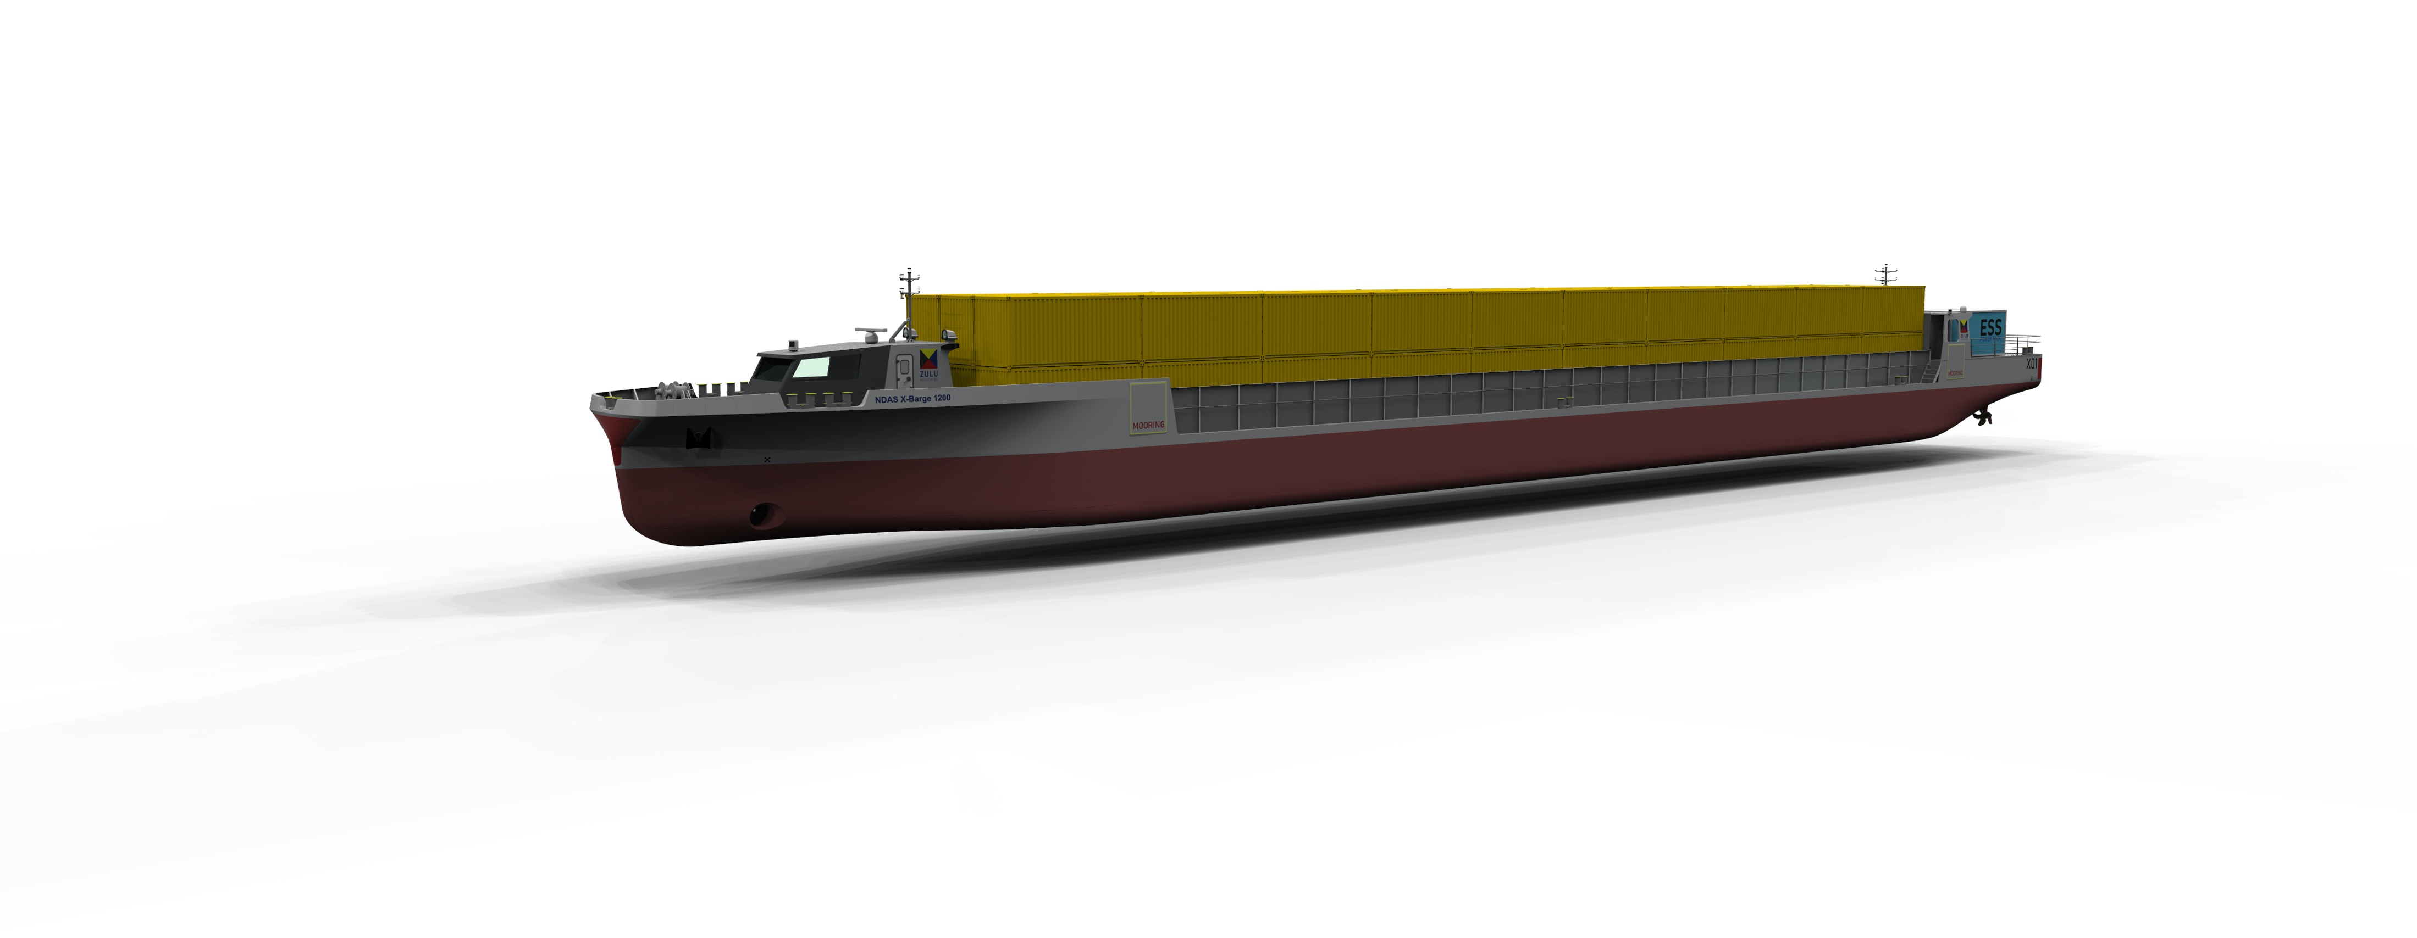
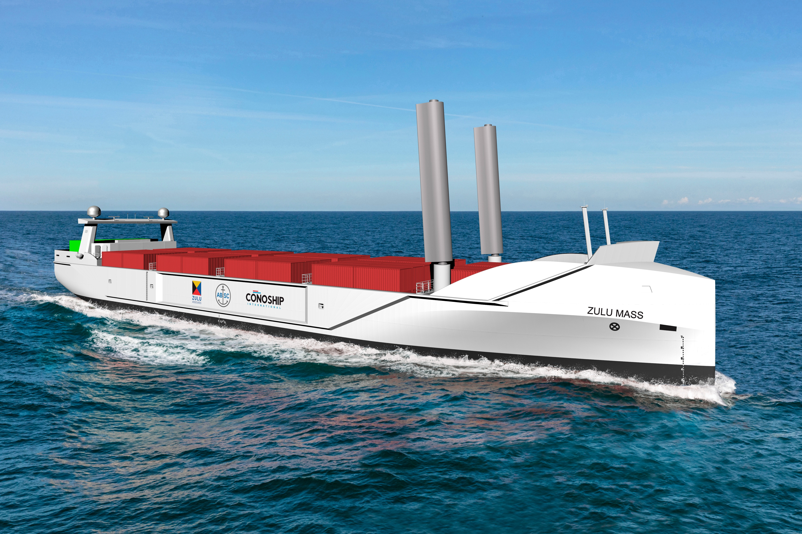
Company
A real solution provider
ZULU Associates Group, founded in 2019, is active as an initiator, developer and operator of innovations in the marine component of logistic chains.
Goal is to develop a fleet of zero emission commercial vessels, that are price competitive, on shortsea and inland waterways routes combining alternative non fossil fuel propulsion and unmanned operation through remote control/autonomous operation features.
Primary focus is on Western Europe with a potential mid to long-term for global reach.
Raising up to €5 million in equity and subordinated convertible debt to build up the company, develop the structure to operate a fleet of inland barges, realise further developments of autonomous operation with AI creation
Final negotiations with first charter client for inland waterway vessels in final phase, to be concluded in Q1 2025.
Contracting shipyard and suppliers to deliver first 2 inland barges in Q1 2026
Additional investment raising is in final discussions to launch up to the first 10 inland waterway vessels.

Slide 3
Business concept
Purpose
The goal of ZULU Associates is:
Development of
  designs of sustainable and cost competitive vessels for inland and short sea operations
  a fleet of vessels to be time-chartered out to shipping lines
  regulation compatible algorithms for unmanned vessel operations
  data base relating to the operation of the vessels and their environment
Respond to
  the replacement needs of the present inland water and short sea fleets in Europe where many ships are outdated both technically and in terms of performance, with most vessels lacking real sustainable operation
  the looming shortage of crews
Offer investors attractive assets that are sustainable and future proof, responding to market needs

Slide 4
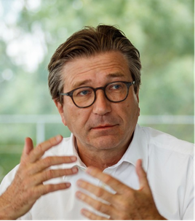
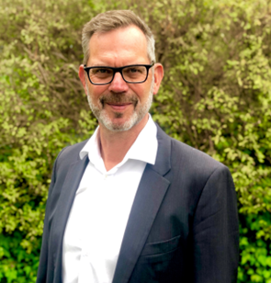
Team
European based
Antoon van Coillie
Chief Executive Officer
Entrepreneur, presently active as director of Blue Line Logistics, an inland shipping company, as well as director ZULU Associates and Anglo Belgian Shipping Company.
He holds an MBA degree of the Anderson Graduate School of Management at UCLA and is an alumnus of the Belgian American Educational Foundation. He also holds a degree of Commercial Engineer (Solvay) of the Free University Brussels.
Before being active in the inland waterway and marine industries, he acquired a wide experience in the construction and the financial industry in different capacities.
He founded Blue Line Logistics in 2011 conceiving and developing the Pallet Shuttle Barge (aka ZULU) concept for moving palletized goods on inland waterways. Since then, he has initiated programs to develop autonomous vessels for inland and short sea freight.
He served as Reserve Officer in the Belgian Navy, minesweeping and fishery protection.
Jan Tellkamp
Chief Technology Officer
Jan is a Naval Architect with over 20 years of experience in the marine industry.
Graduating from Hamburg University, he spent more then a decade with Flensburg Shipyard. Being a part of the yard’s R&D team, he initiated and managed significant research projects on various topics affecting ship safety and ship performance.
From there Jan joined Det Norske Veritas in Germany to support the German marine industry in their innovation activities towards using fuel cells and low emission fuels. The result of this was the first installation of a fuel cell on a passenger vessel on international voyage, and in the first recommended practices for bunkering of LNG. Following the merger of DNV and GL to DNV GL, Jan was given the responsibility to develop the new company’s international consultancy business along the LNG value chain.
In 2019 Jan founded his own company Juliet Tango Charlie, and in 2020 he joined ZULU Associates to guide oversee the groups integration of technologies into zero emission, autonomous ships and supporting infrastructure.

Slide 5
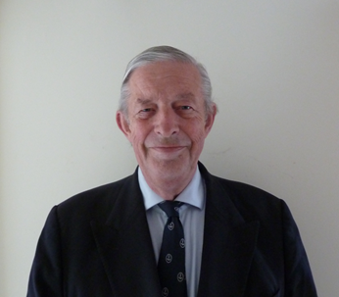

Team
European based
James Fanshawe CBE
Director
James Fanshawe retired from the Royal Navy in 2005 after five commands and an appointment as the Director of Plans at the UK Permanent Joint Headquarters.
James works within a mixed commercial portfolio. He is a Director of the Anglo Belgian Shipping Company. He is a frequent conference chairman and speaker. He chairs the UK’s Maritime Autonomous Systems Regulatory Working Group, which has released Codes for the safe operation of Maritime Autonomous Surface Ships. He is a member of the UK Maritime Autonomous Systems Steering Group and the MAS Council and is a moderator for the UNECE work on Autonomy on Inland Waterways.
He is the Chairman of Care for Veterans.
Ann-Sofie Pauwelyn
Chief Regulatory Officer
Ann-Sofie Pauwelyn is regulatory and policy expert on inland waterways.
She started the Smart Shipping Project for inland waterways in Flanders in 2016 and has been leading the project for 7 years at the Flemish Inland Waterway Authority (De Vlaamse Waterweg nv). During her time at the waterway authority, Flanders became the first region in the world that allows autonomous ships to sail on inland waterways. She worked on the creation of new regulations, safety guidelines and test approval procedures for unmanned and autonomous shipping. These documents served as the basis for the work on autonomous shipping in the Central Commission for Navigation on the Rhine (CCNR).
In 2023 Ann-Sofie joined ZULU Associates to further work on policy and regulations for autonomous ships.

Slide 6
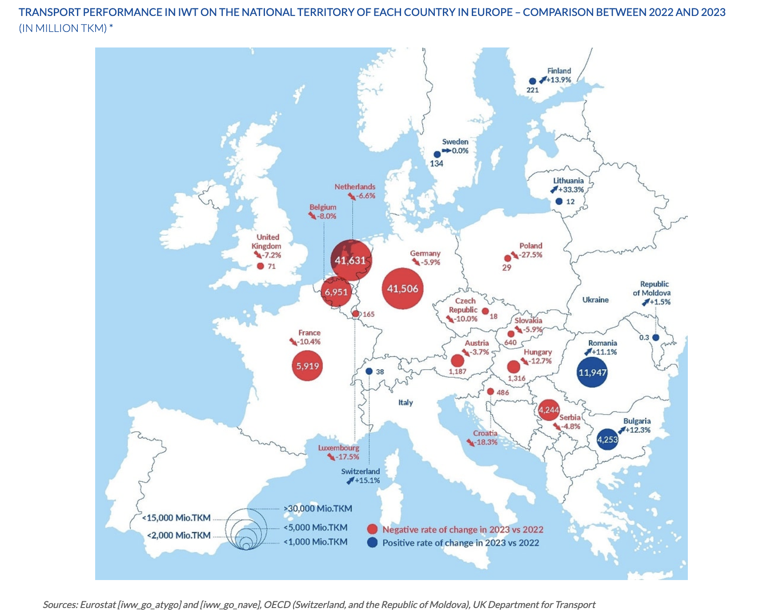
Market footprint
A sizable Inland Waterway Transport (IWT) market in Western Europe
With over 40,000 km of navigable waterways and 250 inland ports, the European continent IWT currently carries some 550 million tonnes of goods per year
Rhine countries (Belgium, France, Germany, Luxembourg, the Netherlands, Switzerland) accounted for 81.1% of total IWT performance in the EU-27, plus Switzerland, Serbia and the Republic of Moldova
There is a need for real modal shift from road to alternatives such as IWT.
A large part of existing infrastructure is structurally underused.
Additional opportunities in Portugal (Douro river) and Italy (Po river and canals)

Slide 7
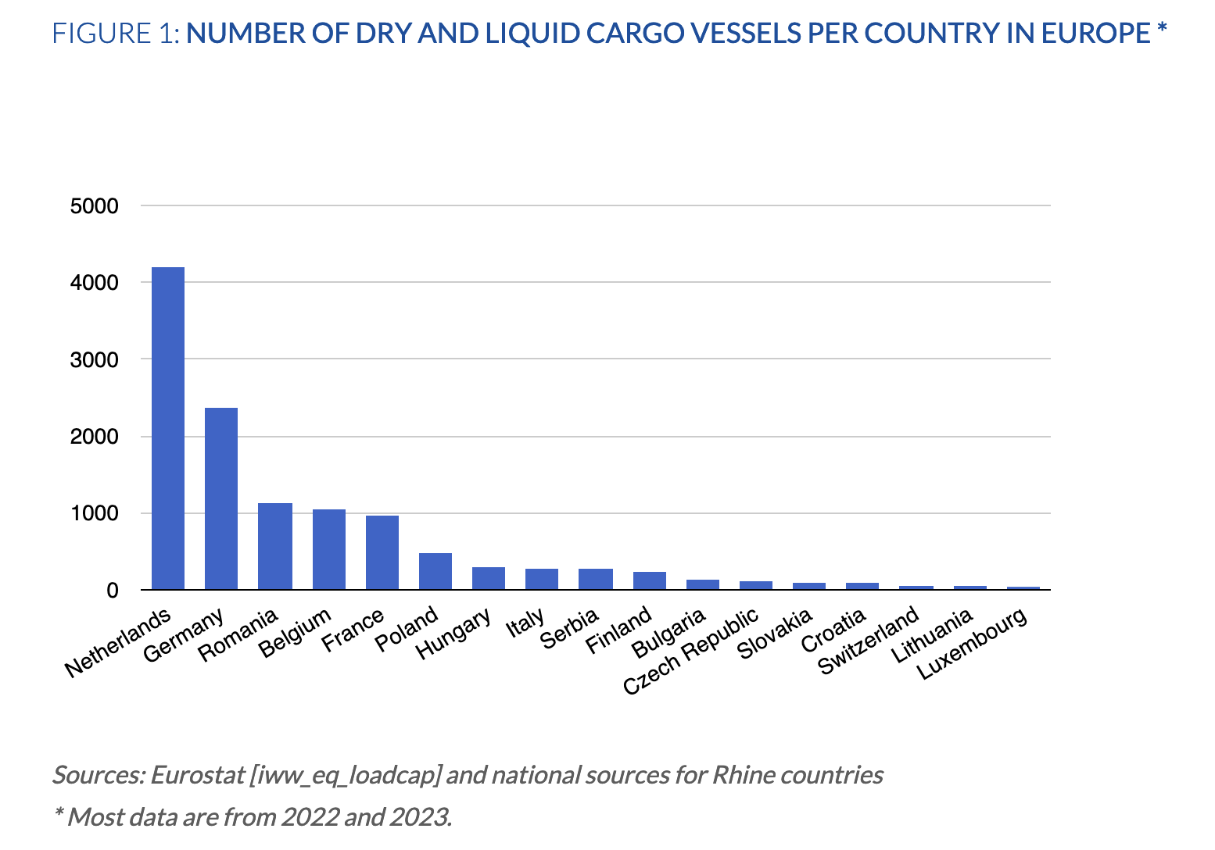
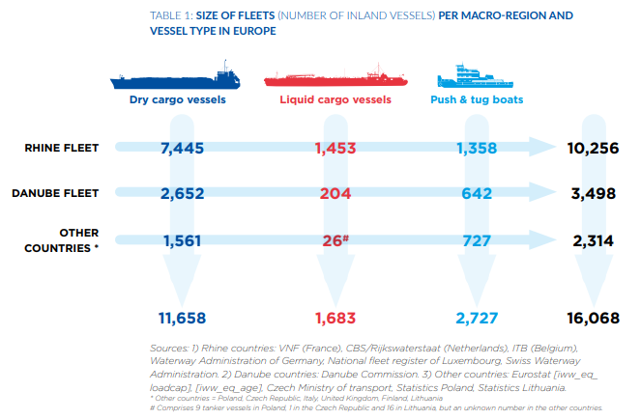
Fleet distribution
A large number of vessels and a highly fragmented corporate field
In 2021, the number of inland vessels in Europe comprised more than 16,000 vessels of which more than 12,500 in Western Europe
In Western Europe the fleet is operated by a large number of sole ship owner operators, which is less the case in Eastern Europe
The high fragmentation of the IWT market in Western Europe is the major hurdle for the energy transition due to the lack of financial resources
In Western Europe, It is expected that new and large industrial operators will emerge as existing operators exit through age
Size of fleet per region and vessel type in Europe
(2021 # vessels)

Slide 8
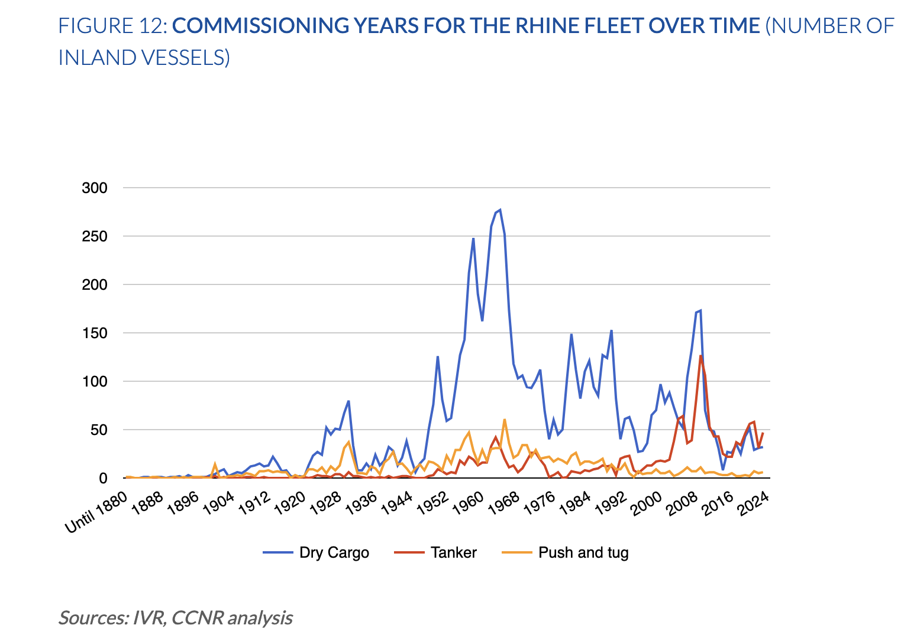
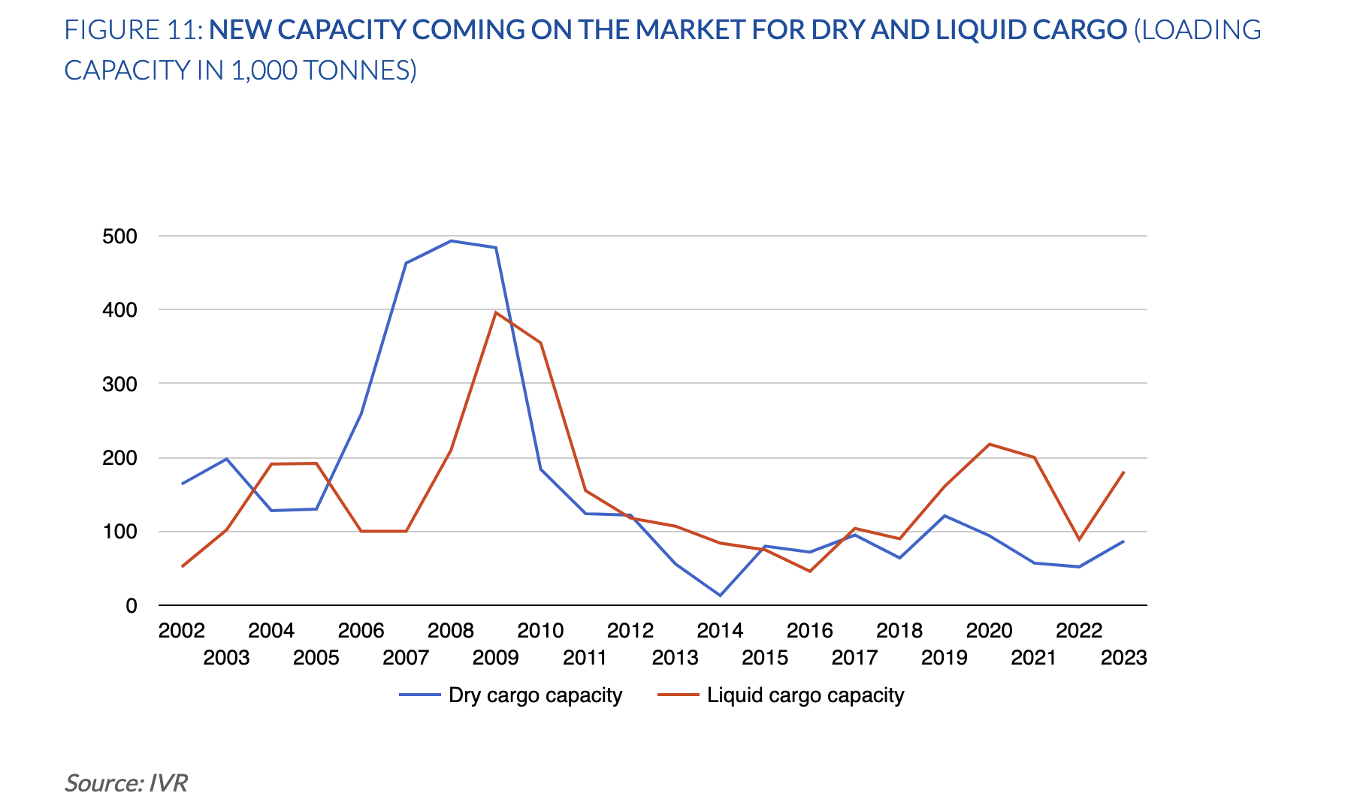
Vessel age and capacity
Replacement opportunity because of obsolete fleet and aging crews
Around 83.2% of the dry cargo fleet was constructed in the 20th century whereas the respective share for the tanker fleet amounts to 41.6% (due to the early implementation of double hulls)
Existing fleet is emits far more CO2 and NOX than is widely accepted (https://topsectorlogistiek.nl/wp-content/uploads/2024/02/TSL51.00.036-TNO-2023-R12671v2-Meten-op-Schepen-final.pdf)
Average age crews around 60 years (https://www.flows.be/binnenvaart/2024/04/vergrijzing-groot-probleem-bij-zelfstandige-binnenschippers-belgie/ ) & crews do not respect worktime regulations (https://www.schuttevaer.nl/nieuws/actueel/2024/01/08/inspectie-binnenvaart-naleving-regels-arbeidstijden-gaat-achteruit/ )
After a long decline following the financial crisis, new dry and liquid capacity showed a slight increase in recent years
Significant scope for new modern sustainable vessel capacity in both dry and liquid markets

Slide 9
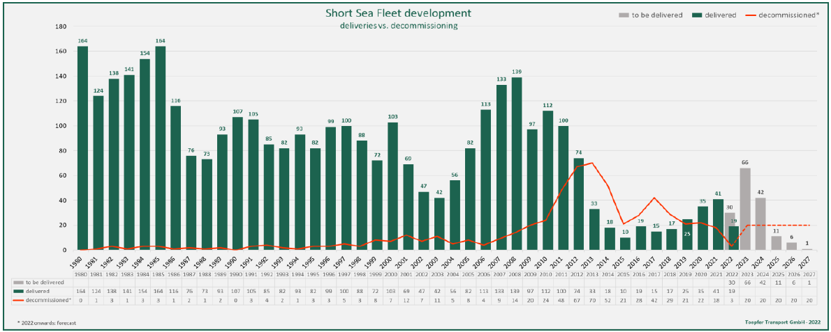
Shortsea market outlook
Obsolete existing fleet and shortage of crewsO
Average age of fleet is still high
  Despite geopolitical and economic uncertainties there is a strong need of shipowners and investors to contribute to green solutions in European short sea shipping
  Many older ships are still in shape but not very fuel efficient and the green transition is the big driver for the orderbook.
  With an average age of nearly 25 years, the European shortsea fleet is reaching the end of its lifecycle
  The speed of energy transition and technologies available for road will play a key role in determining the success of short sea shipping’s future. As road transportation is more adaptable and capable of transitioning faster than short sea ships, thus lowering future emission costs, in order to remain competitive, short sea ships must accelerate their transition to cleaner energy.
Shortsea fleet development forecast
Source: Toepfer Transport, November 2022
9

Slide 10
Technology
An effective combination of innovative developments
Sustainable & cost competitive vessels
Newbuilt energy efficient hulls with systems allowing unmanned operation in order to increase operational margin to be price competitive versus fossil fuel propulsion
Use of modular power packs produced to ZULU requirements to make vessels energy agnostic and future proof
Remote control & autonomous operation developed with third party enabling unmanned operation technically ready with regulatory approval under negotiation and expected by Q4 2026
Economies achieved through standardisation & scale reducing the entry capex and speed up AI development

Slide 11
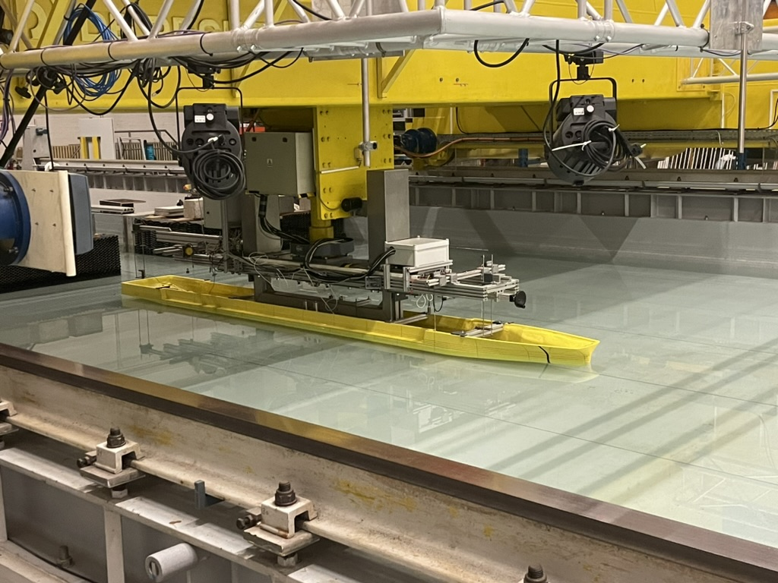
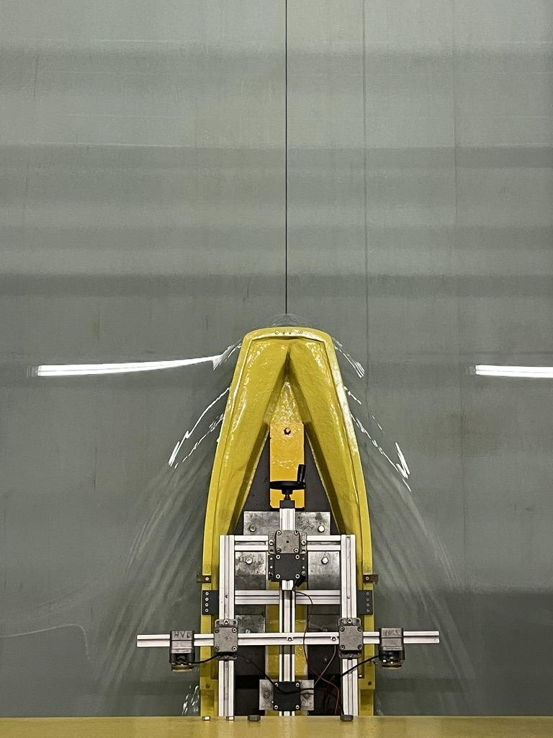
Hull & systems
Efficient hull , tested with CFD and towing tank model (Flanders Hydraulics) to achieve minimal energy needs, also in confined waters
Ship systems digitally controlled and with effective redundancy
Complete review of ship systems to simplify and standardise as much as possible
Full station keeping or DP capability to facilitate autonomous operation and algorithm development
Review of operational/contractual concepts

Slide 12
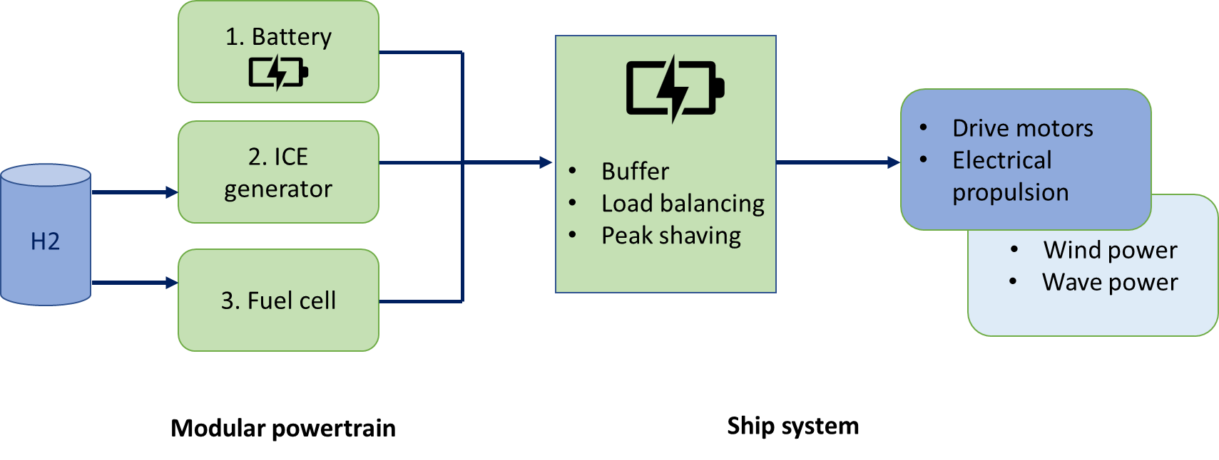
Propulsion
Zero emission objective
Vessel propulsion: electric engines
Power generation: modular containerised system, allowing for simple “bunkering” or replacement for maintenance or repairs when in harbour
Modular system: batteries or hydrogen based, allowing for transition to different alternative propulsion systems without adaptations of vessels
Pay-per-use: modular system provided by third party, allowing payment for energy used rather than investment
ENERGY PROVIDERS:

Slide 13
Unmanned operation
Remote control with Remote Operating Centre (ROC)
Automated operation of ship’s systems wherever possible
AI generated algorithms for conops and colregs
Performant cybersecurity
Full electric propulsion system with predictive maintenance
Redundancy
No crew accommodation

Slide 14
Ships in development
Inland and short sea
X barges
Y barges
Zulu Mass
Designer: Naval Dynamics, Norway
Status: Shipyard and system supplier quotes received
Ship
system: RFP issued Q2 2024
Shipyard: issued in Q2 2024
    targeting EU and Turkish yards
Energy
providers: LOI with ZES, negotiation with other possible providers
Funding LOI by investment fund received for first 2 to 10 units
Designer: TBD
Status: design and specifications in progress
Ship
system: RFP to be issued Q3 2025
Propulsion: definition of zero emission propulsion roadmap finalised
Shipyard: to be issued in Q2 2025
    targeting EU yards
Energy
providers: negotiation with possible providers
Funding To be initiated after LOI of first 2 charter agreements
Designer: Conoship, The Netherlands
Status: design and specifications in progress
Ship
system: RFP to be issued Q3 2025
Propulsion: definition of zero emission propulsion roadmap under development
Shipyard: to be issued in Q3 2026
    targeting EU and Turkish yards
Energy
providers: negotiation with possible providers
Other: AiP received from Lloyds Register
Funding To be initiated after LOI’s on charter agreements

Slide 15
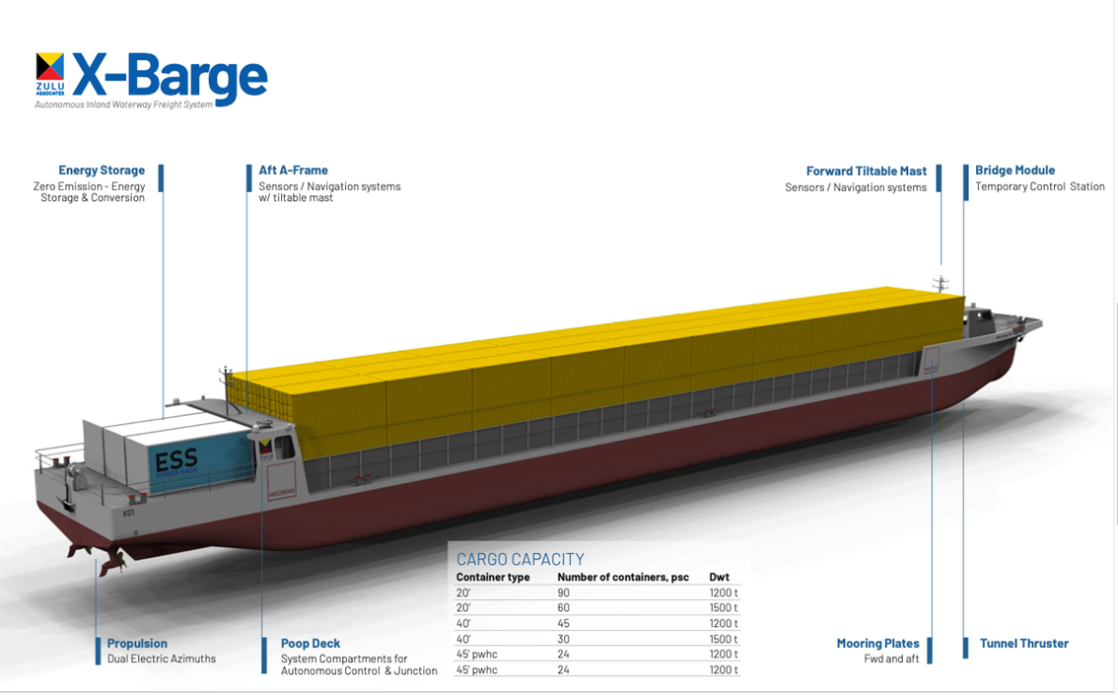
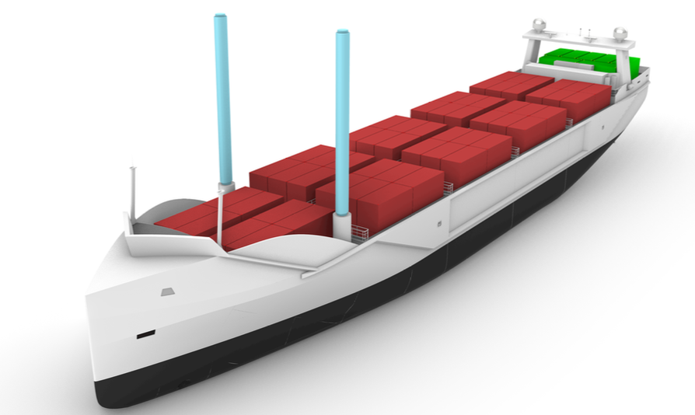
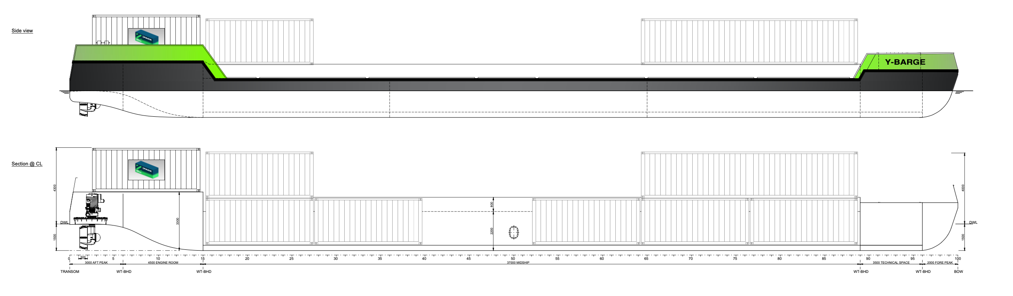
Vessels in development
ZULU MASS
Y-barge

Slide 16
Commercial pipeline
Promising ongoing discussions
X/Y barges
ZULU MASS
Time charter of up to 10x X-barges with a Dutch inland shipping line under final negotiation
Time charter with another Dutch inland shipping line for 10x Y-barges under discussions
Start of discussions on use of X and Y barges with other potential users
Identification of other potential clients started
Time charter of up to 2 units with a Dutch short sea shipping line under discussion
Time charter of up to 2 units with a Belgian logistics line under discussion
Identification of other potential clients started
Increasingly visible pipeline
Following pipeline :
  2026 – 2 X + 2 Y
  2029 – 10 X + 10 Y
Expect to reach 10% of market ie 200+ vessels
Following pipeline :
  2027 – 2 ZULU MASS
  2029 – 6 ZULU MASS
Expect to reach up to 50+ vessels

Slide 17
Status
Design X-barge finalised
Negotiations with shipyard and suppliers for X barge ongoing for delivery Q1 2026.
First client for time charter of 2 X barges in final negotiation , other clients actively approached
Funding for up to 10 X barges in final negotiation
LOI with first client for Y-barge expected in Q1 2025, design to be initiated in Q2 2025
Conceptual design of ZULU MASS delivered with AiP from Lloyds Register
Active discussions with potential client for ZULU MASS

Slide 18
Business Model
Indicative fund flows
Customers will pay weekly Time Charter rate increased with energy costs and Remote Operating Centre costs
The 2 Opcos will provide each vessel to its customers on a “Ship-as-a-Service” basis (ie “Zulu TC”)
The BBC will be set on the underlying vessel price
Asset Co
Construction fee (5%)
Zulu Associates
IP & DATA commercialisation
+
Services & Management fees
investments
Equity / Subordinated debt
100% Profit
Energy acquisition
Vessel SPVs
Bareboat Charter
Min 10 years
Continental Inland
(Opco)
Anglo Belgian
Shipping
(Opco)
Energy providers
Energy costs - Power as a service
Interest and principal on junior and senior debts
Zulu Time Charter =
Bareboat charter + energy + RCC +services
Min 6 years
Bank
X + Y customers
ZULU MASS customers

Slide 19
Growth model and competition
Sales
Target customers are shipping lines that are active in inland and short sea container logistics that operate a fleet of self-owned and/or chartered vessels. They are approached directly through existing contacts or cold calls.
Additional marketing is done towards shippers or end users of waterway and short sea services to make them aware of the proposed vessels. Apart from direct contact, this is also done through participation in events and networking. This is moreover supported by cooperation agreements with shipping lines servicing these clients.
The market is growing through need for sustainability and acute shortage of crews due to aging of crew population.
Competition
There is no real competition that offers the same solution of new-built cargo vessels of this size. There is partial competition through retrofitting existing vessels that lack either or the combination of energy efficient hulls, real zero emission propulsion, unmanned systems, dynamic position capability or remote/AI driven navigation. This inevitably leads to ineffective competition, in essence creating a strategic moat for the vessels developed by ZULU.

Slide 20
Financials
ZULU Associates bv

Slide 21
Challenges
Risk mitigation in place
The challenges are regulatory, technical and commercial, however risk mitigation is in place in all cases.
Regulatory
Operating unmanned vessels is only allowed by exception at present. Although actions (in which ZULU participates ) are undertaken by the relevant authorities to change the regulations in the next 2 to 3 years, the vessels will be operated manned or reduced manned from the start, allowing commercial operation from the start.
Technical
Unmanned operation is already technically possible through remote control and system automation.
The challenges posed by the availability of sustainable power packs and their related infrastructure are managed by making the vessels energy agnostic. If need be, they can be powered by modular power packs equipped with diesel generators, reducing this technical risk.
Commercial
There is a resistance by legacy asset owners and users. This is mitigated by actively marketing the cost effectiveness of the vessels.

Slide 22
Impact
There is a real need for sustainable operation of vessels that is cost competitive versus fossil fueled powered vessels.
Although many stakeholders in the logistics refer to sustainable operation, the reality is that the main driver to switch to sustainable operation is the cost competitiveness of the vessel and therefore of the non-fossil fuel propulsion: i.e. equal or near to equal cost versus fossil fuel propulsion.
As this is the case with the vessels under development, it is expected that more and more potential users will switch, driven by the obsolescence of existing vessels and acute shortage of crews.
Cost competitive and unmanned zero emission vessels will replace existing vessels. The impact will be significant in view of replacing the existing fleet. It is estimated that 3 to 4.000 new vessels will be needed in Europe alone.

Slide 23
Investment termsheet
Key summary
Capital raise: | €5.0 million
Entity: | Zulu Associates BV, Belgium
Equity Investment horizon in Zulu Associates: | 5-7 years
Subordinated debt | Subordinated (convertible) debt 5 years Fixed interest
Governance rights: | Board representation
M&A rights: | Drag Tag along Right of first refusal on AssetCo
Others: | Veto rights on specific decisions Usual reps & warranties
ZA is looking for one or more investors to capitalize the company for its corporate development with up to € 5 million:
  € 3 million equity for company build up to respond to growth and in depth management needs and further IP creation related to the vessels and systems
  € 2 million subordinated debt for operational capability development and operational funding
Funding for the building of vessels is underway. An LOI with an investment fund has been received for the first 10 X-barges. Final negotiations to be concluded in Q1 2025.
ZA is currently also getting the support for possible asset financing from reputable banks.
Zulu Associates

