Slide 1


Energy, Everywhere.
Decentralized and mobile energy supply systems based on transition cryogenic fuels.

Slide 2

The Challenges in the Energy Landscape
Infrastructure Vulnerability & Energy Insecurity
Centralized energy systems are increasingly exposed to risks—whether from natural disasters, cyberattacks, or conflict. Outages leave critical services, households, and industries without reliable power. Remote, off-grid, and high-risk regions suffer the most, requiring decentralized, mobile, and rapidly deployable energy solutions.
Growing Demand for Mobile, Decentralized Energy
Resilience and continuity of operations are now priorities across sectors. From disaster relief and emergency response to military and industrial applications, there is a critical need for flexible off-grid power systems that can be rapidly deployed in diverse environments.
LNG and Bio-LNG: Safe, Scalable Fuels for Decentralized Energy
LNG and bio-LNG provide a safer, cleaner alternative to diesel and hydrogen. With high ignition temperature (~540 °C) and low flammability, they are well-suited for decentralized, mobile power solutions. They deliver quieter, longer-lasting energy with fewer logistics risks—making them a strategic fit for both civil and defense applications.

Slide 3
Why Mobile LNG is Critical
Combination of infrastructure destruction, looming winter demand, and economic strain underscores the urgent need for decentralized energy. Mobile LNG systems—lightweight, modular, and independent—are uniquely positioned to provide rapid, reliable, and scalable support to critical sectors, especially in hard-hit or frontline regions.
Challenge | Impact | Mobile LNG Solution
Severe capacity loss | Peak shortfalls | Locally supply power via modular LNG units
Rolling blackouts | Daily power cuts of hours | Deployable LNG backup generators capable of bridging gaps
Grid & pipeline damage | Infrastructure highly vulnerable | Off-grid LNG bypasses damaged systems, ensuring localized resilience
Slow rebuild & high cost | Centralized reconstruction to take years | Mobile LNG systems can be rapidly deployed and scaled

Slide 4
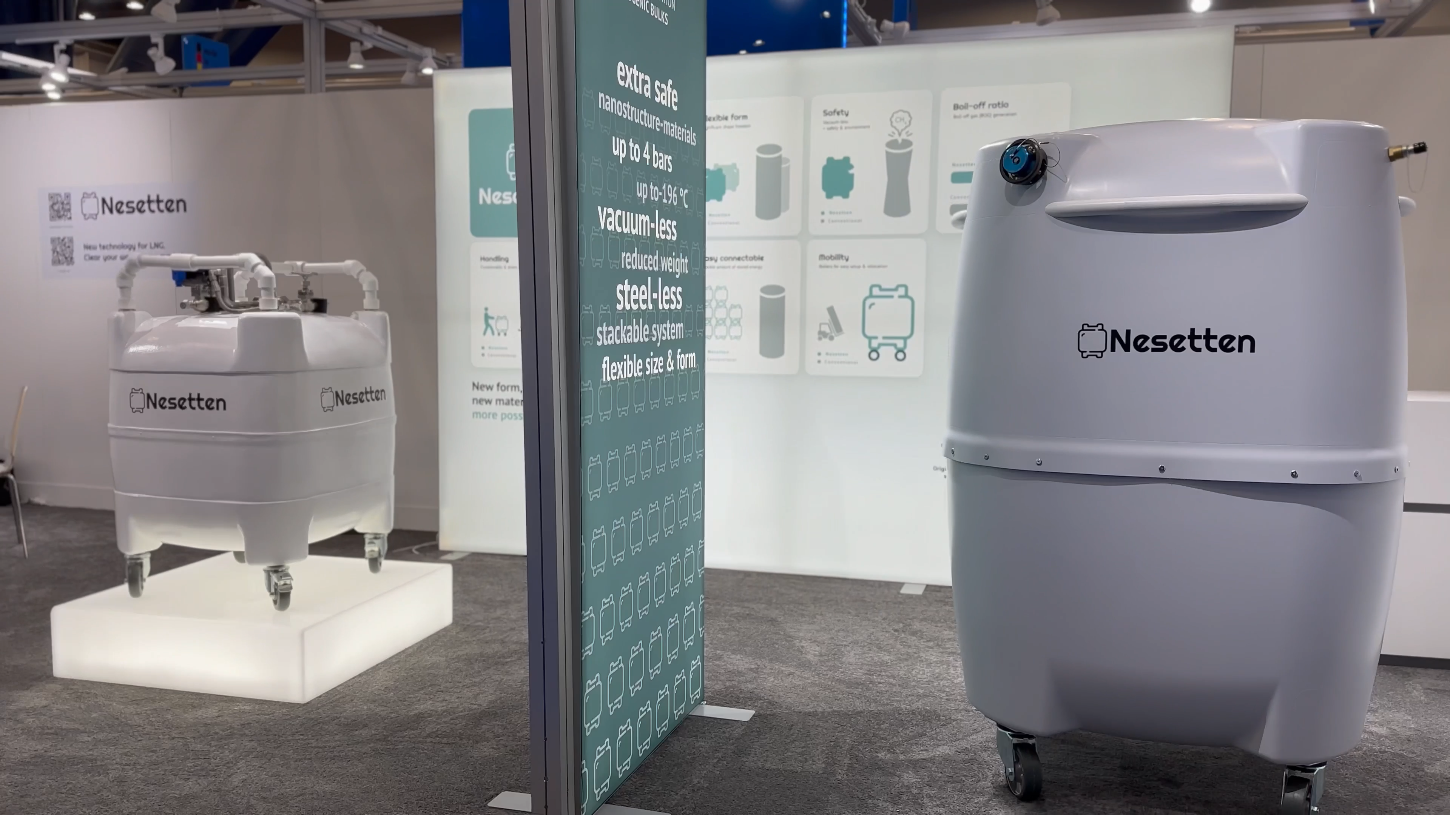
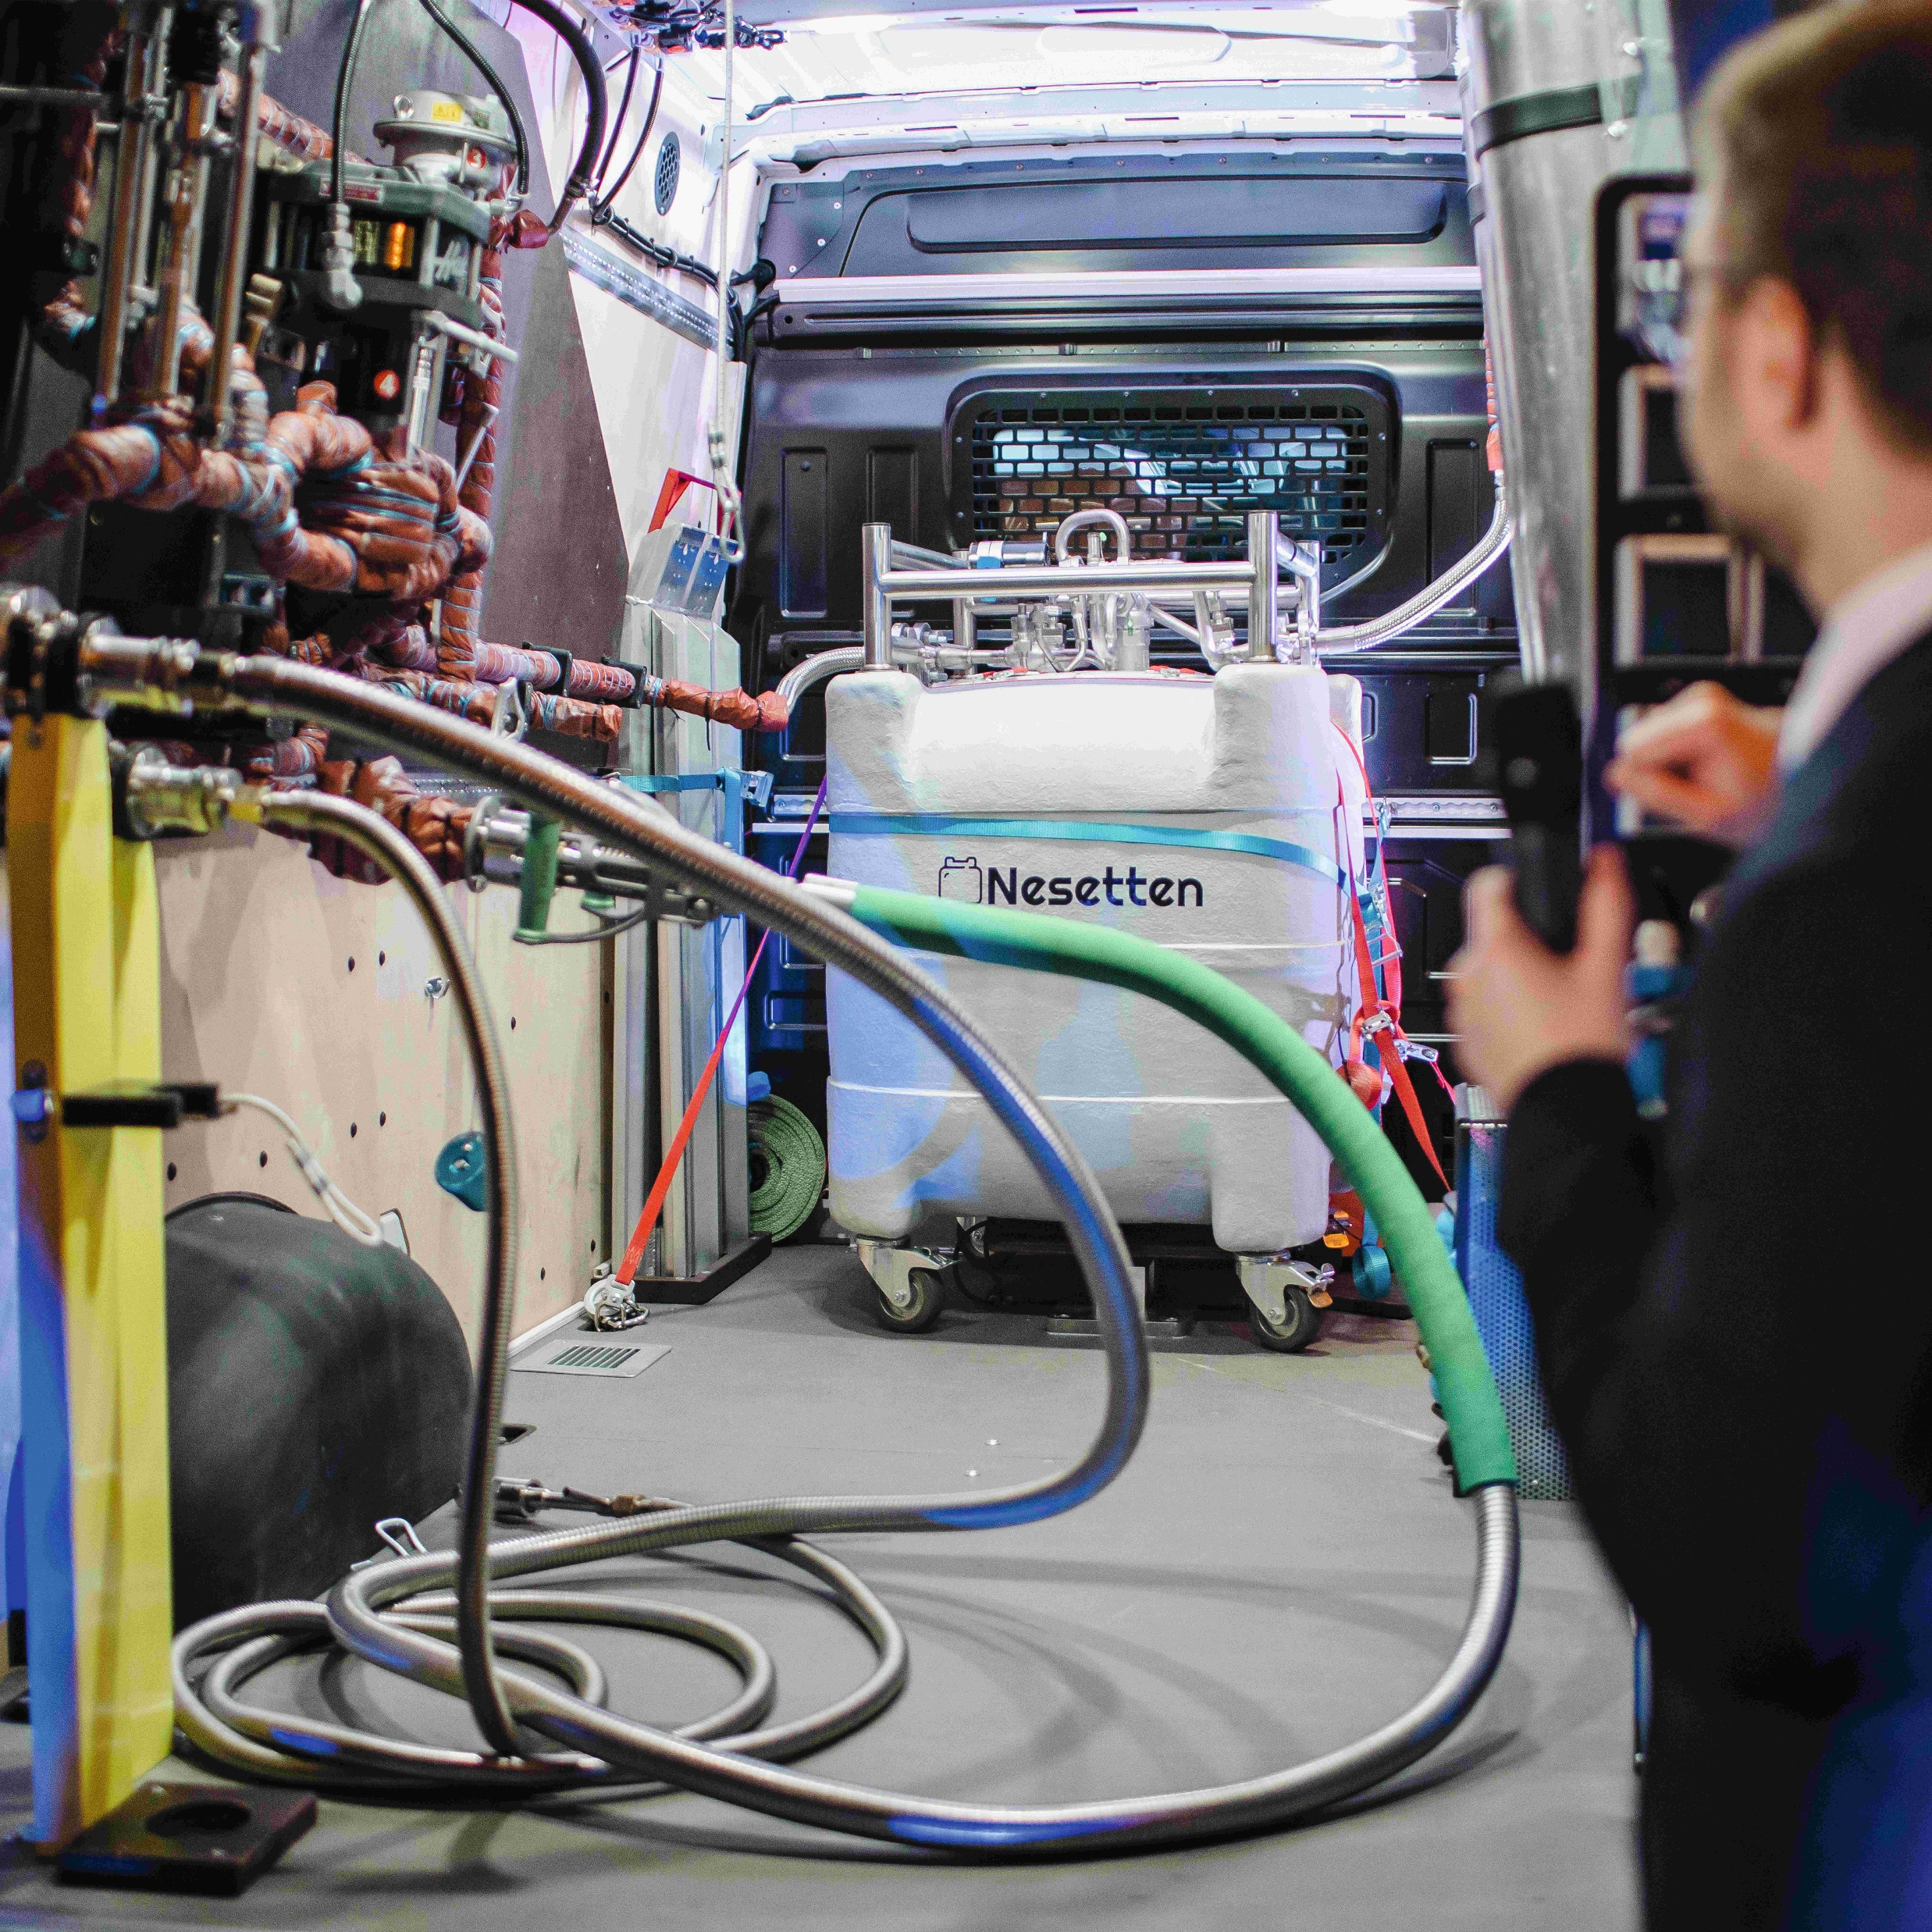
Nesetten Innovative Technology

Slide 5
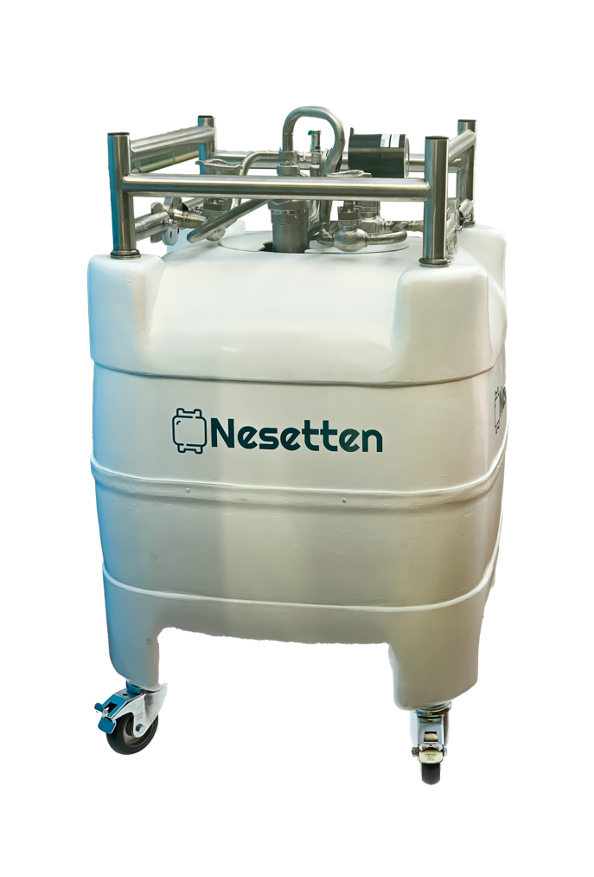
Nesetten Solution
The solution
to a problem: worldwide first vacuum- and
steel-less
cryogenic bulk
1 m³ LNG = 600 m³
natural gas -163°C
1 m³ LNG = 600 m³ natural gas
1 Nesetten tank with LNG
= enough energy for a 900 m² office for 1 month

Slide 6
Nesetten Solution
Our system addresses two critical needs:
Decentralized Energy Access – Powering critical infrastructure and commercial operations in areas disconnected from the gas grid or damaged by attacks..
Dual-Use Potential – With adaptation (e.g., ballistic protection), Nesetten’s technology could support military and civil protection units by delivering mobile, off-grid energy in unstable and high-risk environments.
The solution
to a problem: worldwide first vacuum- and
steel-less
cryogenic bulk for (bio-)LNG

Slide 7






Solution Focused
Decentralised & Resilient
These systems, disconnected from main grids, are safer in the face of catastrophes and disasters and serve as key components for an independent grid.
Genuinely Mobile
through Micro Scale
Serving new use cases, enabling agile implementation, and unlocking a market where big players are not yet active.
Cleaner & Transition-ready
Enabling broader and more
universal use of cryogenic fuels
such as (bio-)LNG (and LNG)
in locations where conventional
fossil fuels are typically employed.

Slide 8
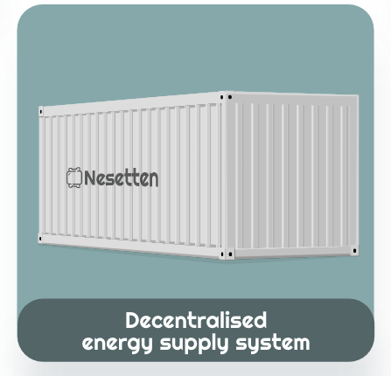
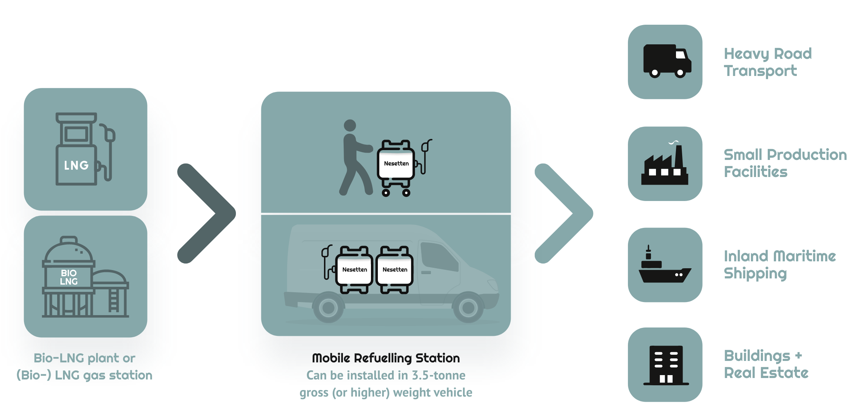
(bio-)LNG Supply Ecosystem enabled by Nesetten’s technology
Nesetten's technology empowers LNG suppliers to innovate their business models, enabling efficient downstream delivery of LNG for energy production.

Slide 9
(bio-)LNG Supply Ecosystem enabled by Nesetten’s technology
Nesetten's technology empowers LNG suppliers to innovate their business models, enabling efficient downstream delivery of LNG for energy production.

Slide 10

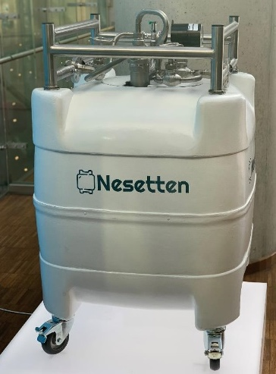
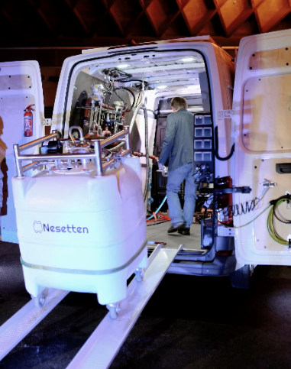
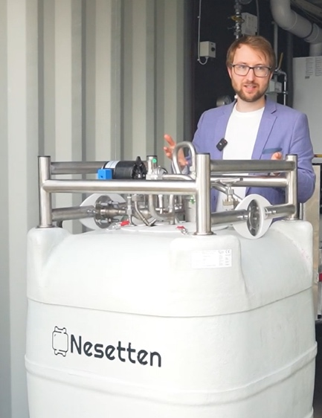
Breakthrough Technologies
Creating Ecosystem
1
Vacuum- and steel-less cryogenic micro bulk
2
Mobile refueling station
for (bio-)LNG
3
Off-grid energy
production unit

Slide 11
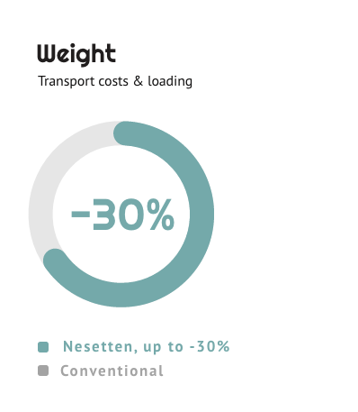
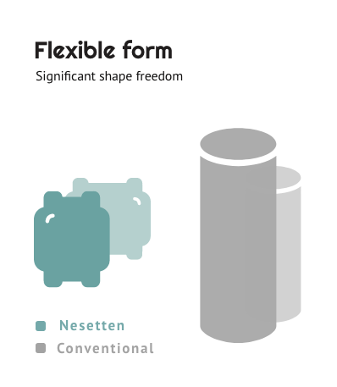
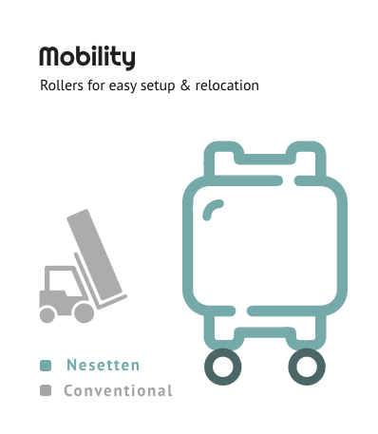
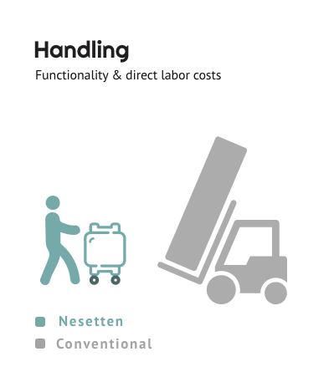
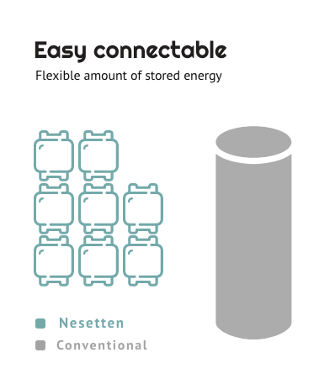
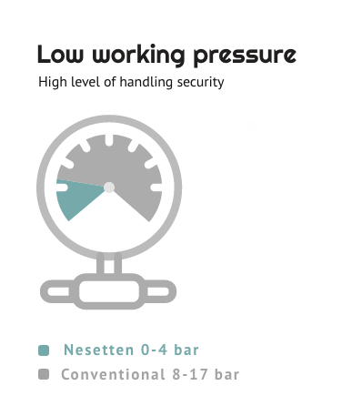
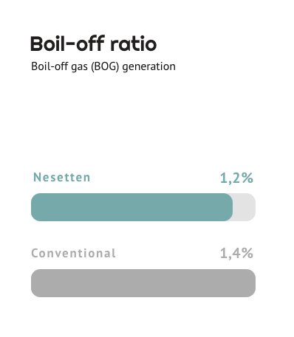
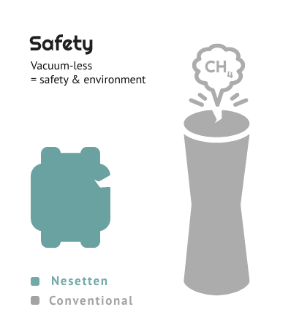
1. Vacuum- and Steel-less Cryogenic Micro Bulk
(500 litre / 230 kg)
Our cryogenic fuel solution enables new (bio-)LNG applications, offering safer, lighter, and easier handling for energy storage and transport.
Our steel-less design uses passive insulation, eliminating the need for a vacuum.
1 m³ LNG = 600 m³ natural gas
1 Nesetten tank with LNG
= enough energy for a 900 m² office for 1 month

Slide 12
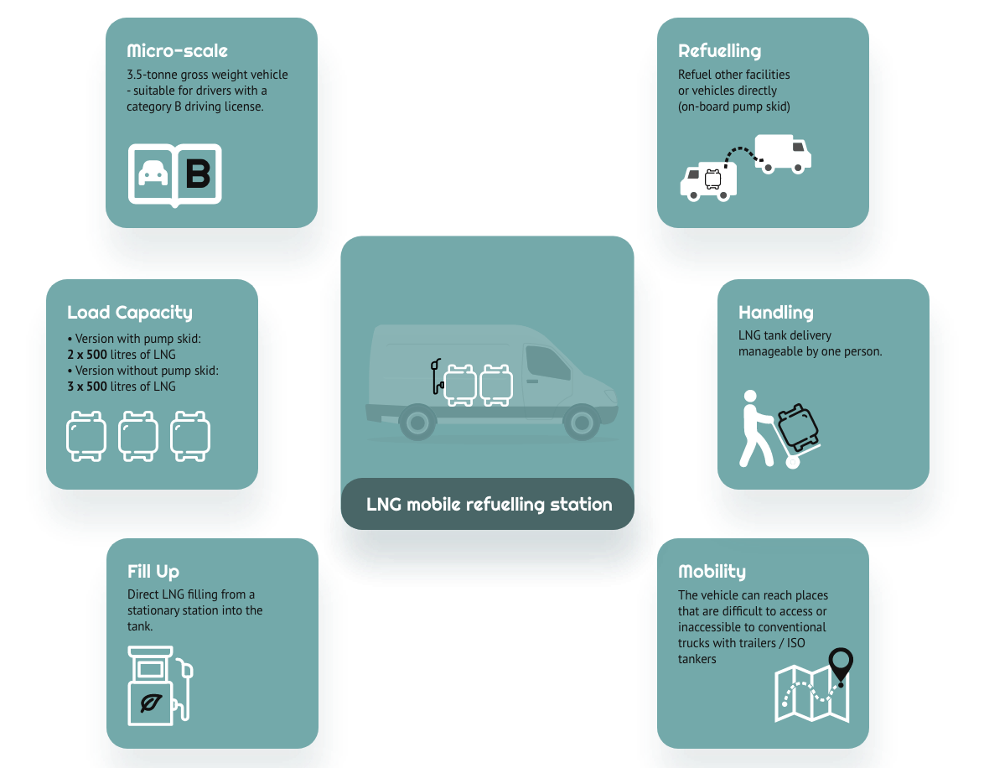
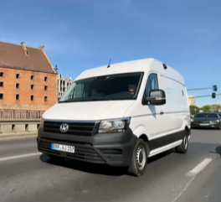
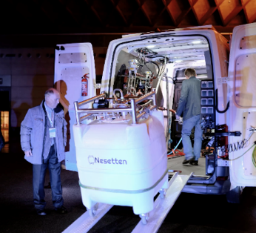
2. Mobile Refuelling Station for LNG
Our micro mobile (bio-)LNG refuelling station supplies liquid methane, for example, for trucks and for supplying
off-grid energy systems.
A micro- and nano-scale (bio-)LNG mobile refuelling station designed to supply small quantities of LNG to end-customers, such as LNG-powered trucks requiring fuel or decentralized energy supply |power generators.

Slide 13
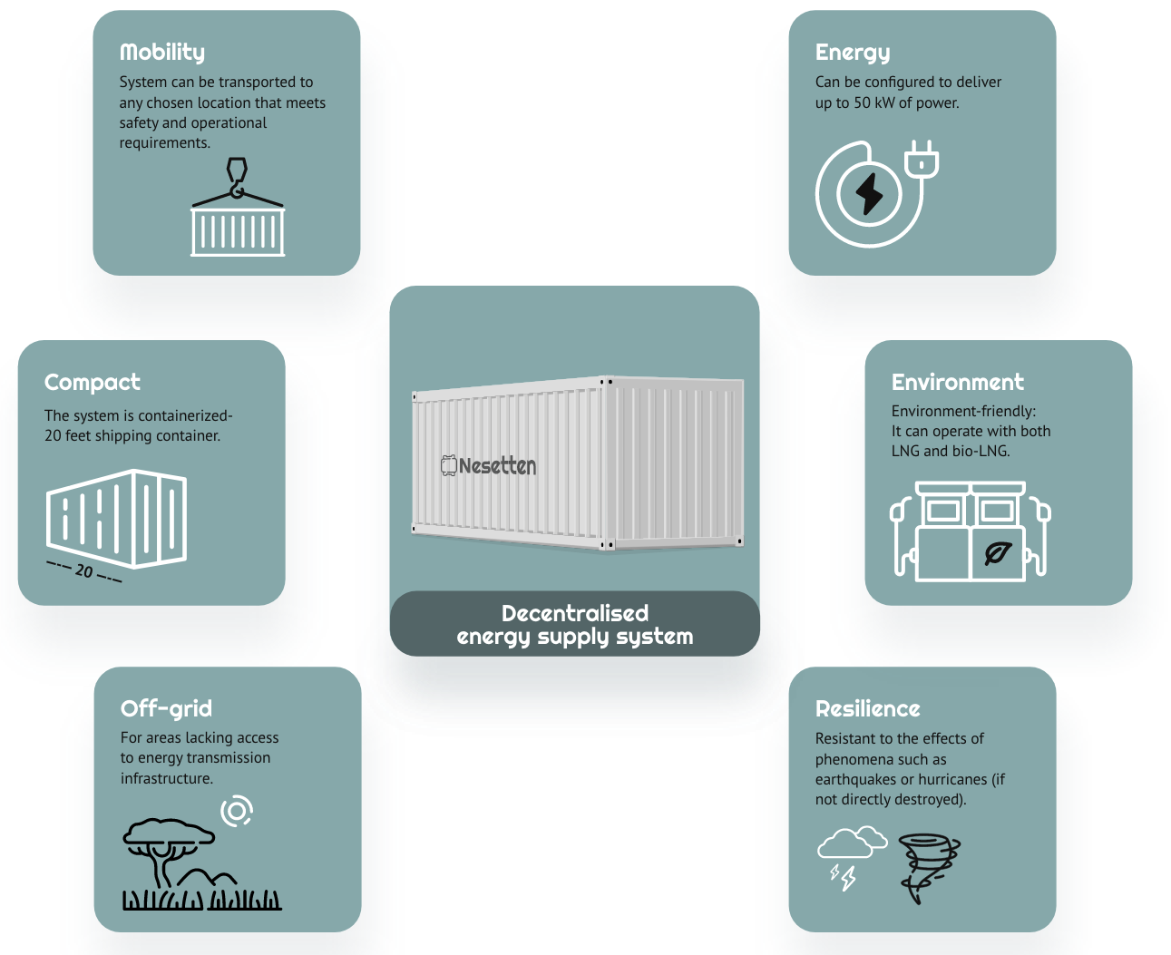
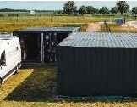
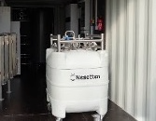
3. Off-grid Energy
Production Unit
Our Off-grid Energy Production Unit,
utilizing (bio-)LNG or LNG, provides a decentralised energy supply in areas lacking energy infrastructure.
This unique technology is an off-grid energy production unit. As with refuelling stations, the unit is also based on our vacuum-less bulks to repurpose them for an independent thermal and electrical power production supply.

Slide 14
Resilient Energy Through Crisis: Nesetten’s Off-Grid Innovation
Nesetten’s Mobile Micro LNG Refueling Solution – Rapid Response Network
Solution Highlights:
Containerized Power Unit – housed in a standard 20-ft container for fast deployment.
Exchangeable Micro-Bulks – full/empty swap without permanent infrastructure.
No Heavy Equipment Needed – only for refilling; no forklift required for daily use.
Rapid Setup – operational within minutes in field conditions.
Low Signature Operation – quieter and cleaner than diesel generators.
Supports Critical Assets – powers command posts, field hospitals etc.
Vehicle Integration Ready – adaptable for mobile deployment with military fleets
Nesetten’s mobile LNG solution is a dual-use asset.
It strengthens civilian infrastructure resilience, supports military logistics in the field, and enables emergency power delivery in crisis zones. Its lightweight, portable, and non-specialist-operated design makes it uniquely suited for conflict, reconstruction, and humanitarian applications.

Slide 15

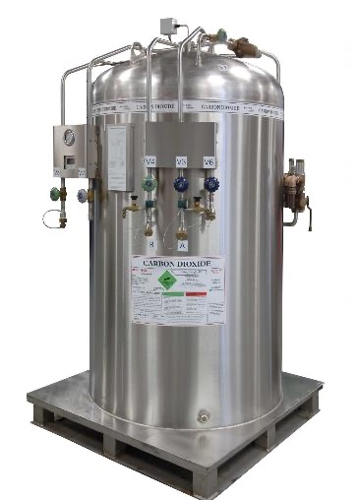
Nesetten innovative technology vs. conventional cryogenic bulks
Nesetten technology
Conventional technology
Steel-less | Steel-based
Vacuum-less | Vacuum-based
Flexible form | Cylinder
Light | Heavy
Safe in case of a minor damage | Dangerous (immediate boil-off)
200 litre
500 litre
1000 litre
230 litre
600 litre
1000 litre
Fully mobile | Stationary / partially mobile

Slide 16


Energy, Everywhere.
Nesetten GmbH
Ringstraße 4
18059 Papendorf, Germany
T: +49 381 4034912
E: info@nesetten.com
W: nesetten.com
IN: Nesetten GmbH
Pawel Warszycki, CEO
M: +49 176 24 04 33 74
E: pawel.warszycki@nesetten.com
© Nesetten 2024

