Slide 1




Deliverable 1
Business Model & Team Canvas
of Team (name)
Make sure your Team’s Deliverables is uploaded HERE before the deadline!
Deadline: September 8th, 2025 (11:00 AM)

Slide 2

What’s the purpose?
Business Model Canvas
The objective is to deepen your understanding of your business model, emphasizing its core elements. Instead of diving deep into minutiae, focus on sketching out the pivotal features and areas of greatest importance. The activity will be centered on utilizing the Value Map and the Business Model Canvas.
Team Canvas
Team Canvas is a strategic framework that helps bring your newly formated team on the same page. It is made to align all members, increase cohesion and performance and to create productive team culture. Team Canvas works across multiple touchpoints such as: creating a team, clarifying goals and addressing overall team performance (e.g. when you feel stuck as a team, or when you need to get a lot of stuff done) also growing and onboarding new team members;

Slide 3

Requirements for Business Model Canvas:
Use It as a Strategic Tool: The Business Model Canvas is not just a worksheet; it's a strategic tool. Use it to shape, challenge, and pivot your business assumptions.
Start with the Customer: The customer is the heart of any business. Understand their needs, preferences, and pain points before mapping out other aspects of your business.
Iterate Frequently: As your understanding of your business and market deepens, revisit and adjust your canvas. This tool is designed for flexibility and change.
Keep It Simple and Visual: The Business Model Canvas is a visual chart; it should be easy to understand at a glance. Use symbols, colours, and concise wording. Avoid overcrowding or overcomplicating.
Employ It as a Communication Medium: Use the canvas to communicate your business strategy with stakeholders, partners, and team members. Encourage dialogue around it to gather feedback and foster understanding.

Slide 4

Requirements for Team Canvas:
To create a Team Canva, you need the following:
Gather together. Designate someone to guide a session as a facilitator. Take an advantage on your Team Building Coach. They can guide you through the difficult topics.
Templates. Use the templates to create your basic or expanded version.
Key Concept: Prepare to discuss Purpose, Goals, Values, Roles & Skills, and Rules & Activities. Additionally, be ready to discuss Team members’ Needs, Expectations, Weaknesses and potential Development Areas.

Slide 5









VALUE MAP OF [COMPANY NAME]
PRODUCT
CUSTOMER
Gain Creators
6 Describe how your products and services create customer gains
Gains
3 Describe the benefits your customer expects, desires or would be surprised by
Products and
Services
5 List all products and services your value proposition is built around
Job to be done
2 Describe what a specific customer segment is trying to get done
1 Client
Pains
4 Describe negative emotions, undesired costs, situations and risks.
Pain relievers
7 Describe how your products and services eliminate customer pains, negative emotions or undesired costs and situations
Our XXXXXXXXXXXXXXXX helps XXXXXXXXXXXXXXXXXXXXXXXXXXXXXXX who XXXXXXXXXXXXXXXXXXXX to XXXXXXXXXXXX and XXXXXXXXXXXXXX through XXXXXXXX and XXXXXXXXXXXXX

Slide 6
BUSINESS MODEL CANVAS GUIDELINE
Who are our key partners?
What key activities does our value proposition require?
Which customer problem are we helping to solve?
Which customer needs are we satisfying?
What is the specific product or service?
What are the features that match customer needs?
How will we get, keep and grow customers?
For whom are we solving a problem or fulfilling a need?
Who are the customers?
Does the value proposition match their needs?
Key Partners
Key Activities
Value Proposition
Customer Relationships
Customer Segments
What key resources does our value proposition require?
Through which channels do our customer segments want to be reached?
Key Resources
Channels
What are the most important costs in our business model?
What is the revenue model?
What are the pricing tactics?
What value are our customers willing to pay for?
Cost Structure
Revenue Streams

Slide 7
TEMPLATE TYPE 1
Project:
NAME
CREATED BY:
NAME
DATE: 00/00/00
Key Partners
Key Activities
Value Proposition
Customer Relationships
Customer Segments
This is a placeholder
This is a placeholder
This is a placeholder
This is a placeholder
This is a placeholder
Key Resources
Channels
This is a placeholder
This is a placeholder
Cost Structure
Revenue Streams
This is a placeholder
This is a placeholder

Slide 8
TEMPLATE TYPE 2
Project:
NAME
CREATED BY:
NAME
DATE: 00/00/00
KEY ACTIVITIES
VALUE PROPOSITION
Your text
Your text
Your text
Your text
Your text
Your text
Your text
Your text
Your text
Website/blog
Search engine/SEO
Social media (FB, Insta, TikTok)
Online chat and customer support
B2B2C
End customers:
Health conscious consumers
Consumers with specific diet
Fitness & Wellness oriented individuals
Aged 25 - 45
Potentially people with hypothyroidism (falls into specific dietary needs)
Worldwide markets (focus on Europe and Middle East)
KEY PARTNERS
Key Activities
Value Proposition
CUSTOMER RELATIONSHIPS
Customer Segments
Key Partners
Customer Relationships
CUSTOMER SEGMENTS
Key Resources
CHANNELS
Your text
Your text
Your text
Own channels such as website
Partner channels:
Specialty supermarkets and food stores, like WholeFoods
High end restaurants
5* Hotels
Gyms & Fitness Centers
Alternative distribution channels: digital retailers in Europe and US
Food focused events/conferences
KEY RESOURCES
COST STRUCTURE
Your text
Your text
Your text
Your text
Your text
REVENUE STREAMS
Business Model Canvas is under Creative Commons license by Strategyzer AG

Slide 9
TEMPLATE TYPE 3
Project:
NAME
CREATED BY:
NAME
DATE: 00/00/00
Key Activities
Value Proposition
Your text
Your text
Your text
Your text
Your text
Your text
Your text
Your text
Your text
Your text
Your text
Your text
Your text
Your text
Your text
Your text
Your text
Your text
Your text
Your text
Your text
Your text
Your text
Your text
Your text
Your text
Your text
Your text
Your text
Your text
Your text
Your text
Your text
Your text
Key Partners
Customer Relationships
Customer Segments
Your text
Your text
Your text
Channels
Key Resources
Your text
Your text
Your text
Your text
Your text
Your text
Your text
Your text
Your text
Cost Structure
Revenue Streams
Business Model Canvas is under Creative Commons license by Strategyzer AG

Slide 10
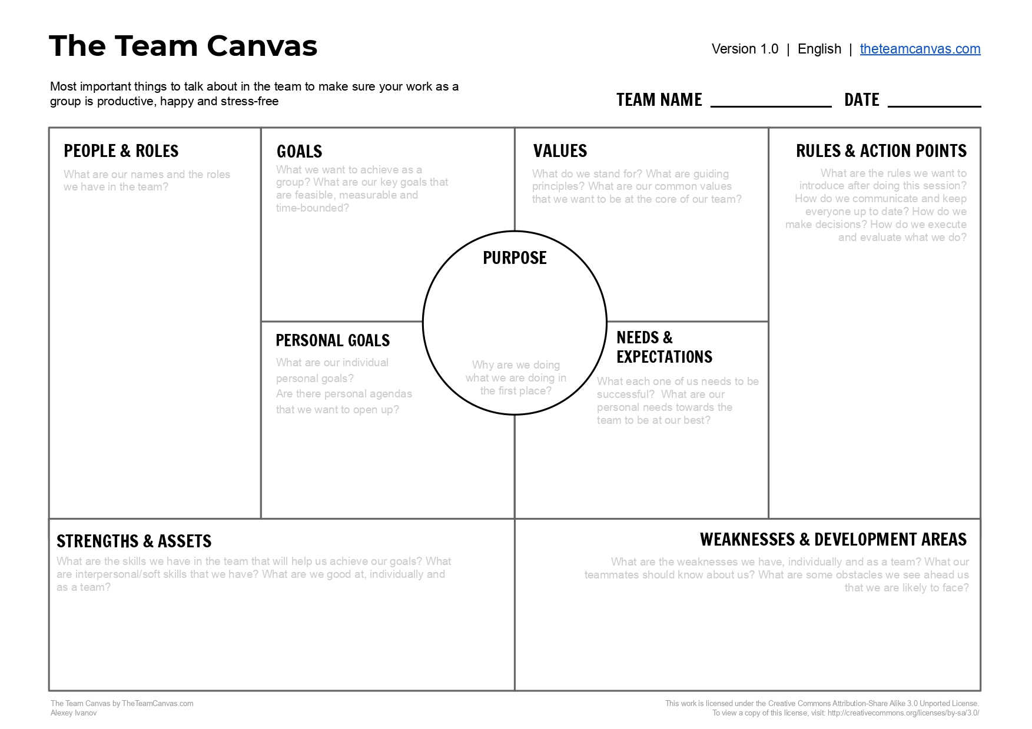
TEAM CANVAS GUIDELINE
Most important thing is to talk about it in the team to make sure your work as a match is productive, happy and stress-free!

Slide 11
TEMPLATE TYPE 1
Project:
NAME
CREATED BY:
NAME
DATE: 00/00/00
PEOPLE AND ROLES
Your text
Your text
Your text
VALUES
Your text
Your text
Your text
Your text
Your text
Your text
PURPOSE
Your text
Your text
Your text
GOALS
Your text
Your text
Your text
RULES AND ACTION POINTS
Your text
Your text
Your text
Your text
Your text
Your text

Slide 12
TEMPLATE TYPE 2
Project:
NAME
CREATED BY:
NAME
DATE: 00/00/00
PEOPLE AND ROLES
GOALS
VALUES
RULES AND ACTION POINTS
Your text
Your text
Your text
Your text
Your text
Your text
Your text
Your text
Your text
Your text
Your text
Your text
Your text
Your text
Your text
Your text
Your text
Your text
PURPOSE
Your text
Your text
Your text
PERSONAL GOALS
NEEDS &
EXPECTATIONS
Your text
Your text
Your text
Your text
Your text
Your text
Your text
Your text
Your text
STRENGHT & ASSETS
WEAKNESS & DEVELOPMENT AREAS
Your text
Your text
Your text
Your text
Your text
Your text

Slide 13

Make sure your Team’s Deliverables is uploaded HERE before the deadline!

Slide 14
Team Canvas Criteria:
Criteria | Explanation
People & Roles | The Team can define their roles and positions within the organisation
Common goals | The Team can identify feasible, measurable and time-bouned goals
Personal goals | Each Team member can define own goals related to the project
Purpose | The Team can define the purpose of the match and cooperation
Values | The Team is able to describe what is standing for, guiding principles and the core of the Team
Strengths & Assets | The Team shares key pieces of skills and their capacity within the Team
Weaknesses & Development Areas | The Team identifies weakness, obstackes and threads within the Team
Needs & Expectations | The Team can express its needs to amplify strengths
Rules & Activities | The Team is able to formulate the expectations and outcomes, can specify the the activities to implement

Slide 15
Business Model Canvas Criteria:
Criteria | Explanation
Customer Segment | The Team can define the segment and define most important customers they are delivering the value
Value Proposition | The Team can describe the UVP that fulfills the needs of customer
Channels | The Team can define tools on how to reach the customer and through which channels
Customer relationship | The Team has ability to built, nurture and grow the relationships with customer
Revenue Streams | The Team is able to find potential revenue sources
Key Resources | The Team has the essential assets in running the business and providing the value
Key Activities | The Team can identify activities needed to create an effective and succesful connection with customer
Key Partners | The Team can prepare and identify the long term partnership with key partners
Cost Structure | The Team can define most essential costs and cost drivers

