Slide 1
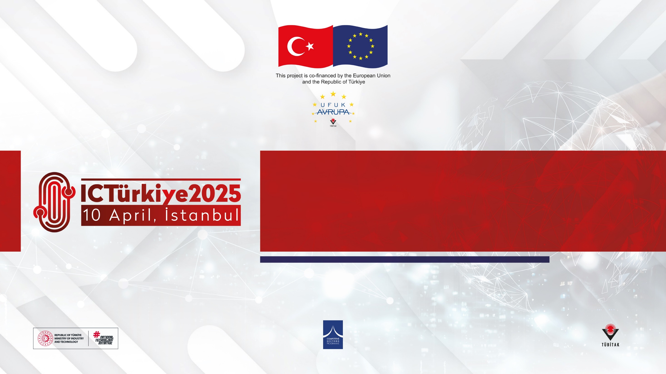
PRESENTER FULL NAME:MURAT AKBAŞ
ORGANIZATION:DİYARBAKIR METROPOLİTAN MUNICIPALITY
WORKSHOP NAME:Workshop#4-Smart Mobility
E-MAIL:muratakbas@diyarbakır.bel.tr

Slide 2

1. Institutional Overview
Diyarbakır Metropolitan Municipality is the largest local authority in Southeastern Turkey, serving over 1.8 million citizens.
The municipality is responsible for urban infrastructure, transportation, environmental protection, cultural heritage preservation, and social services.
Description of the Organisation
2. Strategic Priorities and Activities
Focus on sustainable urban development, climate resilience, and renewable energy projects.
Implementation of smart city solutions, rural development initiatives, and inclusive services for women, youth, and vulnerable groups.
Preservation and promotion of Diyarbakır’s rich cultural heritage in alignment with international standards.
3. International Cooperation and Project Capacity
Strong partnerships with international organizations (EU, Agencies and International Finance Institutions) and national ministries.
Experienced in developing and managing large-scale projects with specialized departments for project management and external relations.
Vision to establish Diyarbakır as a regional leader in sustainable development and international collaboration.

Slide 3

Our Teams’Expertise
Experience in International Cooperation & Partnerships
Our team has extensive experience in building and managing international partnerships, collaborating with municipalities, universities, international organizations and funding agencies (EU, AFD, JICA, IFC) for large-scale development, climate resilience, and infrastructure projects.
Technical Expertise & Project Management We specialize in sustainable urban development, smart city solutions, renewable energy integration, and climate adaptation. Our team has proven capacity in designing, managing, and implementing complex projects in transportation, rural development, and cultural heritage, supported by strong technical and engineering expertise.

Slide 4

Our Research Fields
Innovation in Renewable Energy & Sustainability
We focus on innovative solutions in mobile renewable energy systems, energy efficiency, and climate adaptation strategies for urban and rural areas.
Urban Resilience and Disaster Risk Management
Our research includes urban resilience planning, disaster preparedness, and integration of smart city technologies for risk mitigation.
Social Inclusion & Community Engagement
We work on projects promoting social inclusion, gender equality, and participatory governance in local development.
Sustainable Economic Development & Smart Mobility
Our research areas include sustainable local economic growth, smart transportation systems, and infrastructure development.

Slide 5

Our On-going Projects
Submitted and Awaiting Approval:
Hevsel Gardens Biodiversity and Ecosystem Protection Project (EU Climate Change Grant Program)
Diyarbakır Climate School Project (Horizon Europe – Agroecology Concept)
Patient Transport Ambulance Project (Japan Embassy Local Governments Grant Program)
Diyarbakır Migrant Community Center Project (Mayor Migration Council Grant Program)
Improving Women’s Access to Health Services in Rural Areas (Bloomberg Global Mayors Challenge)
Diyarbakır City Museum Exhibition and Arrangement Project (US Cultural Heritage Protection Grant Program)
Promotion of Geographically Indicated Products in Diyarbakır Gastronomy (GAP Regional Development Administration)
Production and Branding of Karacadağ Rice (GAP Regional Development Administration)
Organic Wheat Heritage Seed Project, Capparis Cultivation Project, Agricultural and Vocational Training Projects (GAP Regional Development Administration)
In Preparation Stage:
Mobile Solar Energy Use in Rural Areas Project (Horizon Europe – LEAP-SE)
Diyarbakır Disaster Risk Management and Resilience Project (Horizon Europe)
Diyarbakır Disaster and Civil Protection Exercise Project (Horizon Europe)
Diyarbakır Disaster Risk Reduction and Resilience Project (Horizon Europe)
Transportation and Infrastructure Investments:
Light Rail System Project (in advanced negotiations with AFD and IFC)
Çarıklı Geothermal Project (discussions ongoing with TSKB for financing)
International Cooperation and Programs:
Women-Friendly Cities 3 Program (EU – UNFPA – UMT partnership)
Participatory, Inclusive, and Green Recovery Project for Earthquake Region (PACE)
UNICEF collaboration projects on child protection, education, youth skills, and psychosocial support
Strategic Partnerships and Future Planning:
ACAR Project: Pilot projects with public, private sector, and NGOs
Institutional capacity-building efforts with ILO and UNESCO
National and International Engagements:
Ongoing dialogues with EU Delegation to Turkey, UN Resident Coordinator, ILO, UNFPA, FAO, UNICEF, WFP, and major financial institutions (JICA, EBRD, AFD, World Bank, Islamic Development Bank, ILBANK, GIZ, IFC, TSKB)

Slide 6
Construction of a 14.1 km tram line with 20 stations.
Deployment of 36 tram vehicles.
Daily ridership of 92,206 passengers by 2028.
Peak hour one-direction passenger capacity of 8,478.
Enhanced urban connectivity and contribution to climate action goals with reduced environmental impact.
Project Idea
Call Topic:Development and construction of the Dağkapı – Gazi Yaşargil Education and Research Hospital Light Rail System Line (14.1 km, 20 stations) with tram vehicle procurement (36 units), focusing on sustainable urban transport and smart mobility solutions.
Deadline Dates: The project was submitted for approval on 18.01.2022 and approved on 05.05.2023. It is included in the Presidential 2025 Investment Program with a project completion target year of 2028.
Objectives:To establish an efficient, sustainable, and environmentally friendly public transportation solution for Diyarbakır.To connect key urban centers and the Gazi Yaşargil Education and Research Hospital with a modern tramway system.To reduce traffic congestion and carbon emissions, and improve urban mobility.
Expected Results:Construction of a 14.1 km tram line with 20 stations. Deployment of 36 tram vehicles. Daily ridership of 92,206 passengers by 2028.Peak hour one-direction passenger capacity of 8,478.Enhanced urban connectivity and contribution to climate action goals with reduced environmental impact.

Slide 7
Consortium - profile of known partners (if any)
No | Partner Name | Type | Country | Role in the Project
01 | IFC | Financing Institution | Türkiye | Financer
02 | AFD | Financing Institution | Türkiye | Financer
03
04
05

Slide 8

PRESENTER CONTACT
DETAILS:
GSM:+90 531 7922436
E-mail: muratakbas@diyarbakir.bel.tr
COUNTRY:Türkiye

