Slide 1
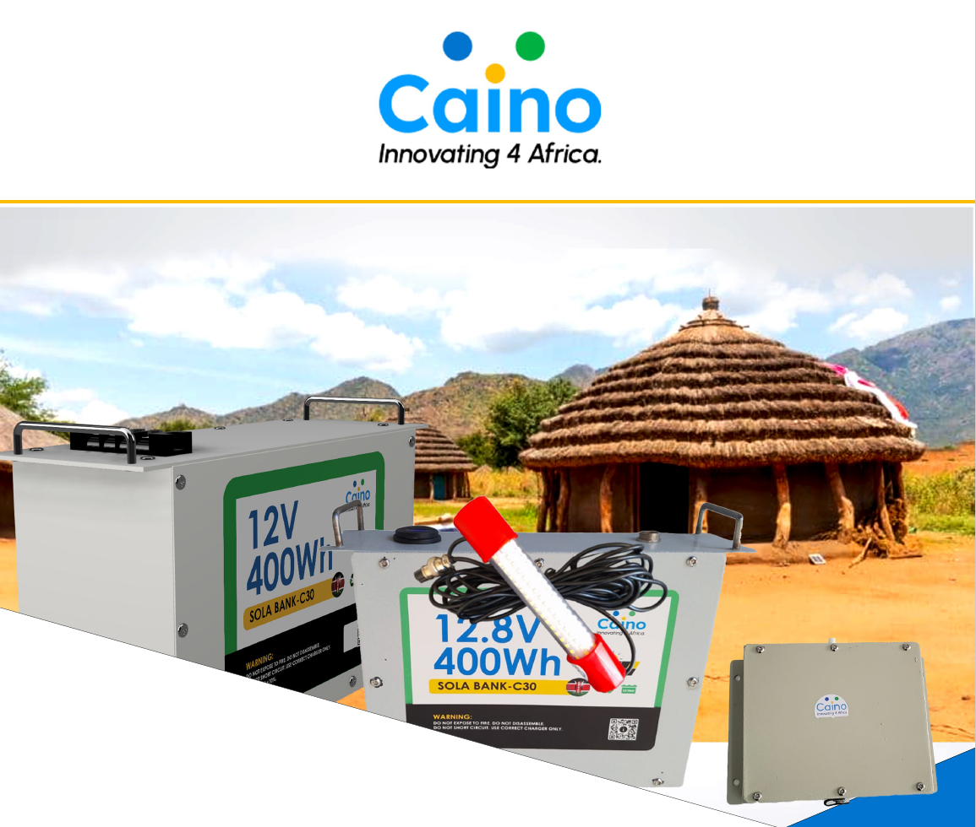

Second-life LiFePO4 Clean Energy Solutions

Slide 2
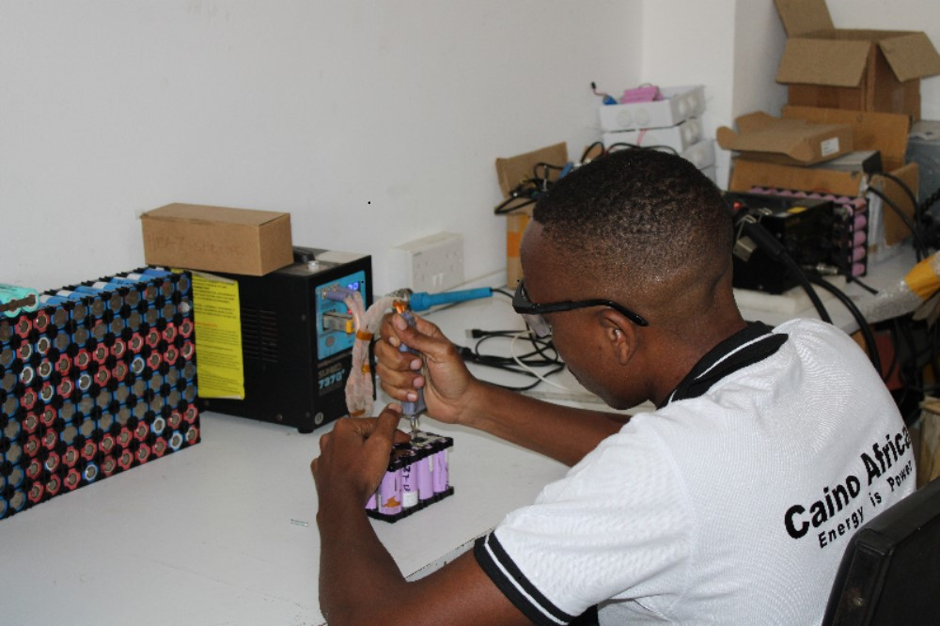
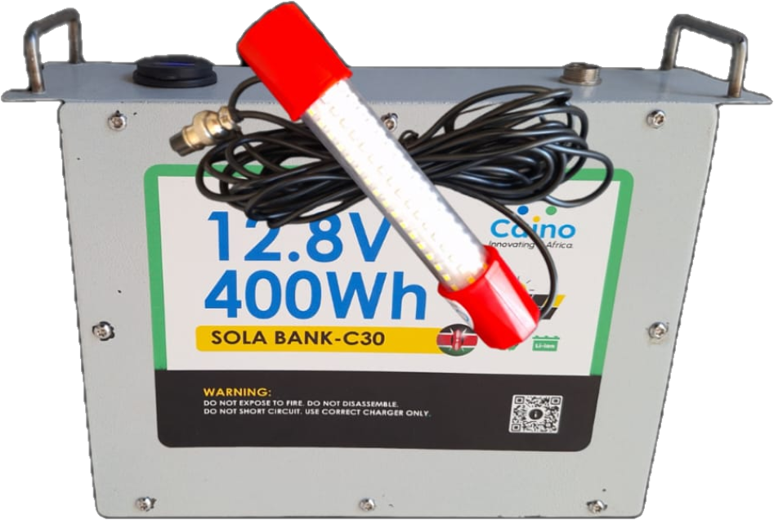

Company Overview
Insert Image
Mission
To create second life lithium-ion battery packs and other accompanying technologies for solar applications targeting low income off-grid communities.
Vision
To empower livelihood through clean and affordable energy.
Overall goal
Creating environmentally friendly renewable energy low-cost solutions to off-grid communities.
Insert Image
Key Insights

Slide 3



Problem Statement
Solution
High cost of battery and energy storage solutions
Repurposed solar-ready lithium-ion batteries for solar applications.
Inefficient PAYGO revenue collection techniques & technologies
PAYGO hardware and API for solar companies that are doing PAYGO business.
Lack of recycling and refurbishment facilities for used lithium battery waste.
Customized renewable energy solutions powered by Second life lithium-ion cells

Slide 4
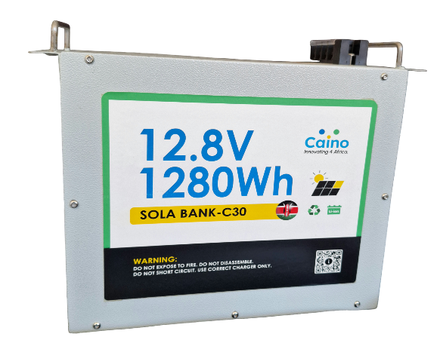
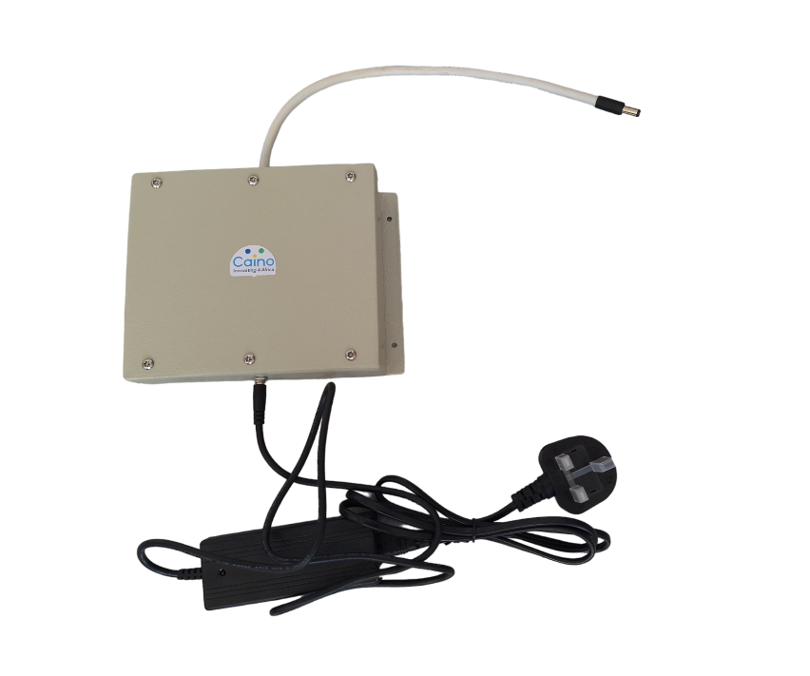
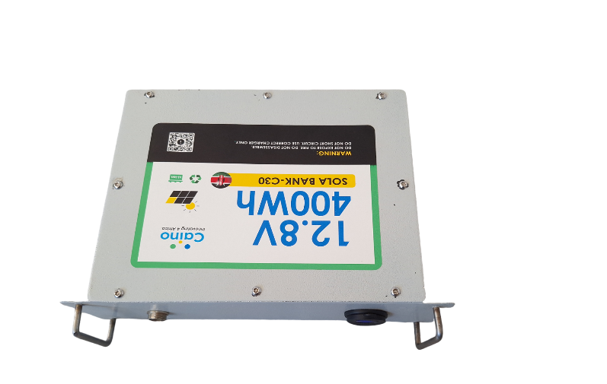
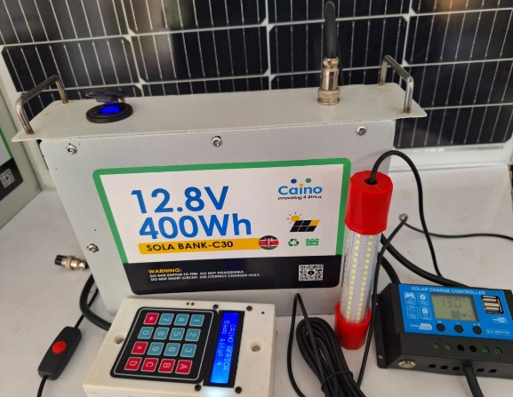
Products and Services
Durable
Repairable
High efficiency
Cost-friendly
Customizable
WIFI-backup
SHS Battery
PAYGO Battery
Professional Fishing lamp

Slide 5
Market Opportunity
600M
120M
12M
Africa
Total Available Market
Serviceable Available Market
Eastern Africa
Serviceable Obtainable Market
(Beachhead market)
East Africa
SAM

Slide 6
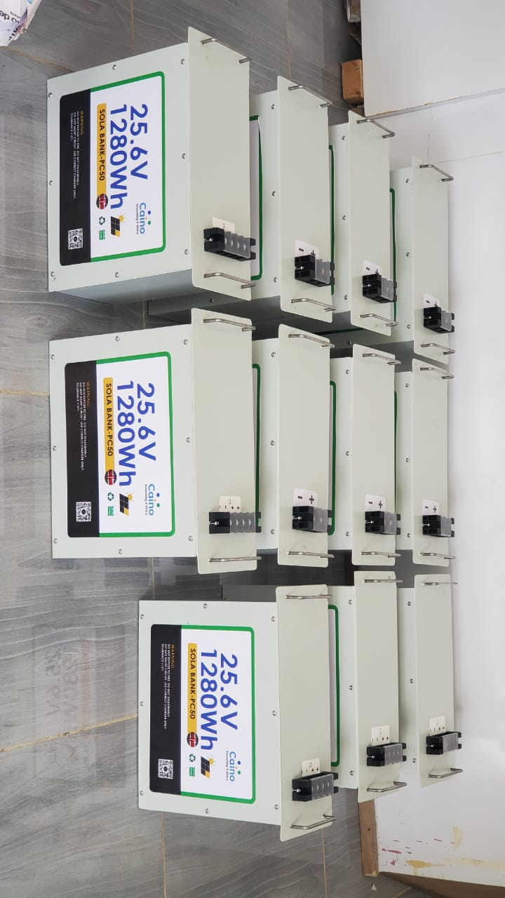
Business Model
1. Sales of battery packs and Wi-Fi routers backup battery on cash basis
2. Sales of solar fishing lamps on pay as you go basis
Insert Image
3. Repair of lithium-ion batteries for cash

Slide 7
Competitive Landscape
Component/Competitor | Component/ Competitor 1 | Component/Competitor 2 | Component/ Competitor 3 | Competitive Advantage
1. Solar Fishing lamps | Pressure lamps/Kerosene lamps | Solar lamps | N/A | Long hours of lighting compared to the ones on the market. Cheaper when compared to Kerosene lamps. Durable compared to the ones on the market. Environmentally Friendly.
2. Battery packs | Local dealers in imported Lithium-ion batteries | Lead Acid Batteries. | N/A | Ability to do local customization and repair of batteries. Reliability and steady product supply. Better performance compared to Lead acid batteries. Good quality compared to lead acid batteries. Cheaper compared to the ones on the market.
3. Wi-Fi Backup battery | N/A | N/A | N/A

Slide 8




Go-To-Market Strategy
2. Partnerships
4. Networking Events
1. Opening other branches.
3. Online presence

Slide 9
Ask Amount
Use of funds description | Amount(USD)
1. Scaling (Marketing, equipment, space, location-wise etc) | 2325
2. Streamlining operations(Standard production tools, Accounting softwares, CRM, procedures, skilled personnel, procurement) | 7752
3. Impact more livelihoods(increased access through PAYGO, intensive marketing, economies of scale, awareness, research and development) | 54264
4. Certification of battery packs | 2325
TOTAL | 118605
Capital Injection
EQUITY INVESTMENT
$118605

Slide 10
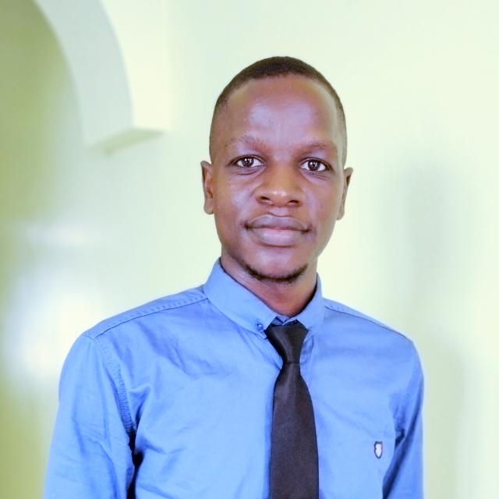
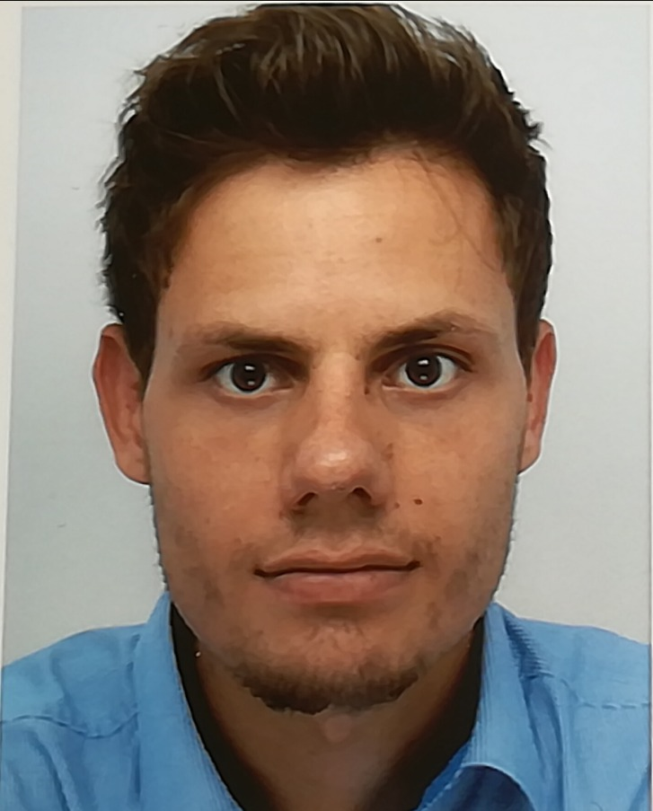
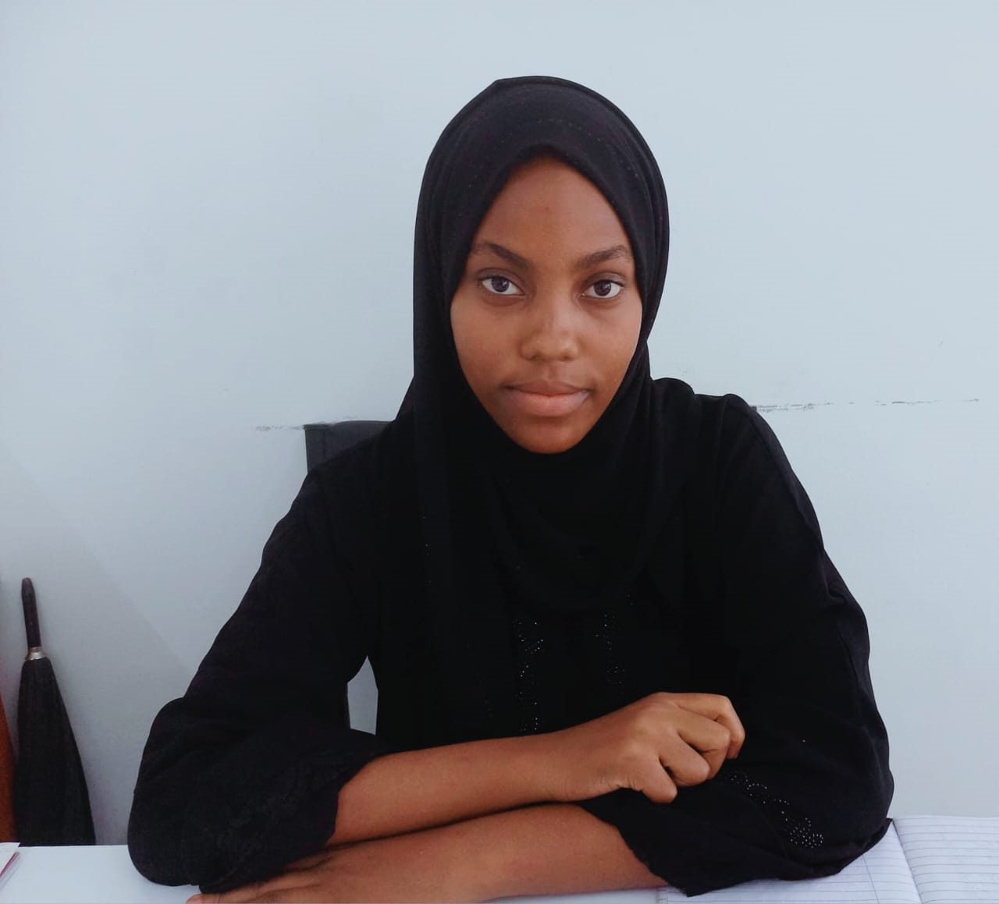
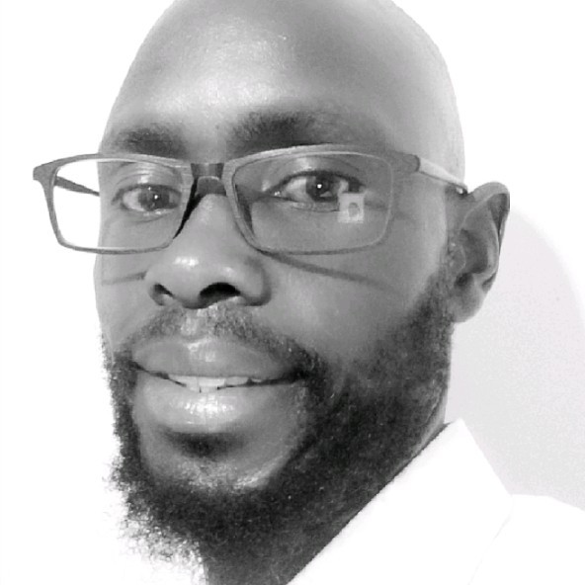
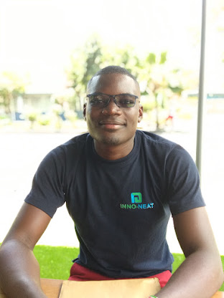
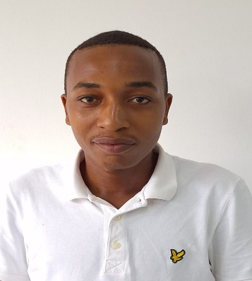
Our Team
Name: Amwoka Edwin
Designation: CEO & Founder
Name: Robin Blank
Designation: CFO &
co-founder
Name: Hajra Athman
Designation: Co-founder
& Business Developer
Name: Oluoch Were
Designation: Business Advisor
Name: Ambetsa Nimrod
Designation: Electrical Engineer
Name: Stephen Bandari
Designation: Electrical Engineer

Slide 11
THANK YOU
Email: info@caino.africa
Mobile: +254793644183
Website: www.caino.Africa

