Slide 1
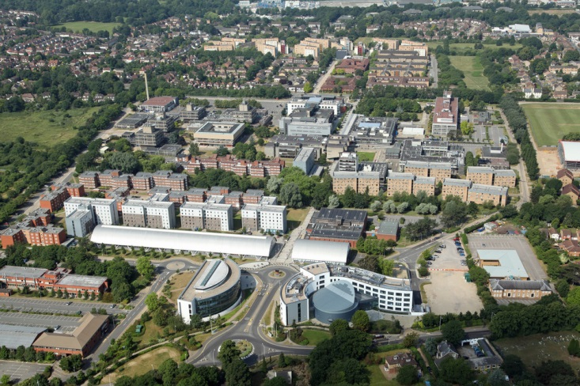
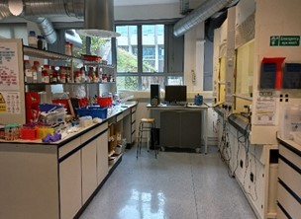
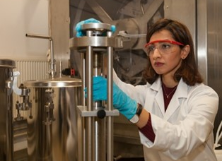
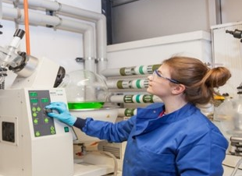
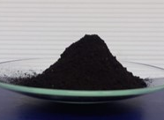
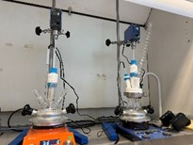
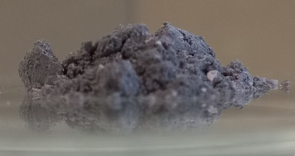
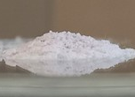
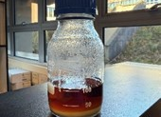
Brunel University of London
Project idea/ Field of expertise - Recycling end of life batteries
Organisation name – Brunel University London
Addressed topic - HORIZON-CL4-INDUSTRY-2025-01-MATERIALS-61- Expected project outcomes:
Developing a carbon-negative and cost-effective process for recovery of critical raw materials
Re-use of the components for other applications
Skills and expertise
New recycling process development
Synthesis of advanced materials from wastes
Solvent extraction technology
Liquid-Liquid separation
Process modelling and technoeconomic analysis
3D printing
BUL Project and collaboration opportunities New recycling process development
Developed a carbon-negative route for recycling end-of-life batteries and permanent magnets (TRL 3-4)
Materials can be repurposed for other applications
Minimum waste generated in the process
Achieved high quality recovered material with improved functional properties
Waste generation and scalability of the process needs to be analyzed
What we can offer
Sustainable process development using eutectic solvents
Solvent extraction techniques for materials recovery
Process modelling and technoeconomic analysis
Process design and intensification for technoeconomic assessment at scale
Development of experimentally-informed detailed process designs
Dr Abhishek Lahiri
abhishek.lahiri@brunel.ac.uk
Dr Svetlana Ignatova
svetlana.ignatova@brunel.ac.uk
Dr Peter Hewitson
peter.hewitson@brunel.ac.uk
Dr Salman Masoudi Soltanisalman.masoudisoltani@brunel.ac.uk

