Slide 1

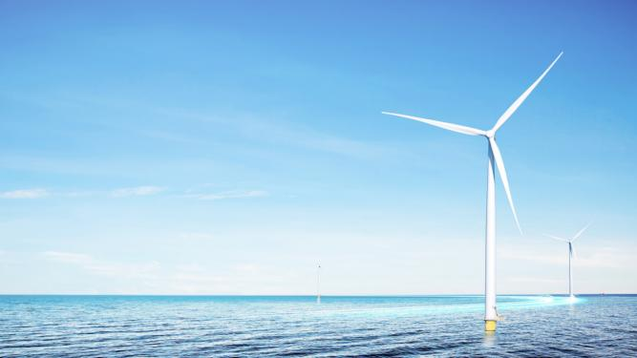
WINDEY
Corporate Introduction

Slide 2
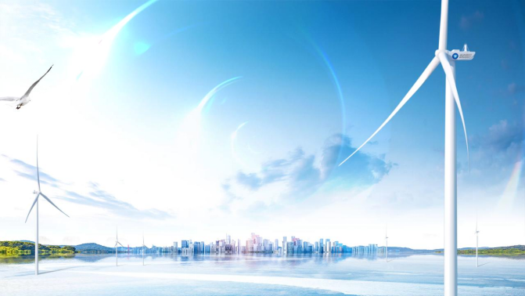
YEARS OF PERSISTENCE
ILLUMINATING OUR WORLD WITH GREEN ENERGY

Slide 3
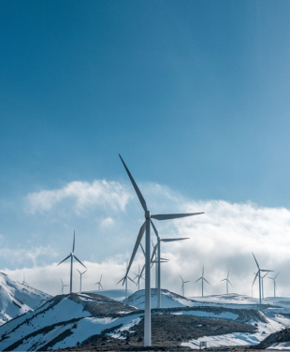
01
Company Overview
02
Smart Wind Turbine
03
Comprehensive Energy Service
04
CSR

Slide 4
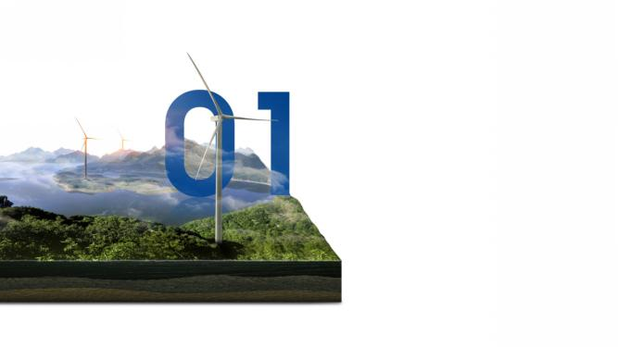
Company Overview
PIONEER OF WIND POWER INDUSTRY IN CHINA

Slide 5
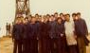





About WINDEY
Unremitting exploration
Successful listing
Zhejiang Windey Wind Power Engineering Co., Ltd.
Transformed to scale and specialized development from the early commercialization of wind power, driving the construction of China's novel wind power generation system.
Zhejiang Windey Co., Ltd.
Listed on Shenzhen Stock Exchange GEM to expand renewable energy development business, leading the industrial development.
Overseas business
Windey International.
Started the second growth curve.
2001
2019
2024
DEVELOPMENT HISTORY
1972
2010
2023
A zero breakthrough
Continuous innovation
A comprehensive renewable energy enterprise
Wind Power Research Center, Zhejiang Institute of Mechanical and Electrical Engineering.
Successfully developed 18kW WTGS, making a zero breakthrough of China in development & manufacture of medium-scale WTGS.
Zhejiang Windey Co., Ltd.
Completed shareholding system reform, and achieved multiple breakthroughs in key WTGS technologies, becoming the leading enterprise in the industry.
Windey Energy Technology Group Co., Ltd.
The company has changed its name from "wind power" to "energy technology", focusing on diversified development of renewable energy business and implementing group management.

Slide 6
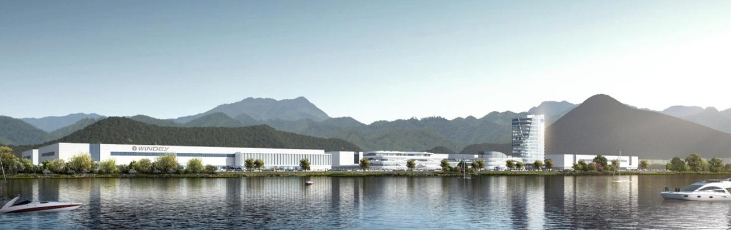

Industry Leading
Global leader
Renewable energy equipment manufacturers
2024 Newly installed capacity
Orders Amount
12.5
6.9
GW
billion USD

Slide 7

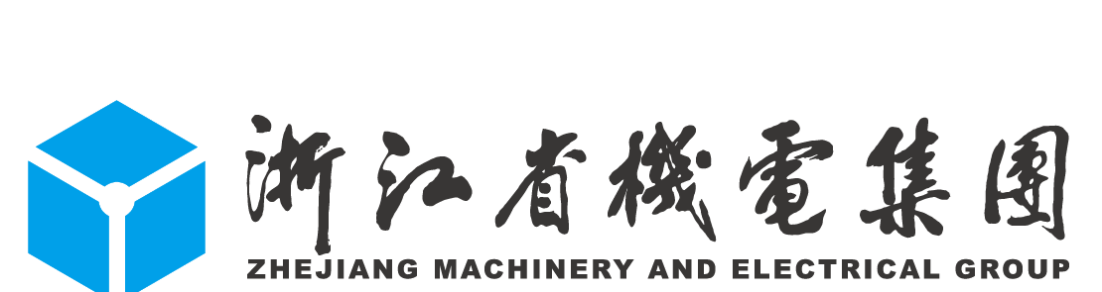

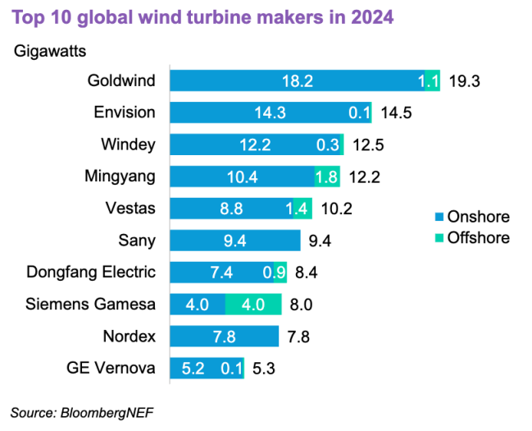


About WINDEY
Public shareholders
46.51%
53.49%
50+ Years
4,500+ Employees
2019 IPO
Over 50 years of experience in wind energy research
2200+ R&D engineers and technicians
Shenzhen Stock Exchange GEM：300772
Shareholding Structure
40+ GW
6 Business areas
200+ Standards
Accumulated capacity over 40 GW until June 2024
Wind turbine OEM, renewable energy investment, technology transfer, energy storage systems, EPC, intelligent services
Issued over 200 international, national, and industry standards
Ranked 3rd in 2024 Global Top Wind Turbine Manufactures List

Slide 8
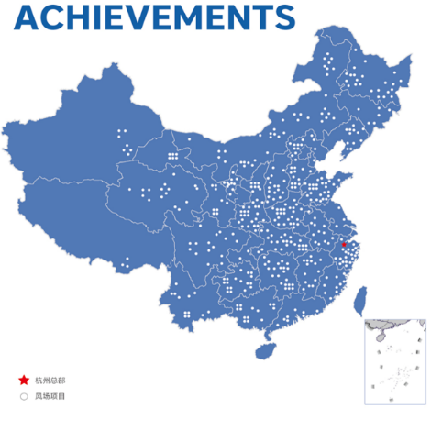
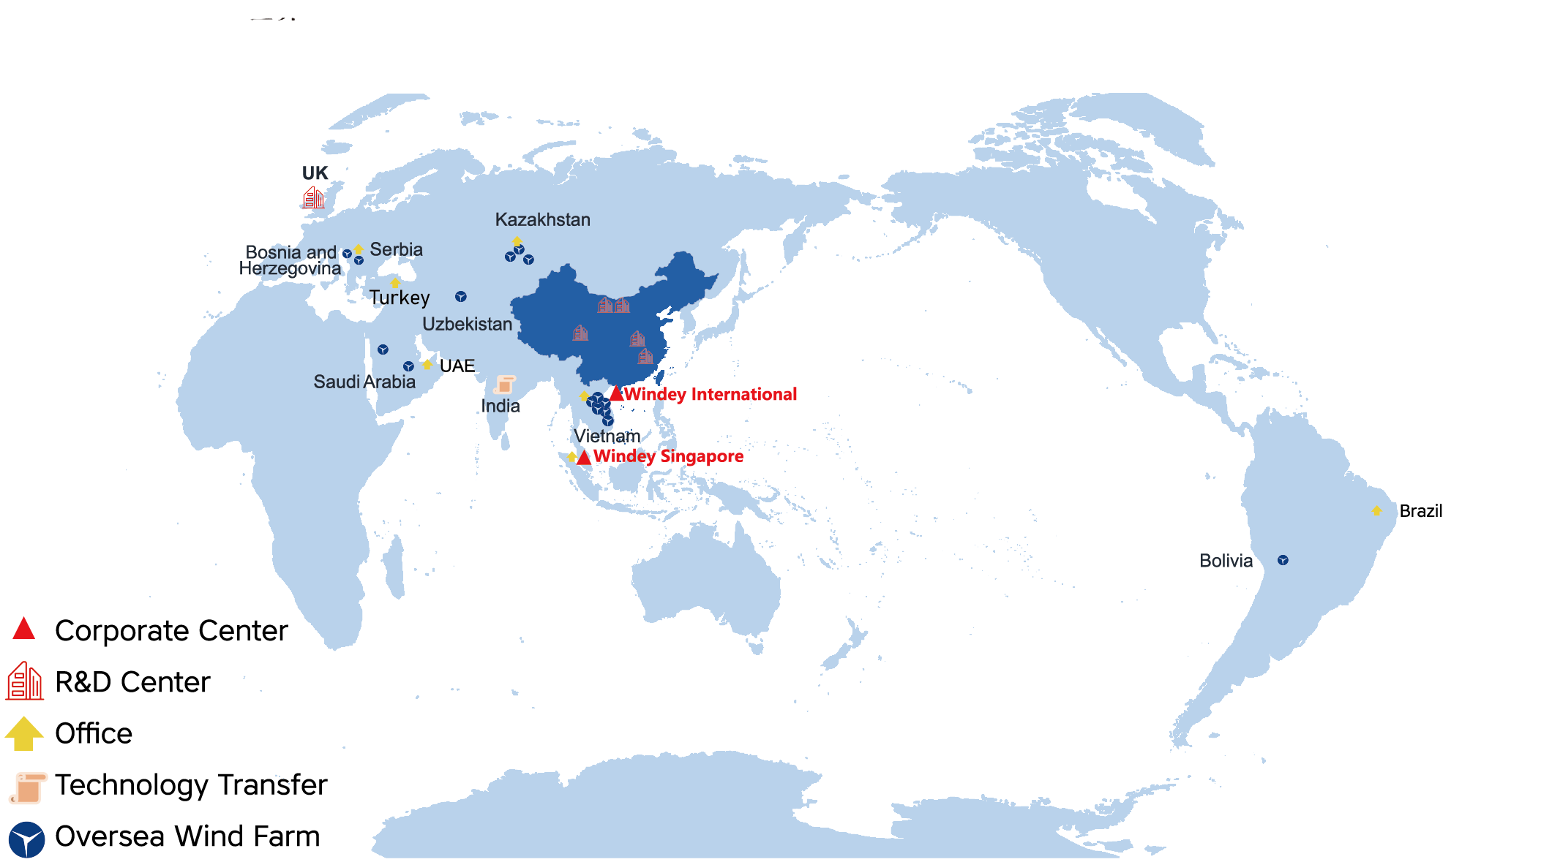
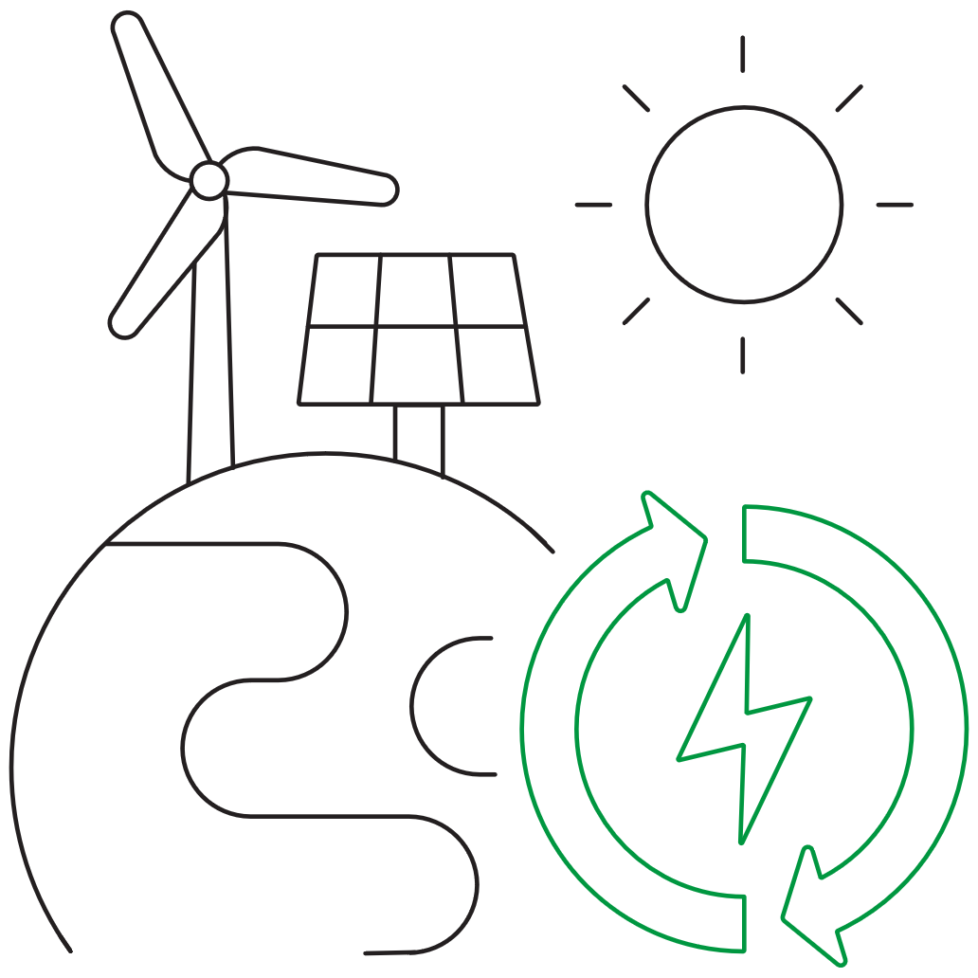
Global Footprint
6
Overseas offices
Singapore | Vietnam | Serbia | Dubai Kazakhstan | Brazil
5500+
MW
Total Overseas Orders
Eastern Europe | Central Asia | Southeast Asia | South America | Middle East North Africa

Slide 9
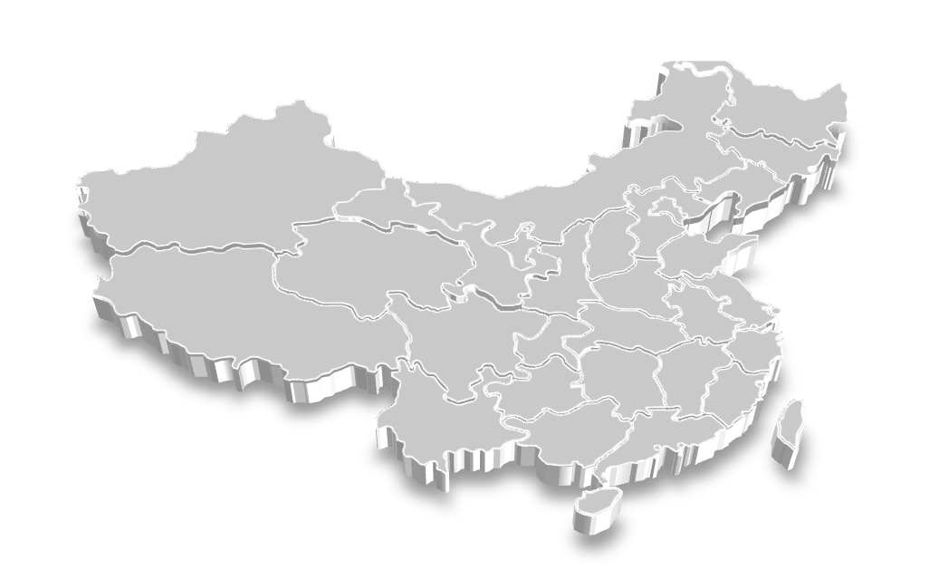
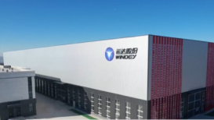
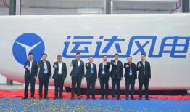


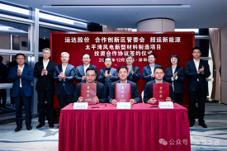
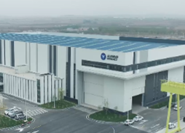
Production Base
Regional Subsidiaries
15 Production Base
Shanxi
Qinghai
Hainan
Shanghai
Yunnan
Hubei
Sichuan
Anhui
Liaoning
Gansu
Northwest
Ningxia
Hebei
Guangdong
Inner Mongolia
Shandong
Liaoning Zero Carbon Industrial Base 2025
Guangdong Intelligent Manufacturing Center 2025
Taiping Bay Blade
Production Base 2025
Northwest Production Base 2023
Hunan Production Base 2023
Yunana Production Base 2023
Wenzhou Energy Storage Production Base 2023
Hebei Production Base 2022
Ulanqab Production Base 2022
Taiping Bay Offshore Production Base 2024
Gansu Production Base 2022
Harbin Production Base 2021
Ningxia Production Base 2012
Hangzhou Production Base 2010
Zhangbei Production Base 2009
……

Slide 10

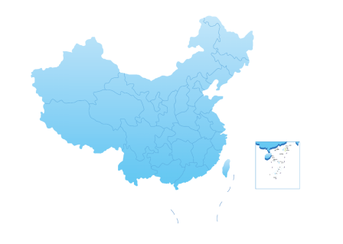










Production Base
Harbin Production Base
Ulanqab Production Base
Taiping Bay Production Base
(Offshore, 2024）
Jiuquan Production Base
Zhangbei Production Base
Wuzhong Production Base
Handan Production Base
Chuxiong Production Base
Hangzhou Production Base
Yongzhou Production Base

Slide 11





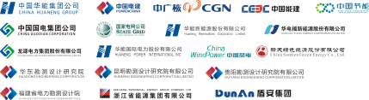




Global Carbon-free Partners
Phu Xuan
Consultation and Construction

Slide 12














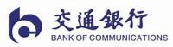


Financial Partners

Slide 13
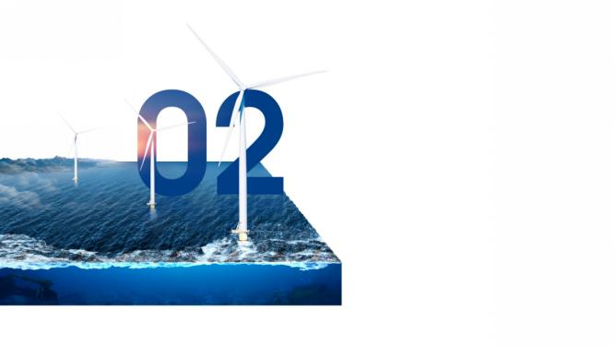
Smart Wind Turbine
PIONEER OF WIND POWER INDUSTRY IN CHINA

Slide 14
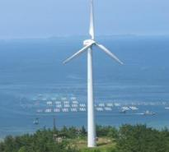
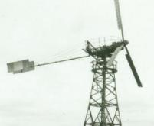
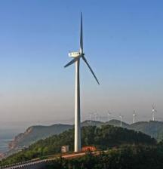
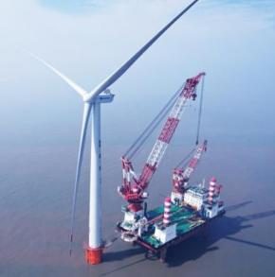
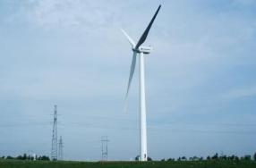
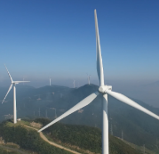
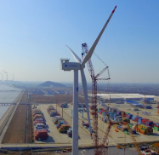
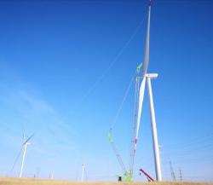
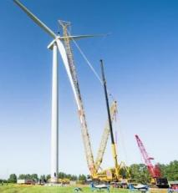
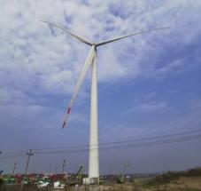
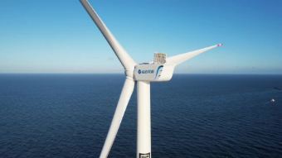
Product Development
18kW
250kW
1972
750kW
1998
First WTG in China
9.XMW
2003
First self-developed WTG in China
2023
First commercial operational WTG in China.
First double-fed offshore WTG
1.5MW
2008
First MW-class WTG using load optimization strategy in China
2.XMW
2010~2017
3.XMW
4.XMW
5.XMW
6.XMW
9.X-15.XMW
2022
“Sea eagle, sea harrier” series sea wind platform
Zhejiang Xiangshan 500WM order
First WTG with independent pitch control system in China
2017
2018
2020
2021
Large capacity
Low wind speed
Large capacity
Middle/High wind speed
Large capacity
High wind speed
The largest rotor diameter in the world

Slide 15


Domestic Product Portfolio
Doubly-fed 1-st brand
WD156/164/172-5.X
5.XMW
WD190/200-5.X
WD172-6.X
6~7.XMW
WD190/200-6.X
WD200-7.X
WD190/200-8.X
8~10.XMW
WD200/220-9.X
WD220/230-10.X
9.X MW Platform
9/15MW
15.X MW Platform
Ultra low wind speed | Low wind speed | Medium wind speed | High wind speed

Slide 16
Domestic Product Portfolio
Doubly-fed 1-st brand
Northwest region: high wind speeds
Northeast region:
medium to high wind speeds
WD190/200-7150/7700
WD200-8500/9100
WD220/230-8500/10000
Large capacity units, high performance, low construction costs
North
WD190-6250/6660
WD200-7150/7700
WD200-8340/8500/9100
WD220/230-8500/10000
WD200-6250/6660
WD200-7150/8340/8500
WD220-7150/8500
Plains
Central Plains:
low wind speed, high wind shear
WD190/200-5000/5560
WD200-6250/6660
WD220-7150
High tower heights of 160 m+ to achieve better power generation returns
WD200-5000/5560
WD200-6250
WD220-7150
高塔（160米及以上）
Central mountains:
low wind speed
Hilly
Area
WD190-5000/WD200-5.X
WD220-5560/6250
Large wind turbine: larger swept area per kW; largest turbulence resistance rating in its class; realizes better mountain wind farm adaptability
WD190-4500/5000
WD200-5000/5560
WD220-5560/6250
Plateau：
WD131-2000/2200
156-3300
WD190-5000
WD200-5000
Coastal region:
typhoon resistance
Southwestern mountains:
medium to high wind speeds
WD156-4500T
WD190-5000T
W190/200-6250
WD200-5000/5560
WD190-4500/5000

Slide 17
Oversea Product Portfolio
Doubly-fed 1-st brand
WD164-3300IW
WD200-5000IW
WD156-4500IW
WD172-5000IW
3.X-5.XMW
WD190-6250IW(anti-typhoon)
WD172-6250IW(IEC II A)
6.X-7.XMW
WD200-7700IW(50Hz/60Hz)
WD200-6250OS (Near shore)
8.X-10.XMW
W10 Platform(50Hz/60Hz)
WD190-9100IW
Low wind speed
Medium wind speed
High wind speed

Slide 18
Key Market Products | Global Onshore WT
Region | Europe
Regional characteristics | Medium-low wind speed/ high turbulent/ mountain
Main country | Serbia, Bosnia and Herzegovina, Turkey
Representative model | WD172-6250IW
Sales order | 1219.5MW
Region | Central Asia
Regional characteristics | Medium wind speed/ Extremely low temperature/ Icing risk
Main country | Kazakhstan, Uzbekistan
Representative model | WD200-7700IW
Sales order | 457.5MW
Region | North Africa
Regional characteristics | High wind speed
Main country | Egypt, Morocco, Tunisia
Representative model | WD190-9100IW
Sales order | 2600MW
Region | Southeast Asia
Regional characteristics | Medium-low wind / Offshore / Typhoon risk
Main country | Vietnam, Thailand, Philippines
Representative model | WD190-6250IW
Sales order | 535MW
Region | Central & South America
Regional characteristics | Medium wind speed / mountain / long distance carriage
Main country | Bolivia, Honduras, Chile
Representative model | WD156-4500IW
Sales order | 45MW
Region | Middle East
Regional characteristics | Medium-high wind speed / high temperature / sandy
Main country | Saudi Arabia
Representative model | WD200-7700IW
Sales order | 1100MW

Slide 19
Key Market Products | Global Offshore WT
Wind farm type | Medium-low wind speed offshore region
Regional characteristics | Weak typhoon/Near shore
Representative model | WD225-9000OS
Foundation type | Single pile foundation
Sales order | 250MW
Wind farm type | Medium-high wind speed offshore region
Regional characteristics | Typhoon/Far offshore
Representative model | WD225-9000OS；WD270-15000OS
Foundation type | Multi-pile foundation/ Jacket foundation
Sales order | 504MW
Wind farm type | Far offshore region
Regional characteristics | Typhoon/Far offshore/Construction challenge
Representative model | WD260-16000/18000OS
Foundation type | Floating foundation
Sales order | 400MW
Wind farm type | Nearshore region
Regional characteristics | Near shore
Representative model | WD200-6250OS
Foundation type | Multi-pile foundation
Sales order | 99MW

Slide 20
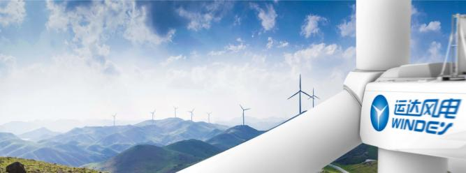
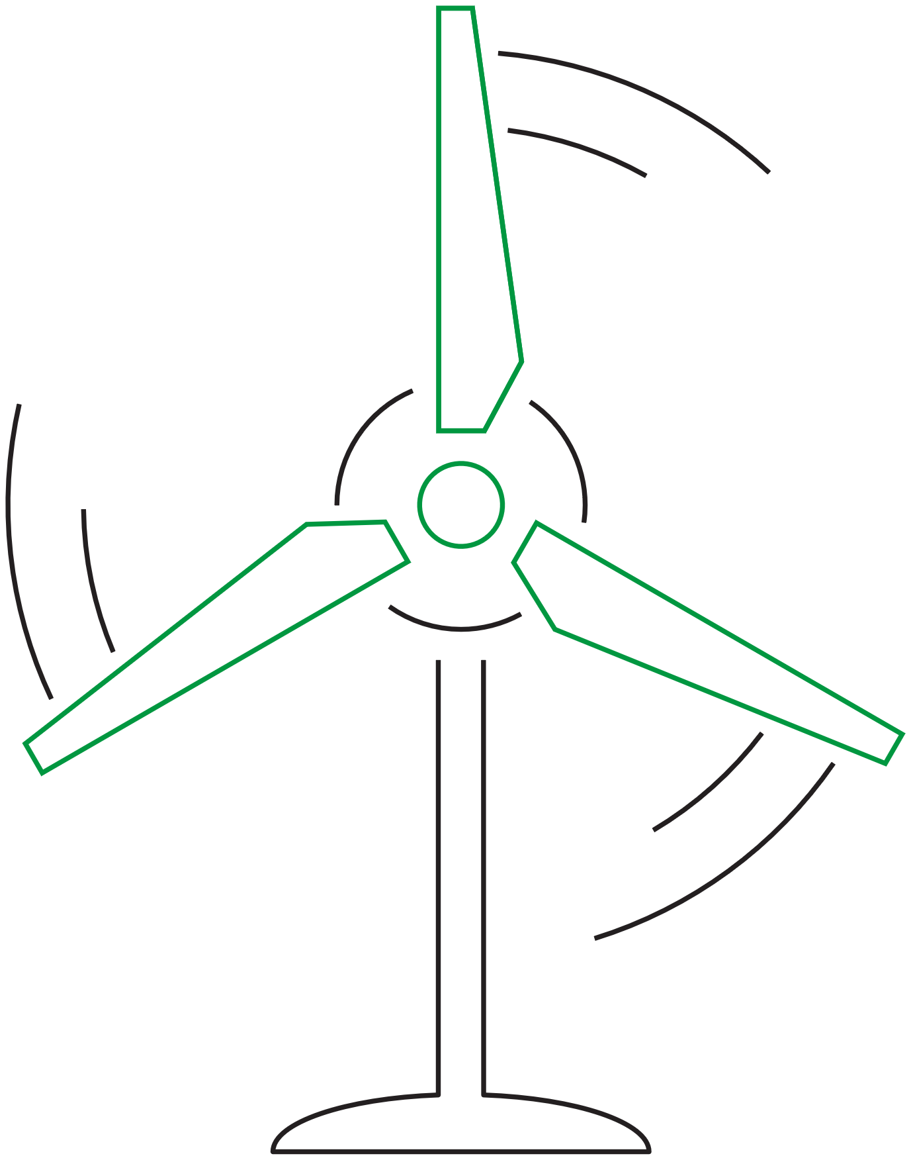



Product Features
High Reliability
Economic efficiency
High Adaptability
Advanced Intelligence
Modular design I Intelligent control I Health management
High efficiency I High performance I Low cost
Environmental adaptability I Site adaptability I Power grid adaptability
Intelligent remote sensing I Intelligent prediction I Intelligent diagnosis I Intelligent operation and maintenance

Slide 21
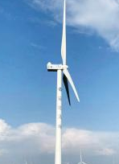
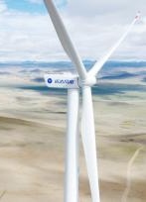
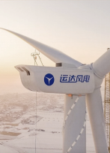
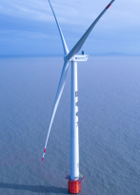
Advanced Technology
Best practices for wind energy technology
Hebei·Zhangbei
Tibet·Cuomei
Liaoning·Tieling
Zhejiang·Xiangshan
First WTG with voltage source in the world
Highest-altitude WTG in the world
Highest WTG (153m) with soft tower in China
First 9MW double-fed offshore WTG in China
First WTG with voltage source in the world

Slide 22
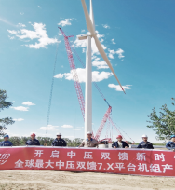
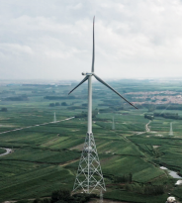
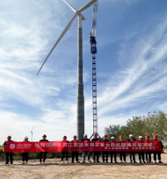
Advanced Technology
Best practices for wind energy technology
Hebei·Zhangbei
Shandong·Qingdao
Lianshui·Jiangsu
Largest medium voltage double-fed 7.X-class WTG in the world
Highest WTG (175m) with truss tower in China
Highest WTG (180m) with hybrid tower in the world

Slide 23
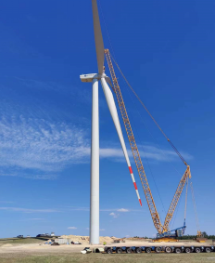
Case Study
Best practices for wind energy technology
Largest wind farm in Middle Asia | Kazakhstan
Project capacity: 206MW
Model scheme: A total of 41 WD172-5000-100mHH
Project features: The largest single capacity, the largest rotor diameter, the most advanced technology
Astana - Borey & ET 150MW project
The first batch of supplies was delivered 40 days after the signing of the contract, and the grid was connected in 11 months
The largest capacity project in Middle Asia to date
Akmora State - SOFIEVSKAYA 39MW & Arkalyk 17MW project
Full capacity was connected to the grid three months earlier than expected
Listed in the List of Key Projects of China-Kazakhstan Production Capacity and Investment Cooperation

Slide 24
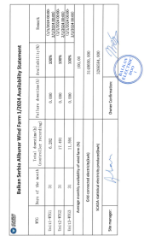
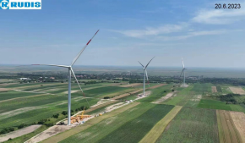
Case Study
Best practices for wind energy technology
ALIBUNAR Project in Serbia
Project capacity: 9.9MW
Model scheme: 3 WD164-3300
Power generation: The cumulative power generation since grid connection 27.91 million KWh
Average availability: 99.88%

Slide 25
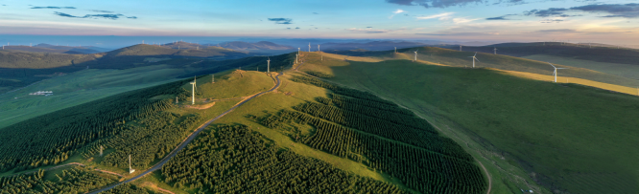
Technology Transfer
Export of Chinese technology and standards
Case study: Windey-Adani Partnership
Licensing: WD147-3000 & WD164-3300
Future Plans:
Assist ADANI in optimizing all aspects of supply chain management, assembly, installation, commissioning, and operation and maintenance.
5MW in plan.
On-site Hoisting Instruction
Technical Training
1
Comprehensive online and offline training for technical personnel of partners.
3
Assist in hoisting and installing equipment of fan on site.
Technical Data Transfer
Installation Guide
2
4
Technical authorization cooperation, provide complete technical data.
Send technical personnel to guide the installation in the factory.

Slide 26



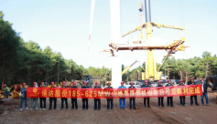









Modular Construction Scheme
Windey has extensive experience in solving key issues such as complex terrain, restricted transportation conditions, and limited operating area in the construction of mountain wind farms.
Windey provides modular solutions, single blade installation solutions, wind turbines to small platform solutions in the entire process of production, transportation and installation.
Modular assembly
Modular
transport
Nacelle module transportation
Transmission chain module transportation
Hub chain module transportation
Modular Install
In August 2022, the WD185-6250 high-altitude WTG was successfully hoisted in Qujing City, Yunnan Province. It was the first model in China using single-blade separation and lifting scheme, and was also the largest onshore WTG in commercial operation at that time.
Tower hoisting
Nacelle module hoisting
Transmission chain hoisting
Upper cover of nacelle hoisting
Completion of nacelle hoisting
Wind wheel module hoisting

Slide 27
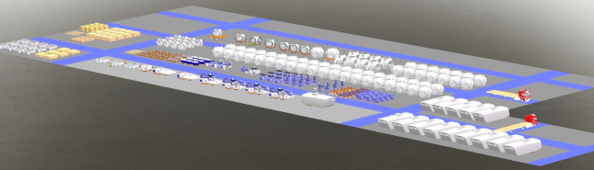
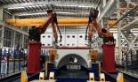
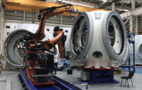
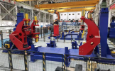
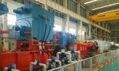
Digital Manufacturing
Yaw bearing assembly Robot
Pitch Bearing assembly Robot
Auxiliary Tools System
Smart Testing System

Slide 28






Lifecycle Services
Digital + Secure Communication Technology + Artificial Intelligence Assisted
Smart Wind Farm
Digital WTG Unit
Real-time
Logistics System
Intelligent Production Management
WTG Status Monitoring
Intelligent Material Management
Performance Management System
数字化机组
智慧物流
智能生产管理
智能健康管理
智能物资管理
智能绩效管理
全状态感知
全数据融合
秒级数据传输
……
智能路况识别
全流程跟踪
物流承运KPI
……
智能运维
智能监控
虚拟培训
……
智能排故
健康预警
主动维护
……
人员管理
物资管理
备件管理
……
后评估
收益考核
场级KPI
……

Slide 29






WINDEY has integrated DeepSeek, empowering the entire wind power value chain with AI-driven intelligence
Windey ✖ DeepSeek-R1 model
  AI-driven validation models optimise blade design, enhancing aerodynamic efficiency and increasing energy output.
Turbine design
AI predicts raw material needs, improves supply chain efficiency, and reduces emergency stock costs, ensuring stable production.
Manufacturing
Site selection
Operations and maintenance
  AI analyses large-scale meteorological and geographic data to guide wind farm placement, assessing wind resource distribution across different terrains.
  AI processes multi-source data, such as sensor and oil monitoring information, to predict equipment degradation and prevent failures. It also supports troubleshooting, streamlining wind turbine commissioning and fault resolution.

Slide 30

Comprehensive Energy Service
LEADER OF GREEN LIFE IN THE FUTURE

Slide 31






Comprehensive Energy Service
EPC
Renewable Energy Investment & Development
Comprehensive Energy Service
Power-to-X
Intelligent Service
Wind Turbine OEM
Energy Storage System

Slide 32

Renewable Energy Investment & Development
115
Projects Involved
1,280MW in operation
1,797MW in construction
5,203 MW approved
Till August 2024

Slide 33



Renewable Energy Investment & Development
Developed Wind Projects
2023 Newly Added
Developed PV Projects
2023 Newly Added
5,900MW
3,800MW
1,400MW
600MW
China: Hebei, Shandong, Guangdong, Yunnan, Hunan, Shanxi, Guangxi, Gansu, Anhui, Hubei, Xinjiang, Inner Mongolia, Hainan, and etc.
Overseas：Bosnia and Herzegovina, Bulgaria, Spain, Kyrgyzstan, Brazil. and etc.
Data as of January 2024

Slide 34










Energy Storage System
35 Billion tons
Accumulated CO₂ Emissions Reduction
Power side
Grid side
3 GWh+
FIVE
Energy Storage shipment performance
Application Scenarios
Microgrid
User side
3 locations
Shared Energy Storage
Major R&D centers：Hangzhou, Nanjing, Bristol

Slide 35



Energy Storage Liquid-Cooled System
Safety
Efficient
Stable
Intelligent
VoltPack Plus-L5000
VoltBlock-L260
Liquid-Cooled Battery Energy Storage System
Type | VoltPack Plus-L5000
C-Rating | ≤0.5P
Cell Capacity | 3.2V/314Ah
Configuration | 12P416S
Rated Capacity | 5015kWh
Dimensions (W*H*D) | 6058*2438*2896mm (20HC)
Operating Temperature Range | -30℃~65℃ (＞45℃ derated)
IP Rating | IP55
Fire Suppression System | Aerosol/perfluorohexanone + Water.
Liquid-Cooled C&I System
Type | VoltBlock-L260 (All in one)
C-Rating | ≤0.5P
Cell Capacity | 3.2V/314Ah
Configuration | 1P260S
Rated Capacity | 260kWh
Rated Voltage | 400VAC
Dimensions (W*D*H) | 1000*1350*2450mm (Battery Carbinet)
Operating Temperature Range | -30~50℃
IP Rating | IP55
Fire Suppression System | Aerosol/perfluorohexanone + Water.

Slide 36





Intelligent Service
Committed to improving the quality and efficiency of wind farms and providing intelligent energy services throughout the life cycle
Full life cycle new energy services
Technical service
Intelligent operation and maintenance
Focus on the wind power after-sales service market:
Provide technical services, unit replacement, smart wind farms, spare parts, and full lifecycle intelligent operation and maintenance services.
Four majors
Product system
2 GW+
99%+
(China) out of warranty in operation and maintenance
Availability
Repowering
Spare parts

Slide 37

Case Study: Intelligent Service in Vietnam
O&M for GE138-3.8，Ninh Thuan, Vietnam
 | Average Availability | Fault Frequency
Before | 97% | 25 times/month
After | 99% | 2 times/month
Scope of the Agent O&M
Trouble-Shooting
Maintenance Work
Annual Blade Inspection
In February 2024, Windey identified a brake hydraulic system fault due to low pressure, traced to the pressure accumulator. After checking and recharging accumulators in other turbines, smooth operation was ensured.
In March 2024, a broken flexible connection strap on a shaft coupling was found and replaced in all turbines to prevent potential overspeed incidents, ensuring safe operation.

Slide 38





EPC
Consultation and design
Power transmission
and transformation EPC
Gross Business Amount
1.5+
Billion USD
Wind farm
and solar power station EPC
Renovation and expansion
of in-service wind farms

Slide 39


Power-to-X
Windey's First Biomethanol Industrial Processes:
Capacity: 180,000 tons/a; COD July 2027
Location: Handan, Hebei Province, China
Zero-carbon production: The process is green, fossil-free and eco-friendly.
Green hydrogen synergy in the future: Coupled with green hydrogen to boost the output.
生物质成型燃料压块厂
Biomass Briquettes Plant
调峰电源
Peaking Power
生物质发电厂
Biomass Power Generation
生物质原料
Biomass feedstock supply
网源友好型控制
Grid-Friendly Control
稳定的离网绿色电力
Stable Off-Grid Green Power
智能微电网
Smart Grid
氧气 O₂
CH₃OH
+
-
不稳定电源Unstable Power
O₂
H₂
WATER
储氢罐/管道
Hydrogen storage,
Pipeline
生物质气化
Biomass Gasification
甲醇合成
Biomethanol Synthesis
新能源发电
Renewable Energy
水电解制氢
Electrolysis

Slide 40

Power-to-X
Certification of Green Methanol
China’s First ISCC EU Certificate
Windey Obtained the first ISCC EU certificate of green methanol raw material among First Gathering Point in China.
First GHG Emission Reduction of Green Methanol Certificate in China
High GHG saving potential: the total life cycle GHG emission intensity is about 18.33 gCO2eq/MJ, and GHG saving potential reaches 80.5% (Delivery at Shanghai Port) based on RED Ⅱ calculation principles.
Note: Fuel carbon intensity of GHG saving 65% is 32.9 gCO₂eq/MJ.

Slide 41
4
CSR
LEADER OF GREEN LIFE IN THE FUTURE

Slide 42


Corporate Social Responsibility
Create a carbon-free future
GREEN
DESIGN
GREEN
DELIVERY
National-level green factory construction
Green Low Carbon Advocacy
Products adhere to green design principles
Lightweight, detachable and recyclable
Environmental-friendly factory
Energy-saving enterprise
Use clean power and reduce polution
Scientific and safe transportation
Lightweight and recyclable packaging design
GREEN
PROCUREMENT
GREEN
PRODUCTION

Slide 43




Corporate Social Responsibility
560+Hundreds of millions of kWh
17,000+Ten thousand hectares
166+ Megaton
Contribute green and clean energy to meet the needs of 23 million households every year
The equivalent of reforestation every year
Annual carbon dioxide reduction
Promote sustainable development of resources and environment
Poverty Reduction
Rural Revitalization
Public Charity
Contributing in 26 underdeveloped districts
From Zhejiang to Henan-Inner Mongolia-Hebei
Joint donations with the Charity Federation

Slide 44

Thousands of Villages Wind Ad Hoc
Industrial support and rural revitalization | CGNPC Guangxi Leye County rural revitalization Demonstration Project
Profit model: shareholding dividends · guaranteed minimum income
Construction scale: The total installed capacity of the first phase is 51,000 kilowatts · 16 units have been delivered · Design annual power generation is 110 million kilowatts
Operation situation: In 2022, the total on grid electricity reached 122 million kilowatt hours, equivalent hours were 2400 hours, and the utilization rate was 99.9%
Stabilize residents' income · Help rural revitalization · Drive industrial development · Promote employment transfer · Boost tourism industry revitalization · Promote high-quality local economic development

Slide 45



Corporate Social Responsibility

Slide 46



The fleeting wind grants us with the source of power
The historic wind endows us with the weight of responsibility
At Windey, responsibility is a Legacy passed down through generations
We regard it as a belief, holding nature in eternal reverence
We see it as dedication, unwavering in our commitment to technology
Swift success brings momentary glory
Deep-rooted efforts yield a century of honor
World-leading century-old wind power enterprise
To become a renewable energy service enterprise with leading technology, reputation, and international competitiveness.
World-leading comprehensive
new energy solution provider
To provide wind turbine manufacturing, wind farm investment, and technical services throughout the entire lifecycle.

Slide 47


"First in China" marks our technological foundation, "Serving the longest" is our relentless pursuit. We uphold the future of renewable energy with a sustainable service attitude.
Unceasing wind, unfailing trust.
a reliable and trusty companion, in any journey, for every mile.
Windey,

