Slide 1


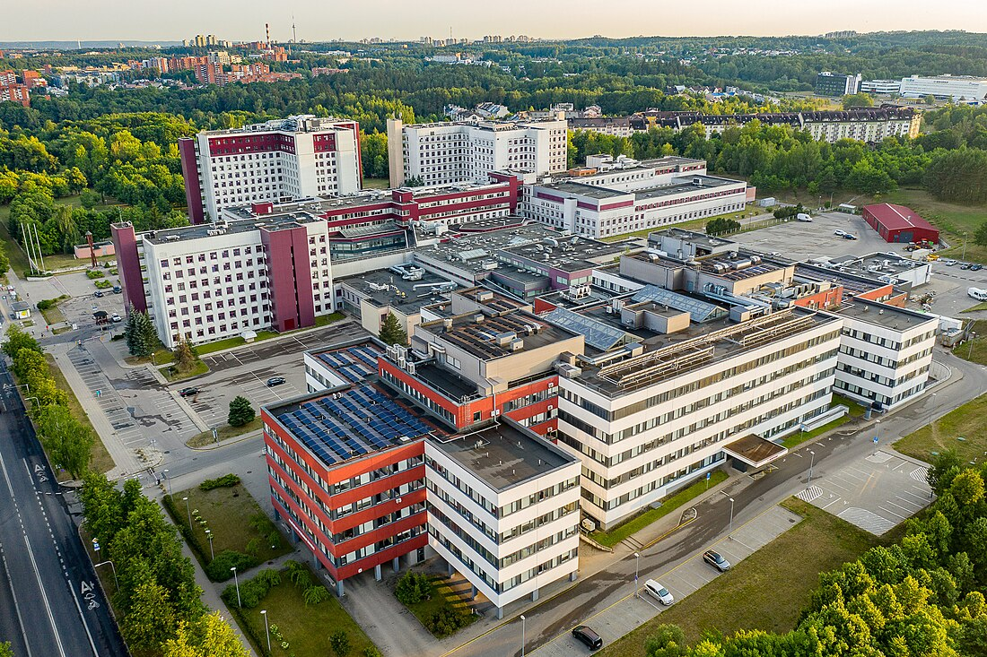
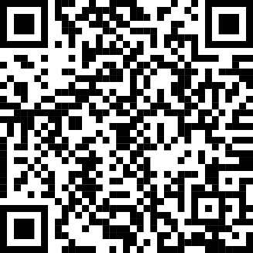
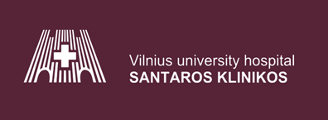
Vilnius University Hospital Santaros Clinics
Research and Projects
Information Technology and Development Center (ITDC)
The largest and most advanced hospital in Lithuania, offering multidisciplinary services for both children and adults. The hospital has extensive experience in providing top-level medical, scientific, and educational services.
Key Facts and Figures:
Over 8,000 employees, including:
  2,200+ doctors
  2,350+ nurses
  70+ professors
  67+ associate professors
  230+ biomedical science PhDs
35 medical centers – covering a wide range of treatment areas.
3 specialized coordination and consultation centers – dedicated to providing top-quality consultations and coordinating complex patient care.
Over 2,000 beds.
1 million outpatient consultations per year.
80+ million EHR documents over the last 25 years.
10 million new EHR documents annually.
Data with varying levels of maturity.
AI-driven equipment for decision-making.
Education and biomedical research base – integrating science with practice and advancing innovative medical technologies.
Experience in clinical research – participation in EU and national projects aimed at improving treatment methods and patient care.
Involvement in 24 international and 7 national projects – covering various medical fields, contributing to the development of advanced treatment methods. Project coordinator for one project (SCARLET).
Key Areas:
CANCER (PANCARESURPASS, eCan EU +, JANE-EU-2, etc.)
RARE DISEASES (JARDIN, OD4RD2, ERDERA, Orphanet)
GENETIC TECHNOLOGIES (GDI, GoE, Hemato, Oncointegra)
CARDIOVASCULAR DISEASES (Telegraft, EuroHeart, CARAMEL)
PREVENTION (eproBES, JApreventNCD, etc.)
RESEARCH ON PNEUMONIA AND OTHER LUNG DISEASES (TBmicrobiome)
ITDC places special emphasis on innovative treatment technologies and scientific research, aiming to achieve the best outcomes for patients and contribute to the advancement of medical science. ITDC has modern technological infrastructure, including implemented solutions that facilitate and optimize diagnostic and treatment processes. Additionally, our on-site data center (DC) ensures secure and efficient processing and analysis of large datasets, providing crucial data for clinical research and treatment decisions, thus contributing to the development and implementation of innovative and advanced treatment methods. ITDC is a leader in healthcare IT solutions. The IPC implements advanced systems such as the Hospital Information System (SANTA-HIS) and provides IT infrastructure and data management services. The Center also contributes to international projects, including AI solutions in healthcare.
Key Metrics:
3+ PB of medical data
2+ million medical images
3,500+ workstations
200+ servers
3,000+ phone network
500+ wireless network points
100+ highly qualified specialists (IT and IS experts, data analysts, medical IT professionals)
8 divisions covering various IT and data management functions.
For more information, feel free to contact us:
Vidas Kapušinskas
Chief Information Officer
📧 Vidas.Kapusinskas@santa.lt
Martyna Atraškevičienė
Chief Technology Transfer Officer
📧 Martyna.Atraskeviciene@santa.lt
www.santa.lt

