Slide 1
Parallel Solutions Technology
January 2025
Dr. Yehuda Singer Dr. Joshua Gur
yehuda.singer@llp.co.il Joshua.gur@llp.co.il

Slide 2
Parallel Solutions Technology main Applications
Parallel Solution has developed a unique application - Auto Parallel TM - with the following features:
      Automatic acceleration of execution of any application on several core computer. (Speedups are of the order of the number of cores)
      Automatically saving about 90% of the power for a multi-core system not supporting idle management techniques.
      Novel distributed computing systems
        Multi-core computer: Every computer runs a portion of the program; utilizing its cores, a tremendous power saving & execution acceleration is achieved
        Applicable to various HW platforms:
          1. Servers,
          2. Embedded System
          3. Cloud.
      Portability: the parallelizing application will work without any change on Windows/ Linux platform & Generic: using the standard compiler, linker and debugger.
      Automatic maintainability.
      Maximization of Cache utilization FOR Reverse Engineering immunity and Enhance performance.

Slide 3
Why current technology cannot compete
Present technology faces A Major Problem:
In current State Of The Art Software containing tightly coupled threads, the required decomposition to independent threads involves inter-thread Communication and synchronization code.
This is a very difficult and time-consuming effort
Using our technology, this is performed automatically!

Slide 4
Our Solution is the Auto Parallel TM
Our Auto-parallel - Breaking Dependencies Paradigm can:
Automatically parallelizes any SERIAL high-level program.
Automatically accelerates the execution of any application on a multi-core computer.
Automatically accelerates execution of programs on a set of multi-core computers connected via a communication network on a distributed computer system.
Remark: Currently C/C++ are supported.

Slide 5
Proof of the Auto Parallel Performance shown by Parallel Solution Demo
Program (3 threads) | Description | Run-Time (Seconds) |  | Acceleration Ratio
 |  | Debug | Release | Debug | Release
Exe_Sample_2_Classes | Sequential | 26.596041 | 11.58855
Exe_Sample_2_Classes_include_ Auto _ Parallel | Parallel | 11.715507 | 3.965835 | 2.2701 | 2.9220
Platforms and Operating System
# cores | Distribution | Operating Systems | Platform
4,8 | Microsoft; Red-Hat UBUNTO | Windows ; Linux | Intel-x86
8 | Yocto Project | Embedded Linux | PowerPC 4080
4 | UBUNTU | Linux | ARM

Slide 6
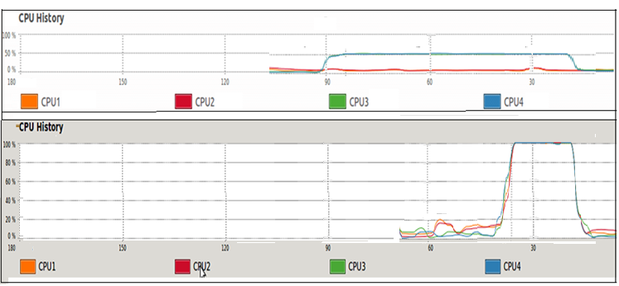
Proof of the Auto Parallel Performance shown by Parallel Solution Demo
Without Auto-Parallel Technology
Amount
of core
usage in %
A
Amount
of core
usage in %
With Auto-Parallel Technology
B

Slide 7
Proof of the Auto Parallel Performance shown by Parallel Solution Demo
Program | Run mode | Auto -parallel Engine code status | Execution Time | Acceleration Factor | Threads | Active cores
Program1 Power PC | Sequential | Release | 366 | NA | 12 | 1
 | Auto -parallel | Release | 47 | 7.8 | 12 | 8
Program1 on Intel i5 | Sequential | Release | 44 | N/A | 12 | 1
 | Auto -parallel | Release | 11.5 | 3.8 | 12 | 4
Program2 on ARM | Sequential | Release | 30.4 | NA | 12 | 1
 | Auto -parallel | Release | 7.79 | 3.9 | 12 | 4
Our technology has achieved so far, an acceleration factors of 3.9 for 4 cores & 7.8 for 8 cores when running on the following platforms:
Intel-x86 4 cores Red-Hat Linux, UBUNTU Linux and MS-Windows.
Power PC platforms (8cores) under Embedded Linux
3. ARM(4 cores) under UBUNTU-Linux

Slide 8
Auto Parallel showing sequential & parallel Performance comparison
Acceleration Ratio & Gain in reducing O/H
Intel 80x64 Debug program # 1 ; 4 cores, Red Hat Linux
Number of threads |  |  |  | 4
 | Sequential |  |  | Cycles | 45,000 | Parallel
 | Execution Time sequential | O/H for each thread | O/H for all threads | O/H for all iteration | Execution time Parallel | O/H for each thread | O/H Parallel cycle time |  | O/H Parallel threads total cycle time |  | Acceleration Ratio | Gain in reducing O/H
Debug | 284.03 | 0.00014 | 0.00056 | 25.2 | 67.9 | NA | 0.00017 |  | 7.65 |  | 4.1830 | 3.2941

Slide 9
Problem Definition
Multiplication of tow large matrices A and B to produce matrix C.
Every matrix has a minimum size of 1024X1024 elements.
Matrix elements type:
Long integers
Float
Goal: To reduce the computation time by number of processors np.

Slide 10
Results Initial Computation method
Measured by the internal clock of the Linux system.
Accuracy 1ns.
Matrix size | Serial Time | Parallel version time | Acceleration Ratio
1024X1024 | 2.03451 | 0.044720 | 45.4944
Matrix size | Serial Time | Parallel version time | Acceleration Ratio
1024X1024 | 2.03451 | 1.038041 | 1.9599
2048X2048 | 65.056 | 6.1396 | 8.9
4096X4096 | 589.051 | 37.076 | 15.88

Slide 11
Results of Optimization the threads of previous calculation
Measured by the internal clock of the Linux system.
Accuracy 1ns.
Matrix size | Serial Time | Optimized Parallel time | Acceleration Ratio
1024X1024 | 2.03451 | 0.044720 | 45.4944
2048X2048 | 65.056 | 3.011256 | 21.159
4096X4096 | 589.051 | 25.0819 | 23.485

Slide 12
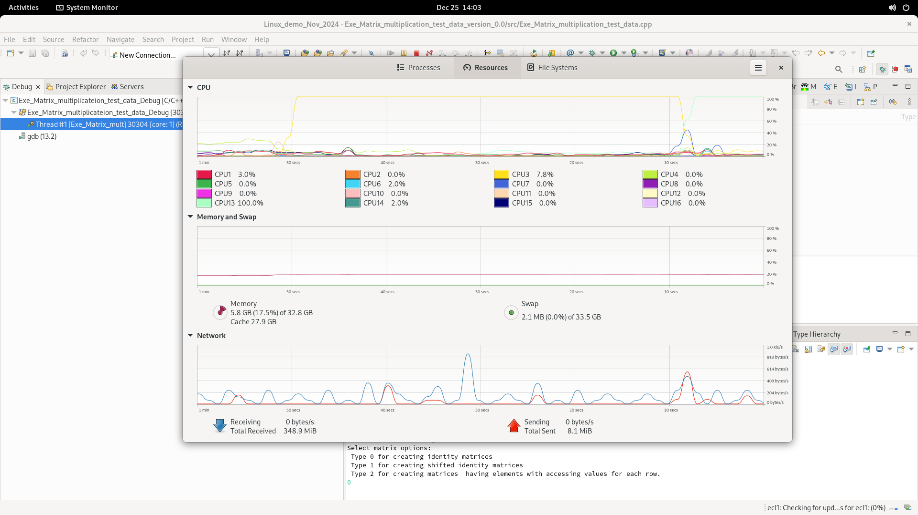
Serial Running on a 16 cores Processor
At any time,
Only one core
is active.

Slide 13
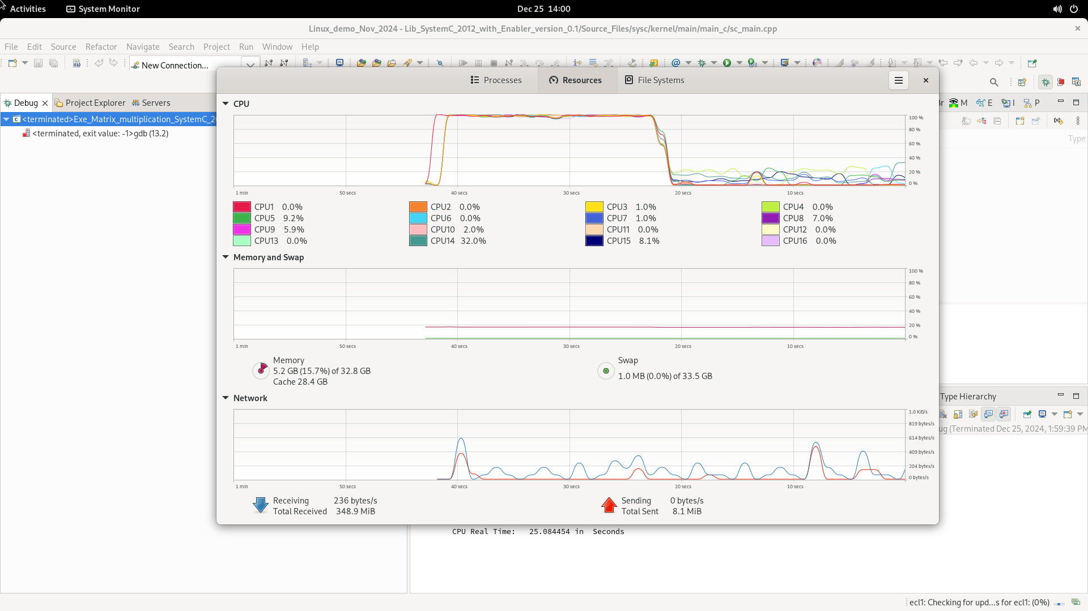
Parallel Running on a 16 cores processor
At any time,
ALL the cores
are active.

Slide 14
Float Matrix Multiplication using scalar instructions on 16 core machine
Matrix Size | Sequential Program Execution time (seconds) | Parallel Program Execution time (seconds) | Acceleration Ratio
1024X1024 | 2.029150000 | 0.051397 | 39.47993074
2048X2048 | 32.999700000 | 3.082414 | 10.70579747
4096X4096 | 539.000000000 | 26.080434 | 20.666834
Remarks:
For 1024X1024 matrices we get execution time which is applicable to Real-Time AI.
.

Slide 15
Float Matrix Multiplication with
Vector AVX512 instructions
Matrix Size | Sequential Program Execution time (seconds) | Parallel Program Execution time (seconds) | Acceleration Ratio
1024X1024 | 0.023584390 | 0.012966 | 1.818941077
2048X2048 | 1.981760000 | 0.090297 | 21.94713003
4096X4096 | 14.041200000 | 6.0554832 | 2.318757981
Remarks:
In spite of smaller acceleration ratio, we get a much faster execution time.
For 4096X4096 matrix multiplication, we use the main memory, which slows the process.

Slide 16
Showing some examples of our parallel Performance advantage
PS method to save Power and accelerate execution time
Distributed computing systems
Reverse Engineering Problem and Solution
Maintainability Tool

Slide 17
PS method to save Power and
accelerate execution time
Set-up cores for
Parallel execution
Core
f _{clock}≠
f _{exec}
Core
Memory
Input
output
Core
Core
Ht
Active core
Ht'
Idle core
Sequential execution
Parallel execution
T _{exec}
  Ht
Ht
T _{exec}
Ht
T _{exec}
Ht
T _{exec}
Ht
T _{exec}
Ht T _{exec}
Ht T _{exec}
Ht T _{exec}
Ht T _{exec}
Ht
T _{exec}
Ht T _{exec}
Ht T _{exec}
Ht
T _{exec}
Ht T _{exec}
Ht
T _{exec}
Ht T _{exec}
Ht T _{exec}
Ht T _{exec}
Ht
T _{exec}
Ht
T _{exec}
4cycles
~16*P _{thread} For power
16 *Ht _{thread} for energy
16*T _{exec} for execution time
1cycle
~4*P _{thread} !! For power
4 * Ht for energy
1*T _{exec} for execution time

Slide 18
Explanation of the PS method to save Power
When a common 4-core system runs a common program sequentially, only one core Is active, and the three others are busy idling burning the same energy Ht for the same time T _{exec} each. Therefore, for each cycle energy of 4Ht is burnt for 4T_{exec} and for 4 cycles 16Ht is burnt for 16 T _{exec}.
Using our technology, the program is parallelized, therefore we get 4 active cores each burning Ht for T _{exec} all at the same time.
We generalize it to n cores in the next slide.

Slide 19
Energy Saving
1. Reducing the clock frequency at the order 10-20% and save energy by 20-40%.
The total performance remain the same: Acceleration Factor as number of cores
2. Automatic cache optimization reduces number of paging activities and saves power.

Slide 20
Novel distributed computing systems based on the PS parallelization algorithm
  Multi-core computer: Every computer runs a portion of the program; utilizing its cores, a tremendous power
  saving & execution acceleration is achieved
  Various HW platforms:
  1. Servers,
  2. Embedded System
  3. Cloud.
  4. H/W platforms: 1. Servers, 2. Embedded System and
  3. Automotive 4. Cloud.
  3. Software application: AI, automotive, communication,
  image processing, robots , fintech etc.
  Remark: Demo on a PC-Linux at Q4 of 2023.

Slide 21
Reverse Engineering Problem
(Short Description)
Sequential execution of the application is easily tracked.
Minimal usage of the cache means that the main memory reflects the real data associated with the application, which again allows easier reverse engineering process.

Slide 22
Solving The Reverse Engineering Problem
Method 1
Automatically breaking every application to many small threads that run in parallel on a multi-core system. This causes the thread execution to be randomly distributed and therefore very difficult to track .
Method 2
Automatically Maximizing locality. This means that the cache and memory are not coherent i.e., the memory does not hold the correct data hence - again - it is very difficult to track the execution.

Slide 23
Maintainability Tool
PS would like to introduce a new maintenance SW,
instead of current tools
1. Legacy code is only partially documented.
2. Disorganized documentation updating
3. Missing of easy-to-use maintainability computer programs
A new maintenance application system which will give large
legacy code owners:
1. Easily appropriate system documentation such as ATP,
SPEC design including diagrams
2. Easily produced code according to specifications.
3. Easily performing maintenance duties

Slide 24
Parallel Solutions: Leading Team
Dr. Yehuda Singer
Ph.D. in computer science, specialized in computer architecture, Real-Time and high performance. Over 46 years of experience in the development of embedded systems and FPGAs in various multi-disciplinary applications.
Dr. Singer was the leader of the Computer Studies of the extension of Derby university in Israel. Dr. Singer holds an M.Sc. and Ph.D. degrees in computer science from Weizmann Institute and Bar-Ilan university respectively.
Dr. Joshua Gur
Joshua Gur – Ph.D. in Physics & Optics, specialized in multidisciplinary computerized system design as a chief Display & Video engineer at a security plant in Israel - the Israeli Aircraft Industries. and other security plants. Over 48 years of experience including 9 patents. Dr. Gur holds a B.Sc. in Physics and Mathematics, M. Sc in Electro- Optics from the Hebrew University of Jerusalem, and a Ph.D. in Physics & optics from the institute of optics at Rochester University in Rochester NY at USA.

